Slide 1
Addressing Alcohol Use Disorder (AUD) in Primary Care Think Tank Series
Session 2
Community Resources and Community Health Workers in the ED
October 21st, 2024, 12:00-1:00PM

Slide 2
Session Overview
Welcome & Introduction (12:00-12:05pm)
    Linda Cabral, MM, Senior Program Manager, CTC-RI
Addiction Care Today (ACT) and Lifespan Recovery Center (12:05-12:20pm)
    Cherilyn Freitas, MSN, APRN, FNP-C, CARN-AP, Nurse Practitioner
    Samuel Kaplan, Patient Transition Coordinator
Community Health Workers in the ED (12:20-12:45pm)
    Michael Warren, CHW, Clinical Supervisor
    Joel Guzman, CHW
Questions and Answers / Open Discussion (12:45-1:00pm)
    Moderator: Nelly Burdette, PsyD, CTC-RI

Slide 3
Series Overview
This is the 2nd session in a 5-part meeting series for Addressing AUD in Primary Care
Meetings are held every 3rd Monday from 12:00 – 1:00 PM EST
September 2024
  Clinical Strategy Committee Meeting
October 21, 2024
  ACT, Lifespan Recovery, CHW
November 18, 2024
  Subject Matter Expert Session #2 - TBD
December 16, 2024
  Vermont and Mass League of CHCs?
January 20, 2025
  Final Report/Presentation

Slide 4
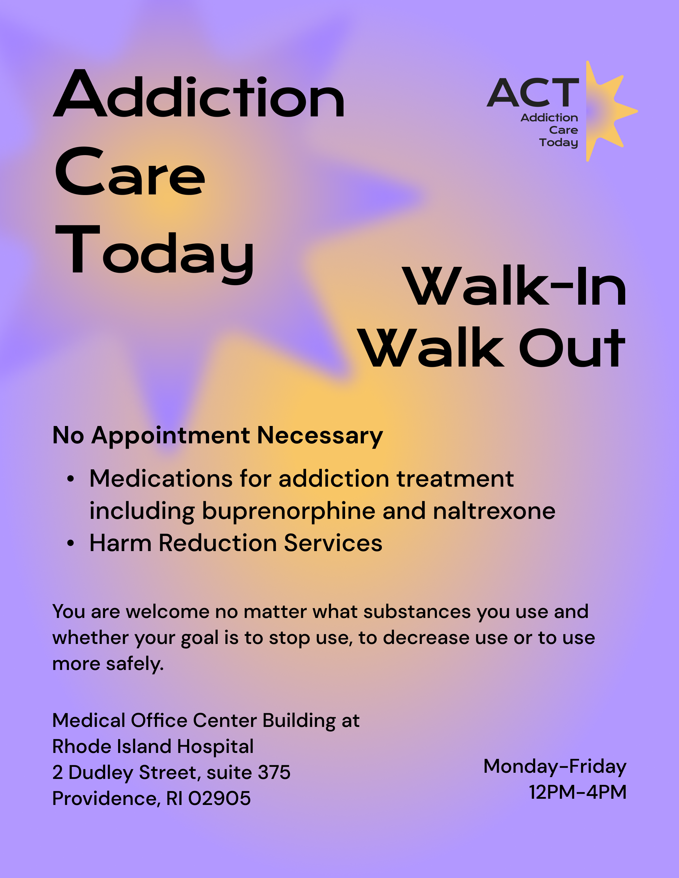
Addiction Care Today (ACT)
Mission:
  Ensure high-quality, evidence-based addiction care is easy for everyone to access
Model:
  California Bridge Model
    Urgent care / walk-in services (no appointment needed)
    Referred from the ED, primary care, community-based organizations
    Helps to reduce inpatient admission and decrease ED visits
Services:
  Initiation/continuation of SUD medication treatment
  Connection to higher level of care (i.e., residential, intensive outpatient, etc.)
  Linkage to longitudinal outpatient treatment
  Referral to other behavioral health providers (psychiatry, CBT, etc.)
  Assistance accessing social needs (insurance, transport, etc.)
⁽¹⁾
Notes:
1. Addiction Care Today. (n.d.). Addiction Care Today – Walk-In Walk Out [Flyer]. https://www.brownhealth.org/centers-services/addiction-medicine/act-addiction-care-today

Slide 5
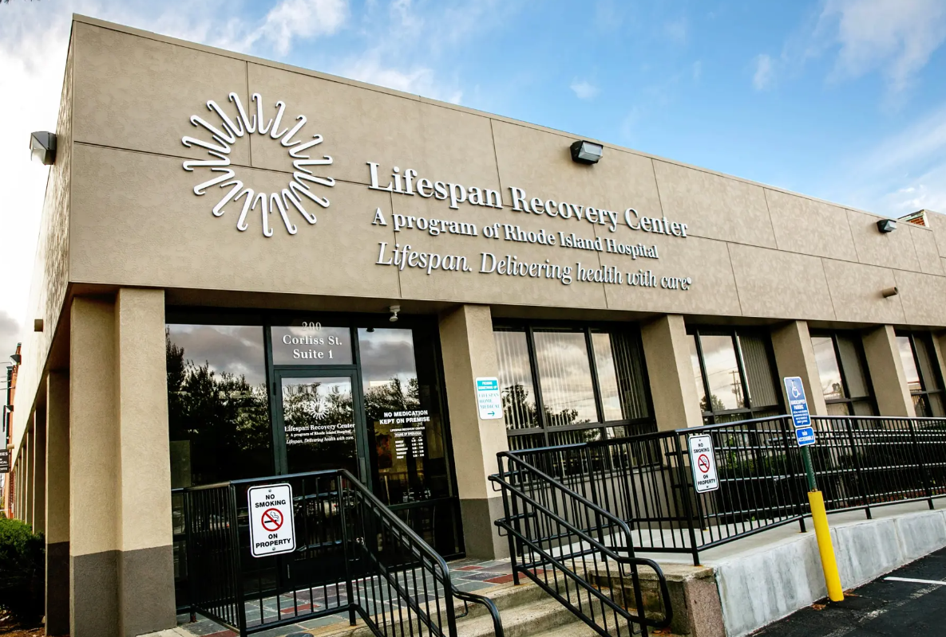
Lifespan Recovery Center
About
  Open from M-F 8am-5pm at 200 Corliss Street in Providence, RI
  Interdisciplinary, evidence-based treatment for SUD and AUD
Services
  Medication Assisted Treatment (MAT) for patients with SUD
    Including Long Acting Injectable (LAI) administration
  Individual and group counseling, either in-person or via telehealth
⁽³⁾
Notes:
2. MapQuest. (n.d.). [Image of Lifespan Recovery Center]. https://www.mapquest.com/_next/image?url=https%3A%2F%2Fs3.amazonaws.com%2Fp.assets.lssdev.com%2Fclient_images%2F6%2F2%2F8%2Fe%2F6%2F4053567%2Ftmp37bbb5d00947bbad86374e2eaa2d9b3d199 2c6b7c8551a1fa9623ea28f4c8ccb.jpg&w=1920&q=75

Slide 6

Community Health Workers (CHW) in the ED
Process:
  2 full CHWs in at RI ED; 3 at Hasbro
  One touch encounter; connects patients (warm hand offs) with places like:
    Anchor Recovery, AdCare, Zinnia, and other detox services
    Outpatient centers such as ACT and Lifespan Recovery Center
  Also assesses for other social and medical needs
  Collaboratives and advocates on behalf of patients and their primary care providers
⁽³⁾
Notes:
3. Rhode Island Department of Health. (2024). Community Health Worker Logo [Image]. https://health.ri.gov/img/logos/chw-logo.png

Slide 7

Open Discussion

Slide 8

November 18, 2024
12-1pm
Contact Phos Ivestei (pivestei@ctc-ri.org) with any questions or suggestions

Slide 9
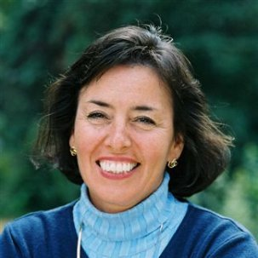
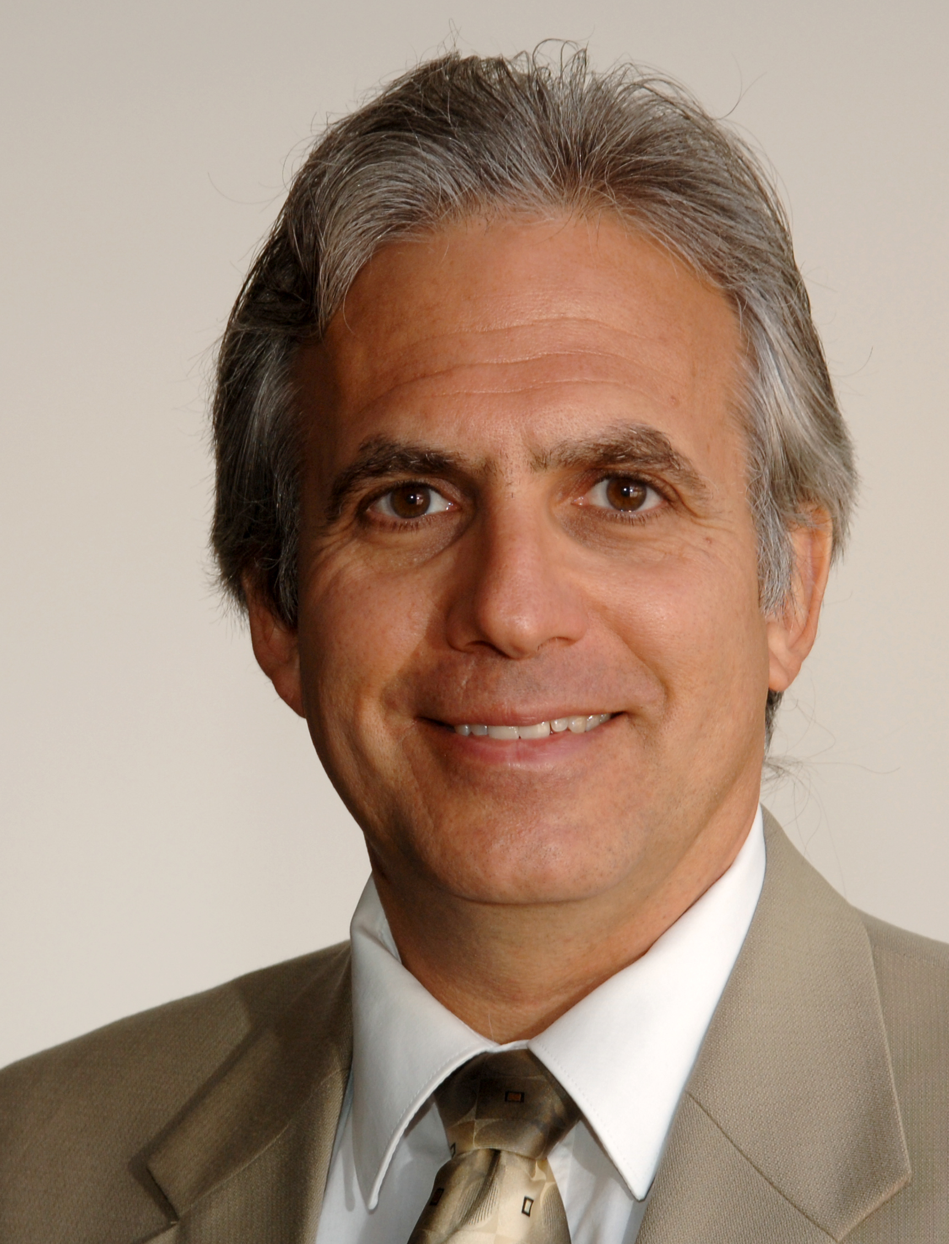
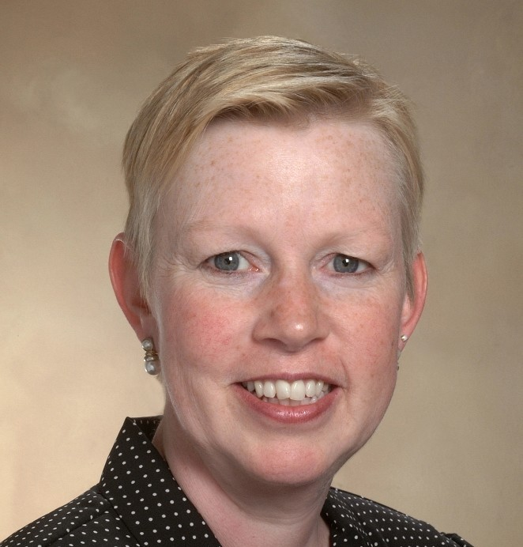
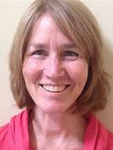

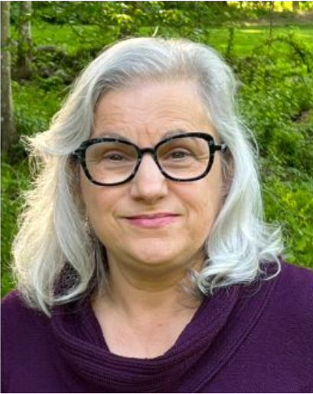
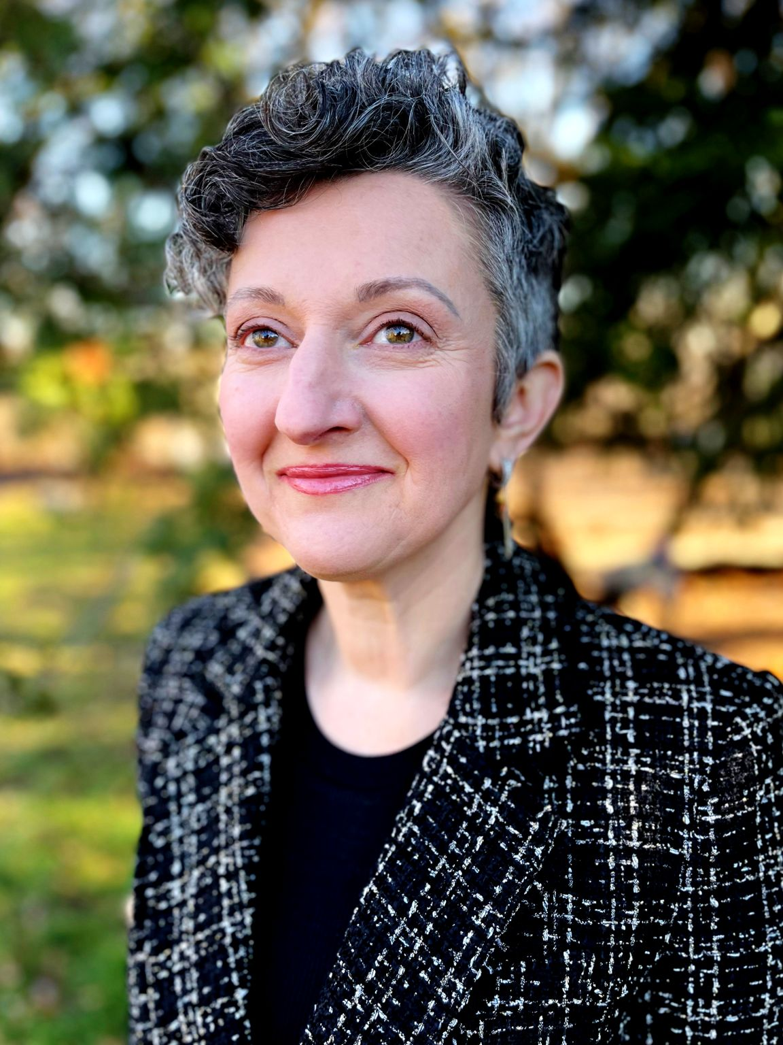
CTC-RI Senior Leadership
Deb Hurwitz, MBA, BSN, RN, Executive Director
Pano Yeracaris, MD, MPH, Chief Clinical Strategist
Patricia Flanagan, MD
Clinical Director & PCMH Kids Co-Chair
Susanne Campbell, RN, MS, PCMH CCE, Senior Program Administrator
Linda Cabral, MM, Senior Program Manager
Yolanda Bowes, BS
Senior Project Manager
Nelly Burdette, PsyD
Senior Integrated Behavioral Health Program Leader
Prepared by Care Transformation Collaborative of RI
Notes:
All – Pat last then Introduces the Practices

Slide 10
References
Addiction Care Today. (n.d.). Addiction Care Today – Walk-In Walk Out [Poster]. https://www.brownhealth.org/centers-services/addiction- medicine/act-addiction-care-today
MapQuest. (n.d.). (Image of Lifespan Recovery Center’s front entrance). https://www.mapquest.com/_next/image?url=https%3A%2F%2Fs3.amazonaws.com%2Fp.assets.lssdev.com%2Fclient_images%2F% 2F2%2F8%2Fe%2F6%2F4053567%2Ftmp37bbb5d00947bbad86374e2eaa2d9b3d199 2c6b7c8551a1fa9623ea28f4c8ccb.jpg&w=1920&q=75
Rhode Island Department of Health. (2024). Community Health Worker Logo [Image]. https://health.ri.gov/img/logos/chw-logo.png

Slide 11

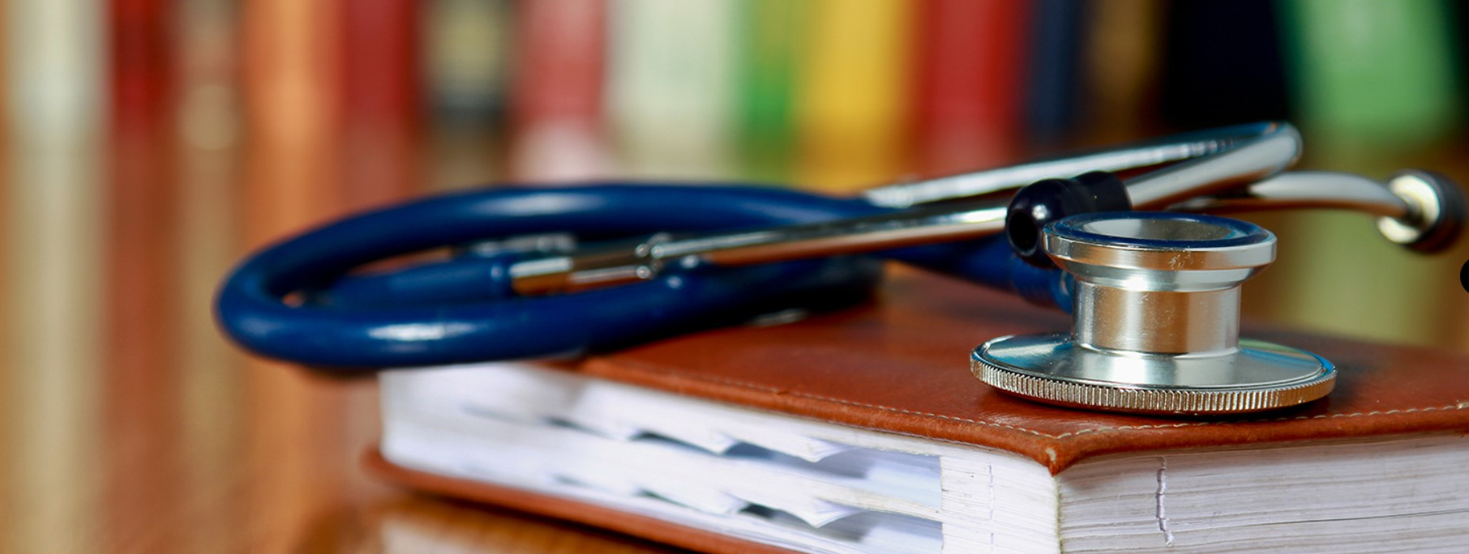


THANK YOU
www.ctc-ri.org
ctc-ri

