Slide 1
Addressing Alcohol Use Disorder (AUD) in Primary Care Think Tank Series
Session 3
The Role of CCBHCs in Alcohol Use Disorders
November 18th, 2024, 12:00-1:00PM

Slide 2
Session Overview
Welcome & Introduction (12:00-12:05pm)
    Linda Cabral, MM, Senior Program Manager, CTC-RI
The Role of CCBHCs in AUD (12:05-12:35pm)
    Beth Matthews, MSN, MBA, Associate Director – Special Programs, BHDDH
Questions and Answers / Open Discussion (12:35-1:00pm)
    Moderator: Nelly Burdette, PsyD, CTC-RI

Slide 3
Series Overview
This is the 3rd session in a 5-part meeting series for Addressing AUD in Primary Care
Meetings are held every 3rd Monday from 12:00 – 1:00 PM EST
September 2024
  Clinical Strategy Committee Meeting
October 21, 2024
  ACT, Lifespan Recovery, CHW
November 18, 2024
  The Role of CCBHCs
December 16, 2024
  Central Vermont Medical Center
January 27, 2025
  Final Report/Presentation

Slide 4


Rhode Island
Certified Community Behavioral Health Clinics
Rhode Island Department of Behavioral Healthcare,
Developmental Disabilities & Hospitals (BHDDH)

Slide 5

CCBHCs in
Rhode Island

Slide 6
Certified Community Behavioral Health Clinics
BRIEF OVERVIEW
A Certified Community Behavioral Health Clinic or “CCBHC” provides Mental Health (MH) and Substance Use (SUD) services to all ages, regardless of ability to pay or insurance status. A CCBHC aims to expand access to care for anyone in need of MH or SUD services with the focus on integrated and quality services to the community. CCBHCs are required to provide:
24/7/365 Emergency Services & Mobile Crisis
General Outpatient Services
Substance Use Services
Primary Care Screening
Person and Family Centered Treatment Planning
Behavioral Health Screening, Assessment, & Diagnosis
Targeted Case Management
Psychiatric Rehabilitation Services
Community Based Mental Healthcare for Veterans
Peer Support, Peer Counseling, & Family/Caregiver Support

Slide 7
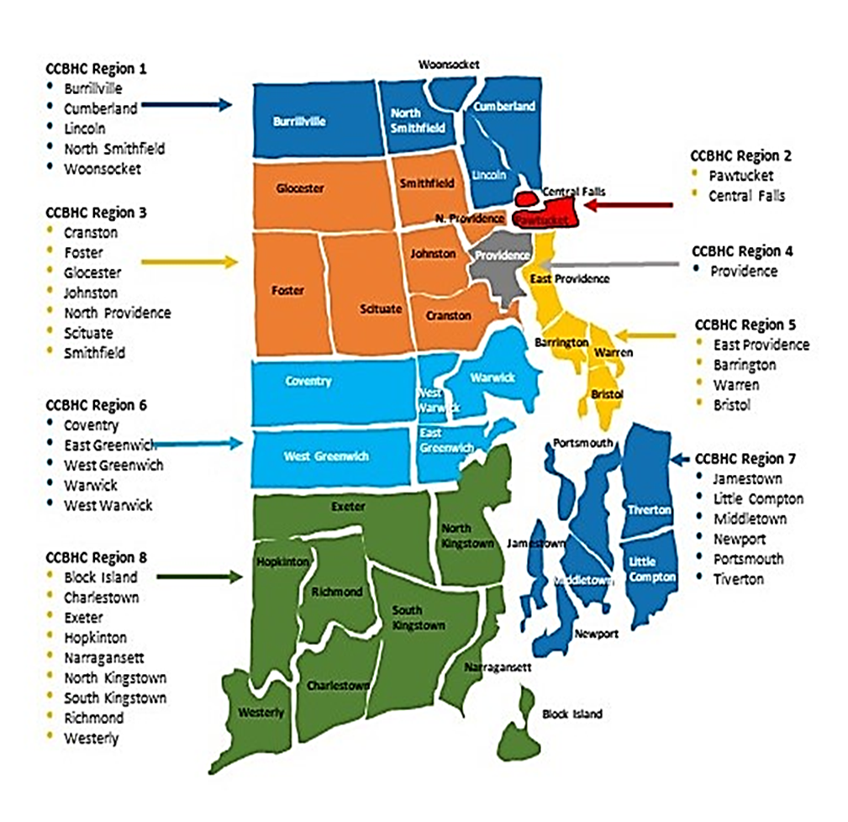
CCBHC Implementation
Eight CCBHC Sites had successful Go–Live on
October 1, 2024
Community Care Alliance
Family Service of Rhode Island
The Providence Center
Thrive Behavioral Health
Newport Mental Health
Gateway Healthcare (3 locations)

Slide 8

RI CCBHC: What to expect
Each CCBHC catchment area will have access to :
Mental Health and Substance Use Mobile Crisis Response 24/7
Open access appointments, decreased time to service and increased hours of operation (evenings and weekends)
Access to enhanced quality services including evidenced-based practices
Increased care coordination with community providers
Assistance with housing, medical, social, vocation and other supports and services
Increased outreach within the community to engage individuals in need of services

Slide 9
CCBHC and Substance Use Service
Each CCBHC will be providing enhanced substance use services for all ages including:
SBIRT (Screening, Brief Intervention, Referral to Treatment)
General Outpatient Substance Use Services (ASAM Level 1)
Ambulatory Withdrawal Management (ASAM Level 1 and 2 W.M)
Intensive Outpatient Services (ASAM Level 2.1)
Seven Challenges Program for Young Adults 12-25
Medication Assisted Treatment for
  Opioid (2 out of 3 medications)
  Alcohol
  Nicotine
Peer Based Recovery Support Services (PBRSS)

Slide 10

Substance Use Provider DCO
Each CCBHC is required to provide the aforementioned CCBHC services either directly or via a Designated Collaborating Organization (DCO).
For Year 1 SUD DCO’s include:
VICTA for IOP and Level 2 W.M
Wood River Health Center for enhanced SUD and Primary Care Integration services
Butler Hospital for IOP and Level 2 W.M services
Bridgemark for enhanced IOP services
CODAC for enhanced MAT and IOP services

Slide 11
CCBHC Substance Use Levels of Care: ASAM Outpatient
Each CCBHC is required to provide SUD treatment and services as described in the American Society for Addiction Medicine Levels 1 and 2.1 and include treatment of tobacco use disorders. If screening determines the individual requires a higher level of care, a CCBHC is required to make this available via referral.
ASAM Outpatient Substance Use Treatment
ASAM Level 1- Outpatient is less than 9 hours of services per week of regularly scheduled individual, group and/or licensed family counseling which includes one or more of the following services:
Individual, Group and/or Family Therapy
Psychoeducation with a focus on harm reduction and relapse prevention
Team Based Services, Outreach Services
Case management and Care Coordination
MAT services (excluding Methadone) and pharmacological intervention
ASAM Level 2.1- Intensive Outpatient Services is more than 9 hours of service per week of intensive clinical interventions with a minimum of 3 hours of treatment per day and one individual sessions per week. Services include:
Individual, Group and/or Family Therapy
Psychoeducation with a focus on harm reduction and relapse prevention
CCBHCS are required to have a referral relationship with ASAM Level 2.5 Partial Hospitalization Program (PHP)

Slide 12
CCBHC Substance Use Levels of Care: ASAM Withdrawal Management
ASAM WITHDRAWAL MANAGEMENT:
ASAM Level 1- Withdrawal Management is up to 4 hours of medically supervised evaluation, withdrawal management and referral services
ASAM Level 2 – Withdrawal management is more than 4 hours but fewer than 24 hours of medically supervised evaluation, withdrawal management and referral services.
Both levels include:
MAT services
Patient education regarding withdrawal management specific to alcohol or substance use
Medical Management of signs and symptoms of intoxication and withdrawal
Access to counseling, social workers, peer and recovery supports, individual and group therapy as needed.
CCBHCs are required to have referral relationships with ASAM Level 3.2 Withdrawal Management and
ASAM Level 3.7 Withdrawal Management

Slide 13
CCBHC and Care Coordination
In Year 1, RI requires Care Coordination Agreements with: Catchment area hospital/ ER Catchment area Urgent Care FQHC Catchment area Primary Care Providers Butler Hospital Bradley Hospital Hasbro Childrens Hospital Catchment area Police/EMS Veterans Administration BH Link 988 FCCP Accountable Entities (AE) Department of Corrections Opioid Treatment Provider (OTP/Methadone)
Each CCBHC is required to have care coordination agreements. These are formal signed agreements that identify:
Jointly agreed upon protocols/procedures for:
  Admission/Discharge
  Referrals
  Sharing of Information
  Tracking of data
Key staff by both providers to monitor the effectiveness of the agreement, troubleshoot problems and consult periodically
Jointly established renewal date, at least yearly, to evaluate effectiveness.

Slide 14

CCBHC and Primary Care Integration
CCBHCs are required to screen individuals for primary care provider enrollment and assist individuals who do not have an active PCP , acquire one.
CCBHCs must coordinate care with the primary care provider to ensure primary health care screenings are up to date, discuss any acute changes in health, track attendance and collaborate on treatment plans as needed.

Slide 15
CCBHC Primary Care Screening and Reporting
CCBHC’s are responsible for outpatient primary care screening and monitoring of health indicators and health risk including:
HIV and Viral Hepatitis
BMI
Blood Pressure
Tobacco Use
Under the CCBHC Demonstration clinics and the state are required to report on quality measures including:
Preventive Care and Screening: Unhealthy Alcohol Use: Screening and Brief Counseling (ASC)
Screening for Clinical Depression and Follow up Plan (CDF–CH and CDF- AD)
Screening for Social Drivers of Health (SDOH)
Initiation and Engagement of Alcohol and Other Drug Dependence Treatment (IET-AD)
Antidepressant Medication Management (AMM-BH)
Use of Pharmacotherapy for Opioid Use Disorder (OUD-AD)
Hemoglobin A1C Control for Patients with Diabetes (HBD-AD)

Slide 16

Any questions?
Notes:
nationally

Slide 17
CONTACT INFO
Beth Matthews
elizabeth.matthews@bhddh.ri.gov
Thank you!!!

Slide 18

Open Discussion

Slide 19

December 16, 2024
12:00-1:00PM EST
Contact Phos Ivestei (pivestei@ctc-ri.org) with any questions or suggestions

Slide 20

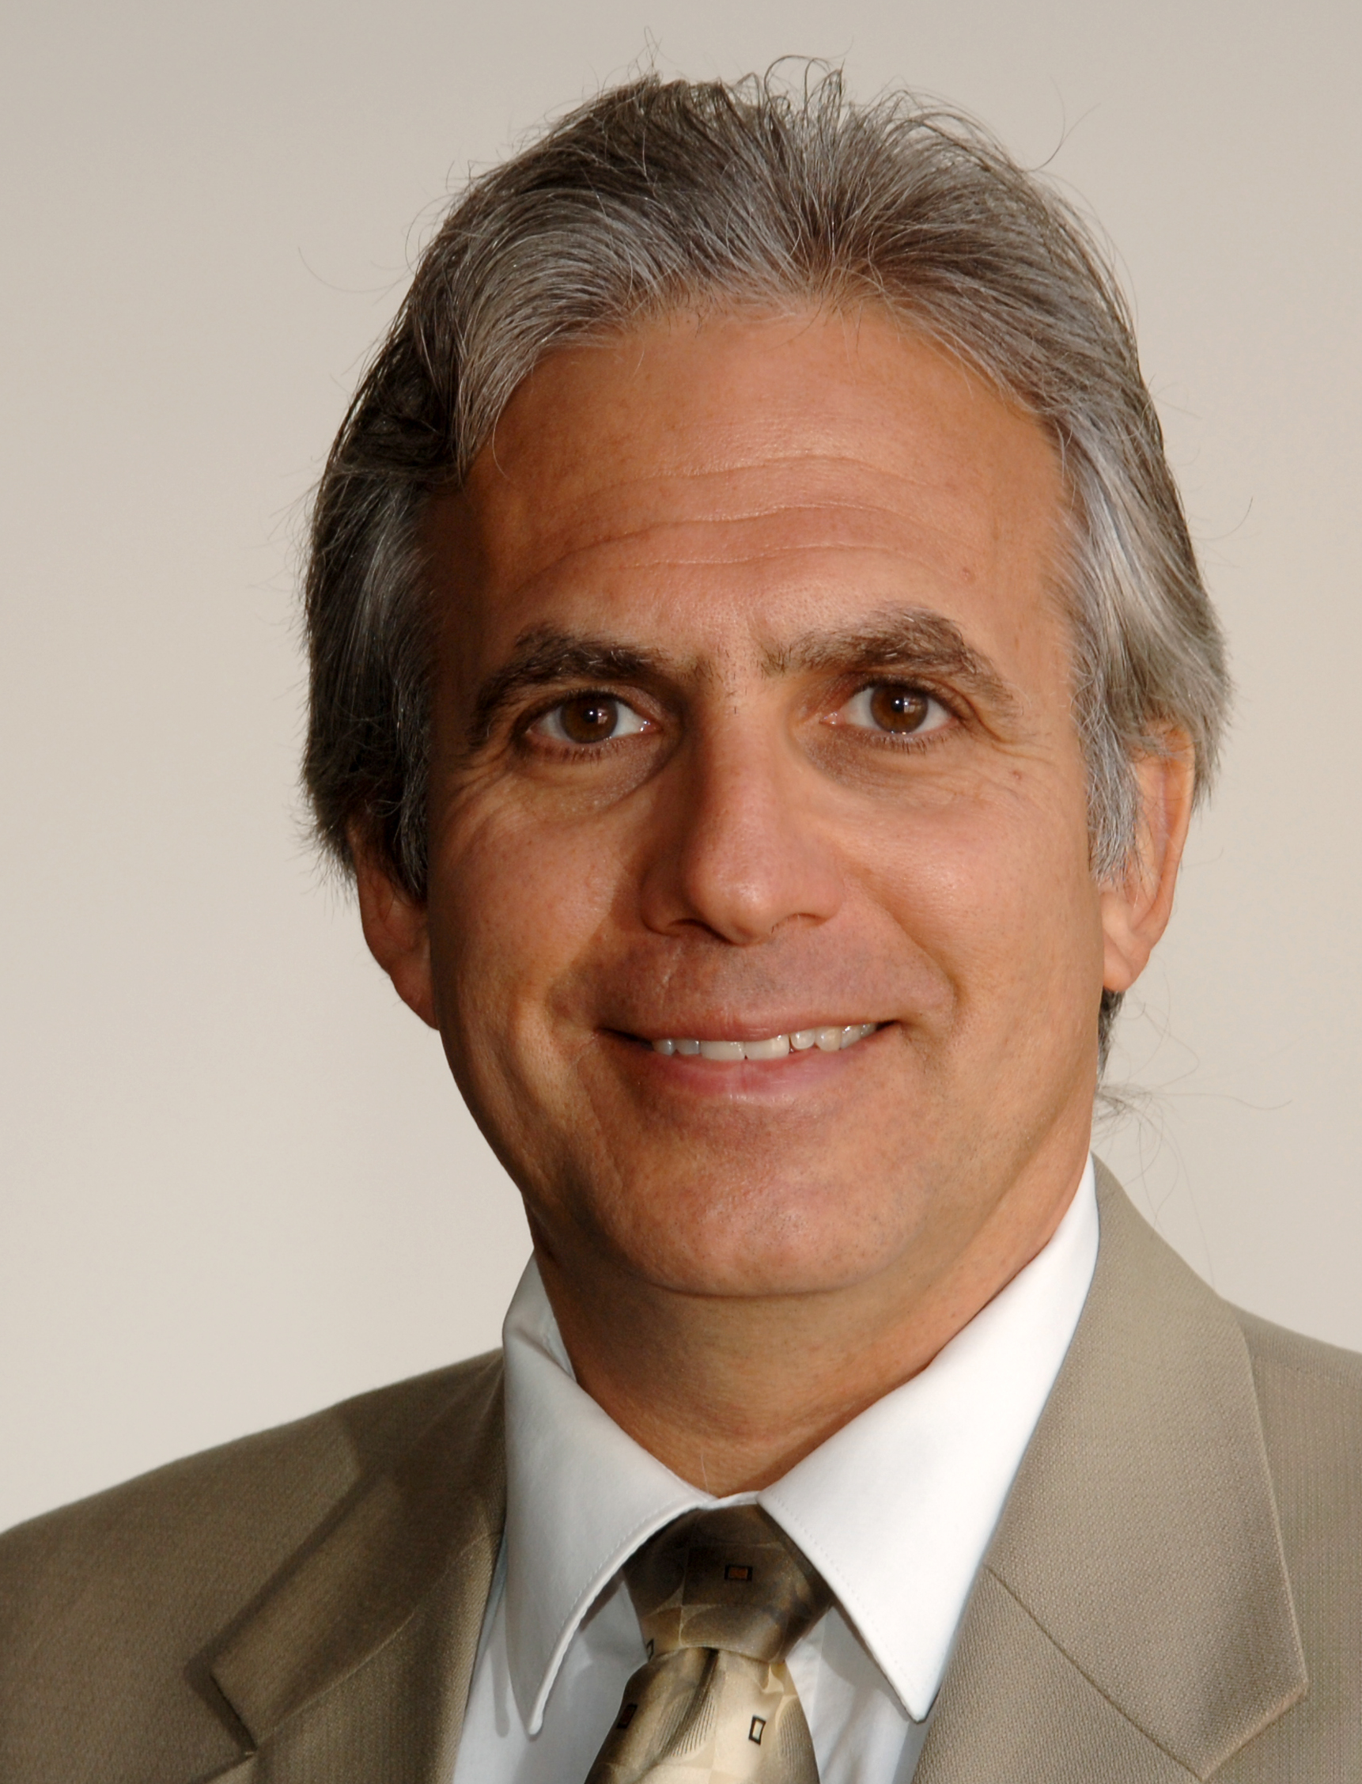
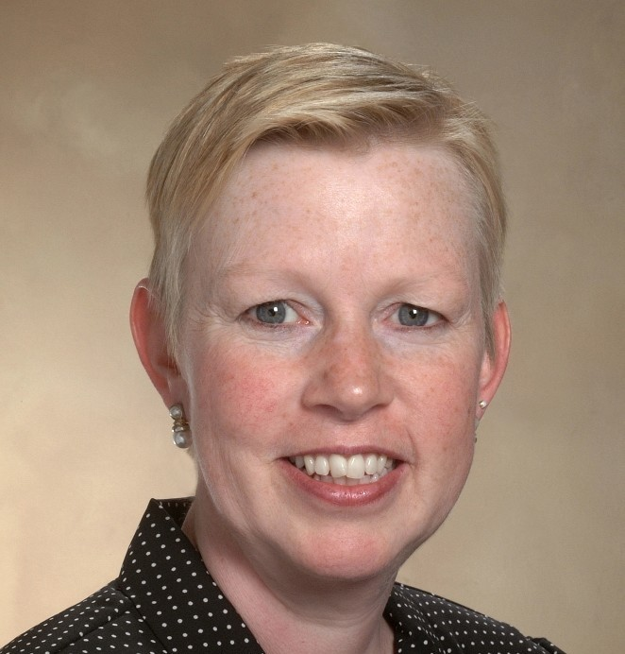
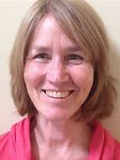



CTC-RI Senior Leadership
Deb Hurwitz, MBA, BSN, RN, Executive Director
Pano Yeracaris, MD, MPH, Chief Clinical Strategist
Patricia Flanagan, MD
Clinical Director & PCMH Kids Co-Chair
Susanne Campbell, RN, MS, PCMH CCE, Senior Program Administrator
Linda Cabral, MM, Senior Program Manager
Yolanda Bowes, BS
Senior Project Manager
Nelly Burdette, PsyD
Senior Integrated Behavioral Health Program Leader
Prepared by Care Transformation Collaborative of RI
Notes:
All – Pat last then Introduces the Practices

Slide 21

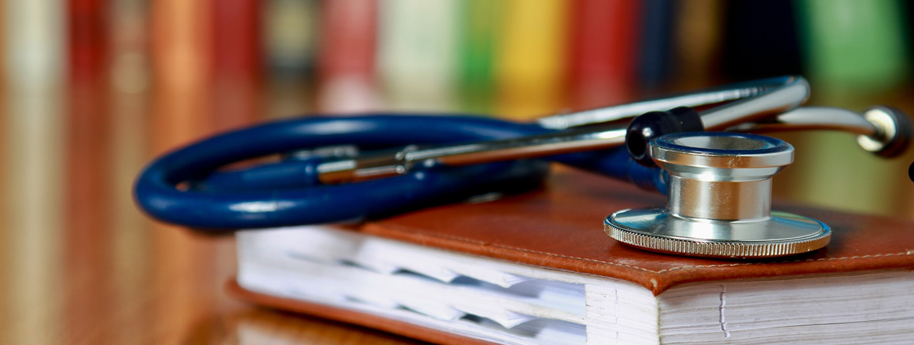


THANK YOU
www.ctc-ri.org
ctc-ri

