Slide 1
Clinical Strategy Committee: Addressing Alcohol Use Disorder Among Patients in Primary Care
9/20/24

Slide 2
Overview
Welcome
Environmental Scan (7:35-8am)
Alcohol Use Disorder: Statistics and Outcomes
AUD in Rhode Island
Options for Primary care in Addressing AUD
Panel Discussion (8-8:30am)
Moderator: Nelly Burdette, PsyD – Director, Population Behavioral Health, Boston Medical Center, and Sr. Director Integrated Behavioral Health, Care Transformation Collaborative-RI
Garry Bliss – Senior Director, Prospect Health Services RI
Barry Fabius, MD – Chief Medical Officer, UnitedHealthcare
Gloria Rose, RN – Director of Community Care Management, Thundermist Health Center
John Tassoni – President, Substance Use and Mental Health Leadership Council of RI
Open Discussion/Brainstorming/Think Tank Next Steps (8:30-9am)
Prepared by Care Transformation Collaborative of RI

Slide 3
Announcements!
Register here: https://bit.ly/CTCRIConference2024
Prepared by Care Transformation Collaborative of RI
Prepared by Care Transformation Collaborative of RI

Slide 4
Meeting Objectives
Review Alcohol Use Disorder (AUD) data nationally and within Rhode Island to understand across age, ethnicity and race impact of AUD
Understand treatment options across primary care as well as integrated behavioral health and community specialists in addressing AUD
Convene a panel to discussion to brainstorm next steps
Prepared by Care Transformation Collaborative of RI

Slide 5
CTC-RI Conflict of Interest Statement
Session presenters have no financial relationships with a commercial entity producing healthcare-related products used on or by patients. All relevant financial relationships of those on the session planning committee have been disclosed and, if necessary, mitigated.
Claim CME credits here: https://www.surveymonkey.com/r/ZDZS5HG
The AAFP has reviewed ‘Advancing Comprehensive Primary Care Through Improving Care Delivery Design and Community Health,’ and deemed it acceptable for AAFP credit. Term of approval is from 03/18/2022 to 03/18/2023. Physicians should claim only the credit commensurate with the extent of their participation in the activity. NPs and RNs can also receive credit through AAFP’s partnership with the American Nurses Credentialing Center (ANCC) and the American Academy of Nurse Practitioners Certification Board (AANPCB).

Slide 6
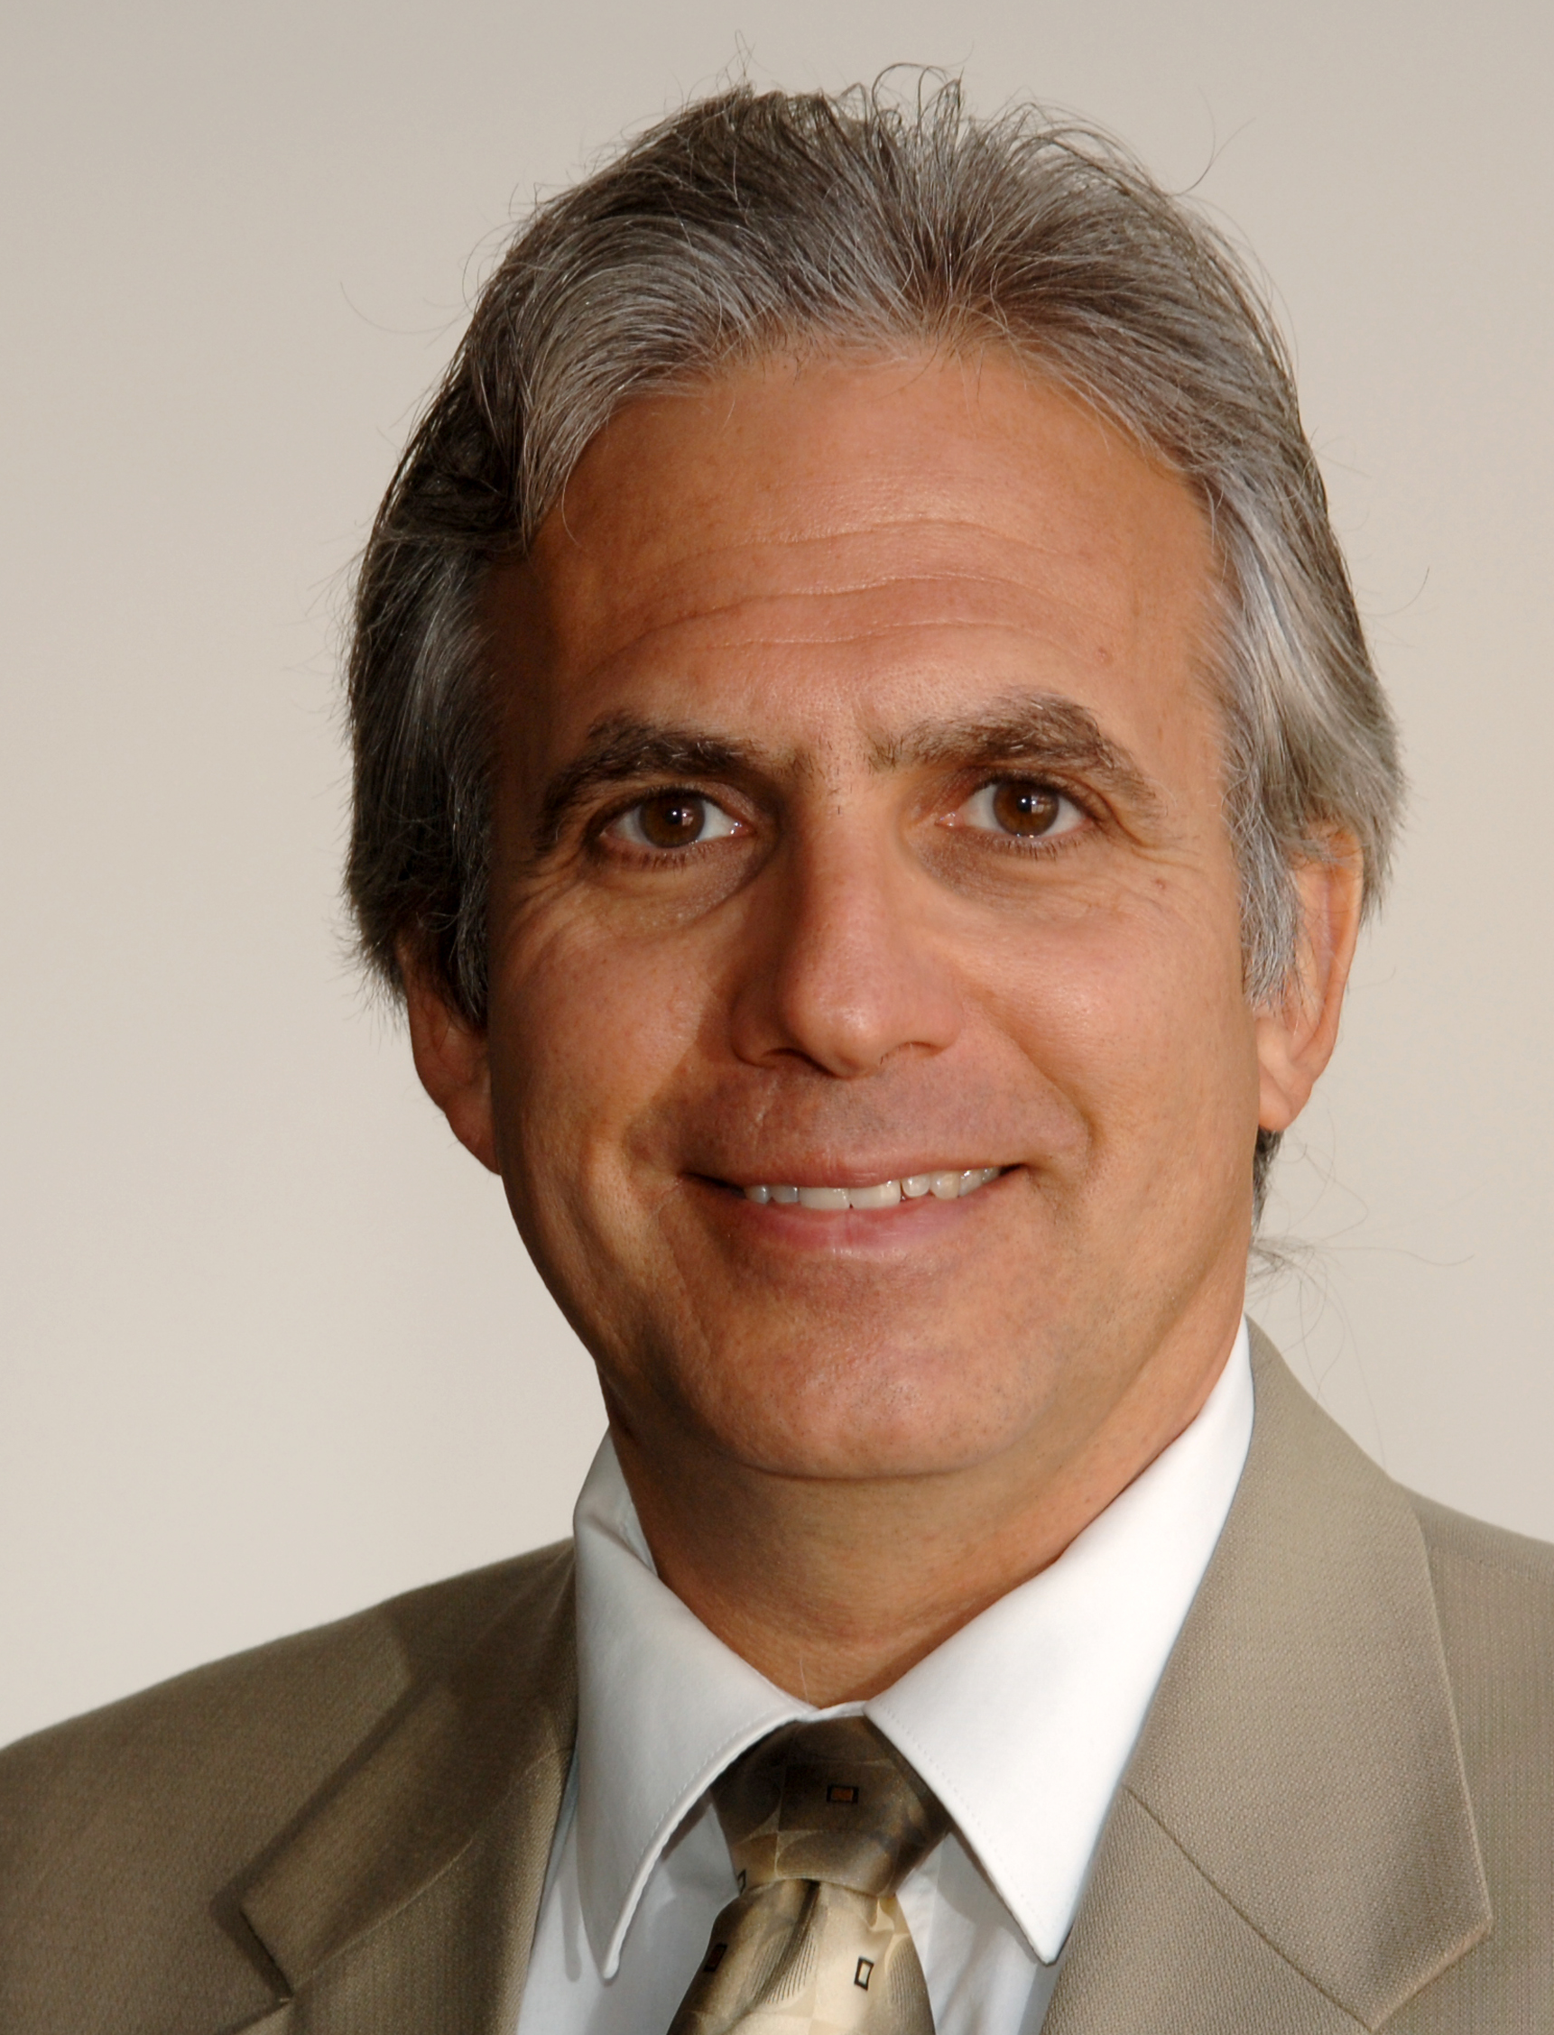
CTC-RI Senior Leadership
Deb Hurwitz, MBA, BSN, RN, Executive Director
Pano Yeracaris, MD, MPH, Chief Clinical Strategist
Patricia Flanagan, MD Clinical Director & PCMH Kids Co-Chair
Susanne Campbell, RN, MS, PCMH CCE, Senior Program Administrator
Linda Cabral, MM, Senior Program Manager
Yolanda Bowes, BS
Senior Project Manager
Nelly Burdette, PsyD
Senior Integrated Behavioral Health Program Leader
Prepared by Care Transformation Collaborative of RI
Notes:
All – Pat last then Introduces the Practices

Slide 7
Setting the Stage
Think Tank Kick off “Improving Primary Care Capacity to Identify and Address Alcohol Use Disorders”
CTC-RI Board support to convene a 5-part meeting series to generate a final presentation of themes identified, best practices and potential strategies for implementation
September 2024
October 2024
November 2024
Clinical Strategy Committee Meeting
December 2024
January/Feb 2025
Subject Matter Expert Session #3
Final Report/Presentation
Subject Matter Expert Session #1
Subject Matter Expert Session #2
Prepared by Care Transformation Collaborative of RI
Notes:
Linda

Slide 8
Acknowledgements
Special thanks to Nash Klinger, ScM
Brown University Warren Alpert Medical School
Prepared by Care Transformation Collaborative of RI

Slide 9
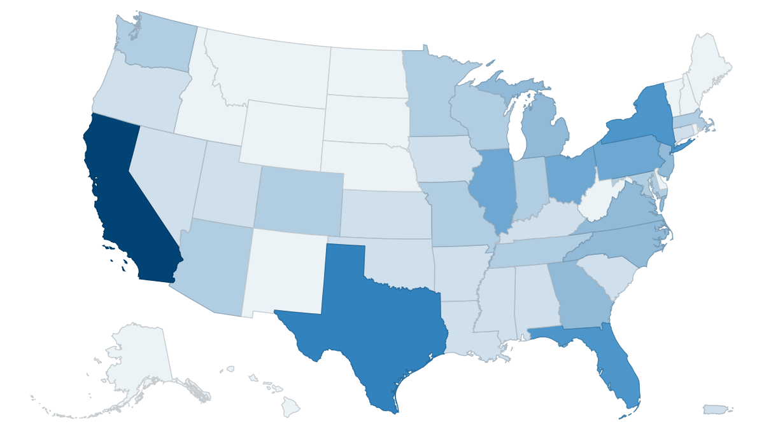
AUD: Data and Impact Nationally
Prepared by Care Transformation Collaborative of RI

Slide 10
Alcohol Use Disorder
Research has shown that people who misuse alcohol have a greater risk of liver disease, heart disease, depression, stroke, and stomach bleeding, as well as cancers of the oral cavity, esophagus, larynx, pharynx, liver, colon, breast and rectum
These individuals may also have problems managing conditions such as diabetes, high blood pressure, pain, and sleep disorders
They may increase their likelihood of high-risk sexual behavior⁽²⁾
“A problematic pattern of alcohol use leading to clinically significant impairment or distress”⁽¹⁾
Notes:
American Psychiatric Association. (2013). Substance-Related and Addictive Disorders. In Diagnostic and statistical manual of mental disorders (5th ed.). https://doi-org.ric.idm.oclc.org/10.1176/appi.books.9780890425787.x16_Substance_Related_Disorders
U.S. Department of Health and Human Services. (n.d.). Alcohol and the human body. National Institute on Alcohol Abuse and Alcoholism. https://www.niaaa.nih.gov/alcohols-effects-health/alcohol-topics/alcohol-facts-and-statistics/alcohol-and-human-body

Slide 11
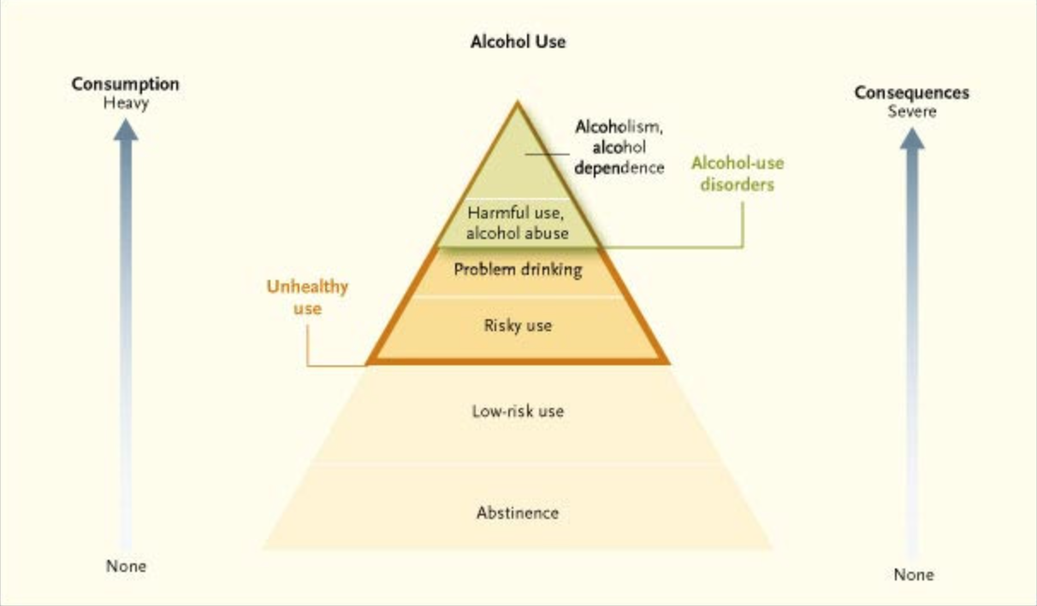
Spectrum of Alcohol Use⁽⁴⁾
Nearly 1 in 3 US adults have risky alcohol use according to NIAAA estimates. Alcohol use disorder has been estimated to affect 29% of adults in the US in their lifetimes.
Excessive alcohol use is the third most common cause of preventable death in the US and is estimated to cause 1 in 10 deaths among working-age adults in the US.⁽³⁾
Prepared by Care Transformation Collaborative of RI
Notes:
3. Patel, A. K., & Balasanova, A. A. (2021). Unhealthy alcohol use. JAMA, 326(2), 196. https://doi.org/10.1001/jama.2020.2015
4. Saitz, R. (2005). The Spectrum of Alcohol Use [Image]. The New England Journal of Medicine. https://www-nejm-org.ric.idm.oclc.org/doi/full/10.1056/NEJMcp042262.

Slide 12
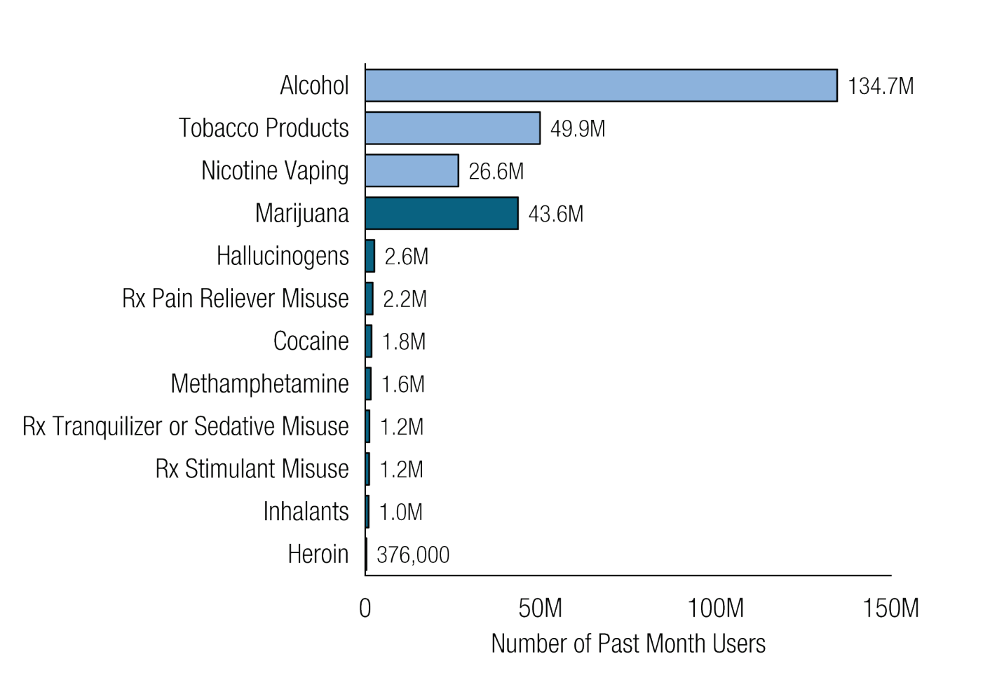
Prevalence of Substance Use in US
Past month substance use: Among People Aged 12 or older in 2023⁽⁵⁾
Prepared by Care Transformation Collaborative of RI
Notes:
5. Substance Abuse and Mental Health Services Administration. (2024). Figure 1. Past Month Substance Use: Among People Aged 12 or Older; 2023 [Table]. https://www.samhsa.gov/data/sites/default/files/reports/rpt47095/National%20Report/National%20Report/2023-nsduh-annual-national.pdf

Slide 13
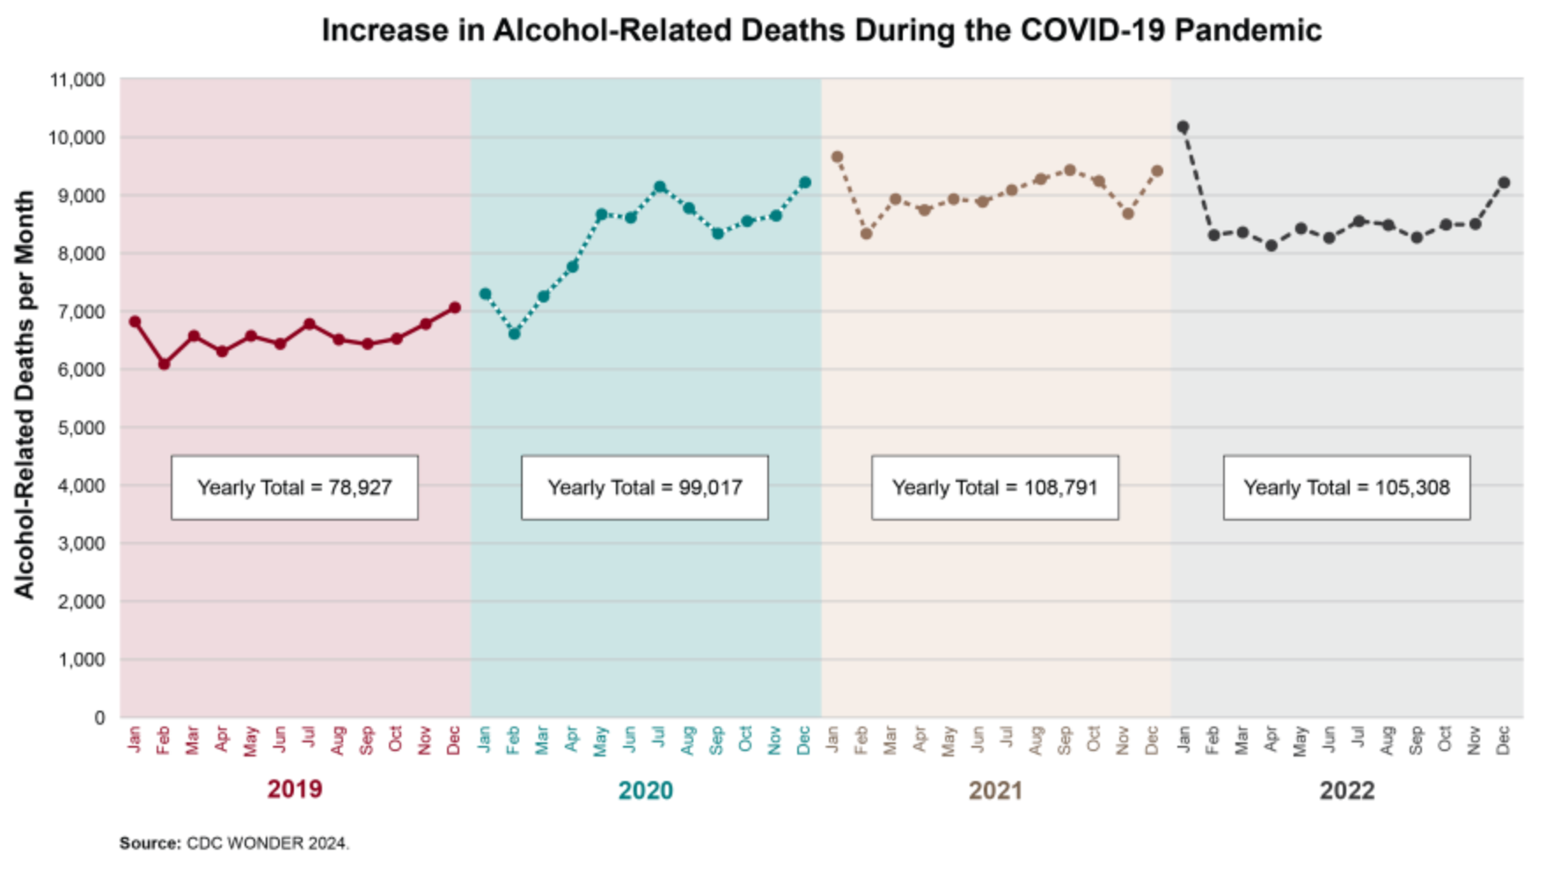
COVID-19 impact on Alcohol Related Deaths
(6)
Prepared by Care Transformation Collaborative of RI
Notes:
6. National Institute on Alcohol Abuse and Alcoholism. (2023). Increase in Alcohol-Related Deaths during the COVID-19 Pandemic [Table]. https://www.niaaa.nih.gov/news-events/research-update/alcohol-related-deaths-which-increased-during-first-year-covid-19-pandemic-continued-rise-2021

Slide 14
AUD in Rhode Island
Prepared by Care Transformation Collaborative of RI

Slide 15
15th
In 2021, RI ranked 15th highest consumer of alcohol in the US, with residents drinking 2.87 gallons of alcohol per capita, higher than the US average of 2.51 gallons of alcohol per capita.⁽⁷⁾
Prepared by Care Transformation Collaborative of RI
Notes:
7. Slater, M. E., & Alpert, H. R. (2023). (rep.). Surveillance Reports: #120 Apparent Per Capita Alcohol Consumption: National, State, and Regional Trends, 1977-2021. National Institute on Alcohol Abuse and Alcoholism. https://www.niaaa.nih.gov/publications/surveillance-reports/surveillance120.

Slide 16
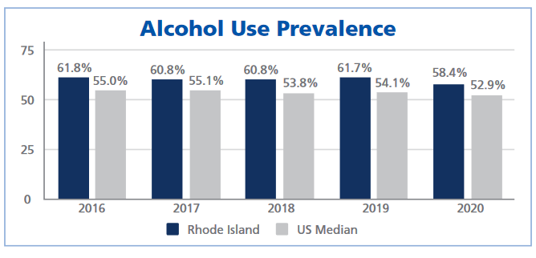
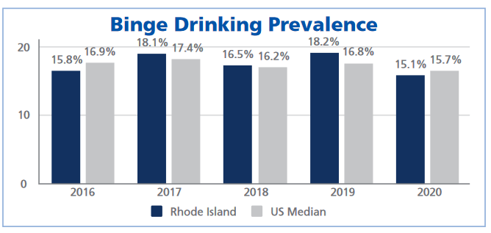
Alcohol Use in RI – Last 30 days
Rhode Island adults consistently reported drinking any alcohol in the past 30 days more often the median US adult, ranging from 5.5% to 7% higher, depending on the year.⁽⁸⁾
The percentage of Rhode Island adults who binge drink changed by year, with some years being higher than the US median and other years being lower.⁽⁹⁾
Prepared by Care Transformation Collaborative of RI
Notes:
8. Ledingham, E. & Scagos, R. (2022) Alcohol Use Prevalence [Table]. Rhode Island Department of Health. https://health.ri.gov/publications/reports/2016-2020AlcoholUse.pdf
9. Ledingham, E. & Scagos, R. (2022) Binge Drinking Prevalence [Table]. Rhode Island Department of Health. https://health.ri.gov/publications/reports/2016-2020AlcoholUse.pdf

Slide 17
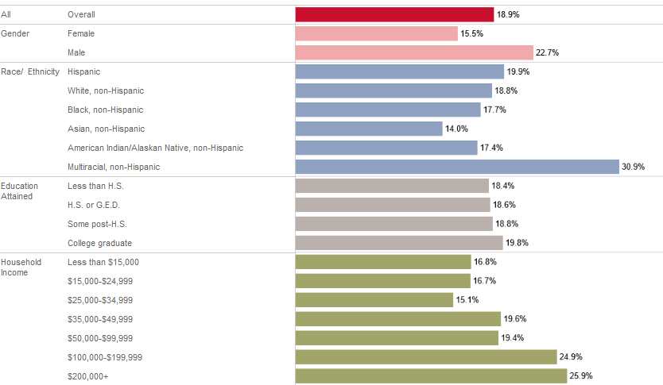
Rhode Island
Excessive
Drinking
Last 30 days (2022)⁽¹⁰⁾
by Demographics
Prepared by Care Transformation Collaborative of RI
Notes:
10. Health in Rhode Island. (2022). Excessive drinking demographic breakout [Table]. https://healthinri.com/data/excessive-drinking

Slide 18
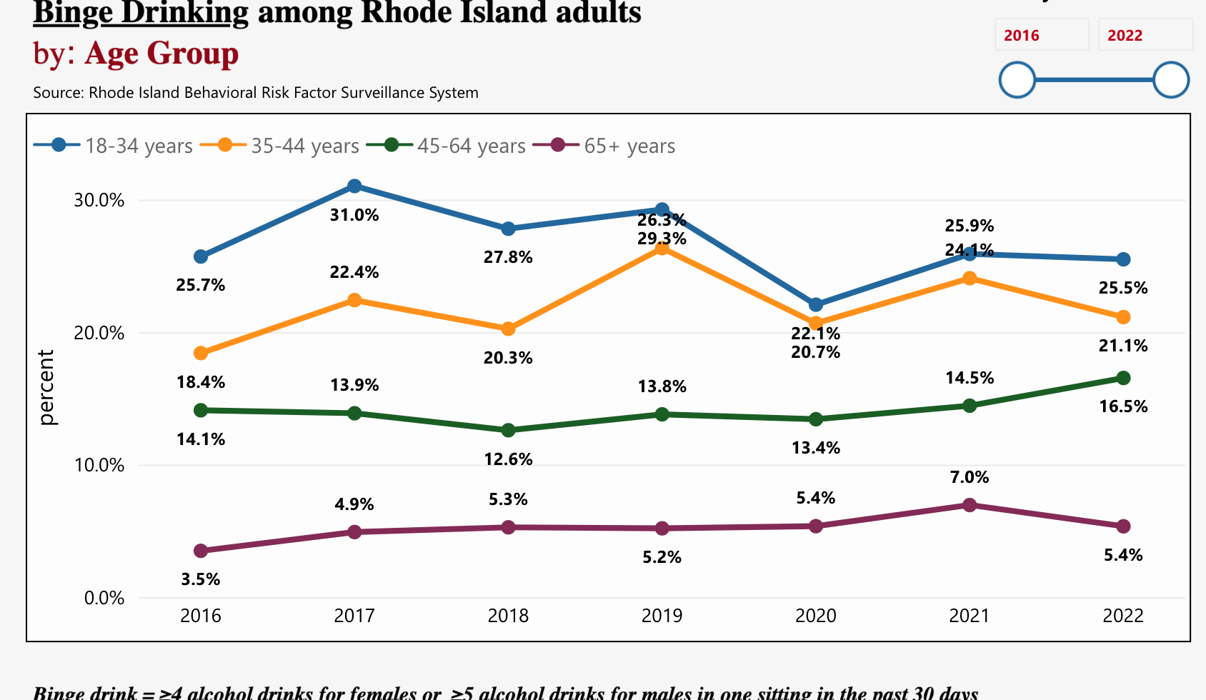
Rhode Island Binge Drinking by age group (2016-2022)
Highest rates for 18–34-year-olds
Increase in binge drinking rates for adults age 35+ since 2016⁽¹¹⁾
Rates of binge drinking in older adults (age 65+) doubled from 3.5% to 7% from 2016 to 2021⁽¹²⁾
Prepared by Care Transformation Collaborative of RI
Notes:
11. Rhode Island Behavioral Risk Factor Surveillance System. (2016-2022). Binge Drinking among Rhode Island adults by: Age Group [Interactive Table]. https://app.powerbigov.us/view?r=eyJrIjoiZmMyMWVkOWYtMDM0ZC00MTdiLWE3MTEtYzU4YWQ5YWM5MWFhIiwidCI6IjUyY2E2YTU0LTQ0NjUtNDYzNS1iZmYzLTY1ZDBhODQxMjI4OCJ9
12. Rhode Island Department of Health. (2023). Excessive Alcohol Use: Data Report 2023. https://ridoh-excessive-alcohol-surveillance-landing-page-rihealth.hub.arcgis.com/documents/be2cca0f05544f3992ef066abf67740e/about

Slide 19
RI ED Visits with an Alcohol-Related Condition
In 2021, 69.3% of visits were for white, not Hispanic; 7% for Black, not Hispanic and 19% Latino.
General demographic for RI: White 71.3%; Black, not Hispanic 5.7%; Hispanic, 16.6% (2020 US Census)
More visits for Males (71.7%) vs. females (28.3%)
More visits for ages 45+ (22.8%) vs younger ages
Alcohol related overdose fatalities rose 148% from 2010 to 2021. Overall, alcohol related overdoses made up about 30% of all overdose deaths in RI.⁽¹³⁾
Prepared by Care Transformation Collaborative of RI
Notes:
13. Rhode Island Department of Health. (2022). Rhode Island Data Brief: Alcohol-Related Emergency Department Visits in Rhode Island, 2018-2021. https://health.ri.gov/publications/reports/2018-20201Alcohol-ED-Visits.pdf

Slide 20
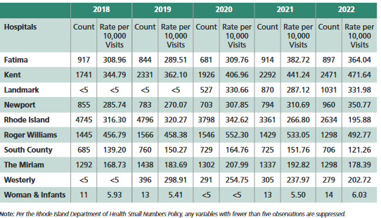
ED Visits in RI
Acute Alcohol Related ED Visits by Hospital⁽¹⁴⁾
In 2022, Rhode Island Hospital had the most ED visits for alcohol-related visits in the state (2,634 visits)
Roger Williams Hospital has the highest proportion of alcohol-related visits out of included hospitals in the state (492.77 per 10,000 visits)⁽¹⁵⁾
Prepared by Care Transformation Collaborative of RI
Notes:
14. Rhode Island Department of Health. (2023). Acute Alcohol-Related Emergency Department Visits by Hospital Patient Count and Rate per 10,000 visits in Rhode Island, National Syndromic Surveillance System [Table]. https://ridoh-excessive-alcohol-surveillance-landing-page-rihealth.hub.arcgis.com/documents/be2cca0f05544f3992ef066abf67740e/about
15. Rhode Island Department of Health. (2022). Rhode Island Data Brief: Alcohol-Related Emergency Department Visits in Rhode Island, 2018-2021. https://health.ri.gov/publications/reports/2018-20201Alcohol-ED-Visits.pdf14

Slide 21
Treatment Options for AUD: Primary Care
Prepared by Care Transformation Collaborative of RI

Slide 22
AUD Treatment Gaps Outpacing Others
Estimates suggest that less than 8% of adult individuals who need AUD treatment receive any treatment (behavioral or medical) within 1 year.
In 2019, less than 2% received one of the FDA-approved medications.
Reasons for this treatment gap include:
lack of knowledge,
lack of screening and brief intervention
lack of referral to treatment
lack of available treatment facilities, and stigma⁽¹⁶⁾
Figure 1. ASAM ad for treating addiction⁽¹⁷⁾
Prepared by Care Transformation Collaborative of RI
Notes:
16. Koob, G. F. (2024). Alcohol use disorder treatment: Problems and solutions. Annual Review of Pharmacology and Toxicology, 64(1), 255–275. https://doi.org/10.1146/annurev-pharmtox-031323-115847
17. American Society of Addiction Medicine. (2017). Only 1 in 10 People With a Substance Use Disorder Receive Treatment [Image]. https://pbs.twimg.com/media/DK6R-_lVoAEQYRU?format=png&name=medium

Slide 23
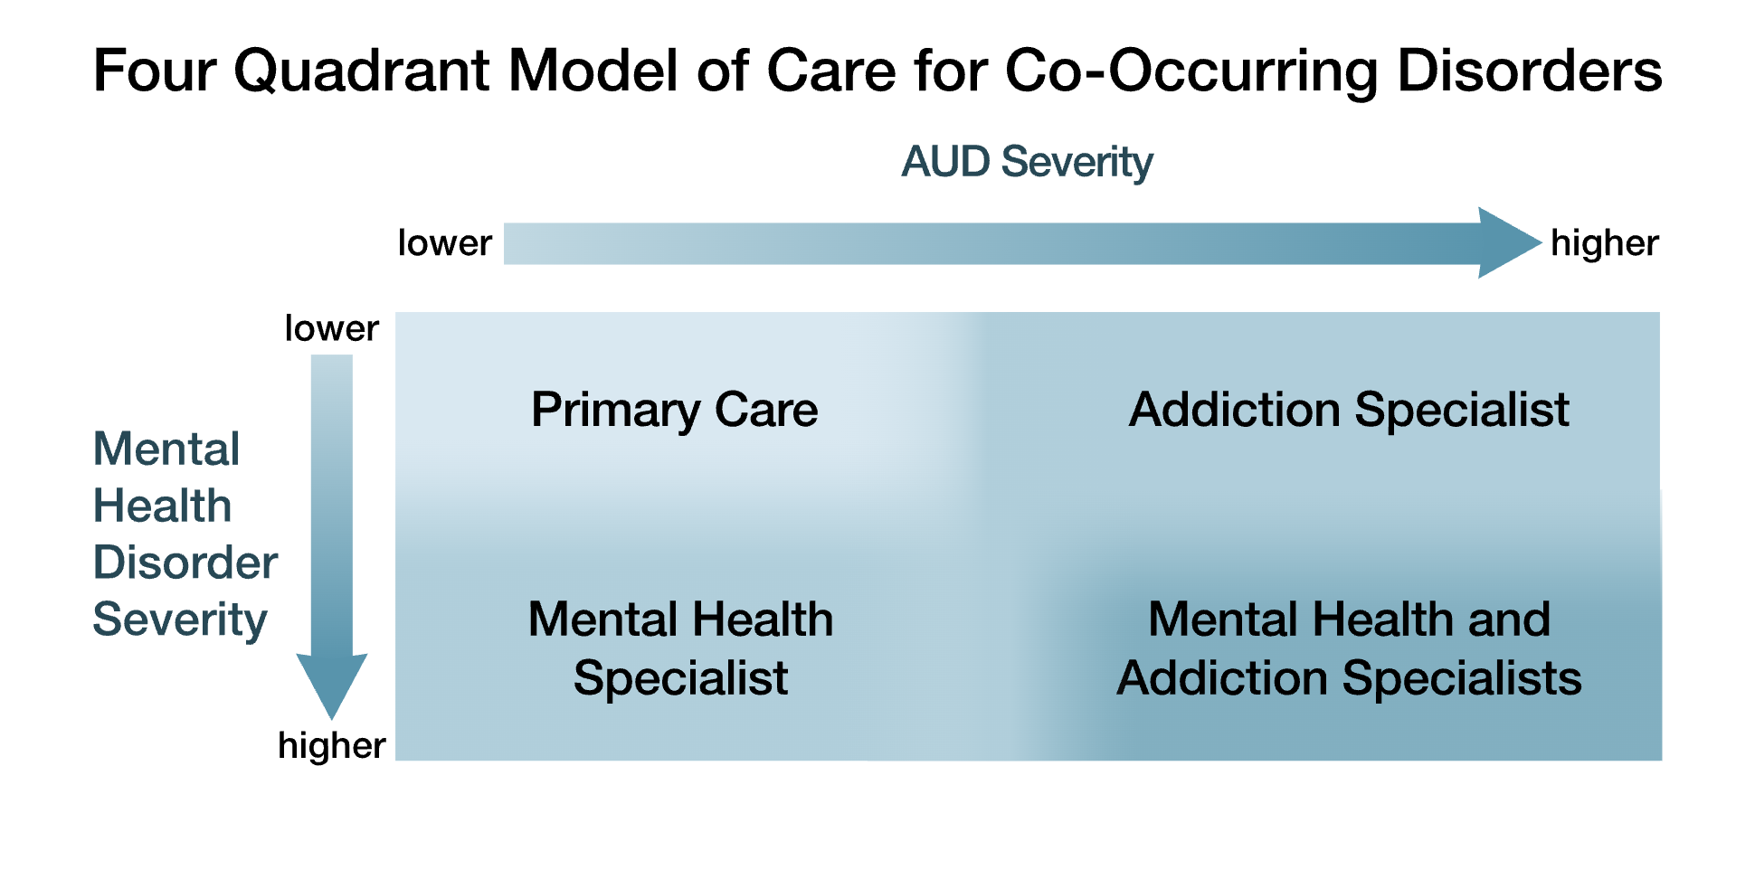
Figure 2. NIAAA Model on Co-Occurring Disorders⁽¹⁸⁾
Prepared by Care Transformation Collaborative of RI
Notes:
18. National Institute on Alcohol Abuse and Alcoholism. (2022). Four Quadrant Model of Care for Co-Occurring Disorders [Image]. https://www.niaaa.nih.gov/sites/default/themes/solstice/images/four-quadrant-model.svg

Slide 24
Baseline AUD Treatment in Primary Care
Screening - USPSTF and SAMHSA recommend routine AUDIT or CAGE screenings in primary care
SBIRT (Screening, Brief Intervention, Referral, Treatment) – includes screening for alcohol misuse and level of risk, offering a brief outpatient intervention to help patients understand the need to manage alcohol use, and referrals to SUD treatment programs for more specialized assessment or intervention.
Motivational Interviewing - Meta-analyses and systematic reviews have found that brief interventions, especially those based on the principles of motivational interviewing, are effective in the treatment of alcohol use disorder, including
self-monitoring of alcohol use,
increasing awareness of high-risk situations,
and training in cognitive and behavioral techniques in relation to MI⁽¹⁹⁾
Figure 3. RI SBIRT poster for substance use⁽²⁰⁾
Prepared by Care Transformation Collaborative of RI
Notes:
19. Witkiewitz, K., Litten, R. Z., & Leggio, L. (2019). Advances in the science and treatment of alcohol use disorder. Science advances, 5(9), eaax4043. https://doi.org/10.1126/sciadv.aax4043
20. RI SBIRT. (n.d.). We Ask Everyone [Image]. https://risbirt.org/wp-content/uploads/2019/06/risbirt-poster-ask-everyone11x17.pdf

Slide 25
Team-based care in Treating AUD
Grow treatment modalities within by utilizing: IBH, Community Health Workers, Peer-Recovery Specialists, Pharmacy
Strengthen community clinical linkages to specialty providers, CCBHCs, CBOs, support groups, Recovery Centers
Offer pharmacological approaches to treating AUD (FDA approved: Acamprosate, Disulfiram, and Naltrexone)
Prepared by Care Transformation Collaborative of RI

Slide 26
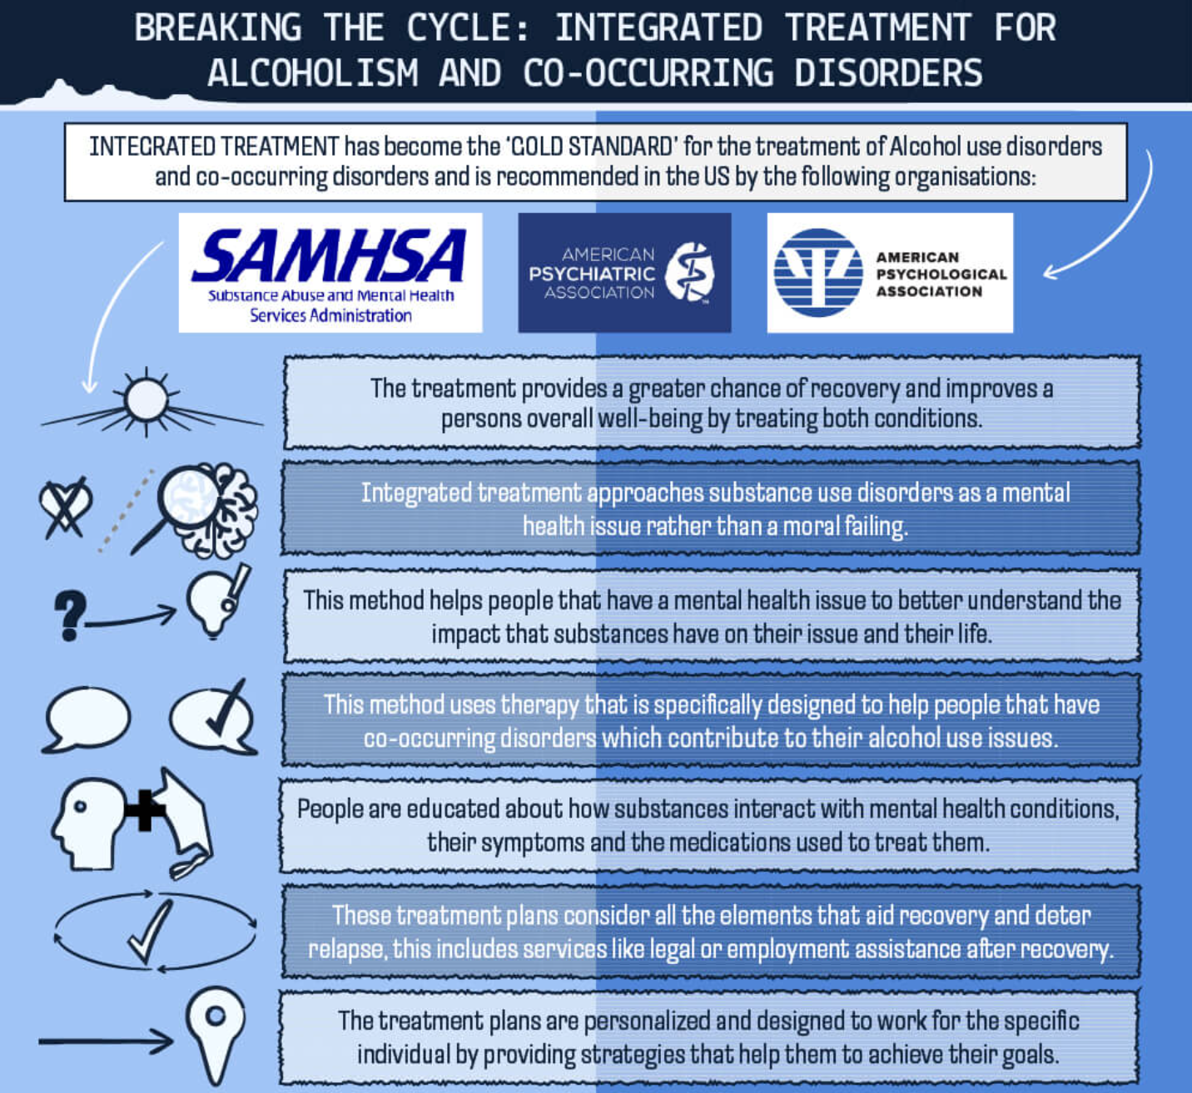
AUD Treatment: IBH
Figure 4. Desert Cove Recovery Poster⁽²¹⁾
Prepared by Care Transformation Collaborative of RI
Notes:
21. Desert Cove Recovery. (n.d.). Breaking The Cycle: Integrated Treatment for Alcoholism and Co-Occurring Disorders [Image]. https://encrypted tbn0.gstatic.com/images?q=tbn:ANd9GcRdKbBoBOldc4mKTY59OxdVMqBtngqNUJ2RsvHhJWfO6p4i8NaG_DITrQAJRvH7zO8aytI&usqp=CAU

Slide 27
AUD Treatment: Collaborative Care (CoCM)
The SUMMIT Randomized Clinical Trial:
Objective: determine whether CoCM improves delivery of evidence-based treatments for OAUD and increases self-reported abstinence compared with usual primary care
Design: 377 primary care patients in 2 clinics for 6 months; 187 were randomized to CoCM; 190 randomized to usual care
Interventions: CoCM interventions were designed to increase the delivery of either a 6-session brief psychotherapy treatment and/or medication-assisted treatment (naltrexone for AUD); usual care patients were told the clinic provided treatment, given a number for appointment scheduling and list of community referrals.
Results: Proportion of participants in the CoCM group that received any treatment was higher in CoCM group compared to usual care (39% vs 16.8%); proportion meeting the HEDIS initiation and engagement measures was also higher among CoCM participants (31.6% vs 13.7%); abstinence from opioids, alcohol, and other drugs was also higher (26.3% vs 15.6%)⁽²²⁾
Prepared by Care Transformation Collaborative of RI
Notes:
22. Watkins, K. E., Ober, A. J., Lamp, K., Lind, M., Setodji, C., Osilla, K. C., Hunter, S. B., McCullough, C. M., Becker, K., Iyiewuare, P. O., Diamant, A., Heinzerling, K., & Pincus, H. A. (2017). Collaborative care for opioid and alcohol use disorders in primary care. JAMA Internal Medicine, 177(10), 1480. https://doi.org/10.1001/jamainternmed.2017.3947

Slide 28
AUD Treatment: CHOICE
CHOICE model of care is a year-long intervention offered by nurses and based on
(1) the Chronic Care Model,
(2) principles of patient-centered care ^{[11]}, and
(3) promising approaches to addressing AUDs in primary care ^{[12–23].}
The first nurse and nurse practitioner were initially given articles and protocols to read [14, 21, 33, 36, 43, 65, 102–108], then received 16 h of training, which included motivational interviewing (MI) skills focused on engagement, ways to increase the importance patients placed on changing their drinking and building patient self-efficacy, as well as 2 h of training addressed medications and laboratory monitoring ^{[21, 65].}
CHOICE nurses, nurse practitioner, and interdisciplinary CHOICE team—including 2 psychologists, 2 addiction psychiatrists, and 2 primary care internists—met weekly, were a critical part of the intervention, lasted an hour, and were held in person/virtually
-------------------------------------------------------------------------------------------------------------------
RESULTS: Reduced heavy drinking and drinking below recommended limits without symptoms⁽²³⁾
Prepared by Care Transformation Collaborative of RI
Notes:
23. Bradley KA, Ludman EJ, Chavez LJ, Bobb JF, Ruedebusch SJ, Achtmeyer CE, Merrill JO, Saxon AJ, Caldeiro RM, Greenberg DM, Lee AK, Richards JE, Thomas RM, Matson TE, Williams EC, Hawkins E, Lapham G, & Kivlahan DR. Patient-centered primary care for adults at high risk for AUDs: the Choosing Healthier Drinking Options In primary CarE (CHOICE) trial. Addict Sci Clin Pract. 2017 May 17;12(1):15. doi: 10.1186/s13722-017-0080-2. PMID: 28514963; PMCID: PMC5436432.

Slide 29
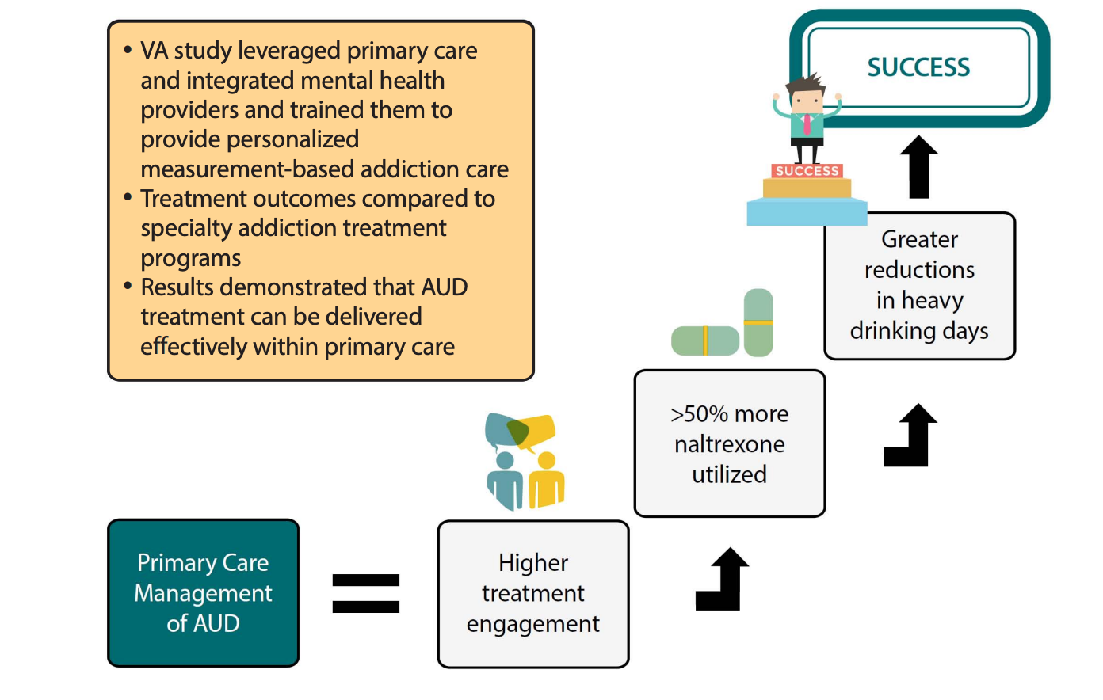
AUD Treatment: VA-AACORN⁽²⁴⁾
Prepared by Care Transformation Collaborative of RI
Notes:
24. Cohen AJ, Russell LE, Elwy AR, Mitchell KM, Cornell PY, Silva JW, Moy E, Kennedy MA. Adaptation of a social risk screening and referral initiative across clinical populations, settings, and contexts in the Department of Veterans Affairs Health System. Front Health Serv. 2023 Jan 30;2:958969. doi: 10.3389/frhs.2022.958969

Slide 30
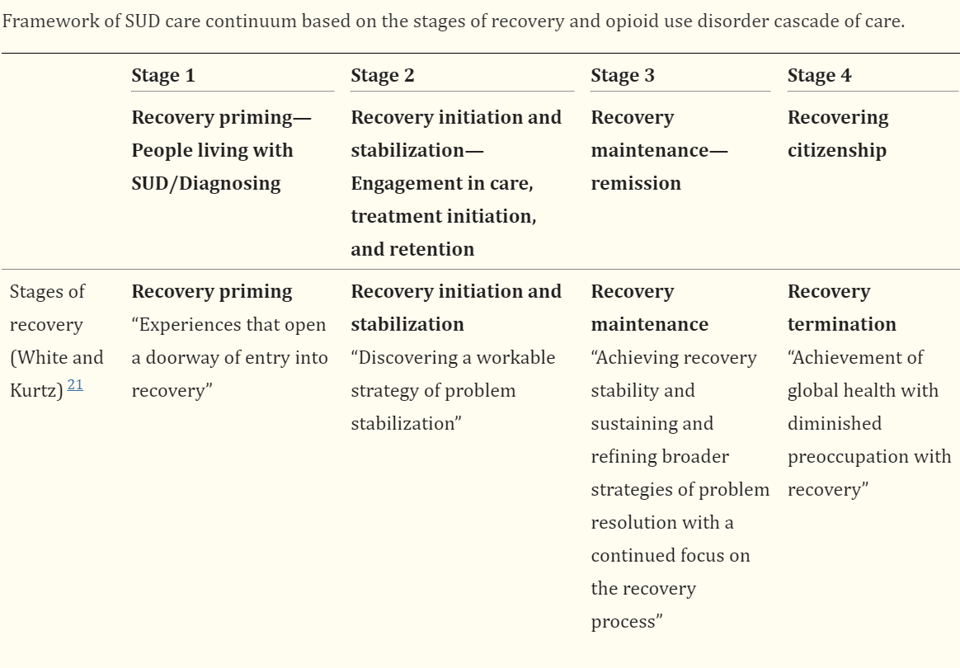
AUD Treatment: Peer Recovery in ED
Peer Recovery support is non-clinical assistance by persons with lived experience of similar conditions to initiate, pursue, and sustain a person’s long-term recovery from SUD. ⁽²⁴⁾
Figure 6. Table 1 from Substance abuse: research and treatment journal article.⁽²⁵⁾
Prepared by Care Transformation Collaborative of RI
Notes:
25. Stanojlović, M., & Davidson, L. (2021). Targeting the barriers in the substance use disorder continuum of care with Peer Recovery Support. Substance Abuse: Research and Treatment, 15, 117822182097698. https://doi.org/10.1177/1178221820976988
26. Stanojlović, M., & Davidson, L. (2021). Table 1. Framework of SUD care continuum based on the stages of recovery and opioid use disorder cascade of care [Table]. Substance Abuse: Research and Treatment, 15, 117822182097698. https://doi.org/10.1177/1178221820976988

Slide 31
Revisiting and Reframing
Figure 5. NIAAA Model on Co-Occurring Disorders⁽¹⁸⁾
Prepared by Care Transformation Collaborative of RI
Notes:
18. National Institute on Alcohol Abuse and Alcoholism. (2022). Four Quadrant Model of Care for Co-Occurring Disorders [Image]. https://www.niaaa.nih.gov/sites/default/themes/solstice/images/four-quadrant-model.svg

Slide 32
Transition To Panel
Moderator: Nelly Burdette, PsyD – Director, Population Behavioral Health, Boston Medical Center, and Sr. Director Integrated Behavioral Health, Care Transformation Collaborative-RI
Garry Bliss – Senior Director, Prospect Health Services RI
Barry Fabius, MD – Chief Medical Officer, UnitedHealthcare
Gloria Rose, RN – Director of Community Care Management, Thundermist Health Center
John Tassoni – President, Substance Use and Mental Health Leadership Council of RI
www.ctc-ri.org
ctc-ri
Please acknowledge that this PP brought to you by the PHSRI-AE and is “owned” by PHSRI-AE, prepared by CTC-RI.
Please acknowledge that this PP brought to you by the PHSRI-AE and is “owned” by PHSRI-AE, prepared by CTC-RI.
Prepared by CTC-RI.
Prepared by Care Transformation Collaborative of RI

Slide 33
Top 5 ER Diagnoses for all Rhode Island AEs
Data source: iPCA

Slide 34
Top 5 Inpatient Diagnoses for all Rhode Island AEs*
*Excludes pregnancy-related diagnoses
Data source: iPCA

Slide 35
Top 5 Diagnoses for all Rhode Island AEs- Readmission within 30 Days
Data source: iPCA

Slide 36
Next Steps
Identify 3 subject matter experts to inform next level of discussion
Ensure all relevant and appropriate stakeholders are involved
After final report and presentation provided, obtain funding needed to pilot any of the recommendations identified as next best steps
September 2024
October 2024
Subject Matter Expert Session #1
November 2024
Subject Matter Expert Session #2
Clinical Strategy Committee Meeting
December 2024
January/Feb 2025
Subject Matter Expert Session #3
Final Report/Presentation
Prepared by Care Transformation Collaborative of RI

Slide 37
References
American Psychiatric Association. (2013). Substance-Related and Addictive Disorders. In Diagnostic and statistical manual of mental disorders (5th ed.). https://doi- org.ric.idm.oclc.org/10.1176/appi.books.9780890425787.x16_Substance_Related_Disorders
U.S. Department of Health and Human Services. (2024). Alcohol and the human body. National Institute on Alcohol Abuse and Alcoholism. https://www.niaaa.nih.gov/alcohols-effects-health/alcohol- topics/alcohol-facts-and-statistics/alcohol-and-human-body
Patel, A. K., & Balasanova, A. A. (2021). Unhealthy alcohol use. JAMA, 326(2), 196. https://doi.org/10.1001/jama.2020.2015
Saitz, R. (2005). The Spectrum of Alcohol Use [Image]. The New England Journal of Medicine. https://www-nejm-org.ric.idm.oclc.org/doi/full/10.1056/NEJMcp042262.
Substance Abuse and Mental Health Services Administration. (2024). Figure 1. Past Month Substance Use: Among People Aged 12 or Older; 2023 [Table]. https://www.samhsa.gov/data/sites/default/files/reports/rpt47095/National%20Report/National%20Report/2023-nsduh-annual-national.pdf
National Institute on Alcohol Abuse and Alcoholism. (2023). Increase in Alcohol-Related Deaths during the COVID-19 Pandemic [Table]. https://www.niaaa.nih.gov/news-events/research-update/alcohol- related-deaths-which-increased-during-first-year-covid-19-pandemic-continued-rise-2021
Slater, M. E., & Alpert, H. R. (2023). (rep.). Surveillance Reports: #120 Apparent Per Capita Alcohol Consumption: National, State, and Regional Trends, 1977-2021. National Institute on Alcohol Abuse and Alcoholism. https://www.niaaa.nih.gov/publications/surveillance-reports/surveillance120.
Ledingham, E. & Scagos, R. (2022) Alcohol Use Prevalence [Table]. Rhode Island Department of Health. https://health.ri.gov/publications/reports/2016-2020AlcoholUse.pdf
Ledingham, E. & Scagos, R. (2022) Binge Drinking Prevalence [Table]. Rhode Island Department of Health. https://health.ri.gov/publications/reports/2016-2020AlcoholUse.pdf
Health in Rhode Island. (2022). Excessive drinking demographic breakout [Table]. https://healthinri.com/data/excessive-drinking
Rhode Island Behavioral Risk Factor Surveillance System. (2016-2022). Binge Drinking among Rhode Island adults by: Age Group [Interactive Table]. https://app.powerbigov.us/view?r=eyJrIjoiZmMyMWVkOWYtMDM0ZC00MTdiLWE3MTEtYzU4YWQ5YWM5MWFhIiwidCI6IjUyY2E2YTU0LTQ0NjUtNDYzNS1iZmYzLTY1ZDBhODQ xMjI4OCJ9
Rhode Island Department of Health. (2023). Excessive Alcohol Use: Data Report 2023. https://ridoh-excessive-alcohol-surveillance-landing-page rihealth.hub.arcgis.com/documents/be2cca0f05544f3992ef066abf67740e/about
Rhode Island Department of Health. (2022). Rhode Island Data Brief: Alcohol-Related Emergency Department Visits in Rhode Island, 2018-2021https://health.ri.gov/publications/reports/2018- 20201Alcohol-ED-Visits.pdf14.
Rhode Island Department of Health. (2023). Acute Alcohol-Related Emergency Department Visits by Hospital Patient Count and Rate per 10,000 visits in Rhode Island, National Syndromic Surveillance System [Table]. https://ridoh-excessive-alcohol-surveillance-landing-page-rihealth.hub.arcgis.com/documents/be2cca0f05544f3992ef066abf67740e/about
Prepared by Care Transformation Collaborative of RI

Slide 38
References
15. Rhode Island Department of Health. (2022). Rhode Island Data Brief: Alcohol-Related Emergency Department Visits in Rhode Island, 2018-2021. https://health.ri.gov/publications/reports/2018- 20201Alcohol-ED-Visits.pdf1
16. Koob, G. F. (2024). Alcohol use disorder treatment: Problems and solutions. Annual Review of Pharmacology and Toxicology, 64(1), 255–275. https://doi.org/10.1146/annurev-pharmtox-031323-115847
American Society of Addiction Medicine. (2017). Only 1 in 10 People With a Substance Use Disorder Receive Treatment [Image]. https://pbs.twimg.com/media/DK6R- _lVoAEQYRU?format=png&name=medium
National Institute on Alcohol Abuse and Alcoholism. (2022). Four Quadrant Model of Care for Co-Occurring Disorders [Image]. https://www.niaaa.nih.gov/sites/default/themes/solstice/images/four- quadrant-model.svg
Witkiewitz, K., Litten, R. Z., & Leggio, L. (2019). Advances in the science and treatment of alcohol use disorder. Science advances, 5(9), eaax4043. https://doi.org/10.1126/sciadv.aax4043
RI SBIRT. (n.d.). We Ask Everyone [Image]. https://risbirt.org/wp-content/uploads/2019/06/risbirt-poster-ask-everyone11x17.pdf
Desert Cove Recovery. (n.d.). Breaking The Cycle: Integrated Treatment for Alcoholism and Co-Occurring Disorders [Image]. https://encrypted tbn0.gstatic.com/images?q=tbn:ANd9GcRdKbBoBOldc4mKTY59OxdVMqBtngqNUJ2RsvHhJWfO6p4i8NaG_DITrQAJRvH7zO8aytI&usqp=CAU
Watkins, K. E., Ober, A. J., Lamp, K., Lind, M., Setodji, C., Osilla, K. C., Hunter, S. B., McCullough, C. M., Becker, K., Iyiewuare, P. O., Diamant, A., Heinzerling, K., & Pincus, H. A. (2017). Collaborative care for opioid and alcohol use disorders in primary care. JAMA Internal Medicine, 177(10), 1480. https://doi.org/10.1001/jamainternmed.2017.3947
Bradley, K. A., Ludman, E. J., Chavez, L. J., Bobb, J. F., Ruedebusch, S. J., Achtmeyer, C. E., Merrill, J. O., Saxon, A. J., Caldeiro, R. M., Greenberg, D. M., Lee, A. K., Richards, J. E., Thomas, R. M., Matson, T. E., Williams, E. C., Hawkins, E., Lapham, G., & Kivlahan, D. R. (2017). Patient-centered primary care for adults at high risk for AUDS: The choosing healthier drinking options in primary care (choice) trial. Addiction Science &amp; Clinical Practice, 12(1). https://doi.org/10.1186/s13722-017-0080-2 .
Cohen AJ, Russell LE, Elwy AR, Mitchell KM, Cornell PY, Silva JW, Moy E, Kennedy MA. Adaptation of a social risk screening and referral initiative across clinical populations, settings, and contexts in the Department of Veterans Affairs Health System. Front Health Serv. 2023 Jan 30;2:958969. doi: 10.3389/frhs.2022.958969.
Stanojlović, M., & Davidson, L. (2021). Targeting the Barriers in the Substance Use Disorder Continuum of Care With Peer Recovery Support. Substance Abuse : Research and Treatment, 15, 1178221820976988. https://doi.org/10.1177/1178221820976988
Stanojlović, M., & Davidson, L. (2021). Table 1. Framework of SUD care continuum based on the stages of recovery and opioid use disorder cascade of care [Table]. Substance Abuse: Research and Treatment, 15, 117822182097698. https://doi.org/10.1177/1178221820976988
Prepared by Care Transformation Collaborative of RI

Slide 39
CME Credits & Eval
Reminder to please complete the evaluation in order to claim CME credits!
Claim CME credits here: https://www.surveymonkey.com/r/ZDZS5HG
The AAFP has reviewed ‘Advancing Comprehensive Primary Care Through Improving Care Delivery Design and Community Health,’ and deemed it acceptable for AAFP credit. Term of approval is from 03/18/2022 to 03/18/2023. Physicians should claim only the credit commensurate with the extent of their participation in the activity. NPs and RNs can also receive credit through AAFP’s partnership with the American Nurses Credentialing Center (ANCC) and the American Academy of Nurse Practitioners Certification Board (AANPCB).

