Slide 1
Addressing Alcohol Use Disorder (AUD) in Primary Care Think Tank Series
Session 4
Central Vermont Medical Center ROAD Program
December 16th, 2024, 12:00-1:00PM

Slide 2
Session Overview
Welcome & Introduction (12:00-12:05pm)
    Linda Cabral, MM, Senior Program Manager, CTC-RI
Central Vermont Medical Center ROAD (12:05-12:35pm)
    The Turning Point Center – Central Vermont
    The University of Vermont Health Network
Questions and Answers / Open Discussion (12:35-1:00pm)
    Moderator: Nelly Burdette, PsyD, CTC-RI

Slide 3
Series Overview
This is the 4th session in a 5-part meeting series for Addressing AUD in Primary Care
Meetings are held every 3rd Monday from 12:00 – 1:00 PM EST
Final Meeting will be January 27, 2025; recommendations.
September 2024
  Clinical Strategy Committee Meeting
October 21, 2024
  ACT, Lifespan Recovery, CHW
November 18, 2024
  The Role of CCBHCs
December 16, 2024
  Central Vermont Medical Center
January 27, 2025
  Final Report/Presentation

Slide 4
Refocus on Alcohol Dependence (ROAD) Primary Care Treatment Pathway
A presentation for the Care Transformation Collaborative- Rhode Island
12/16/2024

Slide 5



Meet the Team
Moriah Haggett, Program Supervisor
John Reese, Certified Recovery Coach
  Javad Mashkuri, MD- CVMC ED physician and Central VT Prevention Coalition physician lead
  Marissa Patrick, MSN, APRN, AGPCNP-BC, HNP, and CVMC Primary Care Nurse Practitioner
  Evan Smith, MSW, LICSW- CVMC Addictions Treatment Supervisor
  Natasha Withers, DO- UVMHN Network AVP Medical Director for High Value Care & Porter Medical Primary Care Physician
  Connie Gavin- UVMHN PHSO Blueprint Program Manager- Barre Health Service Area
Notes:
UVM Health Network:
Central Vermont Medical Center
Javad Mashkuri, MD- CVMC ED physician and Central VT Prevention Coalition physician lead
Marissa Patrick, MSN, APRN, AGPCNP-BC, HNP, board certified adult-gerontology and CVMC primary care nurse practitioner.
Evan Smith, MSW, LICSW- CVMC Addictions Treatment Supervisor
High Value Care Team:
Natasha Withers, DO- Network AVP Medical Director for High Value Care & Porter Medical Primary Care Physician
Connie Gavin- Blueprint Program Manager- Barre Health Service Area
Vermont Agency of Human Services:
Julie Parker- Associate Director of Blueprint

Slide 6
How did we get here?
No established system of care for AUD existed in Central Vermont, despite data that suggest an overwhelming unmet need.
COVID 19 crisis
AUD prevalence 3rd
in the nation
Community - urgent call to action
2x
AUD > OUD
Deaths 2012-2021
136%
Alcohol Poisoning Deaths 2012-2021
Notes:
Vermont had the 8th
highest prevalence of AUD.7 Compared to the U.S., Vermont’s past 30 day alcohol use is
significantly higher (60.9% vs. 50.9%) and past 30 day binge alcohol use is higher (26.1% vs.
24.2%).8 Actual use rates are likely much higher, as survey response rates represent a fraction of
total state-reported alcohol sales.9 Locally collected data indicate that from March 2021-February
2022, 917 people were diagnosed with AUD in our catchment area, higher than the number of
new opioid use disorder (OUD) diagnoses.10 This problem is negatively impacting the health of
our population. Alcohol-attributable deaths steadily increased from 2012 to 2016 across the state
(275 to 342), with 3.6 times as many alcohol-attributable deaths as opioid overdose deaths in
2016.11,12 These deaths are primarily due to chronic alcohol-related conditions, although deaths
due to acute conditions have grown at a faster rate.11 From 2012 to 2016 alcohol poisoning
deaths increased by 129%.11 Our POF is seeking a system to help them that does not exist. While
alcohol-attributable deaths were increasing, the number of Vermonters in treatment for AUD
steadily decreased during the same timeframe (4,061 vs. 3,340).11

Slide 7
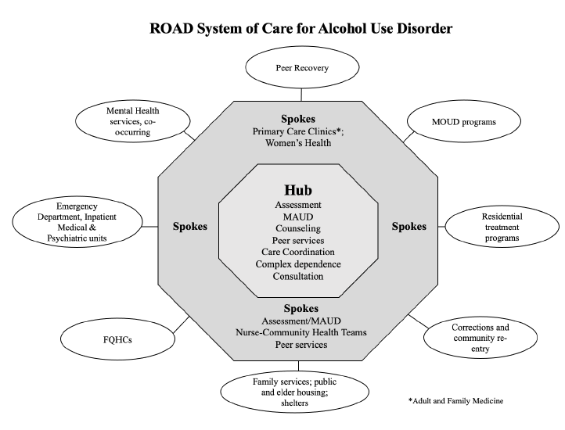
Essential Elements- Year 1
Hub & Spoke Model
  Based on Vermont's nationally recognized OUD model
Engaging Primary Care
Formalize Community Partnerships
  Recovery Coaches

Slide 8
Central Vermont Medical Center Emergency Department Treatment Guide:
Alcohol Withdrawal Syndrome (AWS) and Alcohol Use Disorder (AUD)
Patient presents to ED with AUD/AWS/Intoxication/Requesting Detox
Triage RN does Audit C
Use EPIC AUD Order set
Page Recovery Coach (PRS)
  AUDIT screening
  Enroll/Consent for ROAD
Order Baseline Labs: CBC,CMP,GGT,UDS, hCG
Medical Screening Exam (Physician, APP)
Assess for acute medical issues/emergencies
Review labs/AUDIT 10
Clear for suicidal/homicidal ideation
Assess withdrawal risk: by hx, PE, or PAWSS²
Medical Screening Exam Complete
Assess current clinical status: obtain CIWA³
Per clinical assessment:
Thiamine; B12/Mg++; oral multivitamin; antiemetic.,IVFs
1
2
3
3a
3b
3c
CIWA < 8: DISCHARGE
CIWA 8-15: TREAT
CIWA >15: TREAT
If last drink <72 h consider 24 h ED re-check
Moderate Alcohol Withdrawal
Continue until calm and awake
Severe Alcohol Withdrawal: Admission expected
Continue until calm and awake
Choose 1 of the following options, repeat every 30 min as needed
Max dose 15 mg/kg
Phenobarbital 130mg slow IV push for mild symptoms (CIWA 8-10)
Phenobarbital 260mg slow IV push moderate symptoms CIWA (11-15)
Consider 5mg/kg load if anticipating DC
Consider 10mg/kg load if needed/ tolerated in past and titrate as above
Received benzodiazepine
Did NOT receive benzodiazepine
Medication Considerations*
Acamprosate 666mg TID
Gabapentin 600-900 mg TID (1st dose in ED + go-pack + RX
Naltrexone** 50 mg q d + RX
Topamax 25mg BID x 1 wk.
then 75mg BID
PRS engagement in ED
Follow up at PCP or
  Treatment Associates (TA)
  Better Life Partners (BLP)
CC f/u Provider in EPIC AVS
Minimal Alcohol Withdrawal
Interest in quitting/cutting back
IV Phenobarbital Titration:
260mg slow IV push PRN
Max dose 15 mg/kg
IV Phenobarbital Load:
10mg/kg infused over 30 min
Wait 30 min for additional Rx
Max dose 15 mg/kg
Improved: Discharge if stable
Medication Considerations*
Acamprosate 666mg TID
Gabapentin 600-900 mg TID
Naltrexone** 50 mg qd
Topamax 25mg BID x 1 wk.
then 75mg BID
PRS engagement in ED
Follow up at PCP or
  Treatment Associates (TA)
  Better Life Partners (BLP)
CC f/u Provider in EPIC AVS
Suggested
DC Criteria
Awake/Alert
Ambulatory
VSS
Friend or family can observe pt
Encourage 24h ED recheck
Pt. counselled
NOT IMPROVED: Admit
Inpatient Treatment Pathway
Notify ED CM: ROAD pt being admitted
Admit to Hospital Medicine or consider Valley Vista if appropriate
If social factors lead to self directed discharge (AMA):
Offer ED Re-check in 24 hrs/secure chat PCP/ ED APP F/U re: follow up
Inform or secure chat ED Care Management re: follow up
AMA form/ risk benefit discussion/alternative plan/document
DC Medications*/RX should always be considered and encouraged
PRS engagement in ED
Follow up at PCP or
  Treatment Associates (TA)
  Better Life Partners (BLP)
CC f/u Provider in EPIC AVS
¹AUDIT 10: Alcohol Use Disorders Identification Test: see APPENDIX 1
²PAWSS: Prediction of Alcohol Withdrawal Severity Scale: see APPENDIX 2
³CIWA: Clinical Institute Withdrawal Scale: see APPENDIX 3
Medication Considerations
*Best practice to give med in ED and RX 14 d supply at DC
**Naltrexone contraindicated if taking opioids or AST/ALT > 5x nml
*** Phenobarbital is dosed in mg/kg for Ideal Body Weight (IBW)
ALWAYS SECURE CHAT ED Care mgmt. for all pts that f/u with TA, BLP or PCP (especially after hrs) to facilitate linkage to service
Version 7.5 4/18/2024
Pathway based on Erik Anderson MD’s work @ Northern Navajo Medical Center
Notes:
ED Pathway: History, patients seen in ED. Referred to primary care for follow up. Some breakdown, created opportunity for more integration and warm handoffs.
Operationalize the concept
TOP 3 are triage/medical screening/start of symptomatic med tx
Bottom 3 boxes AWS/AUD TX> Response > DISPO
Medical screening, 3 buckets No AWS: start meds to decrease cravings, euphoria, heavy drinking days and improve sleep,
MOD AWS TX see how they do severe tx aggressively, often don’t need ICU care
IP MED and IPP continue pathway and meds rxs and f/u with hub/PCP, PRS goes and sees inpts as well

Slide 9
Recovery Coaches
Available 24/7 to providers
  Embedded in ED
  Primary Care partnerships
Shared lived experiences with AUD + SUD use
Evidence-based, non-directive and judgement-free
  Evidence based: Motivational Interviewing
    Guide patients through their own thoughts as they consider and choose recovery tools that feel right to them
  Non-directive
    Don’t tell people what to do or how to do it
  Judgement free
    Attend to incongruent feelings and actions by people who are suffering with AUD/SUD
    Approach with empathy, active listening and listening to understand beyond what is possible by those without lived experience

Slide 10

Essential Elements- Primary Care Integration
Survey
Focus groups, gaps analysis
Recovery Coaches integrated in primary care
Primary care “ROAD” show
Continuing Education (CMEs)
AUD Primary Care Pathway

Slide 11
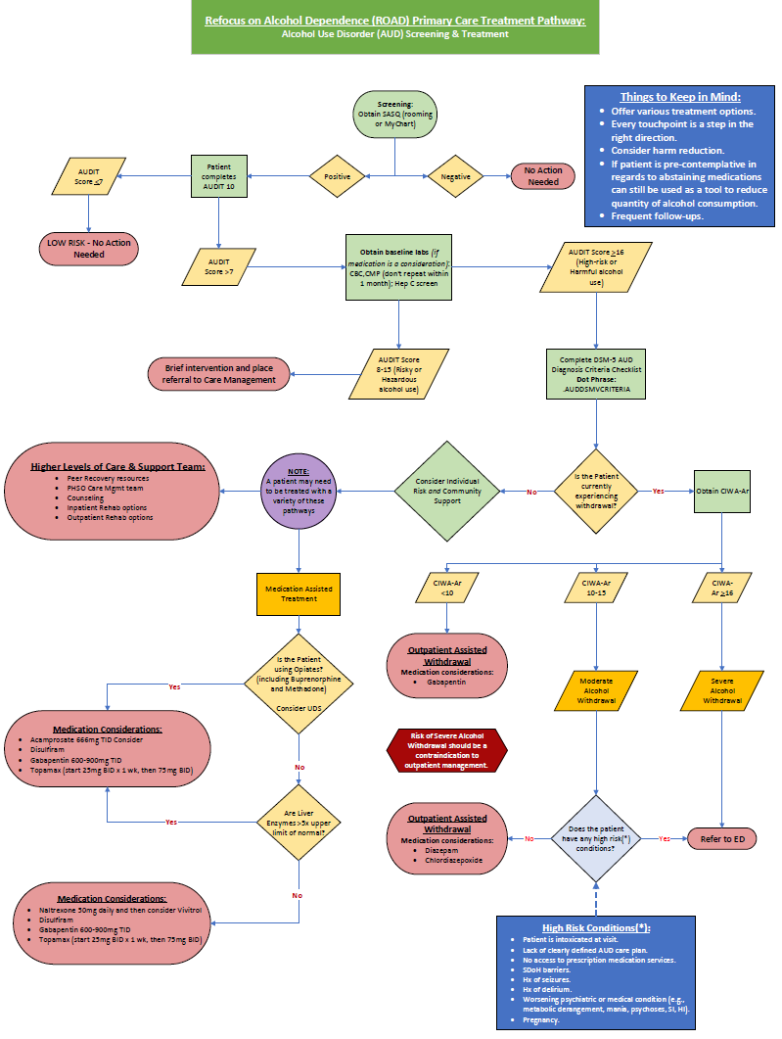
High Value Care Treatment Pathway in Primary Care: AUD Screening & Treatment (ROAD)
Notes:
The workflow
Screening in office
What gets referred to primary care
What is CVMC pilot and where is the state wide approach?
This is UVMHN network wide. Launching next week 11/18

Slide 12
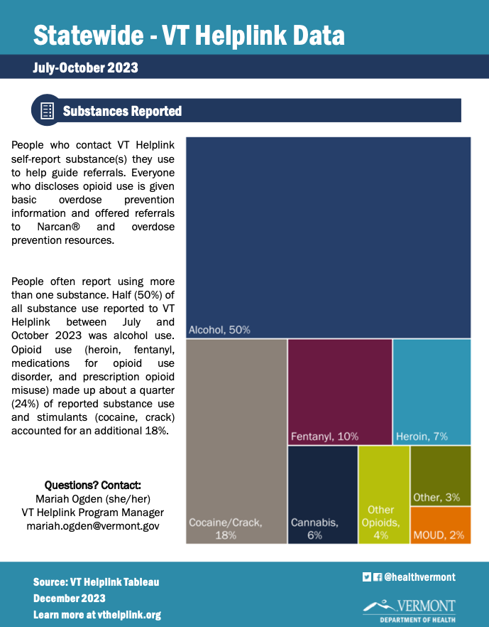
What drugs are Vermonters using?
50% of all Substance Use reported was ETOH
24% Opioids
8% Stimulants
Notes:
ETOH remains the most used and lethal drug in VT , “everyone who disclosed Opioid use is given basic OD prevention info and offered referrals for Naloxone and OD prevention resources”
Difficult to tx, people don’t recognize etoh as drug, MAUS not nearly as effective as MOUD drugs, Stigma attached to going to a “Addiction Clinic”, I’m not and addict.

Slide 13
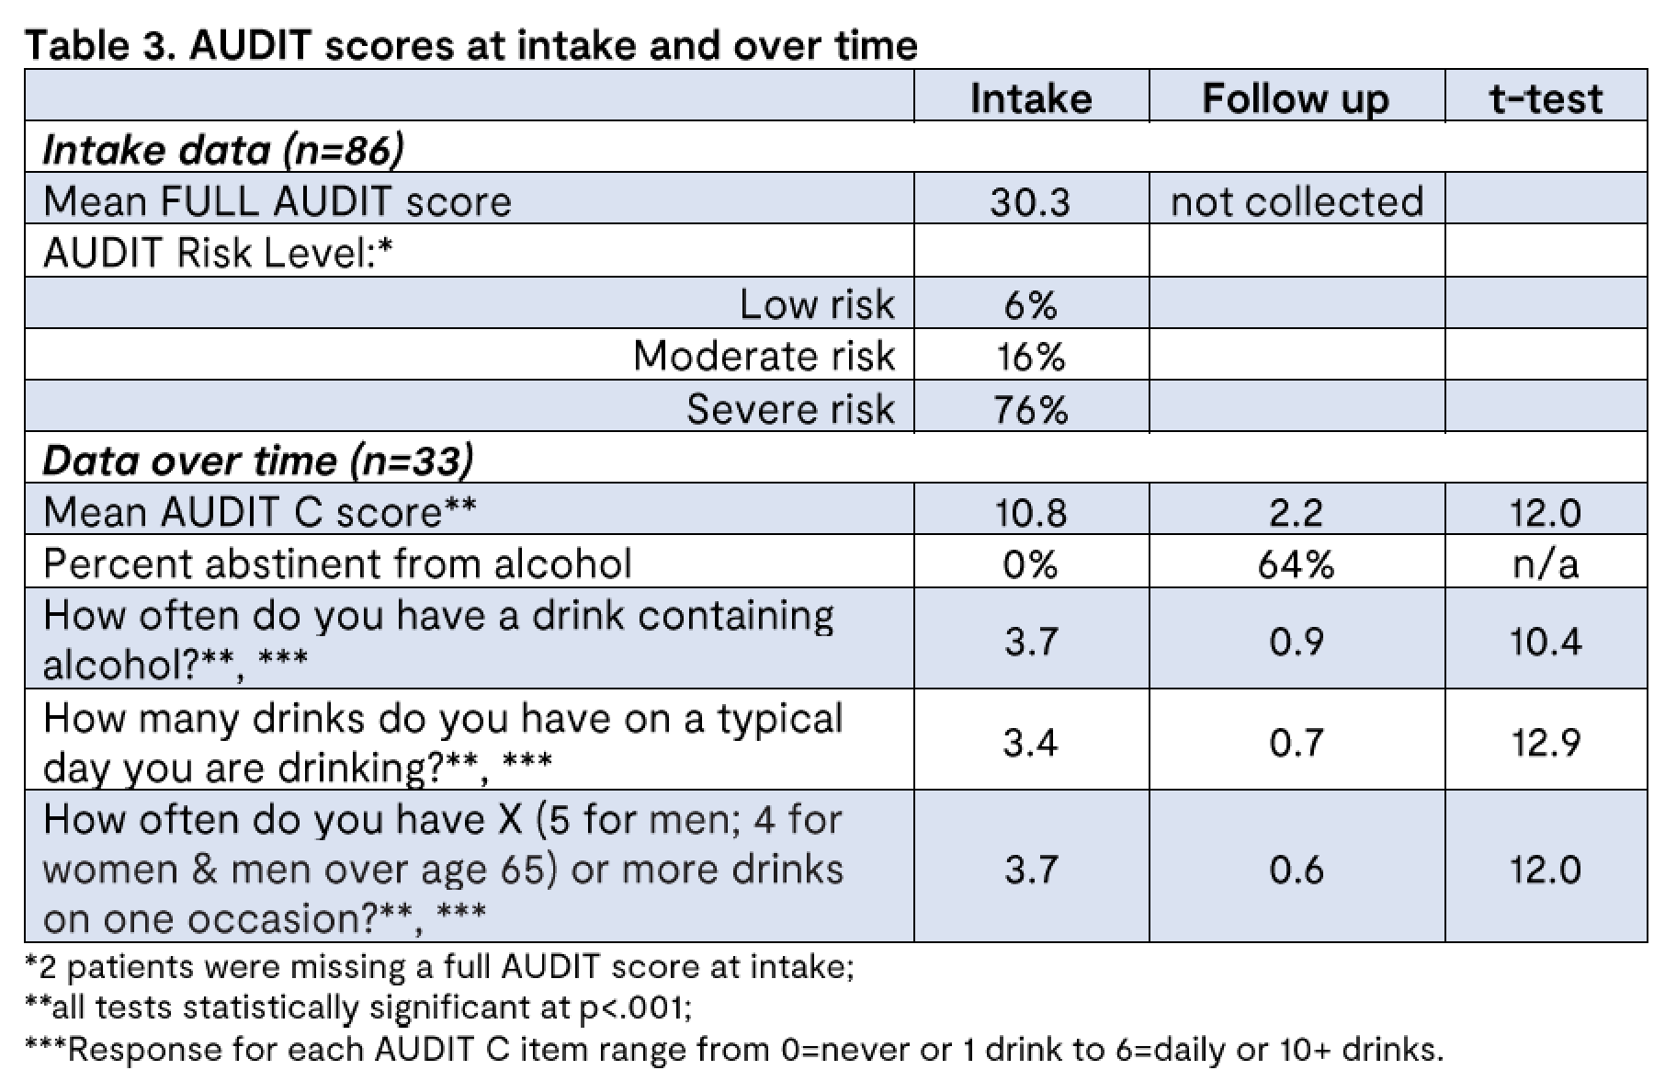
Year 1 Observations
238 pts evaluated
20/months
86 enrolled for ROAD follow up
1.5 pts per week enrolled
Notes:
Mean 82 days from intake to follow up, 38% of those that enrolled. Self reported data, 92% moderate to severe risk, initial AUDIT C 11>2 at 3 mos with 64% abstinence, low risk AUDIT C score
Effort/plan/path/success

Slide 14
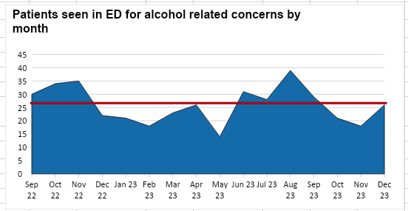
Year 2 Observations
420 ED visits
  Avg 26/mos
67% Male
33% Female
Mean age 46yo
ROAD Enrolled 68 pts
  1 pt per week
Notes:
“Enroll” is agrees to follow up with provider and sharing of information for CQI. Others stll receive services.

Slide 15
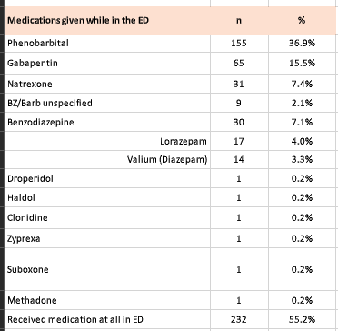
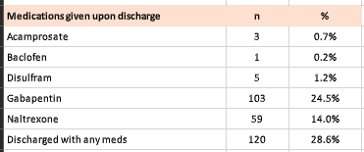
All ED patients
Observations
420 Alcohol Related ED visits
232 (55%) pts received meds in ED
Most common med given is PB
120 (29%) patients received a prescription at discharge
Notes:
Don’t have to be enrolled to get care, Most commonly given med in ED is PB, given that AWS is most common presenting complaint

Slide 16
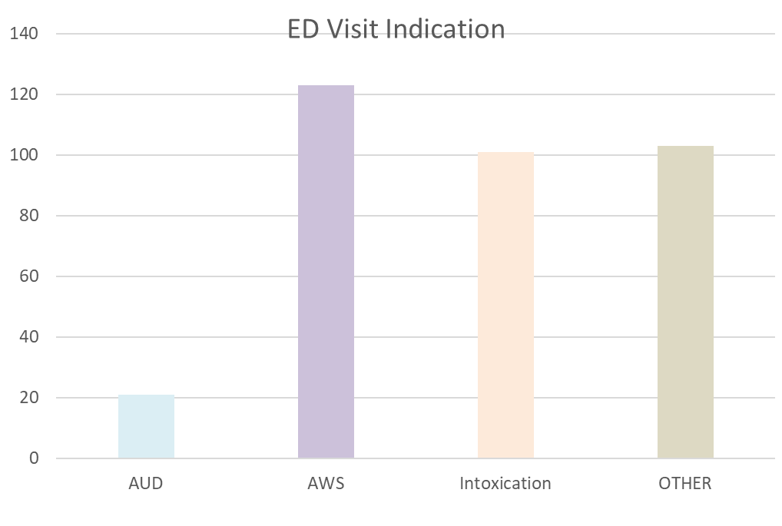
35%
29%
30%
6%
Notes:
64% present with AWS/Intoxication, Other was SI, depression, fall, trauma GI bleed, AMS,CHF,PNA, liver dz, weakness,

Slide 17
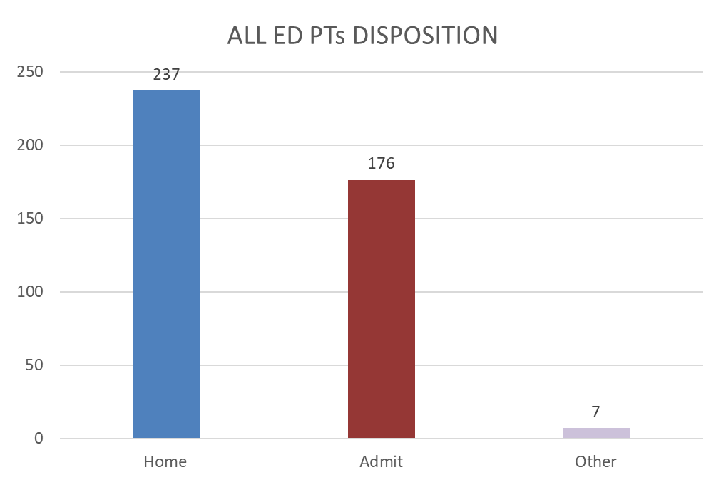
56%
42%
2%
Notes:
56% DC rate, 42% admit, 2% other was ELOPE,VV, LAW, Lighthouse

Slide 18

ROAD Enrollees
AUDIT C avg = 9.6
AUDIT 10avg = 26.7

Slide 19
Enrolled ROAD patients (n=68)
94% initiated services with Recovery Coach
12% were admitted to the hospital
34% initiated treatment with TA or PCP
63% engaged in tx with TA
71% engaged in tx with PCP
Notes:
Tiny numbers, I think concentrating on PC makes the most sense as continued engagement is the key

Slide 20
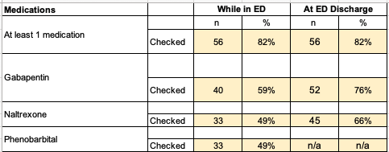
Prescriptions- In ED and at Discharge
Enrolled ROAD patients (n=68)
55%
29%
ALL COMERS
Enrolled pts were more likely to receive ED meds and get a prescription at DC
Half of enrolled patients were treated for AWS

Slide 21
What we’ve learned:
Significant need
Stigma around alcohol use disorders
Focus on a harm reduction approach
Providers are interested in education about this approach and evidence-based medications
Handoff from ED/IN to primary care requires resources and focus to prevent drop-off
Recovery Coaches are essential partners
  Recovery Coaches saw 94% of all ED pts with an ETOH complaint
Conversations about how to fund
Patient Outcomes:
  55% of all ED pts with ETOH complaints received medical tx
  ROAD enrolled pts receive more ED meds and prescriptions at DC
  Gabapentin was the most used medication for AUD tx
  Phenobarbital was the most used medication for AWS
  There were less ROAD enrollments than year 1
  Pt’s referred to specialty treatment tend to engage for shorter periods of time than those that see their PCP
  Non hospital services for AWS remains a missing key element

Slide 22
It’s all about options
Meet people where they are
  Peer Coaching
  Counseling
  Treatment Groups
  Medically Assisted Withdrawal (MAW)
  Medication for Alcohol Use Disorder (MAUD)
  Linkage to services
Notes:
They come to you, it’s a touch point People present in varying states of readiness for change, plant a seed

Slide 23
Observed Care Gaps & Opportunities
Short term stabilization
Primary Care- gaps in wrap around care, care coordination
Funding
Vivitrol access
Stigma- AUD and associated with specialty clinics

Slide 24
Thank you!
Connie Gavin
Blueprint Program Manager
University of Vermont Health Network constance.gavin@uvmhealth.org

Slide 25

Open Discussion

Slide 26

January 27th, 2024
12:00-1:00PM EST – Final Meeting!
Contact Phos Ivestei (pivestei@ctc-ri.org) with any questions or suggestions

Slide 27
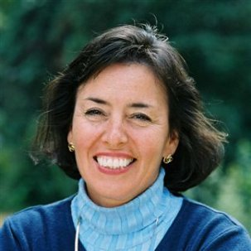
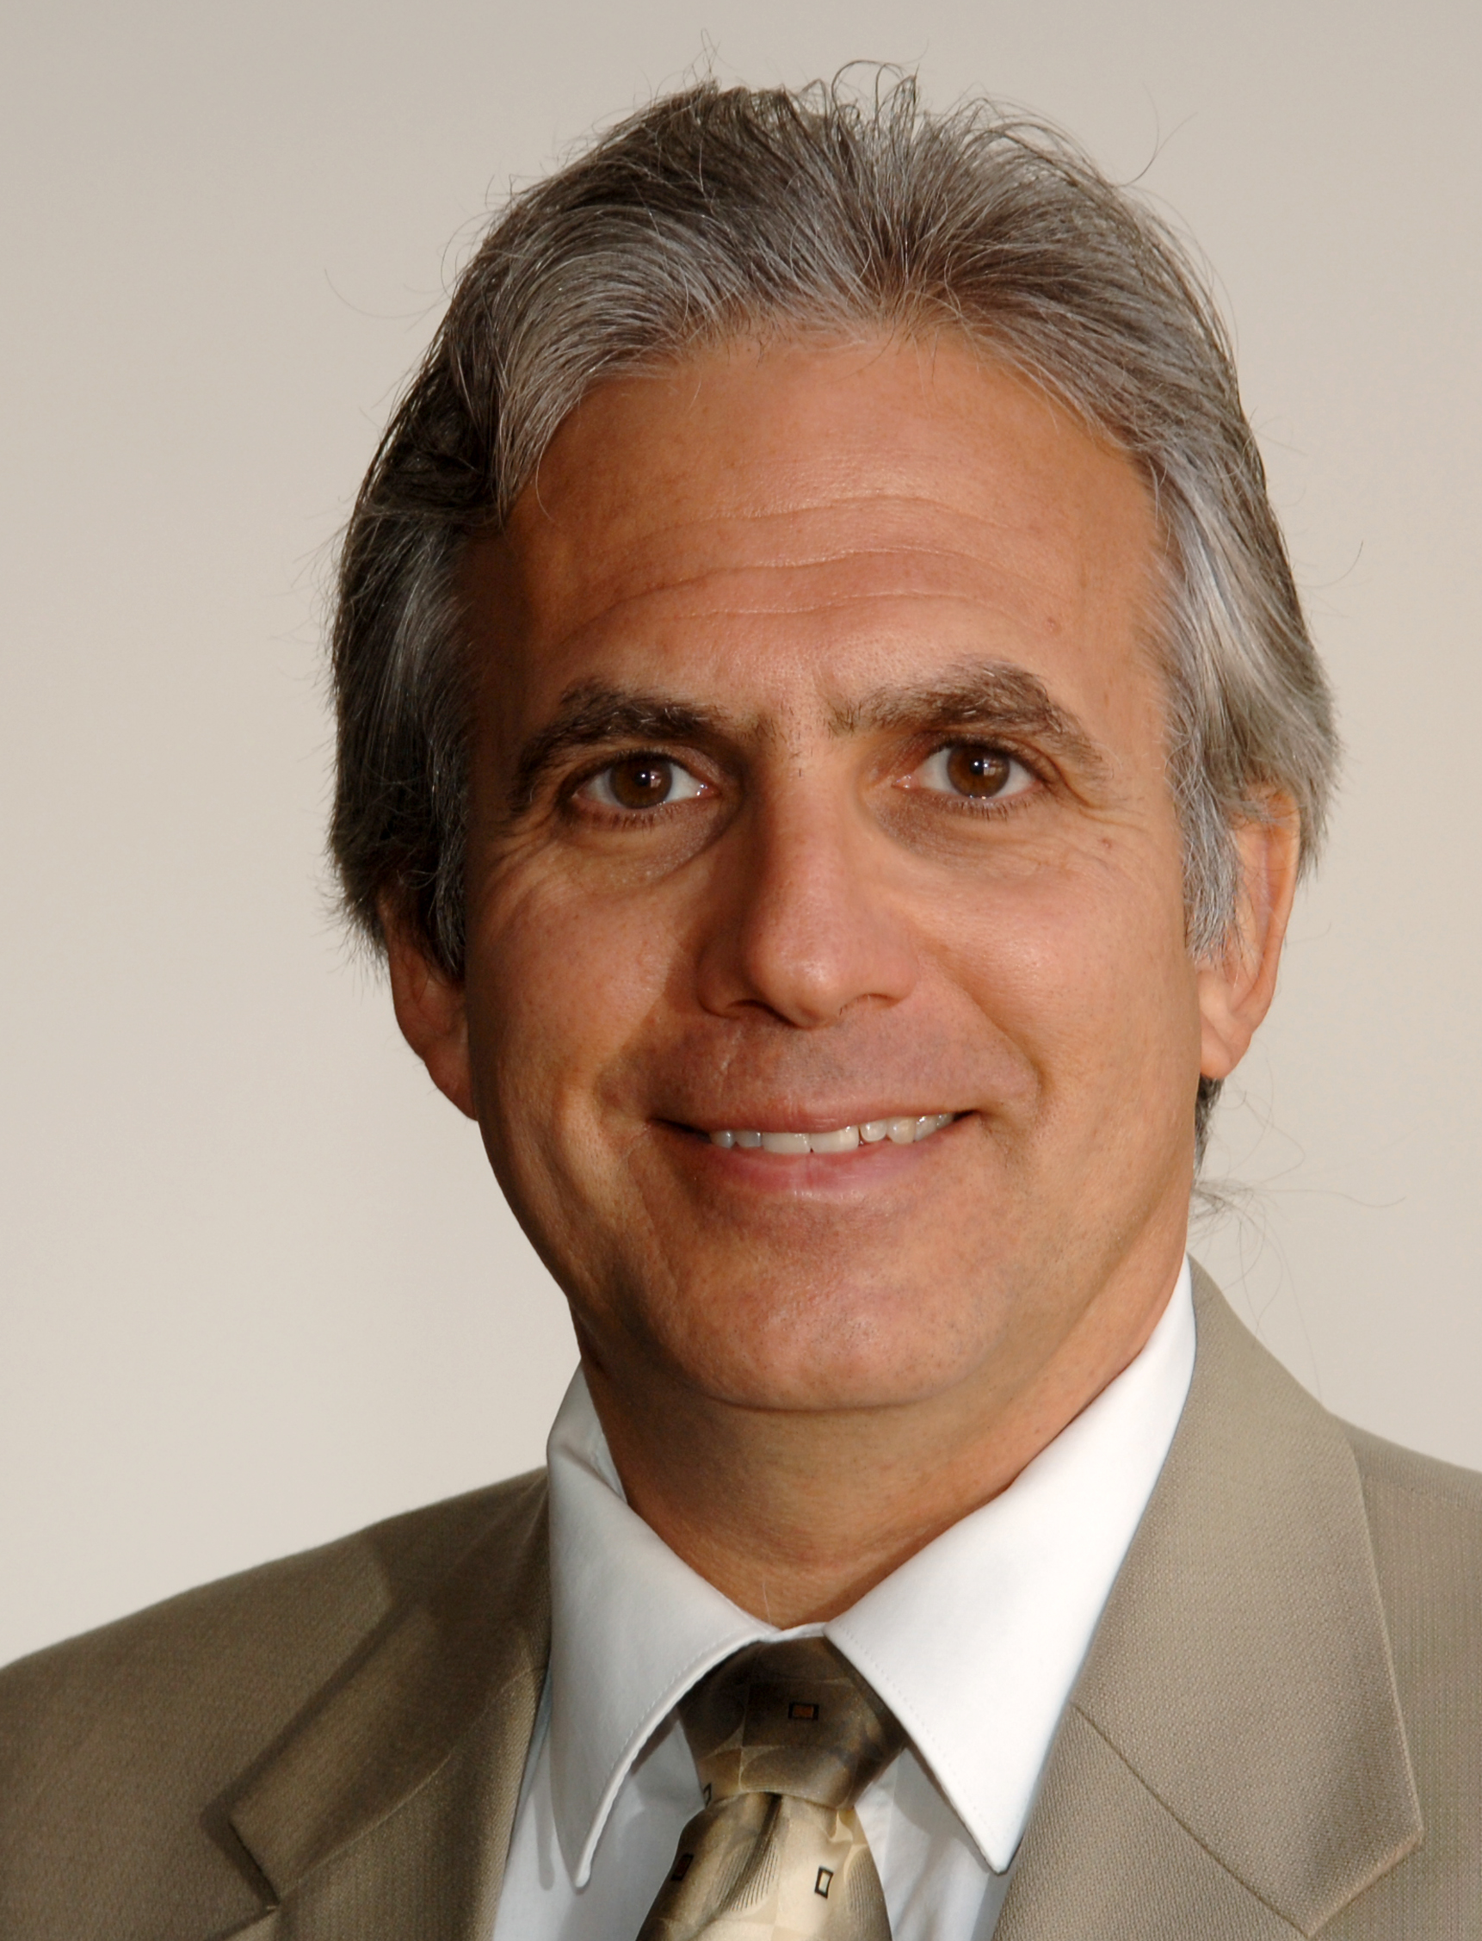
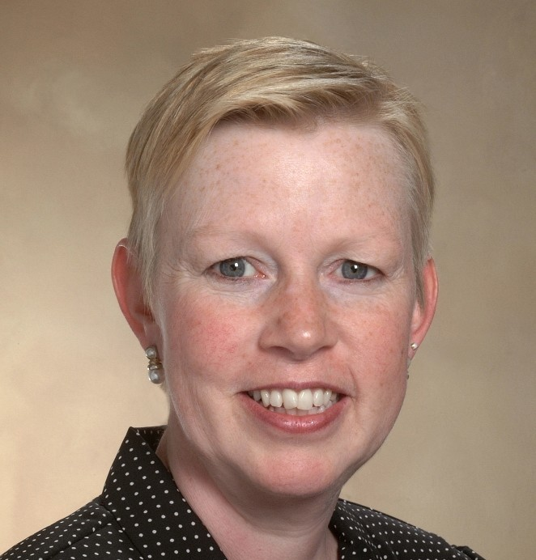
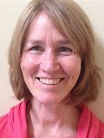



CTC-RI Senior Leadership
Deb Hurwitz, MBA, BSN, RN, Executive Director
Pano Yeracaris, MD, MPH, Chief Clinical Strategist
Patricia Flanagan, MD
Clinical Director & PCMH Kids Co-Chair
Susanne Campbell, RN, MS, PCMH CCE, Senior Program Administrator
Linda Cabral, MM, Senior Program Manager
Yolanda Bowes, BS
Senior Project Manager
Nelly Burdette, PsyD
Senior Integrated Behavioral Health Program Leader
Prepared by Care Transformation Collaborative of RI
Notes:
All – Pat last then Introduces the Practices

Slide 28




THANK YOU
www.ctc-ri.org
ctc-ri

