Slide 1
Resource Management: Bibliographic Records
Shared Library Services Platform Project
Maggie McGee

Slide 2
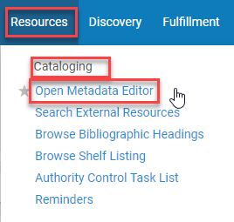
Accessing the Metadata Editor
The Metadata editor can be accessed by
Resources>Cataloging>Open Metadata Editor or
Edit Record from a repository search in the IZ

Slide 3
Navigating the Metadata Editor – left Pane
Templates
Used to create a new (brief) record
Records are grouped by type:
Icons next to the bib record tell you about the bib record
Institutional Zone
Suppressed
Network Zone
Rules
Normalization
Merge
Indication
Brief record levels

Slide 4
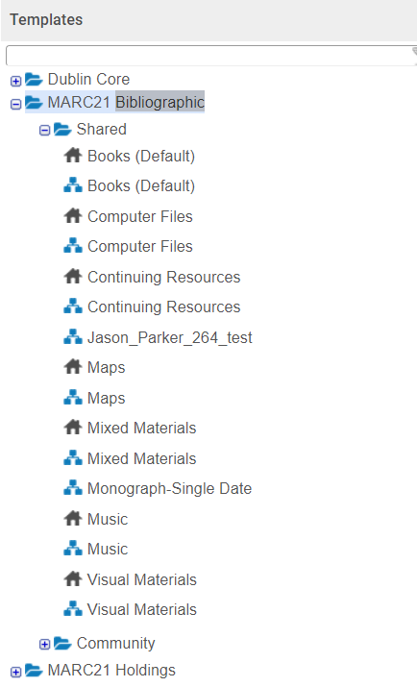
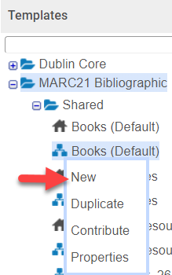
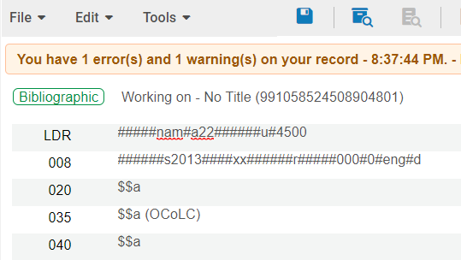
Navigating the Metadata Editor – left Pane
Templates are used to create a new (brief) record
Choose NZ template unless it’s an IZ exception
Click on the material type and desired Zone
Click New
The template will open in the MD
Begin cataloging

Slide 5
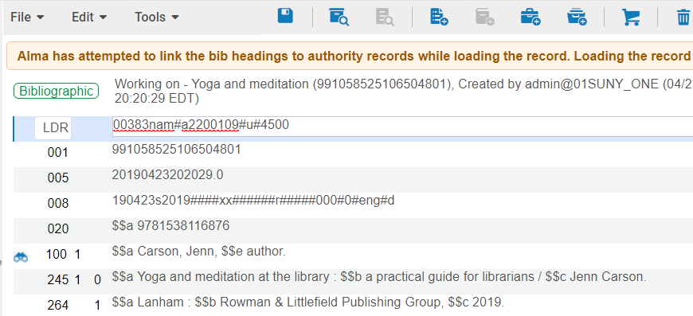
Navigating the Metadata Editor – left Pane
Templates are used to create a new (brief) record continued
Brief records should contain:
Title
ISBN
Author
Edition (if it has an edition statement)
Publication date

Slide 6
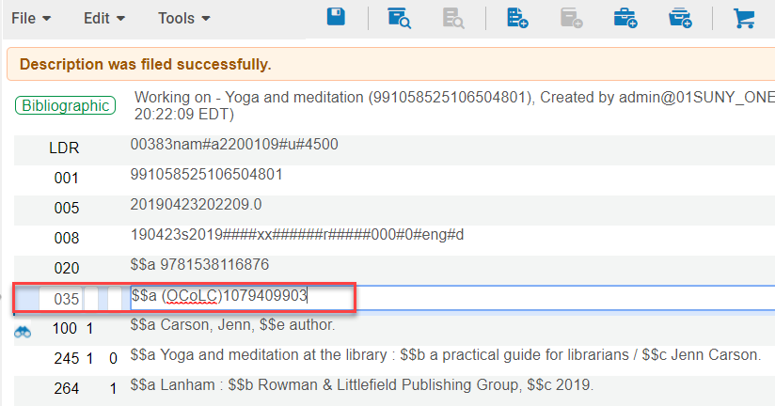
Updating a Brief Record in the NZ
Perform a repository search for the item in hand
Click Edit Record
MD Editor opens
Add field (F8) or Edit>Add field
035 $$a (OCoLC)########
Save and release the record (Ctrl+Alt+R) or File>Save and Release Record
Export the record from OCLC to Alma or wait until the next morning after the NZ has been updated

Slide 7
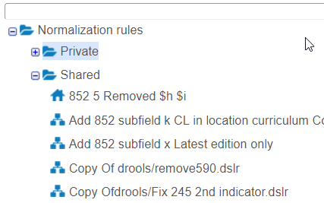
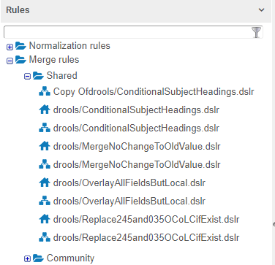
Navigating the Metadata Editor – left Pane
Rules
Normalization
Used to enhance MARC 21 or holdings records according to predefined rules
Add, replace, or remove MARC fields
Merge
Rules on how two records will be merged
Either remove information from the primary record or copy information from the secondary record

Slide 8
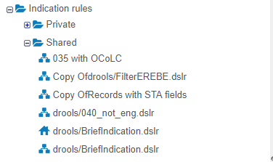
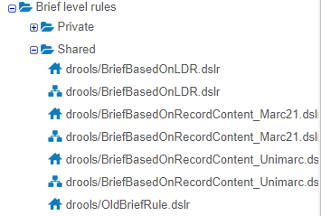
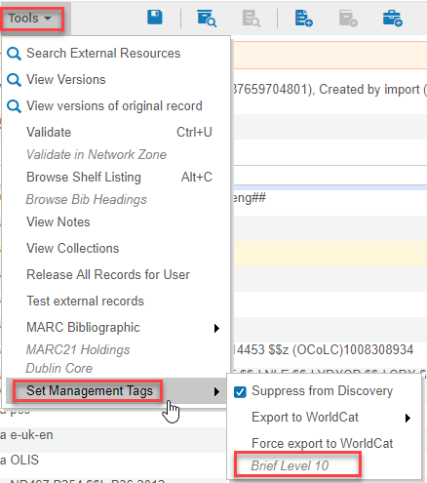
Navigating the Metadata Editor – left Pane
Rules continued
Indication
Are used to filter sets and creates a subset of the original set
Brief record levels
Allow you to set the acceptable briefness level
The brief level displays under Tools>Set Management Tags

Slide 9
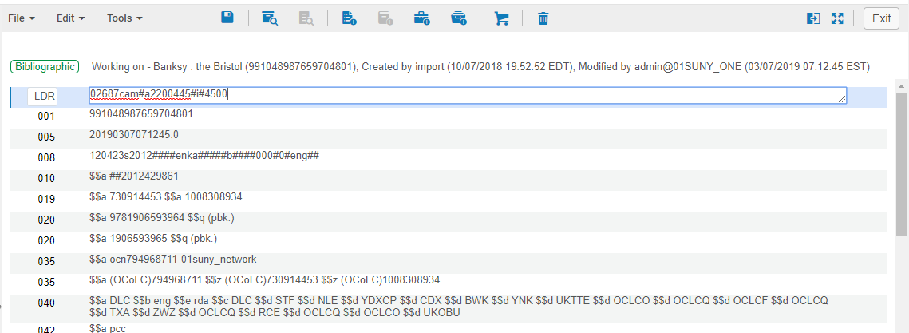
Navigating the Metadata Editor – Main Pane
The main pane of the Metadata editor is the working area and where the bib record or holdings record are displayed
The MD editor has a flexible cursor and it can be placed any where to start editing
Ctrl+F opens forms to edit fixed fields

Slide 10
Navigating the Metadata Editor – Main Pane
The main pane toolbar
Menus
File
Edits
Tools
Toolbar
Save icon
View inventory Icon
View bibliographic record icon
Add holdings icon
Add item icon
Add portfolio icon
Add representation icon
Create Po Line & Exit icon
Delete record icon
Split screen editor
Full screen editor

Slide 11
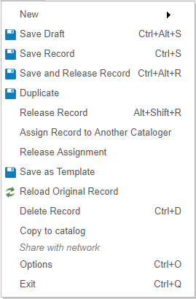
Navigating the Metadata Editor – File Menu
File
New
Save Record (Ctrl+S)
Save and Release Record (Ctrl+Alt+R)
Duplicate
Release Record (Alt+Shift+R)
Assign Record to Another Cataloger
Release Assignment
Save as Template
Reload Original Record
Delete Record (Ctrl+D)
Ctrl+d does not create a delimiter like it does in OCLC
Share with Network
Share a IZ created record with the NZ
Options (Ctrl+0)
Exit (Ctrl+Q)

Slide 12
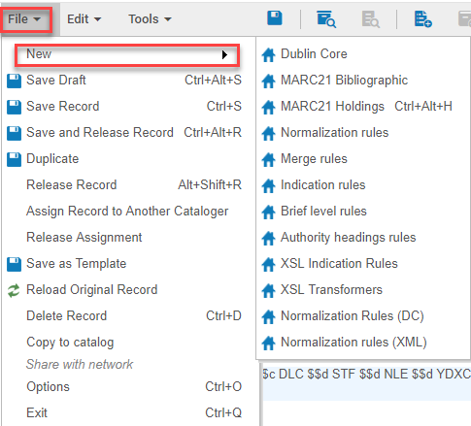
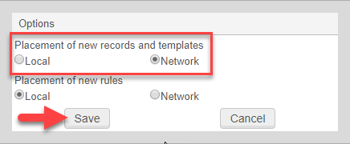
Creating a New Record Without Using a Template
First go to Files>Options
Select where the new record and templates go
Placement of new records and templates: [use NZ, unless it is for an IZ exception]
File>New>[Select the record type]
Create the Bib record in the MD Editor

Slide 13
Save and Release a Record Best Practices
Bib records in the NZ are being shared across all SUNY campuses
When a bib record is in use other users cannot access that record until it has been released
The bib record will be released after an hour after exiting the Metadata editor without releasing the record, unless the time has been configured to be different
Configuration>Resources>General>Other Settings
working_copy_lock_timeout

Slide 14
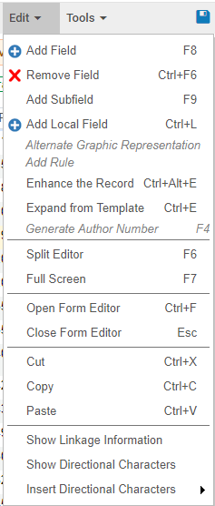
Navigating the Metadata Editor – Edit Menu
Remove Field (Ctrl-F6)
Add Subfield (F9)
Add Local Field (Ctrl+L)
Split Editor (F6)
Full Screen (F7)
Open Form Editor (Ctrl+F)
Close Form Editor (Esc)
Cut (Ctrl-X)
Copy (Ctrl+C)
Paste (Ctrl+V)

Slide 15
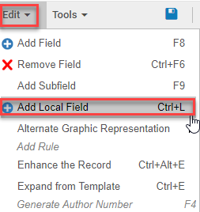
Adding Local Fields
Local fields are the ONLY fields that should be added/edited/deleted in the IZ bib record
Any other changes made in the bib record that are not local will be overwritten from the NZ record
The MSP Working Group has designated local MARC fields to be used in Alma and the associated MARC field previously used
Bibliographic Record Network Zone and Local Fields Policies
In the Metadata editor for an IZ bib record
Go to Edit>Add Local Field (Ctrl+L)
Enter the appropriate local MARC field
The local field icon will appear
Click Save (Ctrl+S)
Saves the record and moves the local field to the
appropriate place in the bib record
Click Save and Release the record (Ctrl+Alt+R)

Slide 16
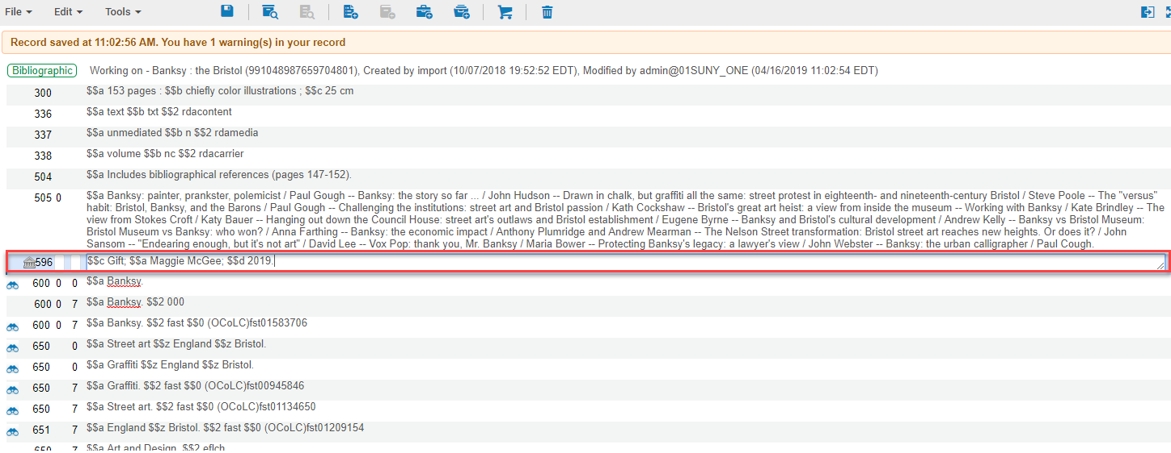
Adding Local Fields Example

Slide 17
Local Fields in Alma

Slide 18
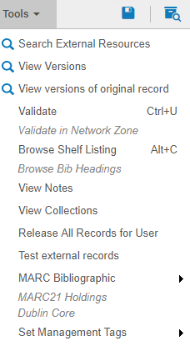
Navigating the Metadata Editor – Tools Menu
Search External Resources
OCLC
View versions
View versions of original record
Validate (Ctrl+U)
Validation issues are displayed in the Alerts tab
Validate in Network Zone
Base on validations rules in the NZ
Browse Shelf Listing (Alt+C)
Browse Bib Headings
Release All Records for User
MARC Bibliographic
MARC21 Holdings
Set Management Tags

Slide 19
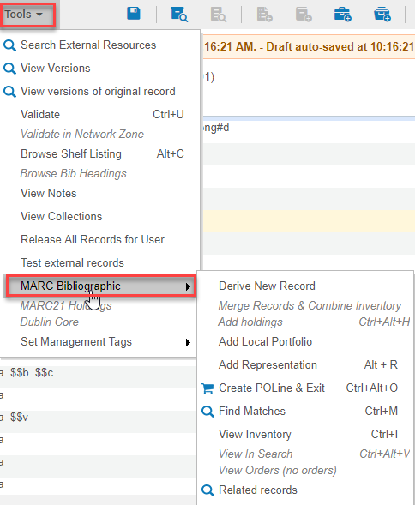
MARC Bibliographic
Tools>MARC Bibliographic
Derive New Record
MSP-28 recommends not using this for NZ records
Create POLine & Exit
Find Matches
View Inventory
View in Search
Related Records

Slide 20
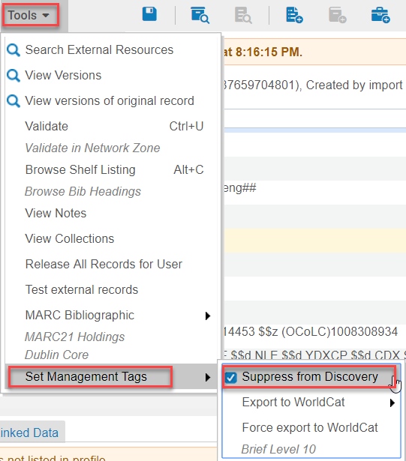
Set Management Tags – Suppress a Bib Record
To suppress a bib record go to Tools>Set Management Tags
Check the box next to Suppress from discovery
To Unsuppress a bib record
Uncheck the box next to Suppress from discovery

Slide 21
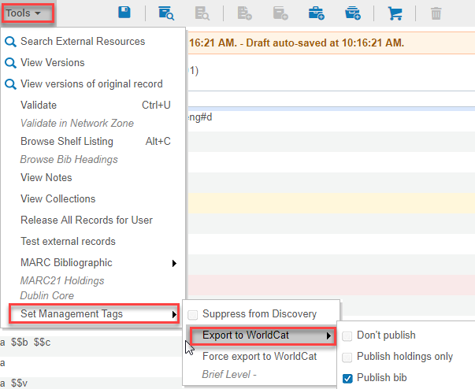
Set Management Tags –Export to WorldCat
Tools>Set Management Tags>Export to WorldCat
Used when Publishing Profiles jobs are used to update the campus’s holdings
Flags
Don’t publish
Publish holdings only
Publish bib

Slide 22
Metadata Editor Shortcut Links
Metadata editor shortcut links:
https://innhold.bibsys.no/edx/alma/Alma_Metadata_Editor_Shortcuts.pdf
https://wiki.harvard.edu/confluence/display/LibraryStaffDoc/Keyboard+Shortcuts#KeyboardShortcuts-KeyboardShortcuts(%22HotKeys%22)

Slide 23
Adding Diacritics to a Bib Record
Diacritics can be added to bib records when:
Needed for local fields in the IZ record
Creating a brief record in either the IZ or NZ
To enter diacritics or special characters into the MD Editor:
From the Windows Start menu, select All Programs > Accessories > System Tools > Character Map
Select a font from the Font drop-down list
Select the special character that you want to insert into the MD Editor
Click Select, and then select Copy
Paste the character in the MD Editor
Link to diacritic resource for Alma:
https://wiki.harvard.edu/confluence/display/LibraryStaffDoc/Guide+to+entering+combining+diacritics+and+symbols+in+Alma#symbols
Click on the symbol and copy and paste it into the MD Editor

