Slide 1

SUNY Library Services Update
February 26, 2021
www.suny.edu

Slide 2

Update on SLS Initiatives and Projects
Shannon Pritting
www.suny.edu

Slide 3
SUNY Library Accessibility Cohort
Completed VPAT Reviews and Top-Level Testing of about 20 of the ~80 most commonly e-resources in SUNY.
  https://slcny.libguides.com/vendor_accessibility
Repository updating would be a project that would address every 1-2 years as needed.
Working with Cohort to finish reviews for the remaining commonly held resources.
SLS will need to address/respond to needs expressed by campuses that would best be addressed as a shared service, rather than cohort.
Some in cohort working on toolkit resources.
SLS will commit to ongoing VPAT review at a sustainable pace; further details forthcoming.

Slide 4


Procurement Update
OCLC
Direct Linking Service
  Approved to Move Forward. Working on Procurement Now.
  Please let us know if you’re not subscribing and are interested in Third Iron products.

Slide 5
Working Through Backlog of “Lost” RS Items
SUNY hasn’t had policy until recently on intra-SUNY ILL via Alma.
  Previous SLC boards reviewed many times, and decision was to wait and look at data.
  Grossly overdue items hadn’t been an issue until pandemic hit.
Lost policy approved last year is anything over 120 days or 30 days in transit is considered lost.
Need to develop billing policy and process.
Currently, 750 items meet Lost criteria.
  430 are more than 120 days overdue; 320 are more than 30 days in transit
  Some campuses still not open for ELD and other mitigating factors
SLS will be working with ASRS and LSP Advisory Board on project to frame work to help address these lost items.
  Need to weigh collection stewardship and extenuating circumstances patrons are facing.
SLS and SLC will work on ensuring resolution of lost items happens for loans going forward.

Slide 6
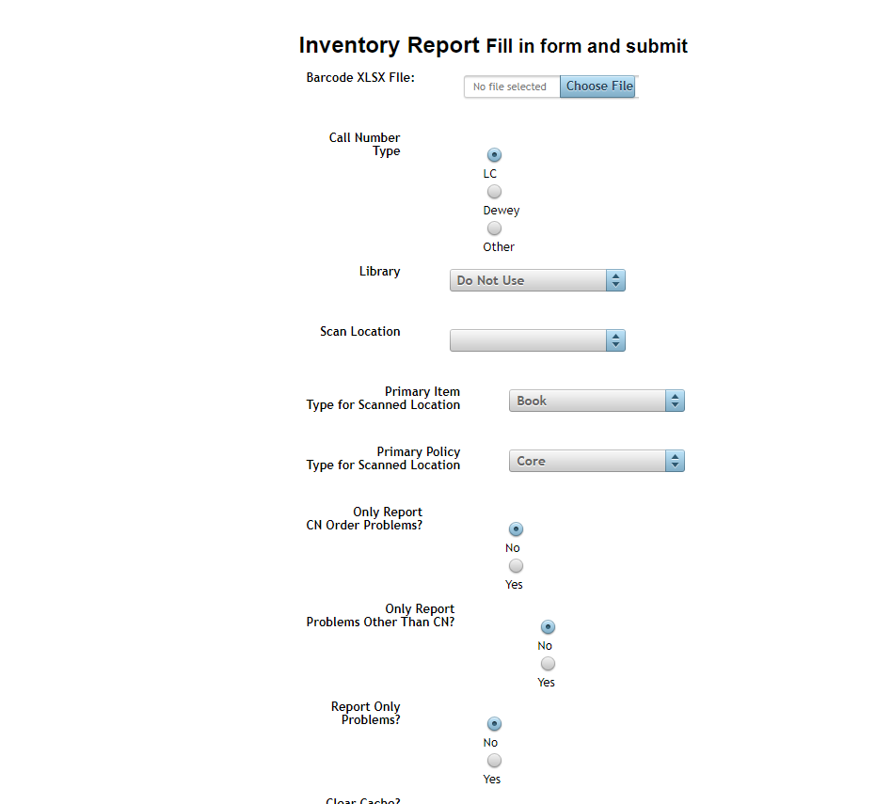
Shelf-Reading Web App
Created a web-based version shelf-reading app that was intended for desktop use.
Requested via Basecamp.
Web-based app will complement built-in shelf inventory functionality in Alma.
Training(s) upcoming to review what both can and cannot do.

Slide 7
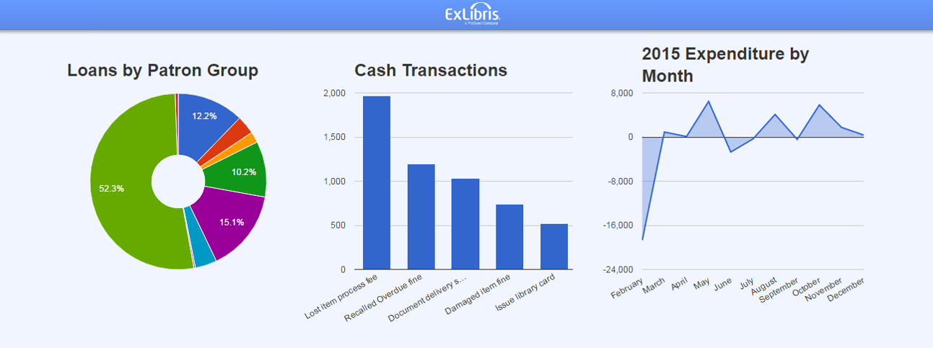
Alma Analytics
This is going to be one of our focus areas over Spring-Summer.
Will take a highly consultative approach to assist campuses and build more shared reports and expertise.
Won’t be moving forward on Tableau integration at this point.
Look for more information on resources coming soon.

Slide 8

Rialto
Free product (but would prefer PQ vendors)
Full integration with Alma.
Two campuses currently adopting: BSC & MVCC
SLS monitoring implementation and usefulness of product to simplify acquisitions.

Slide 9
Discovery & E-Resources
Michelle Eichelberger
www.suny.edu

Slide 10
March Release Note Highlights:
Link Resolver did not return Unpaywall links in the View-It of a Services Page if generated by Primo Citation Linker or Google Scholar. This was fixed.
Display CTO now includes the url/fields that Primo is sending to Alma for the live look-up when you open the full record. Will help you troubleshoot which ISSN or title is being sent for matching.
Improved "Did you mean" suggestions, confirmed by Discovery Working Group
Reminder: keep an eye on the CKB release notes: https://knowledge.exlibrisgroup.com/Alma/Content_Corner/Release_Notes/2021_Alma_CKB_Release_Notes_January_-_June
April will be a maintenance update: no changes
Full release notes:
https://knowledge.exlibrisgroup.com/Primo/Release_Notes/002Primo_VE/2021/010Primo_VE_2021_Release_Notes

Slide 11
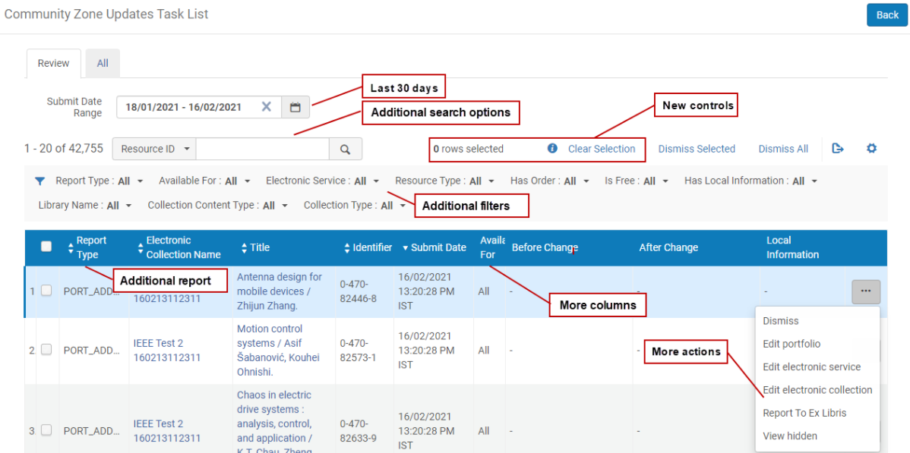
Community Zone Update Task List
Reminder: set a calendar reminder to go check this regularly
Focus on changes to collections, services rather than individual titles
March update will provide better searching and filtering
Updates will now show in portfolio editor if you have Repository Manager role

Slide 12
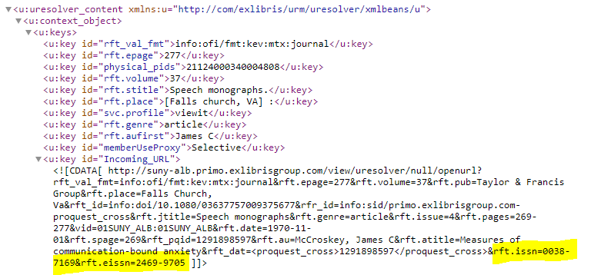
EISSN
If article metadata contains both ISSN and EISSN, live matching prioritizes EISSN over ISSN and will stop once it's found a match
Chances are good that vendor bib records from CZ and physical records don't contain both ISSN and EISSN, so it may miss matches
Only way to fix is to add 776 $x with EISSN to bib record, will need to refresh in IZ and ask info@slcny.libanswers.com to refresh in Network

Slide 13
Gale Ebooks (Formerly GVRL) Reconciliation
Ran Analytics report in the NZ to see how many titles active for this collection at all SUNYs
Working with Angela Palmieri of Cengage to get holdings for all SUNY campuses, so we can reconcile where necessary
So far have drastically reduced the number of portfolios at one campus and added over 250 titles to two campus collections
Will do the reconciliation for Extended Support campuses over the next few weeks
Will share lessons learned after working with extended support.

Slide 14
SUNY Shared Collections
Esta Tovstiadi
www.suny.edu

Slide 15
ESWLCA: Invitation for Bids (IFB)
14 vendors provided bids for 330 products
Thank you to review group members
We are finalizing administrative review
  Procurement contacting vendors for missing documents
Likely moving forward with contracts for the following vendors:
  Oxford University Press (recharge application submitted)
  JSTOR (recharge application submitted)
  EBSCO (potential recharge)
  ProQuest (potential recharge)
  New York Times
  Chronicle of Higher Education (recharge application submitted)
More information forthcoming in the following weeks

Slide 16

eBook Central DDA Pilot
Title access and purchasing went live in early February
Huge thank you to Michelle Eichelberger for setting up access, trouble-shooting, managing ProQuest
Cohort A (6 campuses):
  16 titles purchased, $3,226.38 spent, average per title cost to each campus: $33.61
Cohort B (14 campuses):
  5 titles purchased, $3,635.04 spent, average per title cost to each campus: $51.93

Slide 17
Other updates
Artstor contract extension approved but not yet executed
  SUNY Procurement is working with Ithaka to complete required forms
  There should be no interruption in access; if you have access problems please let me know
ProQuest whole ebook ILL pilot
  Pilot timeline has been delayed due to changes in staffing and leadership at ProQuest
  Update meeting next week with ProQuest; more information following
  Please return signed participation letters ASAP
STAT!Ref renewal (next term starts 8/1/21)
  We have a central pricing agreement (no central contract)
  We plan to secure multi-year pricing at this renewal, if possible
  More information forthcoming in the next month

Slide 18
Resource Management
Maggie McGee
www.suny.edu

Slide 19
New MSP Policies
MSP-58: Suppressing Dedup/FRBR for 130 and 630 $a Bible. in the Network Zone
  The SMSP approved suppressing Dedup/FRBR for all Network Zone (NZ) physical bibliographic records that contain 130 and/or 630 $a Bible. on December 23, 2020
  Institution only bibliographic records will not be impacted by the changes made to the NZ bibliographic records. Contact the Network Zone Coordinator at info@slcny.libanswers.com for institutions interested in applying these changes to their IZ only records as well
MSP-60: Non-Romanized Titles in Alma and Primo VE display (Flip Linked Fields)
  Non-Romanized MARC records will be imported into Alma using Ex Libris’ “out of the box” configuration
  Alma is configured to import Non-Romanized titles with a linked MARC 880 with the Romanized title from MARC 880 in MARC 245 and the non-Romanized title in MARC 245 to the linked MARC 880
  Importing non-Romanized MARC records into Alma in this manner supports MSP-12 which states: “‘Language of Cataloging’ for records in the Network Zone must be in English

Slide 20
Upcoming SUNY Initiatives for Resource Management
MSP-59: Foreign Language and Fast Subject Headings
  Foreign Language and Fast Subject Headings will be removed from physical MARC records upon import into the Network and Institution Zones
    Testing normalization rules to remove current foreign language and fast subject headings in the Network sandbox
    Testing normalization rules to remove foreign language and fast subject headings from import from OCLC into Alma

Slide 21
Configuration Change Tracking in Code and Mapping Tables
January 2021 Alma release added a new parameter that provides the ability to view the history of changes made by Alma users to code and mapping tables
  Default is set to 0 (zero) days, which does not store any change history
  Code and mapping change history can be viewed in analytics using the Events and Systens Events subject areas
    Analytics does not include full details of the changes made to the code and mapping tables
SLS made configuration changes to the code_and_mapping_table_log_retention_period (Configuration>General>General Configuration>Other Settings) from 0 (zero) to 5,000 days for all institutions, except for:
  University centers
  Institutions who already configured this other setting

Slide 22

March 2021 Release Notes – Resource Management
New MD Editor Updates
  The new MD Editor will be the default editor
    Users can still toggle to and from the new and old MD Editor
    This release provides the ability to opt-out of the new MD Editor for users with specific roles
      Not recommended as exclusive use of the new MD Editor will begin with the June 2021 release
  Rules Management will be added to the new MD Editor in production
    All functionality is now available in the new MD Editor with the addition of Rules Management
    Recommended to begin using the new MD Editor for daily workflows
  Creating new holdings from the "Add Inventory" menu
    New holdings records can be created from the "New" menu and the "Add Inventory" menu
    Add Inventory>MARC21 Holdings>[Holdings configured to display from "Template display configuration" can be selected]
  Brief level now appears in the record header for all MARC bibliographic formats

Slide 23
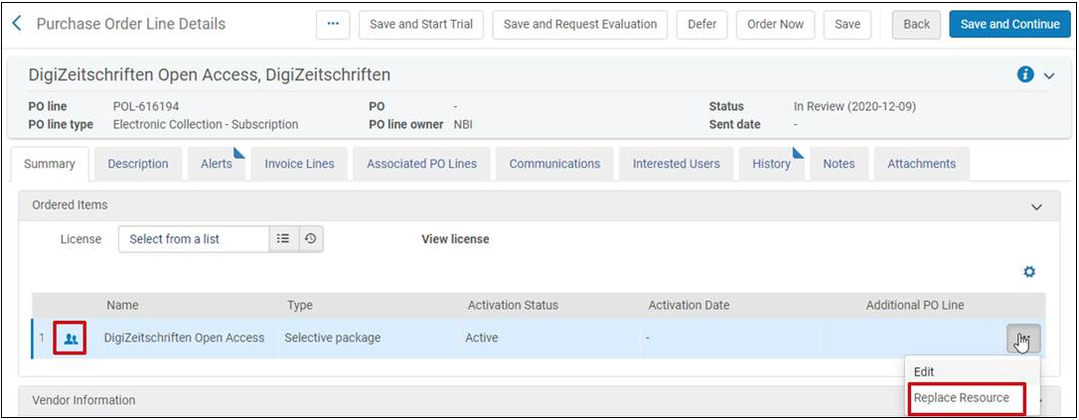
MARCH 2021 Release Notes – Acquisitions
New Option To "Replace Resource" Associated With An Electronic PO Line
  Electronic POL (portfolios/collections) now allows the resource to be replaced when a POL is accidentally created for the wrong electronic resource
    Prevents the need to delete the POL and create a new POL
    "Replace resource" can only be used on the same electronic resource type
    Displays the icon for the zone the resource is associated with and indicates if it is active or not

Slide 24
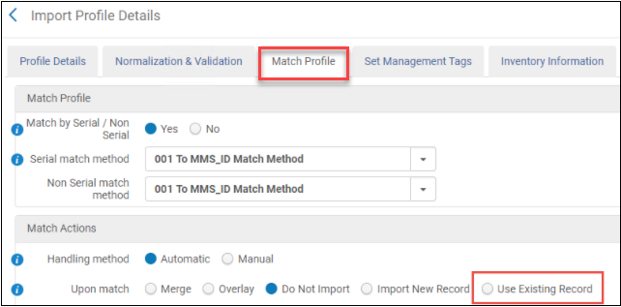
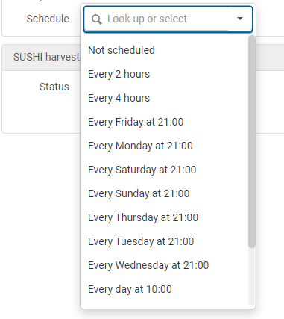
MARCH 2021 Release Notes – Acquisitions
Import Profiles will have the ability to match on an existing bib record when this option is selected under Match Actions>Upon match
Multiple runs per day for PO packaging Job to now exist to facilitate better communication between vendors and Alma
  Can be applied to:
    Manual packaging jobs (Configuration> Acquisitions>General>Acquisitions Job configuration)
    EDI jobs
  New options to run the PO Packaging job:
    Every 2 hours
    Every 4 hours

Slide 25
MARC 2021 Release Notes - Acquisitions
Physical Inventory Viewer Privileges Added to All Relevant Roles
  All staff users will be able to view all inventory (physical, electronic and digital) in the institution, regardless of the user role's scope
    Users who do not have the permissions to edit the inventory can only view it
    Contact Ex Libris customer support to limit the ability to view holdings and items in your institution only to certain roles

Slide 26
March 2021 Release Notes – Other
Exclusive use of the New Alma Layout
  The old Layout will no longer be available to use in Alma with the March 2021 release
New "System Events" Subject Area (analytics)
  Will replace the current "Events" subject area
  The new "System Events "subject area will only include a select number of events so that reports can be run quickly and efficiently
Chat with Support in Alma & Leganto
  Available in the European region with the March release
  North American region will have the ability to chat with support in Alma a few weeks later
  Chat can be used to:
    Simple how-to questions and configurations
    Behavior and general inquiries
    Known issues

Slide 27
Resource Sharing
Timothy Jackson
www.suny.edu

Slide 28
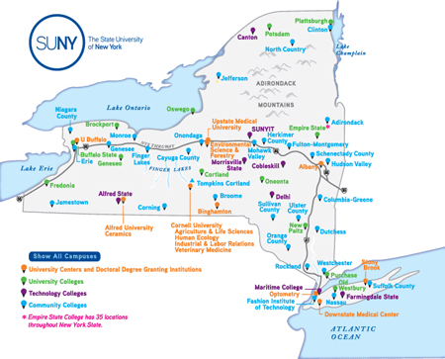
Automated Fulfillment Network Project
Three AFN meetings held in January & February
Recordings, slides, and project info available at https://slcny.libanswers.com/faq/335353
AFN Interest Survey distributed to institutional leads
  Response deadline is today
Responses will determine whether we:
  Move forward with current project scope and timeline
  Move forward with modified project scope and/or timeline
  Abandon project
Collection size and geographic location will be factored into analysis of survey results
Survey results will be announced in mid-March

Slide 29
Resource Sharing
Alma resource sharing between SUNY and Ithaca College is now live
  24 SUNYs borrowing and lending books with Ithaca College
  ESC lending articles to Ithaca College, looking to expand artice RS with Ithaca
Continuing to have discussions about Alma RS with Nazareth College, Union College, St. John Fisher College, WRLC, CSU, and CSCU
Hierarchical locate feature implemented for all SUNY
  Alma will first locate on identifiers (ISBN/ISSN, OCLC number, LCCN), needs only one match
  Alma will locate on author and title only if the request has no identifiers
  Has allowed us to reintroduce OCLC number into our locate settings
  Will hopefully reduce number of locate issues
Lost Resource Sharing Items Policy
  Working with ASRS to get a lost RS item policy approved by end of Spring 2021 semester
  SLS will not be centrally managing lost RS item invoices
  Policy will be implemented gradually so libraries don’t suddenly receive a bunch of invoices
  Please refrain from invoicing for lost RS items until policy is implemented

Slide 30


Questions or Discussion?
www.suny.edu

