Slide 1

DULCE Learning Collaborative
September 12, 2024
5/12/2022
Care Transformation Collaborative of Rhode Island
‹#›
Prepared by Care Transformation Collaborative of RI

Slide 2
Agenda
Presenter/Topic | Time
Welcome & Announcements Susanne Campbell, RN, MS, PCMH CCE, Senior Project Administrator | 5 minutes
Practice Updates: Coastal Toll Gate Pediatrics Hasbro Tri-County Community Health Center Blackstone Valley Community Health Center CNEMG Family Care Center | 20 minutes
Supporting Parent Needs with Family Visiting Michelle Hirst, MSW, Supervisor, Healthy Families America, Children’s Friend | 10 minutes
6 Month Graduation Discussion Success Stories – all practices | 20 minutes
Sustainability Options: Brazelton, Intensives and Reflective Consultation Susanne Campbell, RN, MS, PCMH CCE, Senior Project Administrator | 10 minutes
The Greatest Eight Susan A. Orban, LICSW, Director, Washington County Coalition for Children Tiffanie Cataldo, Family Specialist | 15 minutes
Q&A / Discussion | 10 minutes
Prepared by Care Transformation Collaborative of RI

Slide 3


Announcements!
Join us for sessions on:
Keynote: AI in Healthcare: Pitfalls and Promises
Building Trusted Relationships with Patients
Engaging Behavioral Health Providers in Integrate Care: Building a sustainable IBH model with the use of a Supervisory Protocol
Taking a Positive Sexual Health History
Innovation in Expanding Integrated Behavioral Health Capacity in Pediatrics
Advancing Health Equity for Young Children: Implementing Expanded Autism Assessment and Diagnosis in Pediatric Primary Care
90 minute Special Session: From Data to Equity: Improving LGBTQIA+ Health in RI
AND MORE!!!!
Register here: https://bit.ly/CTCRIConference2024
Prepared by Care Transformation Collaborative of RI
Prepared by Care Transformation Collaborative of RI

Slide 4


Announcements!
September 13 - PCP Specialist Forum: Improved Patient Care and Lower Costs Through Better Primary Care-Specialist Alignment: https://ctc-ri.zoom.us/meeting/register/tZUqdeCqrT0sGN0bQMf5VdMBLCx9PRh0zl2F
Sept 17: Best Practices in Team Base Care: Strengthening Collaboration Between Pediatric Practices and School Nurses
Register here: https://ctc-ri.zoom.us/meeting/register/tZ0qceuurzIiGtYP4VNxnkCGUHBJS8SVQUsZ#/registration
Clinical Strategy Meeting: Sept 20, 2024
Addressing Alcohol Use Disorder Among Patients
Email Michelle Mooney to join: mmooney@ctc-ri.org
Prepared by Care Transformation Collaborative of RI
Prepared by Care Transformation Collaborative of RI

Slide 5


Coastal Toll Gate Pediatrics
Warwick, RI
Enrollment Data*:
Team Members
  134 enrolled in DULCE; 48 graduated
  127 (94%) received WCV on time
  269 (75%) of WCV CHW/FS attends
  All patients screened for SDOH – no exact data
  45 (34%) needed support
    100% received support
  Family surveys – 3 received
  53 organizations available for referral
Lauren Landry, LCSW, Family Specialist
Stacey Nickerson, Practice Manager
Raymond Zarlengo, MD
Denise Green, RN
Cynthia Lover, LICSW
Jenn Cioffi, Data Specialist
PDSA:
  AIM: to increase the number of patients who are connected to resources
    Challenge: FS doesn’t always see the SDOH screening in real time
  Baseline 17 out of 77 (22%); final 45 out of 134 (34%)
  Method: increasing awareness of families that this is an option
  Note: all patients who indicate a need and want support receive support
*Through July 19, 2024
Prepared by Care Transformation Collaborative of RI

Slide 6

Hasbro Children’s Hospital
Providence, RI
Team Members
Enrollment Data*:
Lizeth Garcia Garcia, CCHW, Family Specialist
Jennifer Jencks, LICSW, PhD, Manager of Peds SW
Carol Lewis, MD, Director, Refugee Health Program & Clinician Educator
Joel Guzman, CCHW, CHW Supervisor
Laudine Koster, BSW, Program Coordinator
  37 enrolled in DULCE (current)
  8 graduated (current)
  59 (89%) WCVs on time
  51 (77%) of WCV CHW/FS attends
  28 (93%) screened for SDOH
  27 (90%) received support
  Family surveys not rec’d yet
PDSA:
  Aim: 90% of WCVs are attended by Lizeth
  Challenges: 2 babies scheduled at the same time; some babies scheduled on Saturdays; large number of Residents/trainees
  Method: Lizeth tracks appointments herself so she knows when they are coming up, attends morning huddles, prioritizes WCVs above other appointments; new residents being trained
*As of Sept 2024
Prepared by Care Transformation Collaborative of RI

Slide 7

Tri-County Community Action Agency
Team Members
Enrollment Data*:
Belinda Soares - Family Specialist
Brenda Dowlatshahi – COO & Health Center Director
Rebecca Friedman, MD, Pediatrician
Bettina Cullinane, RN, NCM, Nurse Care Manager
Jennifer Caffrey, LICSW, Director of Behavioral Health
Pre-Natal Partner: Suzanne Lowe, CNM, Director of Women’s Health
Anne Marie Barone, Director of Health Information Management
  47 babies enrolled in DULCE, 9 graduated**
  10 prenatal patients enrolled overall**
  36 (100%) WCV that CHW/FS attends*
  42 screenings*
  39 linkages (93%)*
  36(85.7%) received WCV on time*
PDSA:
  75% of WCV are attended by CHW/Family Specialist - TriCounty = 100%
**As of 9/11/24
*As of 7/15/24
Prepared by Care Transformation Collaborative of RI

Slide 8
CHW billing – TriCounty
  Data Collection: Define data that can be collected and monitored to measure success and evaluate sustainability.
  Minimum Required: # of billed FS/CHW Services from grant proposal
Reporting Period | # of Billed FS/CHW Services since 2/2/24 | # of Held Claims for No MID# | # of unique patients (Medicaid)
Baseline 2/2/24 – 7/15/24 | 96 (included CHW overall) | 47
2/2/24 – 8/31/24 | 86 (FS/CHW) | 27 (reduced from 60) | 46+ encounters
Prepared by Care Transformation Collaborative of RI

Slide 9

Blackstone Valley Community Health Center
Team Members
Enrollment Data*:
Manuela Andres -CHW/Family Specialist
Scott Hewitt, Assoc. Dir. Of Integrated Care
Morgan Motia, MD, AE Medical Director
Kathleen Ricci, Nurse Care Manager
Pre-Natal Partner: Carolyn Pearce, MD, Family Medicine & OB/GYN Medical Director
  49 enrolled in DULCE, 12 graduated**
  8 - prenatal patients enrolled overall**
  43 (36%) of WCV that CHW/FS attends*
  24 (69%) of screenings*
  3 (100%) of linkages*
  30 (88%) received WCV on time*
  Family surveys on-going
PDSA:
  90% of families with concrete needs identified through HRSN receive support – BVCHC = 100%
** As of 9/11/24
*As of 7/15/24
Prepared by Care Transformation Collaborative of RI

Slide 10

Care New England Family Care Center
Pawtucket, RI
Enrollment Data:
Team Members
  71 enrolled in DULCE, 12 graduated **
  17 prenatal patients enrolled overall**
  123 (91%) of WCV that CHW/FS attends*
  39 of screenings *
  39 of linkages*
  27/35 (77%) received WCV on time*
  Family surveys on-going
Jalyn Alzate, Family Specialist
Marybeth Sutter, MD
Nicole Quindazzi, MS, Practice Manager
Margaret Lebeau, Nurse Care Manager
Debra Moorhead, Academic Social Worker
PDSA: performance compared with national data
  95% of families are screened for Health-Related Social Needs (HRSN) – CNE = 100%
  90% of families with concrete needs identified through HRSN receive support – CNE = 100%
** As of 9/10/24
*As of 7/15/24
Prepared by Care Transformation Collaborative of RI

Slide 11
Supporting Parent Needs with Family Visiting
Michelle Hirst, MSW, Supervisor, Healthy Families America, Children’s Friend
Prepared by Care Transformation Collaborative of RI

Slide 12

6-Month Graduation
  What does a successful graduation look like?
  How do you prepare for graduation with families?
    What are the pain points? What works well?
  What are the transition options?
  How do you celebrate families’ completion of the program?
  Please share a graduation success story
Prepared by Care Transformation Collaborative of RI

Slide 13
CHW Billing/Sustainability Update
  1 Practice has implemented billing – Tri County
  High rate of claims held due to no Medicaid ID number
  Implemented workflow to follow up on missing #s
  Working to identify non-face to face billable encounters
3 Practices preparing for CHW billing
  Complete Readiness Checklist
  Use Billing Checklist to identify potential claims
  All Practices to complete Sustainability Plan by March 2025
  Use Cost Calculator Tool & Sustainability Planning Tool (coming soon)
Prepared by Care Transformation Collaborative of RI

Slide 14
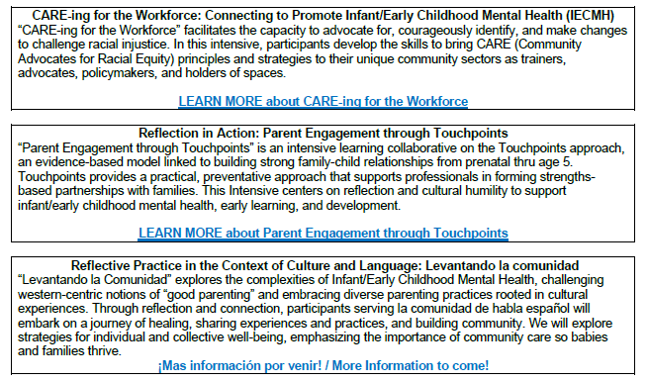
Sustainability/Training Options
  Brazelton Trainings Options
  RIDOH Family Visiting has two slots available in an Jan. 2025 Brazelton Touchpoints
  The training hours are 9:00 AM – 1:00 PM each day in January 2025: 1/14, 1/16, 1/21, 1/23, 1/28, 1/30 (Tu/Th) - must be present all days to complete
RIAIMH Intensives:
Registration is offered at NO COST to participants (and includes NASW CEUs & CELP credits, as desired).
Participants can receive a $1,000 stipend and a RIAIMH membership for 2025.
All training content is aligned with IMH Competencies® to support Endorsement®.
Registration is limited to 15 participants per Intensive.
Prepared by Care Transformation Collaborative of RI

Slide 15
Sustainability/Training Options
  Reflective Supervision Series to increase internal capacity
  What is Reflective Supervision?
  Reflective Supervision is a relationship-based supervisory approach that supports direct service providers so they can do their job well.
  This is all in service of helping providers grow professionally, reducing stress and burnout, and ensuring high quality services for children and families.
  Sessions meet for 2 hours monthly
  Must attend 75% of sessions to be considered complete
  2025 Dates TBD
  Reflective Practice Large Group is occurring virtually November 14th and 21st 9-1 pm (both days are required).
  Next steps: CTC to schedule information session to learn about options with Bradley and RI Association of Infant Mental Health
Prepared by Care Transformation Collaborative of RI

Slide 16



Slide 17









Collaborative Effort
With funding support from:

Slide 18
Goal of The Greatest 8TM
  To support lifelong mental health and well being by ensuring that parents, caregivers and practitioners have the training and resources they need to promote social-emotional competence in children ages 0-8

Slide 19
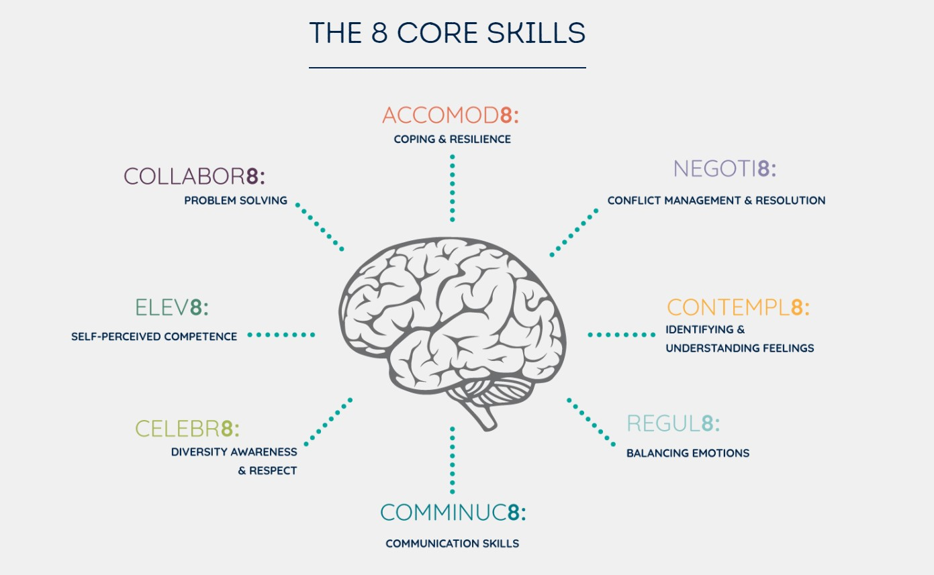

Slide 20



8 Empirically Supported Skills Linked to:
► Higher levels of academic achievement – fewer struggles with reading/ writing
► Increased communication skills
► Better social relationships, including peer relationships
► Increased independence and confidence
► Increased empathy and openness/acceptance
► AND Improved mental health and resilience

Slide 21






8 skills for a lifetime of health and wellness
COMMUNIC8:
How well does a child communicate their thoughts
and feelings with others?
Communication Skills
CONTEMPL8:
REGUL8:
Can a child recognize their emotions and the emotions of others around them?
Identifying &
Understanding Feelings
Can a child manage
strong emotions?
Balancing Emotions

Slide 22






ELEV8:
COLLABOR8:
ACCOMMOD8:
How confident is a child
in their abilities?
What does each child do when problems arise?
Can a child bounce back after encountering difficult experiences?
Self-Perceived Competence
Problem-Solving
Coping & Resilience

Slide 23




NEGOTIA8:
CELEBRA8:
Can a child solve problems independently?
How does each child react to new people and experiences?
Conflict Management/Resolution
Diversity Awareness/Respect

Slide 24


The Greatest 8TM
Created with today’s busy and digitally connected parents in mind
TMS
Website
Weekly Texts:
Actionable tips
Activity suggestions
Helpful reminders
Available in English & Spanish
Link to G8 website
for more content
Information is:
Research-based
Easily accessed
User friendly
Wide reaching
Translatable in <100 languages!
Content is Age Appropriate!

Slide 25
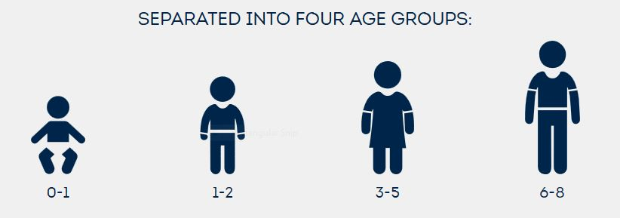
The Greatest 8TM
Created with today’s busy and digitally connected parents in mind
Blogs and Podcasts
Workshops
Parent-written blogs:
Add a parent voice
Engaging podcasts with parent/experts
Held with:
Parents
Physicians
Child Care
Providers, etc.

Slide 26

Spread the word about our Text Messaging Service (TMS) for weekly tips!
Subscribers select language for texts (English or Spanish)
Only known TMS focused exclusively on building mental health skills in young children

Slide 27


Slide 28
Sample Message

Slide 29

Text Messaging Service Evaluations
Parents appreciate the weekly tips & reminders
Few disenroll from the service!
Currently, we have ~1,200 subscribers
Our 3 year goal = 20,000 subscribers

Slide 30

Why Engage Primary Care Practices?
Primary care teams can educate parents about The Greatest 8TM skills as part of your efforts to support children’s healthy development. You are in a front-line position to:
Identify need, model and promote healthy behaviors, and prevent crises
Destigmatize seeking support, identify and link parents/ caregivers to available (local!) resources/ supports
Empower parents/caregivers to play a greater role in their children’s health mental health development
Parents/Caregivers often don’t know to ask questions about their child’s behavior – or TO WHOM? By opening the conversation on your end, parents learn they can come to you.

Slide 31
Help Us Spread the Word!
For more info or to obtain promotional materials, contact Susan Orban at wccc@washcokids.org

Slide 32



Follow us on social media:
https://www.facebook.com/Greatest8/
https://www.instagram.com/thegreatesteight/
https://www.linkedin.com/company/the-greatest-8

Slide 33




THANK YOU
www.ctc-ri.org
CTC-RI
5/12/2022
Prepared by Care Transformation Collaborative of RI
‹#›

