Slide 1

Shared LSP Update
February 26, 2020
www.suny.edu

Slide 2
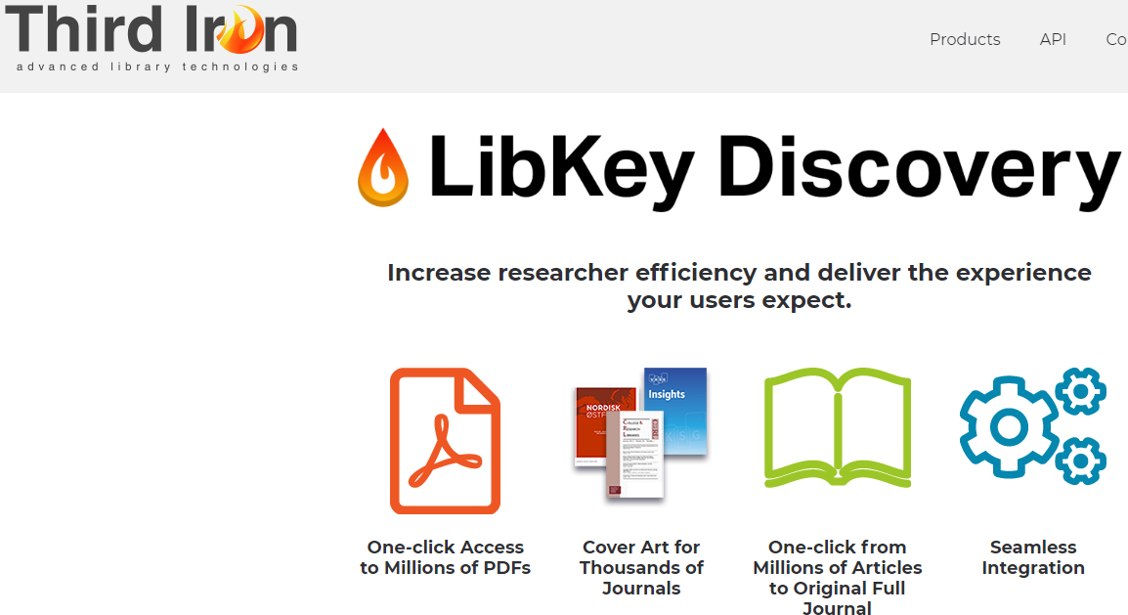
Libkey
We’ve heard your feedback about how many are unhappy with the extra clicks in Primo VE/Alma Link Resolver.
SUNY will be providing a group purchase option for Libkey at a highly reduced price.
Pricing range distributed to Institutional Leads last week.
SUNY will configure Libkey in Alma/Primo if you'd like us to.
  Will begin set ups within the next week for campuses who have expressed an interest.
Please indicate by March 2nd if your campus is interested via this survey:
  https://slcny.libwizard.com/f/SUNYlibkey2020-21
www.suny.edu

Slide 3

Gobi API
  SUNY has been working with Ebsco and YBP to review upcoming charges for Gobi API.
  YBP and Ebsco have recently let SUNY know that there will be no charges for use of the Gobi API.
www.suny.edu

Slide 4

Gathering Interest in ILLiad/Atlas Support and/or Development
The SLSS has been getting many, many questions about ILLiad, far beyond just ILLiad-Alma integration.
Now that ILLiad’s future is clearer, this system will begin changing very soon.
SUNY will be gathering interest in getting support or engaging in development projects with Atlas Systems.
www.suny.edu

Slide 5
Support Update: the Highlights
SLSS/SLC met with Ex Libris support managers on February 19th
Discussing issues with Primo link resolution, especially when there is unique id info. missing.
Reviewed issue of no RS showing on print if campus owns e. Escalating this issue with product mgmt.
Reviewing cases across institutions, including campus ability to accidentally complete borrowing RS requests, ghost eBook records in NZ, etc.
Course reserves issues: some inactive course content is showing. Escalating with product management (who referred back to support), now escalating to administration at EXL.
CZ ghost records in the NZ. Reviewing best practice to get rid of these, and want to make sure we are doing this right way.
www.suny.edu

Slide 6

Please Bring Cases to our Attention
  We're doing our best to review cases across the consortium, and to find issues that we need to escalate.
  But, we're not perfect, so if there's a case that needs to attention that we haven't discovered, please let us know by emailing info@slcny.libanswers.com
www.suny.edu

Slide 7

Transition on Training
SLSS has been providing many training opportunities over the past 4-5 months.
Contract of Consultant (Jennifer) ending in roughly 3 months.
SLSS developed complex maps of curriculum in all functional areas.
Almost all areas have presentations, FAQs, or other content.
In the coming month, we’ll be winding down training and will provide only occasional all-SUNY training, and this will change in nature and focus.
Will be providing some further focused sessions on having campuses sustain local training.
SLSS program managers will focus much, much, much less on training and more on system-wide initiatives.
www.suny.edu

Slide 8
Update on Planned Initiatives
Network E-Resources Task Force
Has met three times
Gathered useful information from other consortia managing e-resources centrally
Narrowing down criteria to help determine what could and should be managed centrally
Plan to wrap up by mid-March
www.suny.edu

Slide 9
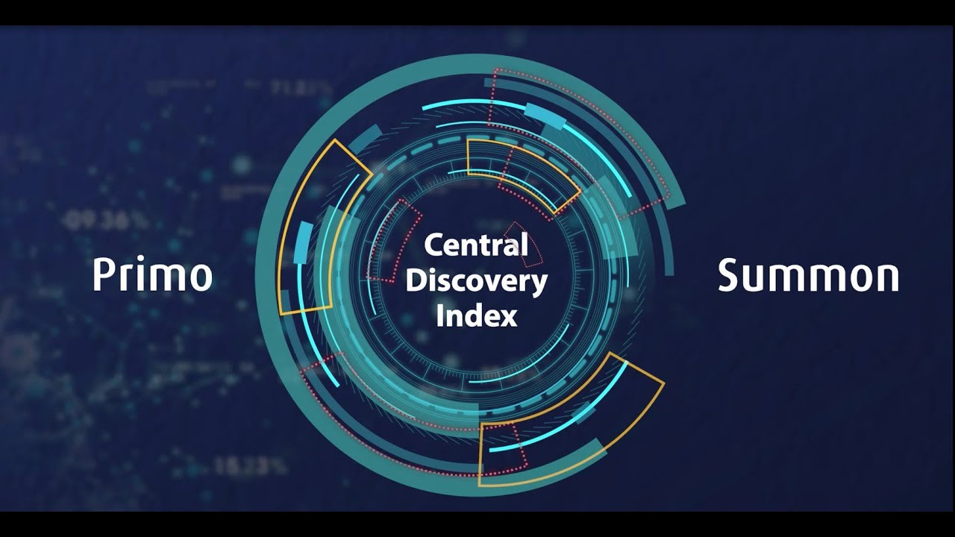
Central Discovery Index Update
Plan to go live on Sunday, May 24
Presented updated overview and testing information on Friday, February 21
Q&A session planned for Friday, Feb 28
Campuses will have several months to test and configure CDI. Will continue to run in parallel to PCI
Minutes and Ex Libris Documentation
Ex Libris YouTube https://www.youtube.com/watch?v=9k-JZdtSuo8
www.suny.edu

Slide 10
March Primo Updates
Data Visualization (DV) will be deployed in 'Preview Mode', meaning it is available for testing and evaluation but is not yet intended for full production use.
Quick Access service: a new service on full record, to be used with Alma Digital Viewer for files that you've added to Alma, not for e-resource collections
Online services information from other institutions: like physical view it from other institutions, no links, just info about what other SUNY schools might have it electronically
Local Extensions for CZ Bibliographic Records: good way to enhance CZ content
Custom Search Scopes with Course Code
Improved Email Template for Send To Email: can edit with or without Primo Studio
https://knowledge.exlibrisgroup.com/Primo/Release_Notes/002Primo_VE/2020/010Primo_VE_2020_Release_Notes
www.suny.edu

Slide 11

Café Alma:
Thanks to all who volunteered to Emcee.
Due to low attendance and a lack of Emcee volunteers, we're cancelling future Café Almas
www.suny.edu

Slide 12

Resource Sharing Update
Timothy Jackson
www.suny.edu

Slide 13
February Resource Sharing Volumes
Top 10 Borrowers |  | Top 10 Lenders
Campus | Volume | Campus | Volume
1. University at Buffalo | 807 | 1. University at Albany | 267
2. University at Albany | 196 | 2. Binghamton University | 206
3. Binghamton University | 175 | 3. University at Buffalo | 206
4. SUNY Purchase | 146 | 4. SUNY New Paltz | 112
5. SUNY Geneseo | 83 | 5. The College at Brockport | 86
6. SUNY New Paltz | 53 | 6. SUNY Oswego | 80
7. SUNY Brockport | 45 | 7. SUNY Oneonta | 68
8. SUNY Oswego | 40 | 8. Erie Community College | 63
9. SUNY Potsdam | 33 | 9. Buffalo State College | 61
10. SUNY Cortland & Oneonta | 30 | 10. SUNY Plattsburgh | 56

Slide 14
Resource Sharing Volume Takeaways
No significant changes in borrowing and lending requests volumes
Now that we have a whole semester of Alma resource sharing under our belts, I'm starting to look more closely at lending fill rates
  Overall lending fill rate for February was 80%
  ILLiad/OCLC based lending loan fill rates typically around 50%, so 80% is good!
  Will be reaching out to libraries with low fill rates later this spring to see if any configuration changes need to be made
www.suny.edu

Slide 15
Resource Sharing Turnaround Time and Fill Rate Statistics
Month | Fill Rate | Turnaround Time
August | 50.2% | 4.7 days
September | 54.0% | 4.3 days
October | 56.1% | 4.3 days
November | 60.0% | 3.9 days
December | 55.1% | 3.8 days
January | 57.8% | 4.4 days
February | 57.8% | 4.1 days
www.suny.edu

Slide 16
Resource Sharing Turnaround Time Takeaways
Turnaround times continue to be good (4.1 days for February)
ILLiad vs. Alma turnaround times at Albany
  ILLiad: 6.8 days
  Alma: 3.8 days
ILLiad vs. Alma turnaround times at Buffalo
  ILLiad: 6.3 days
  Alma: 3.9 days
ILLiad statistics do not include requests exported from Alma to ILLiad or requests filled by non-ELD libraries
Alma providing significantly faster turnaround time than ILLiad
www.suny.edu

Slide 17
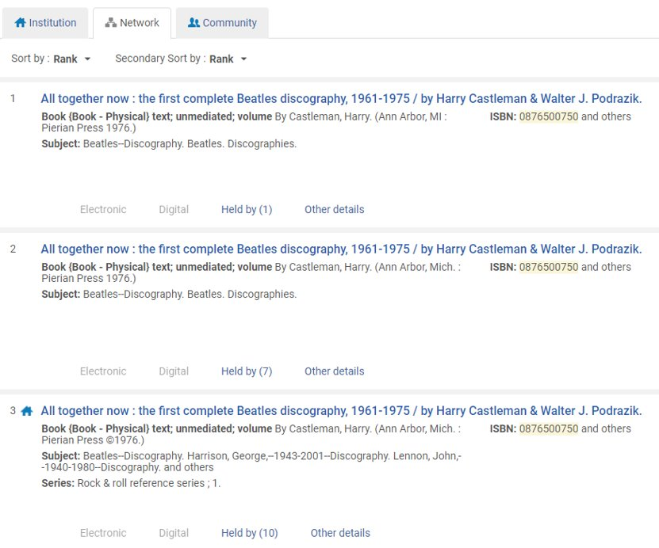
Resource Sharing Fill Rate Takeaways
Fill rates continue to hover between 55% and 60%
Some requests go unfilled because SUNY holdings are spread out over multiple records with different OCLC numbers
www.suny.edu

Slide 18
Resource Sharing Fill Rate Takeaways
Have removed OCLC Number from all locate profiles
Locate now uses author, title, ISBN, LCCN
Ignoring OCLC number should increase fill rate, but it has also increased the number of lending locate failures
Sessions on lending locate failures will be held on March 6 and March 13 from 1:00pm-2:00pm
  Session #1: https://slcny.libcal.com/event/6557633
  Session #2: https://slcny.libcal.com/event/6557744
Talking to Ex Libris about our issues with the locate process, so hopefully improvements can be made
www.suny.edu

Slide 19
Other Resource Sharing Updates
Expiry time for RS requests increased from 3 to 4 days
New ILLiad Borrowing NCIP addons now available
  Allow libraries to chose which ILLiad field is used as barcode in Alma
  Will eventually be able to update existing Alma requests instead of creating new requests (hopefully)
  Borrowing client addon: https://slcny.libanswers.com/faq/260720
  Borrowing server renewal addon: https://slcny.libanswers.com/faq/263830
Spring and Summer Resource Sharing Initiatives
  Article Resource Sharing in Alma (Spring)
  Resource sharing with non-SUNY libraries in Alma (Summer)
www.suny.edu

Slide 20
Network Zone
Maggie McGee
www.suny.edu

Slide 21

OCLC Import Profile Updates
The February 2020 enhancement that allowed the absolute path to be used was rolled back. The enhancement will now be included in the March 2020 release
Once the enhancement has been successfully tested in the production environment on March 2, 2020:
  The SLC will update the OCLC publishing profiles S/FTP definitions for campuses we configured their publishing profiles
  For all other campuses: Instructions will be posted to the Institutional Leads Basecamp and an email will be sent to Cataloging contacts
www.suny.edu
Notes:
Good attendance and engagement for all sessions. A successful switch to registration-based training, which makes it easier to communicate with and count participants.

Slide 22
New Order API Task Force Update
Marla Gruner worked with Ex Libris and GOBI to test GOBI's New Order API's ability to match eBooks to the Community Zone (CZ)
  The test was successful!
  Currently, there is no expected release date for this enhancement
The New Order API Task Force completed its charge and the New Order API Policy is ready to be submitted to the LSP
www.suny.edu
Notes:
Good attendance and engagement for all sessions. A successful switch to registration-based training, which makes it easier to communicate with and count participants.

Slide 23

New Order API Task Force Update
Thank you to the members of the New Order API Task Force for volunteering and all their hard work!
Members include:
  Marla Gruner – Ulster Community College
  Kate Jones – SUNY Oswego
  Jason Parker – University of Buffalo
  Noah Roth – Broome Community College
  Marian Stern – Binghamton University
www.suny.edu
Notes:
Good attendance and engagement for all sessions. A successful switch to registration-based training, which makes it easier to communicate with and count participants.

Slide 24

OCLC Institution Zone Integration Profile
The Overlay All Field But Local merge rule does not work as expected
  This merge rule only impact the IZ OCLC export
  Overlays existing fields
  Does not remove pre-existing fields that are no longer in the OCLC master record
A new merge rule has been created to address this called:
  SUNY – Overlay All But Local Fields
www.suny.edu
Notes:
Good attendance and engagement for all sessions. A successful switch to registration-based training, which makes it easier to communicate with and count participants.

Slide 25
March Acquistion's Release Notes
Preferred Material Type In Purchase Requests – allows the requestor to select the preferred material type
  Material Type was previously called Requested Format
  A default format can be configured for purchase requests
  See Ex Libris Documentation: Creating a Purchase Request
Sushi Performance Improved
  The SUSHI harvest process now contains new performance enhancements
  The Missing Data tab has been renamed to the Monthly Usage Data tab
    Connection issues are refined and color coded for ease of use
  See Ex Libris Documentation: Viewing Usage Data
www.suny.edu
Notes:
Good attendance and engagement for all sessions. A successful switch to registration-based training, which makes it easier to communicate with and count participants.

Slide 26
March Resource Management Release Notes
Bibliographic MMS ID will now appear:
  In repository search results for:
    Physical items
    Electronic collection
    Portfolios
  In the header for:
    Physical Item Editor
    List of Holdings
    List of Items
    Electronic Collection Editor
    Electronic Portfolio Editor
    Electronic Service Editor.
www.suny.edu
Notes:
Good attendance and engagement for all sessions. A successful switch to registration-based training, which makes it easier to communicate with and count participants.

Slide 27
Analytics Update
Gail Pawlowski
www.suny.edu

Slide 28
Analytics Oracle OBI upgrade to Version 12
Upgrade of Analytics OBI from Oracle 11 to Oracle 12
Ex Libris has not given an exact date but will be in the next several months
Data Visualization (DV) – a different way of creating a graphic view of your data
New view – Heat Matrix
Design Analytics will look a little different, mainly the graphics
www.suny.edu
Notes:
Good attendance and engagement for all sessions. A successful switch to registration-based training, which makes it easier to communicate with and count participants.

Slide 29
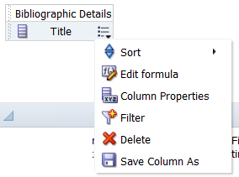
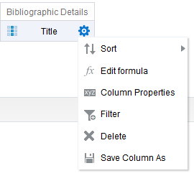
Analytics Oracle OBI upgrade to Version 12
NOW
OBI 12
www.suny.edu
Notes:
Good attendance and engagement for all sessions. A successful switch to registration-based training, which makes it easier to communicate with and count participants.

Slide 30
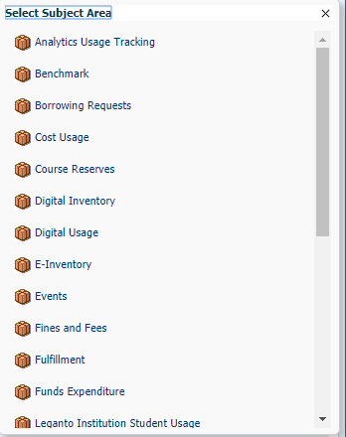
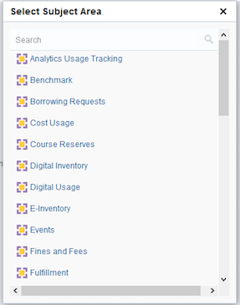
Analytics Oracle OBI upgrade to Version 12
NOW OBI 12
www.suny.edu
Notes:
Good attendance and engagement for all sessions. A successful switch to registration-based training, which makes it easier to communicate with and count participants.

Slide 31
Analytics Oracle OBI upgrade to Version 12
Some important things to know:
Analytics freeze for about a week before it becomes available – no new reports during that time
Institutional reports will be migrated but reports in “My Folder” might not migrate
www.suny.edu
Notes:
Good attendance and engagement for all sessions. A successful switch to registration-based training, which makes it easier to communicate with and count participants.

Slide 32
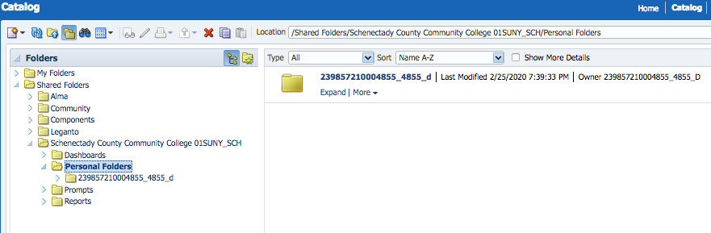
Analytics Oracle OBI upgrade to Version 12
The suggestion is to copy the contents of "My Folder" to your Institution Folder before the scheduled freeze date.
Create a folder in your institution folder named Personal Folders. Then this can be where all staff can copy their "My Folder" content.
If you copy the entire "My Folder" directory you will see the folder is now re-named with a string of numbers which is actually your unique user ID in Alma. You could rename the folder so it's easier to identify.
www.suny.edu
Notes:
Good attendance and engagement for all sessions. A successful switch to registration-based training, which makes it easier to communicate with and count participants.

Slide 33
Analytics Oracle OBI upgrade to OBI Version 12
Links for additional information
What's new in OBI 12:
https://developers.exlibrisgroup.com/blog/whats-new-in-obi-12-2/
An Introduction to Alma Analytics Data Visualization (DV)
https://developers.exlibrisgroup.com/blog/an-introduction-to-alma-analytics-data-visualization-dv/
Data Visualization (DV) and OBI 12 – Presentations and Documents:
https://knowledge.exlibrisgroup.com/Alma/Training/Extended_Training/Presentations_and_Documents_-_Data_Visualization_(DV)_and_OBI_12
www.suny.edu
Notes:
Good attendance and engagement for all sessions. A successful switch to registration-based training, which makes it easier to communicate with and count participants.

Slide 34
Training Update
Jennifer Koerber
www.suny.edu

Slide 35
Training Guides
Main Training Site: https://slcny.libguides.com/lsptraining
Cross-Functional Guides
Functional Area Guides
Search and Navigation:
https://slcny.libguides.com/training-search-navigation
Sets & Jobs:
https://slcny.libguides.com/training-sets-jobs
Analytics:
https://slcny.libguides.com/training-analytics
Discovery/Primo VE:
https://slcny.libguides.com/training-primo-discovery
EResources:
https://slcny.libguides.com/training-eresources
Fulfillment:
https://slcny.libguides.com/training-fulfillment
Resource Sharing:
https://slcny.libguides.com/training-resource-sharing
Resource Management:
https://slcny.libguides.com/training-resource-management
www.suny.edu

Slide 36
Developing Campus-Level Training
Webinar recording & files: https://public.3.basecamp.com/p/k3Z1zWPTfeJuZKCy2esrk1Lz
Supporting documents: https://public.3.basecamp.com/p/JPL8a7pseBKYzqv3hpTinzsm
  Links to webinar & files
  Examples of training & documentations from SUNY Campuses
  How-to document on developing technical training for Alma/Primo VE
www.suny.edu

Slide 37
Upcoming Training
In-Person Training
E-Resources Online Course
https://public.3.basecamp.com/p/gfX1JGHAtbHTumxn8LPiUkEa
Cataloging/Resource Management
    March 18 – SUNY New Paltz
    March 20 – SUNY Poly
E-Resources Management
    April 6 – UAlbany
    April 7 – SUNY Genesee
    April 9 – SUNY New Paltz
Fulfillment Units Configuration
    April 22 – SUNY Genesee
    April 28 – SUNY New Paltz
6 weeks, 2 session/week
Starts March 18
https://public.3.basecamp.com/p/gfX1JGHAtbHTumxn8LPiUkEa
Online Sessions
Calendar: https://slcny.libcal.com/calendar/training/
Resource Management Analytics, 2/27
CDI Overview Q&A, 2/28
Processing Lending Locate Failures, 3/6 & 3/13
Weekly Discovery & E-Resources sessions, Wednesdays
www.suny.edu

Slide 38
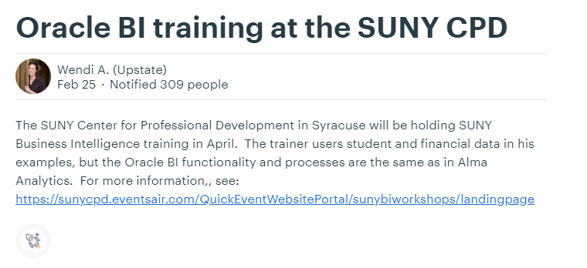
Upcoming Training
Basecamp post: https://public.3.basecamp.com/p/vuYZk5YbXR9LdUFv9CtokEUc
www.suny.edu

Slide 39
Still to Come...
Remaining Training Guides
More on Developing Local Training
"Turning Documentation into Training" webinars, late March and April
Additional documents and support
Proposed pre-conference workshop at SUNY-LA
Configuration/Systems Librarian guide (March)
Acquisitions (April)
www.suny.edu

Slide 40
Additional Updates
www.suny.edu

Slide 41
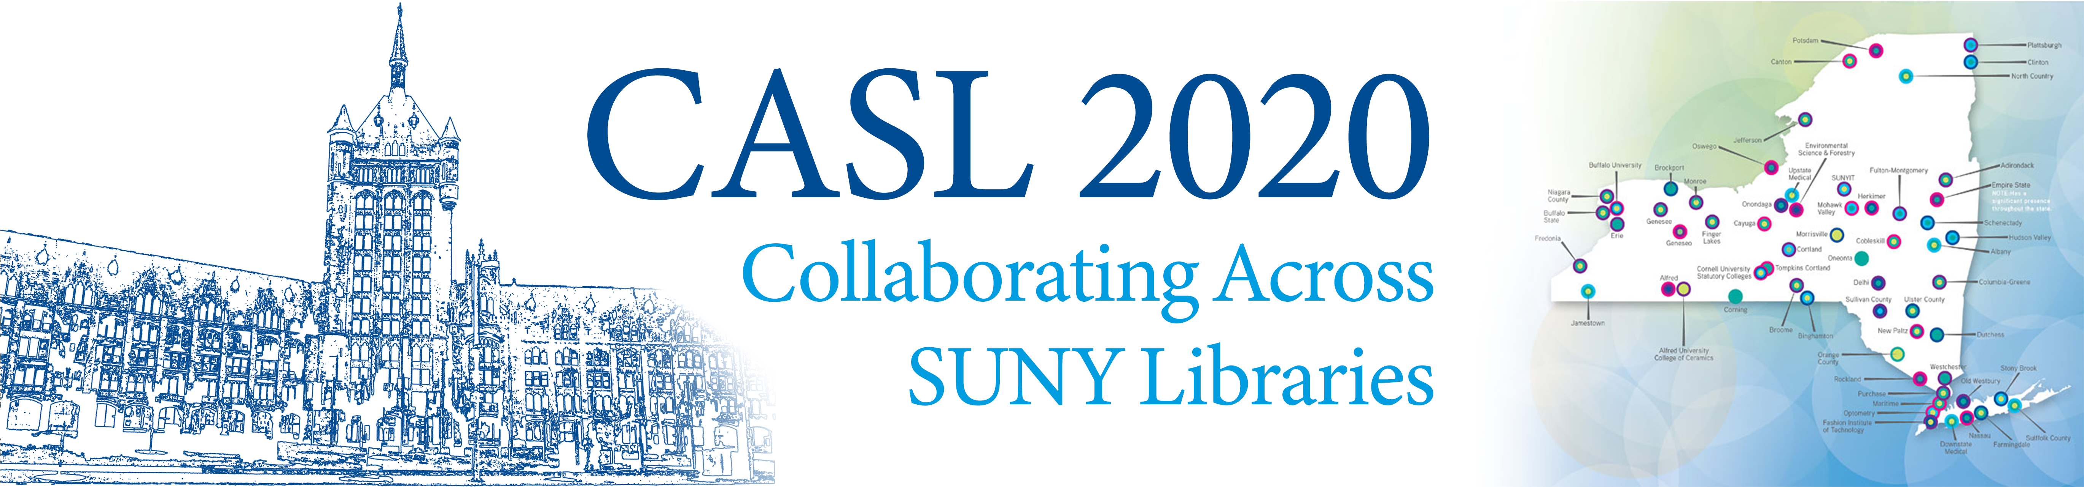
Collaborating Across SUNY Libraries (CASL) 2020
July 14-15 Albany, NY
Join your colleagues across SUNY for an engaging two days focused on envisioning SUNY Libraries in a shared environment. Hear from nationally and regionally-recognized speakers and leave with a plan of action for moving your library collections, services and infrastructure forward.
www.suny.edu

Slide 42

SLSS Taking Stock of Needs and Capacity
SLSS staff have already scheduled 12-15 visits, with more to be scheduled:
  Training needs
  Capacity for more Alma/Primo work
  Hear general feedback on Alma/Primo
Will only visit about half of campuses this cycle.
Engaging
Overwhelming
www.suny.edu

Slide 43

Update on Renewal
Working towards final 1-year renewal and exploring options for alternatives to SUNY-wide master agreement.
Will be reviewing/discussing issues with cross-sector group and then reviewing/presenting issues and options at SLC in June (if proposal is accepted at SLC).
No immediate changes, but long-term review of approach occurring.
www.suny.edu

Slide 44


Questions or Discussion?
www.suny.edu

