Slide 2
NC AHEC Overview
This slide deck can be used as an orientation tool for new staff or as a helpful resource for staff who want to learn more about other areas within NC AHEC.
For presentations with partners, check out About NC AHEC

Slide 3
NC AHEC
The mission of the NC AHEC Program is to provide and support educational activities and services with a focus on primary care in rural communities and those with less access to resources to recruit, train, and retain the workforce needed to create a healthy North Carolina.
Our vision is a state where everyone in North Carolina is healthy and supported by an appropriate and well-trained health workforce that reflects the communities it serves.
3

Slide 4
NC AHEC MAP

Slide 5
NC AHEC – CORE STRATEGIES
NC AHEC provides and coordinates services and support to achieve our results.
Recruit
Train
Retain
To ensure an appropriate supply of trainees/students to pursue health careers, particularly those who reflect their communities
To encourage health professions trainees/students and healthcare professionals to practice in interprofessional and primary care settings in rural and under-resourced communities
To retain the health workforce with a focus on the diversity of providers, interprofessional teams, and primary care settings in rural and under-resourced communities
5

Slide 6
NC AHEC – ORIGINATION
NC AHEC evolved to leverage NC’s medical schools and community hospitals to respond to national and state concerns with the supply, distribution, retention, and quality of health professionals
A national focus on the health care workforce coincided with a growing effort in NC to establish statewide community training for health professionals and to reverse a trend toward shortages and uneven distribution of primary care physicians in the state’s rural areas.
Interview with Dr. Cutchin on AHEC’s History
The NC General Assembly approved and funded a plan to create a statewide network of nine AHEC regions in partnership with NC medical schools and community hospitals.
The NC AHEC Program began in 1972 with three AHEC regions under a federal AHEC contract with the UNC Chapel Hill School of Medicine.
By 1975, all nine AHECs were operational.
1970s
1972
1974
1975
There are AHECs across the country in other states- to find out more about national efforts visit NAO
6

Slide 7
REGIONAL AHECS – GOVERNANCE & EXPENDITURES
AHEC | 501(c)(3) or Contractual Agreement
Area L | 501(c)(3)
Eastern | 501(c)(3)
Piedmont | Moses H. Cone Memorial Hospital
Mountain | 501(c)(3)
Northwest | Wake Forest University Health Sciences
South East | Novant Health New Hanover Regional Medical Center, LLC
South Piedmont | Wake Forest University Health Sciences/Atrium Health
Southern Regional | 501(c)(3)
Wake | WakeMed
Duke AHEC Program Office | Supports Southern Regional AHEC
7

Slide 8
NC AHEC PROGRAM – STATE FUNDING EXPENSES, FY23
Total NC AHEC Expenditure = $48,730,103
8

Slide 9
Operating More Like A System
Define the use of state funds: 5-year operating contract
Define the work: Annual Work Statement
Measure the work: Performance Measures
Improve the work: RBA and our Strategic Plan
Align finances and the work: Unallocated funds & Budget Guidelines
This positions us to:
respond to opportunities
understand gaps and opportunities for alignment and efficiency
demonstrate need for additional funding
FY23-25
Strategic Plan

Slide 10
Infusing Results-Based Accountability (RBA) Concepts in NC AHEC
The NC AHEC Strategic Plan adopted Results-Based Accountability as our framework to translate strategies into program results.
RBA teaches there are two types of accountability: population accountability and performance accountability. Being accountable for the performance of our programs is our direct responsibility. We use data and disciplined thinking to tell how much we do, how well we do it, and most importantly, if anyone is better off from the service(s) we provide.
RBA “turn the curve thinking” ensures accountability for the performance of our programs and demonstrates our contribution toward achieving the NC AHEC population result: “Everyone in North Carolina is healthy and supported by an appropriate and highly competent health workforce that reflects the communities it serves.”
Each AHEC and the Program Office have at least one certified RBA professional as their in-house resource.
Notes:
Claire
What is RBA?
RBA is a straightforward method of measuring impact that starts with the aim in mind and works backward to the means. It is a method of thinking and doing that can be used to enhance the lives in communities, cities, counties, states, countries, and program performance.
RBA was developed by Mark Friedman and described in his book Trying Hard is Not Good Enough.
RBA is being used in all 50 States and in more than a dozen countries around the world to create measurable change in people’s lives, communities, and organizations.
Give examples of who using it
Where is RBA being used in North Carolina?
SHA -SHIP
CHA-CHIP-SOTCH
Strategic Plans
Hospitals/health systems beginning to use it in their community health improvement work
Funders

Slide 11
NC AHEC – CORE SERVICE LINES
NC AHEC weaves through all sectors of health care education and workforce.
Health Careers & Workforce Diversity
Student Services
Graduate Medical Education Support
Continuing Professional Development
Practice Support
Library Services
11

Slide 12
PRACTICE SUPPORT

Slide 13
Practice Support
NC AHEC works with medical practices to transform delivery of care.
Our practice support teams ensure that our state’s health workforce provides high quality, cost-effective, and inclusive care to all individuals in NC, while thriving in a value-based care environment, ultimately reducing costs and improving quality of care.
13
NC AHEC

Slide 14
Practice Support
The aim is to help practices thrive with value-based care across their entire patient panel including Medicaid, Medicare and all other payors.
This service is offered at no cost via a team of 42 practice support coaches located at 9 regional AHEC centers across North Carolina.
Our coaches work 1:1 with independent primary care practices and specialists, FQHCs, rural health centers, health departments with primary care services, behavioral health providers and some health system primary care/specialist practices.

Slide 15
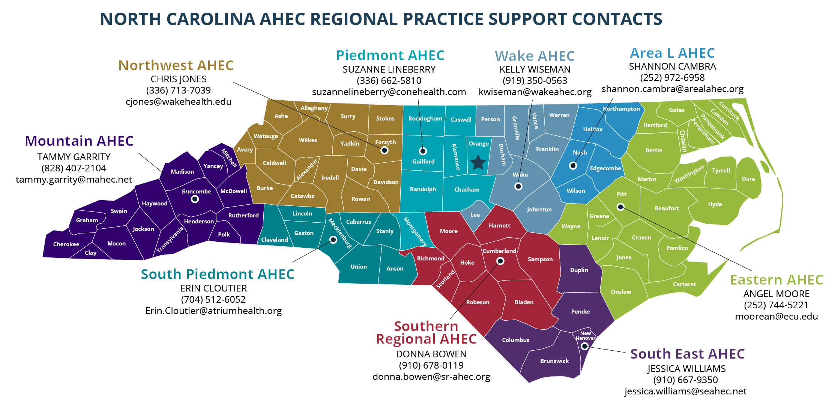
Alleghany
Surry
Stokes
Rockingham
Warren
Northampton
Gates
Currituck
Caswell Person
Granville
Vance
Hertford
Camden
Halifax
Pasquotank
Watauga
Wilkes
Yadkin
Forsyth
Orange
Chowan
Perquimans
Mitchell
Avery
Alamance
Durham
Franklin
Nash
Bertie
Madison
Yancey
Caldwell
Alexander
Davie
Guilford
Edgecombe
Tyrrell
Iredell
Davidson
Wake
Martin
Washington
Dare
Buncombe
McDowell
Burke
Catawba
Rowan
Randolph
Chatham
Wilson
Pitt
Swain
Haywood
Rutherford
Lincoln
Lee
Johnston
Beaufort
Hyde
Graham
Henderson
Cabarrus
Harnett
Wayne
Greene
Jackson
Polk
Cleveland
Gaston
Mecklenburg
Stanly
Montgomery
Moore
Lenoir
Craven
Cherokee
Clay
Macon
Transylvania
Cumberland
Pamlico
Union
Anson
Richmond
Hoke
Sampson
Jones
Scotland
Duplin
Onslow
Cartaret
Robeson
Bladen
Pender
Columbus
New Hanover
Brunswick
(9
5/19/2022.v4
1/1

Slide 16
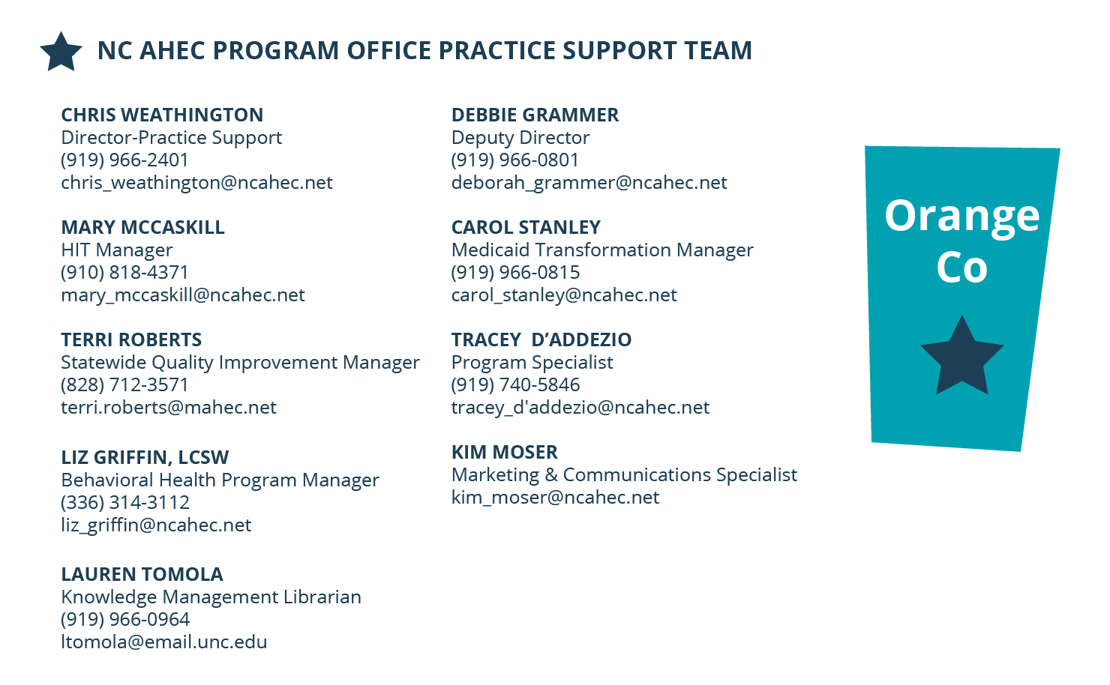
Alleghany
Surry
Stokes
Rockingham
Warren
Northampton
Gates
Currituck
Caswell Person
Granville
Vance
Hertford
Camden
Halifax
Pasquotank
Watauga
Wilkes
Yadkin
Forsyth
Orange
Chowan
Perquimans
Mitchell
Avery
Alamance
Durham
Franklin
Nash
Bertie
Madison
Yancey
Caldwell
Alexander
Davie
Guilford
Edgecombe
Tyrrell
Iredell
Davidson
Wake
Martin
Washington
Dare
Buncombe
McDowell
Burke
Catawba
Rowan
Randolph
Chatham
Wilson
Pitt
Swain
Haywood
Rutherford
Lincoln
Lee
Johnston
Beaufort
Hyde
Graham
Henderson
Cabarrus
Harnett
Wayne
Greene
Jackson
Polk
Cleveland
Gaston
Mecklenburg
Stanly
Montgomery
Moore
Lenoir
Craven
Cherokee
Clay
Macon
Transylvania
Cumberland
Pamlico
Union
Anson
Richmond
Hoke
Sampson
Jones
Scotland
Duplin
Onslow
Cartaret
Robeson
Bladen
Pender
Columbus
New Hanover
Brunswick
(9
5/19/2022.v4
1/1

Slide 17
Practice Support Team
42 experienced and knowledgeable practice support coaches in physical and behavioral health across 9 regional teams
1 embedded health science librarian and digital library resource
Clinical Advisor- Dr. Adam Zolotor, Family Physician
Program Office with expertise in program management, fiscal and contract operations, quality improvement, Medicaid managed care, behavioral health integration, health information technology and communications
Practice Managers
Health Educators
HIT Specialists
QI Specialists
Behavioral Health Specialists
Nurses and Clinicians
17

Slide 18
Practice Support Services
Quality & Health Equity Improvement (Medicaid, Medicare QPP/MIPS, All Payors)
Medicaid managed care education & issue resolution
Clinical workflow redesign & process improvement
Behavioral health integration (including Collaborative Care Model)
COVID19 vaccine & clinical workflow assistance
Practice operational assessments
EHR optimization, telehealth integration
HIE training and optimization
Revenue cycle management
Billing & coding guidance
Advanced Medical Home (AMH) tier education and support
Tailored Care Management (AMH+/CMA) support
Community Health Worker integration and training
Social Drivers of Health Workflow & NCCARE 360 Optimization
Virtual Collaborative Educational Programming

Slide 19
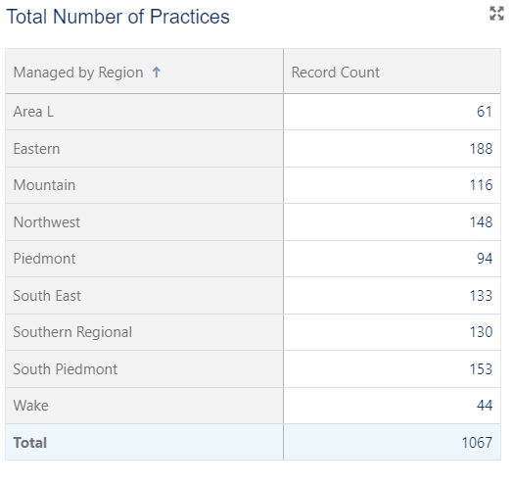
NC AHEC Practice Support Covers 1,067 Practices Serving 100 Counties

Slide 20
Practice Satisfaction Surveys Report Strong User Experience with AHEC Coaches
Practice Satisfaction Survey
2022 Results
Recommend NC AHEC Practice Support?
Satisfied with Quality of Information & Assistance by NC AHEC Practice Support Coach?
99%
90%

Slide 21
Want to Learn More?
Join the NC AHEC Staff Mailing List
Visit the NC AHEC Internal Depository

