Slide 1

George Mason District
Roundtable
June 8, 2023

Slide 2

Pledge

Slide 3
Welcome
New to Roundtable?
Please introduce yourself!

Slide 4
Council Update
2024 National Dues – Update in July
2024 Council Dues – Two listening sessions completed; update in July
Safety Moments for Summer
  Aquatics Safety – Aaron on Scouting; Aquatics Safety the BSA Way
  Lightning – Weather Related Safety; Fairfax Alerts Lightning Awareness Week
Outdoor Ethics Virtual Roundtable (June 14) - Edwin Guevara from the Maryland DNR will introduce a few apps that can be used by youth and leaders to make their outdoor experience more exciting.
VFW Post Cleanup - VFW Post 8469 – the Blue and Gray Post, is having a cleanup this Saturday, June 10, 9:00 am – 12 noon at 5703 Vogue Rod., Fairfax Station, VA 22039. All scouts are welcome to participate in this community service event. A sloppy Joe luncheon is planned. Please consider participating for an hour or so. Thank you. https://www.vfwpost8469.com/ https://www.facebook.com/vfw8469/

Slide 5
NCAC 2023 Unit Growth Conference
Who: Unit Key-3 Leaders, New Member Coordinators, Commissioners, and anyone looking to grow their unit's membership are invited to NCAC's 2023 Unit Growth Conference!
Topics Covered:
  How to market your Unit
  Best Practices for Joining Events
  NCAC's One-Stop-Shop for Membership
  Recruitment & Marketing material pick-up
Location: Prince of Peace Lutheran Church,
8304 Old Keene Mill Rd, Springfield, VA 22152
Date: Saturday June 10, 2023
Time: 9:00am - 12:00pm

Slide 6
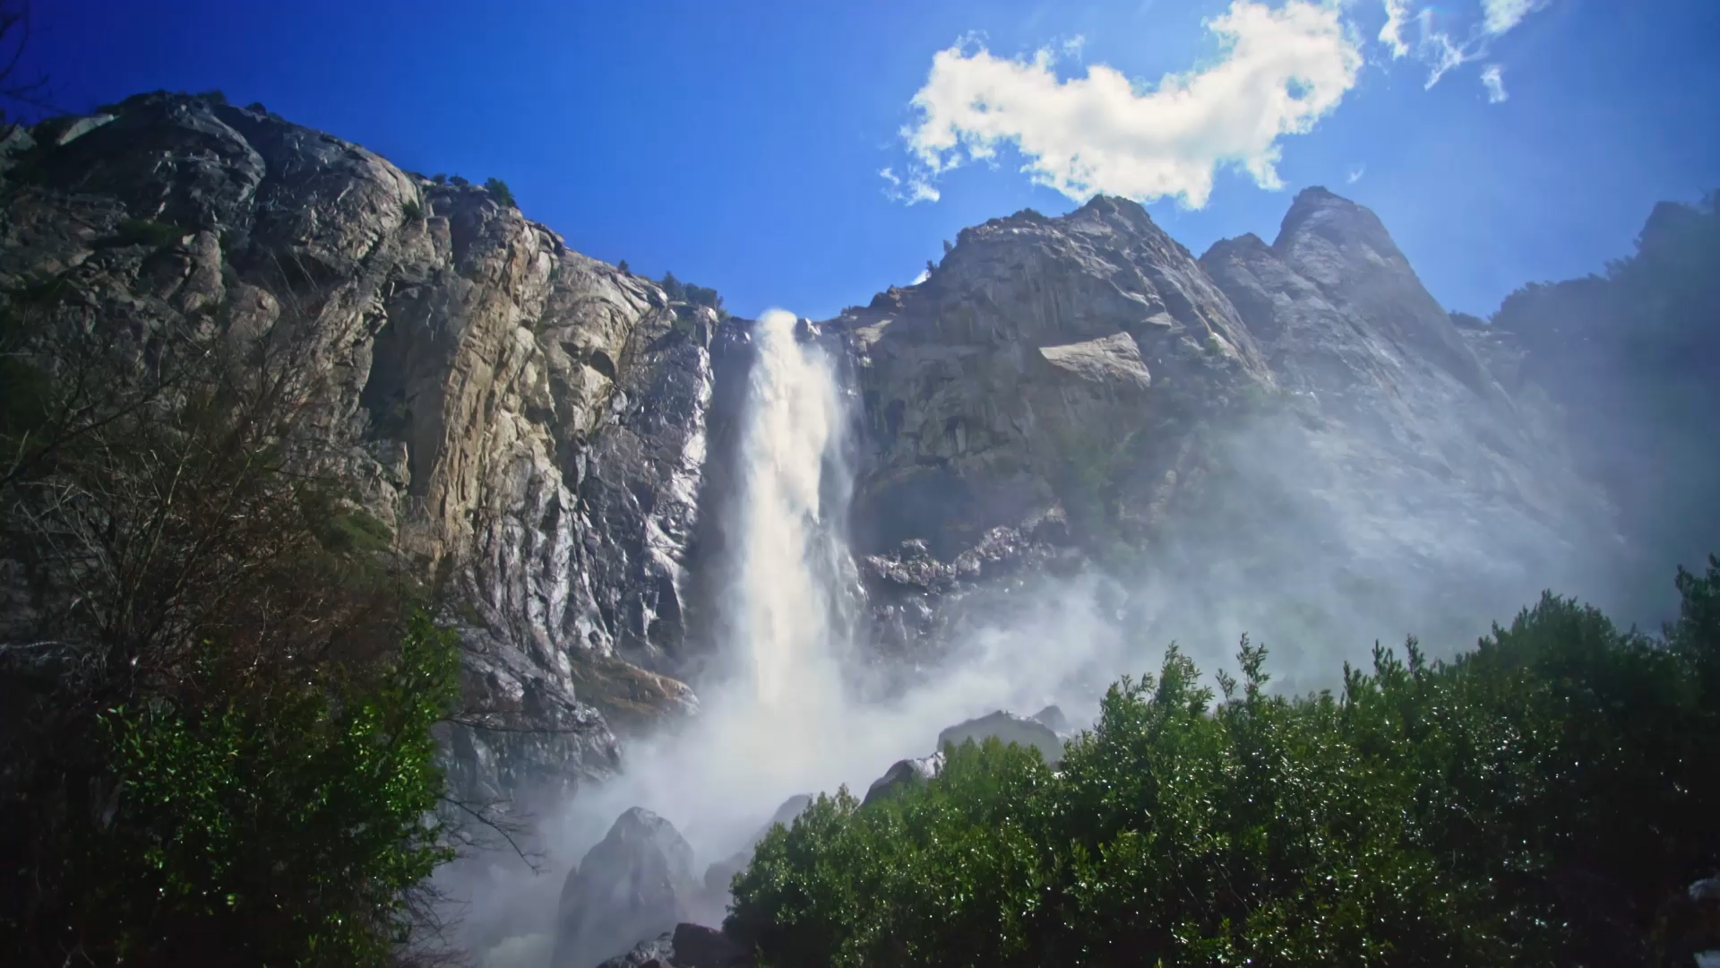
Whitewater Paddling
National Capital Area Council

Slide 7
Aquatics Committee (https://ncacbsa.org/aquatics)
2023 Training Schedule
Paddle Craft Safety (Still – Camp Snyder/Silver Lake; Moving – Riley’s Lock, MD)
  Aug 26 - Still Water Safety - Class Size 12
  Aug 27 - Moving Water Safety - Class Size 12
Aquatic MB Partial Wrap-up(only for those that are missing a few requirements from camp)
  10/01/23 (Sunday); noon – 5pm; Location TBD

Slide 8

Whitewater Outfitters
Best for one-and-done
No need for special training
$$$

Slide 9
Outfitters
Antietam Creek: https://www.antietamcreek.com
Calleva: https://calleva.org
https://shenandoah-river.com
https://harpersferryadventurecenter.com/whitewater-rafting/
https://canoevirginia.net
http://www.blueridgeonline.com/Virginia/VACanoeing
https://harpersferryadventurecenter.com/whitewater-kayaking/
https://aceraft.com/white-water-rafting/gauley-river-rafting/fall-upper-gauley-river-rafting/
https://www.canoeingthenew.com

Slide 10
Paddle Craft Safety
8/26 & 8/27/2023 (Snyder & Riley’s Lock)
https://scoutingevent.com/082-68339
Up to 12 attendees (adults only)
Offered Spring & Fall
Covers the Basics of Whitewater Canoeing

Slide 11
Paddle Craft Safety: Part Two
Council Offering
4-part advanced whitewater training
Up to 24 attendees (scouts & adults)

Slide 12

Proposed Schedule
Sep 9 (1/2 day): Riley’s Lock (flatwater training)
Sep 23 (full day): Lower Antietam
Oct. 14 (full day): GW Canal
Oct. 28 (full day): Angler’s Inn to Lock 10

Slide 13
Request for Support – Optimist International
Optimist International needs 34 Scouts for a flag ceremony on Sunday, July 2, 2023, at the Hyatt Regency in Crystal City. Arrival time is 10am, so that we can work in a little practice. The ceremony itself is at noon. They need to know types and numbers of vehicles, so that they can arrange parking.
Please put this out to your units who might be able to provide Scouts. They don't need to come from the same unit. They can be from any type of unit, in fact, it would be great to showcase all levels of Scouting, however the flags may be too big and heavy for young Cubs.
Contact: Christine.McDanal@scouting.org, 240-395-0606

Slide 14


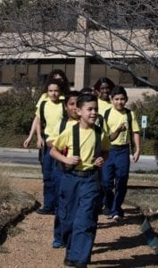

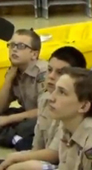


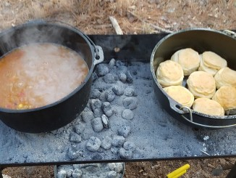
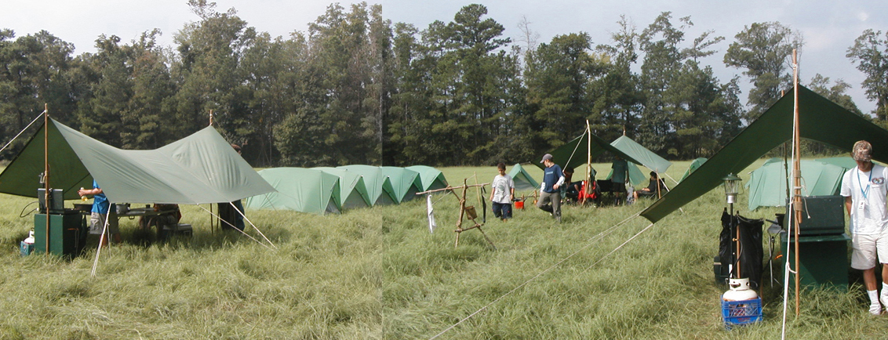
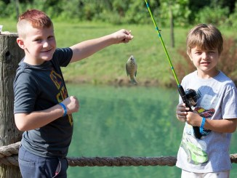
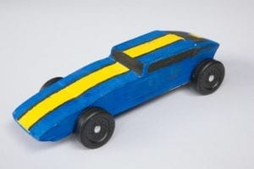
George Mason Program
John Drisco, Vice Chair Program
Matt Burns, Deputy Vice Chair Program
George Mason District

Slide 15

Current 2023 George Mason Calendar
August 10, 2023 – Join Scouting Night/Roundtable
August 16-18, 2023 – Summer Ordeal, Camp Snyder
September 23, 2023 – Scouts Night – Nationals vs Atlanta Braves
September 23, 2023 – Life to Eagle Seminar (in-person)
October 6-9, Climb-o-ree
October 20-22, 2023 – Fall Camporee
October 28, 2023 – Scouting for Food (Tags)
November 4, 2023 – Scouting for Food (Collection)
November 11, 2023 – Flags In (Veterans Day)
November 25, 2023 – 5K Trot & Ride, Camp Snyder, Haymarket, VA

Slide 16
STEM
06/26-6/30 & 8/7-8/11 – STEM MB and Nova at Innovation Academy
07/16 – 07/21 – Scouts BSA Specialty Week, Camp Snyder, Haymarket, VA
08/12 – Townes Supernova Project – Individuals and Small Groups, Camp Snyder, Haymarket, VA
Anytime – DC STEM Trek- Showcases 24 government agencies, private organizations and monuments related to the tenets upon which STEM is based. Two hikes - 10.57 miles, or 4.75 miles

Slide 17

Fall 2023 Camporee
October 20-22, 2023

Slide 18
Merit Badges: Goshen (88)
American Cultures, American Heritage, American Labor, Animal Science, Animation, Archaeology, Archery, Architecture, Art, Astronomy, Automotive Maintenance, Aviation, Basketry, Bird Study, Camping, Canoeing, Chemistry, Chess, Citizenship in Nation & World, Climbing, Collections, Communication, Composite Materials, Cooking, Crime Prevention, Digital Tech, Electricity, Electronics, Emergency Preparedness, Energy, Engineering, Entrepreneurship, Environmental Science, Exploration, Fingerprinting, First Aid, Fishing, Forestry, Game Design, Gardening, Geocaching, Geology, Inventing, Journalism, Kayaking, Law, Leatherwork, Lifesaving, Mammal Study, Metalwork, Mining in Society, Motorboating, Moviemaking, Music, Nature, Oceanography, Orienteering, Personal Management, Photography, Pioneering, Plumbing, Pottery, Programming, Public Speaking, Radio, Reptiles & Amphibians, Rifle, Robotics, Rowing, Salesmanship, Sculpture, Search & Rescue, Shotgun, Signs & Signals, Sailing, Soil & Water, Space Exploration, Sports, Swimming, Theater, Traffic Safety, Water Sports, Weather, Welding, Wilderness Survival, Wood Carving, Woodwork

Slide 19
Merit Badges: Camporee (32)
American Cultures, American Heritage, American Labor, Animal Science, Animation, Archaeology, Archery, Architecture, Art, Astronomy, Automotive Maintenance, Aviation, Basketry, Bird Study, Camping, Canoeing, Chemistry, Chess, Citizenship in Nation & World, Climbing, Collections, Communication, Composite Materials, Cooking, Crime Prevention, Digital Tech, Electricity, Electronics, Emergency Preparedness, Energy, Engineering, Entrepreneurship, Environmental Science, Exploration, Fingerprinting, First Aid, Fishing, Forestry, Game Design, Gardening, Geocaching, Geology, Inventing, Journalism, Kayaking, Law, Leatherwork, Lifesaving, Mammal Study, Metalwork, Mining in Society, Motorboating, Moviemaking, Music, Nature, Oceanography, Orienteering, Personal Management, Photography, Pioneering, Plumbing, Pottery, Programming, Public Speaking, Radio, Reptiles & Amphibians, Rifle, Robotics, Rowing, Salesmanship, Sculpture, Search & Rescue, Shotgun, Signs & Signals, Sailing, Soil & Water, Space Exploration, Sports, Swimming, Theater, Traffic Safety, Water Sports, Weather, Welding, Wilderness Survival, Wood Carving, Woodwork

Slide 20
Merit Badge Instruction
Traditional Half Day/Full Day MB Day Format
Partials Clinic Format (Variable Skill Demo by Scout)
Skills Clinics (Jamboree Format)

Slide 21
Merit Badge Counselors needed!
Google Drive will be available by July
All MB Counselors encouraged to attend, including non-camporee attendees
“Key 3”: EP, S&R, Wilderness Survival

Slide 22
Advancement – Changes to Merit Badge Counselors
Starting August 1, 2023, the fee for new Merit Badge Counselors that are not already registered in a BSA adult position (Unit leader, committee member, district staff, etc.) will be $25.
Current Merit Badge Counselors that are not also registered in a BSA adult position will need to pay $25 when the District recharters in December.
Impact on merit badge counselor re-registration is uncertain.
I’d like a volunteer to help me work with unit merit badge deans to assess impact on MBCs and help recruit new ones to cover gaps.

Slide 23
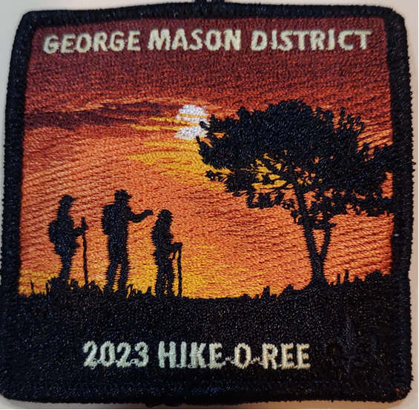
George Mason Hike-O-Ree
Congrats to the following units that supported all three GM Hike-O-Rees:
  Pack 675
  Troop 140
  Troop 152
  Troop 895
  Troop 1539
Kudos also to Troop 13 that supported the Hike-O-Ree in 2022 and 2023.
Other units participating were:
  Pack 78
  Pack 656
  Pack 681
  Pack 1111
  Troop 681
  Troop 1113
All told, we registered 787 miles which is a little lower than the 812 hiked in 2022 but higher than the 666 in 2021.
Patch order site will be open to 6/20/23 - https://scoutingevent.com/082-68269

Slide 24

2023 Elks Youth Recognition Dinner
Thank you to everyone who played a part in this year’s dinner. We had 21 Eagles and 29 Gold Award Scouts and their families attend.
The Elks Lodge 2188 again sponsored the dinner and provided the venue and meal for free.
Next year’s dinner for 2023 Eagle Scouts will be in the spring of 2024.

Slide 25
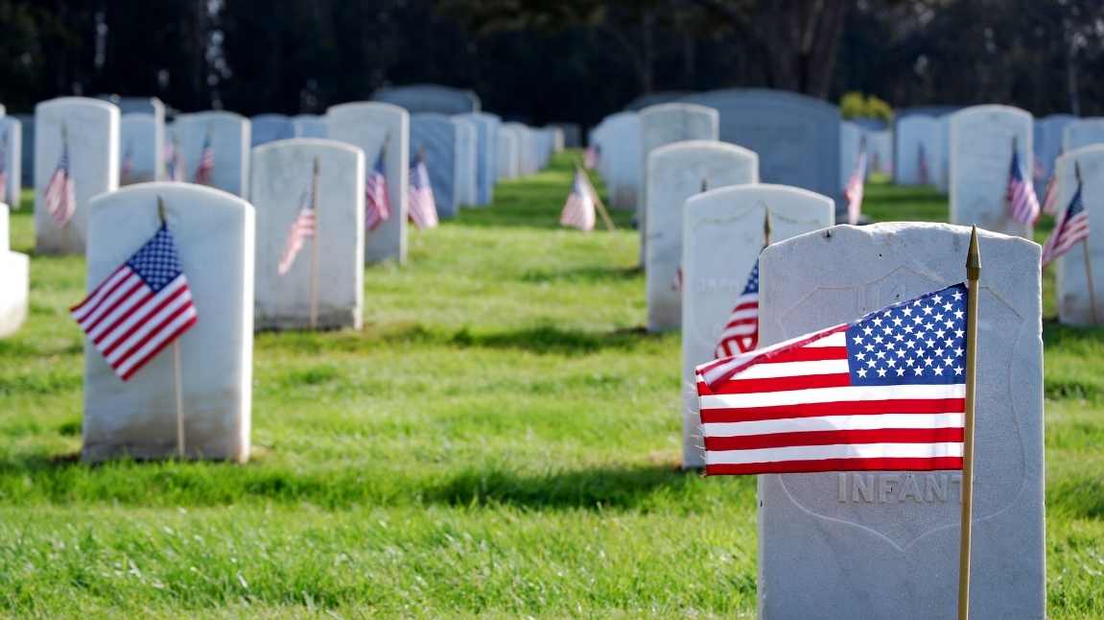
Flags In – May 29, 2023 (Memorial Day)
Thanks to all that attended and those that supported the event!
Approximately 325 Cub Scouts, Scouts BSA, Girl Scouts, Heritage Girls and their families attend.
Next event is on Veteran’s Day (Nov 11)
For more info, contact Russell Pittman at ruspittman@gmail.com

Slide 26

District Life to Eagle Seminar – September 23
Saturday, 23 September 2023
1:00 to 4:00 p.m.
In Person at St. James Catholic Church in Falls Church
Register at: https://scoutingevent.com/082-70702
Who should attend:
Life Scouts or advanced Star Scouts who want to pursue the Eagle Rank
Eagle advisors, coaches or unit leaders that haven’t attended a seminar in two years
Parents of Scouts working on Eagle or other adults interested in Scouting
Registration is live now and must be registered by 21 September 2023.
Any questions contact Matt Burns at 703-938-9550 or at gm.advancement@gmail.com

Slide 27


Merit Badges
The online Merit Badge Counselor registration works for all Scouters who do not already hold another District position.
New Merit Badge Counselors must complete online merit badge counselor training, in addition to YPT. Be sure the counselor uses his/her legal name – no nicknames.
Merit Badge Counselors, or the unit Dean/Leader, also need to scan and send Margee the Merit Badge application form listing the badges the counselor is applying to teach and providing a justification of his/her qualifications.
Youth Protection Training is the essential first step. Don’t hit “send” on the application without it!
Contact Margee if you have questions at GM.MB.Dean@hotmail.com.
Did you know:
The National Council does not limit the number of merit badges a youth may earn from one counselor, though a unit leader is permitted to do so, as long as the same limit applies to all Scouts in the unit. Ideally, Scouts should work with a variety of adults. (GTA 7.0.0.3)
Partial Merit Badges have no expiration except the Scout’s 18th birthday. (GTA 7.0.3.3)
Due to the BSA policies related to Youth Protection and two-deep leadership, a merit badge counselor must have another adult present during all merit badge counseling sessions. However, the parent or legal guardian of the Scout may serve as the second adult. This parent or legal guardian does not have to be a registered leader.
If the requirements for a merit badge differ between the merit badge pamphlet and the current edition of Scouts BSA Requirements, the requirements in the Scouts BSA Requirements book supersede all others.
Merit Badge Opportunities:
07/16/23 – 07/22/23 - Camp Snyder Specialty Week, Haymarket, VA
09/09/23 – Americanism Merit Badge Workshop, Fredericksburg, VA

Slide 28

Training (https://www.ncacbsa.org/george-mason/training/)
Cub Scout Den Leader Specific (C42)
  06/10/23 – Alexandria, VA
Scoutmaster Position Specific Training (S24)
  06/10/23 – Alexandria, VA
Cub Leader Position Specific (C40)
  06/10/23 – Alexandria, VA
Basic Adult Leader Outdoor Orientation (BALOO;C32)
06/17/23 – 06/18/23 – Lorton, VA
Introduction to Outdoor Leadership Skills National Youth Leadership Training (NYLT; S78)
    Back Country Outdoor Leader Skills (BCOLS) – 09/23/23 (Heritage Pres Church, Alexandria, VA) & 10/21/23 -10/22/23 (Camp Big Mac, Markham, VA)
        Powder Horn – 08/17/23 – 08/20/23 – Camp St. Charles, Newberg, MD
        Wilderness First Aid (N02) Wood Badge (A90) - https://www.ncacbsa.org/wood-badge/
  06/17/23 – 06/18/23 – Lorton, VA
        06/18/23 – 06/23/23 – Session 23-2 – Camp Snyder, Haymarket, VA
        06/25/23 – 06/30/23 – Session 23-3 – Camp Snyder, Haymarket, VA
        07/23/23 – 07/28/23 – Session 23-4 – Camp Snyder, Haymarket, VA
        07/23/23 – 07/28/23 – Session 23-5 – Camp Snyder, Haymarket, VA
09/08/23 – 09/10/23 & 10/07/23 - 10/08/23
        09/08/23 - 09/10/23 & 10/07/23 – 10/08/23
BSA Leave No Trace Trainer Course – Outdoor Ethics
  10/16/23 (Zoom) & 10/21/23 (Camp Snyder)
Outdoor Ethics Orientation Course (Scouts and Cubs)
                06/10/23 – Brandywine, MD
            09/09/23 – Brandywine, MD
            12/03/23 – Brandywine, MD

Slide 29
Training for Citizenship in Society MBC
Required to be accepted as a MBC for this MB.
GM District is offering:
  July 16th 4 pm – 6 pm
  American Legion Post 177, 3939 Oak St., Fairfax, VA 22030
  Register at https://www.signupgenius.com/go/4090B4CAFA72BA5F94-citizenship1
  Class limited to 30.
Questions - contact Margee Egan (GM.MB.Dean@hotmail.com ) or Roy De Lauder (eaglescout.roy@cox.net )

Slide 30
Training and Recharter
Cubmasters, Scoutmasters, Unit Committee Chairs, and New Member Coordinators must be fully trained by November 2023. Those who are not fully trained will be dropped at recharter. Any dropped Key 3 member will impact the unit’s ability to recharter.
All required courses are available on-line except for IOLS which is required for Scoutmasters.
NCAC has indicated that IOLS will be available at Goshen this summer.
Many non-NCAC Summer Camps also offer IOLS to adults attending camp.
Contact Roy at eaglescout.roy@cox.net if you need help finding an IOLS course.

Slide 31

GM High Adventure
High Adventure Opportunities for Individuals in 2023
  Lenhok’sin – Backpacking Trek, 07/02 to 07/08 (Week 2) – 4 slots left
  Several NCAC Units have space available for individuals in their crews
NCAC High Adventure Trips - 2024
  Philmont – Jul 13-27, 2024 - Crew of 8-12, 4Y/2A booked - $2,795
    Includes White Water Rafting & Pike’s Peak!
  Northern Tier – Jul 23-Aug 3, 2024, Crew of 6-8 - $2,095
  Sea Base – Jul 29-Aug 3, 2024 - Crew of 6-8, 3Y/2A pre-booked, $2,100
  Lenhok’sin – James River Canoeing Trek - Crew of 6-12, July 7-13, 2024
  FOR INFO: highadventure@ncacbsa.org
Training
  BCOLS: Sep 23/Oct 21-22, Heritage Pres & Camp Big Mac
  Philmont 2024 Sessions: I – 11/19/23; II – 01/07/24; IIIa – 03/24/24; IIIb – 04/06/24
  Philmont Advisor Hikes: 08:00, Sat 3/09 & Sun 3/17/24, 0800 Catoctin Mt Park, Thurmont, MD
  Northern Tier 2024 Sessions: Sat, 04/06/24 (in-person); Sat, 04/20/24 (virtual)
June 2023
Notes:
Sea Base Trip on Jul 29-Aug 3, 2024 - FULL

Slide 32
GM High Adventure (cont)
National High Adventure Base Quick Links
  Philmont: https://www.philmontscoutranch.org/register/
  Northern Tier: https://www.ntier.org/provisional-scout-connections/
  Sea Base: https://www.bsaseabase.org/scouts/scout-connections/
  Summit: https://www.summitbsa.org/registration/scoutconnections/
Other High Adventure Bases
  Adirondack High Adventure Area: https://public.3.basecamp.com/p/hLgsVbk7Suju6cuDzQQJaEn4
  Maine High Adventure Area: https://www.mainehighadventure.org/
  Montana Outdoor High Adventure Base: https://montanabsa.org/camps/high-adventure/
June 2023

Slide 33
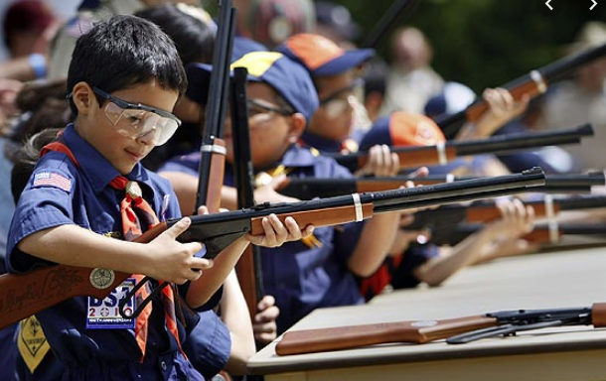
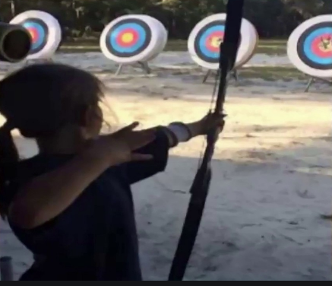
Shooting Sports
Requests for Shooting Events – Lead Time!
  50+ scouts - 6mos
  Less than 50 scouts - 3mos
Shooting on private land:
  Requirements
  Permissions/protocols
Shooting Sports web page
Shooting Sports Instructor Classes:
  Rifle/Shotgun
  Archery

Slide 34
Other Activities (for units, Dens/Patrols, or families)
June/July/Aug (Tues, 10am) – Kids on the Green, Vienna, VA
May 4, 2024 – 19th Annual Scout Orienteering Meet, Triangle, VA

Slide 35
Order of the Arrow
  2023 Dues can be paid online: https://wipit470.org/dues.html
  06/18/23 – 07/01/23 – GOAT
  July-Early August – Goshen Bus Loading
  08/16/23 – 08/18/23 – Summer Ordeal, Camp Snyder
  09/08/23 – 09/10/23 – Fall Fellowship, Goshen
  11/01/23 – Election Season Opens
  * Registrations open online https://wipit470.org/index.html under “Events”

Slide 36
Roundtable Survey

Slide 37
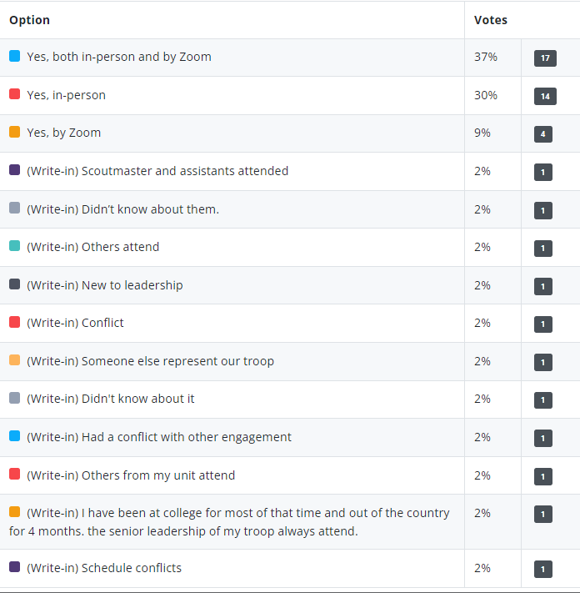
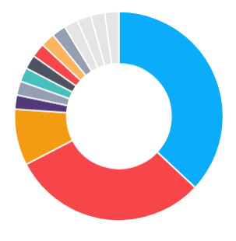
Have you attended a Roundtable?

Slide 38

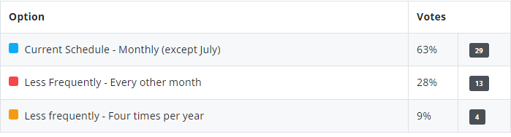
How many Roundtables should we have/year?

Slide 39

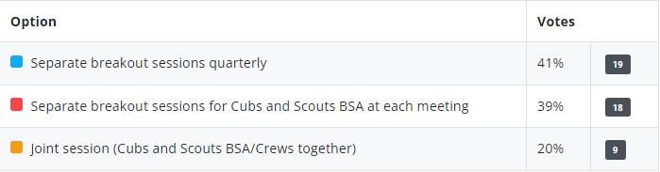
Breakouts for Cubs and Scouts BSA?

Slide 40
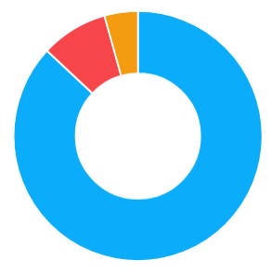
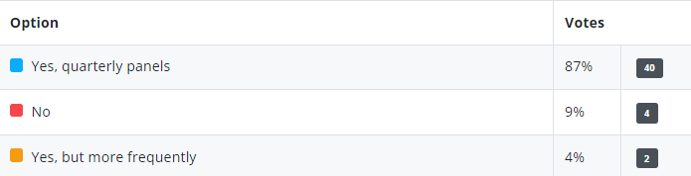
Should we have panel discussions?

Slide 41

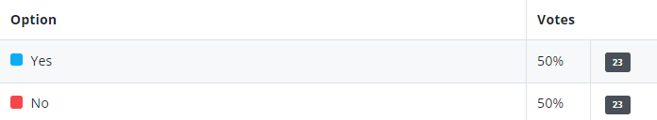
Willing to lead/participate in a discussion panel?

Slide 42

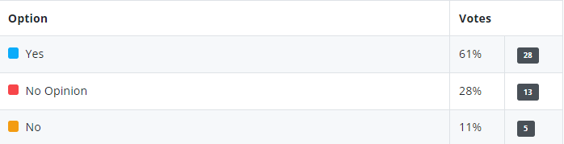
Should we set aside time for unit updates?

Slide 43
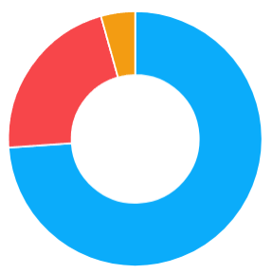
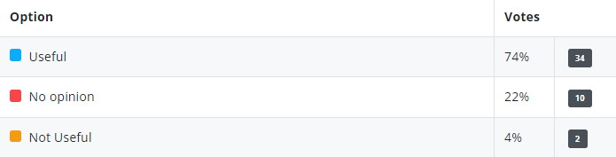
Upcoming community activities slide useful?

Slide 44

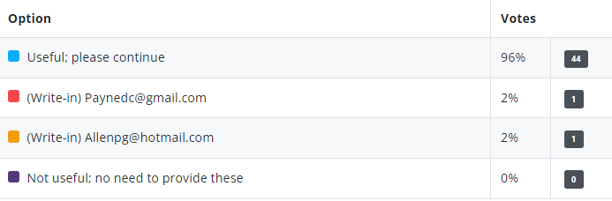
Having minutes/slides available useful?

Slide 45


Become a Roundtable Commissioner?

Slide 46

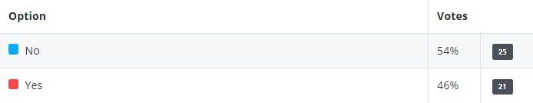
Willing to develop/present topic?

Slide 47

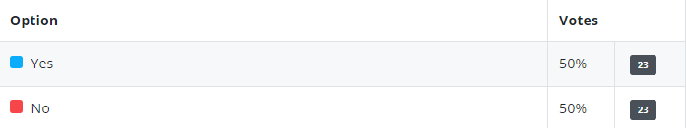
Bring someone from your unit and introduce?

Slide 48
Bring in outside speaker (quarterly)?
Developing Leadership/leadership stories
Success stories – fund raising, recruitment, volunteers, cub program
Effective communication and team building
In-unit youth training – we are all rebuilding after the pandemic
High adventure options
Unique opportunities for scouts, recruiting, fund raising, and training
Kids development
Outdoor/Camping activities and great sites/unique HA activities
Cub camping places and getting approval
Youth Mental Health courses available locally
Local organizations that have activities/programs/opportunities for scouts
Local experts in topics pertinent to scouting program (e.g., Conservation)
Adventures/inspiring service projects
Specific options to expand the scouting experience beyond NCAC
Programming that is not currently part of the unit planning
Discussions related to transition from Cubs to Scouts BSA
Discussions related to issues as scouts age through the program
Recruiting, membership and how to reach non-traditional youth
How to better publicize activities
STEM opportunities
Backpacking, paddle, climbing and biking locations; program support
Eagle Scout project opportunities and fund raising alternatives

Slide 49
Other Comments?
Make the Calendar items a pre-read or handout.
De-emphasize information transmission and focus on comradery
Periodic social event in lieu of standard meeting - Foster more networking
Panels on specific topics – clearly identify if Cubs, Scouts or both
Get more people involved with themes – e.g., advancement coordinator night
Move Scout Expo to a community location for exposure – e.g., Vienna Community Center on Saturday
Roundtable topics planned out for whole year – announce the schedule, type (e.g., panel)
Share best practices
Be more interactive
Stay on time
Thanks (several)
None

Slide 50
Other Topics
General Announcements
District Executive Minute
District Chair Minute
District Commissioner Minute
Minutes and slides available on the GMD web site (District Resources, Roundtable). Password is “GMDRT”
No meeting in July!
Next meeting – August 10, 2023, at Thoreau MS 7:30pm
  Join Scouting Night - Invite your Den Leaders and ASMs

