Slide 1
Discover Discovery
February 5, 2020
Michelle Eichelberger
www.suny.edu

Slide 2
Plan for Today
Top level overview
What’s the point of discovery, history of discovery
What it searches
What it doesn’t search
How it searches in Primo VE
Where fulfillment content comes from in Primo VE
www.suny.edu

Slide 3
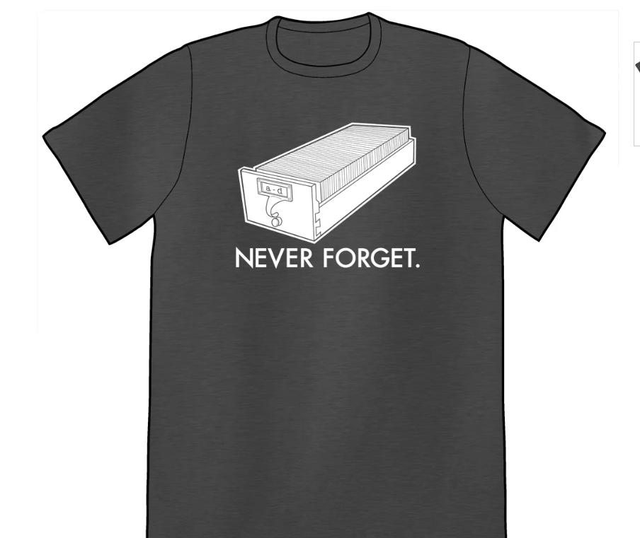
Discovery History
“The era of the card catalog lasted more than 150 years—OCLC printed its last catalog cards less than three years ago in 2015.” - Library discovery: past, present, and future, Abigail Wickes
Early attempts to combine the OPAC and stand-alone databases were clumsy and SLOW – had to do live searches in all collections. Metalib, anyone? Other example of early metasearch products: Central Search (later 360 Search) from Serials Solutions, MuseSearch from MuseGlobal, and WebFeat.
SUNY implemented EBSCO Discovery Service (EDS) in October 2014.
https://topatoco.com/collections/unshelved/products/uns-neverforget
www.suny.edu

Slide 4
Discovery in 2019
Marshall Breeding’s 2019 Library Systems Report, American Libraries, May 1, 2019:
“Discovery products continue to represent an important category, though one of somewhat diminished strategic value. During the initial phase of index-based discovery products beginning in 2009, these offerings were able to drive the direction of a library’s technology investments. Success in placing Primo, Summon, or EBSCO Discovery Service increased the likelihood that a library would eventually acquire other more strategic products from that vendor. Today the tables have turned.
Index-based discovery products are perceived as less differentiated from each other and of more modest strategic value. Each of the discovery services reasonably covers the body of scholarly and professional literature of interest to libraries. Important differences can be seen in interface features and retrieval algorithms. The current trend of product bundling translates into strong sales for Primo, riding on the coattails of Ex Libris’s Alma. But these products have not made a dent in the reality that most researchers rely on Google Scholar or disciplinary indexes more than library-provided discovery services. These products remain in the must-have category, with academic libraries almost universally featuring a single search box powered by one of these index-based discovery services on their websites.”
www.suny.edu

Slide 5
Discovery Products
Breeding’s 2019 Library Systems Report:
“Alma dominates new system selections in the academic and research sector, capturing almost all large libraries, multicampus systems, and consortia. In its shadow, OCLC’s WorldShare Management Services sees moderate success among midsized and smaller academic institutions. Last year Association of Research Libraries member McGill University selected WorldShare Management Services, interrupting the clean sweep of large libraries by Alma. Virginia Tech opted for Koha and Coral, reflecting some academic institutions’ interest in exploring alternatives.”
www.suny.edu

Slide 6
How Discovery Works
Like OPAC and stand-alone databases, discovery is dependent on vendors:
Original cataloging for all things isn't practical or sustainable
OCLC for “catalog” records, usually physical
Vendor electronic records for both search index and fulfillment
Search and fulfillment are only as good as the vendor/community records that are provided or selected by the library (OCLC). You’ll see the same kind of data errors that you see in stand-alone databases in Alma/Primo. Data is never perfect.
www.suny.edu

Slide 7
Physical Content
In Alma you’re either linking to a network record, exporting from OCLC, or creating your own record.
Network:
Records are added by other libraries via OCLC, acquisitions systems like GOBI, or original cataloging
Network Zone (NZ) Coordinator (Maggie McGee) makes sure that network export profiles are working, runs jobs to make sure data is as clean as we can get it, explores system issues like resource types and FRBR, etc.
Campus Export from OCLC:
https://slcny.libguides.com/training/technical-services-workflows
Maintain your own settings in Connexion web or client, can export into NZ or Institutional Zone (IZ)
Local Original Records:
Can create brief records for content that doesn’t need to be shared with SUNY or OCLC, e.g., reserve or circ desk material like laptops, calculators, etc.
www.suny.edu

Slide 8
Electronic Content
Alma uses a Community Zone, which is shared with all Alma customers, not just SUNY.
Benefits:
Single place to look for and activate electronic content
Content is updated for you – you don’t have to do it yourself (titles, urls, new additions to aggregator packages, etc.)
Drawbacks:
Overwhelming amount of content – can be hard to find your version of the package, includes local consortia collections, etc.
Dependent on vendor records, and delivery may be slow, so that you may order something that’s not in the CZ yet. Can add manually but have to remember to link to CZ later once it’s been added.
Records might not be as full as you’d like – missing subject headings, authors, etc.
www.suny.edu

Slide 9
What's not in Alma?
Repository Records like DSpace, or New York Heritage, unless you set up import profile
LibGuides content, unless you set up import profile
Site license type content like Chronicle of Higher Education or New York Times – both show as portfolios with indexing in various databases, but not the same experience as browsing the site
Sometimes have to wait for content to be added to the Community Zone – e.g. Films on Demand
www.suny.edu

Slide 10
Patron Discovery
How do patrons get access to the physical and electronic content that you’ve added to Alma?
Primo
Different “flavors” of Primo:
Primo: original discovery layer, uses “back office” to manage
Primo VE: current discovery layer, what SUNY uses
www.suny.edu

Slide 11
Patron Discovery: Search
What does Primo search?
Alma bib records, should be findable in unexpanded search in 10-30 minutes, includes both physical and electronic bibs
Primo Central Index (PCI):
Whatever you’ve activated for search, whether or not you subscribe to the database
Want to use free to search collections, not ones you have to subscribe to to search
Provides article and chapter level indexing – Alma bib record only has title of resource, authors, publication info, maybe subject headings, etc.
Takes up to 10 days for new activation or deactivation to take effect
Central Discovery Index (CDI) planned implementation for May 2020
www.suny.edu

Slide 12
Patron Discovery: Search, cont.
How does Primo search?
You control view, scopes, slots, etc. See SLSS Discovery Training Guide
Out of the box default search is “unexpanded,” meaning that all of the search results should be full-text or available
Have an “expand” box that patrons can use to widen search to non-full-text content
www.suny.edu

Slide 13
Patron Discovery: Search, Expanded vs. Unexpanded
Default “Unexpanded” searching:
Pros:
Easy for patrons to find full-text content
If they’re only going to look at first two pages, good to have content for them and not make them use resource sharing for things they might not really need
Cons:
Missing anything that’s not full-text – could be very important content, especially for higher level students
Previous systems and stand-alone databases default to expanded, give you everything, people are used to that model
For example, SUNY Geneseo prof looking for journal, was used to being able to see all articles and order whatever she needed, unexpanded search: no records found message
Dropping ILL numbers – may not notice “expand” option
www.suny.edu

Slide 14
Patron Discovery: Search, Expanded vs. Unexpanded
Change to default “Expand” searching:
Pros:
Patrons get ALL results and won’t miss anything
Provides immediate Resource Sharing request options
Good if patron is looking for something specifc
Cons:
Need to carefully curate PCI so that you don’t get too many results – useless if first two pages aren’t really good results
Can push your ILL numbers up *too* much – GCC example
CDI is going to give you way more results because of auto-searching of chapter/article level for everything, might be overwhelming for patrons
Expanded vs. Unexpanded needs to be local campus decision
www.suny.edu

Slide 15
Patron Discovery: Search, Availability
Expand vs. Unexpanded works based on availability. Available content will show in unexpanded search but how does system know what’s available?
Jobs:
Publishing to Primo Central – runs on Wednesday
Publishing electronic records to Central Discovery Index – runs on Wednesday
Takes until Sunday for changes to be fully implemented in Primo. Could take up to 10 days to see availability changes in Primo in terms of content starting or stopping in unexpanded search.
Submit Salesforce case if publishing isn’t accurate after 10 days – there have been problems.
www.suny.edu

Slide 16
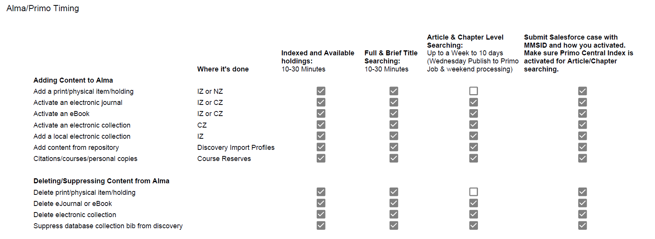
Patron Discovery: Search, Availability
www.suny.edu

Slide 17
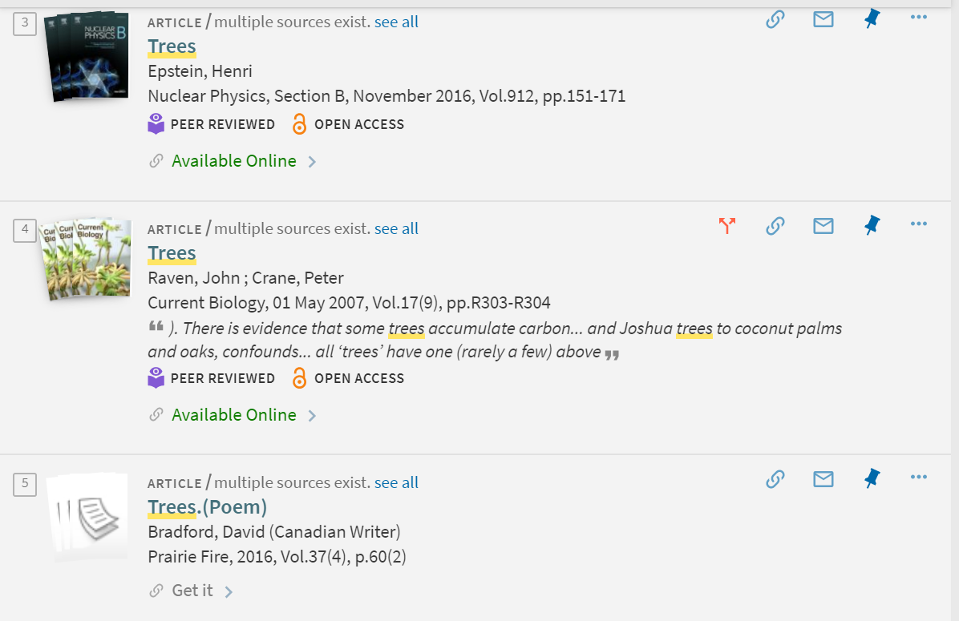
Patron Discovery: Live Look-up
Availability publishing is what makes a result show up in unexpanded vs. expanded searching but the live look-up is what tells you where to find the thing.
“View Online” section
Happens after you open the full record
Searches on ISBN or ISSN unless there isn’t one, may search on title
Can change the “available” or “check availability” notice – e.g. content has been added to Alma but availability publishing hasn’t run. Can only find content in expanded search, Primo thinks that it’s not available but when you open the full record and it finds a full-text link, available will change from unavailable to available. Still won’t appear in unexpanded search, though.
www.suny.edu

Slide 18
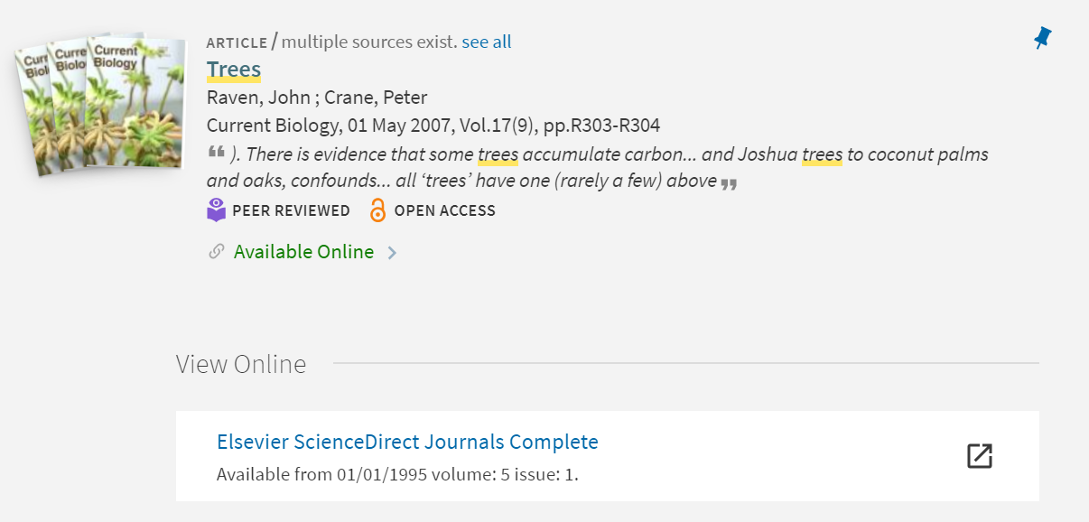
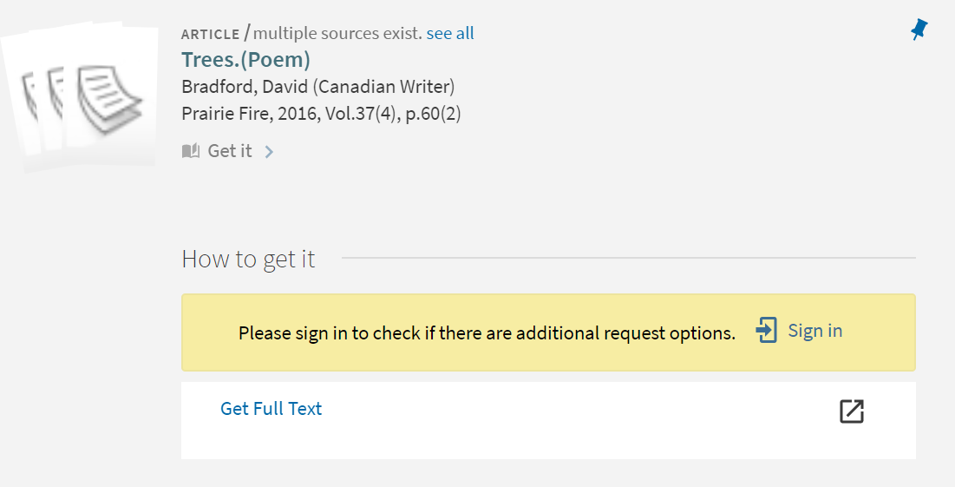
Patron Discovery: Live Look-up
Availability was accurate for these two records – “available online” and “get it” match the findings in the View Online and How to get it areas. Not always the case. Reports problems to Salesforce.
www.suny.edu

Slide 19
Questions?
References
SLSS Training Guides: https://slcny.libguides.com/lsptraining
Discovery Training Guide: https://slcny.libguides.com/training-primo-discovery
Community Zone Content List: https://knowledge.exlibrisgroup.com/Alma/Content_Corner/Supporting_Resources/Alma_Community_Zone_Collection_List
www.suny.edu

