Slide 1
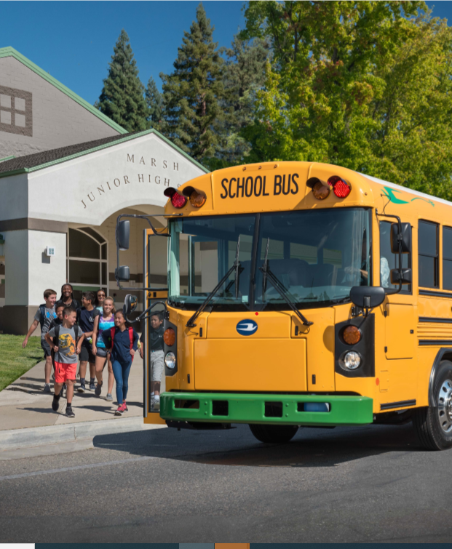



Durham School Services:
Municipal EV Readiness Program Module 2: Electric School Buses
Sept 24th, 2020

Slide 2

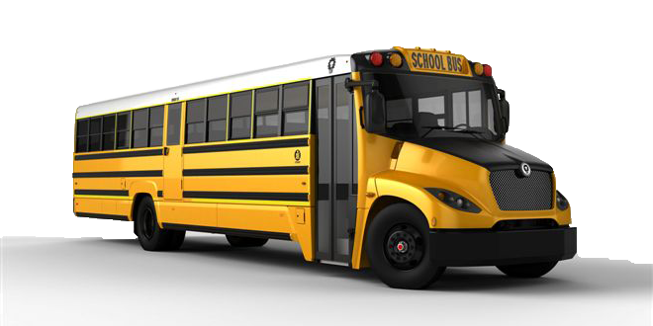
Lion Electric Bus Type C from our White Plains, NY location
Overview
The Story of Wallingford
Benefits of Electric School Buses
How Durham is Meeting the Challenge
Electric School Bus Conversion Process
White Plains virtual case study, Oct 2nd

Slide 3
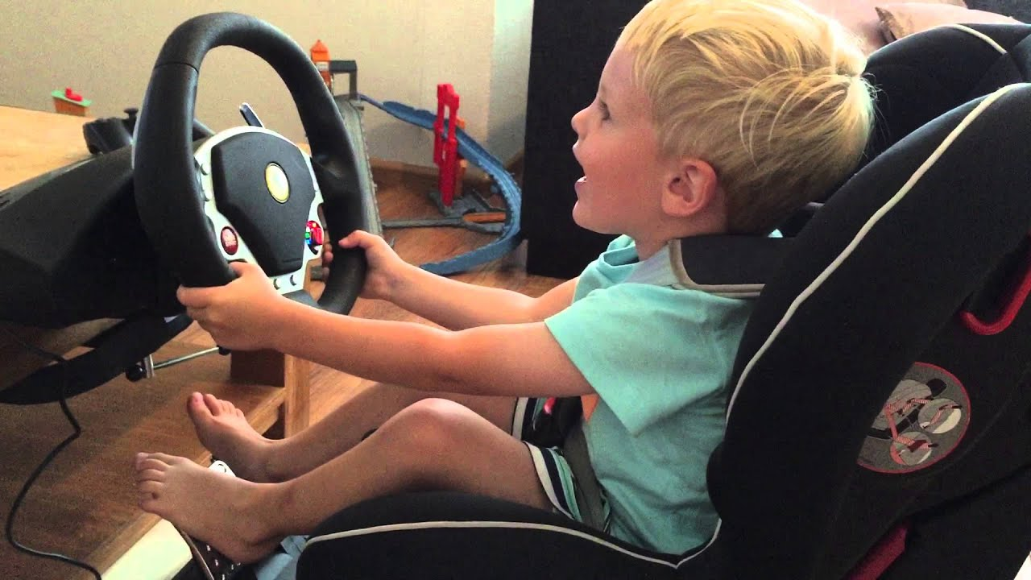
Electric School Bus Toolkit workshop
Wallingford Public Schools & Board of Education
students*, parents, civic groups, community
personal background
Wallingford Electric Division
Education, Advocacy
Durham
School Services
pandemic
Together, we can do this!
contract
CT air quality, emission reduction goals & grants
Municipal EV Readiness – Module 2: Electric School Buses LiveGreenCT, Durham School Services Adelheid Koepfer, Wallingford 9/24/2020

Slide 4

Benefits of
Electric School Buses
Positive environment for the community, students and drivers. No exhaust fumes, reduced noise pollution, better ride-ability, ease of operation, carbon-free depots and promote use of renewable energy generation.
Exceeds the demands of student transportation. Technology advancements in battery, design, and range have matured for full-scale deployment.
Superior vehicle performance. Quieter operation, smoother ride, and sophisticated diagnostics which provide real-time feedback to improve the operation and driving experience
Improved efficiencies and use of resources. EV buses have fewer moving parts, which means: less maintenance, less downtime, less hazardous waste with greater reliability, and a smaller fleet footprint requiring less space
Safety. Driver behavior systems, WIFI, GPS, collision mitigation, fewer road miles, and advanced telematics make the EV option safer than traditional route vehicles

Slide 5
Barriers to Success and
Durham’s Approach to Meeting the Challenge
High purchase price: today the purchase price for an electric school bus is 3-4x that of a traditional diesel bus
Complex infrastructure implementation: depot electrification—a primary challenge of electric vehicles—necessitates complex and carefully-planned infrastructure work across utilities, property owners, operators, fleet owners, school districts, government agencies and others to successfully equip a site to support EV fleet
Requires extensive, dedicated project management: EV requires a combination of the right partnerships with numerous suppliers and stakeholders, the right know-how with technical teams and operations insights, and the right fit to meet the specific needs for your district, all working in concert to deliver a sustainable, long-term solution
At Durham, we believe all communities deserve access to pollution-free, carbon-free, quality, reliable, best-in-value, zero-emission vehicles.
We will leverage grant programs, V2G and infrastructure, and our strategic partnerships with all major school bus providers to bring zero emission vehicles to our valued customers and their communities.
Our dedicated team of experts across school bus operations, fleet procurement, engineering and project management will take the lead from start to finish of your implementation, ensuring right fit, right price and right time – partnering with you every step of the way.

Slide 6

GETTING TO A PROPOSAL: 1-3 MOS.
DISCOVERY
PRICING & PARTNERS
PROPOSAL
As your partner, Durham School Services will take the lead in gathering key information to inform a comprehensive proposal. This includes requirements across fleet, routes and infrastructure, and applying for available grants (e.g. VW grant) to ensure you’re enabled to leverage all funds available for electric school bus conversion.
As part of our proposal, Durham will identify strategic partners for pricing and implementation. Our goal is to ensure our customers get the best pricing and products available.
Durham will deliver a comprehensive proposal to your District for review and alignment before making any commitments. This proposal will include transparency of pricing and partners, timing and expected outcomes.
ELECTRIC SCHOOL BUS ROADMAP
INTEGRATION AND DELIVERY: 6-8 MOS.
FLEET PROCUREMENT
DEPOT ELECTRIFICATION
ON-GOING SUPPORT
After proposal alignment, Durham will move forward with securing the electric fleet with the provider on behalf of the District. Our procurement team will ensure all necessary requirements are met on-time and on-budget.
Durham’s infrastructure team is dedicated to ensure all steps of this process are delivered according to plan, including: design, permitting, build, and integration. We will work with all stakeholders to ensure implementation meets expectations.
Durham is committed to excellence throughout the entire process, including driver training, maintenance of vehicles, infrastructure and charging support.

Slide 7







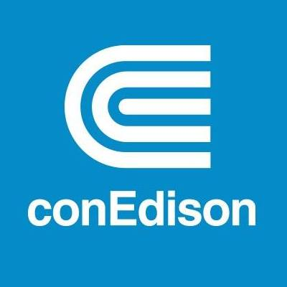
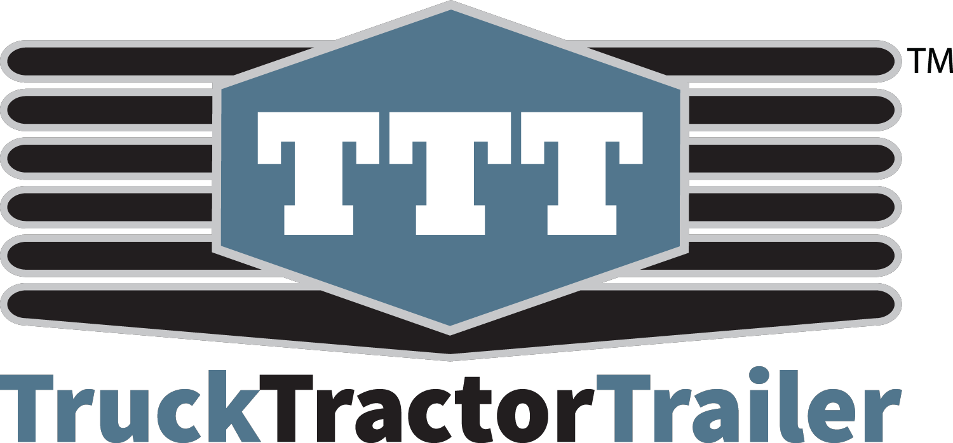
White Plains City School District, NY
Virtual Case Study, Oct 2nd, 11-12PM
White Plains City School District made history as it rolled out the first all-electric school buses in the state of New York.
Strategic Partners:
Notes:
#8, White Plains - (but that might be a pre-made block?) “How do ESB work”, second bullet: “also used to recharge -????”; 3rd point: “reduce…from 4-6 hours”?
#8 “Benefits”: 1st point “Lower cost” - “than ay combustion engineS school buses”; 2nd bullet “than combustion engine vehicles of same category” (swap?)
#8 “Benefits” - healthier: don’t forget the drivers :) they spend a lot more time in there than students

Slide 8
Want to learn more about
how Durham can help you?
Contact:
Maggie Clancy
Director of EV Customer Engagement
Durham School Services
Maggie.Clancy@nellc.com
M. 773-484-8060

Slide 9
Appendix

Slide 10
Why It Matters to Connecticut
CONNECTICUT’S
AIR QUALITY CHALLENGE
ROLE OF DIESEL VEHICLES
STUDENT HEALTH IMPACT
Diesel-powered vehicles account for nearly half of all NOx and over two-thirds of all particulate matter emissions from US transportation sources.
Diesel exhaust contains as many as 40 hazardous air pollutants as defined by the Clean Air Act.
Children are exposed to airborne particulate concentrations inside buses that are sometimes 5-15 times higher than background levels (Yale University, 2002).
Riding a diesel bus everyday can increase a child’s risk for cancer by 4%, lower symptoms of respiratory tract by 6%, and daily asthma hospitalizations by 1% (California Air Resources Board, 2016).
Students who rode electric school buses saw a 6% increase in test scores and a 4.3% increase in overall lung health (Georgia State University, 2019).
The state of Connecticut fails to meet federal health-based standards for ground-level ozone (smog) (CT DEEP).
In 2019 Connecticut experienced 21 days when monitored air quality levels exceeded health-based standards, resulting in significantly more poor air quality days than any other jurisdiction on the East Coast.(CT DEEP)

Slide 11

Connecticut’s Commitment to
Electric School Buses—Taking the Lead
On July 14, 2020, Connecticut joined 14 other states and the District of Columbia in signing an Memorandum of Understanding (MOU) to work collaboratively to advance and accelerate the market for electric medium- and heavy-duty vehicles.
  Under the MOU, signatory states will work toward ensuring that 100% of all new medium- and heavy-duty vehicle sales be zero emission vehicles (ZEVs) by 2050 with an interim target of 30% ZEV sales by 2030. The vehicles included in the MOU include large pickup trucks and vans, delivery trucks, box trucks, school and transit buses, and long-haul delivery trucks.
As a result of the Volkswagen settlement, Connecticut is eligible to administer over $55 million to mitigate excess diesel emissions caused by VW's actions. Grant programs cover a range of heavy duty mobile source projects. In addition, funds will be used to bolster Connecticut's light duty electric vehicle infrastructure. To date, little has be utilized for electric school buses.
Connecticut Public Schools are positioned to take advantage of grant funding now, while it is available, and to start the conversion to zero emission vehicles
Source: https://portal.ct.gov/DEEP/Air/Mobile-Sources/EVConnecticut/EVConnecticut---CTs-EV-Commitment

