Slide 1
The National Initiative for Cybersecurity Education (NICE) NICE K-12 Cybersecurity Education Conference December 5, 2017
Bill Newhouse, Deputy Director of NICE
Applied Cybersecurity Division, Information Technology Laboratory, National Institute of Standards and Technology (NIST)

Slide 2
NICE Strategic Goals
Accelerate Learning and Skills Development
Inspire a sense of urgency in both the public and private sectors to address the shortage of skilled cybersecurity workers
Nurture A Diverse Learning Community
Strengthen education and training across the ecosystem to emphasize learning, measure outcomes, and diversify the cybersecurity workforce
Guide Career Development & Workforce Planning
Support employers to address market demands and enhance recruitment, hiring, development, and retention of cybersecurity talent
https://nist.gov/nice
2
Notes:
Objectives:
Stimulate the development of approaches and techniques that can more rapidly increase the supply of qualified cybersecurity workers
Advance programs that reduce the time and cost for obtaining knowledge, skills, and abilities for in-demand work role
Engage displaced workers or underemployed individuals who are available and motivated to assume cybersecurity work roles
Experiment with the use of apprenticeships and cooperative education programs to provide an immediate workforce that can earn a salary while they learn the necessary skills
Promote efforts to identify gaps in cybersecurity skills and raise awareness of training that addresses identified workforce needs

Slide 3
NICE Strategic Goal #3: Guide Career Development and Workforce Planning
Support employers to address market demands and enhance recruitment, hiring, development, and retention of cybersecurity talent
Objectives:
3.1 Identify and analyze data sources that support projecting present and future demand and supply of qualified cybersecurity workers
3.2 Publish and raise awareness of the NICE Cybersecurity Workforce Framework and encourage adoption
3.3 Facilitate state and regional consortia to identify cybersecurity pathways addressing local workforce needs
3.4 Promote tools that assist human resource professionals and hiring managers with recruitment, hiring, development, and retention of cybersecurity professionals
3.5 Collaborate internationally to share best practices in cybersecurity career development and workforce planning
NICE Framework - https://go.usa.gov/xnXsh

Slide 4
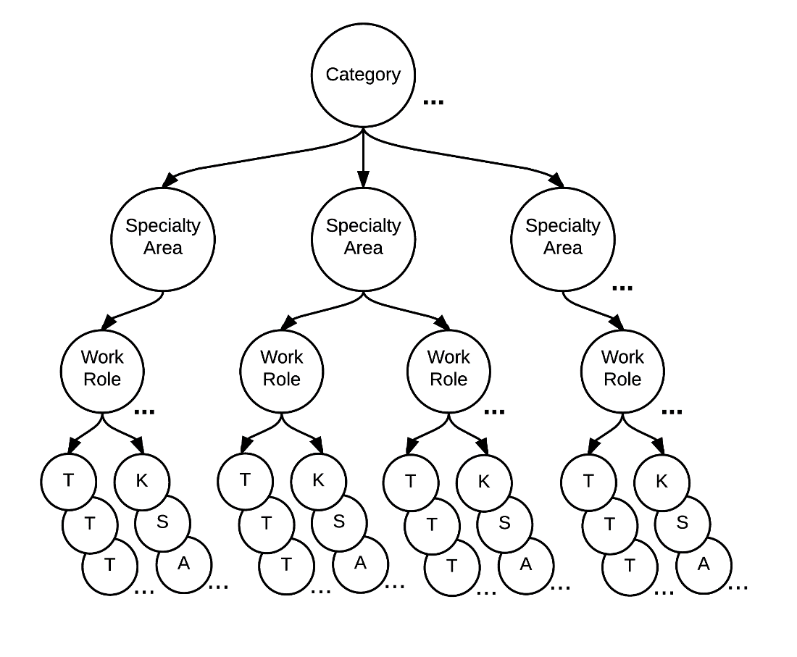
NICE Framework – NIST Special Publication 800-181
Categories of Cybersecurity Work
SECURELY
PROVISION
OPERATE
AND
MAINTAIN
OVERSEE
AND
GOVERN
PROTECT
AND
DEFEND
ANALYZE
COLLECT
AND
OPERATE
INVESTIGATE
Specialty Areas (33) – Distinct areas of cybersecurity work;
Work Roles (52) – The most detailed groupings of IT, cybersecurity or cyber-related work, which include specific knowledge, skills, and abilities required to perform a set of tasks.
Tasks – Specific work activities that could be assigned to a professional working in one of the NCWF’s Work Roles; and,
Knowledge, Skills, and Abilities (KSAs) – Attributes required to perform Tasks, generally demonstrated through relevant experience or performance-based education and training.
Audience:
Employers
Current and Future Cybersecurity Workers
Training and Certification Providers
Education Providers
Technology Providers
Notes:
Let’s talk more about what the Workforce Framework is:
The National Cybersecurity Workforce Framework (Workforce Framework) is a national resource that categorizes, organizes, and describes cybersecurity work.
It provide educators, students, employers, employees, training providers and policy makers with a national standard for organizing the way we define and talk about cybersecurity work, and what is required to do that work.
It identifies the tasks (or activities) performed to carry out cybersecurity work across over 30 Specialty Areas, as well as the requisite knowledge skills, and abilities.
As more organizations align their workforce development efforts the Workforce Framework, our Nation will have a more standardized cybersecurity workforce that more effectively secures our networks.

Slide 5
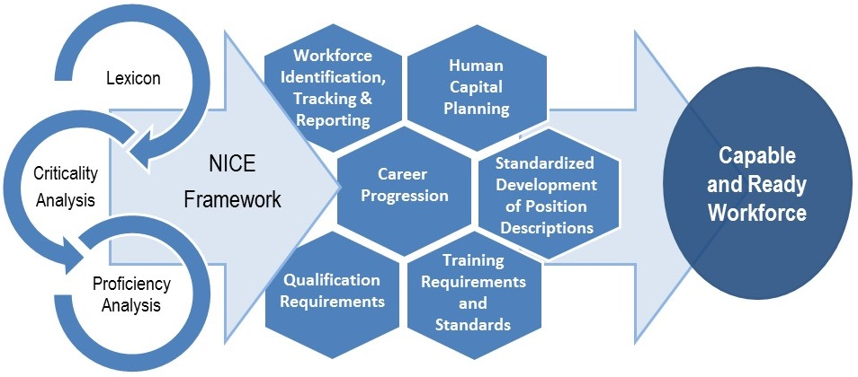
Building Blocks for a Capable and Ready Cybersecurity Workforce

Slide 6
Securely Provision (7 Specialty Areas, 11 Work Roles)
 | Category | Specialty Area | Work Role
 | Securely Provision | Risk Management | Authorizing Official/Designating Representative
 |  |  | Security Control Assessor
 |  | Software Development | Software Developer
 |  |  | Secure Software Assessor
 |  | Systems Architecture | Enterprise Architect
 |  |  | Security Architect
 |  | Technology R&D | Research & Development Specialist
 |  | Systems Requirements Planning | Systems Requirements Planner
 |  | Test and Evaluation | Testing and Evaluation Specialist
 |  | Systems Development | Information Systems Security Developer
 |  |  | Systems Developer

Slide 7
Operate and Maintain (6 Specialty Areas, 7 Work Roles)
 | Category | Specialty Area | Work Role
 | Operate and Maintain | Data Administration | Database Administrator
 |  |  | Data Analyst
 |  | Knowledge Management | Knowledge Manager
 |  | Customer Service and Technical Support | Technical Support Specialist
 |  | Network Services | Network Operations Specialist
 |  | Systems Administration | System Administrator
 |  | Systems Analysis | Systems Security Analyst

Slide 8
Oversee and Govern (6 Specialty Areas, 14 Work Roles)
 | Category | Specialty Area | Work Role
 | Oversee and Govern | Legal Advice and Advocacy | Cyber Legal Advisor
 |  |  | Privacy Officer/Compliance Manager
 |  | Training, Education, and Awareness | Cyber Instructional Curriculum Developer
 |  |  | Cyber Instructor
 |  | Cybersecurity Management | Information Systems Security Manager
 |  |  | Communication Security Manager
 |  | Strategic Planning and Policy | Cyber Workforce Developer and Manager
 |  |  | Cyber Policy and Strategy Planner
 |  | Executive Cyber Leadership | Executive Cyber Leadership
 |  | Program/Project Management and Acquisition | Program Manager
 |  |  | IT Project Manager
 |  |  | Product Support Manager
 |  |  | IT Investment/Portfolio Manager
 |  |  | IT Program Auditor

Slide 9
Protect and Defend (4 Specialty Areas, 4 Work Roles)
 | Category | Specialty Area | Work Role
 | Protect and Defend | Cyber Defense Analysis | Cyber Defense Analyst
 |  | Cyber Defense Infrastructure Support | Cyber Defense Infrastructure Support Specialist
 |  | Incident Response | Cyber Defense Incident Responder
 |  | Vulnerability Assessment and Management | Vulnerability Assessment Analyst

Slide 10
Analyze (5 Specialty Areas, 7 Work Roles)
 | Category | Specialty Area | Work Role
 | Analyze | Threat Analysis | Threat/Warning Analyst
 |  | Exploitation Analysis | Exploitation Analyst
 |  | All-Source Analysis | All-Source Analyst
 |  |  | Mission Assessment Specialist
 |  | Targets | Target Developer
 |  |  | Target Network Analyst
 |  | Language Analysis | Multi-Disciplined Language Analyst

Slide 11
Operate and Collect (3 Specialty Areas, 6 Work Roles)
 | Category | Specialty Area | Work Role
 | Collect and Operate | Collection Operations | All Source-Collection Manager
 |  |  | All Source-Collection Requirements Manager
 |  | Cyber Operational Planning | Cyber Intel Planner
 |  |  | Cyber Ops Planner
 |  |  | Partner Integration Planner
 |  | Cyber Operations | Cyber Operator

Slide 12
Investigate (2 Specialty Areas, 3 Work Roles)
 | Category | Specialty Area | Work Role
 | Investigate | Cyber Investigation | Cyber Crime Investigator
 |  | Digital Forensics | Law Enforcement/Counterintelligence Forensics Analyst
 |  |  | Cyber Defense Forensics Analyst

