Slide 1

The State University of New York
LibKey Link
and
January 21, 2021
Yvonne Kester
Yvonne.kester@suny.edu
LibKey.io
www.suny.edu
Presented by John Lenny

Slide 2


In a Nutshell…
LibKey Link: What Is It?
LibKey.io: What Is It?
LibKey Link is a link-resolver accelerator that provides more efficient access to electronic resources
Capable of using two modes: PDF Express and Format Chooser, but Format Chooser is the default mode
For LibKey Link to work, the requested article must:
  Be requested via an OpenURL that contains either a valid Digital Object Identifier (DOI) or PubMed reference number (PMID), and
  Be available from a subscribed source held by the library (or be an OA article), and
  Be in a journal that is supported by LibKey
LibKey.io is a website that provides direct access to the article resolution technology used by LibKey Link to researchers, librarians, and interlibrary loan staff
Users choose an institution affiliation (e.g., SUNY New Paltz) and LibKey.io will remember it
Once a user is affiliated, they can search DOIs and PMIDs directly through the LibKey.io interface and access content if it’s available through their institution
Uses two link syntaxes:
  WAYFless: Recommended for linking to LibKey.io from library webpage or Databases A-Z
  Universal: Recommended for authors posting links to their work on social media, CVs, etc.
www.suny.edu

Slide 3
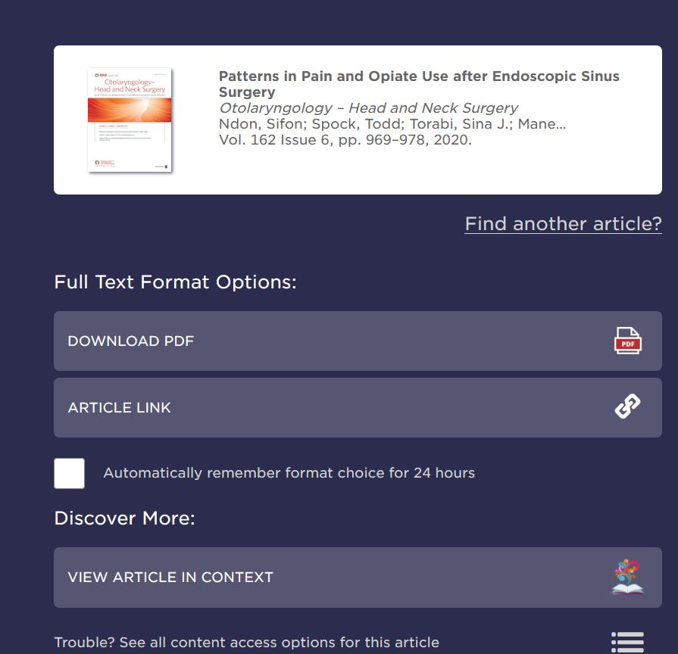
LibKey Link: Format Chooser versus PDF Express
Format Chooser is the default setup for LibKey Link, and provides multiple format options when available, as well as the option to view the article context through BrowZine
Download PDF provides only the PDF, which most users may prefer
Article Link takes the user to the article within the publication, which some users may prefer if they are looking for additional supplements, data sets, cited references, or other materials that are available on the publisher site but not in the PDF
Users may check “Automatically remember format choice for 24 hours,” and they will not need to choose format again in that browser for 24 hours, which can mean one-click access during that time
View Article in Context will take the user to the article on the journal site, showing it in the context of that issue with all other articles and providing access to other volumes/issues of that journal
www.suny.edu

Slide 4
LibKey Link: Format Chooser versus PDF Express
PDF Express can be set up instead of Format Chooser, but only if you are sure all your users will always prefer a PDF
User never sees any LibKey interface and, if a PDF is available, routing will instantly take them to it
If no PDF is available, the request is forwarded to the campus’s link resolver
www.suny.edu

Slide 5
LibKey Link: Format Chooser vs. PDF Express: Unpaywall Data
Format Chooser
PDF Express
LibKey connects to Unpaywall automatically if no LibKey links can be found
Connection to Unpaywall happens only after exhausting Library holdings and Gold OA journals
If article is not found in Unpaywall, LibKey will forward to the campus’s link resolver
Automatic preferences selected within the past 24 hours will not apply to Unpaywall
PDF Express does not consult Unpaywall if no PDF is available, but falls back on the campus’s link resolver
www.suny.edu

Slide 6
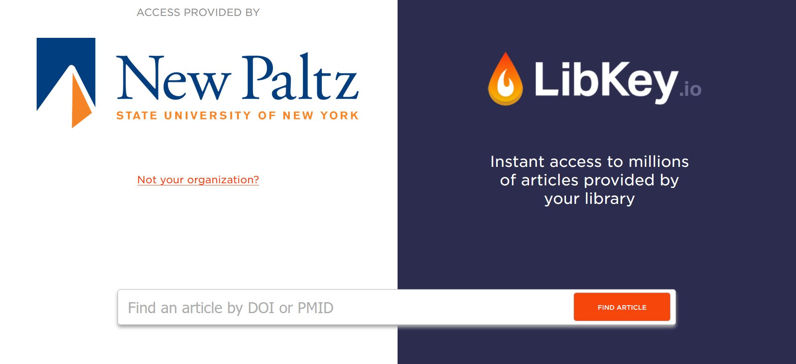
LibKey.io
www.suny.edu

Slide 7
LibKey.io: Link Syntax
LibKey.io Home Page
WAYFless Linking
Universal Linking
https://libkey.io
Easy to remember and direct users to, and they can self-affiliate if they have not accessed LibKey links before
https://libkey.io/libraries/{LibraryID}
Recommended for linking to LibKey.io from the Library home page or Databases A-Z list
Will automatically affiliate user with your institution
Can be bookmarked for ILL, to quickly check availability of articles if DOI is present in request
Your library ID is in the original welcome email from ThirdIron, or you can ask me
https://libkey.io/{DOI or PMID}
Guides users from different institutions to the same article even though they may have different sources/different authentication mechanisms
Recommended for posting scholarly articles in social media, faculty CV pages, etc.*
www.suny.edu
Notes:
*Note from ThirdIron: “If the user is one of more than 10 million researchers in 30+ countries around the world with a subscription to LibKey, they will be able to fully use their organization's access to get to full text. If their organization is not a subscriber, LibKey still builds in knowledge of open access alternatives so that a potential route to submitted manuscripts can be provided. Additionally a doi.org resolved link is ﻿also﻿ provided in case the user has a mechanism to gain access external to the LibKey route (Federated Access, VPN, etc.).”

Slide 8
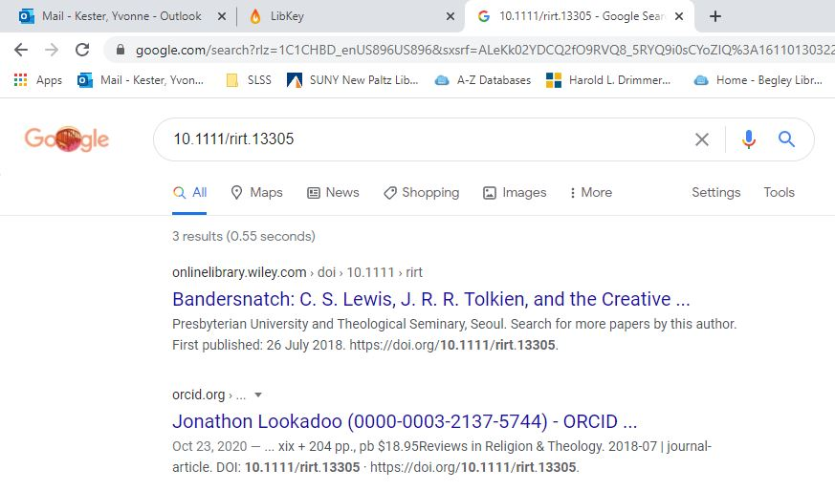
LibKey.io: The Experience
Google search result for a DOI alone brings article up in a search.
www.suny.edu

Slide 9
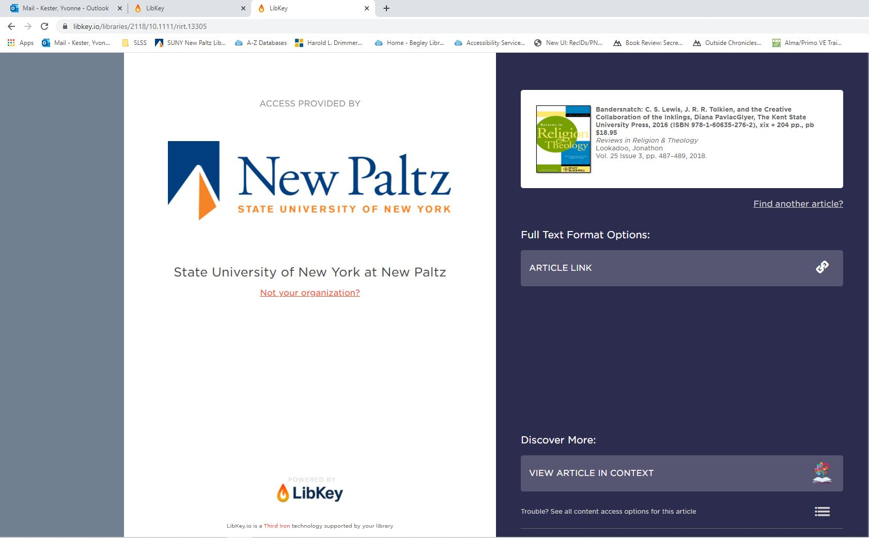
LibKey.io: The Experience
Using the WAYFless link syntax, the affiliated user is brought to the LibKey Link Format Chooser, where they can access the article.
www.suny.edu

Slide 10
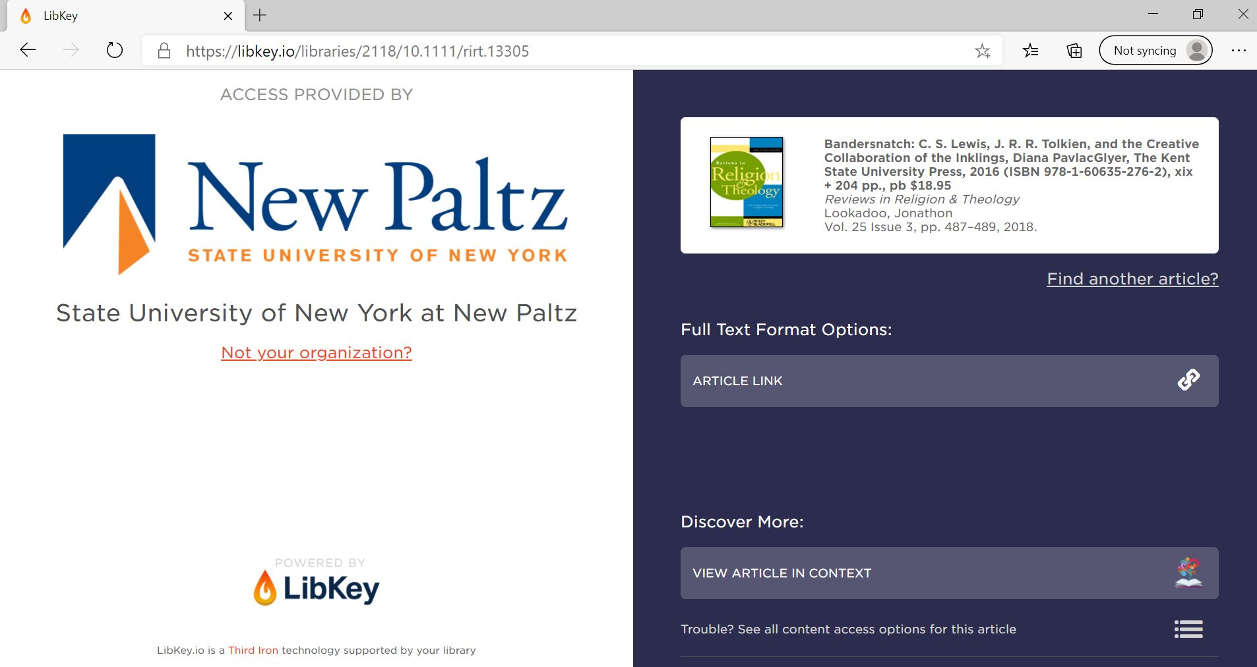
LibKey.io: The Experience
Using the Universal link syntax, the affiliated user is brought to the LibKey Link Format Chooser, where they can access the article.
www.suny.edu

Slide 11
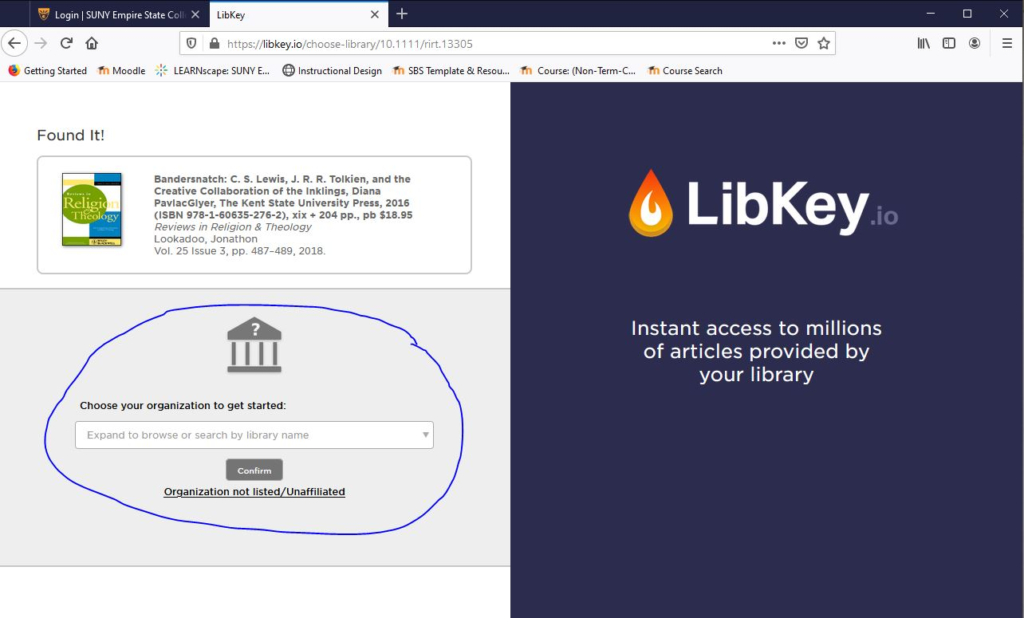
LibKey.io: The Experience
Using the Universal link syntax, the unaffiliated user is brought to the LibKey.io home page, where they can choose their affiliation.
www.suny.edu

Slide 12
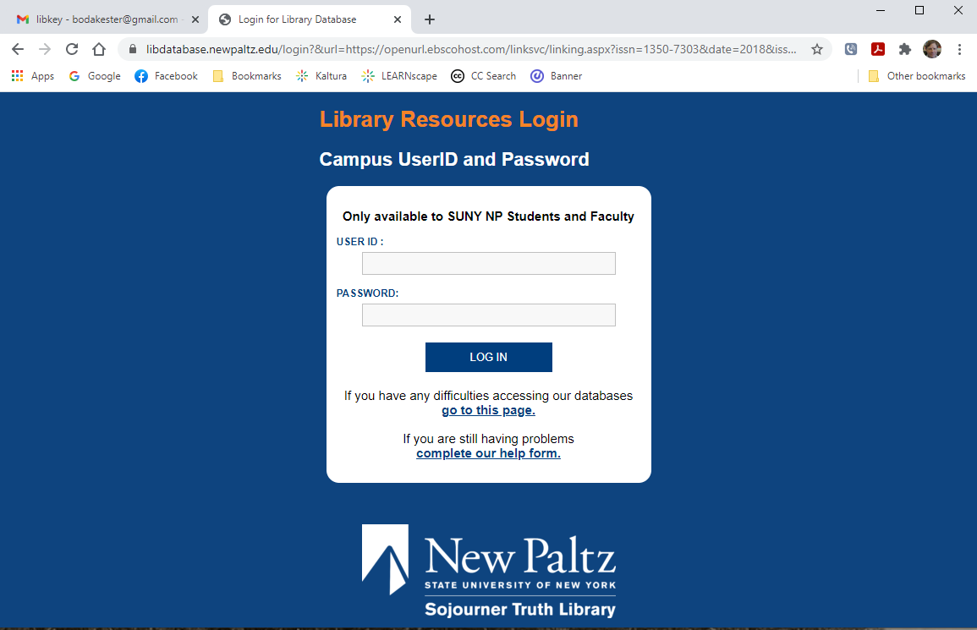
LibKey.io: The Experience
In all cases, once a user is affiliated and tries to access the article, they will be prompted to authenticate.
www.suny.edu

Slide 13
Setting It Up: Workflow
Fill out this form
  You will need your BrowZine Library ID from the ThirdIron welcome email you received last year
  Link Resolver base URL syntax is:
  https://suny-xxx.primo.exlibrisgroup.com/openurl/01SUNY_XXX/01SUNY_XXX:01SUNY_XXX
Remember that the default setup is for Format Chooser, so if you want PDF Express be sure to say so in the “Additional Questions and Comments”
You will receive an email from ThirdIron containing your LibKey Link URL, which looks like this:
https://libkey.io/libraries/{Library ID}/openurl
Use the LibKey Link URL to replace your Link Resolver Base URL
www.suny.edu

Slide 14
Setting It Up Example: Google Scholar
In Alma, go to Resources > Publishing > Publishing Profiles
Select Edit from the ellipsis menu next to the “Publish electronic records to Google Scholar” profile
Under Registration Parameters, enter your LibKey Link URL in the OpenURL base field
Save
www.suny.edu

Slide 15
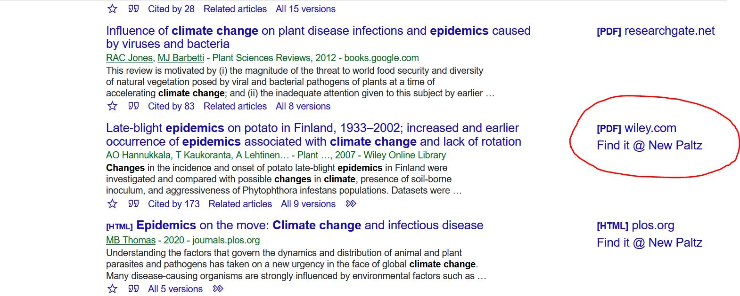
Setting It Up Example: Google Scholar
www.suny.edu

Slide 16
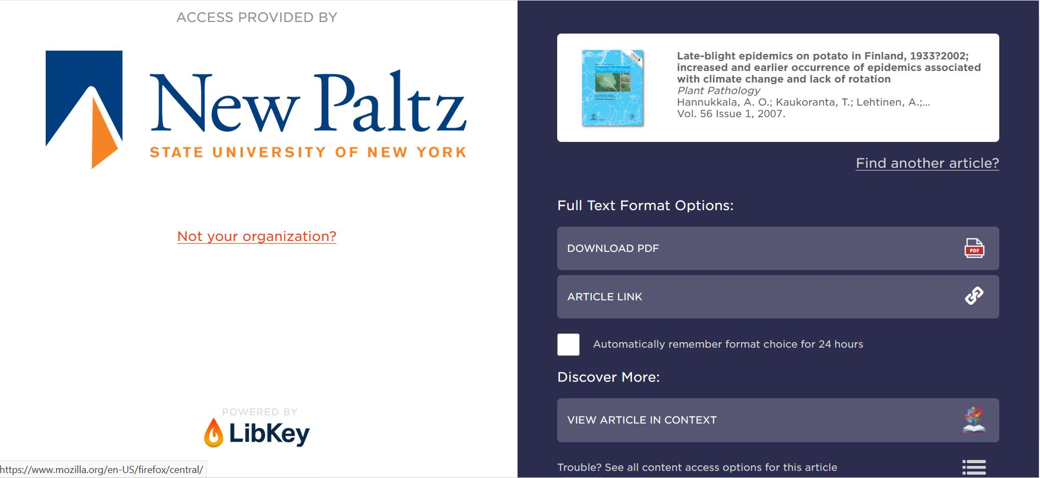
Setting It Up Example: Google Scholar
www.suny.edu

Slide 17
Setting It Up Example: ScienceDirect
You will need access to the Elsevier Admin Tool
On the Admin Tool home page, click on ScienceDirect
Under Linking, click Link resolvers
Under Available Link Resolvers, check to see if any are Enabled
If any Link Resolver other than OpenURL-OpenResolver-Standard is enabled, open it and disable it, Save.
Click on OpenURL-OpenResolver-Standard, enable it, and paste your LibKey Link URL in the Link Resolver base URL field
Save
It takes *15 days* for these changes to take effect
www.suny.edu
Notes:
(Elsevier mistakenly enabled the OpenURL-ArticleLinker-Standard for New Paltz, and we kept getting an error saying we weren’t a Serials Solutions client)

Slide 18
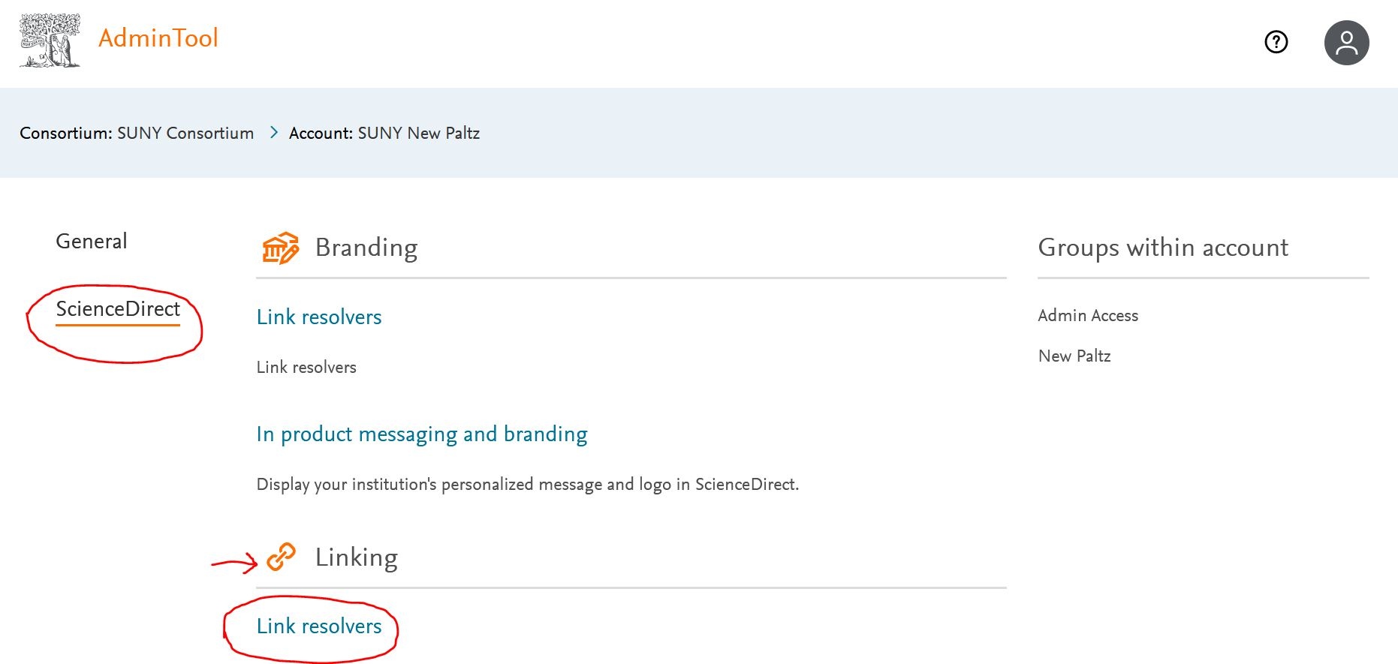
Setting It Up Example: ScienceDirect
www.suny.edu

Slide 19
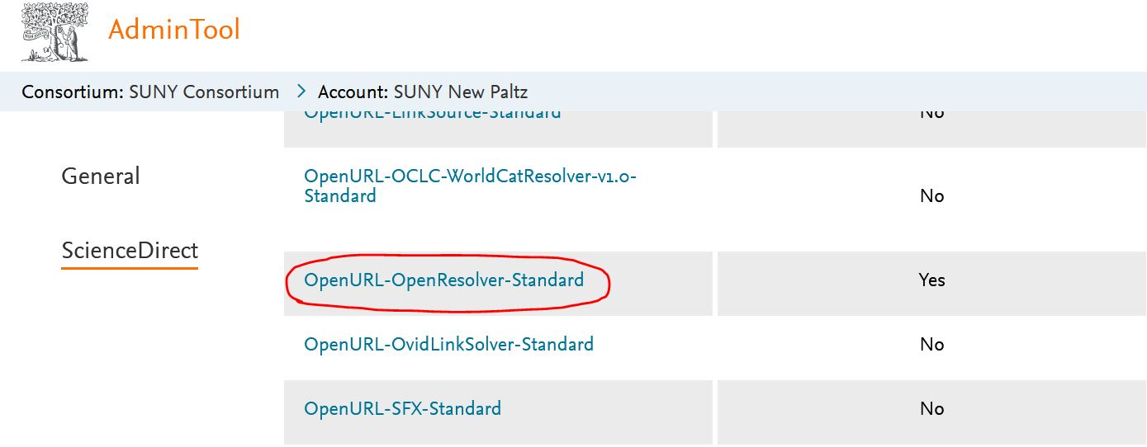
Setting It Up Example: ScienceDirect
www.suny.edu

Slide 20
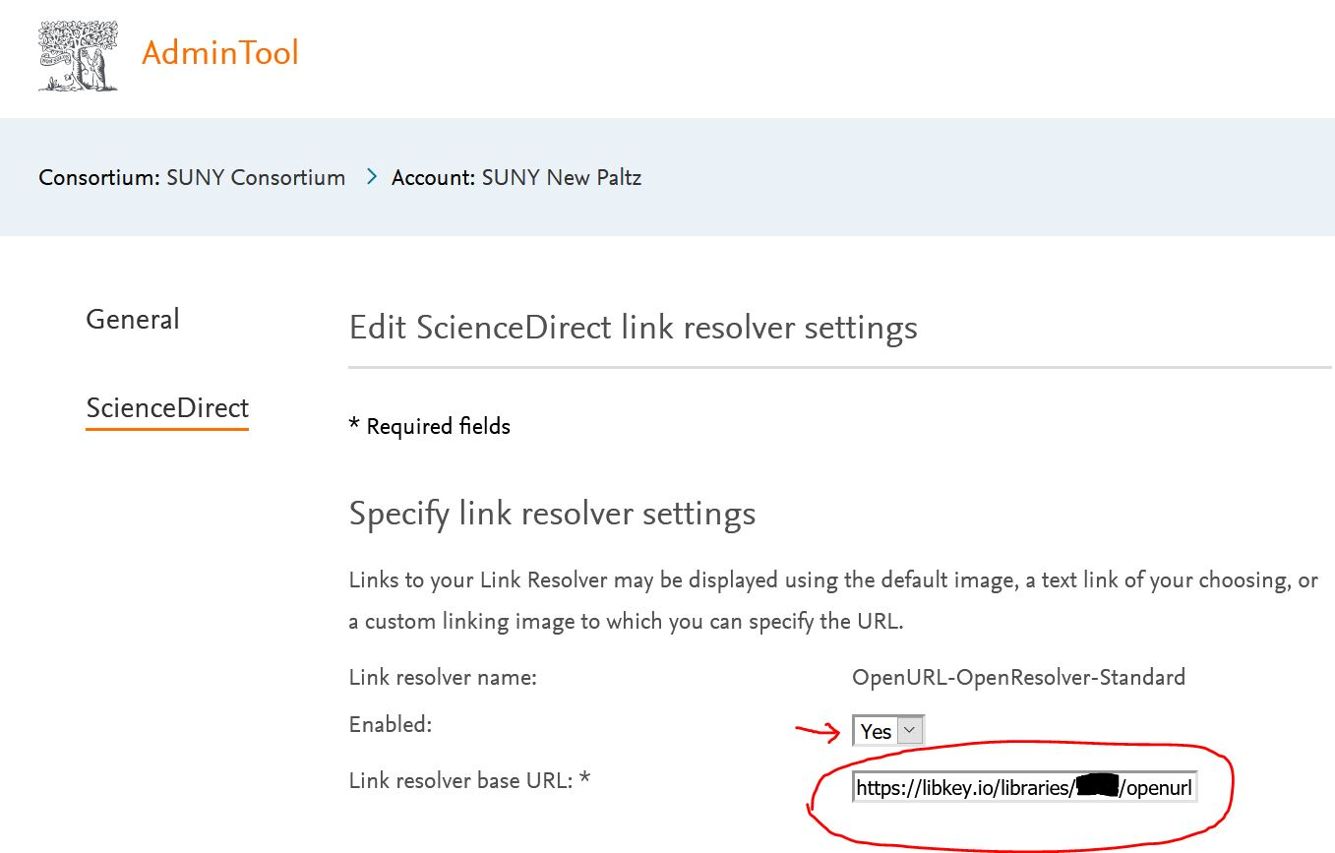
Setting It Up Example: ScienceDirect
www.suny.edu

Slide 21
Helpful Links
Sign up for LibKey Link and LibKey.io
LibKey Link 2.0 Technical FAQ
LibKey.io Technical FAQ
LibKey Link in Common Databases
Supported Publishers
www.suny.edu

Slide 22
The State University of New York
Questions? Comments?
Thank you!
www.suny.edu

