Slide 1
Welcome to (add institution name)
Notes:
Welcome learners to your Go Visit final session at (add name of the institution) of the Think and Go Higher Programme, well done on getting this far.
Explain that we will start with introductions and then explain more about this session and how it fits with the previous 5 sessions they’ve done.

Slide 2
Ice Cream Enterprise Challenge

Slide 3
Who are we?
OO Name
Go Higher West Yorkshire Outreach Officer
Institution Name
OO Name
Go Higher West Yorkshire Outreach Officer
Institution Name
Notes:
OO – Introduce yourself and your institution, as well as what course you studied at university.
Note: Slides 1-8 are introductory slides, which should be completed within the first 15 minutes of the session

Slide 4
Who are we?
SA Name
Course
Institution Name
SA Name
Course
Institution Name
SA Name
Course
Institution Name
Notes:
SA – Introduce yourself, the institution you study at and your course.

Slide 5
What is Think and Go Higher?
Session 1: Go Connect
Connecting knowledge
Making justifications
Explaining your decisions
Session 4: Go Collaborate
Working as a team
Using critical thinking and debating skills in a group setting.
Session 5: Go Present
Do’s and don’ts of presenting
Top 5 presenting tips
Practicing presentation skills
Session 2: Go Analyse
Critical thinking
Asking interrogating questions
Session 3: Go Debate
Do’s and don’ts of debating
Forming an argument
Practicing your debating skills
Session 6: Go Visit
Experience Higher Education
Take on the Ice Cream Challenge
Use skills from the last 5 sessions
Notes:
Outline the project in weeks, the objectives of each session and the campus visit at the end.
Take time to speak about why these skills we will cover will be useful and highlight various slides will have top tips included on them.
Highlight each session and how all the sessions will build up to the campus visit (session 6).
Encourage the use of the SA each session.
Bullet points on the slides provide detail for each session, go through these in order.
Mention that there is a prize at the end of this session for the winning group (£10 voucher per student in winning group)

Slide 6
The Brief
In groups you need to create an new ice-cream product
Your task is to create an ice-cream product for a particular target audience.
As a group, you will decide on the ingredients, cost and design of your ice-cream, as well as a marketing plan.
At the end of the session, you must be ready to pitch your idea to the dragons who will only invest their time in the best ideas!
You do not have long so teamwork is crucial!
Notes:
Share the brief with students

Slide 7
What skills do you need to succeed?
What skills have you practiced over the last 5 sessions and how will they help you to succeed in this task?
Session 1: Go Connect
Connecting knowledge
Making justifications
Explaining your decisions
Session 2: Go Analyse
Critical thinking
Asking interrogating questions
Session 3: Go Debate
Do’s and don’ts of debating
Forming an argument
Practicing your debating skills
Session 4: Go Collaborate
Working as a team
Using critical thinking and debating skills in a group setting.
Session 5: Go Present
Do’s and don’ts of presenting
Top 5 presenting tips
Practicing presentation skills
Session 6: Go Visit
Experience Higher Education
Take on the Ice Cream Challenge
Use skills from the last 5 sessions
Spend a few minutes discussing this with the people on your table.
Notes:
Ask students to identify how the skills they have practiced in sessions 1-5 will be able to help them in this challenge.
Give students a few minutes to discuss on their tables.
After the time is up, ask students to feed back by giving one point per session.

Slide 8
How we decide on a winner…
You will be more successful at this challenge if:
You connect information and justify your decisions using logic and reasoning.
You analyse your target audience, USP and selling location in detail and use critical thinking to decide on how to create a product that matches this.
You use PE as the structure for your presentation.
You collaborate well with others, treating each other with respect and putting forward ideas.
You present your ice-cream product clearly and confidently, using the correct body language and tone of voice.
Notes:
Share the success criteria with students, explaining how each point relates to one of sessions 1-5.
Explain that this is what students will be marked on to decide on a winning group.

Slide 9
Who is it for?
Target Audience
Selling Location
Specific Age Group
Music/Sports Fans
Supermarket
Music Event
The specific group of people who are most likely to want your product
The place that you would like to sell your ice cream
Working Professionals
Sporting Event
Corner Shop
High/Low Earners
Ice Cream Van
Students
Holiday Resort
Tourists
Unique Selling Point
Luxury Product
Environmentally Friendly
What separates your product stand out from other ice creams/why should people buy your ice cream specifically?
Fairtrade
Budget Product
Linked to an Event
Linked to a Season
Healthy Product
Notes:
Share the ideas of target audience, USP and selling location with students.
Explain what each of these mean, why they’re important, and share the examples on the board.
E.g. a luxury product may work better for an older target audience, as they tend to have more money…
Ask each group to discuss what they want their target audience, USP and selling location to be, and to note this down in their booklets.

Slide 10
What’s in your product?
What are your initial ideas for the flavours and ingredients of your ice-cream?
How does this match your target audience, selling location, and USP?
Notes:
Give students 5 minutes to brainstorm what kinds of flavours and ingredients they would like in their ice cream.
Ensure that they can justify how this matches their USP, target audience and selling location.

Slide 11
How much will it cost?
Use the costing table in the booklet to select the ingredients you want to use.
Add the costs for each ingredient to get the total cost for your product.
Now you need to decide how much you will sell your product for. You need to be able to make a profit.
Think about how much your target audience can afford to spend.
Notes:
Give students approximately 10-15 minutes to decide on the ingredients they will use in their ice cream, using the costing table in the booklet.
They need to ensure that they can make a profit, ant that their target audience will be able to afford the ice cream.
Direct them to the example ice cream products and companies in the booklet for inspiration.
They also need to calculate the cost of their product, sale price and total profit, and write this in their booklets.

Slide 12
Marketing a product
Debate with your group: what are some of the ways in which companies market (or advertise) their product? Use the pictures below to help you (3 mins).
Newspapers
Free gifts
Competitions
Online adverts
TV adverts
Posters/billboards
Notes:
Give students three minutes to discuss and write down as many different methods of marketing (or advertising) a product as they can think of.
At the end of the three minutes, ask students to feed back and share the answers with them.

Slide 13
Marketing a product: Bring out the child in everyone
In this impactful marketing campaign example, HARIBO uses humour to draw in their audience and position their brand as a product for all ages. The advert implies that although sweets are generally intended for children, HARIBOs are for everyone, thus increasing the size of their target audience.
Notes:
Share this example of a Haribo TV advert from 2014, highlighting the use of humour.

Slide 14
Marketing a product: Got Milk?
The ‘Got Milk?’ advertising campaign was created in the 1990s and used by American milk processors and dairy farmers to promote their product. Famous celebrities were shown online, on posters and on T.V. with a ‘milk moustache’ an the slogan ‘Got Milk?’
Notes:
Share this example of the ‘got milk’ campaign, highlighting the use of humour, and the use of the same format in different contexts and decades.

Slide 15
Marketing a product: Just Do It
The ‘Just Do It’ advertising campaign was created by Nike in the 1980s and used footage of real people, using their products. After the campaign went live, thousands of people submitted personal stories about times when they decided to take the leap and “just do it”.
Notes:
Share this example of the ‘Just Do It’’ campaign, highlighting the use of real people using Nike products as a way to sell them.

Slide 16
Marketing a product: Go Pro Awards
This campaign asked content creators to submit their best GoPro videos, clips, and photos to have a chance at getting featured and paid. The campaign offers several opportunities to win, which encourages people to purchase and use their products.
Notes:
Share this example of a Go Pro marketing campaign, highlighting how they used competitions and cash prizes to incentivise people to buy and use their products.

Slide 17
Marketing Strategy
Think about how you could market your product (15 mins).
Discuss this with your group and write down your ideas in your booklet or on flip chart paper.
Be as imaginative as you like!
Make sure that it is clear why you are marketing your product in this way, e.g. putting posters in schools because the target audience is school children.
Notes:
Give students the opportunity to create their own marketing campaign, making notes in their booklets.
Again, they need to justify how this would be effective for their USP, selling location and target audience.

Slide 18
Logos
Debate with your group: what makes a logo effective? Use the famous logos pictured below to help you (3 mins).
Simple design
Memorable
Relevant to the product or company name
Uses block colours
Uses limited colours
Includes company name
Notes:
Give students three minutes to debate, ‘What makes a logo effective?’ using the example logos on the slide.
At the end of the three minutes, ask students to feed back to the group, then share some of the answers on the slide.

Slide 19
Slogans
Debate with your group: what makes a slogan effective? Use the famous slogans pictured below to help you (3 mins).
Short and simple
Catchy and memorable
Relevant to the product or company
Unique and original
Used alongside the logo
Notes:
Give students three minutes to debate, ‘What makes a slogan effective?’ using the example slogans on the slide.
At the end of the three minutes, ask students to feed back to the group, then share some of the answers on the slide.

Slide 20
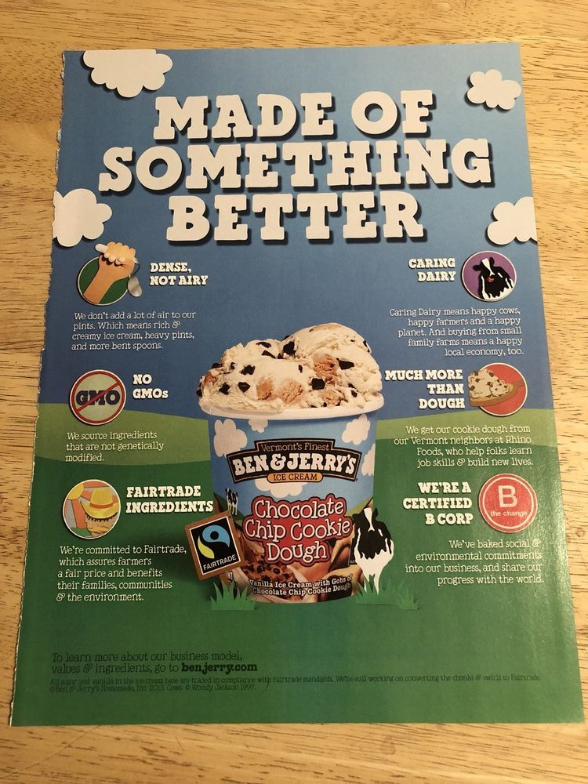
What makes this poster effective?
Here is a poster for Ben and Jerry’s Cookie Dough Ice Cream, taken from a magazine.
What are some of the unique selling points outlined by this poster?
Who do you think the target audience is? Why do you think this?
Where might this product be sold? Why do you think it is sold here specifically
What do you notice about how the product is presented on the poster?
Notes:
Give students three minutes to discuss the questions on the slide.
At the end of the three minutes, ask students to feed back to the group and discuss their answers.

Slide 21
Task: Product Poster
Create a poster for your product, which could be used in a magazine or displayed in public (30 mins).
Your poster must include:
A picture of your product, with a clear logo and slogan.
Information about the product including its unique selling point and where people can buy it.
The design should be appropriate for your chosen target audience.
Notes:
Students now have approximately 20-30 minutes to create their own product poster on flip chart paper, following the instructions on the slide.

Slide 22
Pitch
You will now create a pitch to present your product to the dragons.
Make sure you follow the pitch structure, that you can answer the questions.
Additionally, you should structure each point you make by using PE wherever possible.
Notes:
For the next 20 minutes, students should plan their presentation, which they will then share with the group.
The presentation should be approximately 4 minutes in length, and follow the structure in the booklets.
It is also important that wherever possible, students use PE to structure their point.
Students have a page in their booklets to write down any notes they feel they may need in the presentation.
A recap of PE is shown on the next slide, which students should be shown before planning the presentation.

Slide 23
How we decide on a winner…
You will be more successful at this challenge if:
You connect information and justify your decisions using logic and reasoning.
You analyse your target audience, USP and selling location in detail and use critical thinking to decide on how to create a product that matches this.
You use PE as the structure for your presentation.
You collaborate well with others, treating each other with respect and putting forward ideas.
You present your ice-cream product clearly and confidently, using the correct body language and tone of voice.
Notes:
Share the success criteria with students, explaining how each point relates to one of sessions 1-5.
Explain that this is what students will be marked on to decide on a winning group.

Slide 24
Remember to PE
Each debate point you make should be PE structured:
Point
Explain
Notes:
Reintroduce students to PE, reminding them that they will need to use this as a structure for each point they make in their presentation.

Slide 25
Presentation Time
Notes:
Students present to the group.

Slide 26
And the winners are…

Slide 27
Thank you

