Slide 1
Data Review OVerview
Shared Library Services Platform Project
Shannon Pritting

Slide 2
Data Review Prioritization
There will be more data clean up than any campus can handle.
Data clean up is part of the overall implementation, and should be viewed in the context of having finite time and resources.
If you don’t already have one, now is a good time to consider developing a process for reviewing data clean up or extensive data review projects.
When reviewing data, and identifying areas to clean up, consider:
The effect on staff or users: does this have a large impact or does it matter at all? Can it wait?
How much time will this data clean up take, and is it worth it?
What system (Aleph or Alma) is it better to do the clean up in? This will vary between institutions.
Is the data issue something that is reflective of new practices or new system functionality?
Is this a known issue with/without resolution?

Slide 3
Prepare to ask questions as you review data.
Searching in Alma will take you some time to get used to.
Our ExLibris team is really good at helping to guide you through looking for something.
Use the ExLibris Basecamp extensively to ask questions—others will benefit deeply by your questions.
When asking question, it’s always great to screenshot your search, and then explain what you’re trying to search and why.
Different search indexes and zones will be something you’ll need to adjust to.

Slide 4
When Should I Do Data Cleanup?
Current data is for the “test load,” and will be completely overwritten with the cutover load.
Keep in mind that some clean up may not be able to happen until after the cutover load, or may need to be done in two systems.
You may want to choose to wait and do cleanup later after you’re live in Alma.
Some cleanup or adjustments in Aleph data may lead to disruption in your current Aleph-LR-Discovery ecosystem, and you may want to wait until a month or two before the cutover.

Slide 5
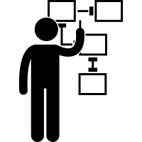
Developing a Data Review Plan at Your Library
Identify a group or an individual from functional areas or identify how you will approach data review if it will only be 1-2 people.
Develop a method for tracking the data that you want to clean up. This will be especially helpful if there is data review that you’re waiting to clean up after the cutover load, or need to do close to the cutover load.
Track where the data cleanup will happen, when it will happen, and who is responsible for both clean up and testing.
Make sure to develop some objective criteria about what data review will be conducted.

Slide 6
Data Review Guide and Checklists
SLC has created a data review guide.
SLC data review guide has checklists by functional area that campuses can use and adapt to their own needs.
We’ll gather together presentations and other information there as well.
Will cover the review guides throughout training.
https://slcny.libguides.com/datareview

Slide 7
For those who like to dig deeper….
The ExLibris documentation is quite good, but is extensive.
You might want to start with some basic testing, and then review the ExLibris documentation to go to a more extensive level.
The SLC Training sessions are based on the ExLibris migration documentation, so this will be another example of “reinforced” training throughout the implementation.
Refer to our Data Review presentation from the Kickoff as well for more recommendations:
https://slcny.libguides.com/dmtf/migprep
https://knowledge.exlibrisgroup.com/Alma/Implementation_and_Migration/Migration_Guides/030Testing_Migrated_Data

Slide 8
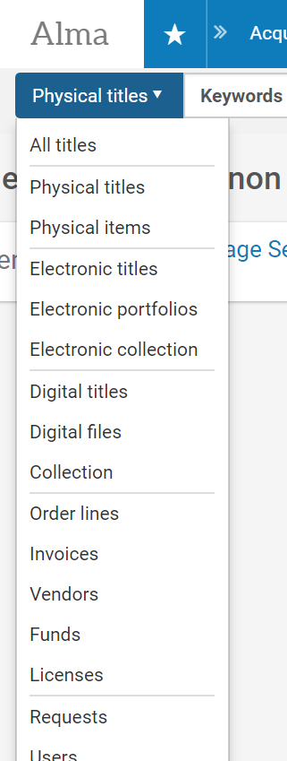
Where am I, and What Should I be Searching?
We’re implementing a shared system, and you’ll need to adjust to the local->SUNY->global nature when you search and review records.
Alma is a unified resource management system, so all formats are here, with different search indexes for different resources.
Each of our data review sessions will focus on how to search, but asking questions is a great way to learn as well.
Institution Zone: all your local stuff
Network Zone: SUNY—mostly physical titles
Community Zone (Alma Global Index), mostly e-resources

Slide 9
Known Issues
These are based on what we learned from the Vanguard phase, and also further investigation in Aleph and Alma.
Some of these known issues don’t necessarily have resolutions, but are good to know about so that your data review can be as efficient as possible.
Some are high priority, others not.
This is certainly not representative of all data issues you’ll find. Due to the brevity of the Vanguard phase, campuses could not do in-depth data review.

Slide 10
Known Issue 1: If it’s not deleted, it will migrate.
If you have bib records that are STA=DISCARDED or another STA you’re using for withdrawing records, these will migrate. Aleph records must be deleted if you do not want them to be migrated.
Resolution:
Delete records in Aleph. OLIS coordinate a bib delete project earlier this year, and can continue to delete bibs for libraries who cannot delete bib records.

Slide 11
Known Issue 2: 852 subfield b creates additional libraries | HIGH PRIORITY
This issue was not something that we could have fixed in Aleph, but does cause issues that will be a constant annoyance for staff.
Resolution:
Identify erroneous 852 b records in Alma by searching for libraries that are not legitimate.
Delete libraries in Alma.
Remove problematic 852 b fields from Aleph.

Slide 12
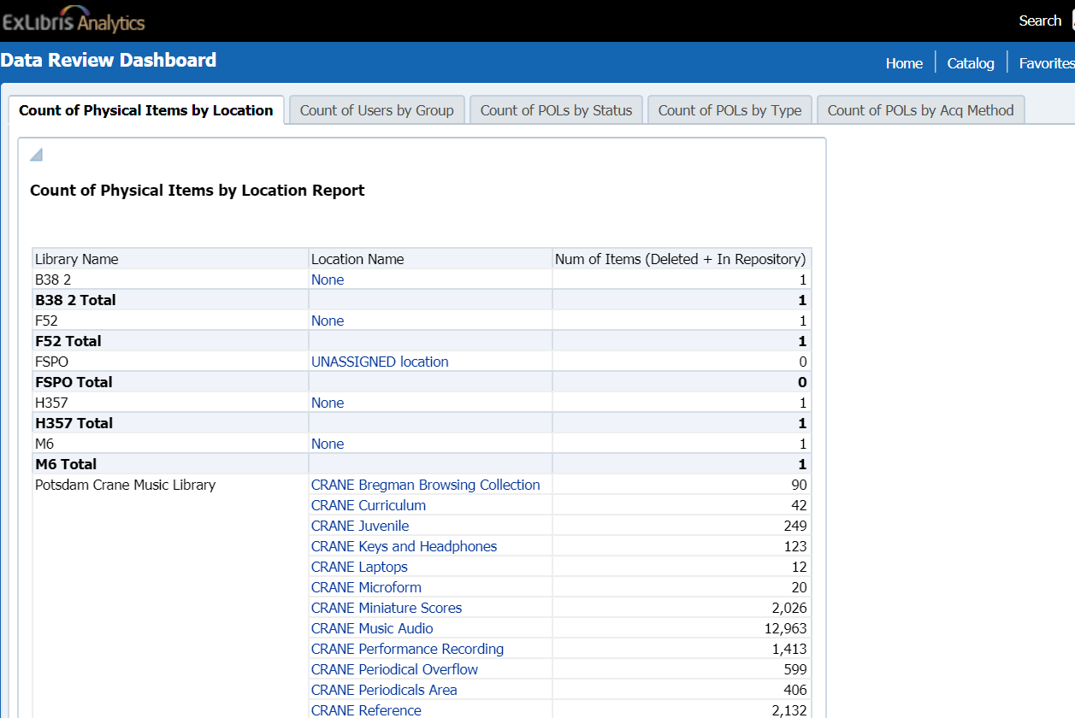
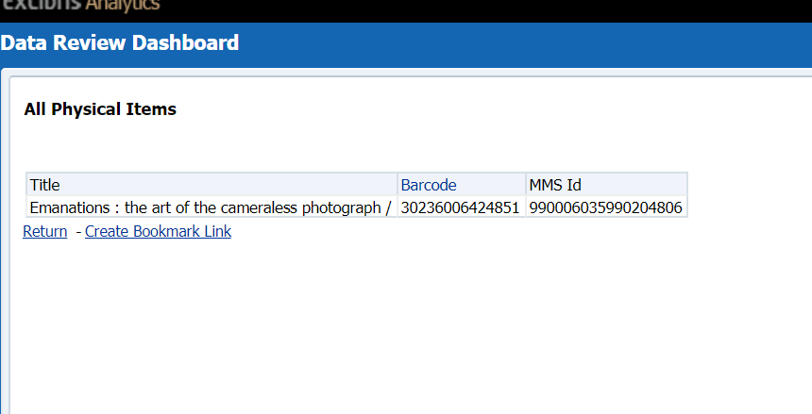
How to fix 852 b in Aleph
Find the barcode of the inventory for that library.
In Data Review Dashboard in analytics, use the “Count of Physical Items by Location,” then select the hyperlinked location name.
Use the barcode to find the bib record in Aleph.
Remove or correct the 852b
Notes:
Where do you get the inventory for a library in Alma? I think it’s a standard report, but need to verify

Slide 13
Can also see the erroneous libraries in holdings search, and can easily get to OCLC # from there.

Slide 14
How to delete an Alma Library
1. Move inventory to correct library. You can do this manually or with a job. 2. Make sure there are no other records: active loans (return items), resource sharing requests (delete), fines/fees (delete), POLs (close or move to another lib), requests (close or move), unclosed invoices (close). This shouldn’t be an issue, but it’s good to check. 3. If any users have scoped roles to lib - remove the role. 4. Scope config to library and remove work order departments. 5. Delete the related circ desks. 6. Delete any printers for that lib. 7. Delete library.
For most Libraries, you’ll just need to do steps #1 and #7.

Slide 15
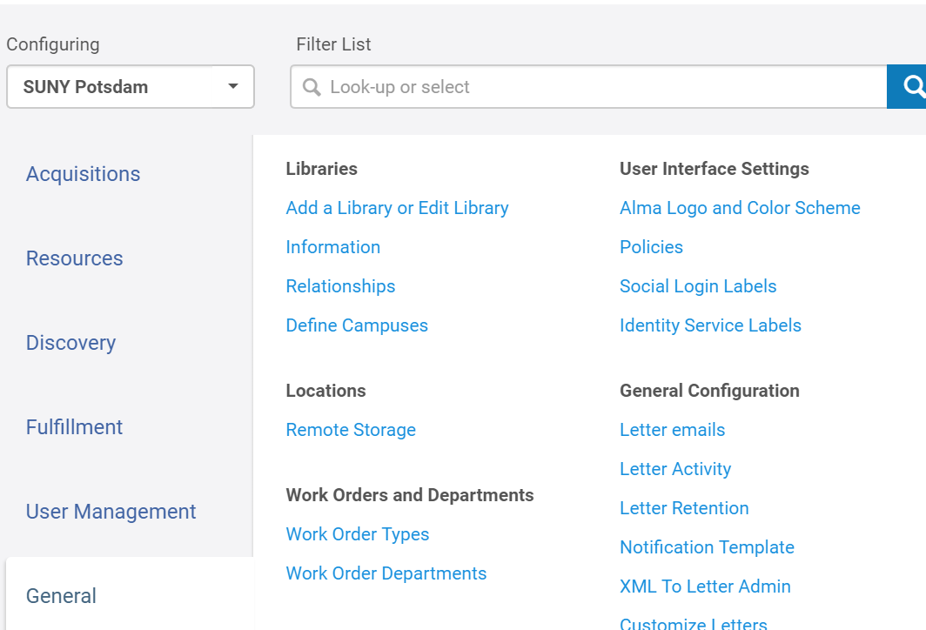
Okay, but how do I delete a library?
Go to general configuration menu
Scope by institution
Click Libraries > Add a Library or Edit Library Information
Go to ‘libraries’ tab
Do ‘Actions > Delete’
https://knowledge.exlibrisgroup.com/@api/deki/files/50597/Misc_-_How_to_delete_a_library.docx?revision=1

Slide 16
Deleting a Library Interface

Slide 17
Known Issue #3: Patron Address Data does not map cleanly
Low Priority as there is no easy way to fix, and focus should be on getting clean data into Alma through SIS integration.
Can run reports and then create sets and jobs to update any fields that you see are problematic in specific patron areas.
Clean up in Aleph isn’t best approach as there won’t be a way to test until cutover load.

Slide 18
Known Issue #4: Temporary locations in items records in Aleph creates both a permanent and temporary location in Alma
Review Footprints Public KB 9261 regarding this issue.
To get a list of bib records for items with a Temporary Location box checked used custom-46 found in the Circulation module / Services / Custom Services – Items / List of Items in Temporary Location (custom-46).
Note that bib records with STA values are not included in the output.

Slide 19
Known Issue #5: Bib records with duplicate OCLC #s
Medium Priority: will create duplication, but does not create major staff/user issues.
In Alma, bib records with duplicate OCLC #s will have duplicate inventory due to IZ/NZ matching.
How to find in Alma:
Use Alma Duplicate Analysis in “Resources→Advanced Tools→Duplicate Title Analysis
How to fix in Aleph:
Remove the duplicate OCLC # before cutover load.
Documentation on how to find Duplicate OCLC #s using Duplicate Title Analysis:
https://knowledge.exlibrisgroup.com/Alma/Product_Documentation/010Alma_Online_Help_(English)/040Resource_Management/070Advanced_Tools/020Using_Duplicate_Title_Analysis
Shared server libraries will have received a list of records with duplicate OCLC #s from OLIS through footprints as part of 2nd Reclamation efforts.

Slide 20
Known Issue #6: Course Reserves Data doesn’t map cleanly
High Priority for libraries who migrated reserves.
No easy resolution, and will need to clean up in Alma.
Can ask that course reserves structure (not inventory or citations) stay from test load to cutover load.
Some fields such as instructor, will reliably come over as a note.
Limited testing in Vanguard load, but is a known issue with Aleph to Alma migration.

Slide 21
Known Issue #7: Item Process Statuses Become Technical Migration
Alma does not have “Item Process Statuses,” so any Aleph items will migrate as “technical migration”.
Alma handles “item process statuses” through the work order workflow.
To resolve, you can create a set of technical migration status items in Alma, and change any that are problematic.
Technical Migration displays to user as not on shelf, so if Item Process status in Alma is not available, you can leave these for later.
However, you may want to suppress some of these items in Alma if you don’t want them to display to public.

Slide 22
Finding Technical Migration Records
Thanks to Sandy Card and Marian Stern at Binghamton for process and screenshots.

Slide 23
Exporting makes it easy to work on in batches and to review/fix in multiple systems.

Slide 24
What Technical Migration will look like in Primo/Alma
Primo will display “Item Not in Place”
Alma will display Technical Migration.

Slide 25
Known Issue #8: Subscription records not linked to purchase orders.
Aleph subscription records (z16) that are not linked to Aleph purchase orders (z68) – subscription records will migrate without order records and will be waiting for a renewal status in Alma.
Recommendation:
Review if you would like to clean up in Alma, or you can work with OLIS to delete z16 records.

Slide 26
Known Issue #9: Unassigned Locations or incorrect locations.
Will be in data review dashboard in analytics.
Can see unassigned or erroneous locations there.
Items with no location: defined as “none”

Slide 27
Look in location of “None” and the word “none” is a hyperlink.

Slide 28
Why None or Unassigned?
Can indicates problem with holdings records in Aleph.
Problem could also be with the item, such as a barcode issue.
A large number attached to “Unassigned location” can mean that a code was missing from your tab40.eng or from your configuration file.

Slide 29
If you prefer to review records directly in Alma.
Do a Physical Items “permanent physical location” search for unassigned, or whatever erroneous holdings issue you have.
This is something that you can do in Alma after cutover, or fix in Aleph so that the problem doesn’t persist in the cutover load.

Slide 30
Cases where migration doesn’t fix or worsen the issues in Aleph source information.
Missing barcodes: if they were missing in Aleph, they will be missing in Alma. If they weren’t a problem in Aleph, then I wouldn’t worry about fixing in Alma.
Duplicate barcodes: they will be handled the same as they are now.
Many of these have been in Aleph since migration, and likely will not cause an issue in Alma.

Slide 31
Where’s my field?
Not all local fields were migrated.
For a list of the fields that were migrated for shared server campuses, please visit:
https://slcny.libguides.com/ld.php?content_id=41984304
OLIS mapped local fields in Aleph to local extensions that will be supported in Alma.
If you had local fields that were not mapped and you want them in Alma, you’ll need to move them to another local extension field.

Slide 32
What’s NZ and What’s IZ?
You’ll get percentages of NZ linking. If you don’t have a high percentage (90% and above), please consider the following:
The NZ was created from an OCLC query in late August/Early Sept. of print resources only.
Any P2E records count against your percentage, as they would not be linked to NZ (for the most part).
Any ILS records without holdings in OCLC would not be in the NZ. This may be intentional (such as computers, etc.), or may be something you want to correct.

Slide 33
Easy way to get a snapshot of what’s not linked.
Check for titles that are not linked, and add other limiters if needed.
If you’re comfortable with what’s not in the NZ, great.
If not, you’ll need to update by either:
Adding OCLC # in Aleph
Adding holdings in OCLC

Slide 34
Data review is like cake, because…..
Notes:
If you don’t have a recipe, it probably won’t turn out very well.
If you don’t follow the recipe it probably won’t be very good.
It should fit the occasion: don’t make an elaborate cake for a small gathering.
Don’t eat too much at once.
Cake should made to improve things, not as a downer
You should throw cake away if you have too much of it
Sharing cake with others is always a good idea.

