Slide 1

Advanced ERM: Usage Data, SUSHI, and Licenses
February 5, 2020
Michelle Eichelberger
www.suny.edu

Slide 2
Plan for Today
Cover why to add usage data to Alma
How to add usage data
What it can and can’t do
We’re not going to go into designing analytics, but will provide links to how-tos
Licenses
www.suny.edu

Slide 3
Why add Usage Data to Alma?
Stores usage in same system with acquisitions, will allow you to analyze cost per use
Makes it easier to compare usage across platforms
Replaces outdated Excel tracking sheets
Can export data from Analytics to make graphs, charts, etc. Note that data visualization is coming for Alma Analytics
www.suny.edu

Slide 4
Usage Stats in Alma
Assumes that you have an admin portal for your database where you can currently get access to usage reports
Not meant to replace these reports – adds value to the data that you can get already
Will need admin account info for these databases
Not all databases give you usage data, though most do, and not all have the kind of usage data ingestion options that you might want (SUSHI)
Alma uses COUNTER (Counting Online Usage of NeTworked Electronic Resources) compliant usage statistics, using COUNTER 5 version as of Jan 2020
www.suny.edu

Slide 5
Usage Stats Roles
“Users with the following roles can perform tasks related to COUNTER compliant user statistics:
  Acquisitions Administrator - Configure COUNTER subscribers and activate, deactivate, or manually run the automatic harvesting job.
  Vendor Manager - View usage data related to a particular vendor, manually harvest data for the vendor, manually upload data for the vendor, and manage any uploaded data files.
  Usage Data Operator - Manually upload or delete data for any vendor, manage the uploaded data files, and view missing COUNTER data.
  General System Administrator - Activate, deactivate, schedule, or monitor the automatic harvesting job, view the job's history, report, and events, and configure email notifications for the job.”
  https://knowledge.exlibrisgroup.com/Alma/Product_Documentation/010Alma_Online_Help_(English)/020Acquisitions/090Acquisitions_Infrastructure/010Managing_Vendors/Managing_COUNTER-Compliant_Usage_Data#User_Roles_Summary
www.suny.edu

Slide 6
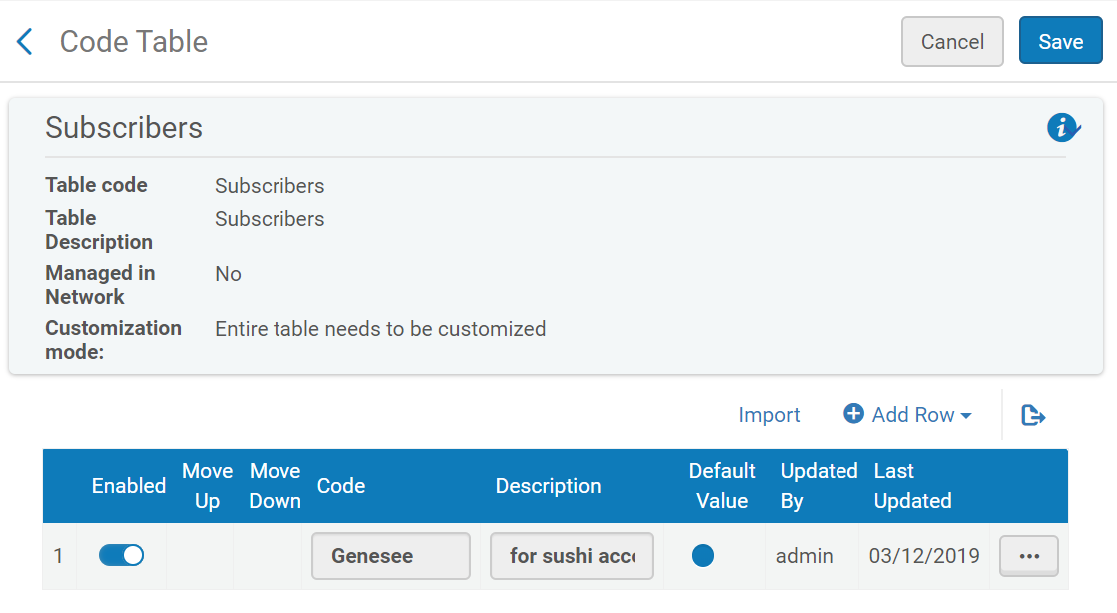
Set up Subscriber
Why?
Need it to make analytics work correctly – it’s a way for Alma to organize your reports
Usually only have one subscriber, but larger institutions may have more than one.
Doesn’t have to match usernames or other vendor info.
Do this in Config->Acquisitions->General->Subscribers
www.suny.edu

Slide 7
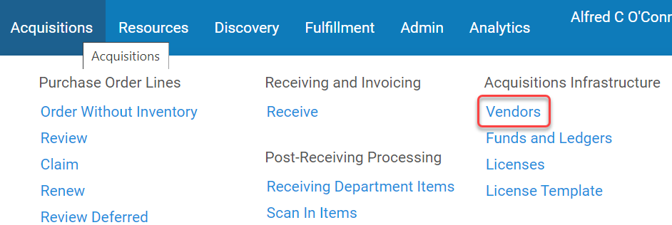
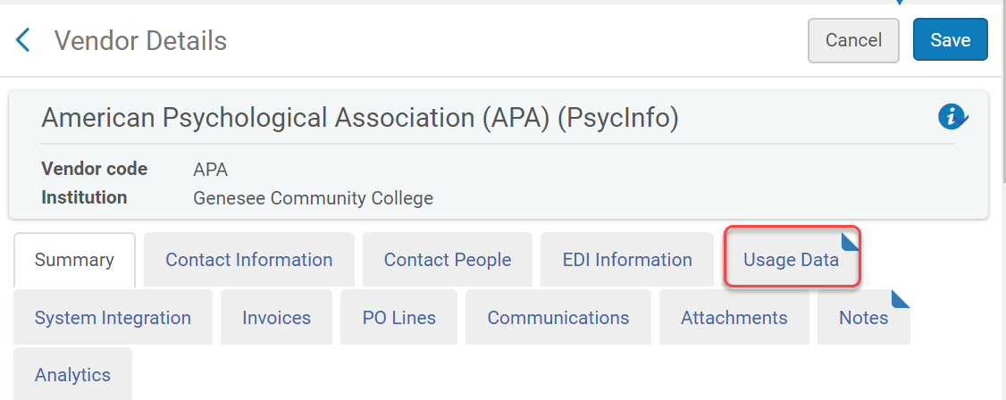
Setting up Usage Reports in Alma
Done in Vendor area, under Acquisitions->Acquisitions Infrastructure
Don’t have to have full ACQ set up to use usage reports
Create a vendor if you don’t have one, and open the Usage Data tab
www.suny.edu

Slide 8
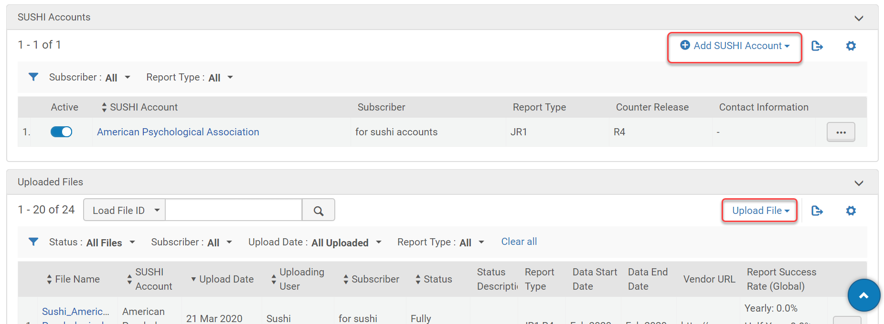
Usage Data Tab
www.suny.edu

Slide 9
Manual Upload: Retrieve Files
Retrieve COUNTER file from your vendor site or from monthly stats email
Which file? Some commonly used reports are:
  TR_J1 (replaces JR1 from COUNTER 4): Reports on usage of journal content, excluding Gold Open Access content, as Total_Item_Requests and Unique_Item_Requests. The Unique_Item_Requests provides comparable usage across journal platforms by reducing the inflationary effect that occurs when an HTML full text automatically displays and the user then accesses the PDF version. The Total_Item_Requests shows overall activity.
  TR_B1 (replaces BR1 from COUNTER 4): Reports on full-text activity for books, excluding Gold Open Access content, as Total_Item_Requests and Unique_Title_Requests. The Unique_Title_Requests provides comparable usage across book platforms. The Total_Item_Requests shows overall activity; however, numbers between sites will vary significantly based on how the content is delivered (e.g. delivered as a complete book or by chapter).
  Other supported reports
www.suny.edu

Slide 10
Manual Upload: Upload Files
Manual Upload (xlsx, xls, csv, tsv, ssv, txt formats), shouldn’t have to manipulate file contents
“When you manually upload a data file, the file is considered new data if several key fields are different (vendor, dates, etc), including subscriber. Uploading the same data file a second time overwrites the data from the first upload. If you change the subscriber in the data to a different, valid subscriber, the data is uploaded as new data.” https://knowledge.exlibrisgroup.com/Alma/Product_Documentation/010Alma_Online_Help_(English)/020Acquisitions/090Acquisitions_Infrastructure/010Managing_Vendors/Managing_COUNTER-Compliant_Usage_Data#Manually_Uploading_and_Deleting_COUNTER_Data
www.suny.edu

Slide 11

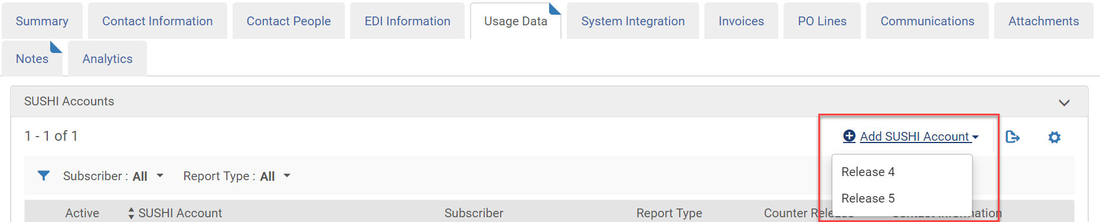
SUSHI
What is it?
In some cases your vendor supports the SUSHI protocol (Standardized Usage Statistics Harvesting Initiative), which allows Alma to automatically retrieve (harvest) and upload the data automatically.
For more information about SUSHI, see http://www.niso.org/workrooms/sushi/.
For SUSHI vendors lists for R5 and R4, see the SUSHI Vendors List.
In release 5, all SUSHI reports are returned in JSON format.
www.suny.edu

Slide 12
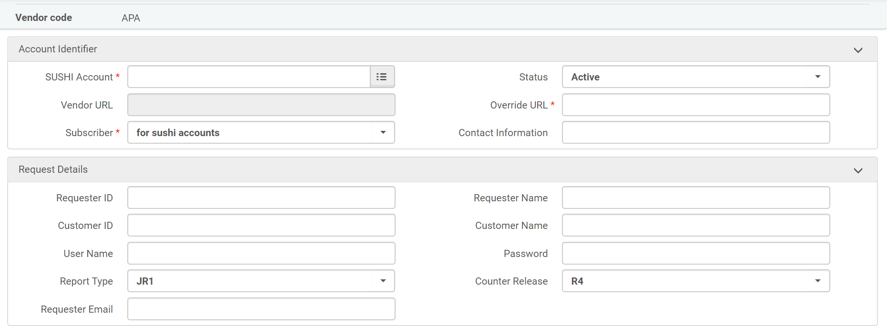
SUSHI COUNTER R4
For COUNTER R4 you create a SUSHI account for each vendor and for each report type; a single vendor may require multiple SUSHI accounts, one for each report type.
www.suny.edu

Slide 13
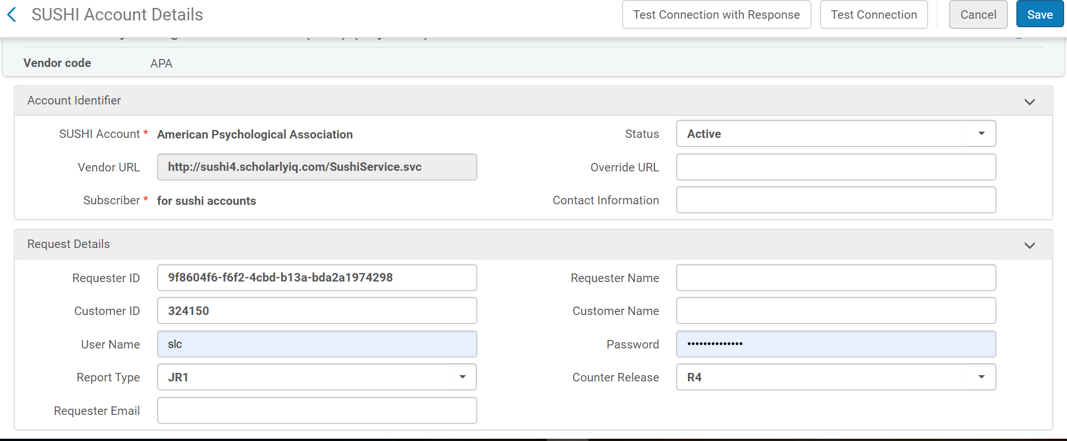
SUSHI COUNTER R4 Example
Alma will try to add your username and password. Delete! Unless you need one for sushi access.
www.suny.edu

Slide 14
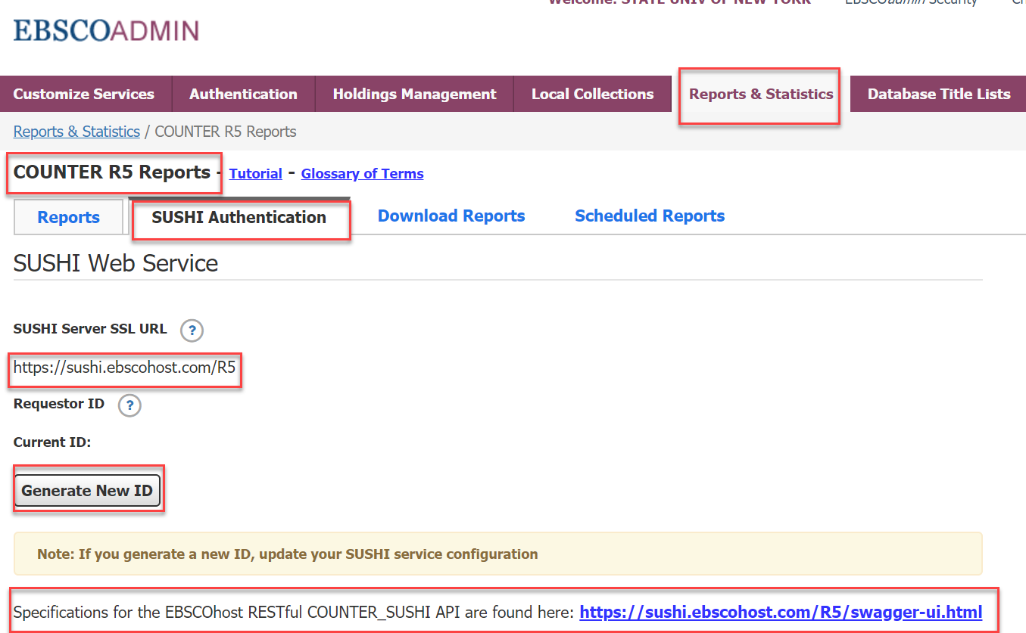
SUSHI Credentials
Where do these come from and how do you set them up?
Varies by vendor, may need to contact vendor tech support, e.g. Elsevier
Sometimes you can find them in the Admin portal, e.g. EBSCO:
www.suny.edu

Slide 15
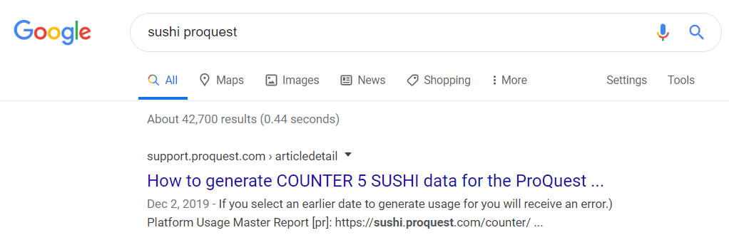
SUSHI Credentials, cont.
Where do these come from and how do you set them up?
Sometimes a Google search helps – may find vendor data or how-to posted by another library
Post on Basecamp to see if colleagues know how to set up vendor
www.suny.edu

Slide 16
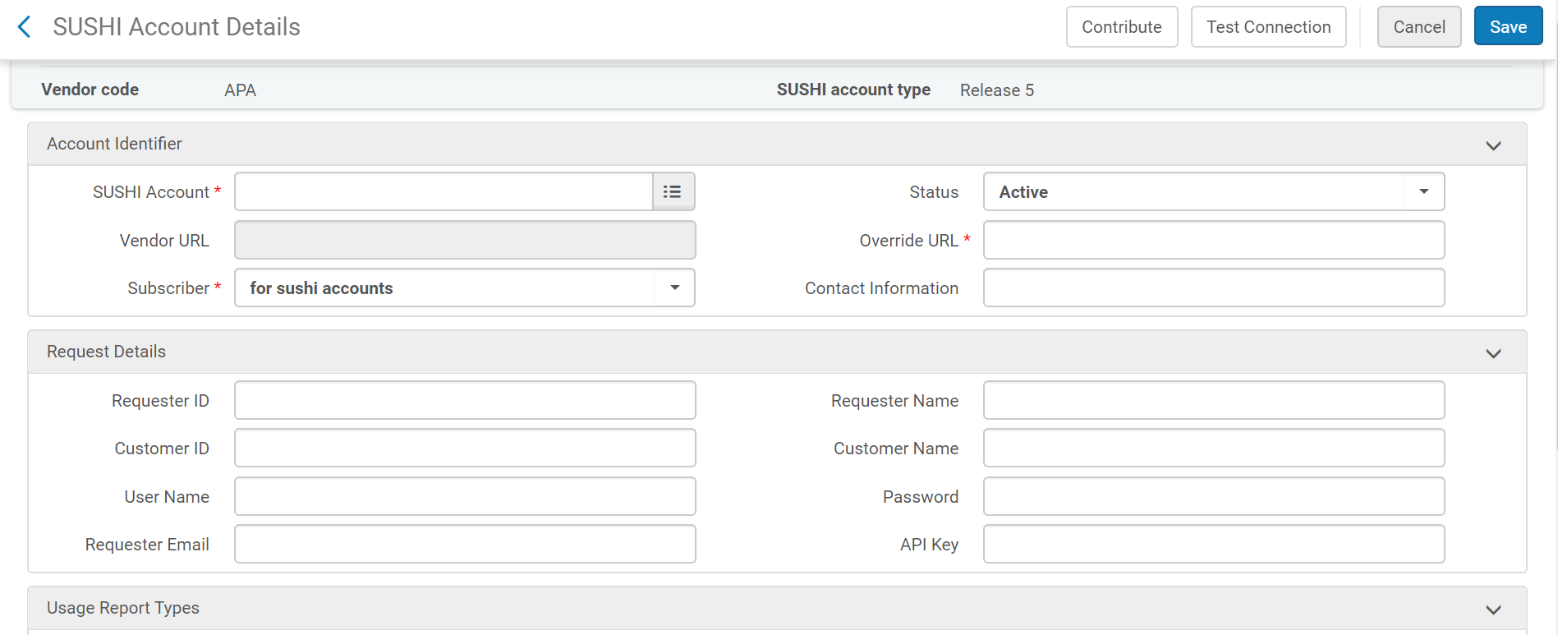
SUSHI: COUNTER 5 Template
www.suny.edu

Slide 17
SUSHI: COUNTER 5 Notes
If you have selected release 5, only release 5 vendors appear in the drop-down list
If you select any of the vendors from this list, Vendor URL is prefilled with the correct URL for the vendor (other information may also be prefilled). However, you do not have to select a predefined certified vendor; you can enter any value you like.
Enter contact information in Contact Information. Typically, this will be a URL or email account of the vendor.
Enter the required credentials in the Request Details area. Some information may already be prefilled; your vendor will supply you with the required information for this area. For information on special cases, see the SUSHI Vendors List.
Select Add Report Type for each of the report types needed on this account.
When you are done, select Save. The account is saved and appears in the Usage Data tab.
https://knowledge.exlibrisgroup.com/Alma/Product_Documentation/010Alma_Online_Help_(English)/020Acquisitions/090Acquisitions_Infrastructure/010Managing_Vendors/Managing_COUNTER-Compliant_Usage_Data#Managing_SUSHI_Accounts
www.suny.edu

Slide 18
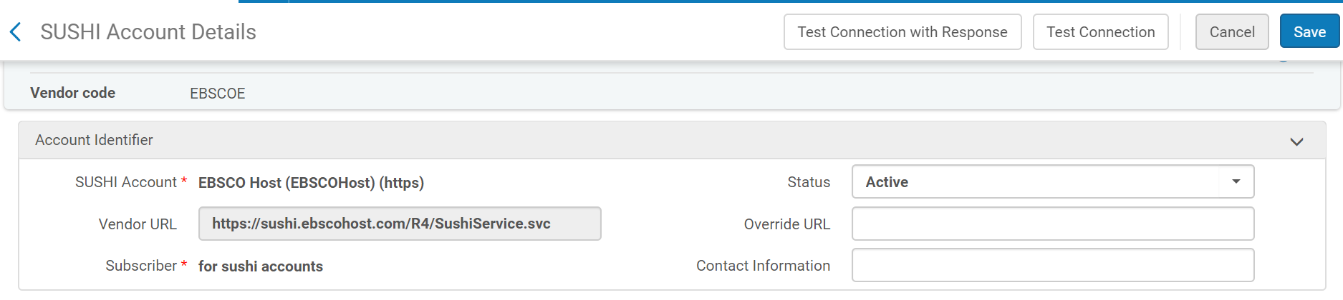
SUSHI COUNTER R4 & R5 Testing
To test the connection, select Test Connection.
For Release 4 accounts, if there is an error, an error message appears at the top of the page. Select Test Connection with Response to view a Zip file containing both the SUSHI request and response packages (in XML) sent to/from the vendor. These packages may help you debug the connection.
For Release 5 accounts, a JSON file is displayed with the connection status, and any errors, if applicable.
You should also select Test Connection with Response for each report type from its respective row action menu to detect any further possible errors.
www.suny.edu

Slide 19
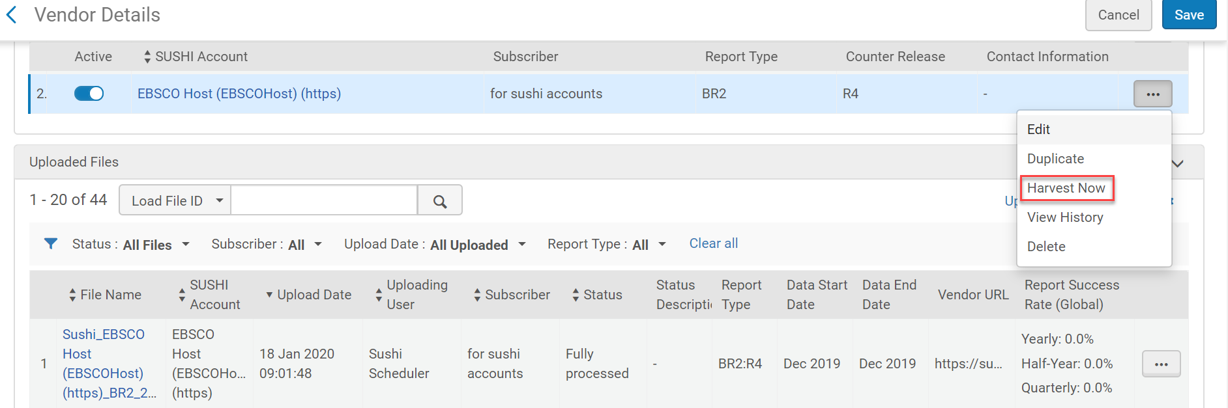
SUSHI: Harvest Now
If it works, you should see content populate the Uploaded Files area. Needs to run a job – won’t happen instantly.
www.suny.edu

Slide 20
SUSHI: Scheduler
By default, the SUSHI harvesting job harvests all COUNTER data from all active SUSHI accounts.
The job runs some time between Friday evening and Saturday morning, depending on your time zone.
Before uploading, Alma checks whether overlapping data exists in the database.
File needs to be ready at the vendor site before it can be ingested into Alma. When the job receives a response that indicates that the report will be available at a later time, Alma automatically retries to collect a report a random amount of time later. If the error persists, a number of such iterations are attempted, increasing the retry interval each time, until the attempt reaches a maximum number of retries.
The actions you can perform depend on your role. As an Acquisitions Administrator, you can activate, deactivate, or schedule this job, or run it manually. As a Vendor Manager, you can run the job manually for a single vendor account and view a history of how often this was performed.
As a General System Administrator, you can activate, deactivate, schedule, or monitor the job, view a job's history, report, and events, and configure email notifications for the job on the Monitor Jobs page. For more information, see Viewing Scheduled Jobs. Viewing Running Jobs, Viewing Completed Jobs.
https://knowledge.exlibrisgroup.com/Alma/Product_Documentation/010Alma_Online_Help_(English)/020Acquisitions/090Acquisitions_Infrastructure/010Managing_Vendors/Managing_COUNTER-Compliant_Usage_Data#Managing_SUSHI_Harvesting
www.suny.edu

Slide 21
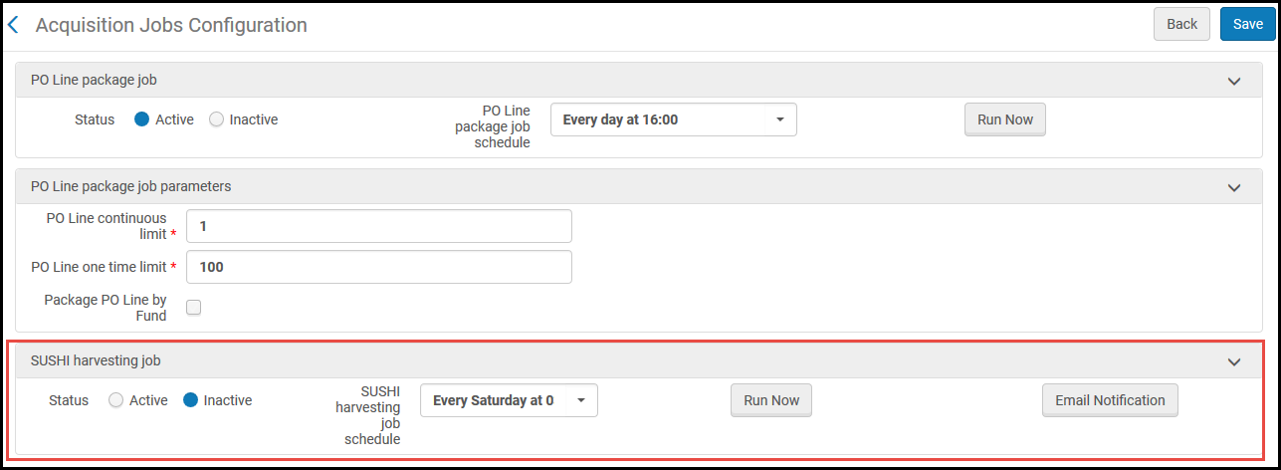
SUSHI: Scheduler
Configuration Menu > Acquisitions > General > Acquisition Jobs Configuration
www.suny.edu

Slide 22
SUSHI: Analyzing the Data
Need to wait until next day to use analytics to pull out data: plan ahead!
The ERM training guide has information about how to create reports in Alma Analytics: https://slcny.libguides.com/training-eresources/analytics_erm
www.suny.edu

Slide 23
Usage Data Known Issues
If you’ve got SUSHI R4 set up and R5 is available, should you change it? Probably. R4 will stop being updated at some point.
SUSHI Parameters for Gale (not connecting, BR1 not running): https://3.basecamp.com/3649838/buckets/2511260/messages/2414409284
Salesforce: Unable to pull SUSHI R5 for GeoScienceWorld, NEJM, Bio One
Can be tricky to set up, problems could be Alma, vendor, or your account info
www.suny.edu

Slide 24
Licenses
Can track in Alma and also display in Primo if you want your patrons to know what you’re legally allowed to do with this content
Helpful to store all of this information in one spot rather than in scattered files or on paper
Alana Nuth put together excellent overview of how licenses work: https://slcny.libguides.com/training-eresources/licenses
We’ll look at a couple of key points
www.suny.edu

Slide 25
Licenses
Roles needed: To work with licenses in Alma, one needs the role of License Manager. To view licenses in Alma one needs one of the following roles: License Viewer, Selector, Purchasing Operator, or Purchasing Manager.
Add them under Acquisitions menu->Acquisitions Infrastructure->Licenses
Can add manually, from ONIX-PL file, or via template created from manually loaded template
Can add terms of use and display those to the public
www.suny.edu

Slide 26
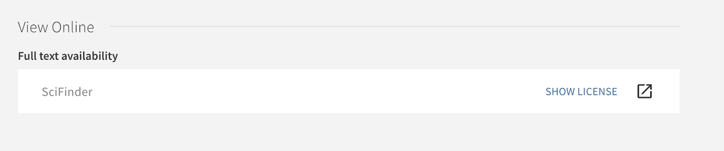
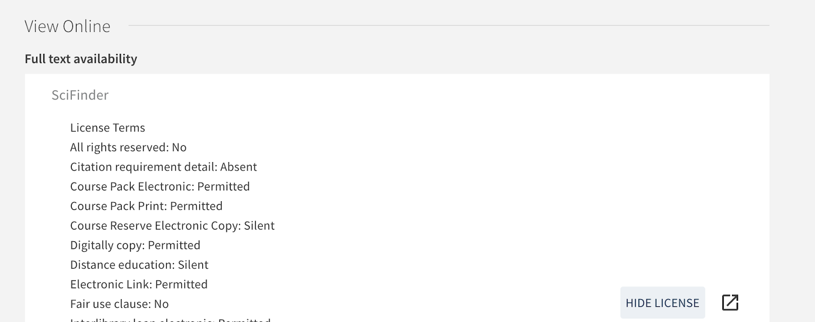
Licenses: Display in Primo
www.suny.edu

