Slide 1
E-Resource Summer Tune-Up
August 5, 2021
Michelle Eichelberger
SUNY Library Services
www.suny.edu

Slide 2
Plan for Today
Searching by Electronic Collection
Decoding the Electronic Collection
Recommended CDI settings for aggregator and selective packages
Data testing best practices
Data clean-up recommendations
www.suny.edu

Slide 3
Alma’s Connection to Primo VE
For the most part, what you see in Primo is directly related to what you have active in Alma.
If you see something with an Alma record id in Primo, it’s usually because that record exists in Alma and is publishing to Primo.
If you think that you should be seeing something in Primo but you’re not, there’s probably a problem with how it’s been activated in Alma.
Exceptions are problems with indexing:
You’ve fully deleted something (including bib records) and it’s still showing
You’ve activated something and it’s not showing
www.suny.edu

Slide 4
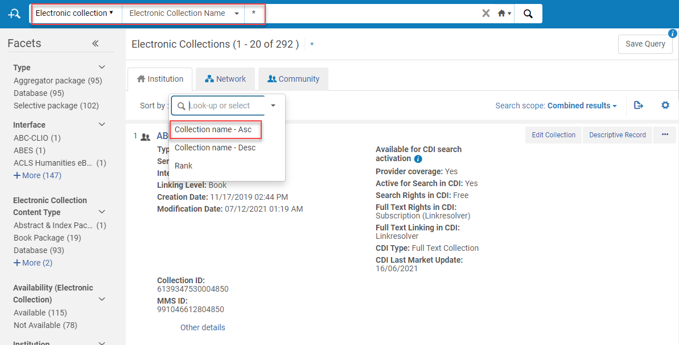
Searching Alma for Electronic Content
The summer is a perfect time to tune up your electronic collections, especially this year when you may need to tidy up COVID only collections that may no longer be available.
Recommendation: Do a * search for all of your electronic collections and compare this to your Database A-Z list. Use the Export option to send to Excel file and track your review progress.
www.suny.edu

Slide 5
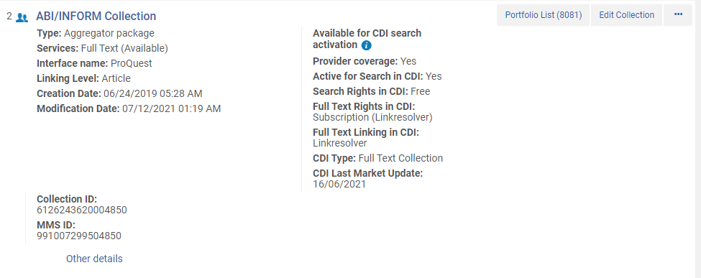
Anatomy of a Collection
www.suny.edu

Slide 6
Collection Hierarchy
Collection (Top level):
Includes Service, which includes portfolios
Where you suppress Collection bib, set CDI search preferences, change public name
Service (Middle level):
Where you set proxy, parser parameters, available or not available, selective or auto-add titles, etc., linking access codes
Portfolios (Bottom level):
Connected to bib records for each title
Controls linking to that specific title – usually has jkey or other title key from CZ
Where orders should be placed
Titles:
Both Collections and Portfolios have associated Title records, AKA Bib records, or MARC records that describe an item
One Title record can be used by more than one portfolio
Identified by MMS id
NZ version is what’s used for searching in Primo
Can have title records with nothing attached
www.suny.edu

Slide 7
Collection Hierarchy Best Practices
You can activate portfolios as stand-alone, outside of a collection, but it’s not recommended. Keeping all portfolios from a collection together helps manage access.
When buying a title from a new collection, activate the collection first and then add the portfolio for that title. You need to order/activate the portfolio rather than the title bib record because the title may exist in multiple collections and Alma needs to know where you’re getting it.
Your best bet is to activate/order content from the CZ as much as possible. Let Alma do the work for you: don’t add permalinks for portfolio URLS because it will be hard to find these and update them yourself if anything changes.
www.suny.edu

Slide 8
Collection Checklist
Is the collection local (house icon – maintained locally) or is it connected to the CZ? CZ is preferred because you don’t have to maintain additions, deletions, changes to linking, etc.
Is the collection active? Is the icon blue or black, and is the service available or unavailable? This will impact what shows in Primo.
Is the collection’s bib record being published to Primo, or is it suppressed? May have to open collection to see for sure.
Are there portfolios? The portfolios are what create Alma records in Primo for each title in the collection.
www.suny.edu

Slide 9
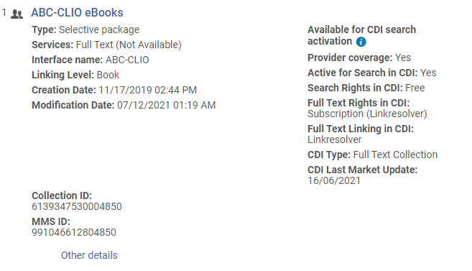
CDI Search Activation
Is the collection activated for search? Should it be?
Both search and fulfillment is managed in Alma. Can have an “Not Available” collection still available for search.
The packages that you activate for search are not the only search records you’ll get – they’re meant to populate your expanded search with records for content that you don’t own. We can control non-full-text search records, but anything full-text is searched from pool of merged records
www.suny.edu

Slide 10
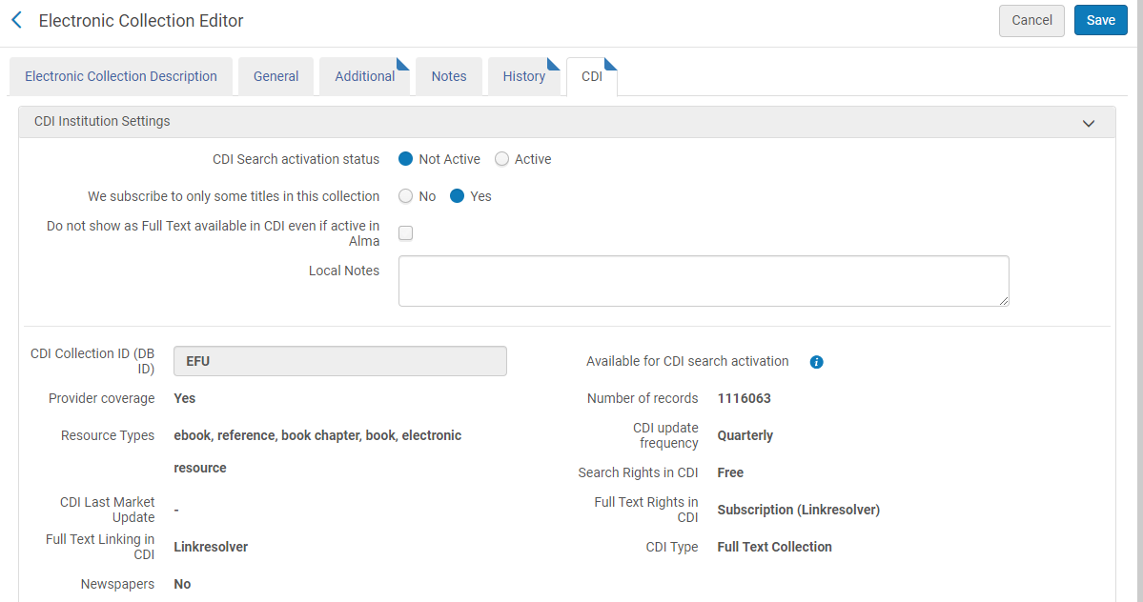
Recommended CDI Settings
Best Practices:
Aggregator & Selective Journal packages:
CDI Search status = active
We subscribe to only some titles = yes
Do not show as Full Text = leave blank
Aggregator eBook packages:
CDI Search status = Not active
We subscribe to only some titles = yes
Do not show as Full Text = your choice – check if you don’t want duplicate titles – uncheck if you chapter level indexing
Selective eBook packages:
CDI Search status = Not active
We subscribe to only some titles = yes
Do not show as Full Text = check box
www.suny.edu

Slide 11
Tune-Up Checklist
As you go through your list of collections, here are some things to check:
Compare to your current A-Z list. Do you still get this collection? And vice versa, are there things on your A-Z list that you don’t have active in Alma? There may be good reasons for this, such as the content not existing in the CZ. If you don’t get it, and don’t need it for search, fully delete it.
Is the correct version of the collection activated? For example, APA content is available from multiple vendors and has multiple collections in the CZ.
Is access to the collection working? If there are portfolios, look one up directly in Primo and test the linking.
If it’s a journal collection, also find an article from one of the journals (most journals have websites) and make sure that search records for the titles are showing as available and that linking is working.
If it’s a selective package, compare number of titles in Alma to what’s in the vendor’s admin total. E.g., if you’ve purchased 116 titles from Salem, make sure they’re all active in Alma. Exception: EBSCOhost eBooks
www.suny.edu

Slide 12
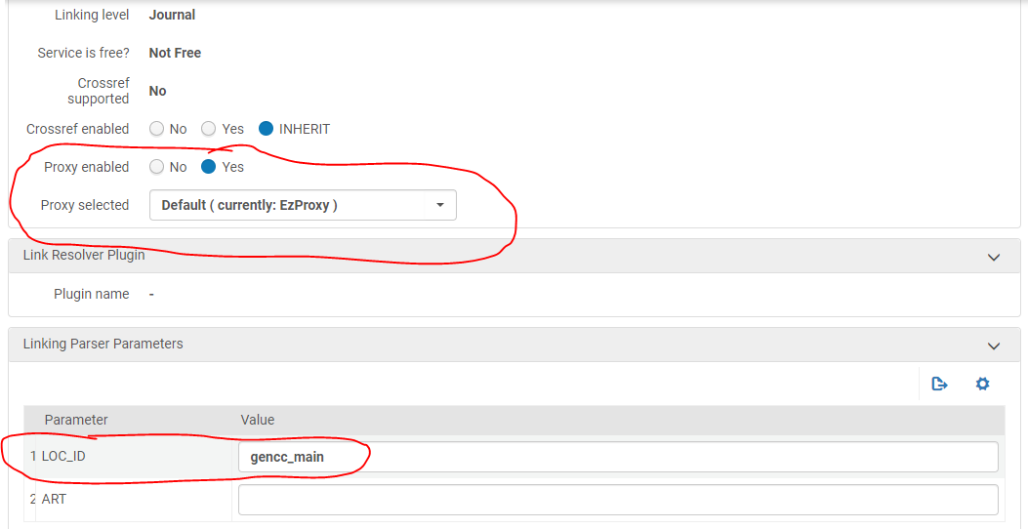
High Level Troubleshooting
Biggest cause for linking failure is lack of proxy or linking parameters – located in Edit Service, Linking tab.
Also check your proxy stanzas.
E-Resources Troubleshooting and Ticket Best Practices
www.suny.edu

Slide 13
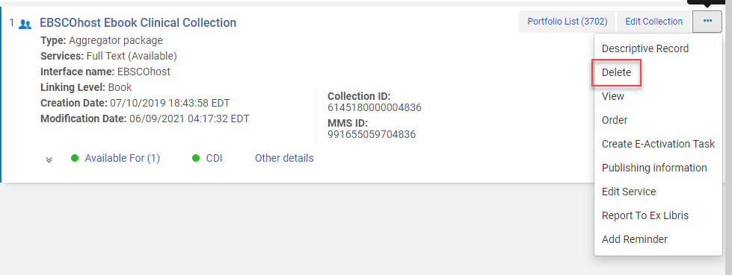
Deleting vs. Deactivating
Deleting is preferable to deactivating:
Information about the collection, portfolios, etc. will be stored in analytics if you need it for the future
If you deactivate a portfolio for a title that’s still available in another collection, the deactivated portfolio can stop the good record from publishing to Primo
If you accidentally delete something, it’s easy to reactivate it
It’s tidier to delete, and makes your content easier to track and manage
If you don’t see “delete” as an option, check your roles and make sure that you have Electronic Inventory Operator Extended
www.suny.edu

Slide 14
Deleting vs. Deactivating Cont.
Recommendation: Clean up deactivated portfolios.
Titles are often deactivated in selective packages during CZ Updates, and if you’ve said that you don’t want titles automatically added to selected packages (which is best practice), you’ll need to check these titles yourself to see if they should be replaced or just fully deleted
Find them with Electronic Portfolios Advanced Search, Availability of Electronic Portfolio = Not Available.
For each title, check your vendor records to see if it really has been removed from your package – e.g., go to the stand-alone database and look up the title. If it’s gone, it should be fully deleted from your package in Alma. If not, check to see if it’s a newer version that needs to be activated in Alma. And if it’s the same version, submit a ticket to the Alma Content Team to see why it was deactivated.
www.suny.edu

Slide 15
Additional Clean-up Opportunities
Fake physical collection for electronic content. Frequent practice in Aleph, not recommended in Alma. Find titles with Advanced Physical Items Search, Holdings: Permanent physical location equals [location name – choose from list]. Pull list, make sure content has been activated electronically in the correct collection, clean up items, bib records, and holdings as needed
Identify standalone portfolios with no collections (could be result of P2E, etc.). Electronic Portfolios Advanced Search, Electronic Portfolio Is Standalone = yes. To fix, edit portfolio and choose “attach to an electronic collection.” Once added, you can go to that collection and choose to link local records to CZ, which will match titles to the proper CZ portfolio.
www.suny.edu

Slide 16
Bib Record Clean Up
One of the main causes for records showing up in Primo with no holdings is bib records in Alma with no physical or electronic holdings. To find these and get rid of them, do the following advanced search in All titles: has inventory = no
Can save results as a set and use the delete bibliographic records job to get rid of them. You don’t have to detach anything connected to the NZ before running the job.
www.suny.edu

Slide 17
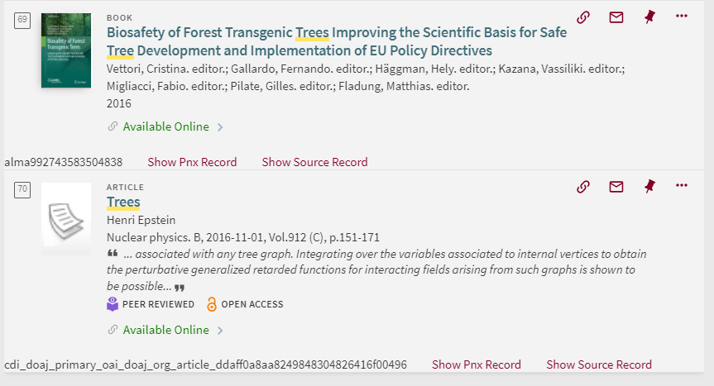
Primo Tools
If you find something in Primo that you didn’t expect, here are some tools for troubleshooting:
How can I troubleshoot Primo VE search results and links using Record Id, Display CTO and Show PNX?
www.suny.edu

Slide 18
Demo & Questions
Browse Collections
Find Collection in CZ and activate
CDI settings
Primo troubleshooting
www.suny.edu

