Slide 1

Resource Sharing Update
September 3, 2020
www.suny.edu

Slide 2
Agenda
Alma Resource Sharing Restart Update
Resource Sharing Training Guides
Borrowing Workflow Changes
Lending Workflow Changes
Alma/ILLiad Integration Improvement
Walk-in Borrowing Reminder
Returns from Other SUNYs Reminder
Automated Fulfillment Network Update
www.suny.edu

Slide 3


Alma Resource Sharing Restart Update
33 SUNY libraries have resumed resource sharing in Alma as of today
  All but 5 are both borrowing and lending
9 SUNY libraries in the NYC area are waiting for an ELD restart date
  No estimate for when ELD service will resume in NYC area
SLSS will reach out to libraries about turning Alma RS back on once they’ve been assigned an ELD restart date
  Libraries who wish to borrow will be required to lend unless there are extenuating circumstances
  SLSS will do all configuration work needed to turn Alma RS back on
www.suny.edu

Slide 4
Alma Resource Sharing Restart Update
Currently using a single rota for all of SUNY
Will switch back to regional rotas once NYC area libraries start borrowing and lending again
Lending requests are currently set to expire after 99 days to make sure as few requests go unfilled as possible
  SLSS is monitoring for unprocessed lending requests
Requests will start expiring after 7 days once ELD service resumes in NYC area and we switch back to regional rotas
SLSS will resume posting RS statistics at the end of September
www.suny.edu

Slide 5
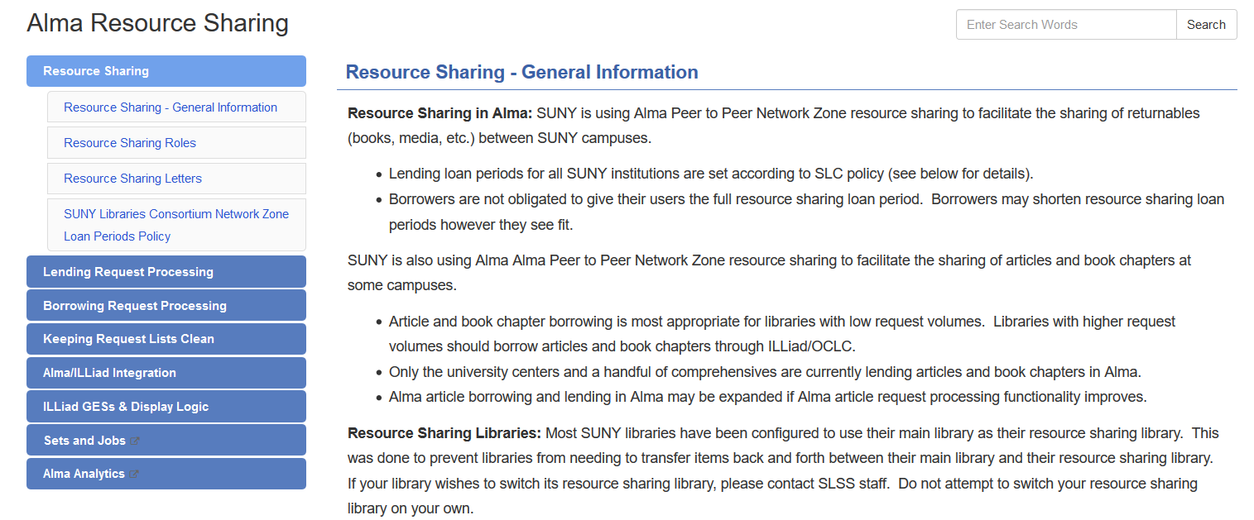
Resource Sharing Training Guides
Borrowing: https://slcny.libguides.com/training-resource-sharing/borrowing
Lending: https://slcny.libguides.com/training-resource-sharing/lending
Alma/ILLiad Integration: https://slcny.libguides.com/training-resource-sharing/illiadintegration
www.suny.edu

Slide 6
Borrowing Workflow Changes
The borrowing workflow for articles has now been fully automated
  Users receive an email with a download link as soon as the lender fills the request (Document Delivery Notification Letter sent from borrowing library, not lending library)
  The borrowing request is automatically completed once that email is sent
Alma article borrowing may now be a feasible alternative to ILLiad/OCLC for libraries who rarely exceed the Rule of 5
  ILLiad/OCLC still the best option for libraries who frequently exceed the rule of 5
  SLSS will be testing Alma’s copyright compliance capabilities in the near future
Email info@slcny.libanswers.com if ILLiad/OCLC costs are a concern for your library and you’d like to test Alma article borrowing
www.suny.edu

Slide 7
Borrowing Workflow Changes
UAlbany discovered that Alma does not make sure a user is eligible to submit resource sharing when you convert a hold request to a resource sharing request or when you manually create a resource sharing request in Alma
Rota assignment rules can be modified to make sure these requests aren’t sent to other libraries for fulfillment
  Requests will end up in Created Borrowing Request status and can be manually cancelled
Submit ticket to info@slcny.libanswers.com if you would like us to modify your rota assignment rules to help manage this issue
www.suny.edu

Slide 8
Lending Workflow Changes
Processing of lending renewal requests has been automated
  Renewal requests automatically approved as soon as they’re received from the borrowing library
  Alma blocks borrowing renewal requests that do not adhere to SLC policy, so no need to worry about renewal requests that violate SLC policy being automatically approved
All returns should be processed using the Scan In function, not the Return Items function
  Scan In function now gives you a warning message if you are returning a request that was never updated to received by the lender
  The Return Items function does not give you this warning, so it’s easy to inadvertently complete a request
  If you see this warning message and you’re unsure what to do, email info@slcny.libanswers.com
www.suny.edu

Slide 9
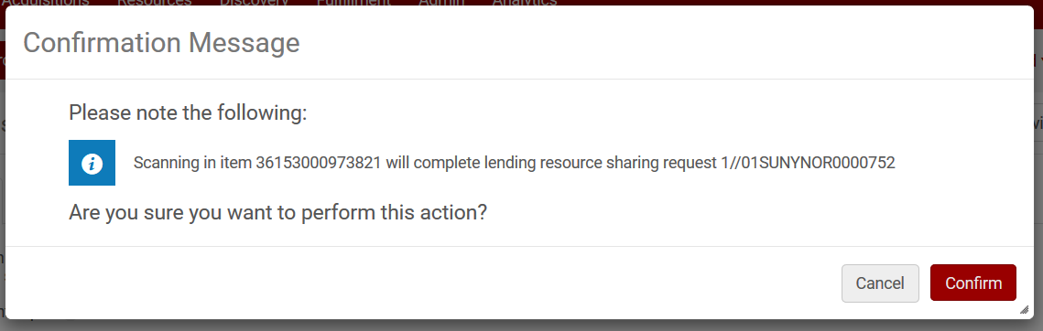
Lending Workflow Changes
www.suny.edu

Slide 10
Lending Workflow Changes
Article lending workflow may have been streamlined
If you click the Manage Fulfillment Options function and then click on an electronic resource, you may be brought directly to the requested article
  request must have sufficient metadata
  vendor must allow direct linking
Doesn’t work 100% of the time, and you have to click back to the lending requests list to ship the article when it does work, so this may not make article lending more efficient
Have submitted a case to Ex Libris asking for clarification on workflow
www.suny.edu

Slide 11
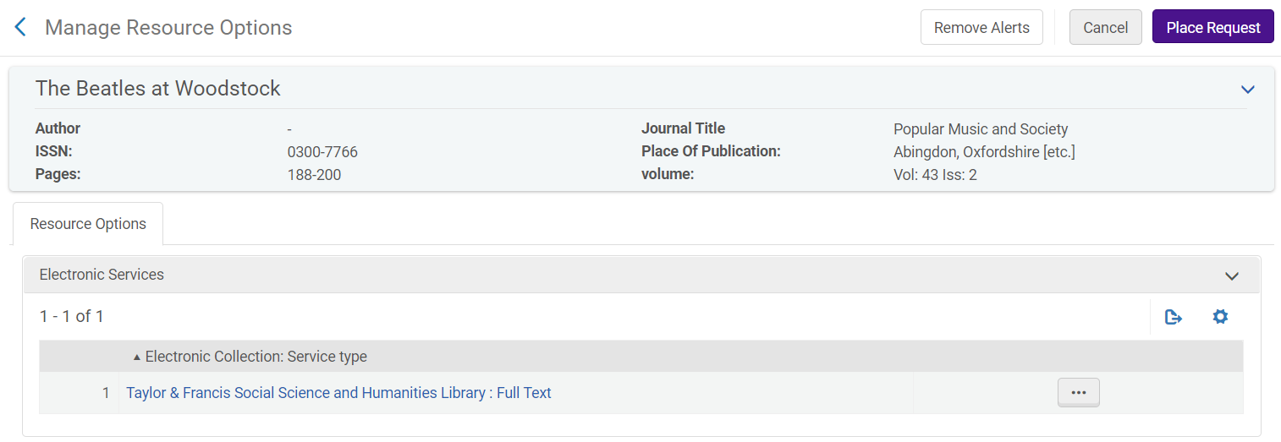
Lending Workflow Changes
www.suny.edu

Slide 12
ILLiad Integration Changes
Borrowing NCIP addon was initially configured to create new requests in Alma, so requests exported from Alma to ILLiad would be duplicated in Alma once they were received in ILLiad
Borrowing NCIP addon now capable of updating Alma requests that were exported to ILLiad
To implement this change:
  ILLiad Resource Sharing Partner (Alma): Make sure the Close Request When Exported box is not checked
  Borrowing NCIP Addon Configuration (ILLiad Client): Make sure the “ILLiad_field_to_get_external_identifier” setting is the same as the “Export Request ID Name Tag” setting in your ILLiad resource sharing partner
Reinstalling the Borrowing NCIP Addon is not necessary if you’re already using Version 2 of the addon
  FAQ: https://slcny.libanswers.com/faq/285842
www.suny.edu

Slide 13
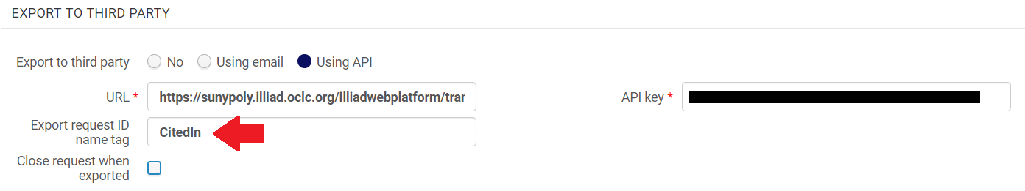
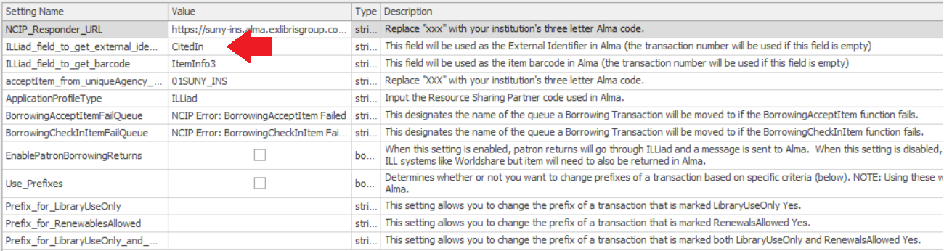
ILLiad Integration Changes
www.suny.edu

Slide 14
Walk-In Borrowing
SLC approved a temporary policy allowing walk in borrowers to submit resource sharing requests
  Policy in place until July 31, 2021
  Currently the only way to allow users to pick up items from any SUNY at any other SUNY
Walk-In Borrowing FAQ: https://slcny.libanswers.com/faq/260608
When searching for a user from another institution, name searches must produce only one exact match
Search by a different identifier if you cannot find a user by name
www.suny.edu

Slide 15
Returns from Other SUNYs
SLC approved a temporary policy allowing users to return items borrowed from a SUNY library to any SUNY library
  Policy in place until July 31, 2021
FAQ of libraries accepting returns from other SUNYs: https://slcny.libanswers.com/faq/302298
  Please check to make sure your library’s information is accurate
  Submit updates to https://slcny.libwizard.com/f/returns
If your library received a return from another SUNY, please provide barcode(s) to SLSS
  https://slcny.libwizard.com/f/othersuny
  SLSS will remove item from user’s record and place it in temporary “Returned at Other SUNY” location
www.suny.edu

Slide 16
Automated Fulfillment Network
Temporary SLC policies designed to accommodate users who need to borrow and return items but aren’t close to their home campus
Alma’s Automated Fulfillment Network (AFN) functionality may be a better way to accommodate these users in the long term
  Allow users from any library in the AFN to request items from, pick up items at, and return items to any other library in the AFN
  Some AFN functionality already being used for walk-in borrowing
SLSS currently testing AFN functionality in our sandboxes
  Working with Ex Libris Professional Services
  Multiple smaller AFNs have been configured since that seems to be the most likely scenario for SUNY
www.suny.edu

Slide 17
Automated Fulfillment Network
SLSS will start reaching out to libraries about AFN participation once we’ve been able to thoroughly test AFN functionality
Looking to start small and then gradually expand AFN participation
AFN implementation will be a major change that will require a lot of configuration work
  AFN implementation will be permanent, not temporary
  Current RS loan policy will apply to AFN loans
www.suny.edu

Slide 18
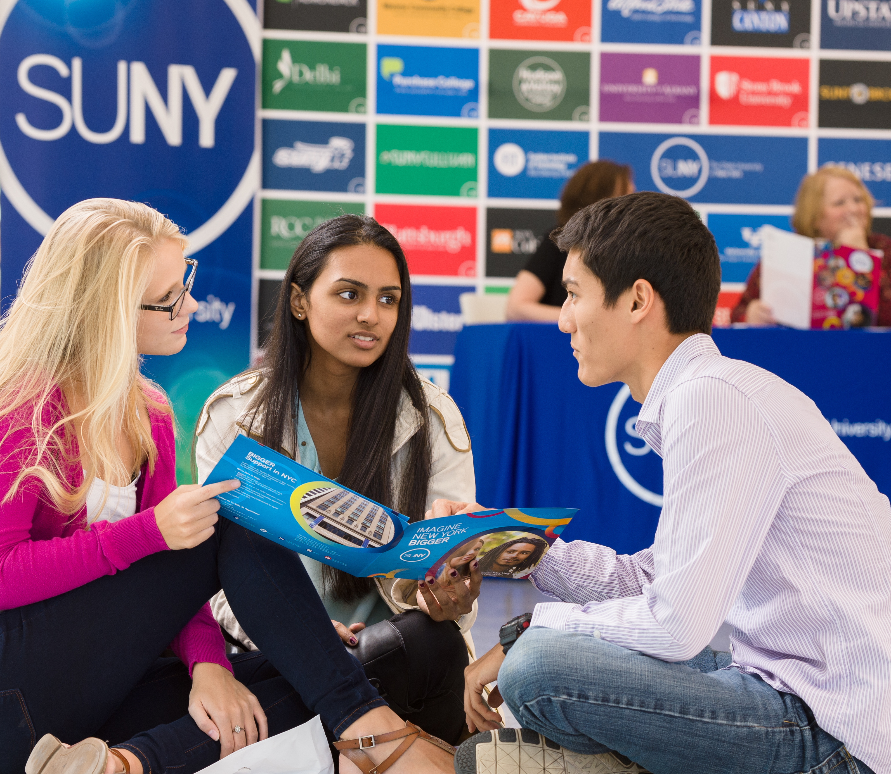

Questions or Discussion?
www.suny.edu

