Slide 1

Maintaining Electronic Collections
August 24, 2021
Michelle Eichelberger
SUNY Library Services
www.suny.edu

Slide 2
Plan for Today
Searching Collections
Activating Collections
CDI Settings
Maintaining Selective Titles
Bib record quality
Deleting Collections
www.suny.edu

Slide 3
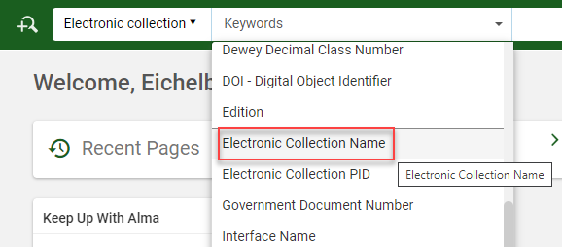
Adding Collections: Searching
Best Practice: Search by Electronic Collection Name
  “Title” searches 245 field in MARC records associated with collection and portfolios
  Local Collections don’t have MARC records unless you manually create them, so there won’t be a 245 to find and search will fail
  Keyword search will include publisher info, so a search like “Proquest” or “Gale” will give you too many results
  Try variation on name if it’s not coming up – Proquest Research Library may not include “Proquest” in collection name in the CZ
www.suny.edu

Slide 4
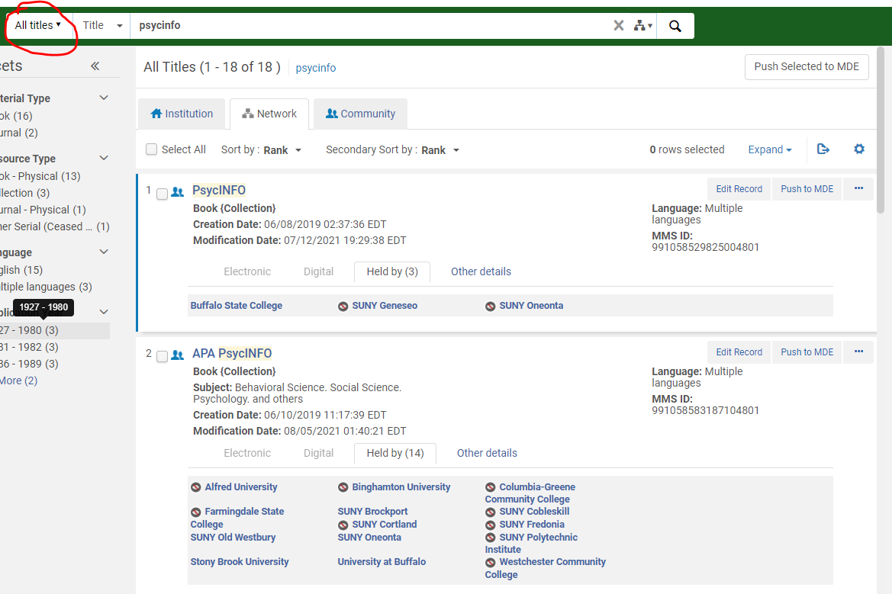
Adding Collections: Searching NZ
Sometimes you might want to see what collections have been activated by other SUNY schools.
When someone at a campus activates a portfolio or a collection from the CZ, the bib record is added to the NZ for tracking and indexing.
There should be a CZ icon next to the item, to show that it’s linked to the CZ.
www.suny.edu

Slide 5
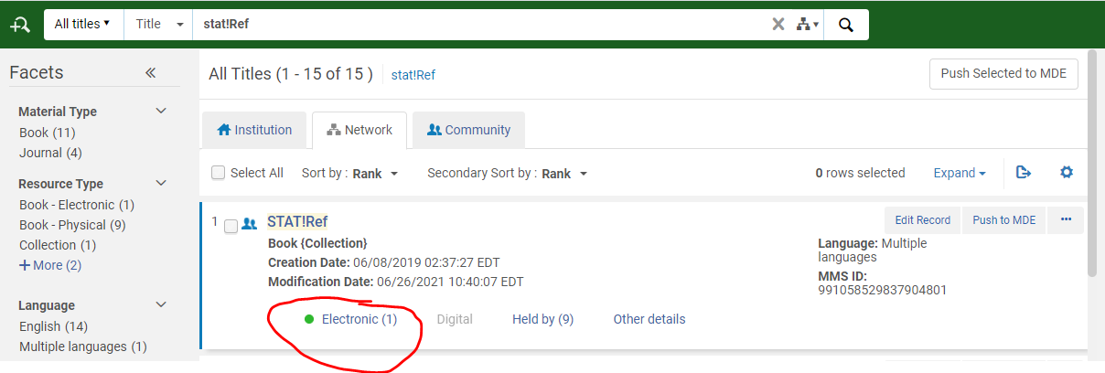
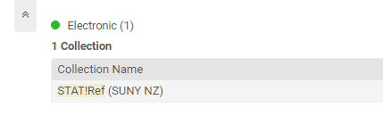
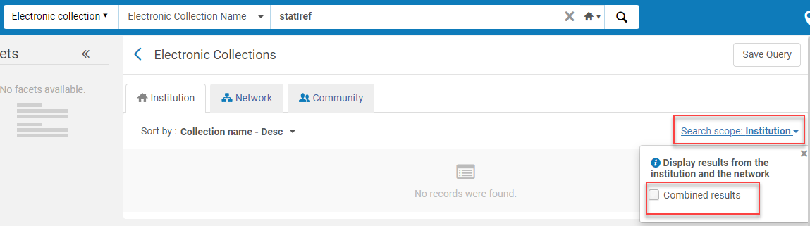
Adding Collections: Searching NZ cont.
If you find an entry in the NZ, it doesn’t mean that that collection is being managed there – it just means that someone in SUNY has it.
You won’t find this info in the Primo SUNY catalog search because we only display physical items in that search.
If there are electronic holdings, that means it’s being managed in the NZ. If your campus is part of the group being managed, you’ll be able to find the NZ managed content in your IZ search.
www.suny.edu

Slide 6
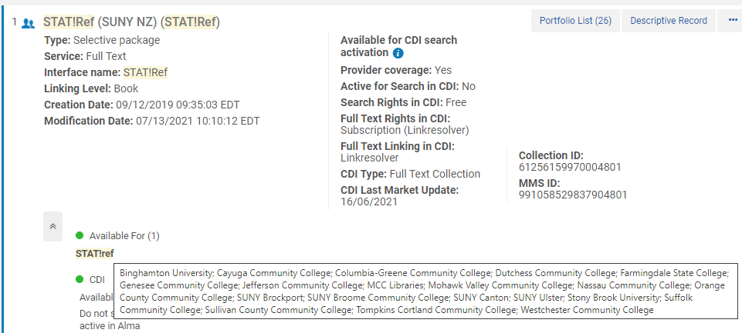
Adding Collections: Searching NZ cont.
If you want to see which campuses are part of the NZ-managed group, you can:
Switch to an electronic collection search
Search the NZ
Expand the Available For area
Hover over the group name
www.suny.edu

Slide 7
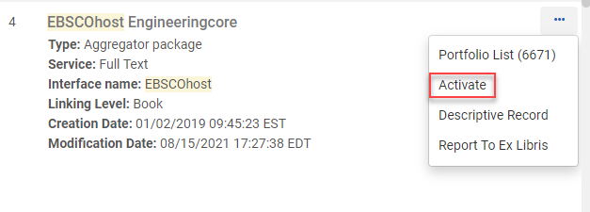
Adding Collections: Aggregator Package
Aggregator: you purchase the whole (aggregate) collection. E.g. Academic OneFile, Academic Search Complete, etc. Should see number in Portfolio List.
Activate from CZ (can find it in the NZ, but it’s just the bib – you wouldn’t be able to activate from there) because you want automatic content updates
Choose Activate from three dot menu (if you don’t see it, check roles)
“Activate” will trigger an activation job.
Large collections can take many hours to activate. Once collection is done loading (check jobs), Alma bibs should show in Primo in 15-30 minutes.
Collection will show in Alma results before loading is done.
Article records from CDI won’t appear for 3-4 days, but you may be able to find full-text links in expanded search, even when it says “not available.”
www.suny.edu

Slide 8
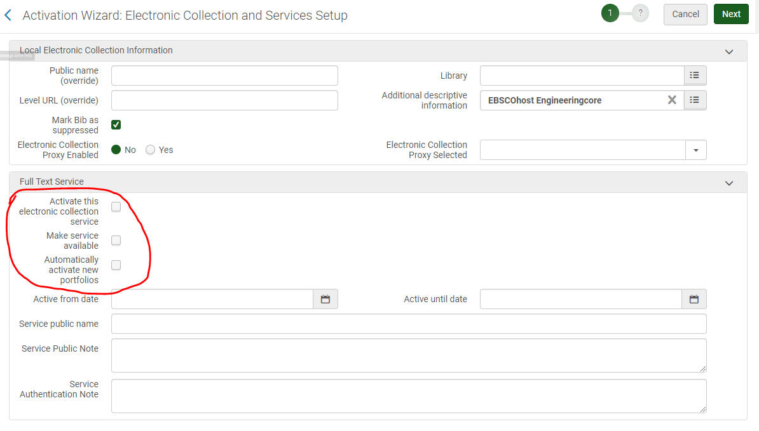
Adding Collections: Aggregator Package Activation
Check each box in circled area
Proxy will be activated at service
Bib is suppressed by default
All other fields are optional, not functional
Can edit collection later if you need to
www.suny.edu

Slide 9
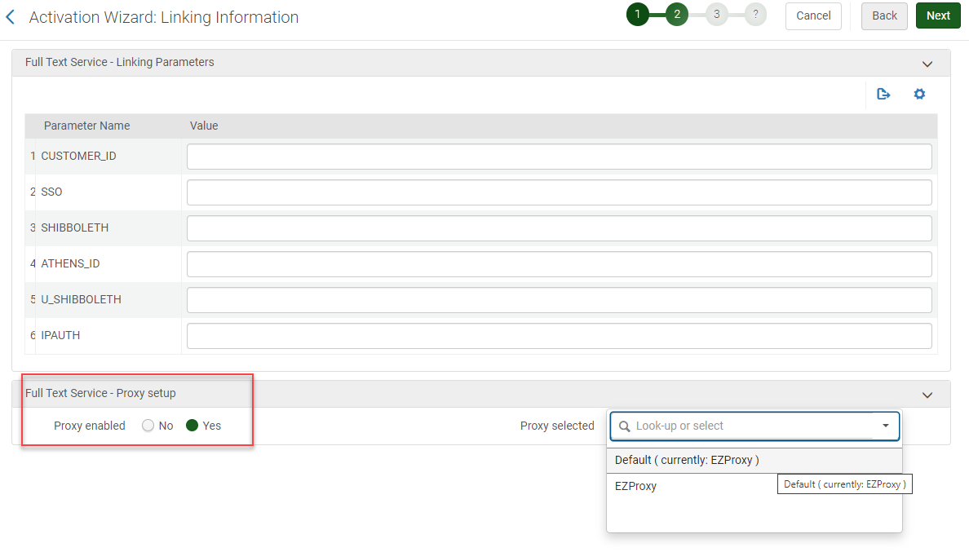
Adding Collections: Aggregator Package Activation p.2
May need to fill in linking parameters (Gale loc_id, Ovid, etc.) Check other active packages from vendor or post in Workplace.
Activate proxy for full text service – be sure to choose Default so that you can easily swap it in future if you change proxy
www.suny.edu

Slide 10
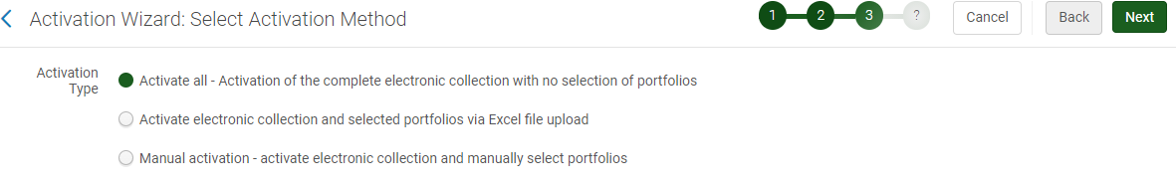
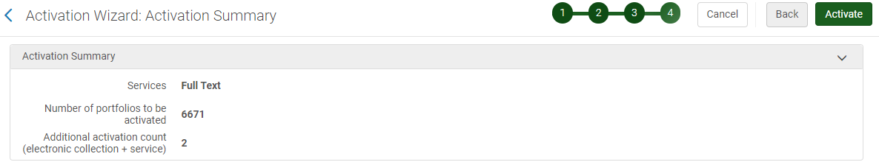
Adding Collections: Aggregator Package Activation p.3/4
Choose activate all because you don’t need to select individual portfolios
www.suny.edu

Slide 11
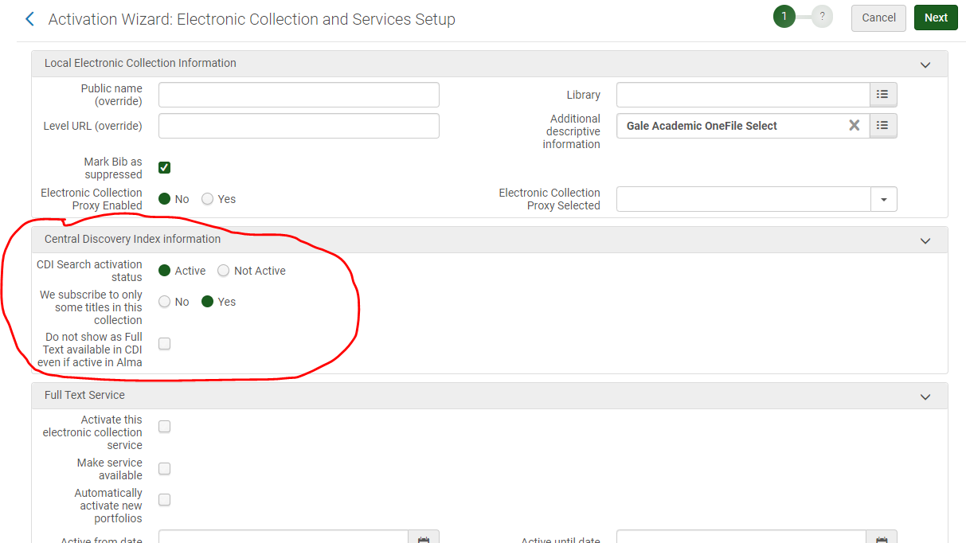
Adding Collections: Aggregator CDI Settings
If the collection has a CDI component (has its own search records, etc.), CDI options will be part of the Activation Wizard
For collections like EBSCO, with no CDI search records, all full-text content will be automatically searchable - you no longer need to set up alternate coverage
Aggregator CDI settings for journal and mixed resource collections:
  Active for search
  We subscribe to only some titles = yes (counterintuitive but necessary for accuracy)
  Don’t check box – want articles to to be searchable
www.suny.edu

Slide 12
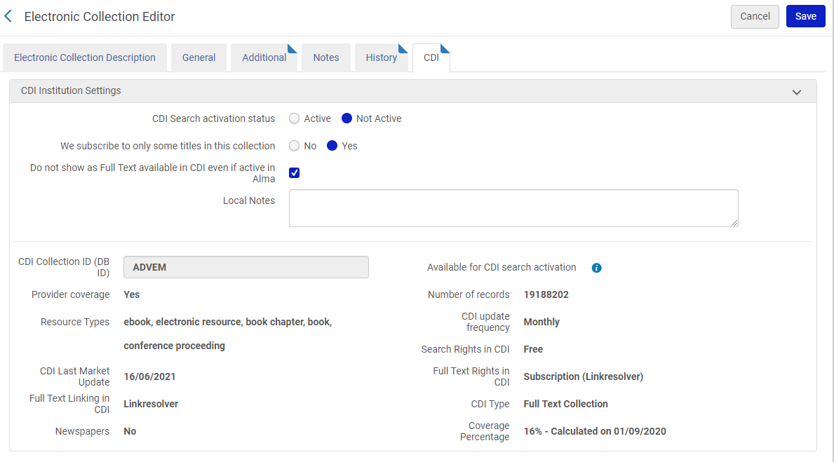
Adding Collections: Aggregator eBook CDI Settings
Aggregator eBook collections are less common than selective ebook collections, but some examples are eBook Central Academic Complete, EBSCO eBook North America, etc.
CDI settings: Edit Collection
Best Practices:
CDI Search: not active. Choosing active would give inaccessible results in expanded search.
We subscribe to only some = yes (again, nonintuitive but necessary)
Do not show as full text = checked. This is your preference, but checked is recommended. This will turn off chapter searching and extra representation of record from CDI in Primo. Will only get Alma bib in Primo.
www.suny.edu

Slide 13
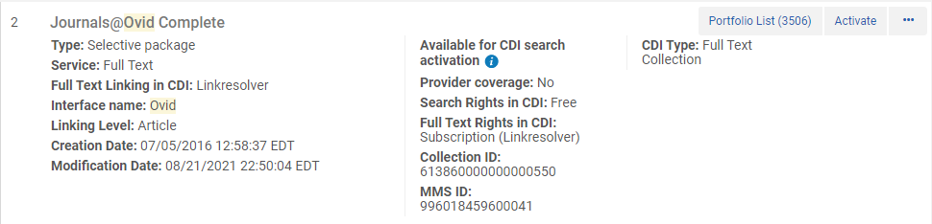
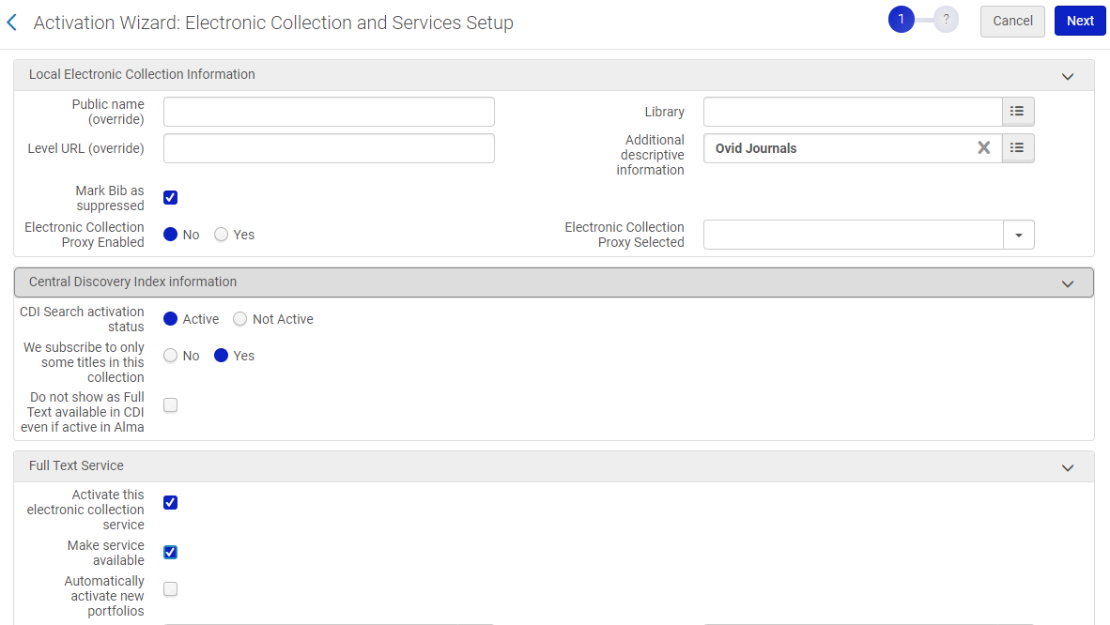
Adding Collections: Selective, Journals
Type: Selective package
Activate with “Activate” option
CDI settings: CDI search active, we subscribe to only some = yes, don’t check “do not show as full text” box
Full Text Service: check activate this collection and make service available
P.2 add any necessary parameters, enable default proxy for full text service
www.suny.edu

Slide 14
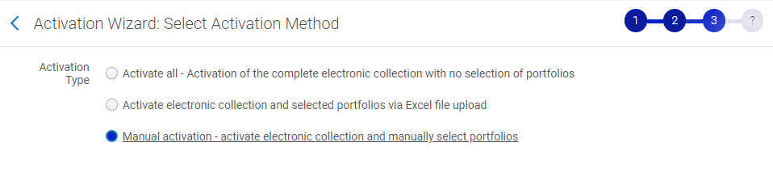
Adding Collections: Selective, Journals cont.
Choice for how you want to add titles:
Activate via Excel file upload (use portfolio loader file)
Manually select titles (can still use portfolio loader later)
www.suny.edu

Slide 15
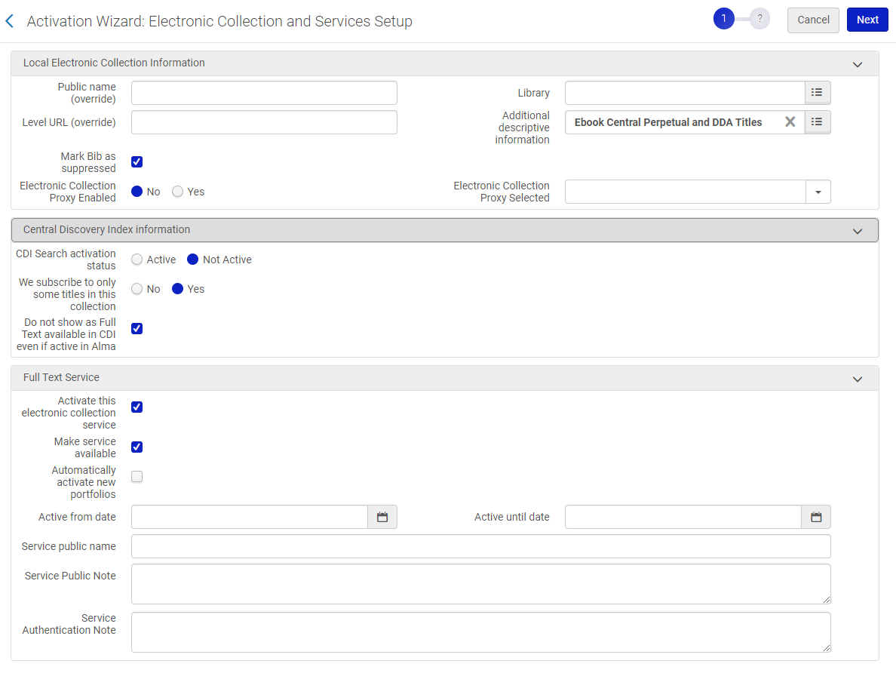
Adding Collections Detour: Selective, eBooks
Activate from three dots
CDI: not active for search, we subscribe to only some = yes, check Do not show as full text
Full Text Service: yes to activate, yes to make service available, no to automatically activate new portfolios
Page 2: add cust_id or other parameter if needed, yes to proxy service, pick default proxy
Page 3: add titles with excel file or manual – same process as for journals
www.suny.edu

Slide 16
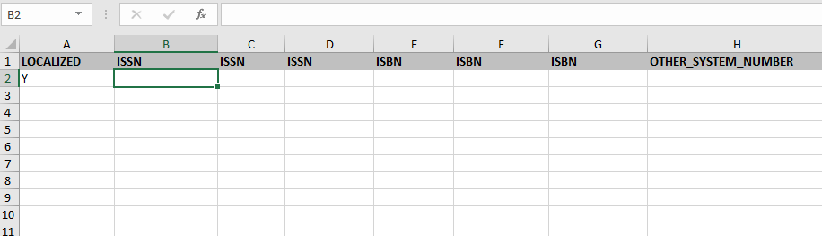
Adding Collections: Selective, Activate via Excel File
If you choose “Activate via Excel file upload” you’ll be asked to use portfolio loader before finishing collection activation.
Ex Libris portfolio loader documentation
Portfolio loader template
You’re loading a list of titles that will try to match on portfolios in this collection in the CZ, usually by ISSN or ISBN
You can add as little or as much information to this file as you’d like. Can get away with just Localized Y and one ISSN/ISBN number if you’d like.
Job will give you errors that you can download and review
Notes:
The ISSN/ISBN that you have may not be in the CZ, so it may not match
If you have titles with multiple coverage dates, it can only match once
If more than one portfolio in the collection has that ISSN/ISBN, it can’t match
www.suny.edu

Slide 17
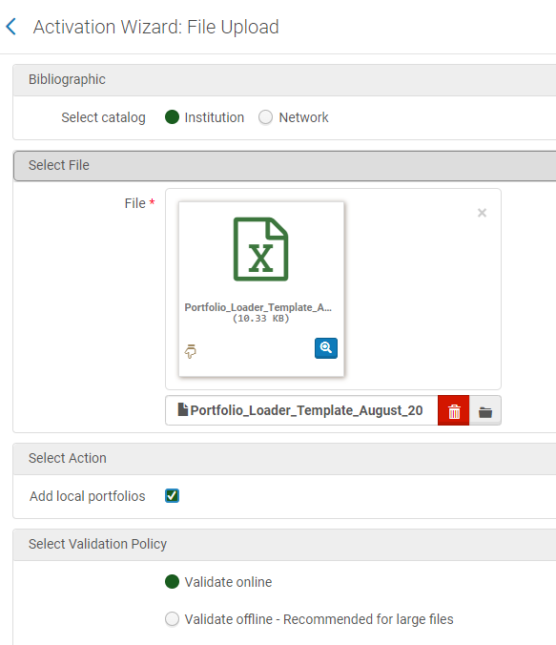
Adding Collections: Selective, Portfolio Loader cont.
Pick Institution for bibliographic record (tells system where to put local bibs if it can’t find match in CZ)
Pick your file
Select action: add local portfolios
Validate online: will give you immediate feedback if there are any problems with file
www.suny.edu

Slide 18
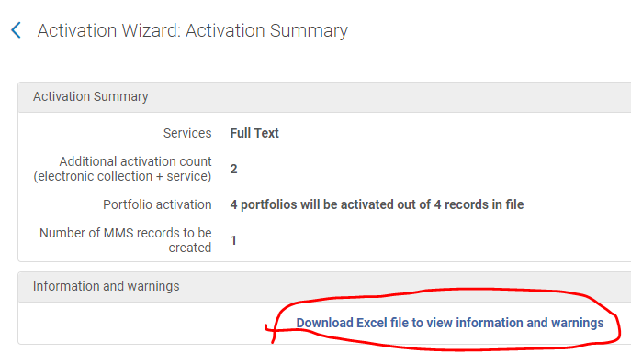
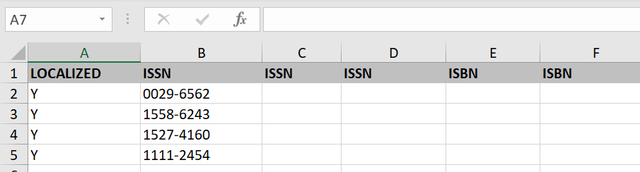
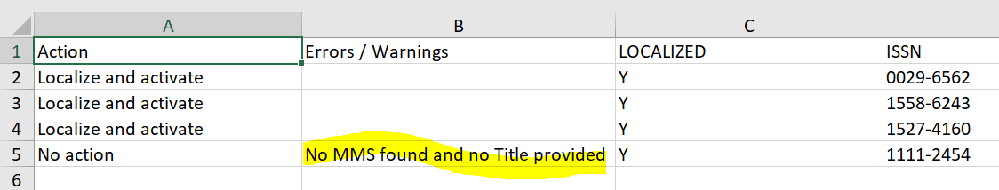
Adding Collections: Selective, Portfolio Loader cont.
Added 4 ISSNs: 3 good ones and one bad one – it’s adding all 4 but one is local
Original file:
www.suny.edu

Slide 19
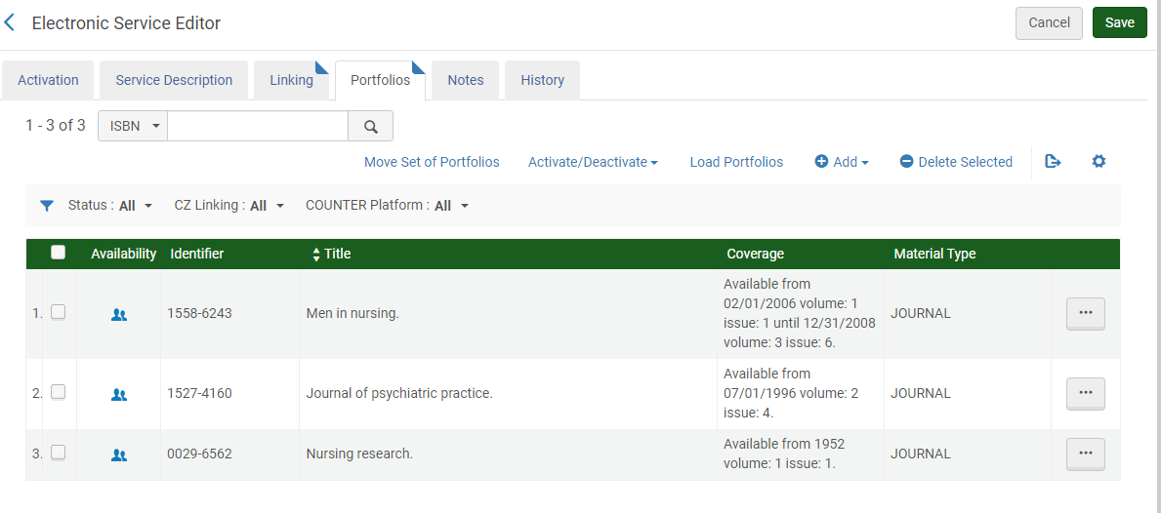
Adding Collections: Selective, Managing Portfolios
May need to edit what you’ve added through the portfolio loader, or manually add content
Manage portfolios in Edit Service in three dots after looking up collection
Added my three CZ matches, took coverage dates from CZ
Not sure what happened to MMS for fake one
Add drop-down: Can add titles manually from here one by one (manual form or pick from CZ) or using portfolio loader
Can delete portfolios, adjust coverage dates, relink bib to better bib from CZ, link local portfolios to CZ, etc.
www.suny.edu

Slide 20
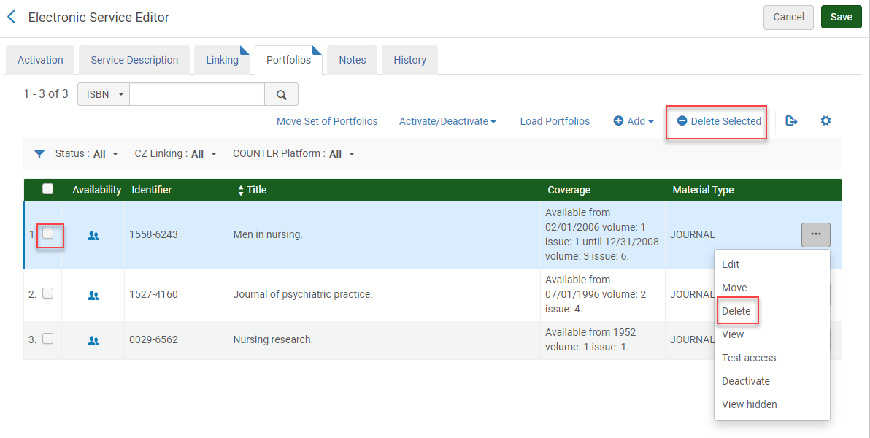
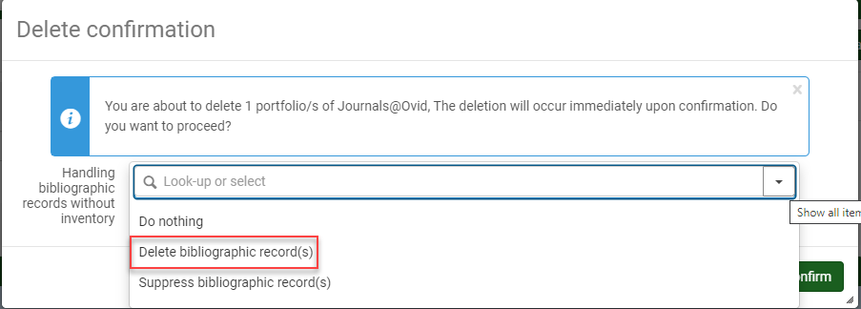
Modifying Content in Selective Collections: Deleting
Deleting is preferable to deactivating
Multiple ways to delete: from three dots or check box and delete selected
Make sure to delete bib records with no holdings
Keep an eye on CZ Task Updates report and/or DARA – will notify you when something in a selective collection has been deactivated and you’ll need to delete it and/or activate new version. Not managed for you because it’s a selective package
www.suny.edu

Slide 21
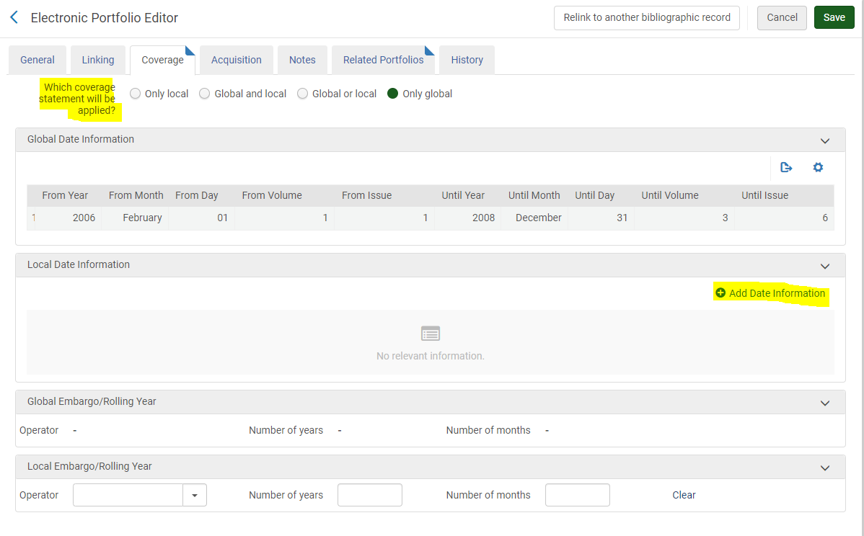
Managing PTA with Current Access, Title Back Files
Multiple date ranges don’t work when loading through portfolio loader, may have to adjust
To change dates, edit portfolio and go to Coverage tab
If PTA and current access are through same package and have same link, it’s recommended to just add local dates to current portfolio.
If your local access to title ends, can add your local coverage and choose to use “only local” coverage dates. Allows you to keep using CZ record for linking.
www.suny.edu

Slide 22
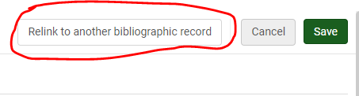
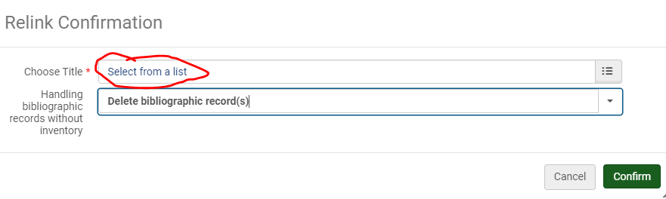
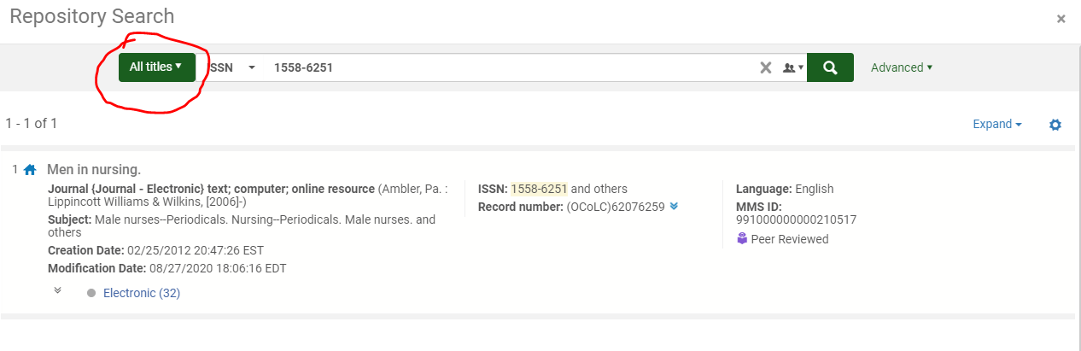
Relink to Better Bib in CZ
You want to activate the portfolio from the correct collection, so that your linking/access will work, but if you don’t like the bib record that’s in that collection, you could try to find a better one. This only changes the metadata, not the linking.
Relink:
Click relink button
Choose select from list to search CZ by ISSN, ISBN, etc.
Pick the bib that you want to use, if there is one
Choose Delete Bibliographic record(s) before confirming
www.suny.edu

Slide 23
Editing CZ records
If you really hate the record that’s in the CZ for your portfolio, and you can’t find a better one to link to in the CZ, you can edit the metadata but here are caveats:
Primo indexing for CZ content comes from the NZ, so if you only edit your IZ copy of the bib for the title, nothing will change in Primo. The edits have to be both in your IZ and the NZ.
In theory, you should be able to edit the CZ record, and that change will populate out to the NZ at the next CZ update job. Job timing is getting better for the NZ, but it’s still not immediate. Submit a ticket to info@slcny.libanswers.com if you want SLS to apply the changes in the NZ ASAP.
There’s no guarantee that your changes will be kept. We’ve had some success at adding EISSNs to CZ bibs (often needed for link look up in Primo), but adding 246s are still unstable (longstanding BUF case), and there’s no telling if a future load from the vendor will or won’t override your changes.
Some CZ collections are managed by the vendor and the content may not be able to be edited.
www.suny.edu

Slide 24
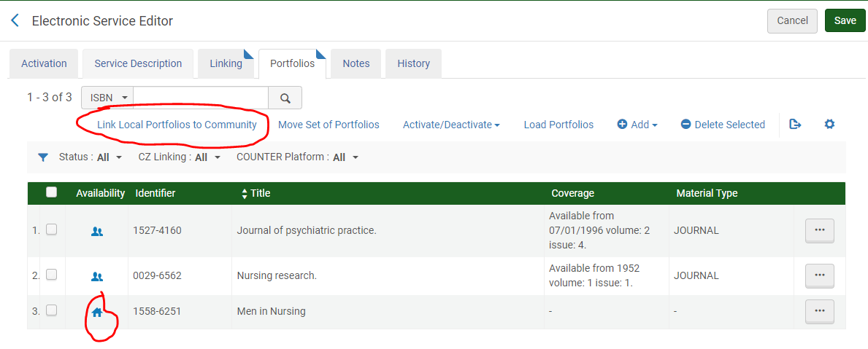
Link local portfolios to CZ
Sometimes you need to create a local portfolio if the title hasn’t been added to the CZ yet. DARA will let you know when that title appears in the CZ, and will recommended linking it, or you can periodically check.
Link to CZ:
DARA will walk you through steps
Or, go to Edit Service and choose Link Local Portfolios to Community – will do all of them, will match on ISSN
www.suny.edu

Slide 25
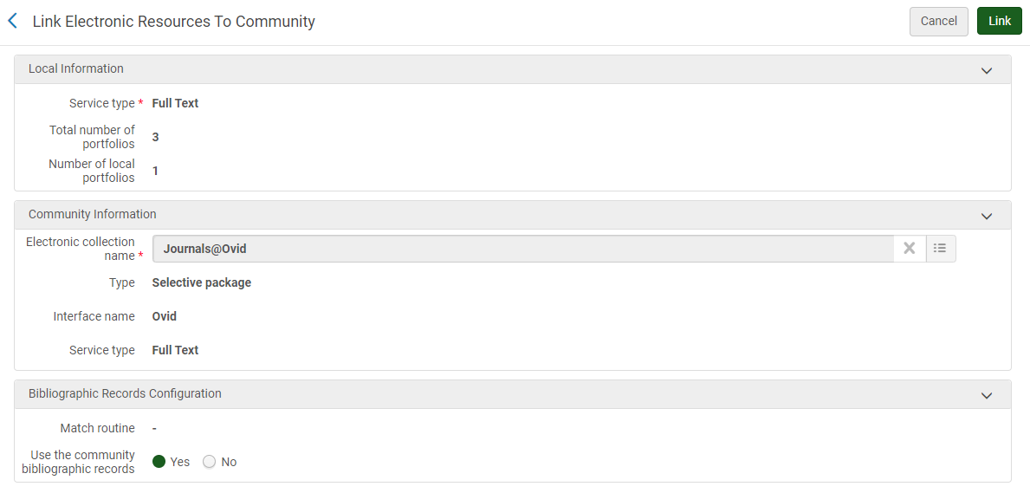
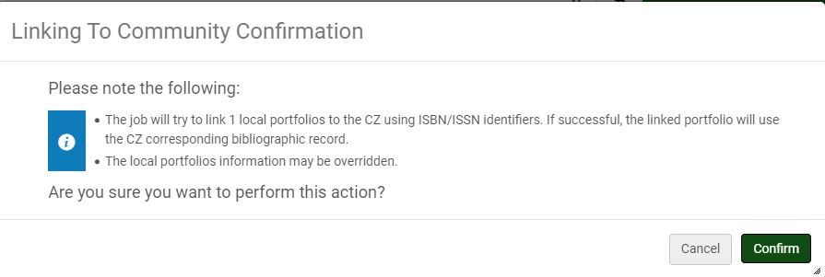
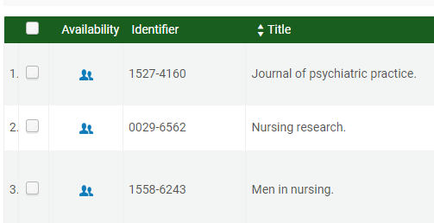
Link local portfolios to CZ, cont.
Will tell you how many local portfolios you have, and total number of portfolios.
Bib records configuration:
If you really like your local bib record, that you may have imported as a MARC record, you can say “no” to use the community bib record, but it’s recommended to use the CZ one
If you chose to keep your own bib, you’d still want to link to the CZ to maintain linking updates
Don’t be alarmed by warning
“Confirm” activates job, portfolios get linked
www.suny.edu

Slide 26
Link local portfolios to CZ, cont. Reminder!
Remember to test your linked portfolios in your Primo. Indexing for CZ titles comes from the NZ. If there’s no NZ bib record for your title, it won’t be able to be found in your Primo. It’ll look correct in your Alma system, it’ll show the CZ icon, but it won’t be findable in Primo.
Currently, the only way to fix this is to submit a info@slcny.libanswers.com ticket and Maggie or Michelle will get the bib record into the NZ for you.
We are tracking on this problem in case #00947014 NZ record not created when a portfolio is linked to the community, with target target fix date of Q1 2022.
www.suny.edu

Slide 27
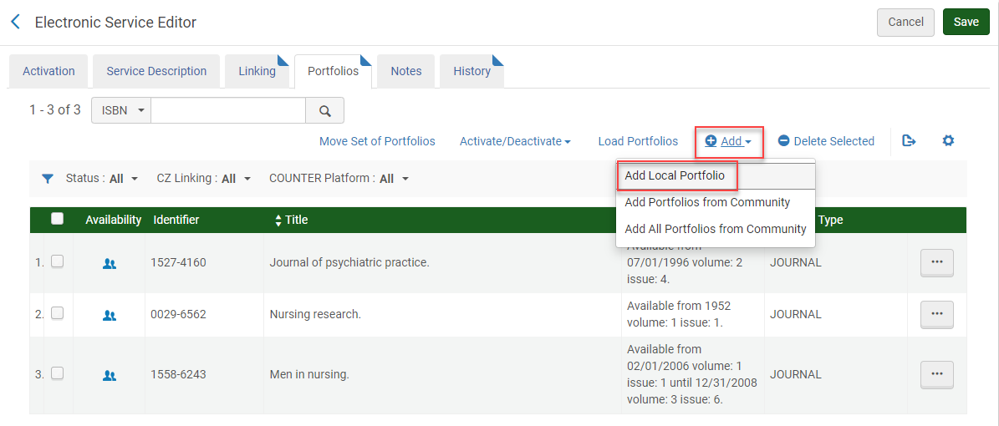
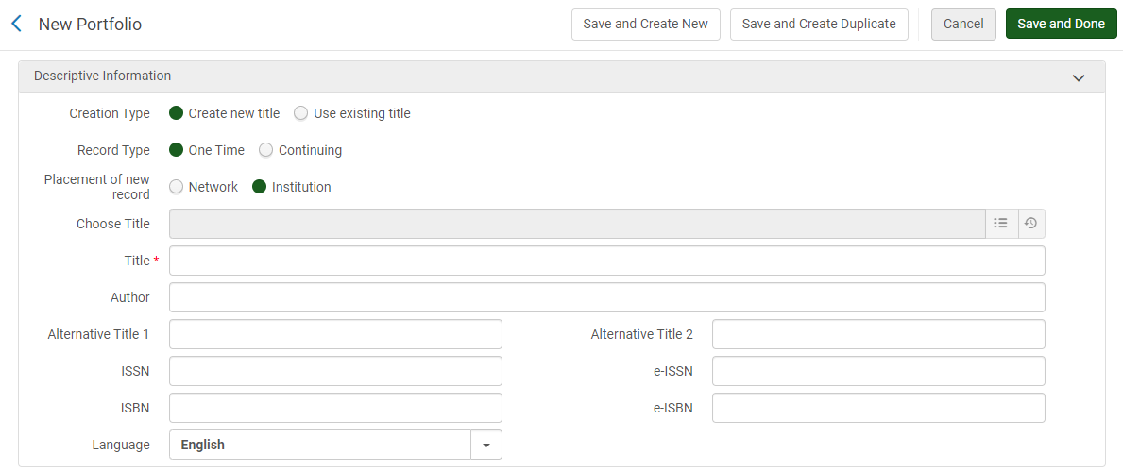
Adding Titles to Selective Packages
If your title doesn’t exist in your package in the CZ yet, you can add it manually and then link it later when it’s added to CZ.
Easiest way:
Add local portfolio from Edit Service, Portfolios tab
Can manually add title info (Create new title) or take title info from a CZ bib record (Use existing title). If you create new, make sure to add to IZ, not NZ
www.suny.edu

Slide 28
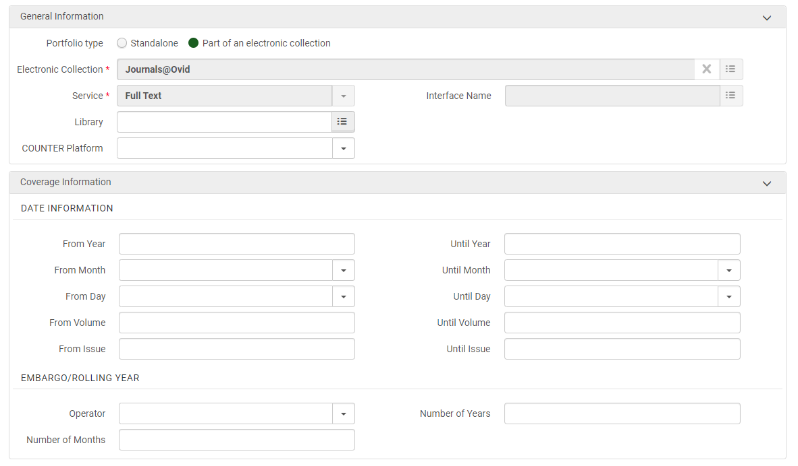
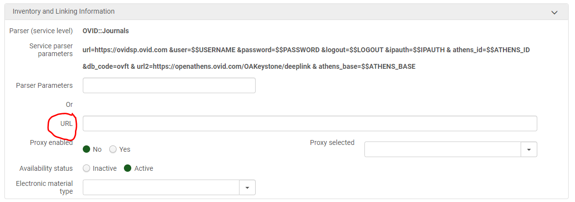
Adding Titles to Selective Packages, cont.
Keep default General Information
Add Coverage Information if relevant – applicable mainly for journals
Linking information is vital, will probably want to use a static URL until title is added to CZ
Don’t need to add proxy – inheriting it from service
www.suny.edu

Slide 29
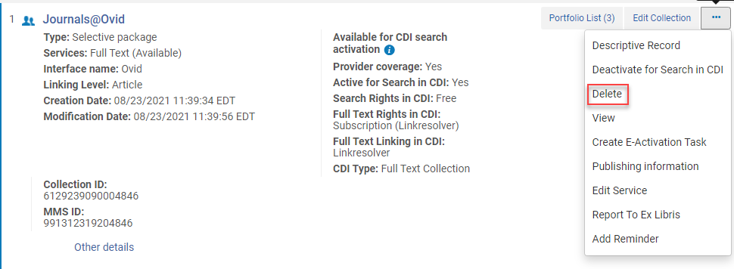
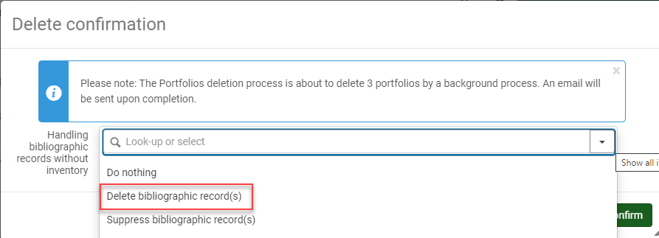
Deleting Collections
If you need to get rid of a collection, always fully delete it, and say yes to delete bibliographic records with no holdings.
“Confirm” will trigger delete job, large collections will take many hours to delete. Once deleted, Alma bibs should no longer appear in Primo. Article and other CDI records will take 3-4 days to go away.
www.suny.edu

Slide 30
Other Topics
Local Collections:
https://slcny.libguides.com/training-eresources/local_content
Import profiles for MARC records:
Alma Resource Management – Import Profiles
Link in Record Collections:
What's a Link in Record collection and how do I manage it? FAQ
CDI Best Practices webinar
Activating Collections for Search Only:
How does the Central Discovery Index (CDI) work and what do I need to know?
OA content:
How does Open Access (OA) content work in Primo VE?
www.suny.edu

Slide 31
Questions?
www.suny.edu

