Slide 1
Streamlining workflows with widgets in Alma: Adding Analytics data to your alma homepage
Mary Tuttle
Binghamton University

Slide 4
Why Add data to your alma homepage?

Slide 5
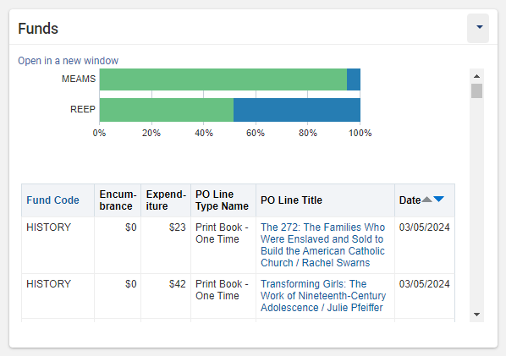
Value of adding this data
See visualizations and item-level detail in an environment you’re already opening frequently
View this data quickly and easily, rather than waiting for a scheduled report
Make Analytics data more accessible to users who rarely or don’t use Analytics
Creates a shortcut to that report on your homepage (“Open in a new window”)

Slide 6
Value of adding this data
Subject Librarians/Acquisitions:
Check fund expenditures and balances
View order history with action links to view resources in Primo
See as much detail about funds/orders as you want

Slide 7
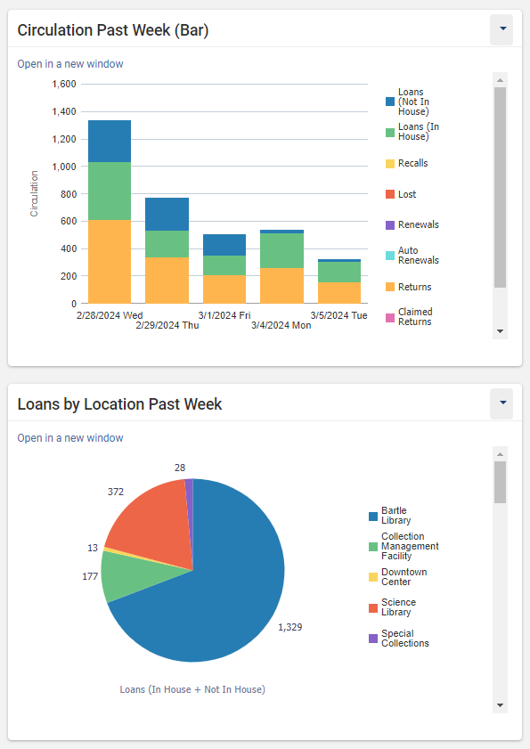
Value of adding this data
Reader Services:
See fulfillment activity over the past week
Compare circulation across library locations

Slide 8
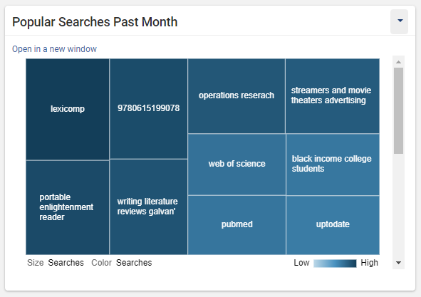
Value of adding this data
Research help/communications:
View current trends in Primo searches to see what the campus is searching lately

Slide 9
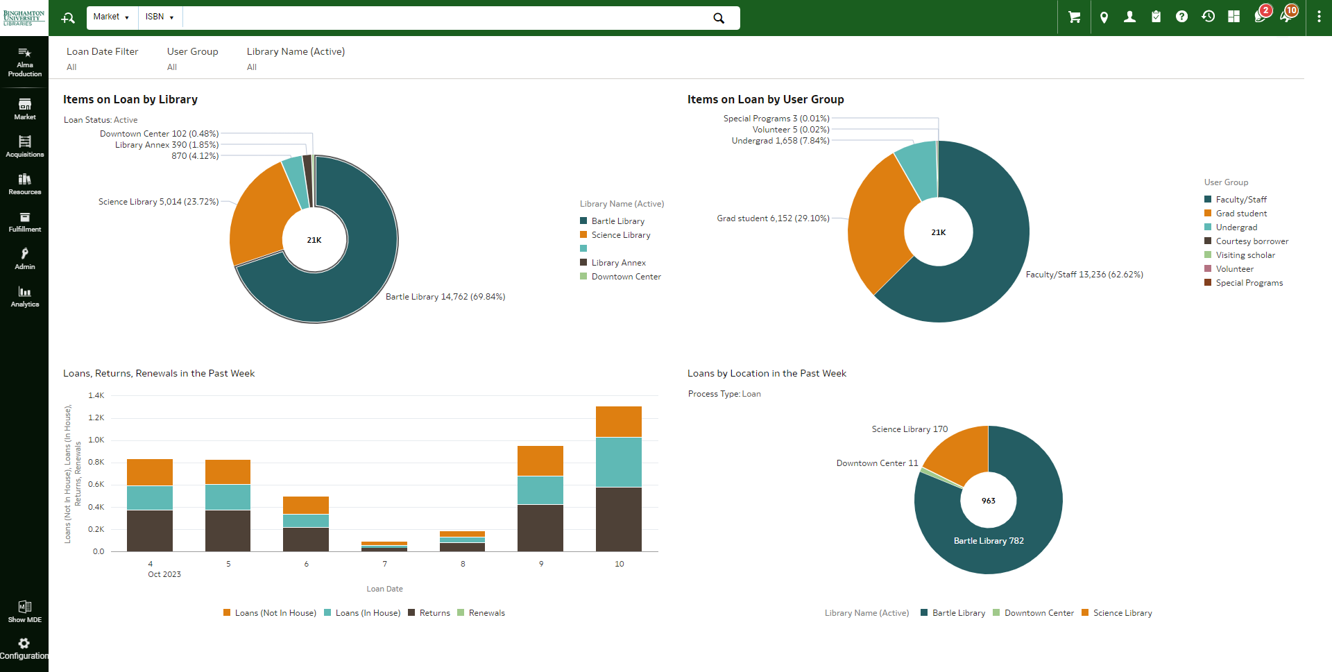
Data Visualization Workbook as Homepage
Adding Widgets to Homepage

Slide 10
Advantages of each
Widgets
DV Workbook
Can simultaneously show data from multiple subject areas
Can also have non-Analytics widgets (Recent Pages, Search in Discovery, etc.)
Dynamic filters on individual widgets
More modern looking
More user-friendly with more formatting and visualization options
Dynamic filters on your homepage
Better if you want more flexibility for your homepage
Better if you want to be able to use filters on all visualizations on your homepage

Slide 11
Creating an Analytics Widget for your homepage
Reports and Workbooks:
Alma: /Shared Folders/Community/Reports/Institutions/Binghamton University/Widgets
Primo: /Shared Folders/Primo Community/Reports/Binghamton University/Widgets

Slide 12
Creating an analytics widget
Create your report with all of your columns and filters, then go to the “Results” tab.
Note: Since Analytics data is from the previous day, my Loan Date filter is “>= CURRENT_DATE – 7” because I still want to see a full week of data.

Slide 13
Creating an analytics widget
Next to “Views”, click the “Add Visualization” icon, then navigate to Stacked Vertical bar graph.

Slide 14
Creating an analytics widget
Drag each column where you want it to appear in the graph. Drag anything you don’t want to appear to the “Excluded” box.
Measures: quantitative data for the y-axis
Bars – Group By: bars for the x-axis
Bars – View Color By: what bar colors represent

Slide 15
Creating an analytics widget
To add filters to the visualization, drag the desired column to the “Graph Prompts” section.

Slide 16
Creating an analytics widget
When finished, hit the “Done” button in the top right.

Slide 17
Creating an analytics widget
In the “Views” box on the bottom right, select the Graph you made and click the right arrow to add it to your report.
It will display under the other view(s) already on the report. You can drag to reorder them, or click the X to remove a view (you can readd it later if you want).

Slide 18
Creating an analytics widget
To configure the graph, click the “View Properties” icon in the top right.

Slide 19
Creating an analytics widget
On the “General” tab, set the width to 497px and height to 300px. These are the dimensions that work for me, but depending on your screen size you may need to adjust them.

Slide 20
Creating an analytics widget
To set custom colors or conditional formatting for your graph, go to the “Style” tab and select “Style and Conditional Formatting”.

Slide 21
Creating an analytics widget
To set custom colors, click the “+” and the first value will appear. The position number refers to the value’s position in the legend (1 = the first legend item). Click the box under “Color” to open the Color Selector. Select a color or type in a custom hex code, and click “OK” to save your changes. Continue until all your values have the colors you want.

Slide 22
Creating an analytics widget
On the “Titles and Labels” tab, uncheck the “Use measure/column name” options if you’d like to have custom titles and axis labels for your widget.

Slide 23
Creating an analytics widget
If you have a table under your graph, you’ll need to adjust its dimensions, too. Click the Format Container icon to adjust table dimensions.

Slide 24
Creating an analytics widget
Click the arrow next to “Additional Formatting Options” to expand the section. Type in your preferred dimension in the “Width” box. Analytics will override your dimensions if the table can’t fit so you don’t need to set a height. If the table is still too wide, you may need to remove or rename columns to condense it to better fit your widget box.

Slide 25
Creating an analytics widget
Now our graph is ready to become a widget. Don’t forget to save!

Slide 26
Creating an analytics widget
In Alma, open the “Analytics Object List” (under the Analytics menu on the left).
To create widgets, you’ll need the Analytics Administrator or General System Administrator role.
Notes:
https://knowledge.exlibrisgroup.com/Alma/Product_Documentation/010Alma_Online_Help_(English)/080Analytics/03Working_with_Analytics_Objects#Creating_an_Analytics_Object

Slide 27
Creating an analytics widget
Click “Add New Alma Analytics Object” on the top right (you may have to click “Actions” to see it). If you made a different Analytics report instead, click to add that type of Object.
Set the file path to your report, select the report, and set a name for your widget/object, then click “Save”.
Notes:
https://knowledge.exlibrisgroup.com/Alma/Product_Documentation/010Alma_Online_Help_(English)/080Analytics/03Working_with_Analytics_Objects#Creating_an_Analytics_Object

Slide 28
Creating an analytics widget
Set who you’d like to share the widget with – either with individual users or with anyone with a certain role.
Check the “Add as a widget” option.

Slide 29
Creating an analytics widget
Back on your homepage, click the plus button on the top right.
Check the box for each widget you’d like to add to your homepage.

Slide 30
Creating an analytics widget
Drag your widgets around if you’d like to rearrange them on your homepage.

Slide 31
Creating a Data Visualization workbook for your homepage
Reports and Workbooks:
Alma: /Shared Folders/Community/Reports/Institutions/Binghamton University/Widgets
Primo: /Shared Folders/Primo Community/Reports/Binghamton University/Widgets

Slide 32
Creating a DV Workbook
In the Data Visualization tool, click “Create” on the top right, and then “Workbook”.

Slide 33
Creating a DV Workbook
Switch to the “Subject Areas” tab, select a subject area, then click “Add to Workbook”.

Slide 34
Creating a DV Workbook
Your workbook is created. Start dragging in columns from the left (structured the same as Analytics).

Slide 35
Creating a DV Workbook
The visualization will change depending on the number and types of columns you add.

Slide 36
Creating a DV Workbook
Sometimes the visualization the tool chooses isn’t the one we want. We have to change the visualization type before we can switch columns between axes.

Slide 37
Creating a DV Workbook
Now all of our measures are on the y-axis and our loan dates are on the x-axis. Let’s set a filter to just see the past week.
You can right-click any column in the shelf to use it as a filter (“Create Filter”). This option doesn’t allow for SQL, though.

Slide 38
Creating a DV Workbook
In the filters section, click “Add Expression Filter”. Type in your SQL statement (helper dropdowns will appear). Hit “Validate” to make sure there are no errors, then click “Apply”.

Slide 39
Creating a DV Workbook
To set custom titles and axis labels, use the box in the bottom left. Click “Auto” and change the selection to “Custom” to type in your own.

Slide 40
Creating a DV Workbook
You can also set custom colors for each measure represented. Right-click the graph and select “Manage Assignments…” under “Color”.

Slide 41
Creating a DV Workbook
You can add multiple visualizations to the same canvas in a workbook by clicking the “Visualizations” icon in the top left and dragging in another visualization type.

Slide 42
Creating a DV Workbook
You can add filters that apply to all of the visualizations on this canvas. Click the little plus (hover over the bar for it to appear), and create your filter using a column from the dropdown or create an expression filter (SQL). These filters are usable on your Alma homepage.

Slide 43
Creating a DV Workbook
Don’t forget to save!
You can have multiple canvases in your workbook, but only the canvas that’s selected when you save the workbook will appear as your Alma homepage.

Slide 44
Creating a DV Workbook
In Alma, open the “Analytics Object List” (under the Analytics menu on the left).
To create widgets, you’ll need the Analytics Administrator or General System Administrator role.
Notes:
https://knowledge.exlibrisgroup.com/Alma/Product_Documentation/010Alma_Online_Help_(English)/080Analytics/03Working_with_Analytics_Objects#Creating_an_Analytics_Object

Slide 45
Creating a DV Workbook
Click “Add New Alma Analytics Object” on the top right (you may have to click “Actions” to see it). If you made a different Analytics report instead, click to add that type of Object.
Set the file path to your report, select the report, and set a name for your widget/object, then click “Save”.
Notes:
https://knowledge.exlibrisgroup.com/Alma/Product_Documentation/010Alma_Online_Help_(English)/080Analytics/03Working_with_Analytics_Objects#Creating_an_Analytics_Object

Slide 46
Creating a DV Workbook
Set who you’d like to share the widget with – either with individual users or with anyone with a certain role.
Check the “Add as a Homepage Dashboard” option.

Slide 47
Creating a DV Workbook
Open the “Alma Production” menu, the click “Alma Homepage” under “My Homepage”, and change the selection to the DV Workbook Object you just created.

Slide 48
Creating a DV Workbook
Your DV workbook is now set as your Alma Homepage. If you added canvas filters, you can use them directly on your homepage.

Slide 49
Thank you
Feel free to contact me with questions or to let me
know how you customized your Alma homepage!
Mary Tuttle
mtuttle@binghamton.edu
Reports and Workbooks:
Alma: /Shared Folders/Community/Reports/Institutions/Binghamton University/Widgets
Primo: /Shared Folders/Primo Community/Reports/Binghamton University/Widgets

Slide 50
SQL Resources for Analytics
Date and Bibliographic Fields: https://developers.exlibrisgroup.com/blog/alma-analytics-sql-filter-examples/
Regular Expressions in Analytics: https://developers.exlibrisgroup.com/blog/alma-analytics-regular-expression-examples/
REPLACE() vs. Regular Expressions: https://developers.exlibrisgroup.com/forums/topic/sql-regular-expressions-in-alma-analytics/
Harvard’s Advanced Formulas Wiki: https://wiki.harvard.edu/confluence/display/LibraryStaffDoc/Advanced+Formulas

