Slide 1

SUNY Library Shared Services Update
March 31, 2020
www.suny.edu

Slide 2
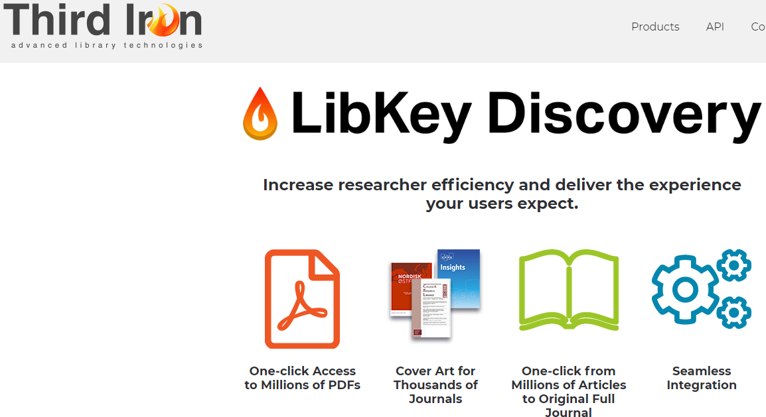
Libkey
All campuses who have expressed interest have been set up.
  SLSS handled Alma/Primo work.
Pricing range distributed to Institutional Leads.
Final pricing will be close to the high end of the range due to # of campuses participating.
www.suny.edu

Slide 3
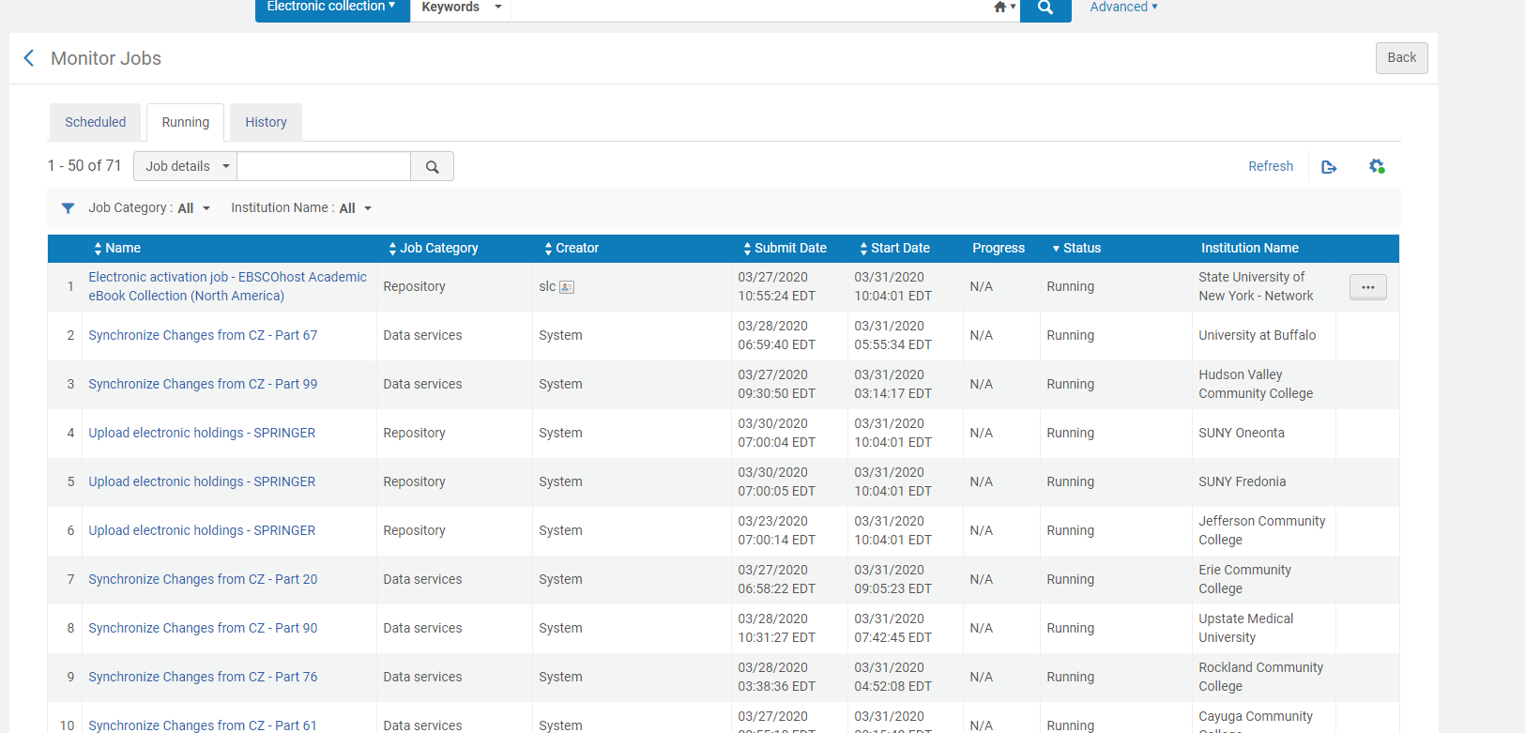

Update on Repository Jobs Issue
  We’re working with ExL to resolve issue.
  Sunday server restart to try to free up stuck/zombie jobs.
  Server restart created another issue with our attempt to activate a large job from NZ.
  Head of development and ExL admin are working on this.
  Will keep everyone up to date as much as we can.
  Affecting all Repository jobs, whether scheduled or user generated.
www.suny.edu

Slide 4
COVID 19 Response Webinars and Resources
COVID Library Response and Planning Group:
  https://3.basecamp.com/3649838/join/JCAEYjmRR3H8
Will plan webinars/updates when there is more information.
www.suny.edu

Slide 5

SUNY Shared Collections Strategies
Esta Tovstiadi
www.suny.edu

Slide 6
Shared Collection Strategies - Immediate
  Coordinate renewals for the next renewal cycle
  Developing rubric to evaluate vendor offers
  Assessing our current collection
    Gathering data on current e-resource collections
    Plan to explore print collections
  Exploring Cooperative Collection Development
    Across SUNY
    Within sub-cohorts (by campus type, program area, etc)
  Building our relationship with vendors
  Lessening burden of Procurement from campuses to SLSS when possible
    System-wide deals for resources many of us are already subscribing to
    Getting more vendors on State Contract
www.suny.edu

Slide 7
Current & Upcoming Projects
  Academic Video Online (currently trialing)
    20 campuses currently subscribe
    We are hoping to secure a SUNY-wide deal for interested campuses
  SUNYConnect databases
    Currently EBSCO databases, expires 6/30/2021
    Working with EBSCO on a multi-format offer that allows campuses more flexibility in choosing what to subscribe to, varied access options
    Goal is expanded access, more relevant content and cost-savings across the consortium
  SpringerNature
    Potential Nature or Springer eBook deal
    Working on State Contract process
  Ebook Central DDA pilot
    Working with a small group of campuses to develop workflow in Alma
    Goal is to test SUNY-wide DDA if there is interest
www.suny.edu

Slide 8

Current & Upcoming Projects
  Chronicle of Higher Education Renewal
    1 year renewal
    25% discount off retail price, 4% increase over last year's price
    29 campuses currently participating
    Please put a ticket in by April 10 if you are interested in pricing
      info@slcny.libanswers.com
www.suny.edu

Slide 9

Central Management of E-Resources
Network E-Resource Task Force finalized recommendations, including criteria for central management of e-resources, approved by LSP Advisory Council
Looking at collections that change regularly and require a lot of staff time to manage
Started pilot STAT!Ref central management last week, good feedback from campuses
Free COVID-19 content: activation at many campuses bogged down server, planning to manage EBSCOhost Academic Search Ultimate, Business Source Ultimate, and eBooks North America packages centrally
Submit form if you want to request a free package to be hosted centrally:
  https://slcny.libguides.com/libraries-COVID19/eresources
www.suny.edu

Slide 10

Central Management: Elsevier 2020 New Deal
Received 25 responses for central management survey – thanks to all who responded
E-Resources Management Plan:
Current 248 titles:
  SLSS will set up in Network Zone unless you've asked us not to.
  Access will be from 2016-Current
Local Perpetual Title Access:
  Received files from Elsevier with this content for each campus
  SLSS will set up and activate for you in your IZ unless you've asked us not to
  May affect the access to Current 248 titles
Campus to-dos:
  Deactivate your local collections, including bib records: https://slcny.libanswers.com/faq/291468
  If desired, turn off Elsevier holdings integration.
Job slowness will impact this work
www.suny.edu

Slide 11
Support Update: the Highlights
Network Jobs
Continuing to pursue ghost records problem
Bringing up bad Ebsco linking
Worked to gather stale or problematic cases.
On a regular basis, we submit in-case feedback to try to free up issues.
Still working on some course reserve display issues in Primo across cases.
Top 5 Issues:
  RS pop up message to prevent “looping” for unreceived lending requests. DEV planned and coming.
  Ghost records: are working on processes to handle these records.
  RS request options for print when lib. has ebook: May 2020 target release.
  Boost local holdings in Primo: Late 2020 target release.
www.suny.edu

Slide 12

Please Bring Cases to our Attention
  We're doing our best to review cases across the consortium, and to find issues that we need to escalate.
  But, we're not perfect, so if there's a case that needs to attention that we haven't discovered, please let us know by emailing info@slcny.libanswers.com
www.suny.edu

Slide 13
Resource Sharing Update
Timothy Jackson
www.suny.edu

Slide 14
Alma Resource Sharing Shutdown
Alma Resource Sharing shut down for all SUNY campuses as of March 18
  Approved by SLC Board
  Configuration work done by SLSS staff for libraries that hadn't already turned off resource sharing
No date for turning resource sharing back on at this time
  Please be sure to keep SLSS posted on when your library plans to repoen once you start having those conversations on your campus
Empire Library Delivery suspended until April 3
  Likely to be extended until April 15
www.suny.edu

Slide 15
Temporary Resource Sharing and Fulfillment Policies
Full details:
  https://slcny.libguides.com/ld.php?content_id=52873224
  Approved by SLC Board
All resource sharing loan periods are now 16 weeks with 3 renewals
  SLSS staff did all necessary configuration
Users may return any item borrowed from a SUNY library to any other SUNY library
  Specific procedures and link to tracking form will be shared soon
Temporary policies in place until July 31, 2020
  SLSS staff will undo configuration changes once policy expires
Safety measures take precedence over temporary policies
www.suny.edu

Slide 16
Resource Sharing Due Dates & Hold Expiry Dates
Lending Due Dates:
  Cannot batch update lending due dates
  Best to wait for borrower to submit renewal request
  Automatic renewals for borrowing requests may not be possible
  Submitted a case to Ex Libris
Borrowing Due Dates
  Can be batch updated by running the Bulk Change Due Dates job
  Will result in discrepancies between users' due dates and lending library due dates
  Don't worry about these discrepancies
Hold Expiry Dates
  Cannot be batch updated
  Hold expiration dates can be seen by users, so you may want to manually update them
  Expired holds can still be checked out to users if manually updating all hold expiry dates isn't feasible
www.suny.edu

Slide 17
Resource Sharing Projects
Alma resource sharing with non-SUNY libraries
  Successfully sent requests between SUNY and Union College sandboxes
  Working with Ex Libris on resolving some renewal related workflow issues
  In addition to Union, CUNY, Ithaca College, St. John Fisher, Canisius, and Marist have expressed interest
Alma walk-in borrowing with non-SUNY libraries
  We know it's theoretically possible, and we'll be looking into it more
Article resource sharing in Alma
  Successfully sent digital RS requests between SUNY sandboxes
  Working with Ex Libris on what the optimal workflow should look like
www.suny.edu

Slide 18
RapidILL & ILLiad
RapidILL:
  Ex Libris is offering free article borrowing through RapidILL for 3 months or September 1 (whichever comes first)
  150+ libraries have agreed to lend
  No lending obligation if you choose to borrow through RapidILL
  SLSS will coordinate with libraries looking to take advantage of this offer
  More information will be coming soon
ILLiad:
  Published article on managing ILLiad workflows during COVID-19
  https://support.atlas-sys.com/hc/en-us/articles/360044552474
www.suny.edu

Slide 19
Network Zone
Maggie McGee
www.suny.edu

Slide 20

New Order API Task Force Update
The New Order API was approved this month!
The New Order API Policy is available:
  Approved Policies
  New Order API page under the Resource Management Training Guide
Google Forms to be sent to Institutional Leads to gauge interest in having the SLSS help setting up New Order APIs for campuses
  New Order API Interest ConfigurationQuestionnaire
www.suny.edu
Notes:
Good attendance and engagement for all sessions. A successful switch to registration-based training, which makes it easier to communicate with and count participants.

Slide 21

OCLC Import Profile Updates
April 30, 2020 deadline to move to OCLC's new exchange servers has been currently suspended by OCLC due to COVID-19
  They encourage moving to the new servers as soon as possible
  Once the changes have been made the access to the old server will no longer be available
The SLSS made the server changes for the 39 campuses that the SLSS configured publishing profiles for
Instructions on how to make the server changes to the Bib and LHRs s/ftp definitions were emailed and posted in the Institutional Leads Basecamp for the remainder of the campuses
The OCLC exchange server changes will need to be made for any other OCLC services being used in Alma beyond publishing profiles for all campuses
  https://help.oclc.org/Librarian_Toolbox/Exchange_files_with_OCLC
www.suny.edu
Notes:
Good attendance and engagement for all sessions. A successful switch to registration-based training, which makes it easier to communicate with and count participants.

Slide 22

OCLC Institution Zone Integration Profile
Created a local merge rule for all SUNY campuses
  The Merge rule is called: SUNY – Overlay All But Local Fields
Updated all existing IZ OCLC integration profiles to use the new merge rule
  19 out of 60 campuses did not have an IZ OCLC integration profile configured in Alma
www.suny.edu
Notes:
Good attendance and engagement for all sessions. A successful switch to registration-based training, which makes it easier to communicate with and count participants.

Slide 23
Local Holdings Records (LHRs) Publishing Profiles
Currently working on configuring and activating LHRs publishing profiles for campuses the SLSS set up their publishing profiles and responded to the questionnaire
  The LHRs Publishing Profile Questionnaire has been emailed to campuses that did not reply in January
For campuses configuring their LHRs Publishing Profiles on their own:
  The Alma enhancement to remove 004 added to holdings records during migration works! This means the normalization rule/process to remove 004s is no longer necessary
  Run the "Holding OCLC Republish Set of Titles" job if the set of LHRs did not publish correctly to OCLC
www.suny.edu
Notes:
Good attendance and engagement for all sessions. A successful switch to registration-based training, which makes it easier to communicate with and count participants.

Slide 24
CZ Records In the NZ without Holdings
CZ records are linked to the NZ when activated
CZ records remain in the NZ after all holdings have been removed
Deleting CZ records in the NZ without holdings in small batches
11k records were identified and reported to Ex Libris with the incorrect format:
  Ex Libris updated the records to the correct format
www.suny.edu
Notes:
Good attendance and engagement for all sessions. A successful switch to registration-based training, which makes it easier to communicate with and count participants.

Slide 25
Training Update
Jennifer Koerber
www.suny.edu

Slide 26
Training Updates
Training Guides
Developing Campus-Level Training
"Turning Documentation into Training" webinars, April & May
February webinar recording & files:
https://public.3.basecamp.com/p/k3Z1zWPTfeJuZKCy2esrk1Lz
Supporting documents:
https://public.3.basecamp.com/p/JPL8a7pseBKYzqv3hpTinzsm
Alma Systems Librarians & Administrator Training guide:
https://slcny.libguides.com/training-syslibs
Main Training Site:
https://slcny.libguides.com/lsptraining
Acquisitions guide (by end of April)
www.suny.edu

Slide 27
Additional SLSS Updates
www.suny.edu

Slide 28

SLSS Virtual Visits
As we had to cancel in-person visits, we’re going to try virtual visits.
Please don’t feel any pressure to set this up now if this would be stressful to set up.
Will meet with 1-2 SLSS staff to review how things are going.
SLSS staff will be sending out e-mails as invites in the next few weeks.
www.suny.edu

Slide 29

Update on Renewal
Need to wait until OCLC Annual Price increase is established for this year.
OCLC will provide sometime in April.
We'll work as fast as we can after that, but this may result in us being close to deadline for renewal, or a bit late.
www.suny.edu

Slide 30
Offer for SLSS to Provide Accessibility Review
SLSS will use accessibility software to review your library web presence.
We'll provide you with a report of accessibility issues flagged by software.
We won't fix issues for you, but you can use report to address issues.
Initially limited to first 2 campuses that request.
Request via libanswers: info@slcny.libanswers.com
www.suny.edu

Slide 31
SLC Update
Jennifer Smathers, SLC Consortial Engagement Coordinator
www.suny.edu

Slide 32

Working for You:
OLIS working with SUNY Procurement on SLC’s SpringShare agreement to get LibAnswers in place for libraries without chat
SLC Spring meeting will go virtual
  Dates will remain the same June 8-9
  Details TBD
www.suny.edu

Slide 33

You Working for SLC?
Anyone working at a SLC member library is eligible to serve on the Board, with the approval of their Director
At-large positions open:
Three-Year Term #1
(SLC Spring Meeting 2020 - SLC Spring Meeting 2023)
Three-Year Term #2
(SLC Spring Meeting 2020 - SLC Spring Meeting 2023)
Two-year term #1
(SLC Spring Meeting 2020 - SLC Spring Meeting 2022)
The nomination form is open through 4/10/2020
www.suny.edu
Notes:
Thanks to Katie Ghidiu and Ken Fujiuchi as they complete their terms and rotate off.
The SLC Framework, with an overview of Board responsibilities, can be found on the SLC website. There are three openings on the Board, with all three terms starting at the conclusion of the SLC Spring Meeting.
The voting period will open on April 13th and close on Friday, April 24th, 2020.
Please contact Katie Ghidiu, SLC Secretary (kghidiu@monroecc.edu) with any questions.
All messaging around nominations and voting will be distributed to the SLC and SUNYLA listservs.

Slide 34
Helpful links:
SUNY Libraries COVID-19 Planning and Information
SUNY’s COVID-19 Response
SUNY Libraries COVID-19 Survey￼
Basecamp for COVID 19 Library Response and Planning -join link
Ithaka S+R Survey: https://tinyurl.com/covidlibrary
www.suny.edu
Notes:
Nope, not reading this slide ;) PLEASE these Links into chat:
Helpful Links:
SUNY Libraries COVID-19 Planning and Information
SUNY’s COVID-19 Response
SUNY Libraries COVID-19 Survey (take as often as library circumstances change)
Basecamp for COVID 19 Library Response and Planning -join link
Ithaka S+R Survey: https://tinyurl.com/covidlibrary

Slide 35
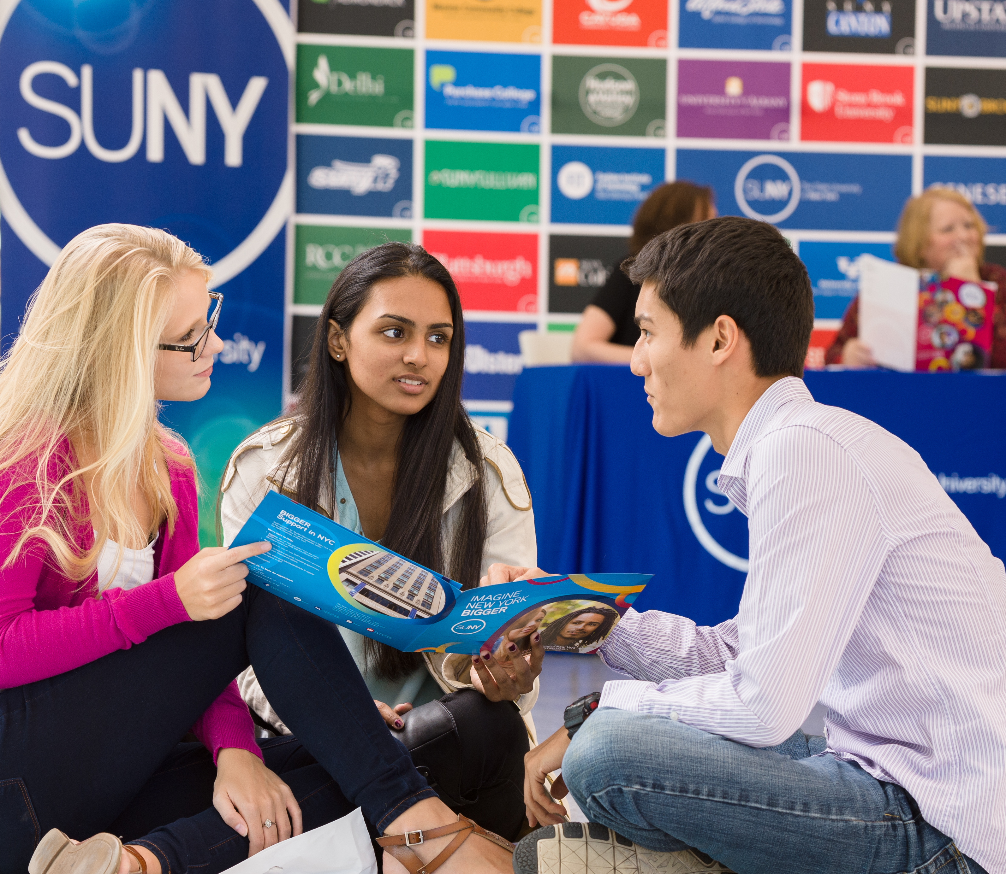

Questions or Discussion?
www.suny.edu

