Slide 1
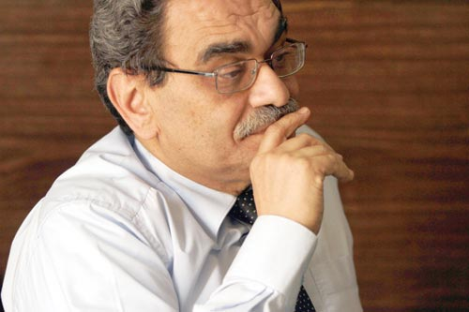
The energy requalification of public buildings across the Mediterranean
Mohamed Salah ElSobki (Jr.)
Alexandria Chamber of Commerce
Confederation of Egyptian European Business Association (CEEBA)

Slide 2
SOLE project (WHY)
Survival
Through resource efficiency (…... & its cheaper )
Understanding
Collaboration (working together)
Implementation
There always room for more

Slide 3
SOLE project results
Involvement
Recipients (beneficiaries)
Service providers
Facilitators (utilities, municipalities, … etc.)
Feasible
Technically (technology, human power, space, duration, …etc.)
Financially (available, room for more, incentives, based on the cost of the avoided fuel )

Slide 4
Technical, Regulatory and Financial aspects of facilitating the energy requalification of public buildings,
Large range (different activities,……)
Regulations are quite important
Permits
Etc…………. (understanding of ………. Stakeholders)

Slide 5
Awareness raising campaign against energy waste
Investing in Energy Conservation is much lower than investing in new resources
In house improvements
Medium
Large investments
New commercial activities

Slide 6
Contribution of rehabilitated public buildings to Renewable Energy Communities.
It opens the markets for innovative applications
High replicability
Baises for applications at new public buildings

Slide 7
Looking forward for working together in the near future for a better future for every one
Survival
Through resource efficiency
Understanding
Collaboration (working together)
Implementation
There always room for more

