Slide 1
Framing and Context
The control of energy has become, for about ten years, a priority put forward by Tunisia. The stakes are high: energy dependence, depletion of fossil resources, pollution and climate change are all concerns that every day show their topicality. This means that the issue of energy efficiency must be integrated into all planning and/or programming instruments at both national and local levels.
Therefore, the Tunisian municipalities are at the heart of the problem and are called to become major players in the national strategy of energy management, which should have an impact on the municipal budget, interventions and services provided by the commune.

Slide 2
As part of the development of its activities and the implementation of activities related to the project ’High energy efficiency for public buildings in the Mediterranean INNEMED- SOLE’ which aims to promote energy efficiency in public buildings and the capitalization / dissemination of good practices and experiences of municipalities in this field, in partnership with the National Association of Italian Municipalities of Tuscany - ANCI, the National Federation of Tunisian Municipalities (FNCT) and the National School of Architecture and Urban Planning (ENAU) are organizing a workshop entitled 'Design and reflection workshop on energy efficiency in public buildings ‘.

Slide 3
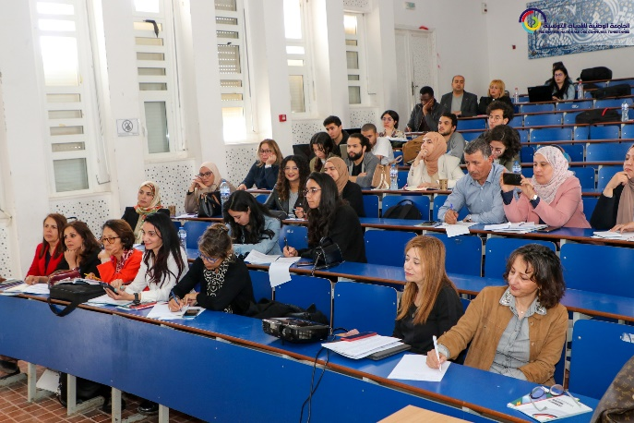
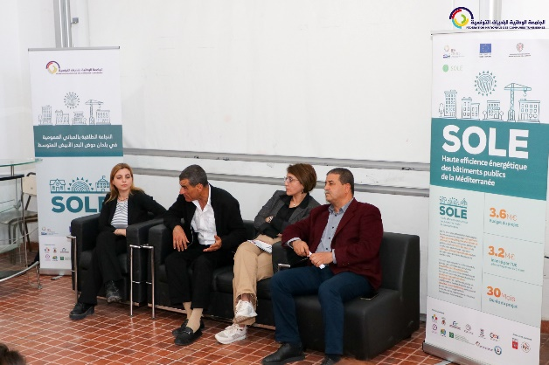
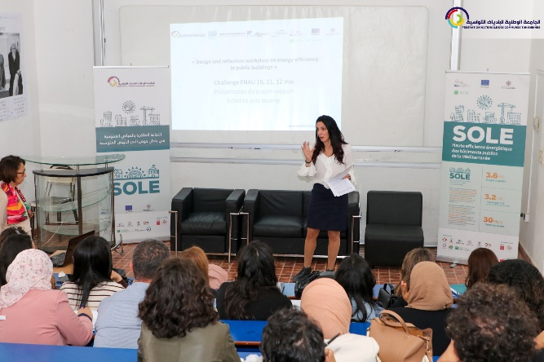
General Objective
This workshop is an opportunity to highlight the essential role of "design" as a lever of innovation proposing solutions and operational responses to strengthen and improve the energy performance of buildings and respond to the challenges and issues raised by the various stakeholders in order to reduce the energy bill in municipal public buildings.

Slide 4
This event will also provide an opportunity to address the issue of energy efficiency and share it in an academic setting with future architects and designers to:
- Conduct a joint reflection on the issues related to energy efficiency with a focus on buildings.
- Develop technical (architectural) and operational recommendations to address energy challenges in buildings.
- Designing an innovative and 'futuristic' vision for buildings in terms of improving their Energy Efficiency.
- To set up/develop a framework for consultation, sharing and coordination which will be a force of proposal for the implementation and the diffusion of approaches, methods and tools related to energy efficiency in public buildings. (Academic and institutional environment, research centers, NGOs, PTF, municipalities, experts...)

Slide 5
The exercise will also be an opportunity and a framework for exchange, consultation and sharing between community architects, students and teachers to increase awareness of the benefits of Energy Efficiency in buildings and the role that can be provide by Energy Efficiency measures and actions to improve thermal comfort for occupants and reduce the energy bill of buildings of municipality In particular, we are aware of the benefits that improving Energy Efficiency in public buildings can bring to make changes in citizen behaviour's and make them adhere to a local approach of energy transition, through the duplication of Energy Efficiency measures in their homes..

Slide 7
URBAN STRATEGY

Slide 8
URBAN STRATEGY

Slide 9
URBAN STRATEGY

Slide 10
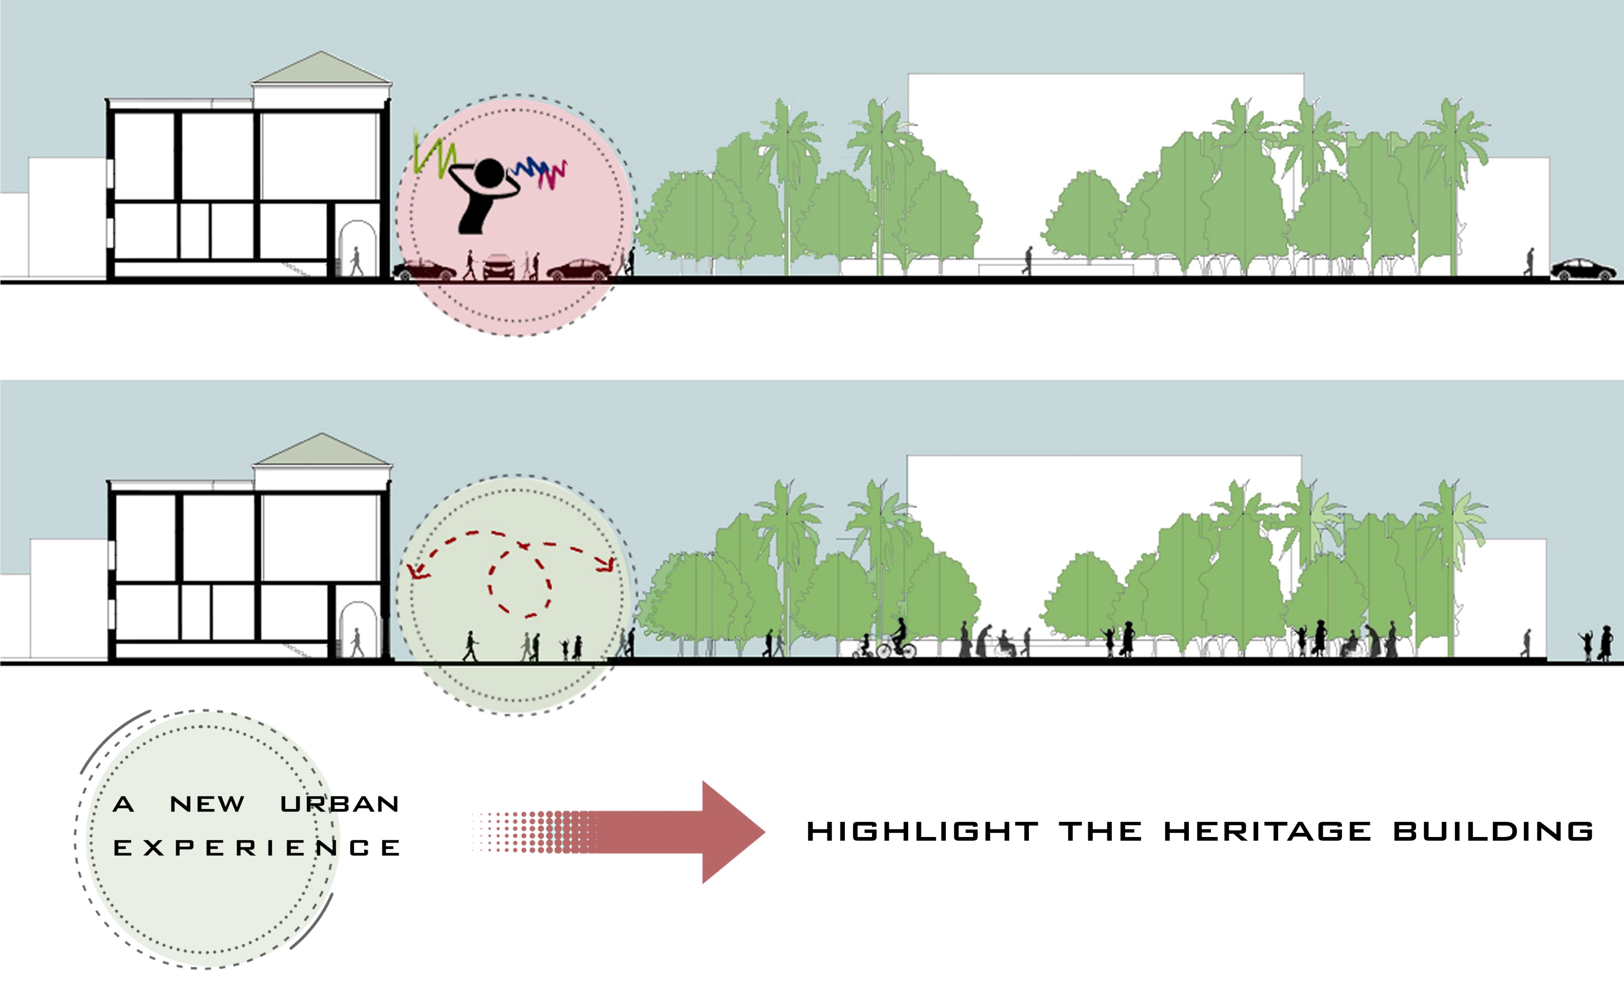
URBAN STRATEGY

Slide 11
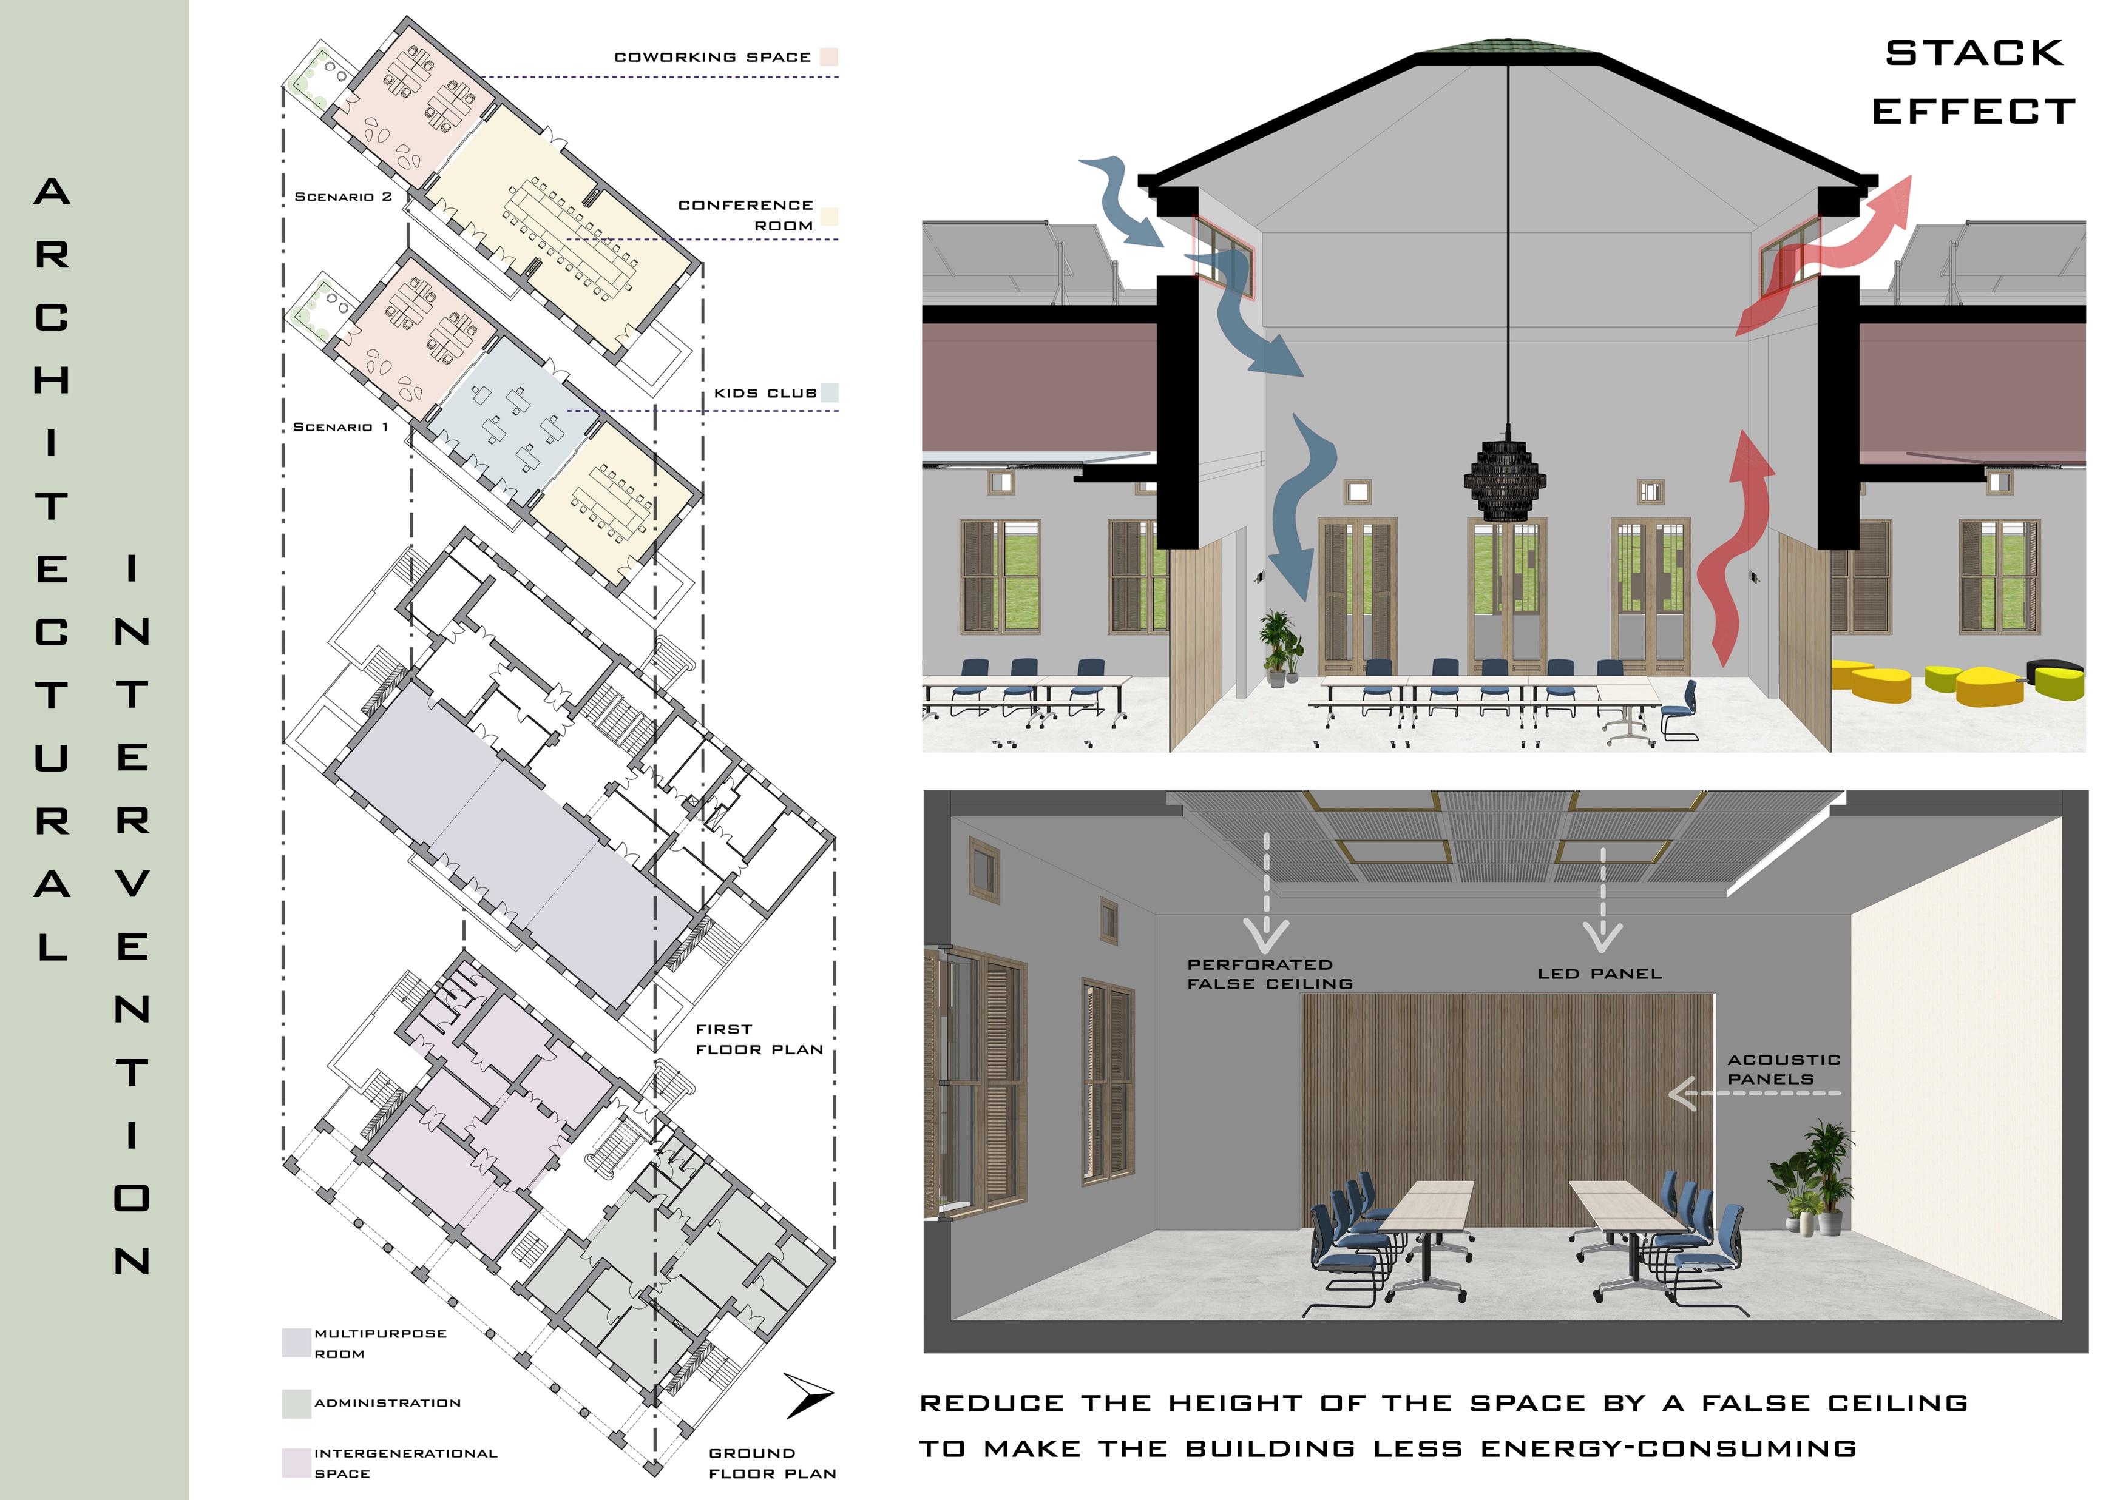

Slide 12
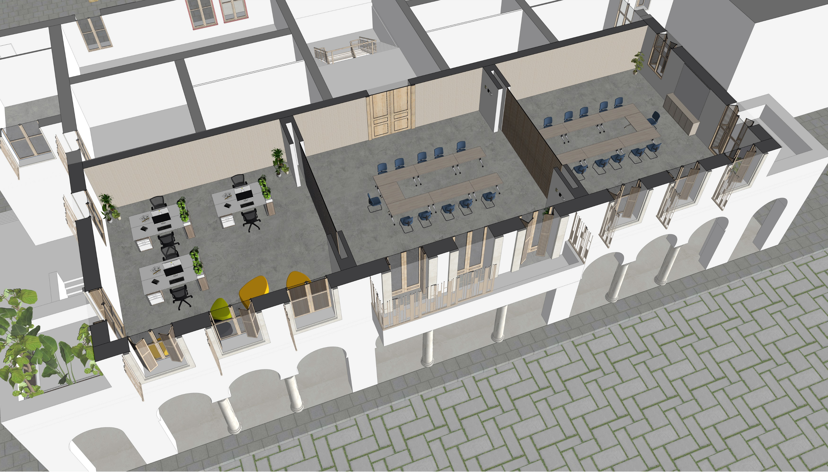

Slide 14
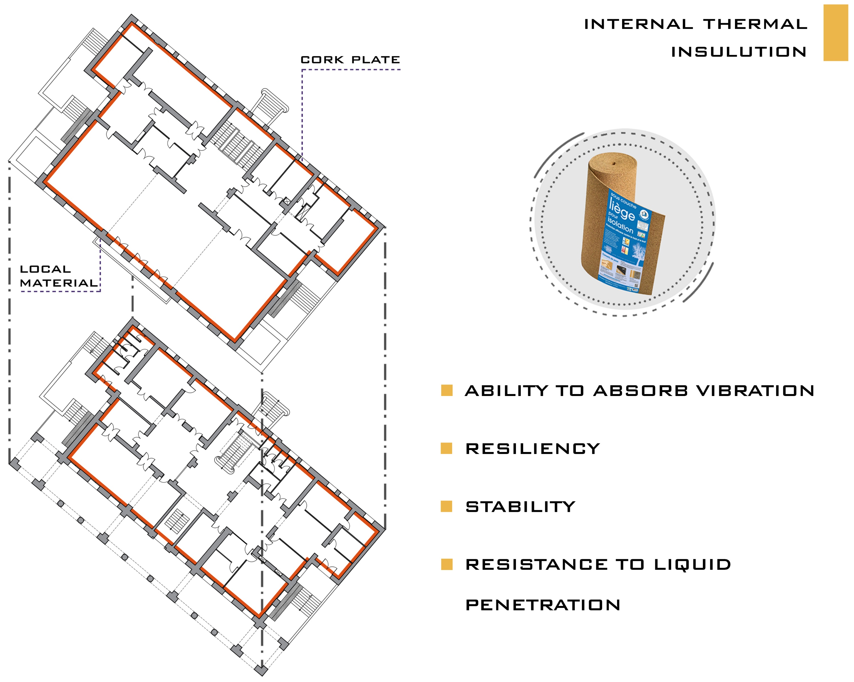

Slide 16
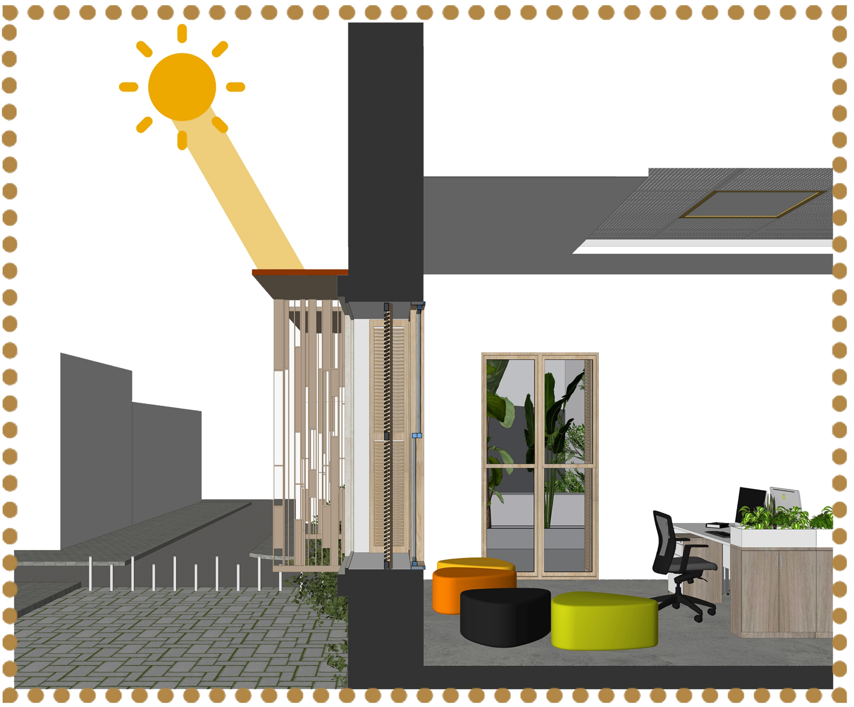

Slide 17
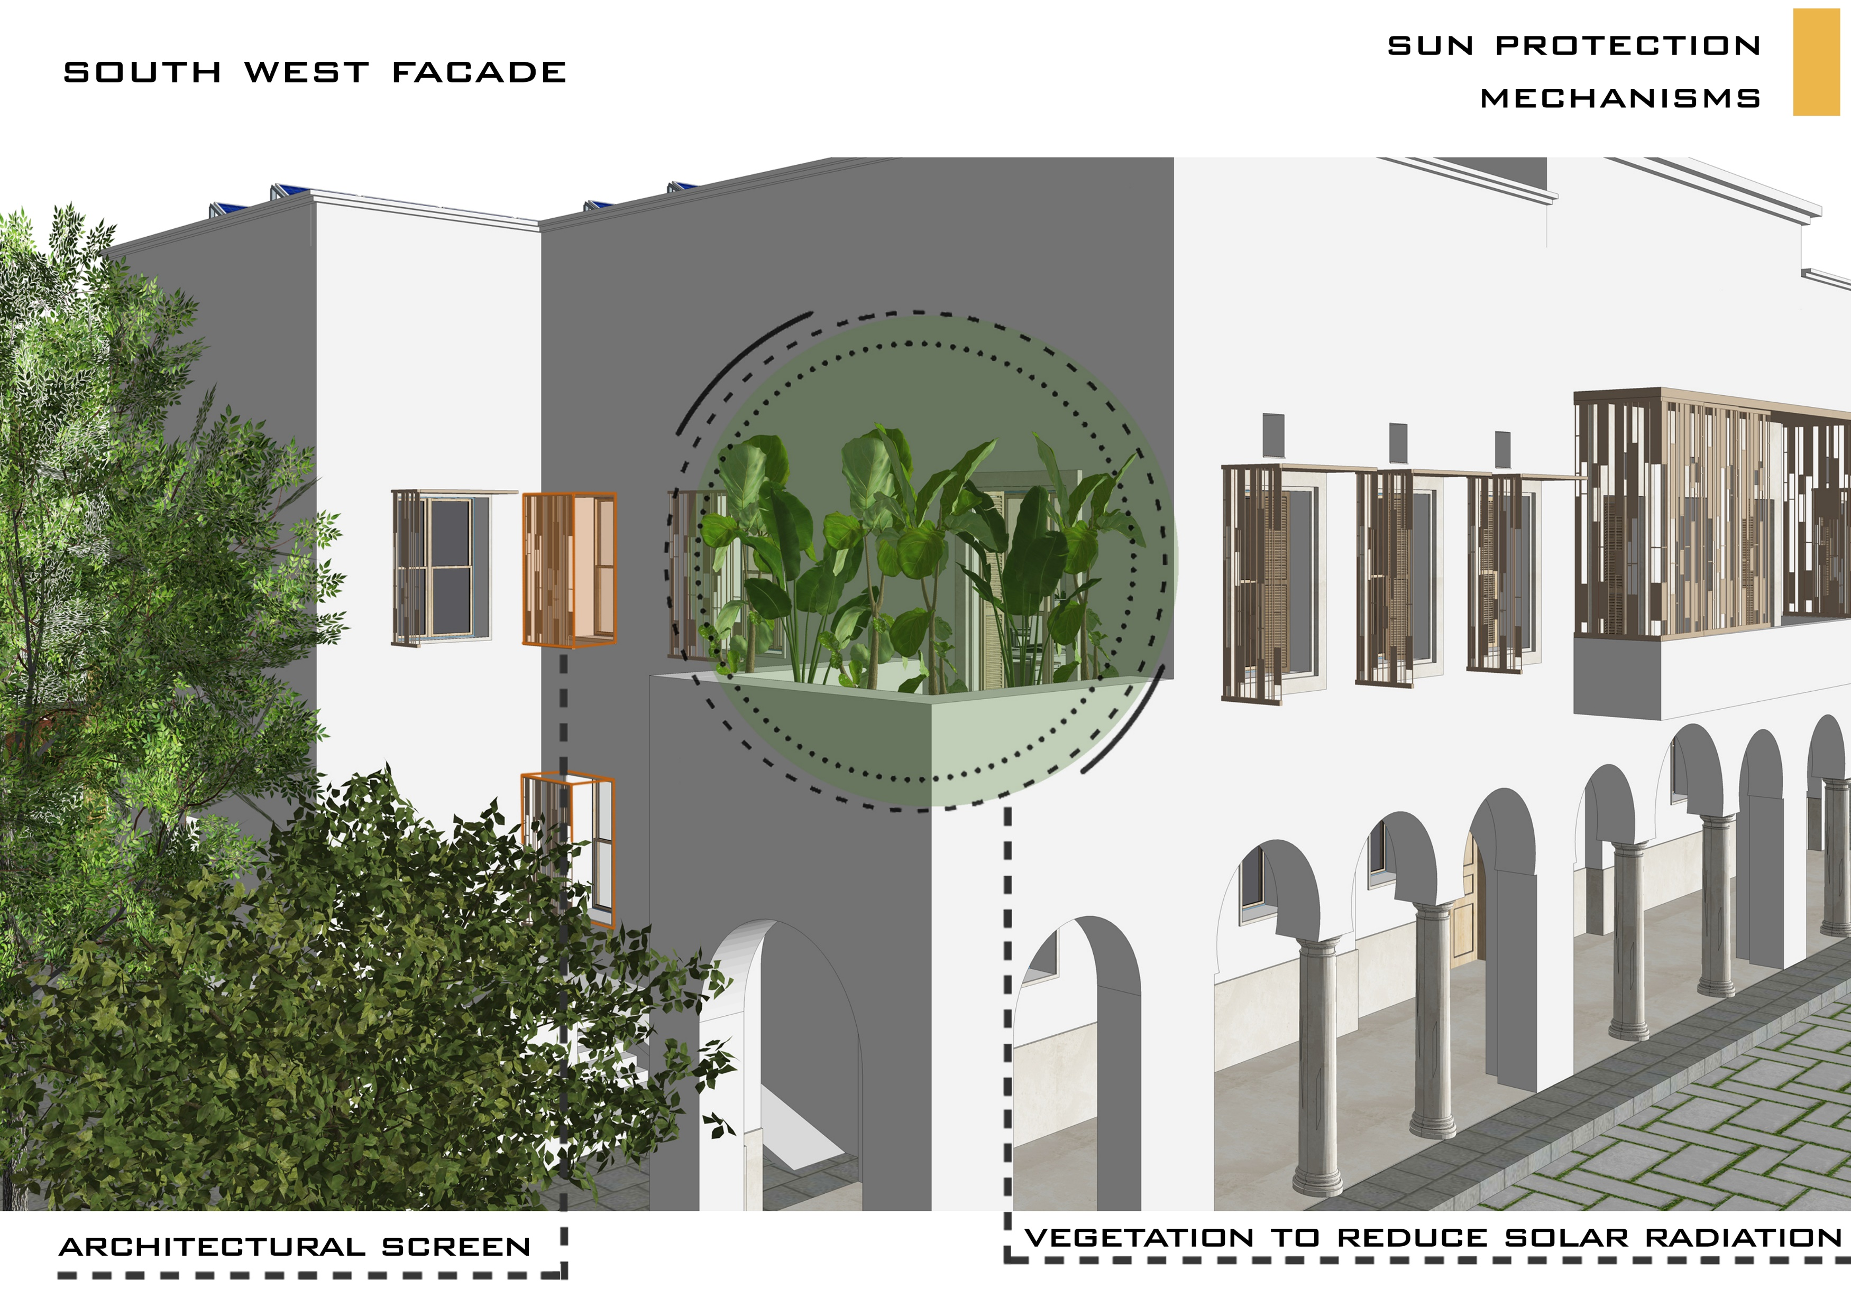

Slide 18
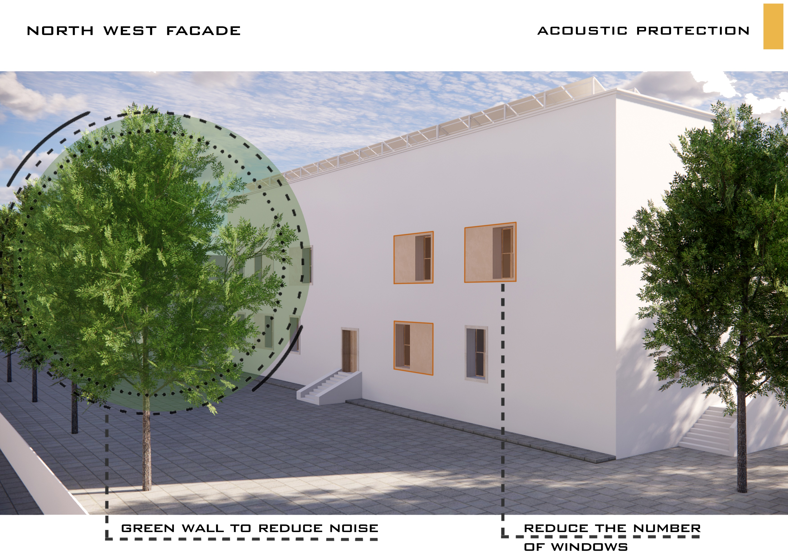

Slide 19
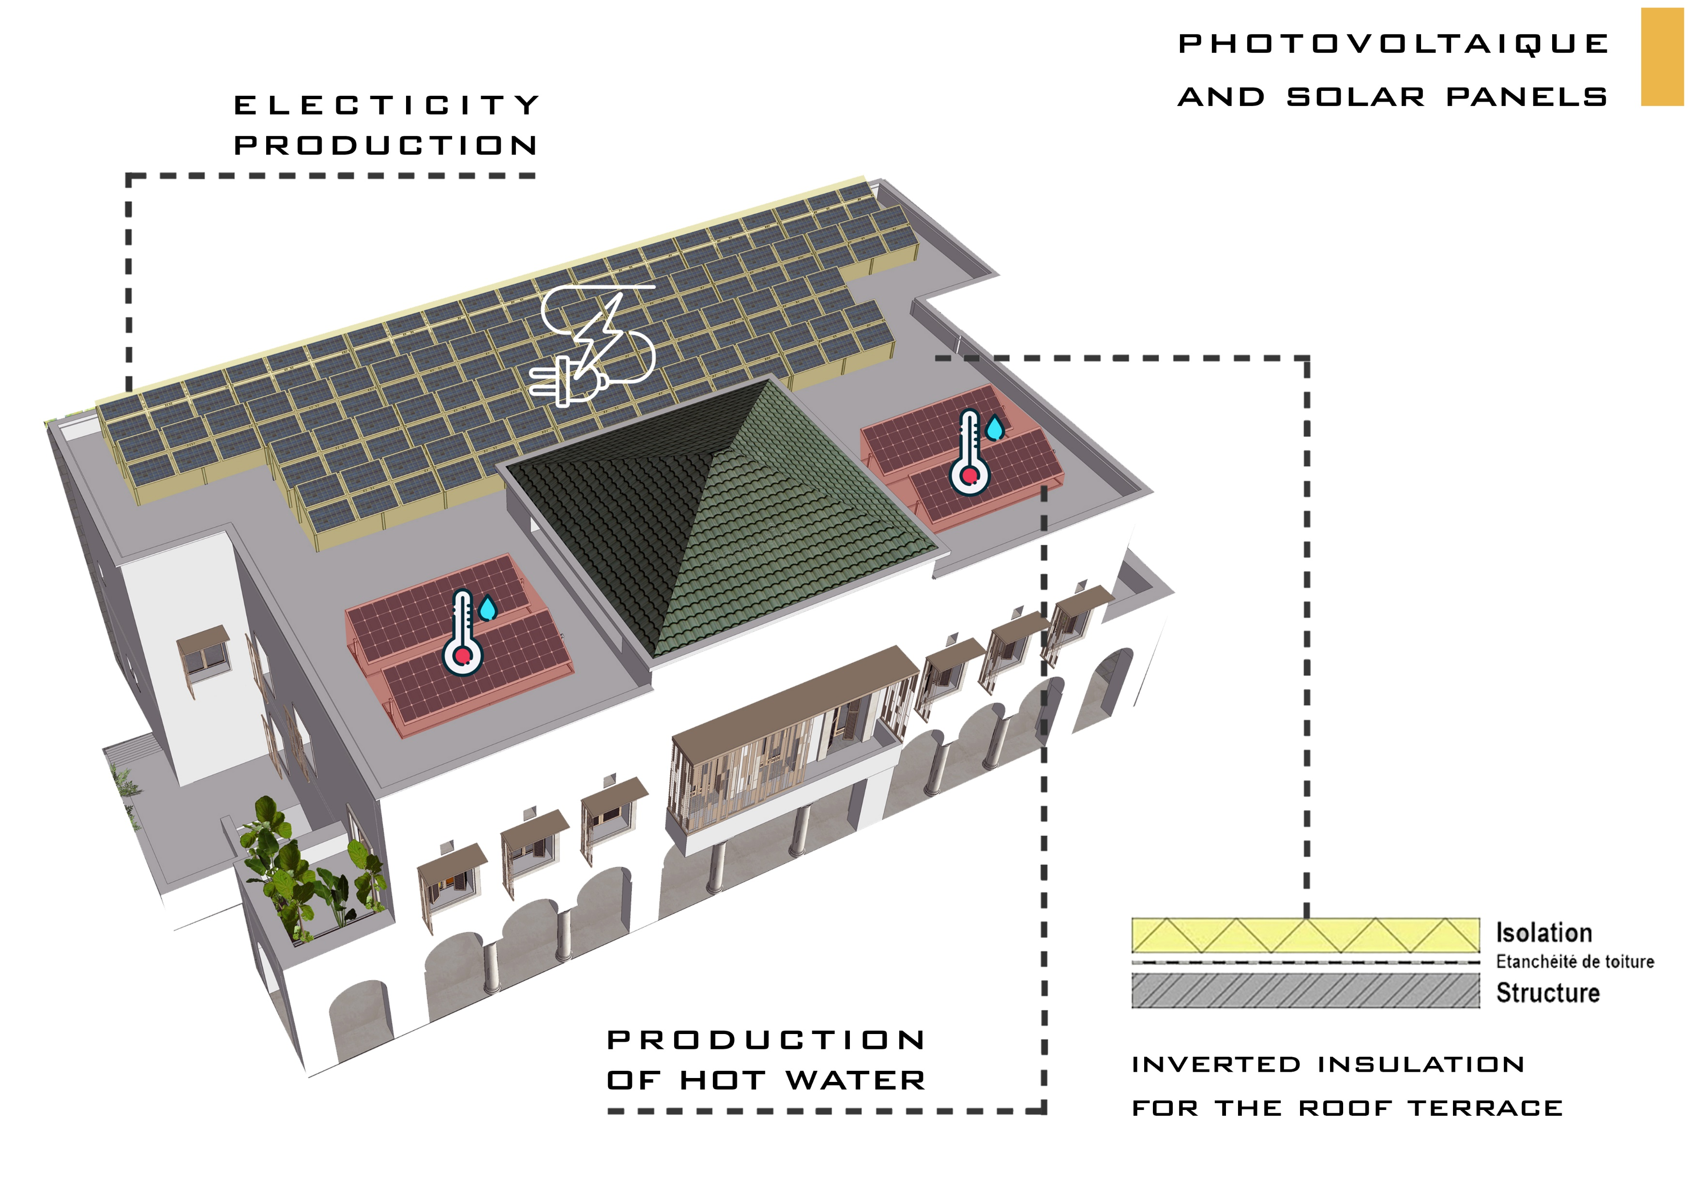
TECHNICAL
SOLUTIONS

Slide 20
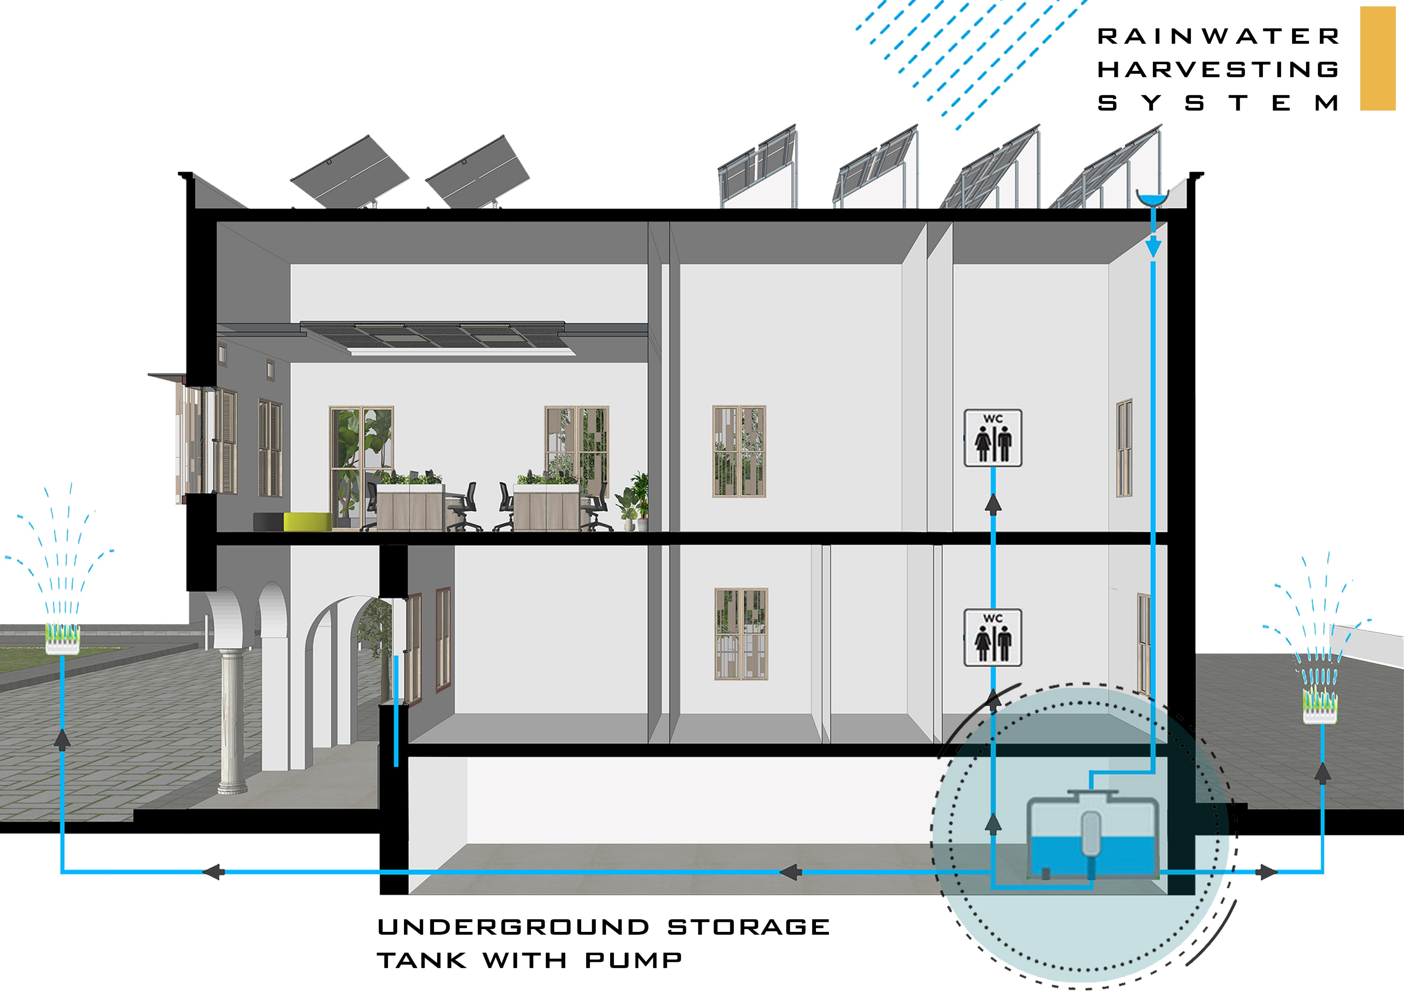
TECHNICAL
SOLUTIONS

Slide 21
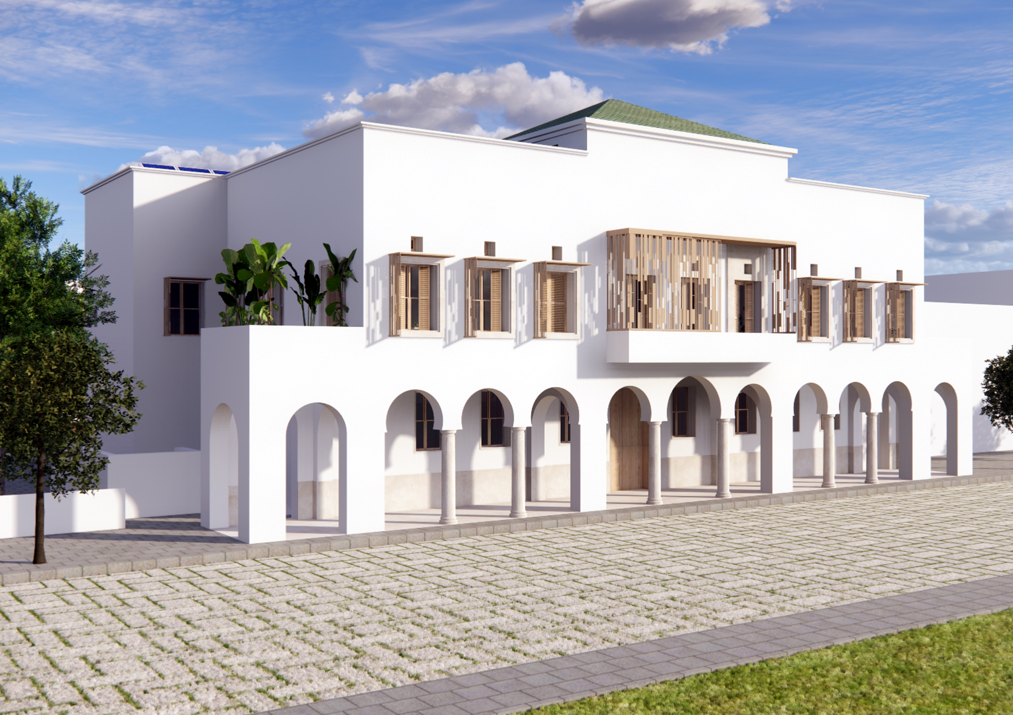

Slide 22
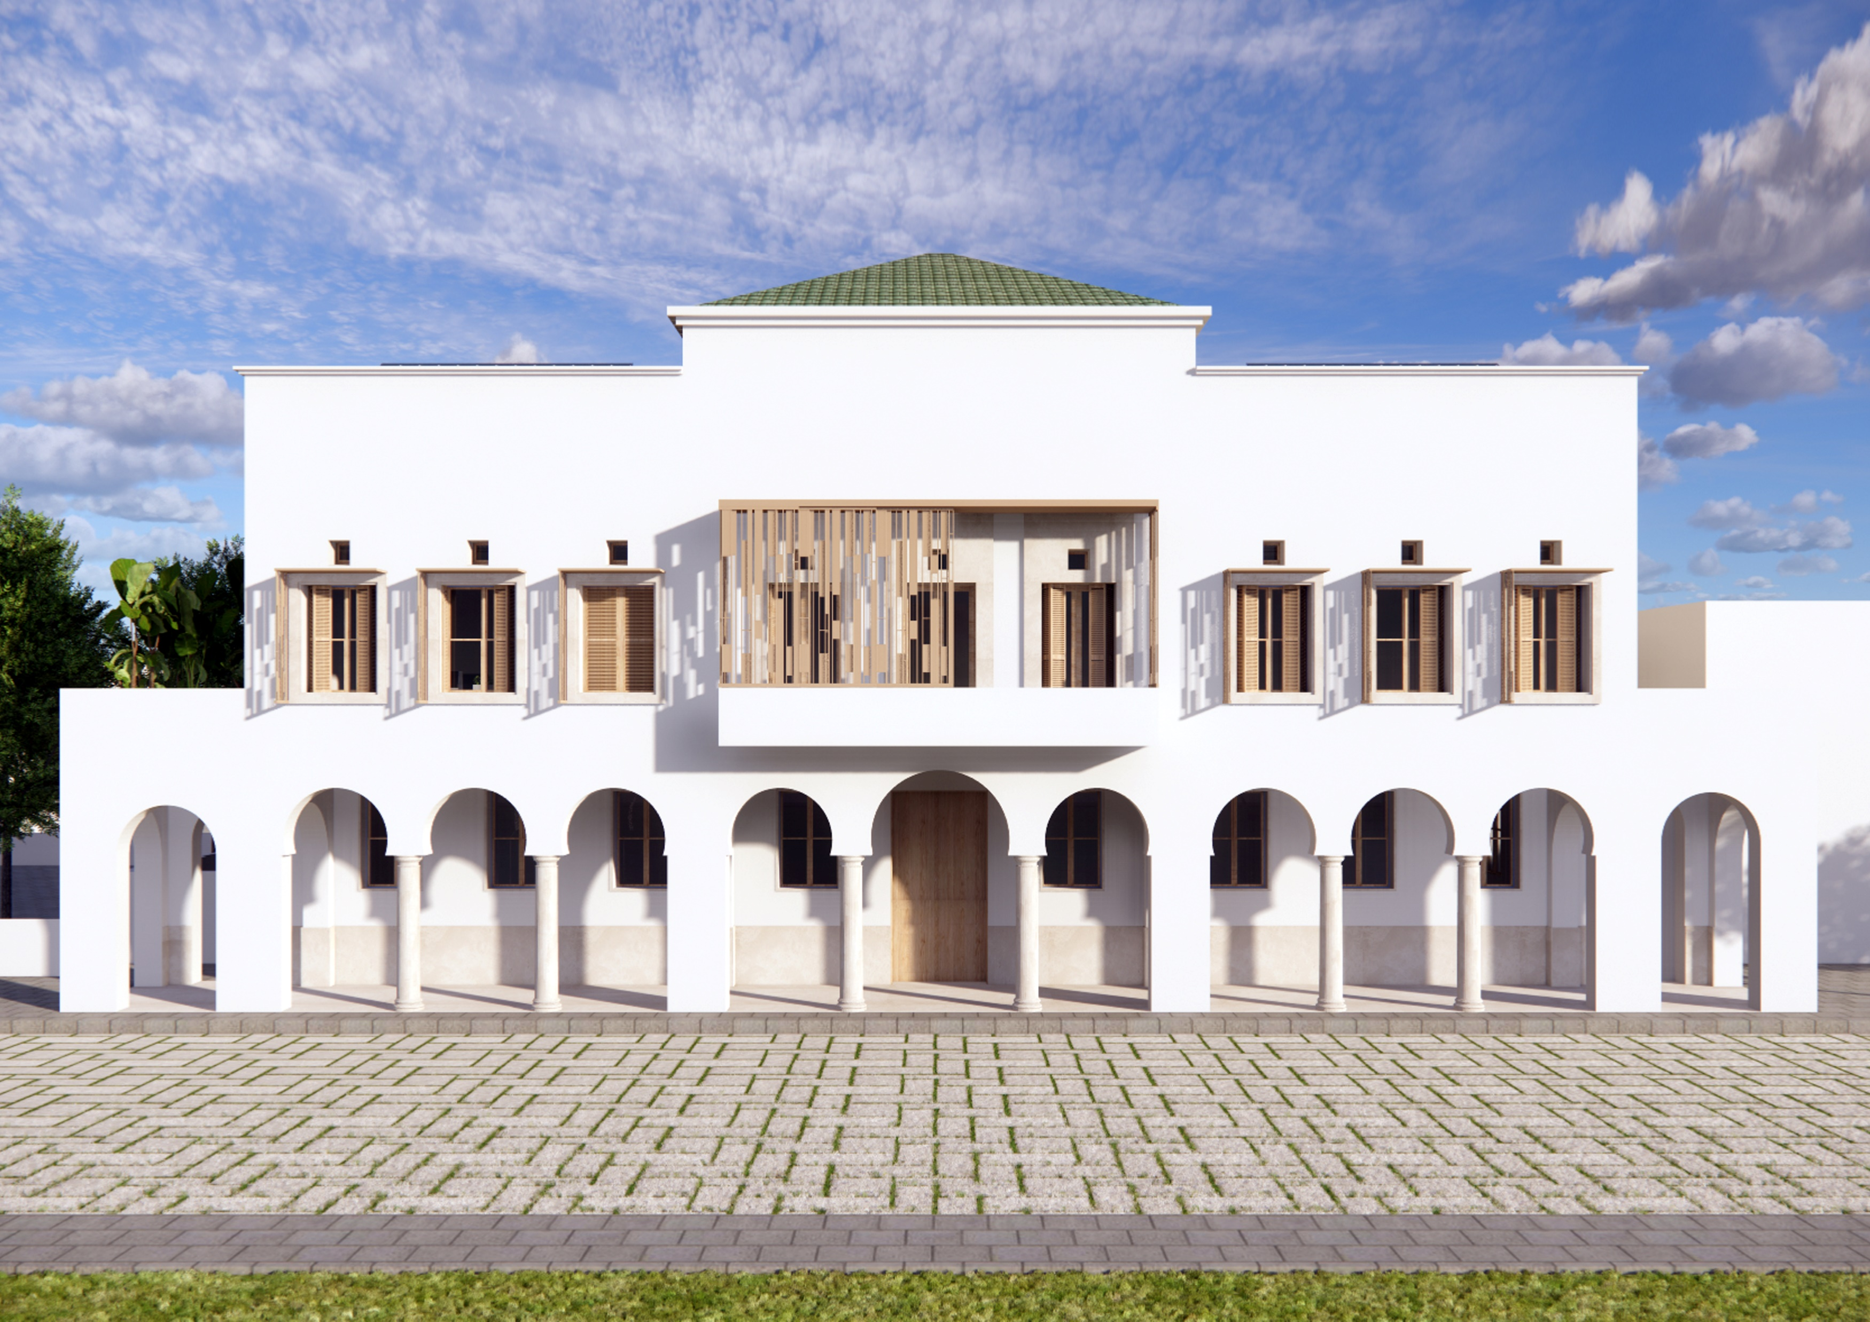

Slide 23
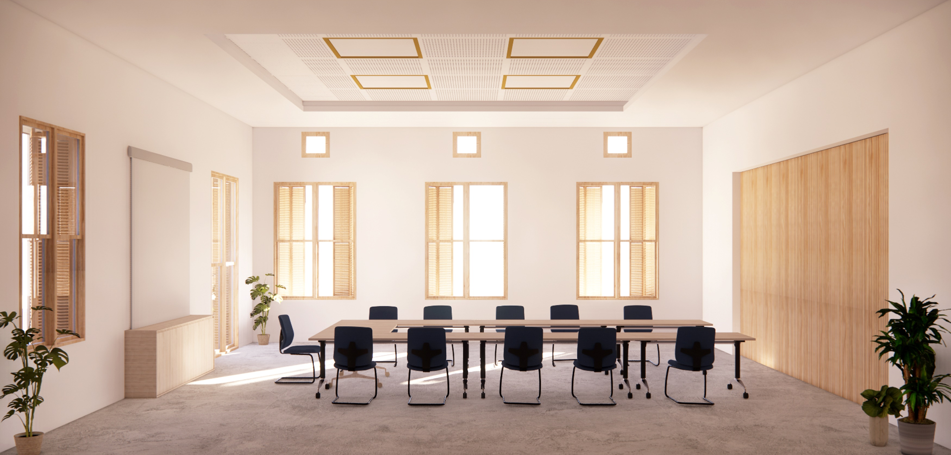

Slide 24
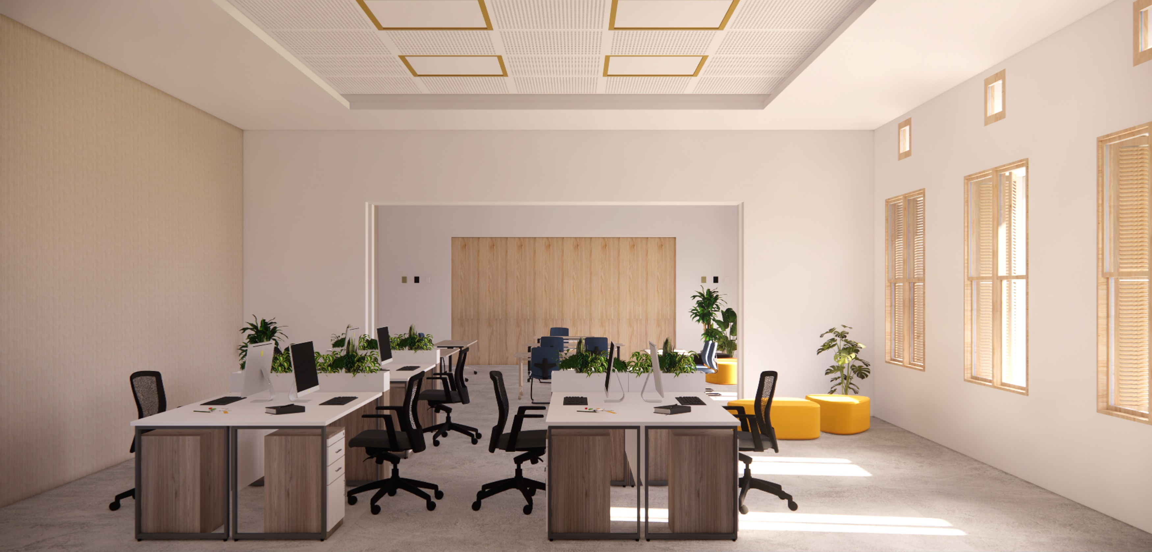

Slide 25
