Slide 1

Municipality of Jounieh: Fouad Chehab Stadium in Lebanon
Talal Salem, PhD
Project Managger

Slide 2
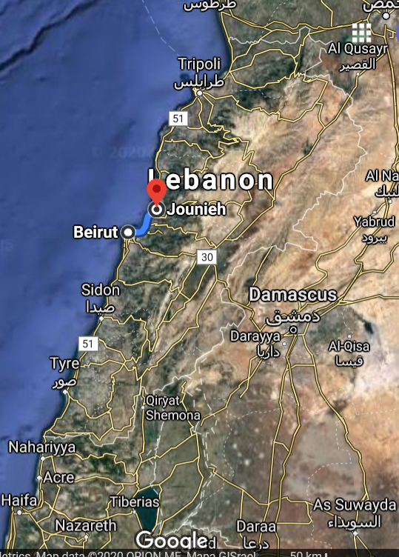
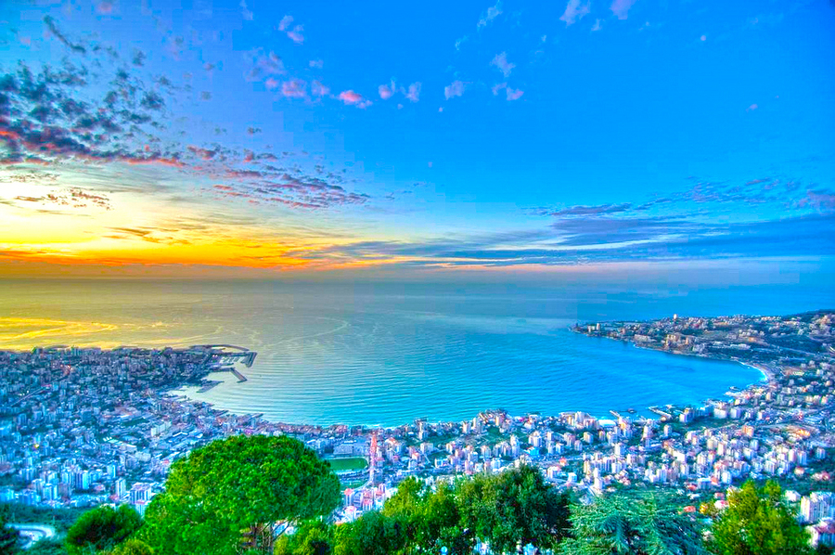
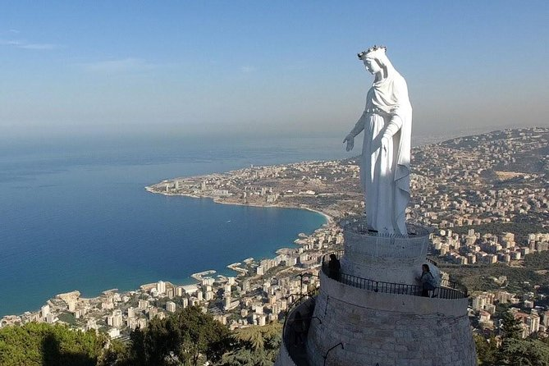
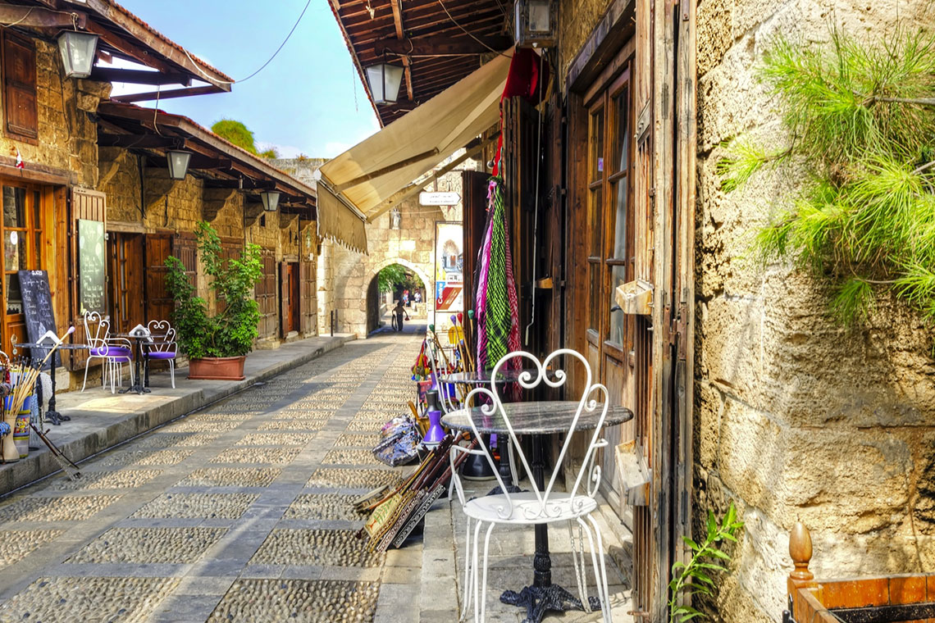
Location of the Pilot
Jounieh
Coastal city in Keserwan District, about 16 km North of Beirut, Lebanon
Population = 115,500

Slide 3
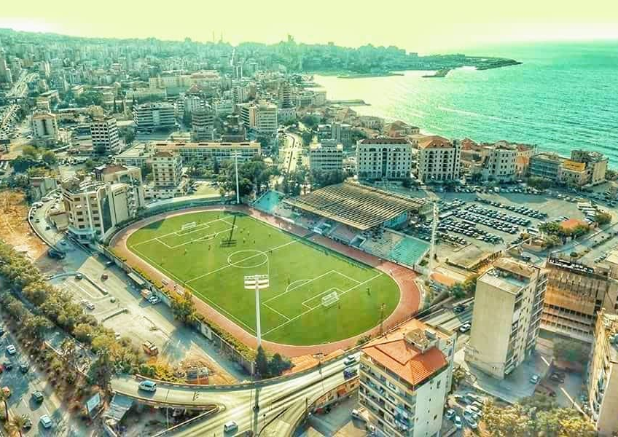
Project Description
The Stadium was built in early 1960’s. It has a large energy consumption for the football stadium lighting, the indoor basketball, outdoor football, parking… most of it supplied by diesel generators.
Parking & outdoor football
Basketball
Football

Slide 4
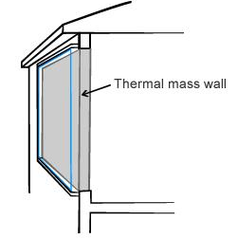



Proposed Local Green Rehabilitation Action
Active
Passive
Achieved within the framework of SOLE

Slide 5
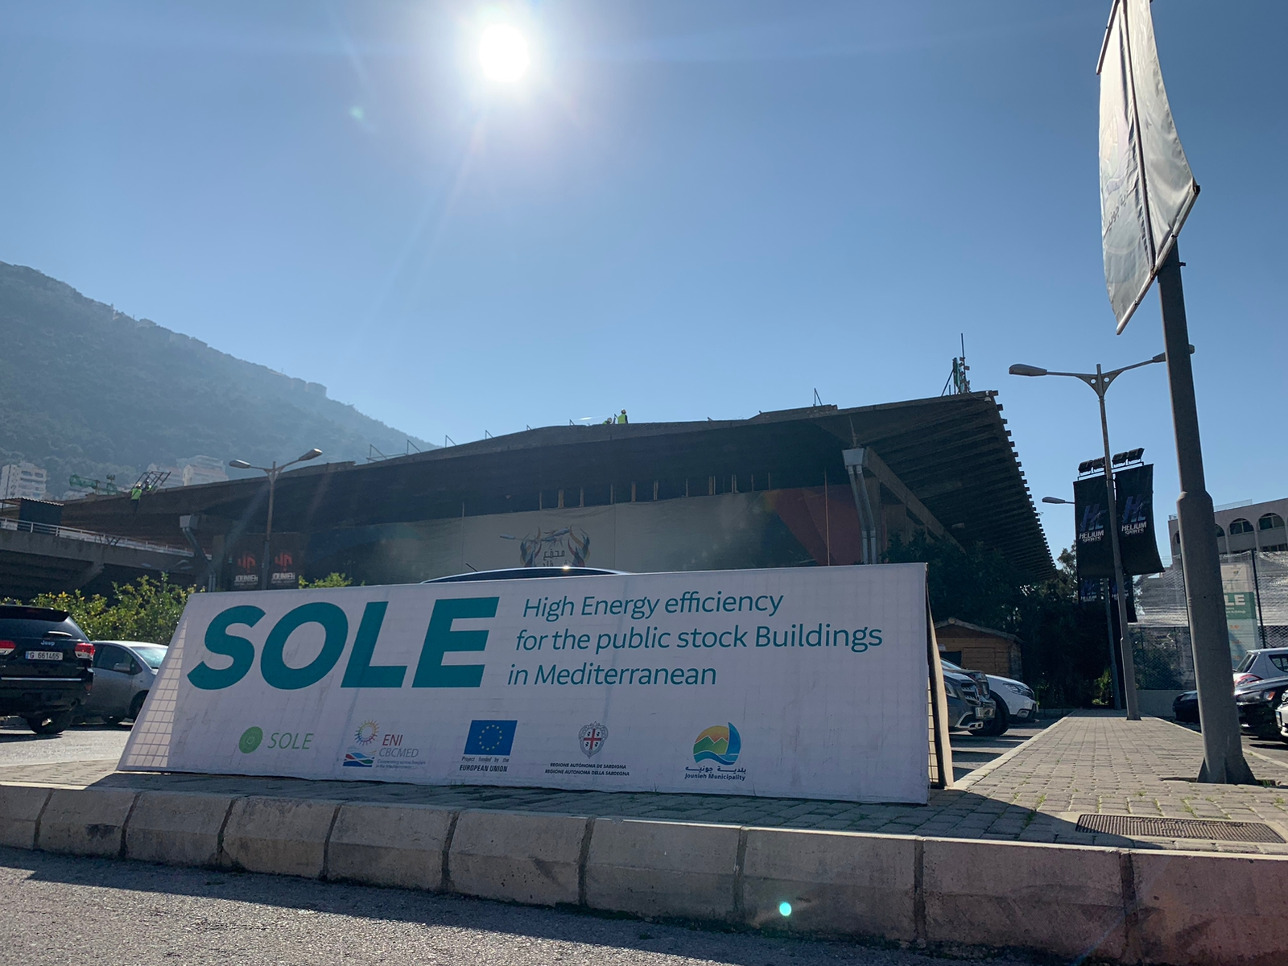
Pilot Action in Jounieh
200kWp Grid Tied PV Solution
398 PV Panel - 550 Wp
To be coupled to 250kWh Lithium Batteries

Slide 6
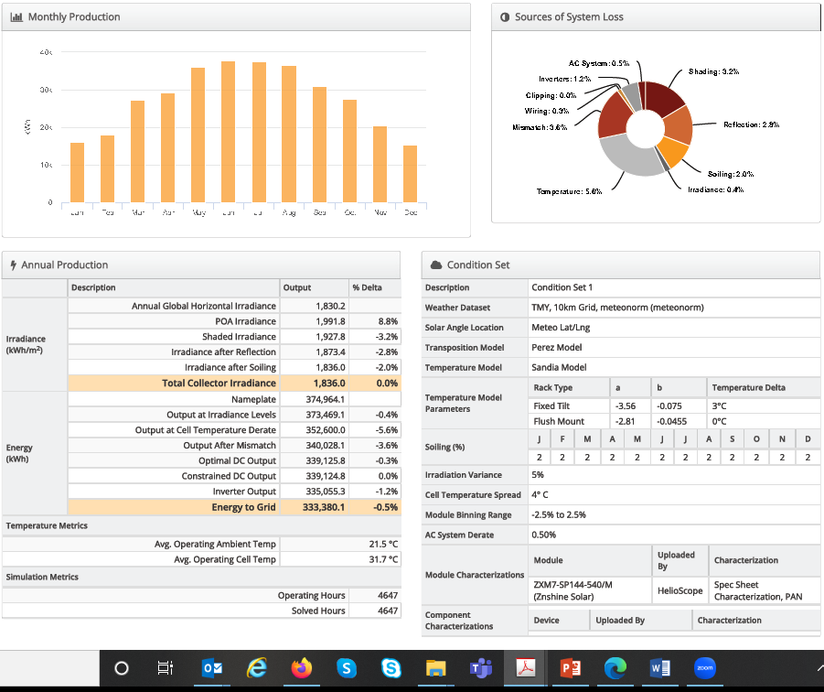
Project Benefits
Annual production around 300MWh¹
Savings around € 120K
Reducing 6000 Tons of CO₂ over 25years
¹Helioscope Simulation

Slide 7
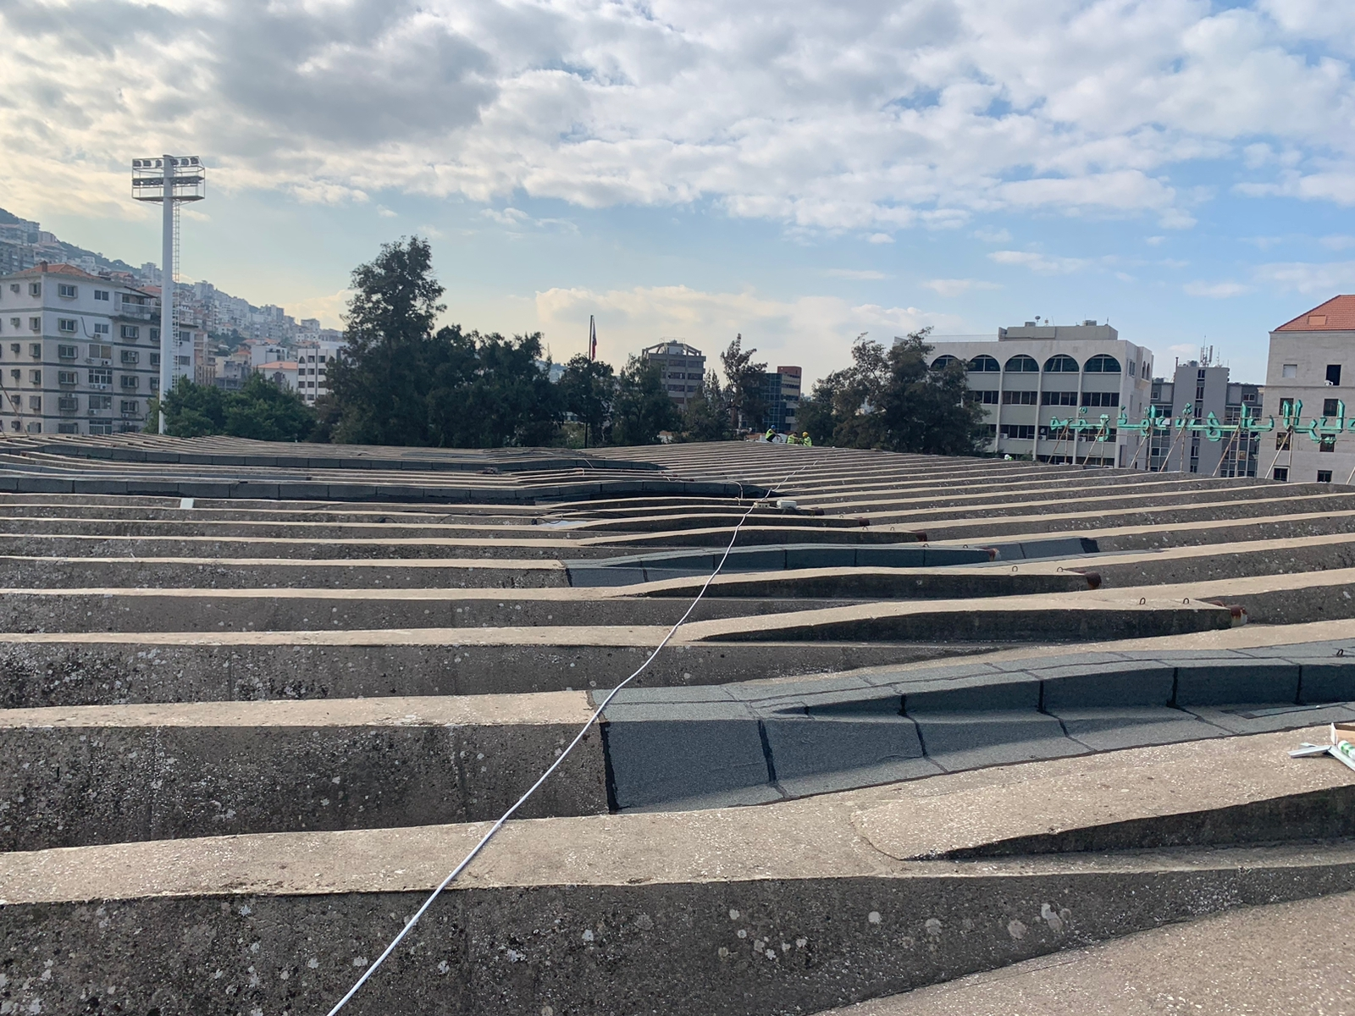
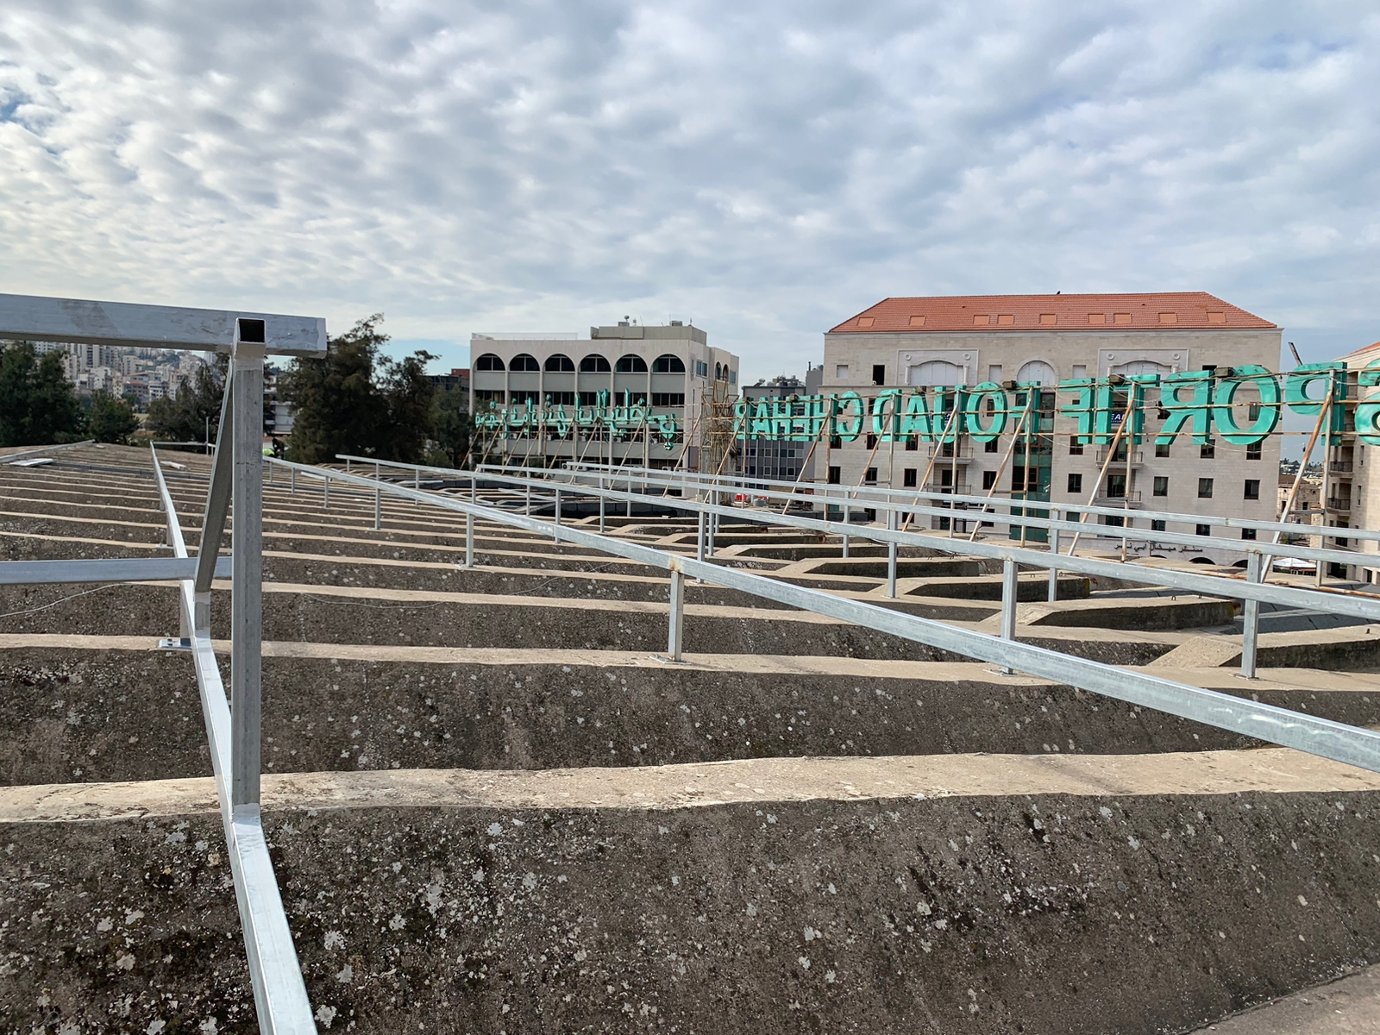

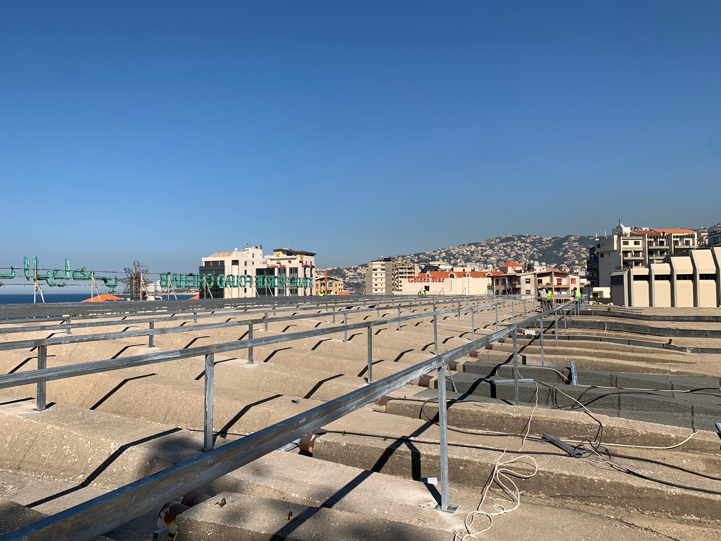
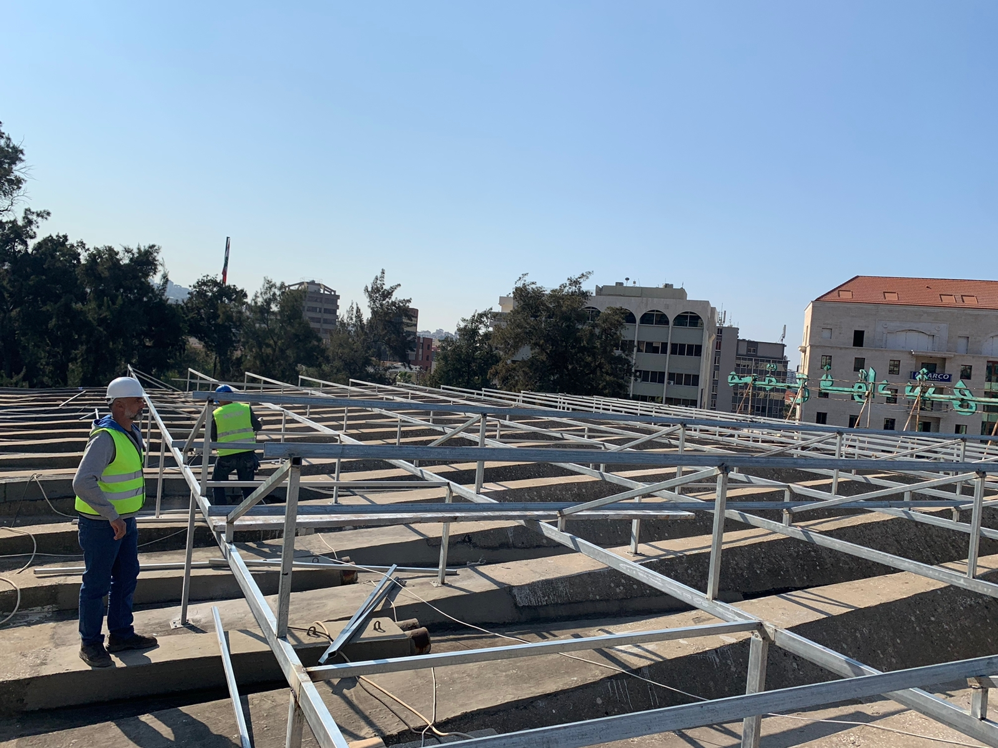
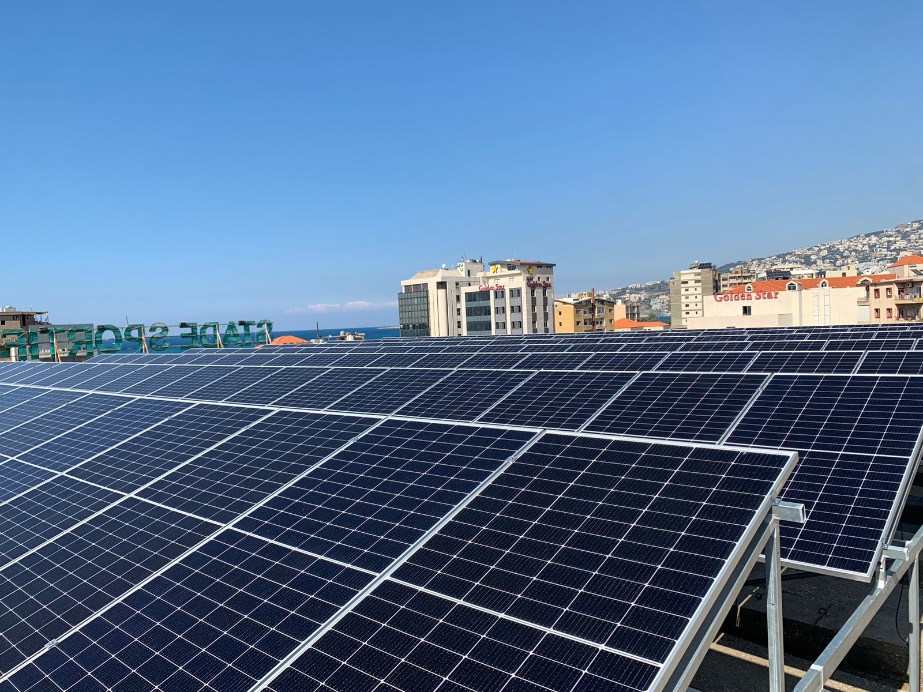
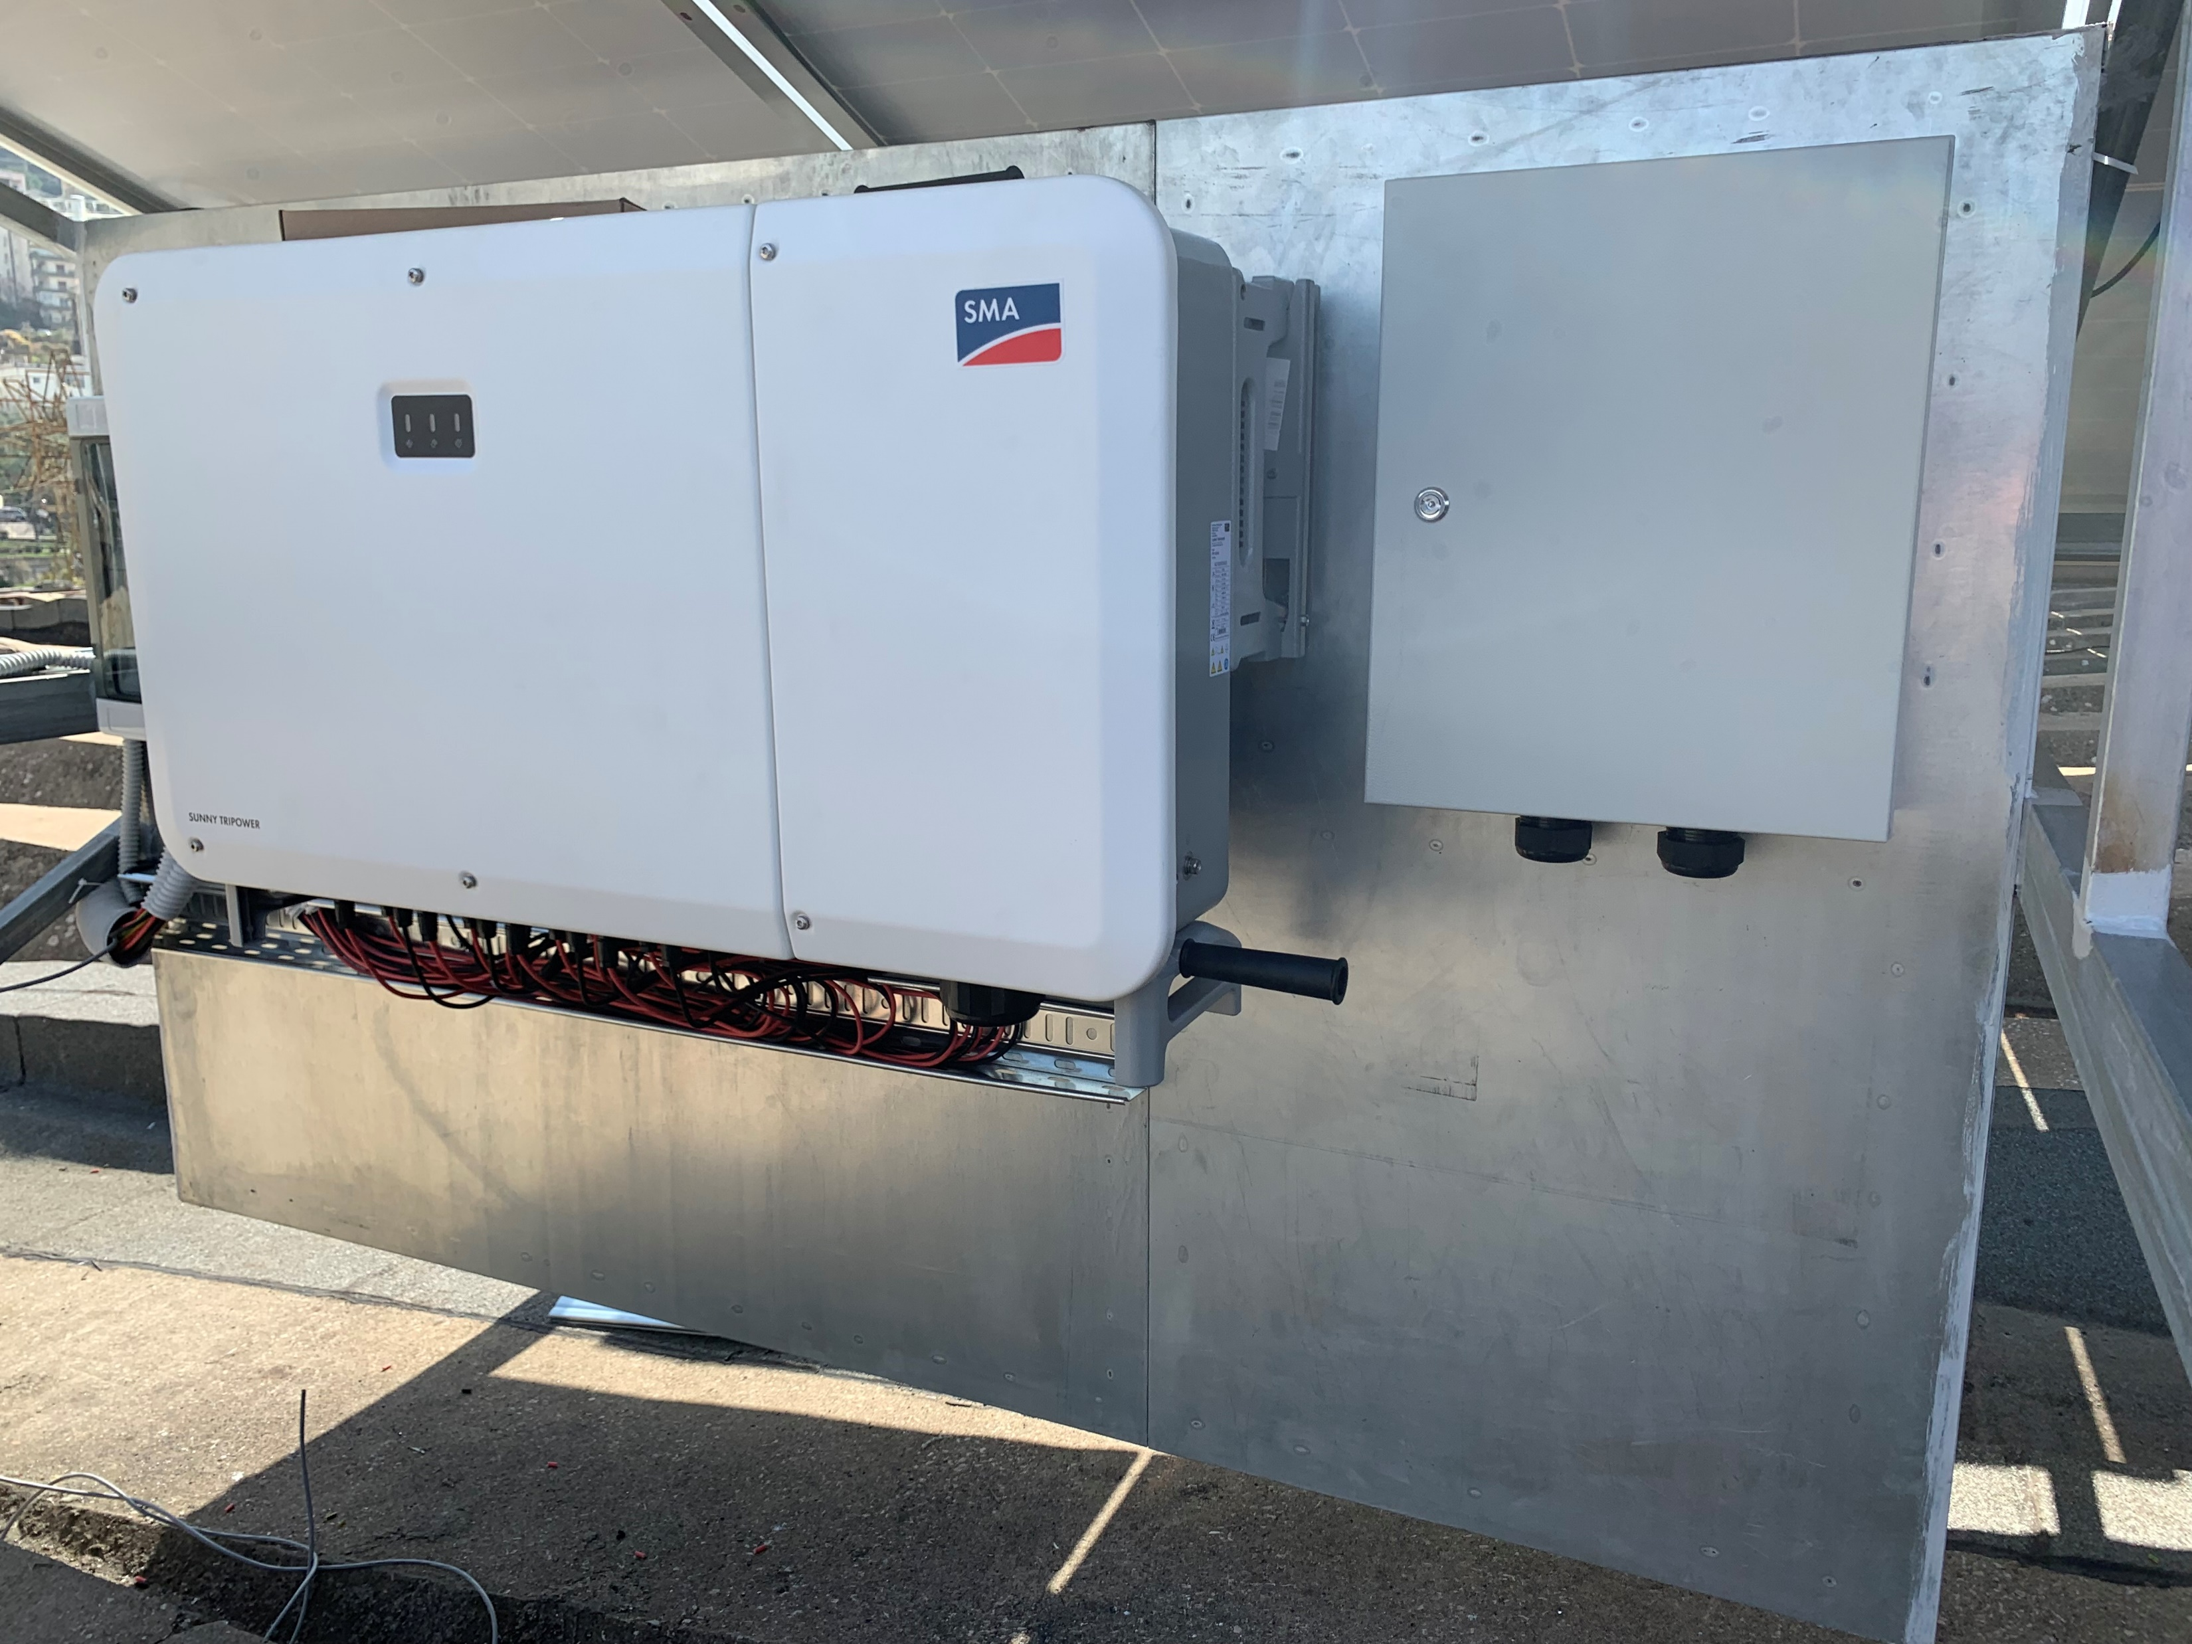

Project Scope of Work
Phase 1:
Concrete Works for pitched roof and horizontal roof
Preparation and Fixing the structure on the concrete slap
Supply and installation of all components (on site)
Fixing the Solar Panels on the mounting structure
Pulling DC Cables to the DC box, and then to the inverter
Pulling AC Cables to the Panel board
Testing and commissioning of the PV system
Phase 2:
Installing 250kWh Lithium Batteries
Conduct a training for the personnel responsible of the site

Slide 8
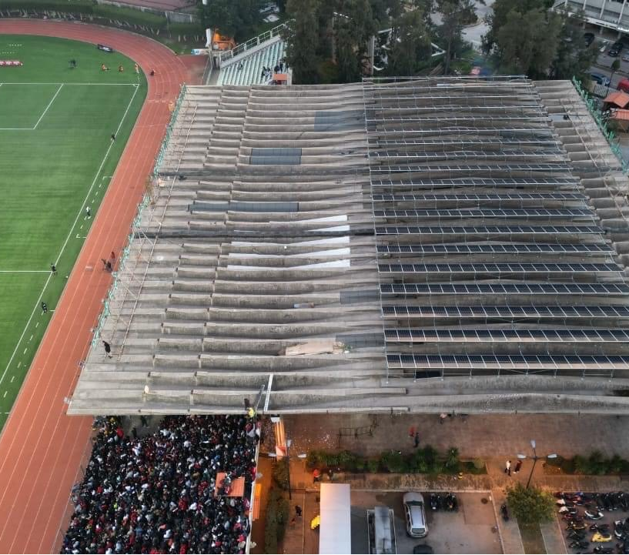
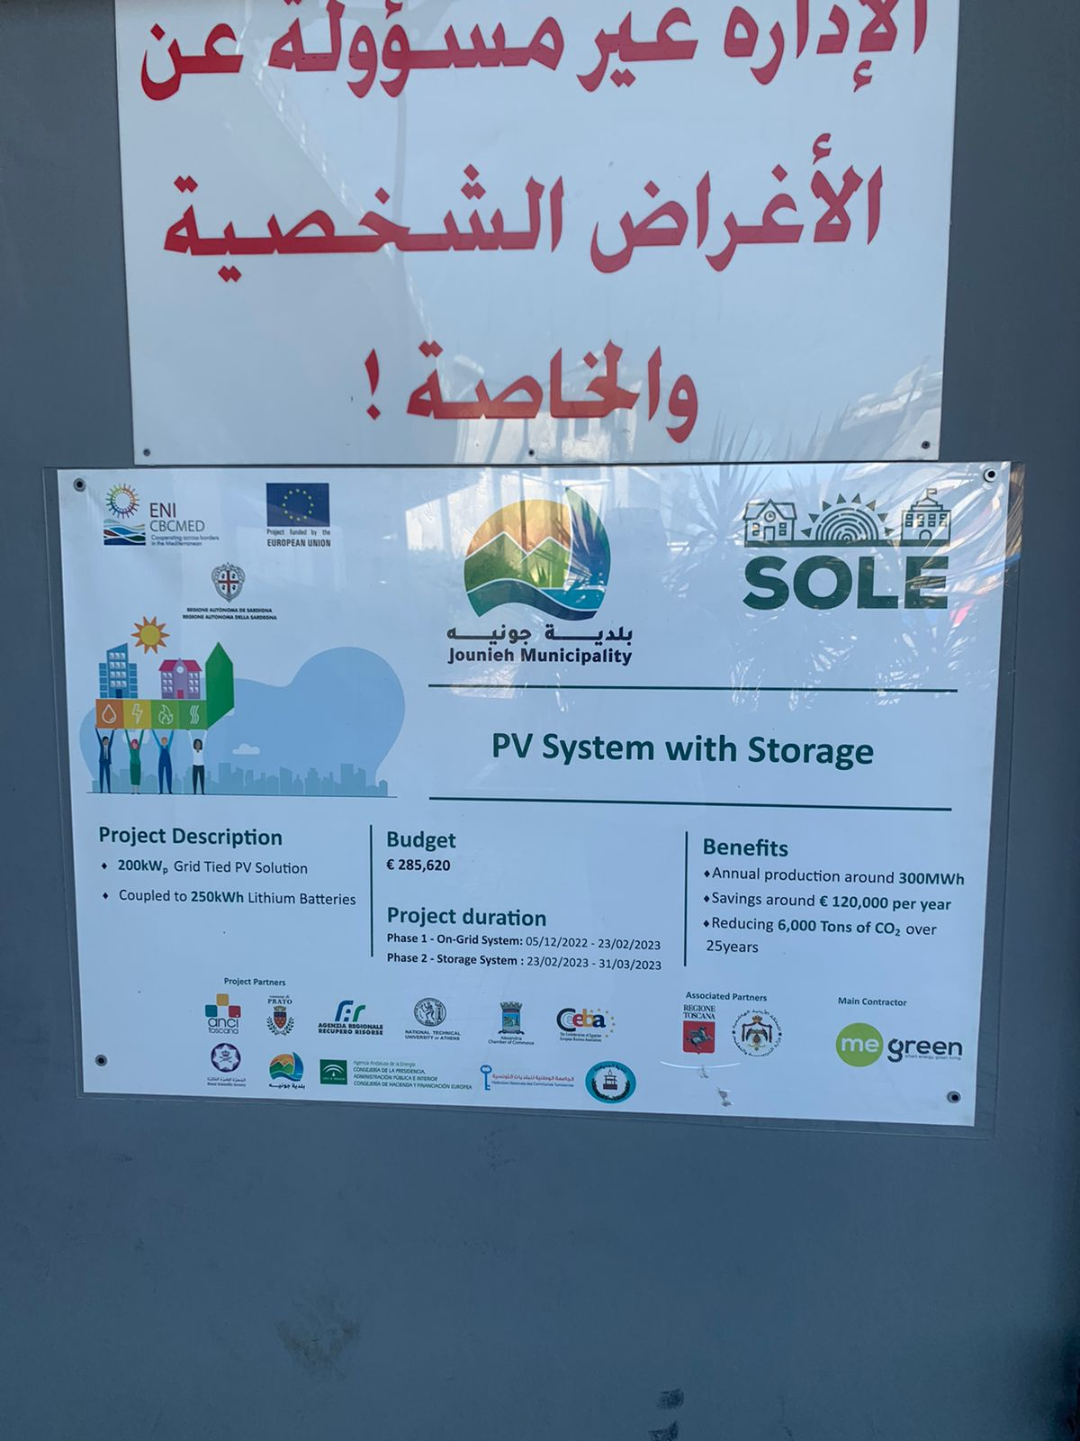
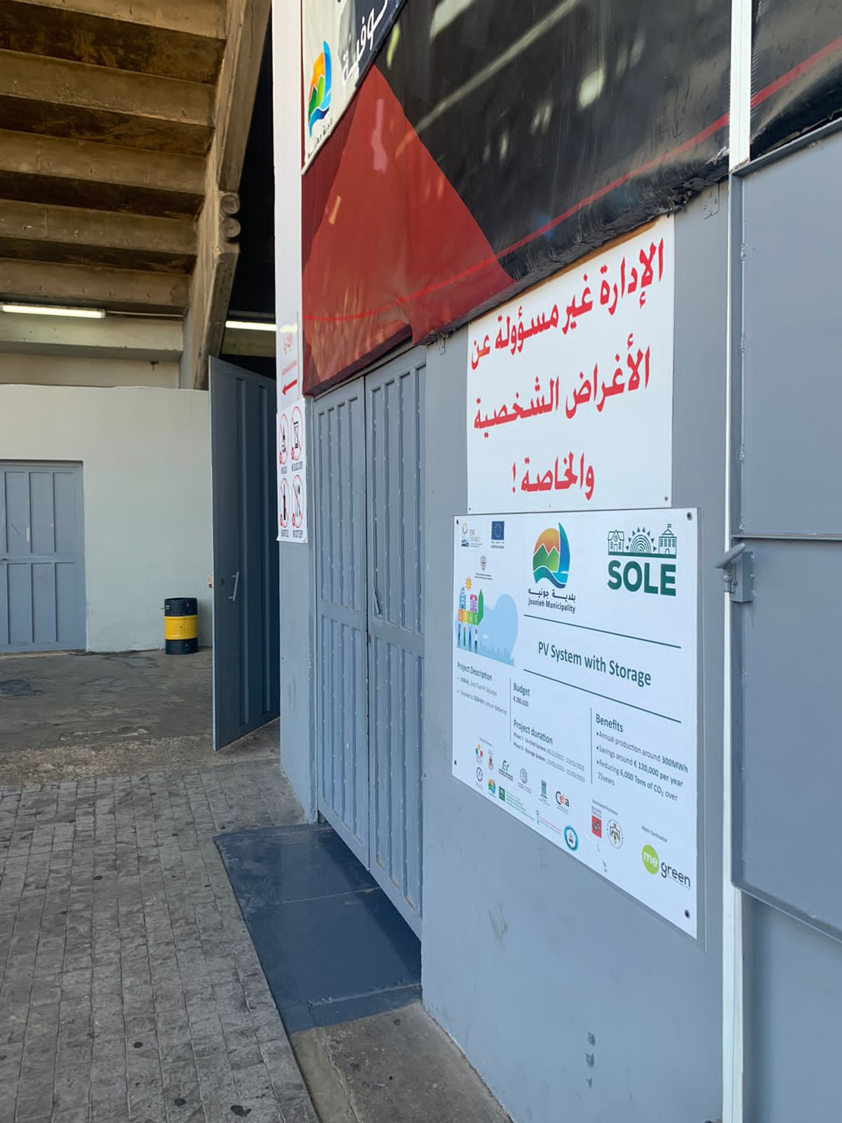
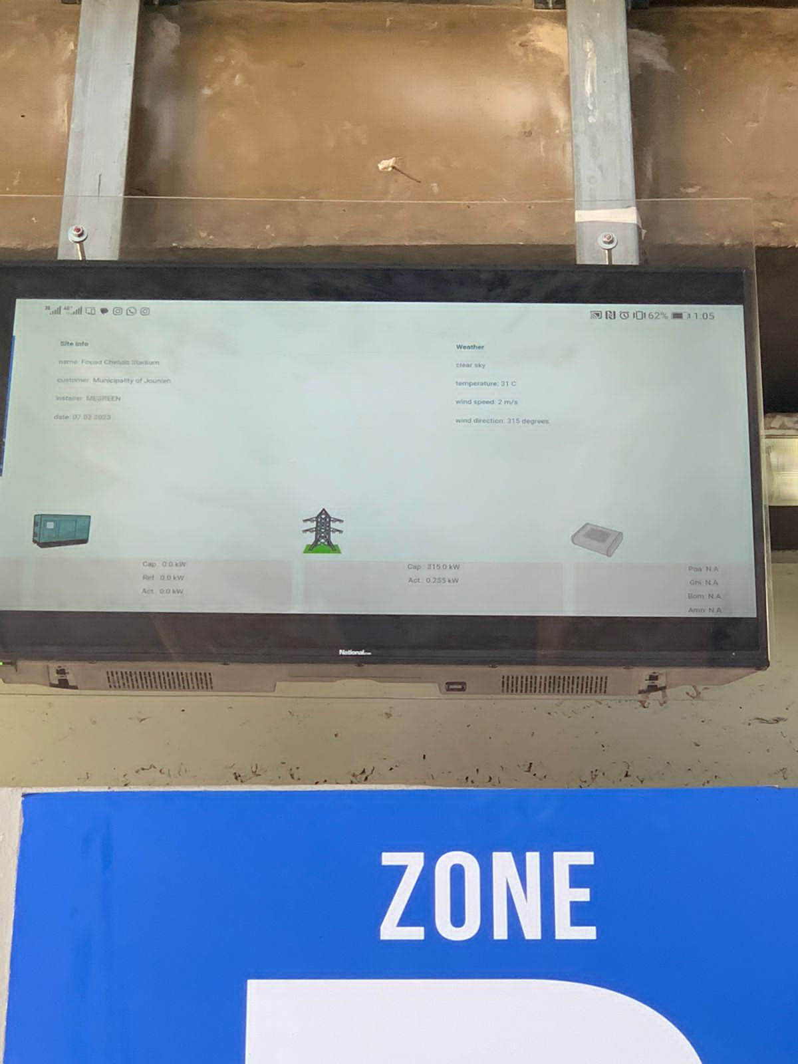
The Installed PV System
Total Budget = €285,000 (Incl. Batteries)

Slide 9
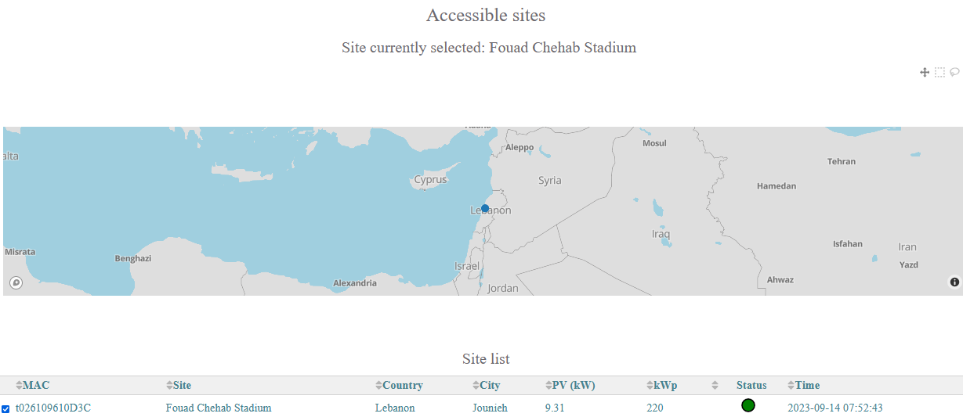
Monitoring - ENcombi Energy Management Tool
https://ecpv2.encombi.online/

Slide 10
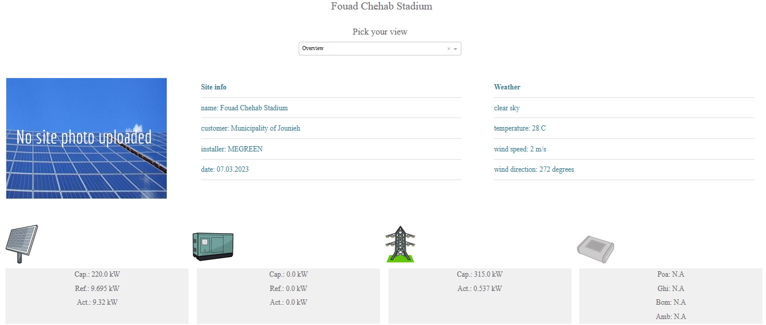
Monitoring - ENcombi Energy Management Tool
https://ecpv2.encombi.online/

Slide 11
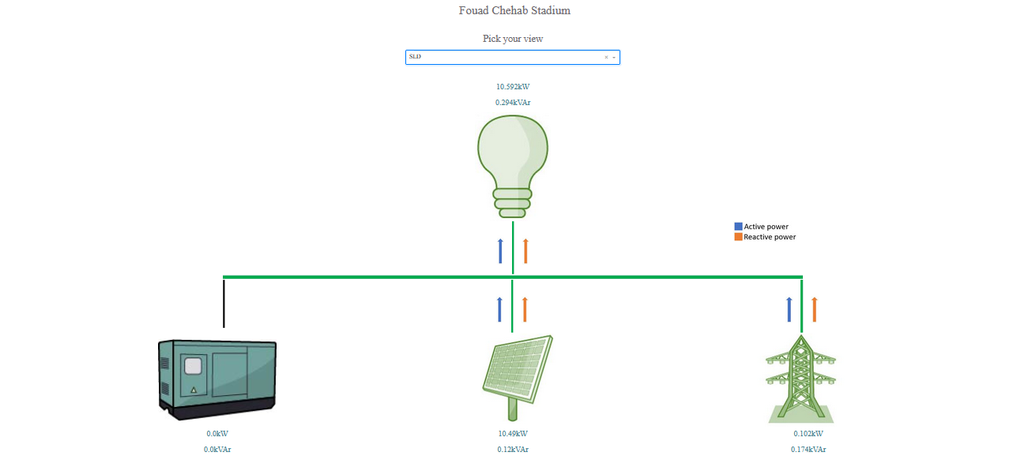

Slide 12
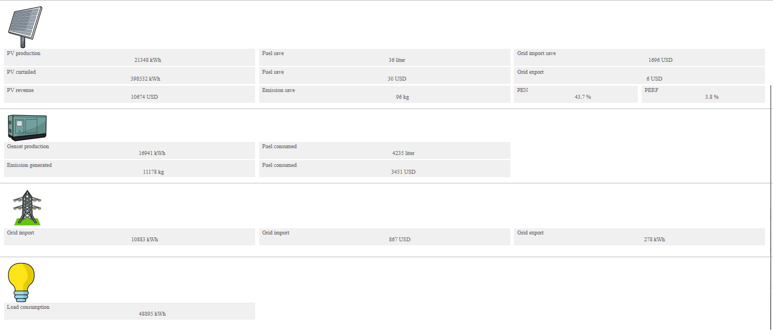

Slide 13
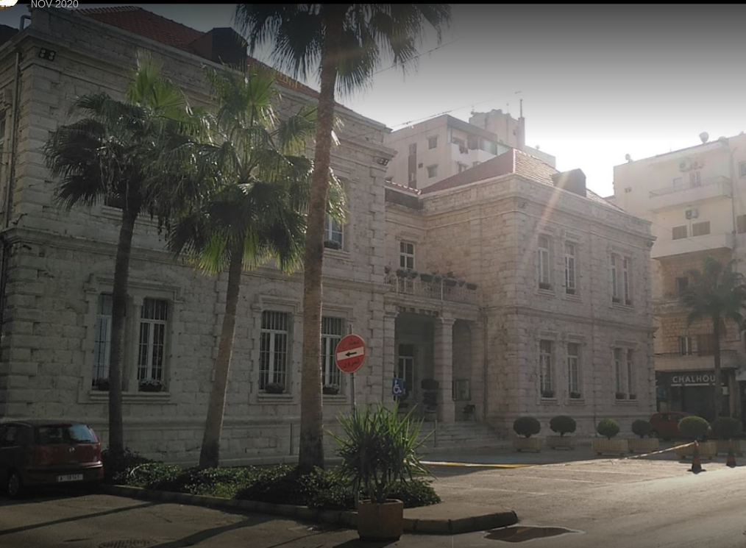
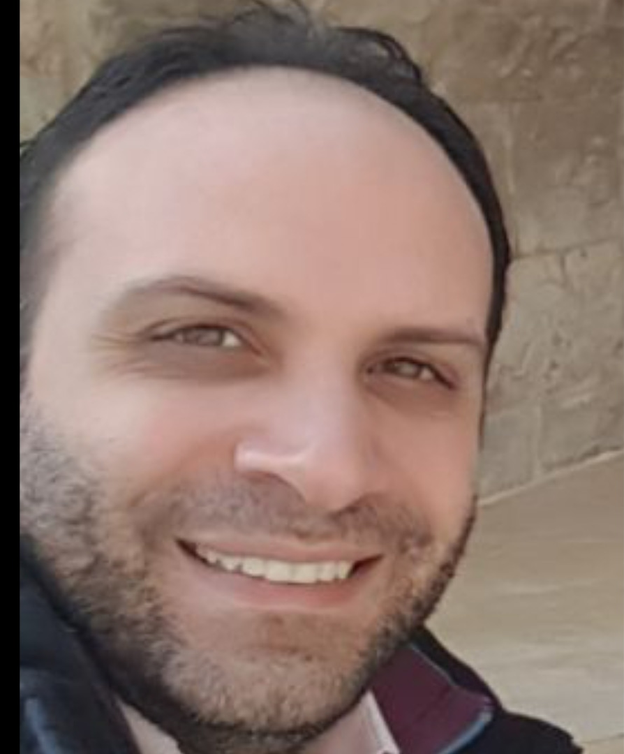
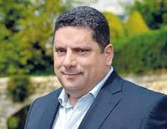
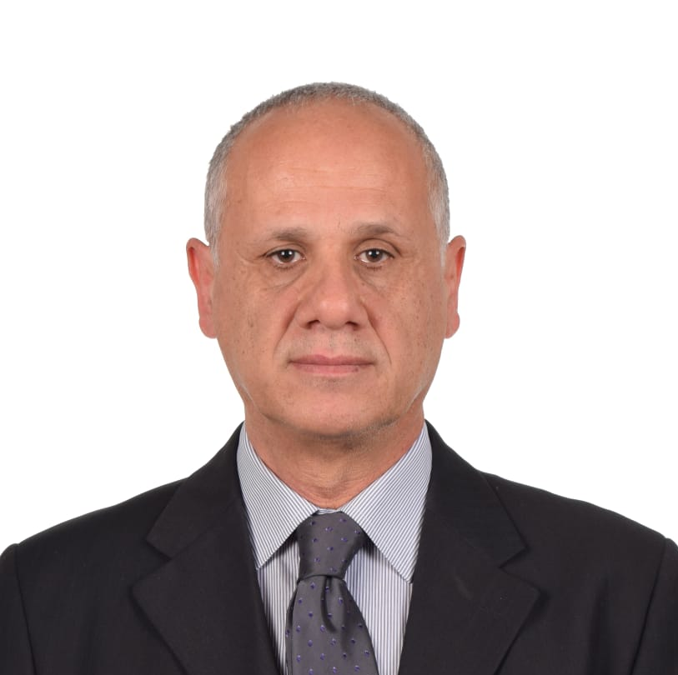
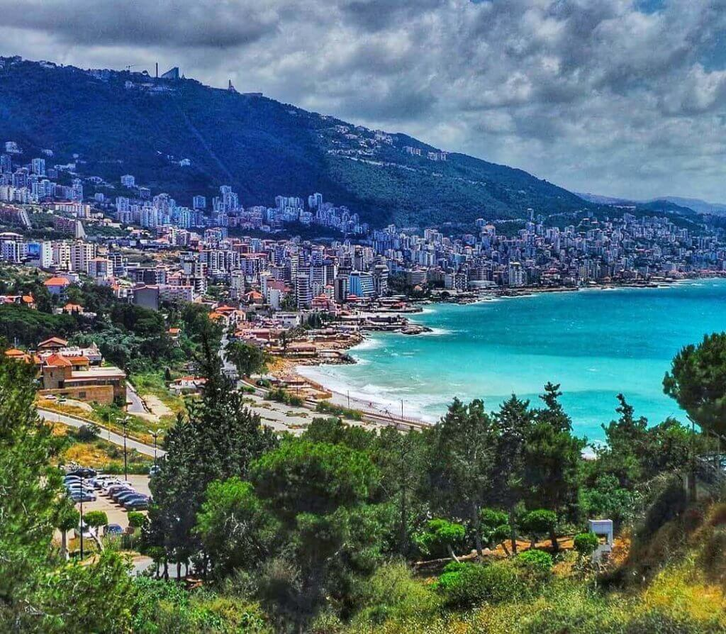
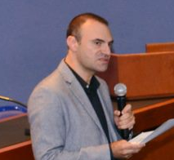

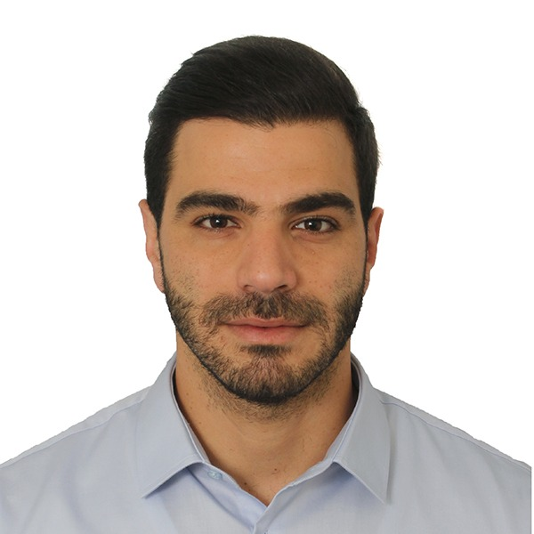
Special Thanks to the Project Local Team
Mr. Juan Hobeiche, Mayor
Legal Representative
Mr. Elie Hokayem, Financial Manager
Dr. Charbel Kadi, Senior Expert
Dr. Talal Salem, Project Manager
Mr. Kozhaya Sakr, Communication Manager
Mr. Nicholas Chahine, Junior Expert

Slide 14
Thank you for your attention
Contact: info@jounieh.gov.lb

