Slide 1
Learning Session 5:
Serving Local Foods and Family Engagement
Enter Coach Name (s)
Notes:
Welcome to Local Foods, Healthy Kids Learning Collaborative Learning Session 5: Serving Local Foods and Family Engagement.

Slide 2
Agenda
Welcome & Introductions
Review Group Norms
Icebreaker
Action Period Check In
Serving Local Foods & Family Style Dining
Family Engagement
Next Steps
Notes:
Here’s our agenda for today’s Learning Session. Please feel free to ask questions throughout our time together. (For Virtual Sessions) You can either unmute to ask questions or add any questions to the chat box.
Read aloud the agenda items.
Please remind participants that they can follow along with the slides during the Session.

Slide 3
Group Norms
Notes:
Share the Group Norms in the chat box (or on a posterboard) and add them to this slide. These are the Group Norms you created in the Orientation Session with this group. Ask anyone if they have any questions or additions.
In our Orientation Meeting we created Group Norms to help guide our discussions. I will review them briefly now. If you have any additions or questions, please share those with the group.
A few suggestions are listed below. Having around 5 group norms is a good goal.
Be on time.
Respect other members of the learning collaborative at all times.
Speak 1 at a time without interrupting.
If something is unclear, ask.
Imagine the other person’s point of view.
Assume good intentions. Listen with respect.
Everyone has something to share. Be sure to share while also making space for others to share.
Share stories and tips with one another. Stories and experiences shared here are confidential.
Accept that each individual participating in the Session will be managing different circumstances in their environment.
Assume technological glitches will happen.
Adhere to agreements on using cameras and muting when possible.
We are going to start with an Icebreaker.

Slide 4
Icebreaker
What is your favorite mealtime memory?
Notes:
Large Group Icebreaker Discussion Prompt: What is your favorite mealtime memory? (Can be as a child or an adult)

Slide 5
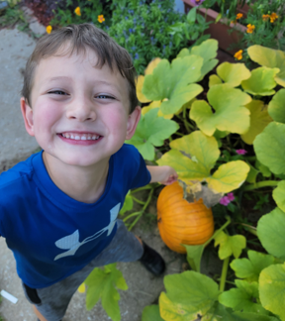
Learning Objectives
Check-in on Action Period 2 progress.
Review approaches to serving Local Foods, including Family Style Dining.
Share Family Engagement ideas.
Notes:
Review learning objectives with participants.

Slide 6
Local Foods, Healthy Kids Learning Collaborative Structure
Session 1: Introduction to Local Foods
Session 2: Sourcing Local Foods- What? When? Where? How?
Session 5: Serving Local Foods and Family Engagement
Session 6: Celebrating Success & Sustaining Healthy Changes
OR
Action Period
LS 3&4
Action Period
LS
5 & 6
Action Period
Session 3: Preparing Local Foods and Food Safety
Session 4: Menu Planning with Local Foods
Notes:
Before we get started with our Serving Local Foods and Family Engagement discussion, let’s quickly check-in to see what went well, troubleshoot any challenges you might have faced, and share any quick successes!

Slide 7
Action Period Check In
During this action period, your Leadership team:​
Met with your coach for technical assistance​.
Worked to complete your initial and any additional action plans with the help of the resources​ shared during this Learning Collaborative.
If your program completed your first 2 action plans, you should have created 2 additional action plans. ​
Filled out and shared the Key Learnings document with program staff and families.
Tracked your program's progress on your Storyboard.

Slide 8
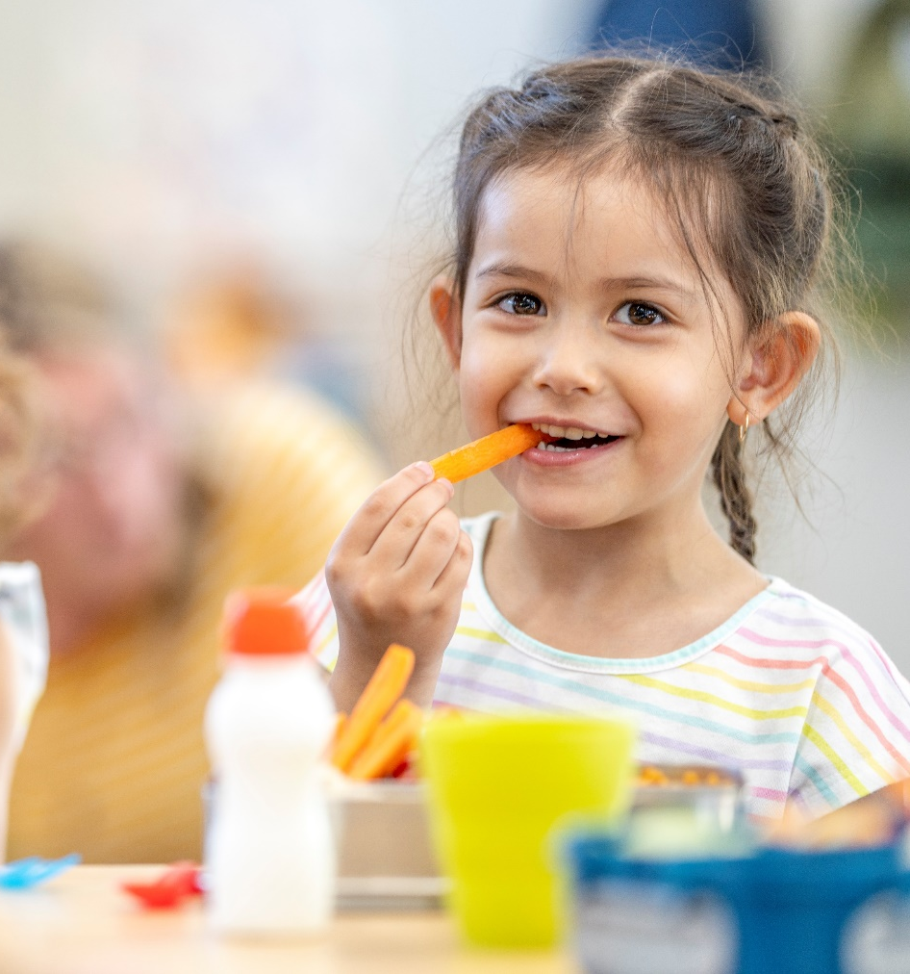
TA Group Discussion
What has been the focus of your action plan activities?​
Did you create any new action plans during this Action Period?​
Did you share the Key Learnings document with staff and families?
Notes:
If there are multiple coaches leading the Learning Collaborative, it may be beneficial to split participants into 2 TA groups, especially if there are many participants. If there is only 1 coach leading the Learning Collaborative, there is no need to split participants into groups, and you should disregard the information on breakout rooms below.​
​
Zoom Breakout Rooms: Consider splitting into breakout groups for this discussion. Zoom Breakout Rooms are used to hold smaller discussions to allow for more participant conversation and community building. Breakout rooms can be created quickly when the meeting first starts. For a TA Group Discussion, the group should be broken into 2 groups based on the list of programs each coach is providing TA to during the Action Periods. One group should continue to meet in the main room, and the second group will be moved to a breakout room. You should copy and paste the questions on this slide in the chat for participants to use as a guide. When finished with this activity, bring the groups back together. Each Coach should ask their group members to share one takeaway or each Coach can share takeaways from their group’s discussion. See below for more guidance on how to use Zoom Breakout Rooms. ​
​
Have people report back after their discussions.​
A few notes in order to make this successful:​
Provide clear directions of the expectations of the small groups; including introductions, the question(s) to answer and choosing a reporter for when the large group reconvenes.​
Broadcast by chat the directions/questions as a reminder.​
​
Facilitate a brief group discussion about the Action Period 2 Tasks. ​
What has been the focus of your action plan activities?​
Did you create any new action plans during this Action Period?​
Did you share the Key Learnings document with staff and families?
​
When finished with this activity, bring the groups back together. Each coach can share one takeaway from their group’s discussion, or each coach can ask for volunteers from their group to share.​
​

Slide 9
Local Foods, Healthy Kids Learning Collaborative Structure
Session 1: Introduction to Local Foods
Session 2: Sourcing Local Foods- What? When? Where? How?
Session 5: Serving Local Foods and Family Engagement
Session 6: Celebrating Success & Sustaining Healthy Changes
OR
Action Period
LS 3&4
Action Period
LS
5 & 6
Action Period
Session 3: Preparing Local Foods and Food Safety
Session 4: Menu Planning with Local Foods
Notes:
Now we are at Learning Session 5! Let’s jump into the information we will learn about today.

Slide 10
Serving Local Foods
Notes:
During this Learning Session, we will focus on approaches to serving local foods, including family style dining. We will discuss strategies for incorporating local foods and conversations about local foods into the full mealtime experience.
Discussion Prompt: Who serves meals or snacks family style? Can you share about your experience?

Slide 11
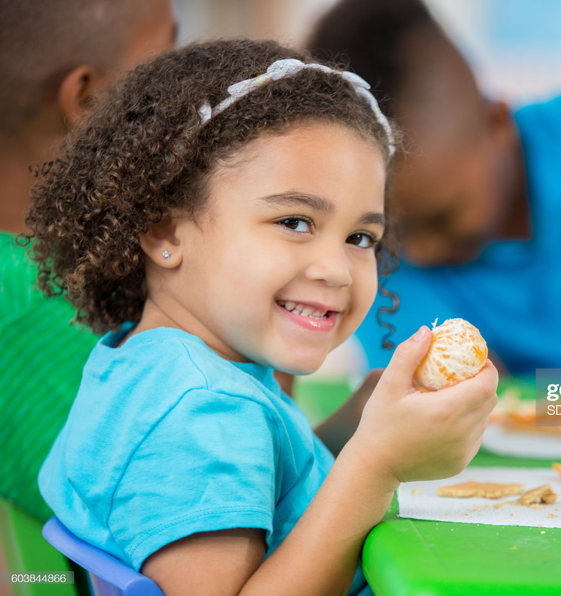
Creating a Positive Mealtime Environment
Involve children in pre- and post-mealtime activities.
Make sure children have enough time to eat during meals.
Have labeled pictures of the foods being served in the classroom.
Introduce new foods to children prior to the meal.
Staff encourage children to try new or less preferred foods.
Encourage children to listen to their hunger and fullness cues.
Avoid using food as a reward or punishment.
Serve meals family style.
Notes:
Your program spends a considerable amount of time establishing a safe and engaging learning environment. Your mealtime is also a learning environment. During mealtimes, children learn healthy habits and they learn many things just through conversations! Creating a positive eating environment takes time, patience, and planning. There are many ways to create a positive mealtime environment, and this is essential for children to feel comfortable trying out new, local foods served in different ways.
Involve children in pre- and post-mealtime activities.
Make sure children have enough time to eat during meals.
Have labeled pictures of the foods being served in the classroom.
Introduce new foods to children prior to the meal by talking or reading books about them. You can even offer a tasting during a classroom activity.
Staff encourage, but never force, children to try new or less preferred foods. If children feel pressured or forced, they will most likely not want to try the food.
Encourage children to listen to their hunger and fullness cues. We want children to be in tune with their bodies. Adults can prompt children to check in with their tummies during the meal to see if they are still hungry.
Avoid using food as a reward or punishment.
Serve meals family style. Serving meals using a family style dining approach is a much more engaging way to help children learn a lot of new skills, including fine motor skills, healthy eating habits, and development of social/emotional skills.

Slide 12
Recommended Local Food Practices that Impact Mealtime Environments
Menus and foods used in meals or activities reflect the cultural, religious, and family preferences of children and families served.
Menus and foods used in meals or activities regularly (e.g., weekly, monthly) expose children to different food cultures in the region and community.
We have a written policy related to prioritizing local, seasonal foods and culturally reflective menus and foods.
Notes:
Unless otherwise noted, recommended practices are found in the “Farm to Early Care and Education Self-Assessment” published by ASPHN (Association of State Public Health Nutritionists) and the National Farm to School Network (NFSN).
There are a few local food practices that can positively impact mealtime environments by ensuring:
Meals reflect the cultural, religious, and family preferences of children and families served.
Menus and foods used in meals or activities regularly (e.g., weekly, monthly) expose children to different food cultures in the region and community.
Programs are encouraged to have a written policy related to prioritizing local, seasonal foods and culturally reflective menus and foods. Updating your mealtime policies will help sustain local food practices!

Slide 13

Meal Service Approaches
Pre-plated
Caregivers know exactly how much food children are being served.
Caregivers can more easily know how much food to prepare of each item.
Family Style Dining
Children are given the opportunity to decide what and how much they want to eat.
Children work on their fine motor skills.
Children learn to check-in with their bodies and to eat based their hunger and fullness cues.
Children develop independence and build self-esteem and confidence.
Children develop social and emotional skills through conversations.
Notes:
There are two primary meal service approaches: serving meals pre-plated and serving meals family style.
First there’s serving meals pre-plated. Of course, serving meals pre-plated is when caregivers add the proper serving size of each meal component to plates and serve the children. What are the benefits of serving meals pre-plated?
Caregivers know exactly how much food children are being served.
Caregivers can more easily know how much food to prepare of each item.
Family style dining includes many different steps to make up the full mealtime experience from setting the table to cleaning up after a meal. It is a recommended approach to serving meals that supports children’s development where food and beverages are placed on the table, children serve themselves and children and teachers enjoy meals and mealtime conversations together. Family-style meals are structured around eating together for the purpose of creating conversation around food, forming good eating habits, and sharing a meal. There are many benefits to serving meals family style:
Children are given the opportunity to decide what and how much they want to eat.
Children work on their fine motor skills by using different utensils to serve themselves and passing bowls to their classmates.
Children learn to check-in with their bodies and to trust their hunger and fullness cues. When children are allowed to decide their own portion sizes, they generally serve themselves a smaller amount and are more likely to eat the amount that their body needs. This decision-making process helps to reinforce children’s eating according to their internal hunger and fullness cues.
Children develop independence and build self-esteem and confidence.
Children develop social and emotional skills through conversations.
There are benefits to both approaches, but we see children grow and develop in their independence and to be more in tune with their bodies when they get to experience family style dining.
Discussion prompt: What other benefits of each approach can you think of? What challenges have you encountered or anticipate you will experience when serving meals family style?

Slide 14
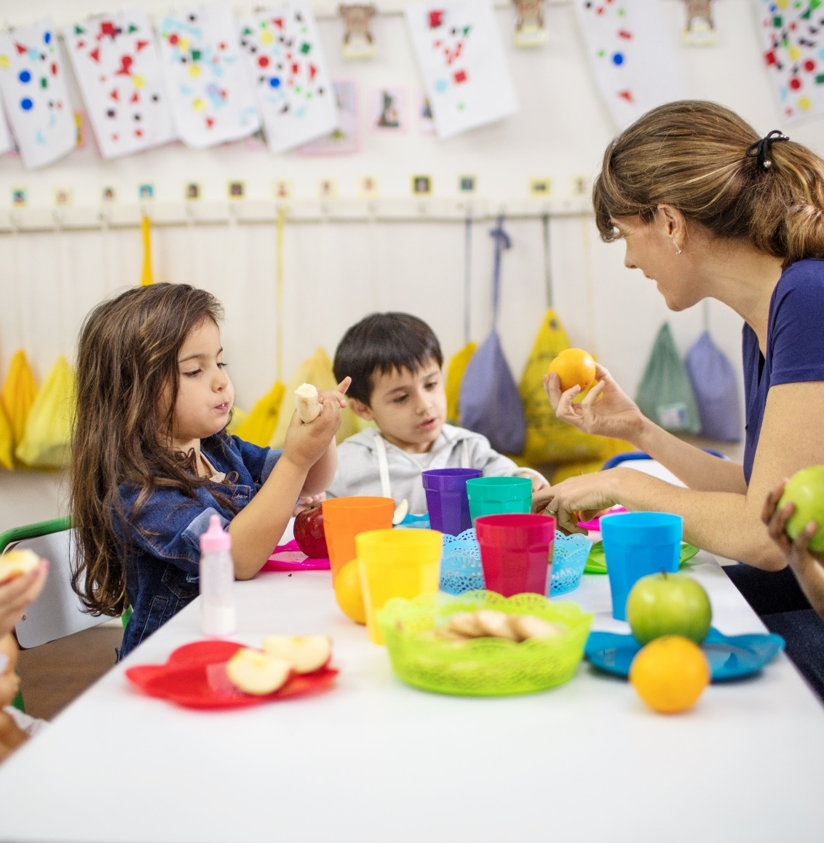
Roles of Children and Staff
Children help set the table
Adults place food on the table in small containers with child-sized utensils
Beverages are served in small pitchers by adults or children
Children serve themselves food
Adults sit at the table with children and role model by eating the same foods
Children and adults engage in conversation
Notes:
So, what does Family Style Dining Look like? Family Style Dining looks different from one ECE program to the next depending on the ages of the children served and whether food is provided by the ECE program, catered by an outside company, or brought from home, but the key elements stay the same. If your ECE program is new to Family Style Dining, you can introduce it slowly by incorporating a few of these elements at a time. If your program isn’t able to incorporate all aspects of family style dining, choosing specific actions that fit your program will also be beneficial for the children.
In its most complete form, family-style meal service involves all of the following elements:
Children help set and clear the table.
Food is placed on the table in small containers with child-size utensils.
Beverages are served in small pitchers.
Children choose their own portion size and serve themselves independently unless adult help is required.
Adults sit at the table with children and role-model by eating the same foods and drinking the same beverages.
Adults intentionally engage with children at the table to talk about trying and enjoying new foods and to guide the conversation to create a positive mealtime environment that supports learning.
Children engage in conversation with one another and with the adults around the table.

Slide 15
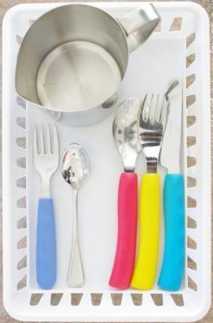
Serving Local Foods Family Style
To have the most success at serving meals family style, consider these ideas:
Model good eating practices in front of the children.
Give the children small samples to taste before the meal.
Use child-sized utensils and pitchers that are easy for kids to grasp.
Feature a local food of the week or month and serve it in different ways.
Let kids practice and build their fine motor skills before mealtime.
Be prepared for accidents to happen!
Center some of the mealtime conversations on topics related to local foods.
Notes:
Family-style meals are a great way to introduce new, local foods and create table talk around these foods. To have the most success at serving meals including local foods family style, consider these ideas:
Model good eating practices in front of the children by serving yourself, passing the containers, and trying new things.
Give the children small samples to taste during an activity before the meal.
Use child-sized utensils and pitchers that are easy for kids to grasp.
Feature a local food of the week or month and serve it in different ways.
Let kids practice and build their fine motor skills by practicing at a sensory table or dramatic play area.
Be prepared for accidents to happen!
Center some of the mealtime conversations on topics related to local foods.
Optional large discussion prompt: What family style dining activities are you already incorporating into your mealtime?
Source: Adapted from Michigan Farm to School- Farm to Early Childhood Programs: A Step-by-Step Guide & Better Together Child Nutrition Learning Collaborative

Slide 16




Local Food Conversation Starters
Talk to children about where their food comes from.
Talk about foods that are currently in-season in your area.
Share about the farmer that grew the local item that is on the menu.
Have you ever been to the farmer’s market?
How we cook our food changes the way it tastes. How does your family cook this food?
Share about the foods being served that were grown locally.
Notes:
There any many opportunities to have conversations during mealtimes about local foods, especially if any local products are being served. Here are a few examples:
Talk to children about where their food comes from. You can even make it a guessing game. If you have local watermelon on the menu, you can ask children where and how they grow. Do they grow in a tree, under ground, on a vine, or on a bush? Of course, you know they grow on a vine. Share how the foods get from the farm to their child care program.
Talk about foods that are currently in-season in your area. There are many Purdue University Extension resources you can review to find out what is in season.
Share about the farmer that grew the local item that is on the menu for the day. You can even share pictures of where the item is grown or who grows it to help the children learn more.
Ask “have you ever been to a farmer’s market?” If so, expound on the question and talk about what they bought, what was their experience like, what kinds of things did they see there, was there anything there that surprised or confused them?
Discuss how cooking foods different ways changes the way it tastes. You can ask how do they like an item cooked best and how does their family cook that food.
Share about the foods being served that were grown locally. Explore the senses and ask how much they like the food. If the item has seeds, point them out and talk about how seeds grow. You can save some of the seeds and look at them under a magnifying glass.
The potential discussion topics are endless!

Slide 17
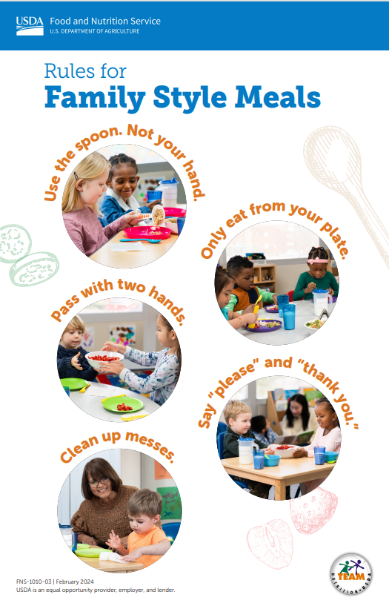
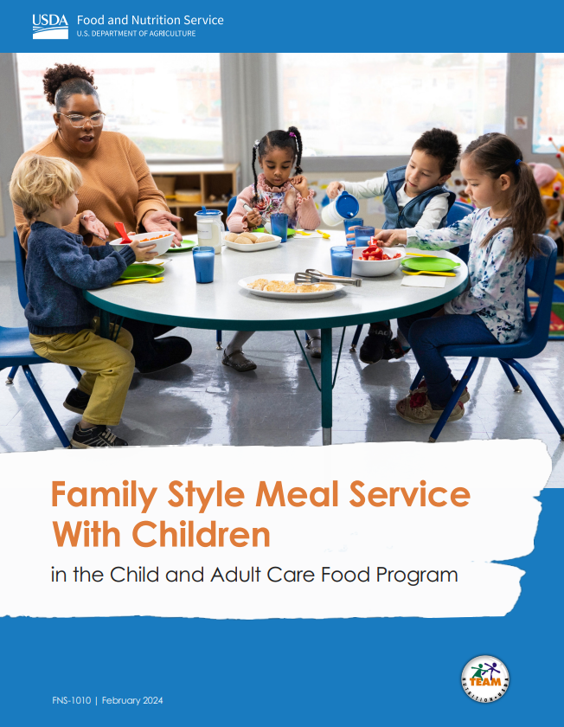
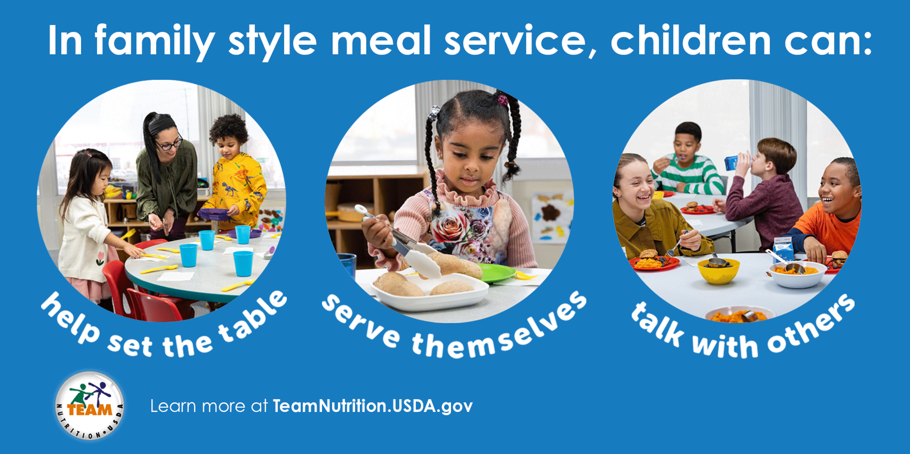
Family Style Dining Resources
New! USDA & Team Nutrition Resources
Notes:
Whether you’re only wanting to incorporate a few activities or the whole mealtime approach, there are several great resources available.
Released in 2024, the USDA’s Team Nutrition Family Style Meal Service with Children guide provides helpful guidance and tips for family style dining, as well as ensuring you are staying in compliance with CACFP requirements. There are also several flyers and posters on this website that you can print off. Family Style Meal Service With Children in the CACFP | Food and Nutrition Service (usda.gov) https://www.fns.usda.gov/tn/cacfp/family-style-meals

Slide 18

Mindfulness Break
Notes:
Mindful Eating Video 1:33
You can find more resources on mindful eating at https://www.hsph.harvard.edu/nutritionsource/mindful-eating/.

Slide 19
Family Engagement
Notes:
Let’s talk about engaging families with local foods.

Slide 20
How have you engaged families in Farm to ECE activities?
What has worked well? What barriers have you faced?
Notes:
Large Group Prompt: How have you engaged families in Farm to ECE? What has worked well? What barriers have you faced?

Slide 21
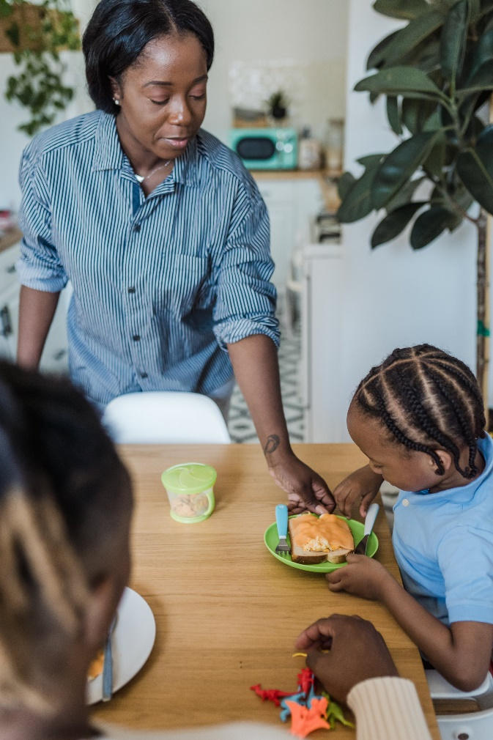
Why Family Engagement?
When families are involved in education, children benefit, the program benefits and families benefit.
Engaging families helps to reinforce the healthy messaging and behaviors.
Families are actively engaged with their children and rely on child care providers for guidance.
Child care providers are role models!
Notes:
When families are involved in education, children benefit, the program benefits and families benefit​.
Engaging families helps reinforce healthy messaging and behaviors.
Families are actively engaged with their children and rely on child care providers for guidance​.
Child care providers are role models. Children spend several hours a day at child care, participating in activities and receiving a great percentage of their daily nutrients. We know that most healthy habits form before the age of 5 and child care providers play a key role in introducing and role modeling healthy behaviors.
Source: https://www.farmtoschool.org/resources-main/training-template-farm-to-preschool-and-family-engagement
Photo- Pexels- Mizuno K

Slide 22
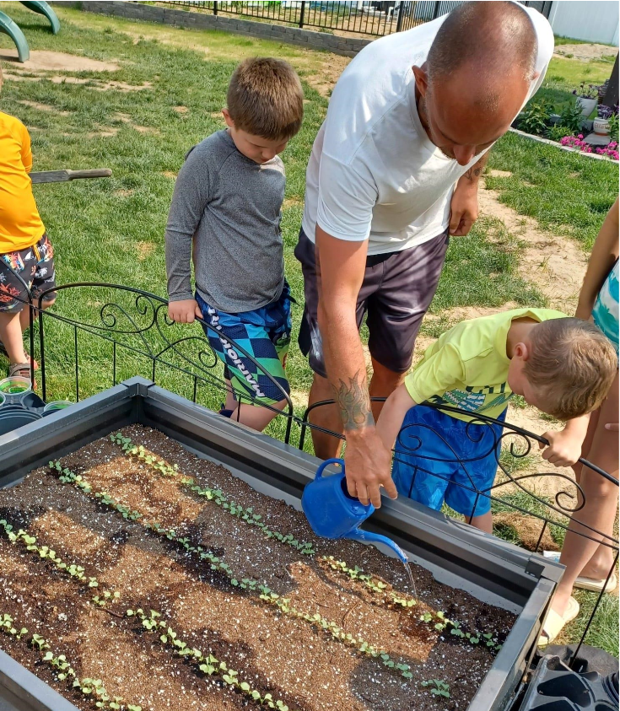
Meeting Families Where They Are
Ideas for engaging caregivers with different strengths
The “Very Busy” caregiver
The artist
The instructor
The leader
The quiet collaborator
The organizer
Photo Credit: Miss Roxy’s Daycare and Preschool
Notes:
Of course, family members/caregivers have different personalities, strengths, interests, and skills. If we can tap into the strengths of each family member/caregiver, we will be able to better involve them in the classroom and engage them in different types of activities. We are essentially meeting them where they are and creating a space for them in the classroom. Here are some examples of ways to engage family members with different strengths, interests, and skills.
The “Very Busy” caregiver: We can find meaningful ways to maximize drop-off and pick-up time to involve this type of caregiver. Consider engaging them in a tasting of a local food during pickup or drop off time, or having them respond to a prompt about local food traditions or preferences (i.e., what is your favorite local food? Have you cooked with local foods at home?) Caregivers may be extremely busy for many different reasons. Helping them to slow down for just a few moments during the times when we see them can help them better understand their impact on their child, the classroom, and the ECE program as a whole.
The artist: The artistic caregiver can help design signage for the classroom highlighting local foods (maybe even a “locally grown” logo for your menus) or organize sing-alongs about farm to ECE topics.
The instructor: These family members can lead children in different farm to ECE activities, including a trip to a farm or farmer’s market or reading farm to ECE stories.
The leader: The leader can organize and motivate families to participate in farm to ECE events your program might host like a farmer’s visit.
The quiet collaborator: These caregivers can help you behind the scenes to plan different projects, which might include the creation of a local foods family recipe book. They can solicit and assemble recipes families in your class/program submit and print copies for all families.
The organizer: The organizer can help develop a calendar of activities or help organize farmer’s visits and ask families to help in different ways to organize events/activities.
Discussion Prompt: What others can you think of?
Source: Engage Families with Farm to ECE: https://www.communitygroundworks.org/sites/default/files/Engage%20Families%20with%20Farm%20to%20ECE_reduced%20size.pdf

Slide 23

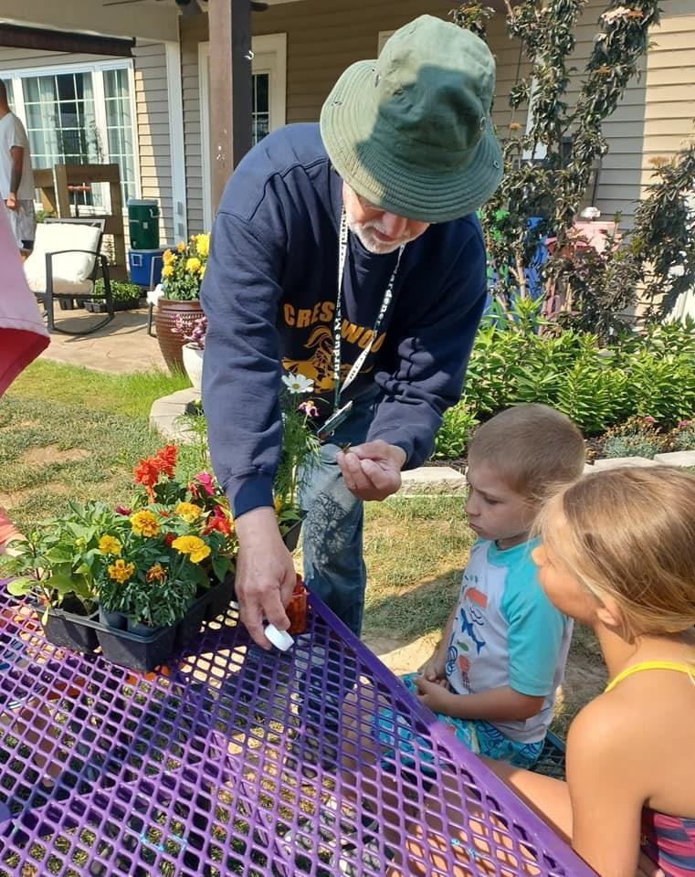
Engaging Families with Local Foods
Take field trips to local farms or have farmers visit your child care site.
  Consider a farmer pop up market on site!
Engage families in tastings when they pick up their children.
Engage families (in conversation or via surveys) to understand what local foods they like to purchase for their families and consider incorporating them into your menus.
Photo Credit: Miss Roxy’s Daycare and Preschool
Notes:
Here are some way to engage families with Local Foods:
Take field trips to local farms or have farmers visit your child care site like on the image on the right here from Miss Roxy’s Daycare and Preschool.
If possible, consider a farmer pop up market on site!
Engage families in tastings when they pick up their children.
Engage families – in conversation or via surveys- to understand what local foods they like to purchase for their families and consider incorporating them into your menus.
Photo credit: canva pro- mediaphotos from Getty Images Signature

Slide 24
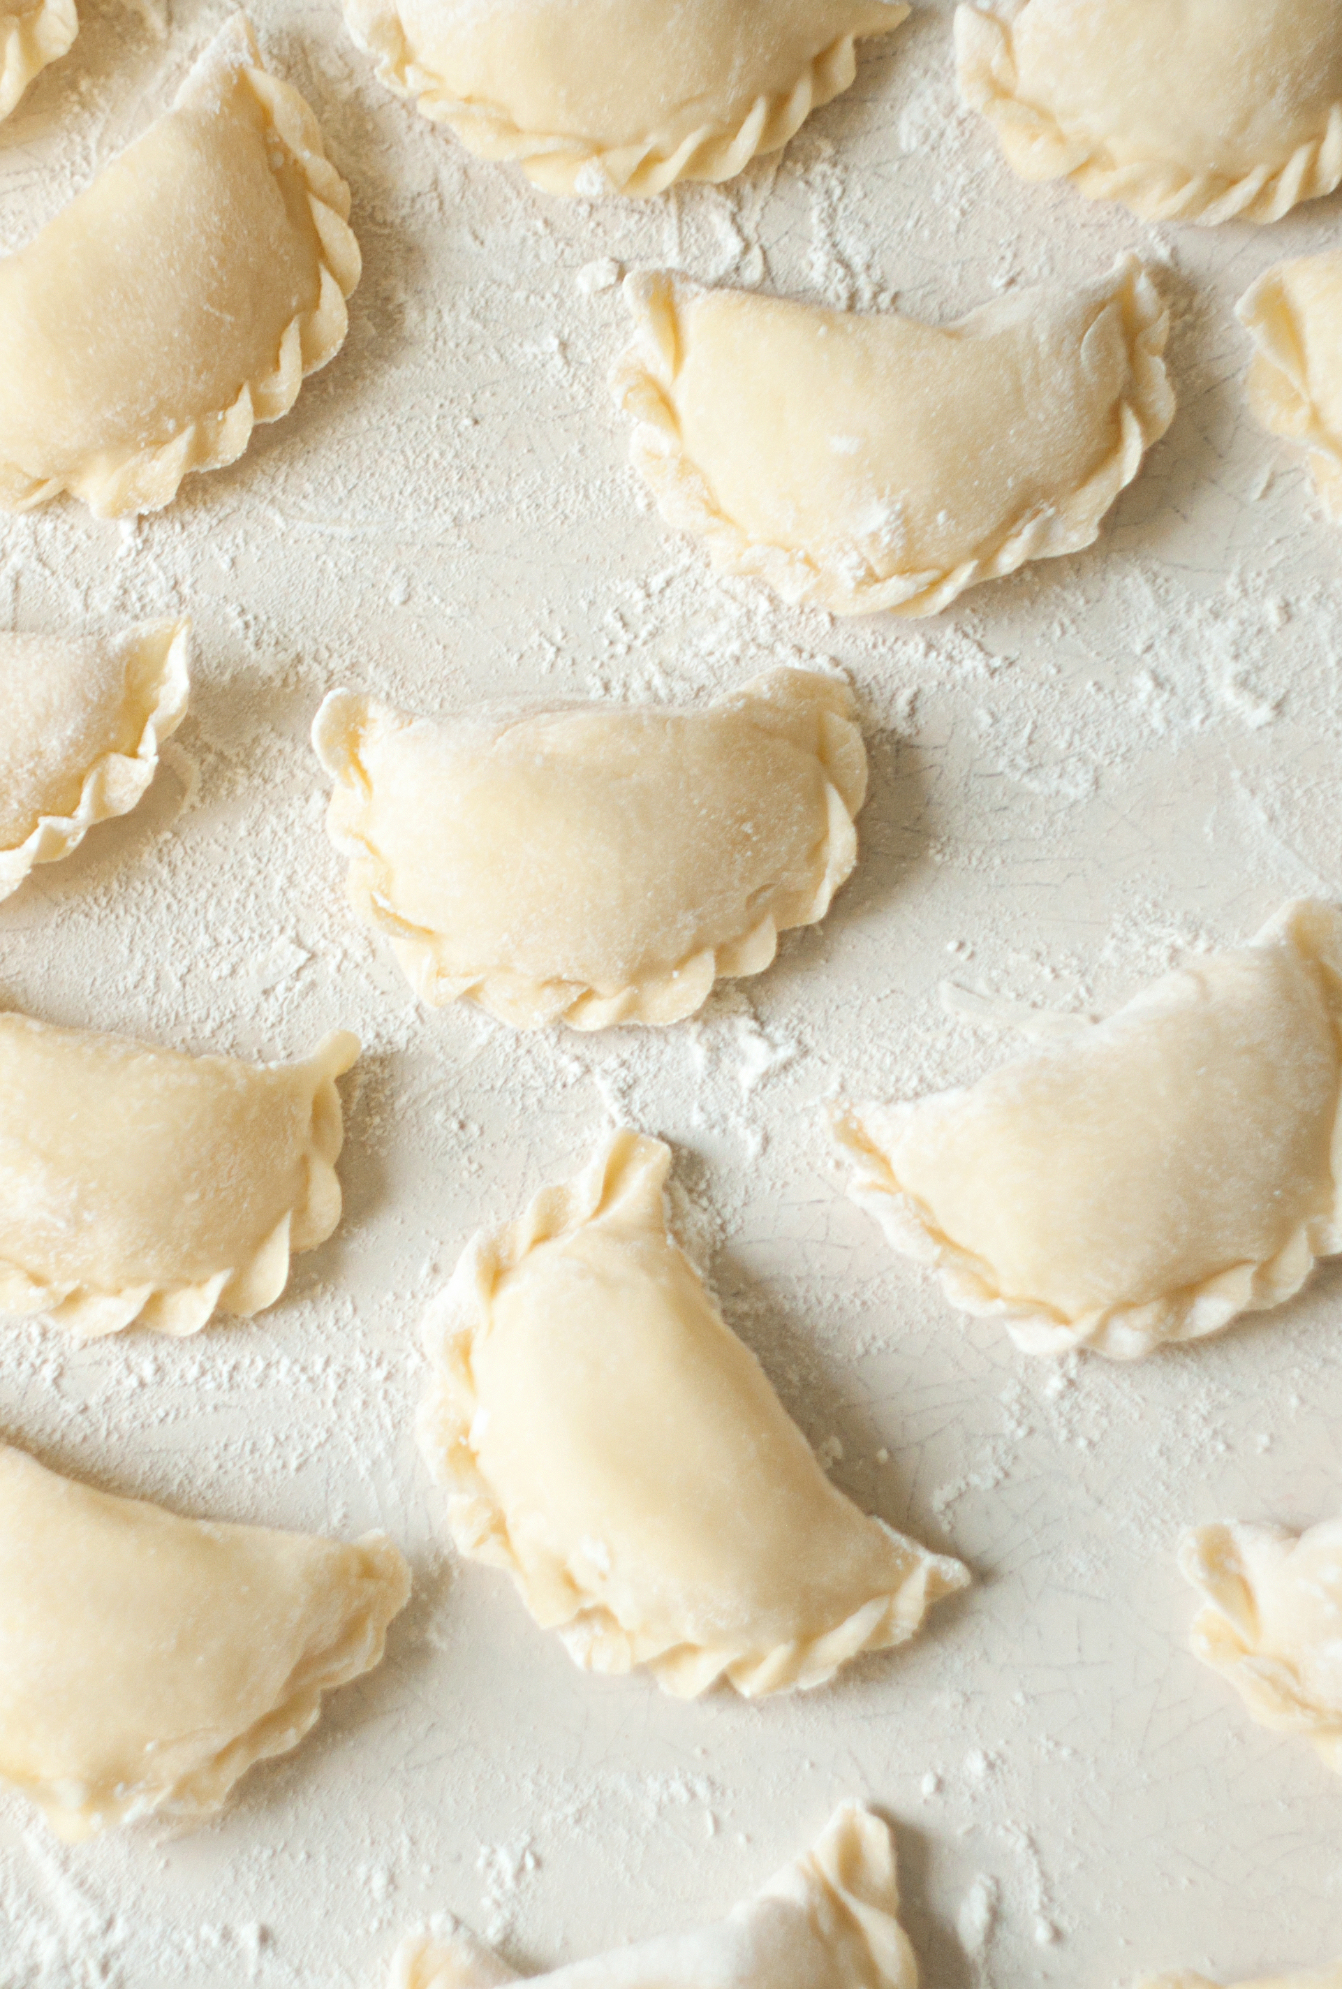

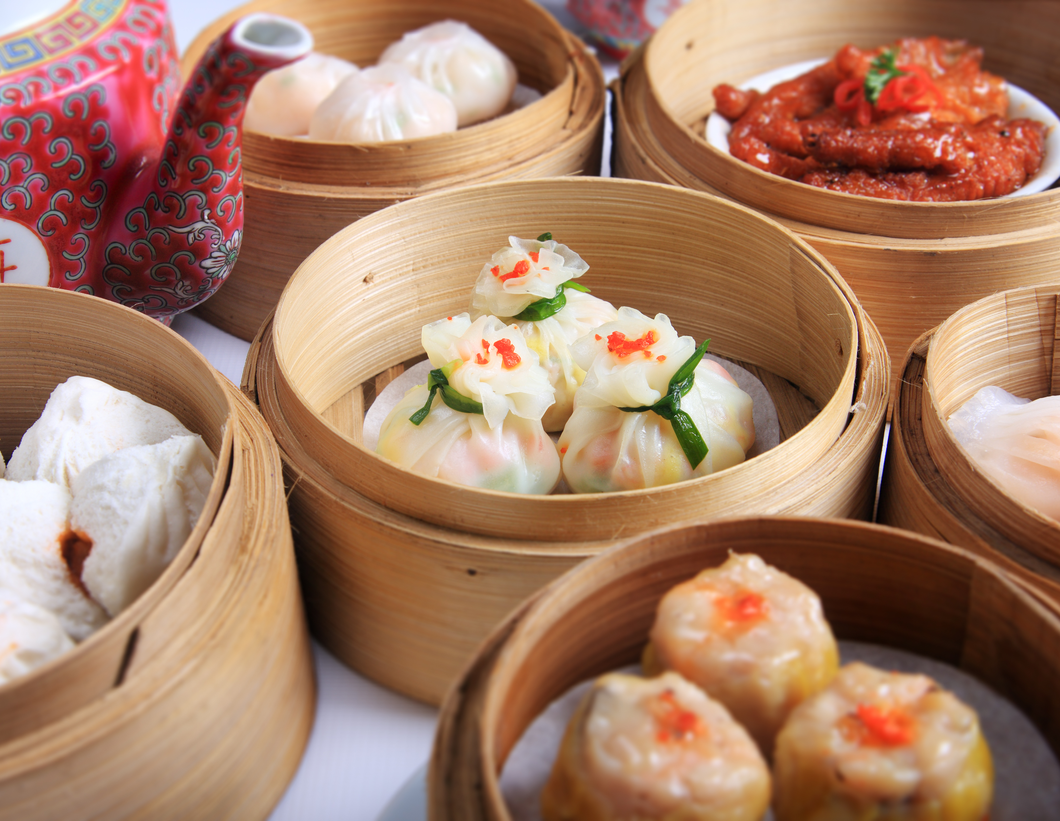
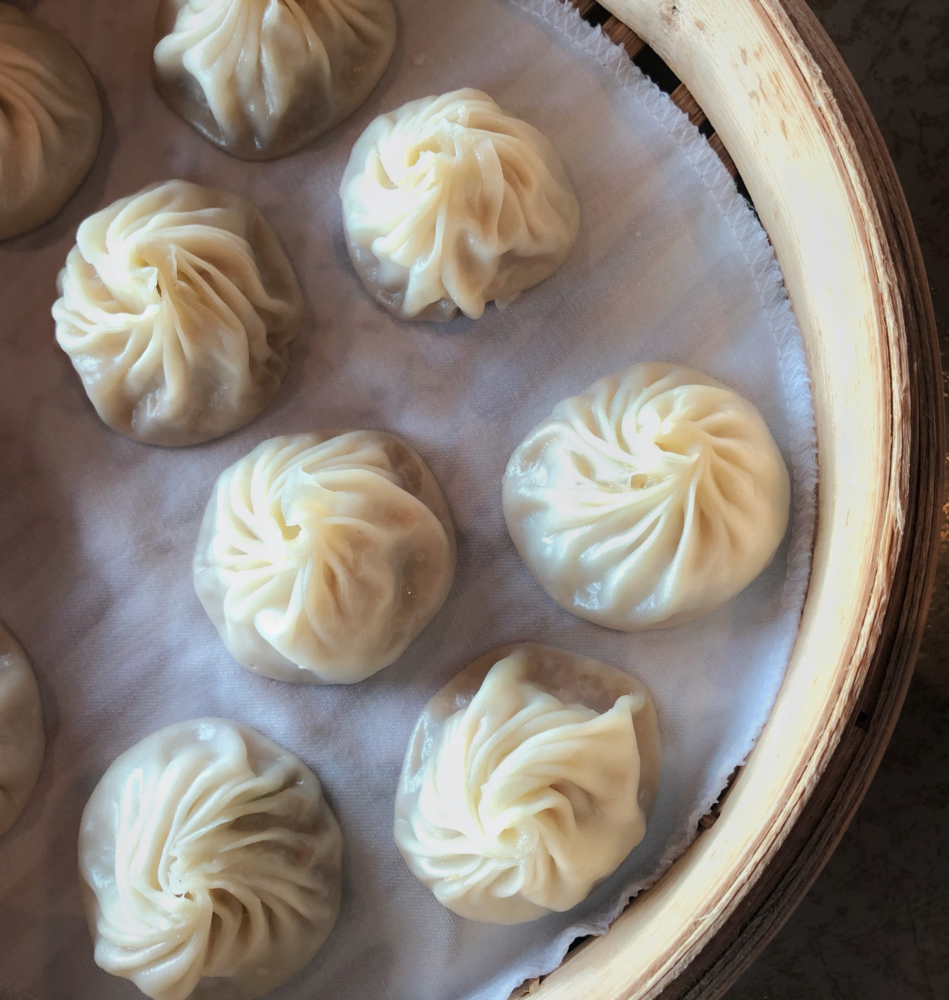
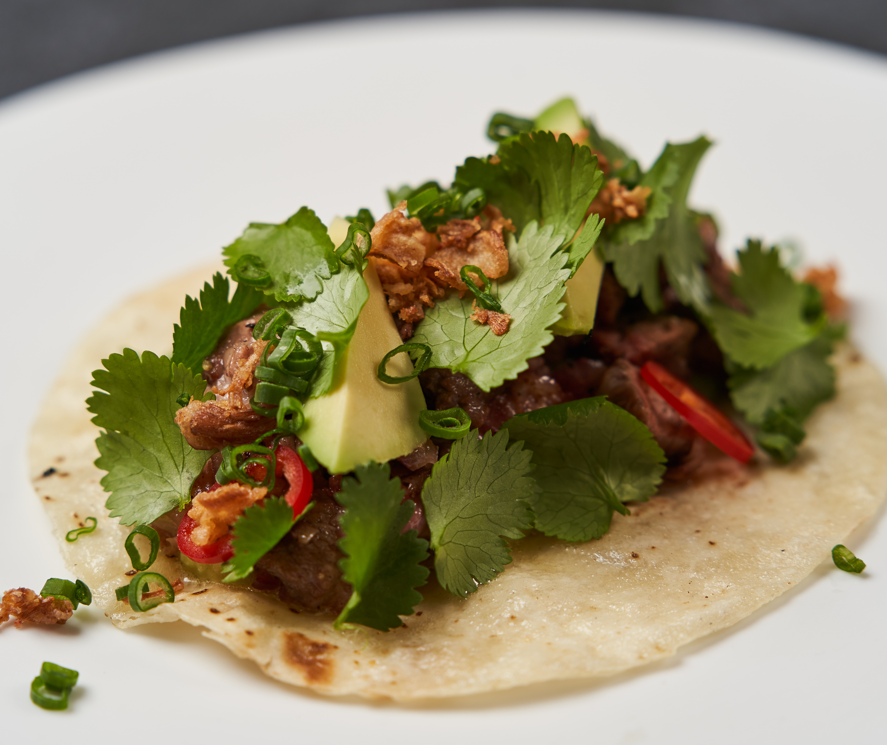
Celebrate Local Foods in Cultures and Traditions
Traditions and Culture
Presentations
Books
Music
Show and tell
Foods
Cooking demonstrations/classes
Tastings
Explore the 5 senses!
Encourage curiosity!
Notes:
Providing opportunities for families to share about local foods that are celebrated and eaten through their family traditions and culture will cultivate a program environment that values and belonging. Celebrating and reflecting different cultures in different aspects of the ECE program helps families to know they are welcome and affirms the important role they play in their children’s lives and in the ECE program. We want family members and caregivers to feel seen and understood and to know their thoughts and opinions are heard and matter. It is our goal, as ECE providers, to ensure our children and families feel welcome, comfortable, valued, respected, and to know they belong. It takes intentional effort to create this type of environment at an ECE program, and Farm to ECE provides many opportunities to celebrate different cultures.
Traditions: There are many ways families can share about foods that are important for different cultures and traditions with the children in your program. They can share a presentation about one aspect of their culture or a meaningful tradition. Families can read books, share music, and bring items that celebrate and honor their cultural and traditional foods, especially those that can be grown and/or purchased locally.
Foods: Invite a family member to share about a traditional food or meal in their culture and include the food in the lunch menu for the day or offer the food through a classroom tasting activity. Family members and teachers can talk with children about how they are experiencing the foods through their 5 senses: how does the food feel, smell, taste, look and even sound. Yes, foods can be associated with a sound! For sound, does it make a crunching sound when you take a bite or chew it, does it make a sound when you rub your finger or eating utensil on it? When you bite into a pickle, it is crunchy!
Discussion Prompt: What are some cultural/traditional foods that the children and families in your programs eat at home?
A note about cultural foods and encouraging acceptance among young children: Encourage curiosity rather than being judgmental. The more we normalize the acceptance of new and different foods and experiences, the more accepting the children in our classes will become. One thing we do not want to do is to perpetuate shame and embarrassment in children that do bring different food items, wear different types of clothes, eat a different way, or speak a different language.
Here are a few ways to encourage young children to be more curious, accepting, and respectful when they have opportunities to explore foods that are new and different to them:
Encourage curiosity: When something new or different is introduced in the classroom, encourage a conversation to explore the item. Don’t be afraid to discuss the “elephant” or the “kimchi” in the room.
Provide a simple explanation: Explain what an item is, sharing differences and similarities to other common items. Share about why a food might be commonly eaten in a particular culture.
Offer positive feedback and solutions: Praise children for trying foods and for showing their curiosity. A simple way to positively reinforce children for trying new foods is to give them a sticker that says “I am brave!” or “I tried a new food today!”
It is also ok for a child to refuse to try a new foods. We should never give children food as reward or pressure children to eat or clean their plate. Such practices may seem effective in the short term to get children to eat or try new foods, but they tend to have negative long-term implications.

Slide 25

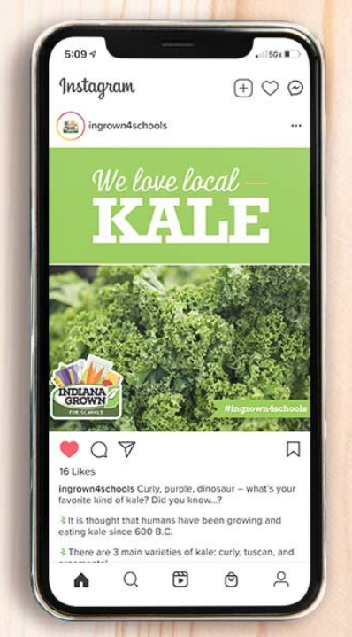
Communicating with Families
Consistent communication
Meet your families where they are
Communicate through many channels
How do you communicate with families?
What communication channels work best?
Notes:
Consistent communication to families/caregivers is important. Opening a conversation to ask questions, gather feedback and share ideas.
When talking to your families, you have to meet them where they are. Try to communicate with and request feedback from families in various ways – in person, in print, online. Remember, people engage with information in different ways (i.e., some families and caregivers may have access to their email all day, while others prefer accessing information in print.) Newsletters are a great way to keep families informed and connected.
Social media offers an opportunity to have an ongoing conversation with groups of families (and community members). Social media outlets include Instagram, Facebook and X (Formerly known as Twitter). Although social media may never reach everyone, it is becoming more popular and offers a unique way to connect with your families. If you and your staff feel comfortable, this is a great communication outlet to explore and take advantage of. Indian Grown for School has ready-made easy-to use content like photos and captions for social media that you can download right from their website and re-post. (https://www.ingrown4schools.com/hom-resources-files/social-post-kale).
Large group discussion prompts: How do you communicate with families? What communication channels work best for your program/families?

Slide 26
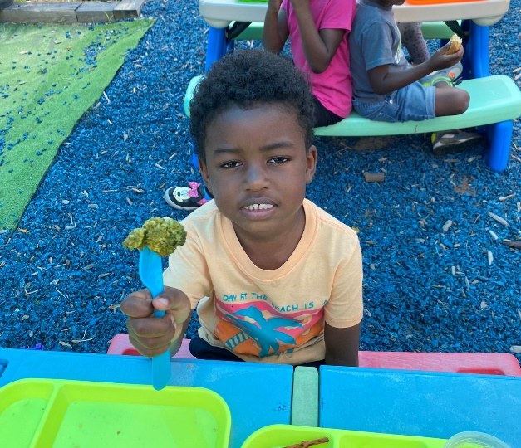
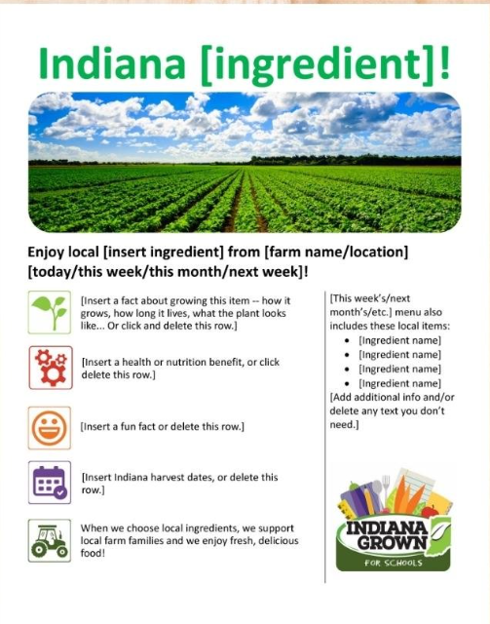
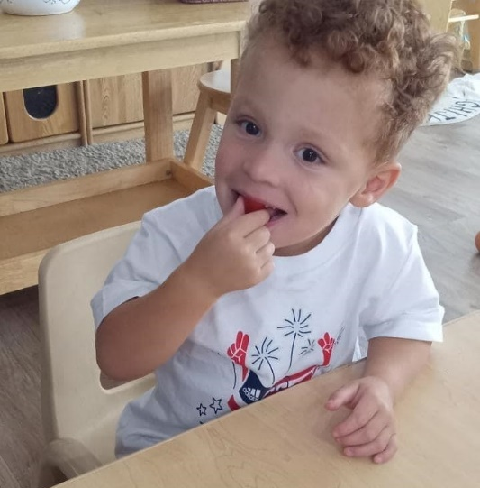
Highlighting Local Foods for Families
Post pictures of children trying new local foods on the front bulletin board.
Highlight local foods on your menu for parents to see.
Share flyers from local farms/markets where you purchase.
Photo Credit- Top: Rhonda’s Little Angels
Bottom: Bright Village Early Learning
Notes:
Another way to engage families is by highlighting local foods in your program:
Post pictures of children trying new local foods on the front bulletin board or maybe include on a newsletter.
Highlight local foods on your menu for parents to see. Remember during the menu planning session we discussed using a special icon to indicate which foods on your menu are local. The document highlighted on the middle of this slide is from Indiana Grown and can be adapted for various Indiana ingredients.
Share flyers from local farms or markets where you purchase.
Farm to School Flyer (Blank)- https://www.ingrown4schools.com/hom-resources-files/blank-farm-to-school-flyer-template

Slide 27
Final Reflection
What challenges are you facing with integrating local foods into your program right now?
What additional information would you like to learn about?​
Notes:
What challenges are you facing with integrating local foods into your program right now?
What additional information would you like to learn about?​

Slide 28
Storyboards

Slide 29
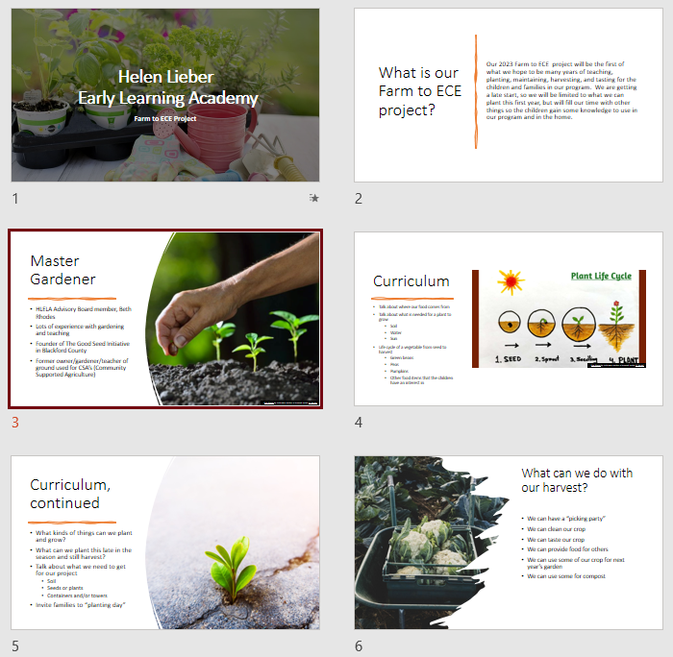
Finalizing Your Storyboard
Capture your ECE program’s journey
Your program’s Storyboard should show your process and accomplishments.
Possible things to include:
  What change(s) were made
  Who was involved or provided help
  What challenges you overcame
  How children reacted to the change(s)
  What policies were updated
  How will you sustain the change(s)
Notes:
Your Leadership Team should work to finalize your Storyboard before the next Learning Session. During Learning Session 6, you will have an opportunity to share your progress and successes with our group.
As a reminder, your Storyboard might include:
Photos of the process, including before, during, and after the change(s);
Stories from teachers, staff, families and children;
Assessments, observations and reflections;
Documents including lesson plans or menus that demonstrate changes; and/or
Children’s artwork that describe the healthy changes in the program.
Remember to capture your changes on your Storyboard. We want to all learn from your challenges and successes!

Slide 30
Storyboard Order
Notes:
Coaches should insert the order that Storyboards will be presented in LS6 (and LS7 if necessary).

Slide 31
Resources

Slide 32
Resources
Share about Double Up Indiana with staff and families!
https://doubleupindiana.org/
Notes:
https://doubleupindiana.org/

Slide 33
Next Steps

Slide 34
Tasks to Complete
Work to complete your action plans with the help of the resources shared during this Learning Collaborative.​
If your program has completed your first 2 action plans, collaborate on the creation of 2 additional action plans. ​
Finish your ECE program’s Storyboard and share with your Coach.
Notes:
Coaches should review and update the “Action Period Tasks” slides at the end of each Session to ensure accuracy, align tasks with Learning Collaborative timeline, and reduce repetitive tasks.
​
Tasks to Complete Before the Next Learning Session:​
Work to complete your action plans with the help of the resources shared during this Learning Collaborative.​
If your program has completed your first 2 action plans, collaborate on the creation of 2 additional action plans. ​
Finish your ECE program’s Storyboard and share with your Coach.
​

Slide 35
Key Dates
Upcoming Session dates (XX:XX- XX:XX ):
Session 6:
Action Period 3:
Notes:
Coaches should add in dates for all upcoming sessions.
Review the timeline. Share dates for all Learning Sessions so providers will know what to expect and to reduce barriers to participation. Be sure to provide a list of actions for each program to complete before and after each Learning Session. The goal is to ensure participants know when they need to complete each action item.
Our next Learning Session will be on ______________. After the next Learning Session, we will be finished with our sessions for this collaborative, and you will have a final action period to complete any action plans.

Slide 36
Questions?

Slide 37
Coach Information
Insert Coach Contact Information Here

Slide 38
Coach Reminders
After Session 5, coaches should:​
Check-in on the ECE programs’ progress to implement strategies to complete action plans. ​
If programs have completed their first two action plans, collaborate on the creation of 2 additional action plans. ​
Remind ECE programs to finish their Storyboard and to share with the coach.
Notes:
This “Coach Reminder” slide gives you, the coach, reminders for the Action Periods and next steps for facilitating the Learning Collaborative. They are hidden in the PowerPoint. They are not intended to be shared with ECE providers. Do not include them in any printed versions of the slides you provide to ECE providers.
After Session 5, coaches should:
Check-in on the ECE programs’ progress to implement strategies to complete action plans. ​
If programs have completed their first two action plans, collaborate on the creation of 2 additional action plans. ​
Remind ECE programs to finish their Storyboard and to share with the coach.

