Slide 1

SUNY Library Shared Services Update
September 24, 2020
www.suny.edu

Slide 2
Support Update: Highlights from September Meeting
Content rep couldn’t make it, so limited engagement on content/CDI cases.
Review of some Primo VE indexing issues related to NZ SD package and Elsevier autoholdings.
Discussion of lag in inbound link resolver links.
Issue with NZ RS locate problems for articles: not supported.
Still investigating issues with editing a CZ record to include alternative title.
www.suny.edu

Slide 3
SUNY Top 5 Update
Completed
  Pop-up when lender tries to check-in item borrower never received.
  Show RS request options when library owns an ebook
  Title Match shows wrong fulfillment info in link resolver service page – new option to match only on identifier not title
Planned in November Release
  Boost Institutional Search Results in Primo VE
  Duplicate title analysis for NZ
  Recalculate Rota Assignment
Not Accepted
  Ability to add multiple Primo deep links to non-SUNY Alma catalogs for RS discovery.
Ongoing Testing and Analysis:
  Lending Locate failures for article RS requests
www.suny.edu

Slide 4
Looking for a New Top 5 Case/Issue
ExLibris indicated we could include another top 5 case.
We're looking for input on what would be Top 5:
  Shouldn't be something that is a major change in system, but could be something that would improve a pain point or functionality.
  Send us suggestions to libanswers.
If we don't receive any additional suitable suggestions, we will propose:
  Add link to article download to My Account in Primo VE for articles borrowed via Alma.
www.suny.edu

Slide 5
New Working Group: Volunteers Needed
Improvements and Enhancements Working Group
  Will help coordinate and guide our requests for enhancements and support improvements.
    NERS
    Idea Exchange
    Top 5 Cases
    Reviewing support trends and system wide issues
  Volunteer form at:
    https://slcny.libwizard.com/f/IECWG
www.suny.edu

Slide 6
SUNY Library Accessibility Cohort
Will begin reviewing resources in next month.
Generating reports of reviews of Accessibility Conformance Reports (VPATs) and high level review of tools.
Reports will be made available online (to internal SUNY people at this point).
If you’re being asked to “review VPATs” or consider accessibility as part of procurement process, we want to hear from you.
www.suny.edu

Slide 7
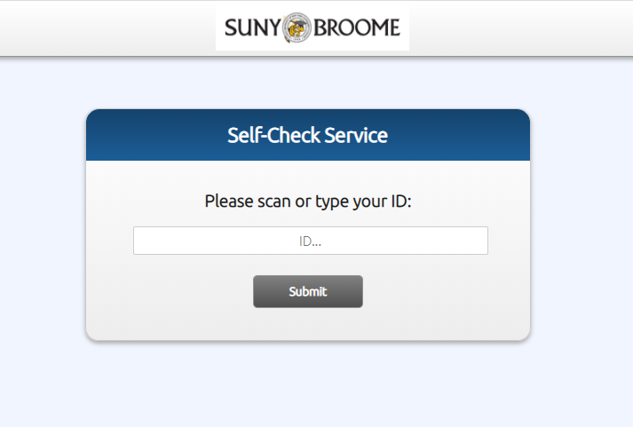
Self-Check Alma Application
Libraries can now request to begin using this in a live environment.
Send us a request via libanswers: info@slcny.libanswers.com
Will begin review of improvements soon.
  Authentication integration is top priority.
Campuses may want to consider whether this has use other than full self-check.
  Ex: self-serve hold shelves, reserves, etc.
www.suny.edu

Slide 8

Cost-Savings Project
Beginning later in the fall, SLSS will begin reaching out to eligible campuses who have high cataloging costs to suggest they move to CatExpress.
Project will focus on helping campuses understand workflow changes needed, overall repercussions, and annual savings.
SUNY had initial meeting with OCLC about project to ensure we had access to an expert to work with on this and learn limitations.
Will reach out to campuses in the near future.
www.suny.edu

Slide 9

Ezproxy
  Charges for updates and maintenance delayed until FY 21 (July 2021).
  OCLC account managers indicated they would be reaching out to contacts soon.
  Sent pricing (which is included in our contract amendment) to SCLD. OCLC indicated that campuses should use this as and add 5% for an estimate for next year's charge.
www.suny.edu

Slide 10





eBook ILL Pilot
Cohorts include California State University, Prospector libraries, The New School/NYU and SUNY
ProQuest is currently negotiating with publishers to secure ILL rights for the pilot and developing the back-end infrastructure to support lending and borrowing via the eBook Central platform
SLSS is currently asking campuses to agree to participate
Pilot anticipated start date is early Spring 2021; focus will be ILL within cohorts
www.suny.edu

Slide 11

Discovery & E-Resources
Updates
Michelle Eichelberger
www.suny.edu

Slide 12
CDI
Continues to be challenging system, spending a lot of time on troubleshooting and trying to understand fluid and rapidly changing product
Planning series of CDI Lunch & Learn sessions (AKA CDI Urgent Care) starting 10/1. Will take shallow dives into various topics like eBooks, Link in Record, recent updates. Meant to be opportunity to ask questions and troubleshoot together.
Looking into CDI House Calls – reviewing campus e-resource activations and may reach out to campuses we haven't heard from with suggestions for CDI optimization
Just added new FAQs today about publishing files, link in record in Searching: CDI section of Discovery Working FAQs page: https://slcny.libguides.com/discoverywg/faqs
www.suny.edu

Slide 13
CDI Audit
Please submit a ticket to info@slcny.libanswers.com if you'd like us to review your electronic collections to make sure that they're optimized for CDI.
We'll check:
Link in record collection activation for search and fulfillment
Possible availability publishing problems
Selective package settings
EBook title duplication options
www.suny.edu

Slide 14

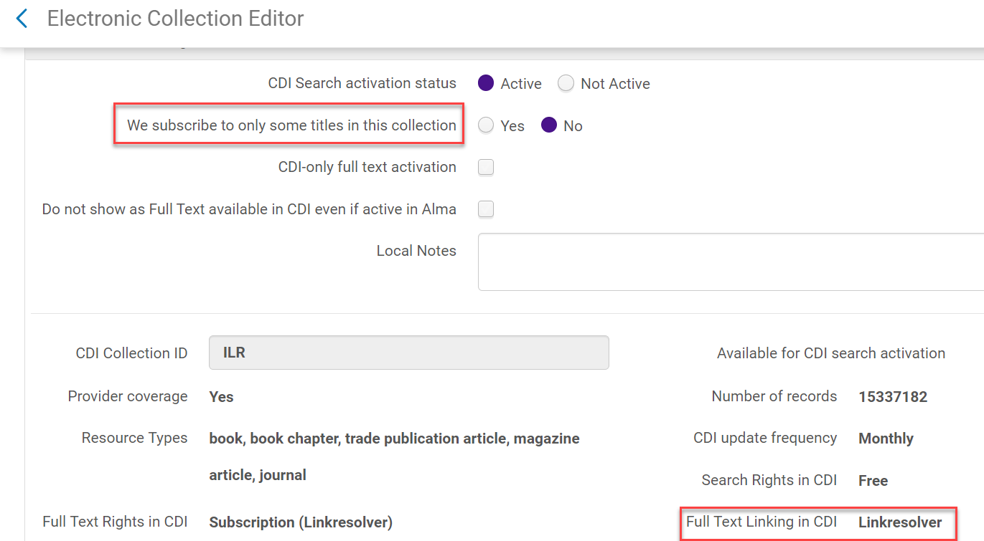
We subscribe to only some titles in this collection = yes
Why is = no a problem for aggregator packages? Causing incorrect availability in Primo – saying that you own things that you don't because there's more search content in the CDI for that package than you actually subscribe to
Ex Libris is going to programmatically fix this for us next week sometime.
www.suny.edu

Slide 15
SUNY Shared Collections Updates
Esta Tovstiadi
www.suny.edu

Slide 16

Alternative Access for Physical Collections
  Analysis of high-circulation physical monograph titles
  Availability via current subscriptions or purchased ebooks
  Pricing and availability from ProQuest and/or EBSCO, if the campus is interested in purchasing an e-book copy (some eligible for 50% discount) on those platforms
  Turnaround time is about 1 week for ProQuest, 2-3 weeks for EBSCO
  EBook Central license is required to purchase from ProQuest
  Doesn't count towards your 5 hours
  If you’re interested in requesting this analysis, email info@slcny.libanswers.com with this information:
    Date you need the analysis by
    Which vendor (ProQuest/EBSCO/both) you'd like us to send the title list to
    Which Alma locations you'd like us to include in the analysis
www.suny.edu

Slide 17
Other updates
  Shared DDA via eBook Central
    ProQuest is currently meeting with publishers to negotiate a list price multiplier (estimated 3x-4x single user license price)
    Anticipated start date within the next 2 months
  Multi-vendor RFP
    Finalizing rubrics and working through procurement paperwork
    Contacting vendors to encourage proposals
  Upcoming renewals:
    Artstor: SUNY-wide contract renewal, 12/31/20, 1 year extension
    NEJM: Negotiated pricing and access, 12/31/20, 1 year
www.suny.edu

Slide 18
Resource Sharing Update
Timothy Jackson
www.suny.edu

Slide 19
Physical Resource Sharing Restart
37 libraries have resumed Alma resource sharing
SLSS will reach out to libraries yet to resume RS once they've been assigned an ELD restart date
  Turning Alma RS back on is optional, but libraries who want to borrow will be expected to lend unless there are extenuating circumstances
  SLSS will take care of all configuration needed to turn RS back on
Currently using a single rota for all of SUNY, and lending requests are set to not expire automatically
Will revert to using regional rotas and switch expiry days setting to 7 days once libraries in the ELD NYC hub start borrowing and lending again
  No estimate for when ELD NYC hub service will resume
www.suny.edu

Slide 20
Locate Issues
Implementing Article RS required us to remove the Author field from our locate settings
Also removed OCLC number to address issues related to SUNY holdings being spread out over multiple OCLC records
Starting to see an increase in locate issues with book requests
  Lending requests for ebooks or books you don’t own
Requests with locate issues being cleaned up by SLSS staff on a daily basis
  Email info@slcny.libanswers.com if you receive a request with a locate problem
Working with Ex Libris on addressing these issues
www.suny.edu

Slide 21
Resource Sharing Update
Held on September 3
Highlights:
  Alma article borrowing workflow has been fully automated
  Possible to create RS requests for ineligible users when converting hold requests to RS requests
  Libraries should always use the Scan In function when processing RS lending returns
  ILLiad borrowing NCIP addon can now update requests that were originally exported from Alma to ILLiad
Recording: https://public.3.basecamp.com/p/atjCfjAA4RBbgUcm9yAQkUAK
www.suny.edu

Slide 22


Alma Resource Sharing with Non-SUNY Libraries
Article RS Pilot Project with Connecticut State Colleges and Universities (CSCU) System planned for Fall 2020
  Adirondack, Cayuga, Corning, Dutchess, Ulster participating as borrowers & lenders
  Empire State and Buffalo participating as lenders
  Finalizing CSCU participants
Hoping to go live sometime in October
Presenting with Patrick Carr from CSCU at ENUG (Friday, October 9 at 2:00pm)
www.suny.edu

Slide 23
Automated Fulfillment Network Update
Automated Fulfillment Networks allow users to pick up and return items at any library in the network
Already using parts of AFN functionality for walk-in borrowing, but wider implementation of AFN functionality may help better serve students no longer living on campus
Multiple small AFNs have been configured in our sandboxes
  Unlikely that we'll implement one large AFN for all of SUNY, so we're testing scenario where campuses are grouped into smaller AFNs
  Will be contacting campuses to assess interest in AFN participation soon
  Email info@slcny.libanswers.com if you already know you're interested
  Goal is to gradually expand AFN participation during 2020/21 academic year
www.suny.edu

Slide 24
Network Zone
Maggie McGee
www.suny.edu

Slide 25


OCLC Import Profile Updates
Deadline to move to the new exchange servers is September 30, 2020
The OCLC exchange server changes will need to be made by libraries to any other OCLC services that are being used in Alma
  Publishing Profiles have all been configured to use the new exchange servers
https://help.oclc.org/Librarian_Toolbox/Exchange_files_with_OCLC
www.suny.edu
Notes:
Good attendance and engagement for all sessions. A successful switch to registration-based training, which makes it easier to communicate with and count participants.

Slide 26
OCLC New Process for Data Sync Collections
OCLC has created a process to divert our bib publishing profile files from the new process to the old process which allows for bib records from Alma to match on bib records in OCLC using the OCN
Switching to the old process required:
  All SUNY bib publishing profiles to be placed temporarily on pause
  Publish a "Full" bib publishing profile file to OCLC from Alma
OCLC will perform scan delete to reset our collections and remove erroneous holdings that were created by the new process
www.suny.edu
Notes:
Good attendance and engagement for all sessions. A successful switch to registration-based training, which makes it easier to communicate with and count participants.

Slide 27
OCLC New Process for Data Sync Collections
OCLC is working to enhancement the new process to allow bib data sync collections to match on the OCN without other qualifiers
  ETA on the release of the enhancement is at the end of 2020
  Bib data sync collections using the enhanced new process will place bib records without OCNs into staging, so they are not published
www.suny.edu
Notes:
Good attendance and engagement for all sessions. A successful switch to registration-based training, which makes it easier to communicate with and count participants.

Slide 28
Training Overview
www.suny.edu

Slide 29
Training Overview for Near Future
Training Schedule Available at:
  https://slcny.libcal.com/
CASL
  Final session beginning
Advanced Acquisitions webinar series: 10/14, 10/21, 10/28, 11/4. Registration is open.
Multiple advanced analytics sessions in functional areas in fall.
New MD Editor Resource Management sessions ongoing.
Spineomatic vs. Libstick
New layout sessions: specific to functional areas.
Continued functional sessions as needs arise.
Collections focused sessions in fall/winter in:
  Liaison librarian models, current trends, alternative access, data-driven collections.
Will be reviewing and planning training for rest of year in near future.
www.suny.edu

Slide 30

Save the Date
SLC Fall Virtual Meeting
afternoons of December 7-9, 2020
www.suny.edu

Slide 31


Questions or Discussion?
www.suny.edu

