Slide 1
Introduction to MissionInsite
Baltimore-Washington Conference of The United Methodist Church
MissionInsite Contact: Lauren Harris, Congregational Development Coordinator lharris@bwcumc.org 410-309-3490

Slide 2
What is MissionInsite?
MissionInsite is an online tool that will help you get a better understanding of the demographics in your church’s neighborhood by allowing you to do the following:
Cross-analyze your church and community
Map the location of your members
Receive household demographic information
Examine future population and household projections.
MissionInsite allows you to 1) know your people, 2) know your locations, and 3) discover what matters most to your church.

Slide 3
How to Register for an Account
Use the following information to register for a MissionInsite account:
https://accounts.missioninsite.com/Register/PeopleView?agencyCode=DFFP4 The BWC Agency Registration Code is: DFFP4
After you complete registration, your account will need to be approved by Lauren Harris. You’ll receive an email confirming that your account has been approved.

Slide 4
Where to Begin?
There are predefined reports in MissionInsite that you can use to research your church’s neighborhood:
QuickInsite Report
ExecutiveInsite Report
FullInsite Report
ComparativeInsite Report
MinistryInsite Report
MinistryInsitePriorities Report
ReligiousInsite Report
ReligiousPriorities Report

Slide 5
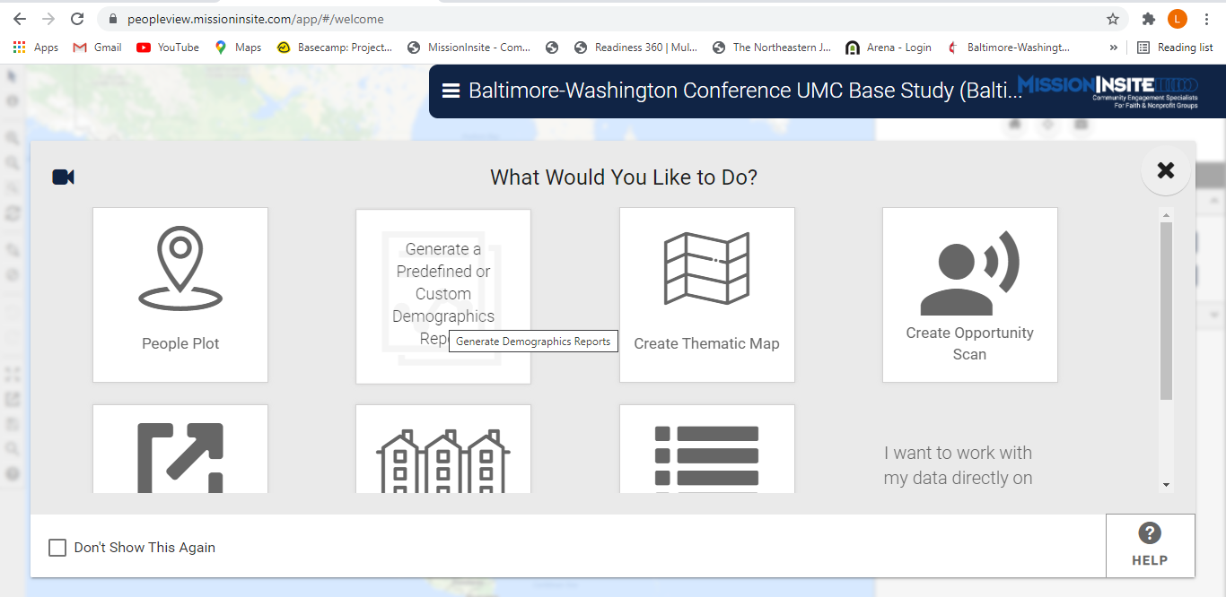
Select “Generate a Predefined or Customed Demographics Report”

Slide 6
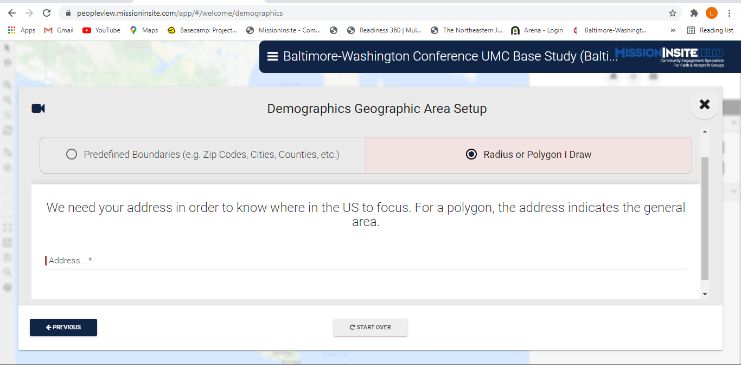
Select “Radius or Polygon I Draw” then Enter Your Church Address

Slide 7
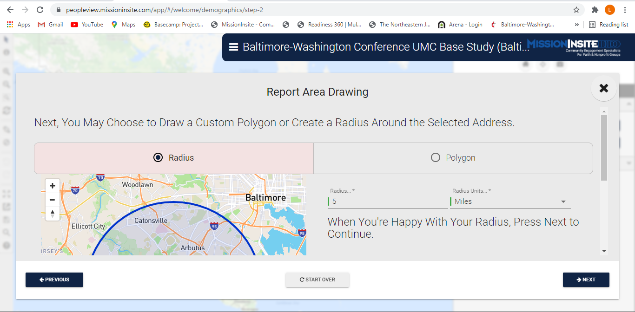
After entering your church’s address, click next. On the page below, you can select “Radius” or “Polygon.” If you want the report to reflect a certain mileage around your church, select “Radius.” Enter the radius distance and select units.

Slide 8
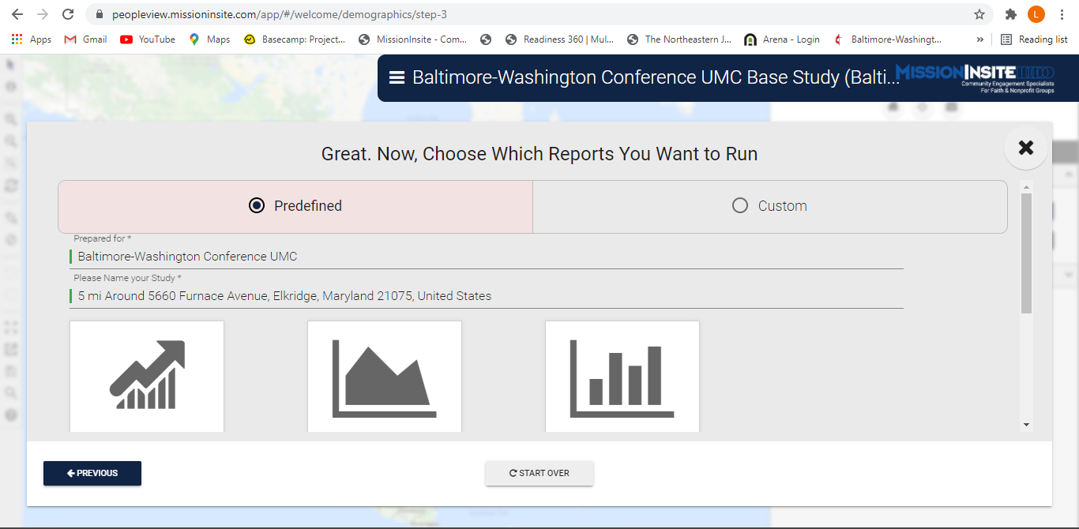
Now, select “Predefined” for the report you want to run. Select the report below.

Slide 9
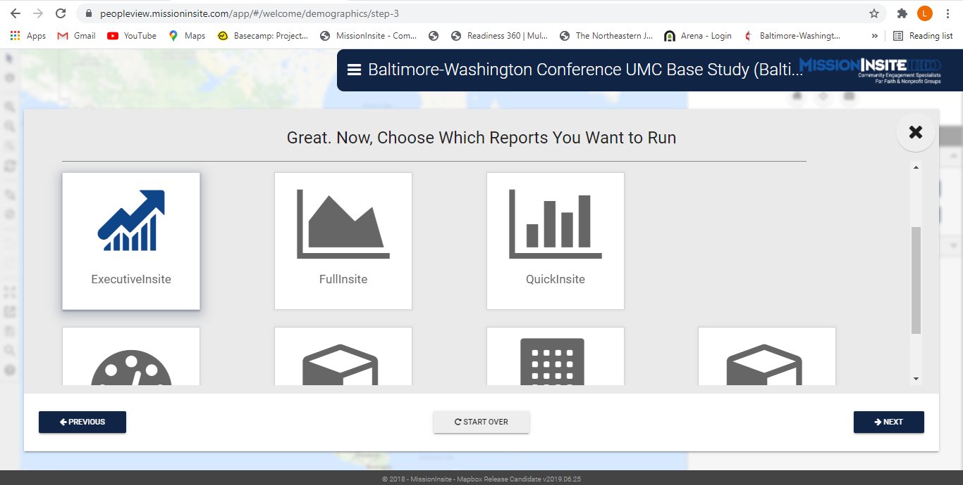
Select the report you want to run. I selected “ExecutiveInsite.” Click Next.

Slide 10
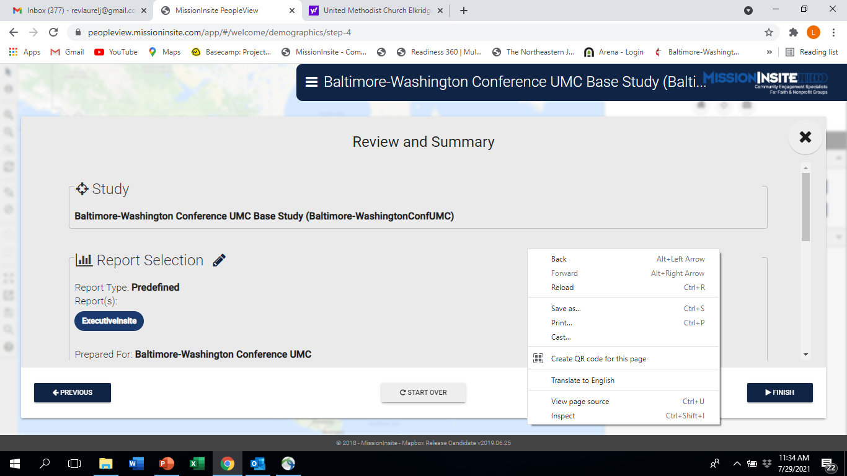
This is the “Review and Summary” page. Click “Finish” and the ExecutiveInsite report will download to your computer. You can repeat these steps for the other reports except for the ComparativeInsite report.

Slide 11
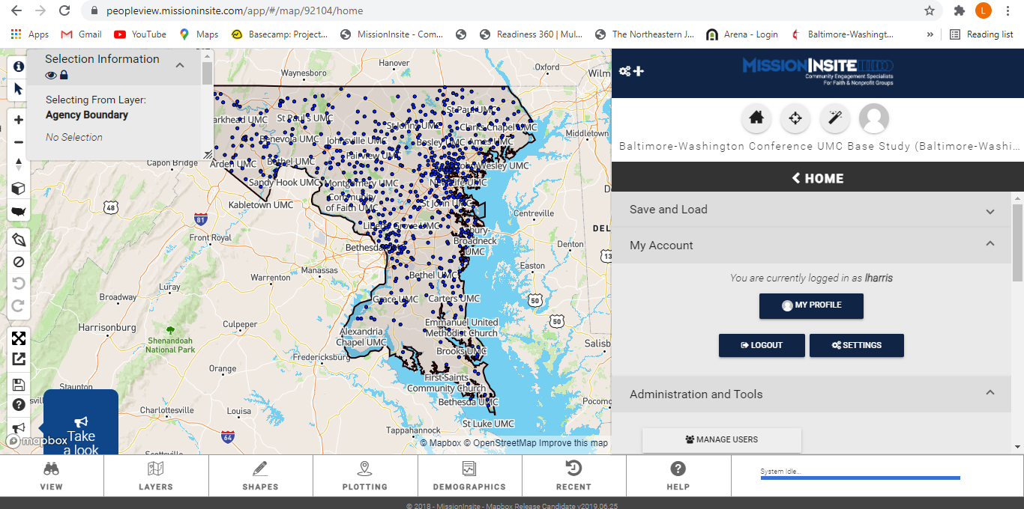
How to Draw Travel Polygons for Predefined Reports
You may want to run a report based on how long it takes for people to travel to your church. You run these reports by drawing a travel polygon. You will start by clicking the “pen” icon on the map.
Please note that my start screen will look different from yours because my map plots all of the churches in the BWC.

Slide 12
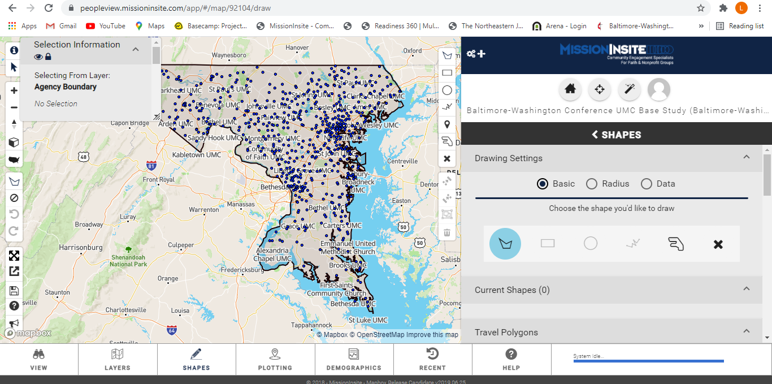
The screen on the right will pop up. Select “Draw a Polygon.”

Slide 13
Scroll down and you will find the options for a travel polygon. Travel by car, walking, and biking.
Select which mode of travel for which you want to run this report. Also, enter your church’s address for the starting location.

Slide 14
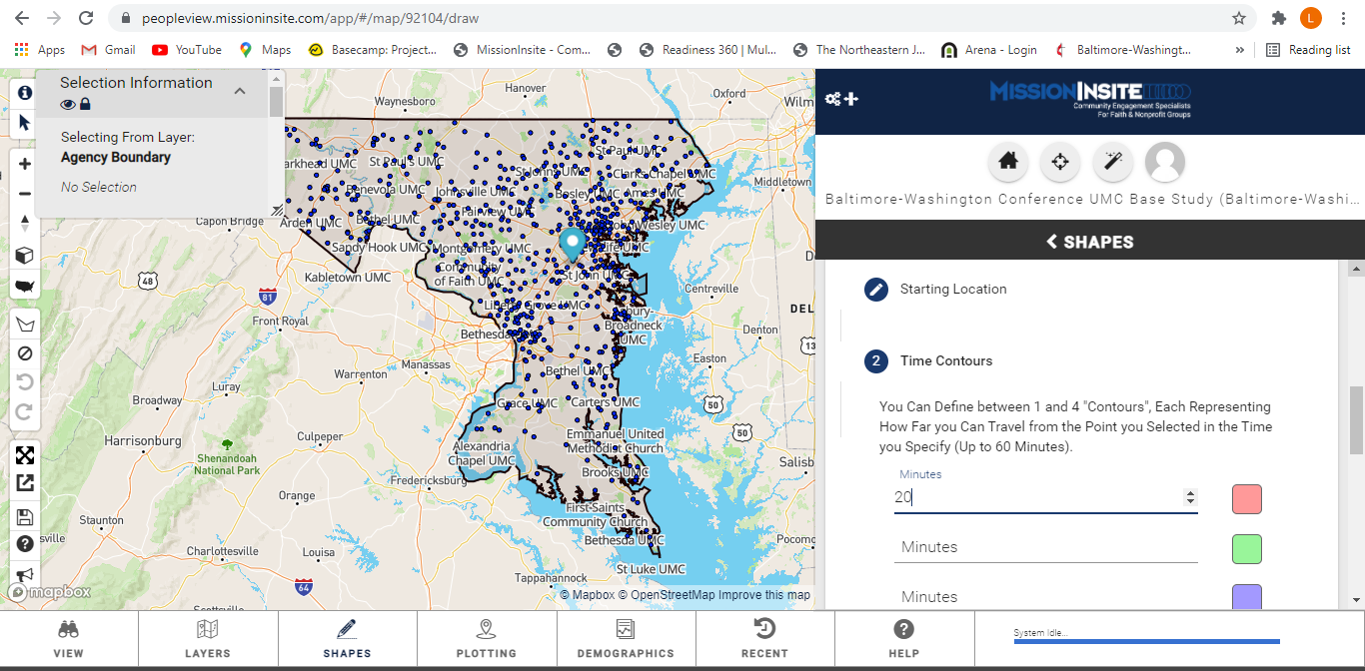
After you enter your church’s address as the starting location, enter the “Time Contour.” For example, I am entering 20 minutes for a report on the demographics of the people that live within a 20 minute drive of the church.

Slide 15
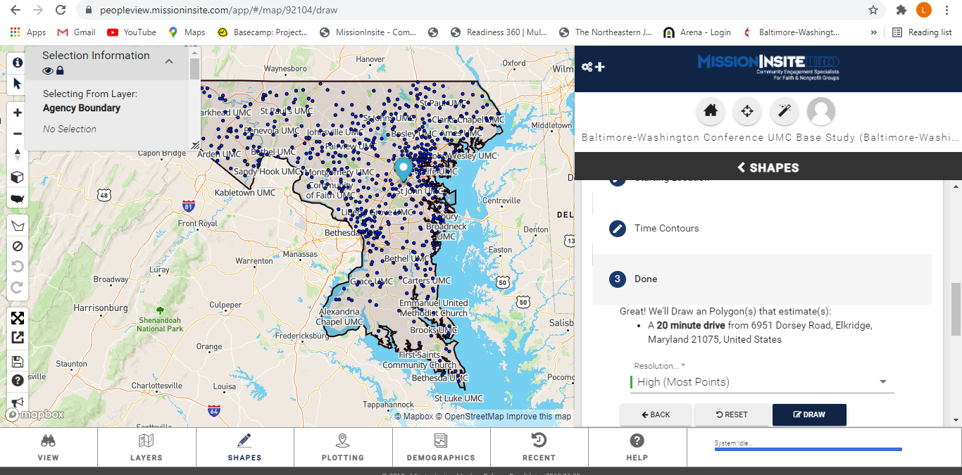
After entering the “Time Contour” and clicking “Next.” You’ll find the summarization of your polygon drawing. Click “Draw.”

Slide 16
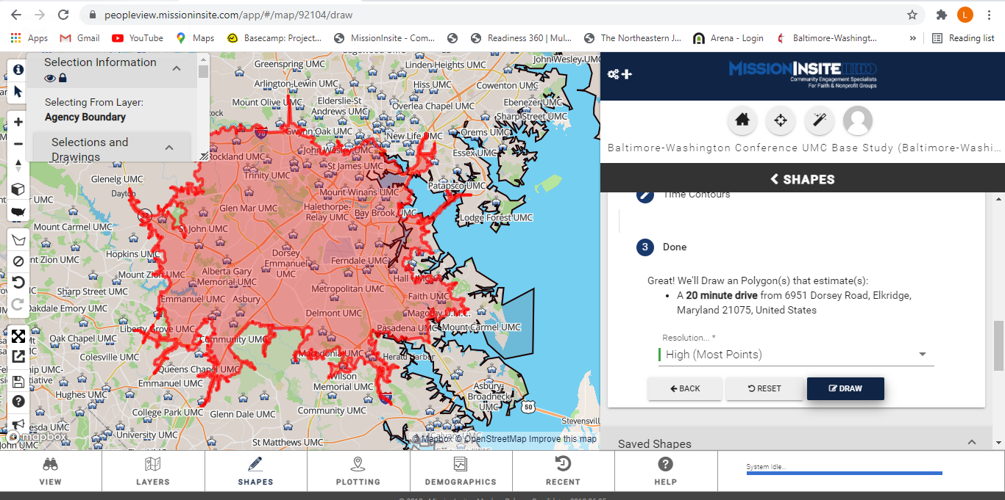
Here is the result of my polygon for the 20-minute drive from the church I selected. If you want to run a predefined report on the polygon, click “Demographics” at the bottom of the screen.

Slide 17
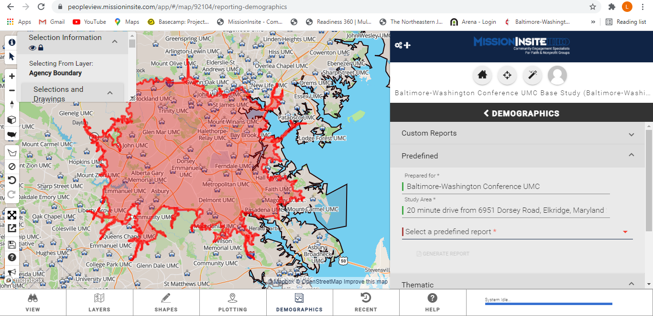
After clicking “Demographics,” you will select the predefined report you want to run based on your travel polygon. The report will download to your computer.

Slide 18
You can follow these same instructions to draw a travel polygon for driving, walking and biking from your church to generate demographic reports.
I hope this brief introduction helps you to get started!

