Slide 1
Asthma QI Kick-Off Meeting
April 7, 2023
5/12/2022
Care Transformation Collaborative of Rhode Island
‹#›
Prepared by Care Transformation Collaborative of RI

Slide 2
Agenda
Item | Time
Welcome & Intros Susanne Campbell, RN, MS, PCMH CCE, Sr. Program Administrator, CTC-RI | 5 min
Overview of Milestones & Practice Facilitation Sue Dettling,BS, PCMH CCE, Program Manager & Practice Facilitator, CTC-RI & June Tourangeau, Certified Asthma Educator | 10 min
Asthma Overview Mansi James, DO, Providence Community Health Center/All | 10 min
Case Study Conversation All | 10 min
Next Steps Michelle Mooney/All | 5 min
5/12/2022
Prepared by Care Transformation Collaborative of RI
‹#›

Slide 3
Welcome & Introductions
Susanne Campbell,
RN, MS, PCMHCCE
Sue Dettling,
BS, PCMH CCE
Pano Yeracaris,
MD, MPH
Pat Flanagan, MD
June Touraganeau
Michelle Mooney, MPA
Clinical Director and PCMH Kids Co-Chair,
CTC-RI
Practice Facilitator & Certified Asthma Educator
Program Coordinator
CTC-RI
Sr. Program Administrator, CTC-RI
Program Manager
CTC-RI
Chief Clinical Strategist
CTC-RI
Ashley Fogarty, MPH
Asthma Program Manager
RIDOH
5/12/2022
Prepared by Care Transformation Collaborative of RI
‹#›
Notes:
This was our first time engaging CHWs and School Nurses intentionally and they really showed up and were some of our most consistent participants

Slide 4
Asthma Planning Committee
Elizabeth McQuaid, PhD
James Ginda, MA, RRT, AE-C, FAARC
Mansi James, DO
Lillian Nieves, PharmD
Miosotis Alsina
Allergy/Asthma
Providence Community Health Center
Clinical Pharmacist
Providence Community Health Center
Program Manager of the Community Asthma Programs and Administrative Director of the Asthma Camp at Hasbro Children’s Hospital
Psychiatry & Behavioral Health Services, Coro West
Respiratory Therapist
5/12/2022
Prepared by Care Transformation Collaborative of RI
‹#›

Slide 5
Asthma Planning Committee
Daniel Fitzgerald, MPH, ICPS
Deborah Pearlman, PhD
Linda Mendonça, DNP, RN, PHNA-BC, NCSN, FNASN
Matthew Lefebvre, PharmD, MBA
Andrew Foderaro, MD
Network Coordinator
Tobacco Free Rhode Island
Assistant Professor in Medicine, Clinician Educator
Division Pulmonary, Critical Care, and Sleep Medicine
Warren Alpert Medical School of Brown University
Epidemiologist and Evaluator for RIDOH Asthma Program
Brown University School of Public Health
Associate Professor of Epidemiology Practice
Hassenfeld Child Health Innovation Institute Affiliated Scholar
Clinical Programs Pharmacist Neighborhood Health Plan of RI
State School Nurse Consultant, RIDOH
5/12/2022
Prepared by Care Transformation Collaborative of RI
‹#›
Notes:
\

Slide 6
Practices
P.R.I.M.A., INC
Cumberland, RI 02864
Dr. Concilio
Lincoln, RI 02865
5/12/2022
Prepared by Care Transformation Collaborative of RI
‹#›

Slide 7
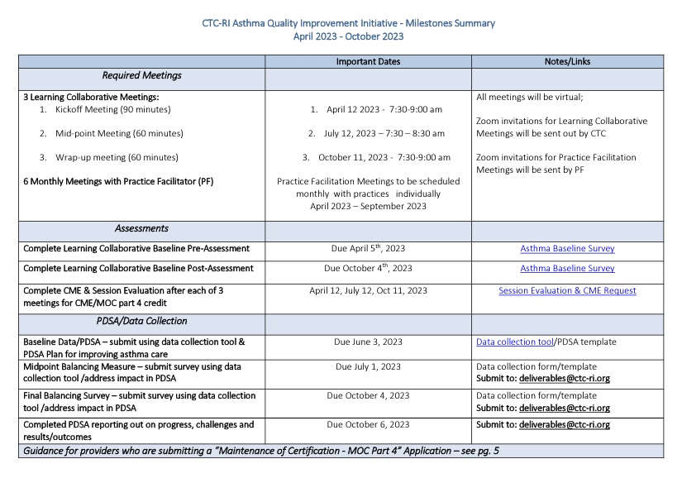
Milestones
Milestone Document & PDSA
5/12/2022
Prepared by Care Transformation Collaborative of RI
‹#›

Slide 8
Practice Facilitation
5/12/2022
Prepared by Care Transformation Collaborative of RI
‹#›

Slide 9
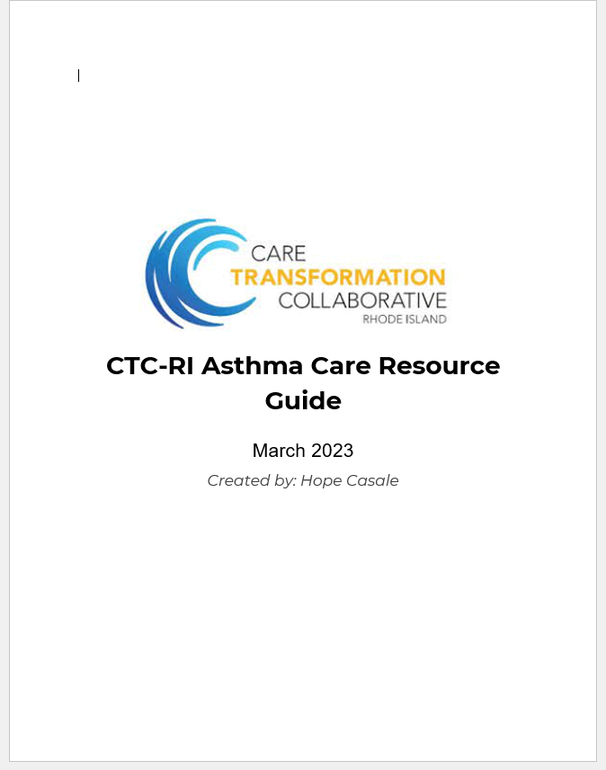
Asthma Resource Guide
Resources for:
Accessing Asthma ECHO Trainings
Environmental Assessments
Asthma Action Plans
How to access HARP
Patient Self Management Tools
5/12/2022
Prepared by Care Transformation Collaborative of RI
‹#›

Slide 10
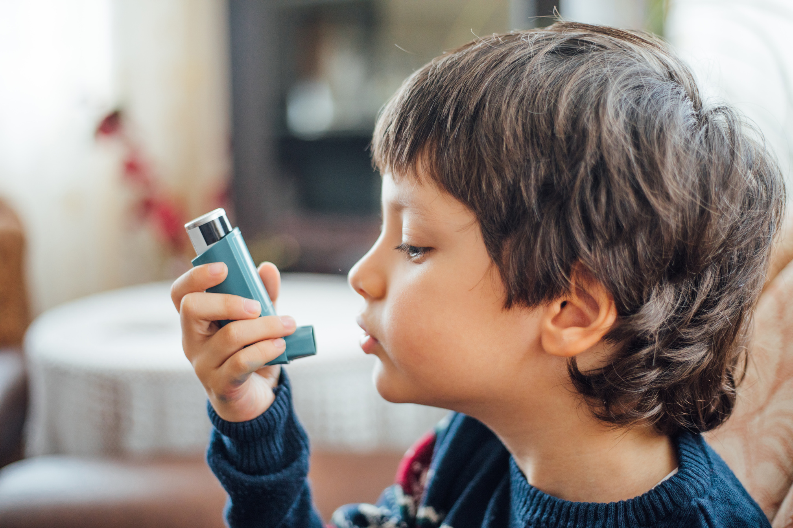
Practice Baseline Survey Overview
Opportunities:
Ensure patients & families receive self-education at each encounter
Assess and document asthma control at every visit using a standardized measure – i.e. Asthma Control Test (ACT)
Use the “Stepwise approach for management of asthma” including prescribing controller therapy as referenced in the updated Asthma Guidelines recommendations for Single Maintenance and Reliever Therapy (SMART).
All patients (or caregiver if child is less than 5 years old) can identify their asthma inhalers from a poster with color photographs & use “teach back” to confirm the patient and/or caregiver describe the purpose, actual use pattern and intended dosing regimen for each inhaler.
All patients receive an asthma action plan
Complete environmental screening questionnaire
Already happening:
Reviewing medication adherence with patients
Tracking patient's ED & urgent care use
Follow-up visits are set at appropriate intervals matching patient’s level of control
5/12/2022
Prepared by Care Transformation Collaborative of RI
‹#›

Slide 11
Presentation from Mansi James, DO
5/12/2022
Prepared by Care Transformation Collaborative of RI
‹#›

Slide 12
Case Study Conversation
5/12/2022
Prepared by Care Transformation Collaborative of RI
‹#›

Slide 13
Next Steps
Next Meeting:
July 19th, 2023 @ 7:30am
Baseline Data due June 3rd, 2023
Midpoint Balancing Measures due July 12th, 2023
Schedule meetings with your Practice Facilitators
5/12/2022
Prepared by Care Transformation Collaborative of RI
‹#›

Slide 14
THANK YOU
Debra Hurwitz, MBA, BSN, RN
dhurwitz@ctc-ri.org
www.ctc-ri.org
CTC-RI
5/12/2022
Prepared by Care Transformation Collaborative of RI
‹#›

