Slide 1
Automated Fulfillment Network (AFN) Kickoff Meeting
Timothy Jackson
Resource Sharing & Fulfillment Program Manager
SUNY Library Services

Slide 2
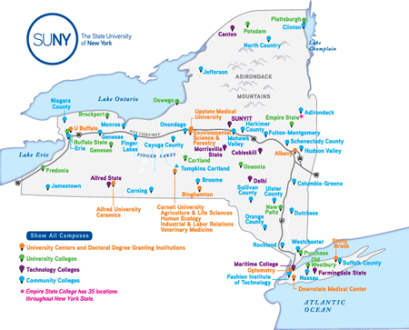
Agenda
Framing the Issue
Project Overview
AFN Functionality Overview
AFN Demo
AFN Implementation Options
AFN Policies
Next Steps

Slide 3
Conceptual Overview
Peer-to-Peer NZ RS (Current Resource Sharing Congif): User Can Only Pick Up at Home Location. Home Location Requests and Receives Book
AFN: User Pick Up at ANY AFN Location. Home Location Primo is Entry Point. User Selects which location to pick up books from any AFN location.

Slide 4
How can this user get the book they need?
A University at Buffalo student needs a book that is owned by SUNY Potsdam. This student is taking all of their classes online, and they’re living in the Albany area, so they rarely visit Buffalo’s campus. Submitting a resource sharing request and then picking the item up from the Buffalo’s library isn’t an option. Driving to Potsdam isn’t an option either. How can they get the book they need?

Slide 5
Why must we address this need?
The COVID-19 pandemic, the SUNY Online initiative, and general trends in higher education will contribute to a long-term increase in online learning in the SUNY system
More SUNY library users will not be in the same physical location as their home institution's library
Empire State College students, faculty, and staff
10,000+ students, faculty, and staff whose current access to physical collections is limited
SUNY Board of Trustees Open Access to Libraries policy (est. in 1974) allows all SUNY students, faculty, and staff to access any SUNY library collection
Must find a way to improve access to physical collections for all SUNY students, faculty, and staff
Need to provide a good user experience
Workflows must be manageable for library staff
Must be cost effective

Slide 6
Currently: How can this user get the book they need?
Submit a resource sharing request to Buffalo and select “home delivery” as the pickup option
Possible in Alma, but shipping items to users is costly
Submit a resource sharing request to Buffalo and ask them to send the book to Albany’s library once they receive it
Theoretically possible, but the workflow would be extremely clunky for both libraries (communication would have to happen outside Alma)
Delivery would be very slow
Request an Open SUNY account from Albany, submit a resource sharing request to Albany, and pick up the item from Albany’s library
Possible in Alma, and temporary SLC policy does allow this, but workflow is extremely clunky

Slide 7
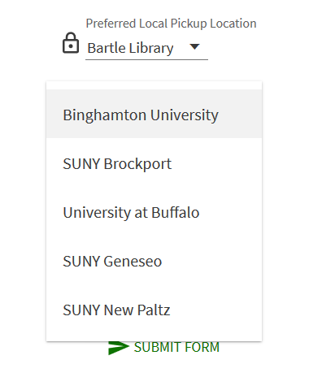
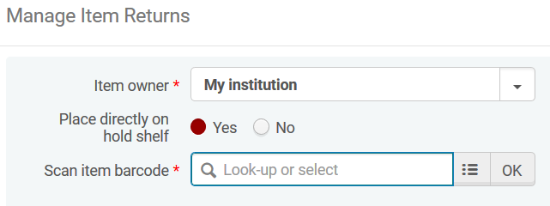
In Future: How can this user get the book they need?
Implement an Automated Fulfillment Network (AFN) for the SUNY system
An AFN allows users to request items from, pick up items at, and return items to any library in the AFN
The Buffalo student in the scenario I outlined could submit a request to Buffalo to have Potsdam’s book delivered directly to Albany’s library.
Can be implemented at no cost to campuses
Delivery times should be similar to Alma RS
Does this provide a good user experience? Is the workflow manageable for library staff?

Slide 8
Why didn’t we implement an AFN at go live?
AFN functionality didn’t exist in live environments when ASRS evaluated Alma resource sharing options in 2018/2019
Fulfillment Network functionality existed, but it lacked the automated features of an AFN
Users had to manually select a specific item at a specific campus when placing a resource sharing request in Primo
Very poor user experience, so ASRS opted for peer-to-peer NZ resource sharing instead
AFN functionality addresses at least some Fulfillment Network shortcomings
Users simply place resource sharing requests in Primo, and Alma automatically constructs a rota in the same manner as peer-to-peer NZ resource sharing
User experience has improved enough that AFN functionality is worth exploring

Slide 9
Automated Fulfillment Network Project Overview
NO final decision yet about implementing an AFN for SUNY
We could potentially not implement an AFN or implement only some AFN functionality
If we do implement any AFN functionality, that implementation will be permanent due to amount of SLS staff time needed for implementation
AFN participation will be voluntary and opt-in
Peer-to-Peer NZ Resource Sharing will still be supported
ASRS Working Group will play major role in project
Evaluate AFN functionality and configuration options
Assess feedback on AFN functionality from campuses
Make AFN policy recommendations to LSP Advisory Board
Assist SLS with AFN training and documentation
SLS staff will handle all configuration work related to AFN implementation
COVID-19 pandemic will undoubtedly impact the project timeline
Can't include an institution in an AFN until users from other institutions are allowed on campus

Slide 10
Automated Fulfillment Network Project Overview
February – December: Monthly Project Update Webinars
February – April: ASRS will evaluate AFN functionality and configuration options, assess campus interest in AFN participation, develop AFN policies, work with SLS to develop plan for implementing AFN functionality, and identify potential beta testers
May: Small group training sessions for AFN beta testers, AFN implementation for beta testers
June – July: Gather and assess feedback from beta testers, small group training sessions for all participating AFN campuses
August: AFN implementation for all participating campuses
September – December: Gather and assess feedback from all AFN participants

Slide 11
Automated Fulfillment Network Project Overview
Issues considered out of scope for this project
Personal/home delivery to users from other SUNY campuses
Adding non-SUNY Alma libraries to a SUNY AFN
Allowing SUNY users to pick up items at and return items to non-SUNY libraries
Providing pick-up anywhere options for requests filled via ILLiad/OCLC
Customization of pickup institution & library dropdowns and other Primo customizations that cannot be achieved through standard Alma/Primo configuration

Slide 12
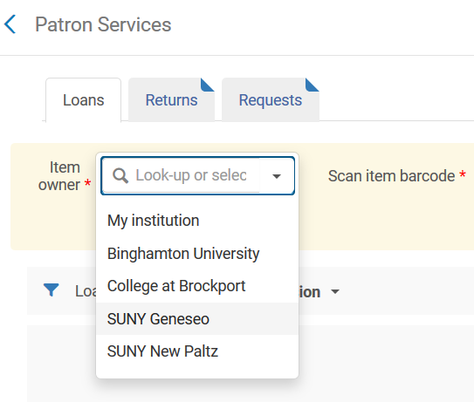
Automated Fulfillment Network Functionality
Walk-In Borrowing
Pick-Up Anywhere
Return Anywhere
Will provide a general overview of AFN functionality
Finer details will be discussed in future AFN project meetings

Slide 13
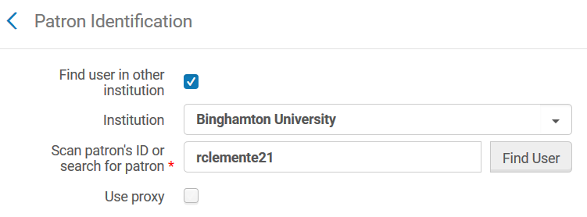
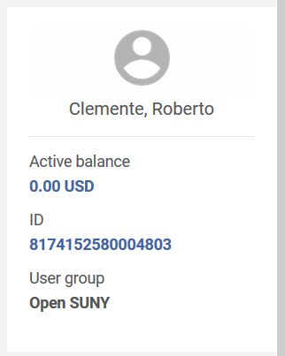
Walk-In Borrowing
Was implemented for all of SUNY at Alma go live
Allows users to walk in to any library in the AFN and borrow
Alma pulls information from the user’s home institution and creates a linked user account at the institution the user has visited
These linked accounts are assigned to the Open SUNY user group
Implementing an AFN will not change how walk-in borrowing works, but it will increase the use of linked Open SUNY accounts

Slide 14
Pick-Up Anywhere for Hold Requests
Hold requests are created when a user requests an item that’s available at their home institution
Pickup locations currently limited to either libraries at the user’s home institution or personal delivery
AFN functionality allows users to select libraries at other AFN institutions as pickup locations
Possible to customize which specific institutions and libraries appear in the Pickup Institution and Pickup Library dropdowns
Not possible to limit pickup institutions to only other institutions, so implementing this functionality will require libraries to provide paging services to their own users
Uses same Primo request form currently used for hold requests
Uses same configuration that currently determines who can and can’t submit hold requests

Slide 15
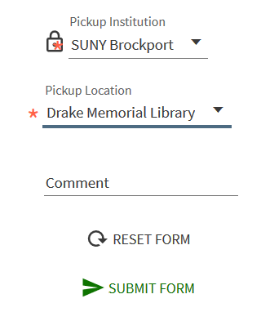
Pick-Up Anywhere for Hold Requests
If the user selects their home institution as the pickup institution
the hold request will behave exactly as it would under our current configuration
If the user selects a different institution as the pickup institution
the item will be placed in transit to that institution once it is scanned in
the user will receive a hold notice from the pickup institution once the item arrives there
Pickup institution staff will need to create linked “Open SUNY” account to check item out
Loan will be a direct loan from home institution to the user

Slide 16
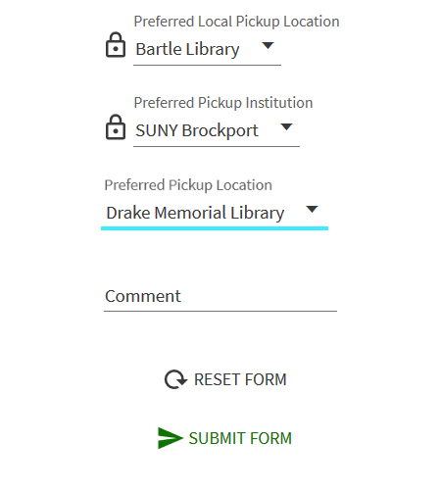
Pick-Up Anywhere for Resource Sharing Requests
Resource sharing requests are created when users request items not available at their home institution
Pickup locations currently limited to either libraries at the user’s home institution or personal delivery
AFN functionality allows users to select libraries at other institutions in the AFN as pickup locations
Not possible to customize which specific institutions and libraries appear in the Pickup Institution and Pickup Library dropdowns
Uses same Primo request form currently used for resource sharing
Uses same configuration that currently determines who can and can’t submit RS borrowing requests

Slide 17
Pick-Up Anywhere for Resource Sharing Requests
When a resource sharing request is created, Alma automatically generates a rota and sends the request
If the preferred pickup institution has the requested item available, that institution will always be first in the rota
Process uses AFN RS partners, not ISO RS partners
Possible for rota to have mixture of AFN and ISO RS partners
Borrowing requests do appear in Borrowing Requests list, but lending requests do not appear in Lending Requests list
Instead, Alma automatically creates a linked Open SUNY account for the requester at lending library and then created a hold request under that linked account

Slide 18
Pick-Up Anywhere for Resource Sharing Requests
Loan is a direct loan from owning library to requester’s linked account at that library
Borrowing request created at user’s home institution is automatically completed once requested item is placed on hold at user’s preferred pickup institution
In order for the requester’s preferred pickup institution to be honored, the request must be filled by a library within the AFN
Each AFN RS request has a local pickup location
If the request is filled by a library outside the AFN, the request’s pickup location reverts from the preferred pickup institution to the local pickup location

Slide 19
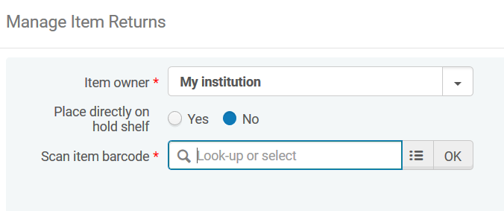
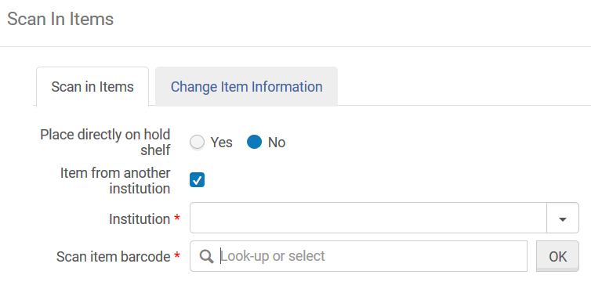
Return Anywhere
Allows users to return any item checked out from an AFN library to any other library in the AFN
Items are removed from the user’s account and then placed in transit to owning institution
Return anywhere functionality available in Manage Patron Services, Scan In Items, and Return Items interfaces
Return anywhere does not require the creation of a linked Open SUNY account unless you are using Manage Patron Services

Slide 20
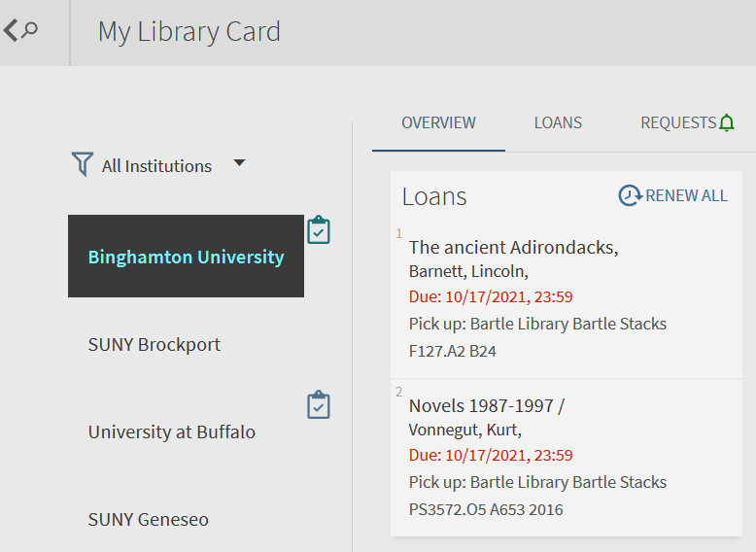
AFNs From a User Perspective
Searching and requesting will remain largely unchanged
Primo My Library Card will contain tab for each institution where user has linked account
Users will need to view loans and requests for each institution separately.
Users will receive notifications from other SUNY institutions
Current users of walk-in borrowing are already seeing most of this

Slide 21
AFN Demo

Slide 22
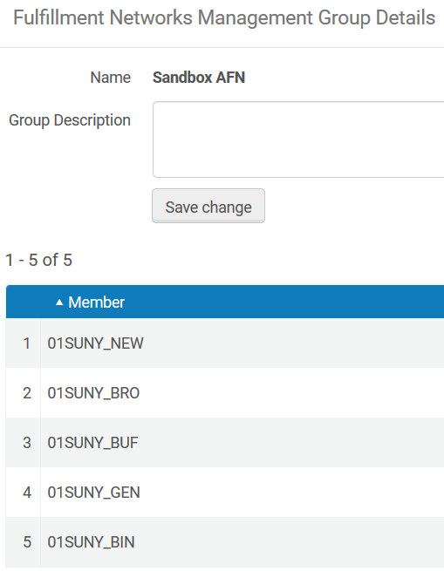
Automated Fulfillment Network Configuration & Implementation Options
Walk-in Borrowing
Determined by Fulfillment Network Group configuration in NZ
Libraries must be in same Fulfillment Network Group for walk-in borrowing to work
Pick-up Anywhere for Hold Requests
Determined by Fulfillment Network Group configuration in NZ, Institutions Relations table in IZ, and Serves Other Libraries settings in IZ
Possible to limit possible pick-up institutions by editing Deliver To column of Institution Relations table
Possible to limit which libraries serve as pick-up libraries by changing Serves Other Libraries settings
Can be implemented independently of pick-up anywhere for resource sharing requests

Slide 23
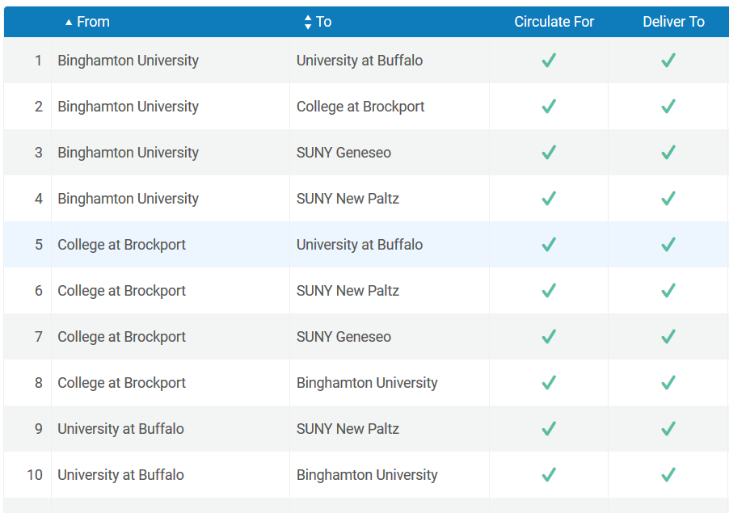
Automated Fulfillment Network Configuration & Implementation Options
Pick-up Anywhere for Resource Sharing Requests
Determined by Fulfillment Network Group configuration in NZ
Possible to limit pick-up institutions by removing them from Fulfillment Network Group
Cannot limit which libraries serve as pick-up libraries
Can be implemented independently of pick-up anywhere for hold requests
Return Anywhere
Participating institutions determined by Fulfillment Network Group configuration in NZ and Institutions Relations table configuration in IZ
Possible to limit return anywhere options by editing Institution Relations table
Possible to implement independently of pick-up anywhere

Slide 24
Automated Fulfillment Network Configuration & Implementation Options
Every institution in a Network Zone Group must allow both walk-in borrowing and RS request pickup from every other institution in the group
Walk-in borrowing, pick-up anywhere, and return anywhere functionality does not work unless all libraries involved are in the same Network Zone Group
Libraries who do not wish to participate in an AFN will not be able to participate in walk-in borrowing via linked Open SUNY accounts
Libraries could still manually create non-linked Open SUNY accounts for walk-in borrowers
Regionalizing RS request pickup institutions will also regionalize walk-in borrowing and return anywhere functionality

Slide 25
Automated Fulfillment Network Policies
Implementing an AFN would significantly alter how users access our physical collections
Increase in loans to linked Open SUNY accounts
Loan and renewal periods for Open SUNY users currently varies from campus to campus
Participating libraries will likely want a consistent user experience
Possible system-wide policies that may needed to ensure a consistent user experience
Loan and renewal periods
Hold request pickup anywhere policy for courtesy borrowers
Overdue and lost loan notification schedules
Fines and fees for late returns and lost items
Hold shelf period
Policies can be applied specifically to Open SUNY users
Policies for loans to your own users can remain unchanged

Slide 26
AFN Project Next Steps
Determine whether there is sufficient SUNY interest in AFN functionality to move forward with this project
Not asking campuses to make any firm commitments at this time
AFN interest will be assessed via survey to be distributed during next AFN meeting
Next AFN Meeting: Wednesday, February 10, 2:00pm-3:00pm
Registration link: https://slcny.libcal.com/event/7427393
AFN Project FAQ: https://slcny.libanswers.com/faq/335353
AFN Project summary, timeline, and updates
Detailed info on AFN workflows
Summary of AFN configuration options
AFN policy information

