Slide 1
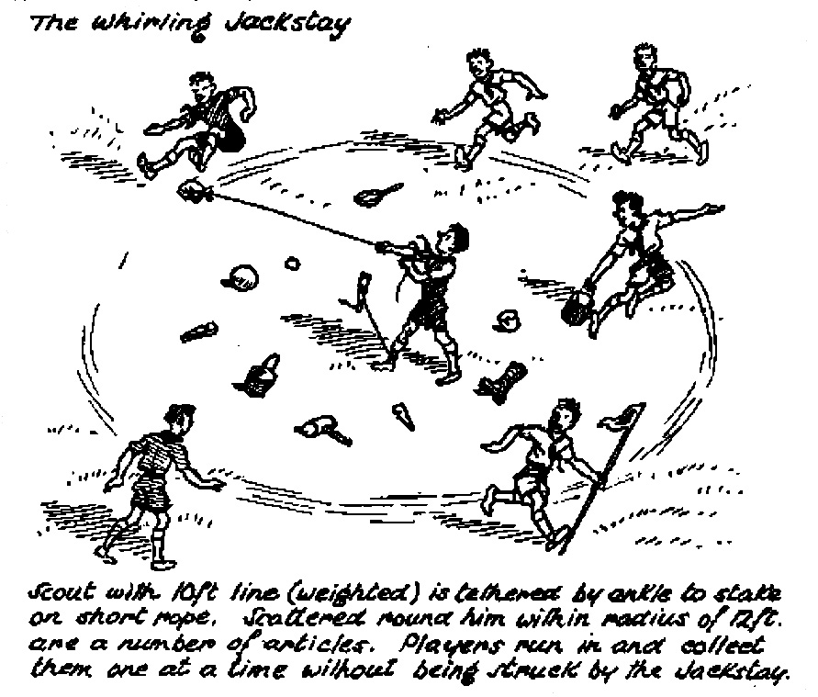
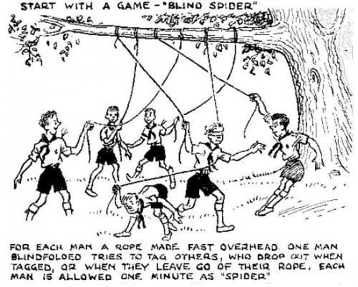
Games with a Purpose
Lord Robert Baden-Powell said,
“Scouting is a game with a purpose.”

Slide 2
Agenda
Why Games?
What is Learned?
Value of New Games
Preparation
Conducting the Game
Reflection
Examples
Resources

Slide 3
Why Games?
Lessons without teachers
Body builders
Mind stretchers
Friend makers
Building blocks
Plain old fun

Slide 4
What is Learned?
New scout skills
Dependence and independence
Self-confidence
Leadership & followership
Social skills
Follow the rules
Waiting turns
Getting along with others
Fair play
Respect for the rights of others

Slide 5
What is Learned?
put skills into action
sense of belonging
self-esteem
exercise their resourcefulness
exemplify teamwork
share responsibility
feel successful
learn a life lesson

Slide 6
Value of New Games
Another planning, leading, and communicating opportunity for the scouts
Requires a scout to research, pre-plan, organize, and eventually explain/communicate the rules
After playing, opportunity to reflect and discuss the purpose, involvement, interactions, communications, lessons, values, benefits, etc.
Integral to ILST

Slide 7
Preparation
Know and understand the game
Prepare to teach the game
Evaluate conditions
Physical arrangement (hazards?)
Equipment needs
Number of participants
Ability of participants
Gather required resources

Slide 8
Conducting the Game
Remove hazards
Full attention before trying to explain the rules
EDGE
Explain, demonstrate, ask for questions
Start the game
Stop if going badly—explain again/guide/modify as required
Insist on fair play
Don’t overplay—more in demand if you stop while still having fun

Slide 9
Reflection
Discuss the results and what can be learned
Did you do your best?
Was anyone left out of the game?
Was anyone physically hurt?
Was anyone picked on?
How would you make the game different next time?
ILST has a great series of thought provoking questions that correspond to the lessons at hand

Slide 10
Examples
Scout Skill Development
Knot Tying Relay
Land Lifesaving Relay
Team Building
Paper Fold
Blanket Volleyball
Communications
Blindfold Compass Walk
Silver Tongue Orator
Physical and Mental Fitness
Relay Tic-Tac-Toe

Slide 11
Scout Skill Challenges
Patrol and Troop activities that rely on the performance of acquired Scoutcraft, Woodcraft, or Campcraft skills can be referred to as Scout Skill Challenges.
They can very easily stand by themselves, because inherent in meeting an appropriate challenge is a sense of pride and a feeling of accomplishment.

Slide 12
Team Building Opportunities
When Scouts engage in an activity that requires them to work together in order to satisfy an objective, team building comes into play.
In order to complete any of these activities, Scouts will need to use:
teamwork
pool their resources
share leadership
all qualities of a well-working patrol and troop.
When accepting any of these team building challenges, a patrol that cooperatively works together can be considered a winner.

Slide 13
Patrol Games
Patrol games are fun to play when pitting patrol against patrol; but, can also be enjoyed when played by a single patrol-sized group.
Healthy competition between patrols can have a positive outcome when presented in the right spirit.
When patrol makeup is homogenous, there’s more of a level playing field.
But, when patrols are organized by age, to compensate for the difference in skill levels, certain handicaps might be introduced. In this instance or when individual patrol attendance is disproportionate, dividing the troop into equal crews can be a practical alternative.
A system of recording patrol points for these activities can be adopted and contribute towards patrol spirit.
But, the presentation of the activities is in itself beneficial, and carries with it its own rewards. Therefore, determining winners, scoring, and points are optional.

Slide 14
Troop Games
Troop games give Scouts an opportunity to team up with the members of other patrols for some friendly play.
In addition to nurturing camaraderie and Scout spirit, their purpose is simply to have fun.
One of the outstanding characteristics of most Scout games is their uniqueness.
Scouts don’t ordinarily get to play them except during Scout gatherings.

Slide 17
Silver Tongue Orator
Let scouts see how long each of them can talk intelligently on a subject
Pick a judge and timekeeper
Box or stump for speaker to stand on
Questions on flash card. Examples
When did you do your last Good Turn?
Define Friendly.
What was your favorite merit badge?
Who was Baden Powell?

Slide 18
Relay Tic Tac Toe
On go, the first person from each team will run down to the tic tac toe board and place their marker in one of the hula hoops.
After they place the marker, they will race back to their line to high five the next student in line.
The next student will then place their marker in an open hoop.

Slide 19
Resources
Troop Meeting Agenda: Games & Challenges -https://www.youtube.com/watch?v=ewHr2zavP2k&feature=youtu.be
Putting Skills into Action -
https://troopleader.org/putting-skills-into-action/
Troop Program Resources: Scout Meeting Activities - https://www.programresources.org/categorized-activities-index/
http://www.boyscouttrail.com/boy-scouts/boy-scout-games.asp
http://www.macscouter.com/games/Games4BS.asp
http://scoutmastercg.com/rediscovered-games-scouts/

Slide 20
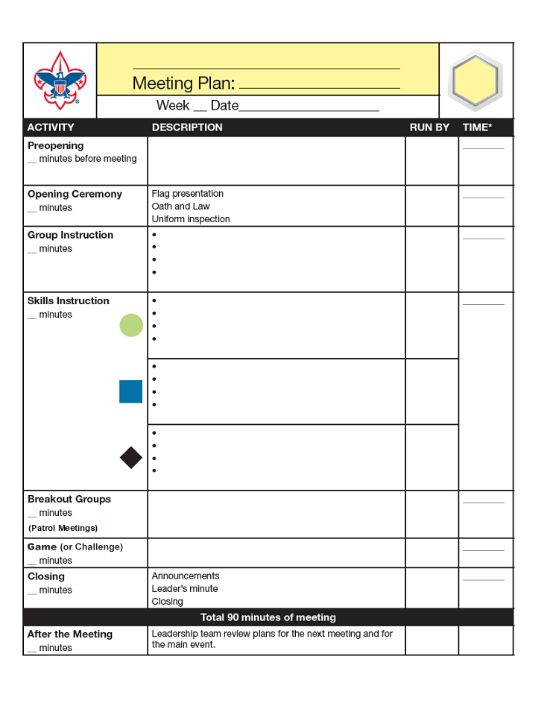
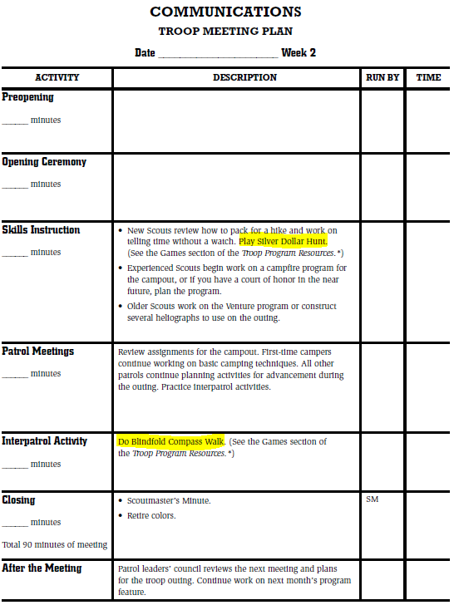
Troop Program Features contain game recommendations that go in hand with the monthly themes
troopresources.scouting.org
https://troopresources.scouting.org/troop-games/

Slide 21
Dodgeball
Dodgeball has never been an authorized activity in Scouting. Games and sports that involve participants throwing objects at each other, including dodgeball, have caused concussions and traumatic brain injuries, broken bones, and ankle injuries. There is also an aspect of bullying in the game, which has led to its removal from other youth-serving organizations.
We are monitoring the results of gaga ball; at this time, we consider gaga ball appropriate if the activity is set up, monitored, and supervised following manufacturers’ guidelines.

Slide 22
Questions?

