Slide 1

SUNY Library Services Update
December 17th, 2021
www.suny.edu

Slide 2

Workplace Transition
SLS Updates of Important Information at:
  https://slcny.libguides.com/sls/blog
  Email subscription and ability to post comments/searchable, etc.
  No need to monitor other channels for high level SLS Communication.
SCLD moved to Listserv
New Collections HQ Created
LSP/Discovery HQ migrated back to Basecamp
SUNY Library Accessibility Group moved to Basecamp
Send us a request to info@slcny.libanswers.com if you need access to any of the new channels or have questions.

Slide 3
Workplace Transition: Channels Not Migrated
SLC Workplace Channel will migrate to SLC Listserv soon.
SUNYLA Workplace channel archived
Institutional Leads channel archived
SUNY Libraries Workplace staying in Workplace and will migrate to Yammer, according to admin (not SLC or SLS related channel)

Slide 4

Procurement Update
Springer-Nature
  SUNY and Springer Nature have agreed on Terms; waiting for signatures/notary and will send to Attorney General soon.
IFB
  6 Contracts: EBSCO, ProQuest, JSTOR, West, Chronicle of Higher Ed, NY Times
  Should have AG Review finished today.
  SUNY working with PQ and Chronicle for partial payments.
Artstor
  Will be developing another long-term contract.
OGS Contract
  Intent to Extend to June 2022 shared
  SUNY continuing to work with OGS to express areas for improvement and system/campus needs.

Slide 5

Whole Ebook ILL
First Campus will go live as borrower today.
SLS will begin implementing whole ebook ILL in the next 3-4 weeks.
SLS will fill majority/all of requests with ebook ILL links (unless things change regarding workflow).
SLS will work with campuses to facilitate discovery of ebook ILL eligible titles.
Workflow will require user to submit their email and then SLS will send them 2-week loan link.
SLS will be setting up meetings/webinars soon with campuses who are pilot participants.
SLS continues to work with Ex Libris to integrate workflows into Alma/Primo VE.

Slide 6

Onboarding
Please let SLS know if you've hired a new staff and would like some assistance in onboarding them.
  Focus will be on Alma/Primo, but can also provide background on SUNY processes if the person works in acquisitions or library procurement.
  Are reviewing and refining methods, and will tailor to individual needs.
  Part of baseline services.
    If needs/demands of campus are beyond what we can offer, we'll suggest an extended support agreement for training. But, this hasn't happened yet.
  Email us at info@slcny.libanswers.com to arrange onboarding.

Slide 7

Professional Development Planning
Planning for DEI Reflective Practice Group for Librarians and Library Staff.
Reviewing how to deliver area-specific prof. dev. that can be connected together like badge programs.
Discussing Library Specific Leadership Program with CPD.
Working with DEI working group to create a community of practice related to DEI and libraries.
Partnering with SUNY Library Accessibility Group to provide sessions on accessibility.

Slide 8
SUNY EIT Accessibility Task Force
Charge:
  The EIT Accessibility Advisory Group will be dedicated to supporting SUNY in sustaining a robust digital accessibility program. The Group will advise the System Provost-in-Charge and Chief Information Officer on ways to support implementation of campus and System EIT Accessibility Plans, including the potential of system-wide shared services. They will research and make recommendations regarding evolving industry standards, and any issues and challenges related to achieving the goals of the SUNY EIT Accessibility Policy.
Librarian Representatives:
  Pauline Lynch Shostack, Onondaga CC
  Claire Payne, Stony Brook

Slide 9

Ex Libris Renewal Planning
Initial meetings about renewal.
Term ends in 11/22.
Will be asking for bib, Primo Document, and named user audit.
If needed, will form a task force to guide SLS through renewal.

Slide 10

Discovery & E-Resources
Michelle Eichelberger
www.suny.edu

Slide 11
Discovery
December Release:
  Quicklinks option is live, see Maria Ziemer's LibKey presentation recording for a comparison of QuickLinks and LibKey. Passcode: q?&3b6?j
  Custom order of locations in Get It: overrides alphabetic or best location sort
  My Library Card: can make expiration date more prominent and add addition email, roles, etc.
  Direct linking did not work for NZ records that have electronic services. This has been fixed
https://knowledge.exlibrisgroup.com/Primo/Release_Notes/002Primo_VE/2021/010Primo_VE_2021_Release_Notes

Slide 12
E-Resources
Content:
  EBC Business-Day Creation of New Book Titles: New Proquest eBook Central titles will now be added daily to the Ebook Central Perpetual, DDA and Subscription Titles CZ Collection
  EBSCO: rolling out new parser to reflect changes to EBSCO OpenURL Connection. Will need to update linking for collections, SLS will manage.
January release: Portfolio loader will support using KBART format files
https://knowledge.exlibrisgroup.com/Alma/Release_Notes/2021/Alma_2021_Release_Notes

Slide 13
SUNY Shared Collections
Esta Tovstiadi
www.suny.edu

Slide 14

SUNYConnect Task Force
The SUNYConnect EBSCO databases are up for renewal June 30, 2022. A task force was formed to review strategies and recommend a course of action to the SUNY Shared Collections Committee and the SLC Board.
Reviewing vendor proposals at 12/22 meeting
More information, including recordings and slides of past updates: https://slcny.libguides.com/sunyconnect_task_force

Slide 15
SUNY ScienceDirect Journal Renewal
SUNY ScienceDirect journal package contract runs through December 31, 2022.
SLS & SSCC rep met with UC stakeholders, who recommended moving forward with extending the current contract
SSCC created task force focused on renewing the current package
Task force work begins in January; more information forthcoming

Slide 16
Other updates
Artstor 1 year contract approved
  https://www.suny.edu/business/contractsearch/details.cfm?it_con_id=165#results
  SLS working on multi-year contract for next Artstor renewal

Slide 17
Resource Management
Maggie McGee
www.suny.edu

Slide 18

Datasync Collections
OCLC completed moving SUNY to the new process on December 8, 2021
  OCLC began moving SUNY libraries to the new process on November 15, 20201
  Moved to the new process once the ability for records to match on the OCLC number (ocn) only was possible
  Only impacts the publishing of physical bib records holdings from Alma to OCLC
New process working as expected
  Holdings are successfully being added and removed in OCLC from files being published from Alma to OCLC WorldShare datasync collections

Slide 19

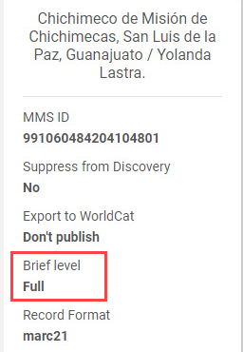
Brief Level Rules Initiative
Defect has still not been resolved with the December 2021 release
  Project on hold until indexing issues impacting Institution Zone (IZ) records linked to the Network Zone (NZ) are resolved
  Salesforce Case #009936/05321456 was expected to be resolved with the December 2021 release
OCLC is updating their encoding level (LDR 17) to adhere to MARC21 standards
  January 2021 OCLC began converting encoding level K to level 7
  MSP-42 Brief level rules in Alma:
  https://slcny.libguides.com/ld.php?content_id=50351537

Slide 20
Graphic Novel/Comics Local Resource Type Initiative on Hold
SLS has paused implementing the Graphic Novel/Comics Local Resource Type Initiative to gather more input from SUNY stakeholders:
  SUNY Metadata Standards and Policy Working Group
    Reviewed fall 2021
  Discovery Working Group
    Discussing on December 17, 2021
  Local Resource Type task force
    ETA on the formation of the task force in early 2022

Slide 21
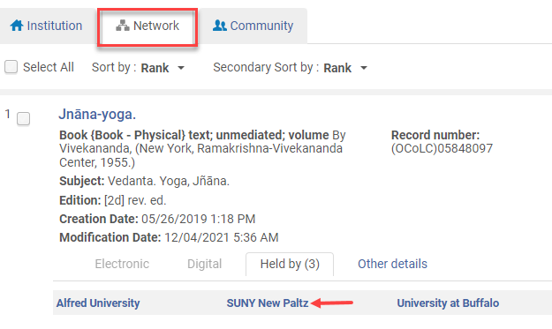
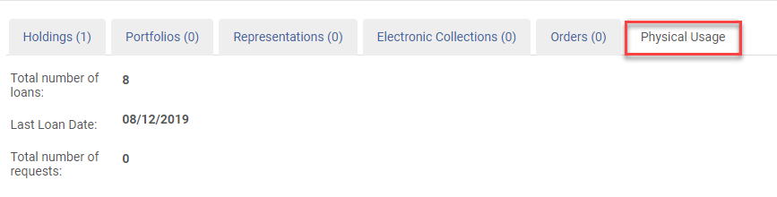
Enabled Physical Usage Information in the Network
Physical usage information enabled in the Network on Monday, December 13, 2021
  Approved by the Access Services and Resource Sharing Working Group on 12/7/2021
  Approved by the Library Services Platform (LSP) on 12/13/2021
Enabling this functionality in the Network allows SUNY users to see the following information for other holding libraries from the Network Zone:
  Number of loans
  Last loan date
  Number of requests

Slide 22
Change the Subject Project Update
Library of Congress (LOC) approved changing aliens and illegal aliens with the following new subject headings of “Noncitizens” and “Illegal immigration" at their annual meeting on of November 12, 2021
  LIBRARY OF CONGRESS SUBJECT HEADINGS APPROVED MONTHLY LIST 11b: https://classweb.org/approved-subjects/2111b.html
OCLC updated approximately 41,000 Worldcat records with the approved LOC changes since the announcement
SUNY Network Zone bibliographic records reflect the changes made by OCLC to these subject headings
SUNY Metadata Standards and Policy Working Group will be reviewing the impact of the changes on current automated processes and determine next steps

Slide 23

Reminder Analytics Office Hours Starting in January 2022
SLS program managers will be providing two one-hour time slots from Wednesday, January 12, 2022, through Friday, June 10, 2022
Analytics Office Hours are designed to assist SUNY libraries with specific reporting needs
Prior to registering to a session:
  Define the analytics need
  Determine the SLS program manager that will best support the need
Register for the sessions at: https://slcny.libcal.com/calendar?cid=15880

Slide 24
Resource Sharing
Timothy Jackson
www.suny.edu

Slide 25
Billing for Lost Alma Resource Sharing Items
Billing for overdue resource sharing items due before March 1, 2020 started on December 13, 2021 (approximately 50 items)
Billing for overdue resource sharing items due after March 1, 2020 and resource sharing items in transit more than 45 days starts on February 1, 2022 (approximately 450 items)
Billing Webinar was held on December 10:
  Recording: https://public.3.basecamp.com/p/7Xbx2z2jmC3PxX4fwzSAd5V9
  FAQ: https://slcny.libanswers.com/faq/359664
Lists of in transit items needing shelf checks sent to campus resource sharing contacts
Will send results of billing survey once more campuses have replied
Email info@slcny.libanswers.com if you have any Alma RS billing related questions

Slide 26
Alma Resource Sharing During Winter Break
Please remember to turn off Alma RS lending if you will not be able to fill requests
You may also turn off Alma RS borrowing if you wish
  Reach out to me if you borrow articles via Alma and want to turn off just your book borrowing
FAQ: https://slcny.libanswers.com/faq/266453
  Need General System Administrator role at this time
  Have open case about whether Fulfillment Administrators should be able to turn resource sharing on and off

Slide 27
Returns from Other SUNYs
Return anywhere feature is being used, but enabling the return anywhere feature at all circulation desks has resulted in a good number of erroneous transit requests and some accidental loans
  Problems are being corrected by SLS on a daily basis
Isolating return anywhere feature at a circulation desk dedicated solely to returns from other SUNYs at the university centers had greatly reduced the number of return anywhere problems
Will make this same change at all SUNY campuses
  Decision made with input from ASRS working group
  Plan to finish by end of January
  SLS will reach out to your resource sharing contact once we're ready to make this change at your library

Slide 28
Empire Library Delivery
Many SUNY libraries have reported issues with ELD courier since service resumed in August 2020
ASRS working group met with Maria DeGaetano from ELSN on December 15 to discuss our concerns about ELD
Recent efforts to improve service:
  Changes made to routes in the Albany & Hudson Valley areas
  Streamlined workflow for moving items from hub to hub
No timetable for implementation of tracking system
ASRS will continue to meet with Maria on quarterly basis
  Will solicit questions/comments from all campuses prior to each meeting
SLS will share Alma resource sharing data that measures courier performance with Maria
Please continue reaching out to Maria about ELD issues at your campus

Slide 29
IEC Working Group & Idea Exchange
Ex Libris Idea Exchange: Crowd-Funded Up-Voting for Everyone
  URL: https://ideas.exlibrisgroup.com/
  Everyone gets 25 votes, and anyone can submit a new idea
  Ex Libris is not contractually obligated to implement any of these ideas, but they do implement some of them
  Voting for an idea increases the likelihood it will be implemented
  SUNY has enough votes to push an idea to the top of the list of most popular ideas
The IE WG will keep a running list of suggested Ideas for SUNY to upvote
More Information on IEC LibGuide
  https://slcny.libguides.com/improvements-working-group

Slide 30


Questions or Discussion?
www.suny.edu

