Slide 1
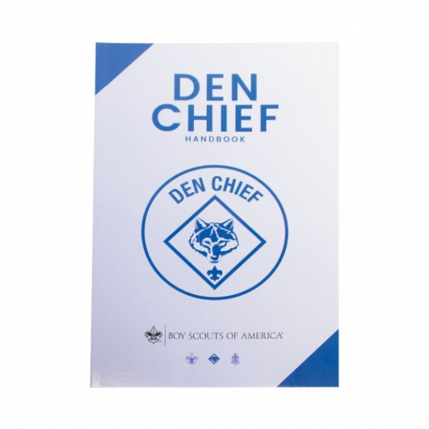
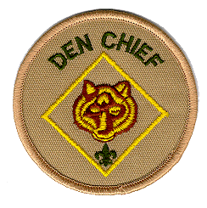

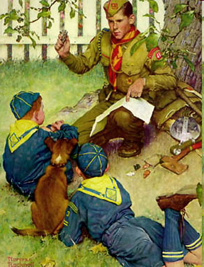
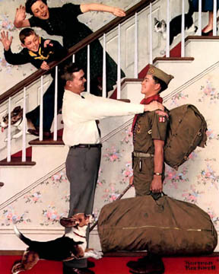

The Den Chief’s Role –
From All Angles
University of Scouting
February 2025
Roger Claff
reclaff@aol.com

Slide 2
What is a Den Chief?
Notes:
Note: for ease of discourse this presentation will presume the Den Chief comes from a troop. The same principles apply, though, regardless of the Den Chief’s unit.

Slide 3
What is a Den Chief?
When Cub Scouts of America began in 1933, original Den Leaders were Den Chiefs
Executed den meeting plans at direction of Cubmaster and Den Mother
Notes:
Den Chiefs were considered the principal leaders in the den for many years, even after the Den Mother position was created.
Not until 1951 were Den Mothers given complete charge of dens, advancement signature authority.

Slide 4
What is a Den Chief?
“A Boy Scout or Explorer who leads the Cub Scout in their games and handicraft work in a Den and helps the Den Mother. The Den Chief is a big brother or friend, but never a boss. The office of Den Chief is a high honor for a Boy Scout. He is a hero to the smaller boys.”
- The Boy Scout Encyclopedia, 1952
Notes:
Den Chiefs were considered the principal leaders in the den for many years, even after the Den Mother position was created.
Not until 1951 were Den Mothers given complete charge of dens, advancement signature authority.

Slide 5
What is a Den Chief?
“Your Cubmaster will help you. The Den Mother and Den Dad, probably parents of one of your Cub Scouts, are also ready to help. One of the Cub Scouts is a Denner, something like the Patrol Leader of your Patrol, but the chief responsibility in den leadership is yours.”
- Den Chief’s Denbook, 1954
Notes:
Den Chiefs were considered the principal leaders in the den for many years, even after the Den Mother position was created.
Not until 1951 were Den Mothers given complete charge of dens, advancement signature authority.

Slide 6
What is a Den Chief?
“The Den Chief serves as the activities assistant for a Cub Scout or Webelos Scout den. The Den Chief meets with the Den Leader to review den and pack meeting plans and helps out however possible. A Den Chief projects a positive image of Scouting and, if serving as a Webelos Den Chief, helps the Webelos Scouts to transition into Scouting in a troop.”
- Scouts BSA Handbook for Boys, 2019
Notes:
Den Chiefs were considered the principal leaders in the den for many years, even after the Den Mother position was created.
Not until 1951 were Den Mothers given complete charge of dens, advancement signature authority.

Slide 7
What is a Den Chief?
Scout from troop, crew, ship
Appointed to help direct activities of Cub Scout den (Wolf, Bear, Webelos, AoL)
Designated unit leadership position
Service to Cub Scouts simultaneous with scout’s participation in home unit

Slide 8
The Value of a Den Chief

Slide 9
Den Chief Value
Scouting Goals:
Character Development
Citizenship
Personal Fitness
Leadership Development
Vision:
To prepare every eligible youth in America to become a responsible, participating citizen and leader who is guided by the Scout Oath and Law.

Slide 10
Den Chief Value
To meet Scouting goals requires leadership by credible role models.
A responsible Den Chief is the definition of an ideal near peer-age credible role model for Cub Scouts.

Slide 11
Den Chief Value
“As you know, boys of Cub Scout age have heroes and secret ambitions. However, there is hardly a Cub Scout alive whose secret ambition is to be a Den Mother. On the other hand, almost every eight- or nine-year-old boy would like to be eleven or twelve. They would like to be Boy Scouts if they could. This means that the Den Chief already is what the Cub Scouts themselves would like to be. That puts him in an ideal position to give leadership to the boys.”
- Den Mother’s Denbook, 1951

Slide 12
Den Chief Value
Why entrust program delivery to a young scout?
Program and Campcraft Knowledge
Cub Scout Program Knowledge
Skill Instruction Capability
Relatability to Cub Scouts
Enthusiasitic Participation in Activities
Scout Role Model
Troop Ambassador
Leadership Development
Icebreaker for Troop Transition

Slide 13
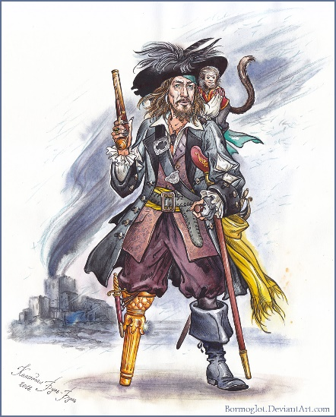
Den Chief
Qualifications
“…more what you’d call ‘guidelines’ than actual rules.”
– Hector Barbossa

Slide 14
Qualifications –
First Class Rank or Above
Waiting until First Class enables:
  Early focus on troop experiences, bonding with peers
  Time for growing maturity, self-reliance, leadership
  Mastery of scouting, interpersonal skills
  Reserving application of Den Chief service to meet troop position of responsibility requirements for advanced rank
Notes:
Requiring First Class before a Den Chief assignment allows the scout to become what’s termed a “complete scout,” enjoying the benefits and challenge of being in a patrol, developing scout skills, and learning some basics of leadership. Missing these opportunities, or delaying them, because of Den Chief assignments is unfair and possibly detrimental to the Den Chief, and to the Den Chief’s patrol and troop.
Requiring First Class also allows time for the scout to mature, and hedges against the Den Chief returning to the pack to go Cubbing again.
So what is best?

Slide 15
Qualifications –
First Class Rank or Above
Is First Class essential? Perhaps more vital:
Den Chief’s maturity
Cubs’ perception of Den Chief’s authority
Den Chief’s den responsibilities
Den Leader expectations
Suggested rules of thumb:
One-year tenure in troop
Younger Den Chief for Wolves-Bears
Older Den Chief for Webelos-AoL
Den Chief training
On-going assessment
Notes:
Requiring First Class before a Den Chief assignment allows the scout to become what’s termed a “complete scout,” enjoying the benefits and challenge of being in a patrol, developing scout skills, and learning some basics of leadership. Missing these opportunities, or delaying them, because of Den Chief assignments is unfair and possibly detrimental to the Den Chief, and to the Den Chief’s patrol and troop.
Requiring First Class also allows time for the scout to mature, and hedges against the Den Chief returning to the pack to go Cubbing again.
So what is best?

Slide 16
Qualifications –
Preferably Former Cub Scout
A former Cub Scout:
Knows program, format, language
Knows leadership structure
Relates well to Cub Scouts
If not a former Cub Scout, use pre-service acclimation period:
Familiarize with program, literature, jargon
Observe den, pack meetings
Make friends

Slide 17
Qualifications –
Youth Protection
Youth protection rules:
    Two-deep leadership does not include Den Chief
    With appropriate two-deep leadership, Den Chief may serve den of opposite gender
    Den Chief may not tent with a Cub Scout, nor with an adult.
    Den Chief must always respect right to privacy of others.
    Den Chiefs not required to complete youth protection training.

Slide 18
Managing the Match

Slide 19
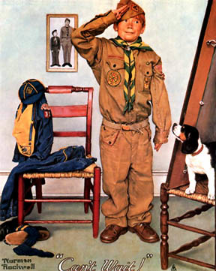
Manage the Match
Identify needs of scout, pack, troop
Continue with honest dialog among scout and pack/troop leadership
Considerations:
  Maturity of Den Chief and Cub Scouts
  Size, maturity of pack, troop
  Types of anticipated activities/skills
  Den meeting schedule

Slide 20
Manage the Match
Some youth should be coached away from Den Chief service.
Others may be a good match otherwise but are still working on self-confidence, introverted personalities
Troops, packs strongly encouraged to have reasonable process and written set of expectations.

Slide 21
Managing the Match
Try to avoid:
Misbehavior history
Immature disposition
Disposition not suited to den age/rank
Overcommitted/unable to attend
Recently graduate from pack
Sibling
Your own son or daughter
But remember Captain Barbossa.

Slide 22
Managing the Match
Meet with Den Chief, become acquainted
Agree upon shared expectations, develop rapport
Ask Den Chief for input often
Share program resources
Meet Den Chief’s needs
Communication is key
Remember: den needs are not known until they are voiced
Den Chief doing a good job? Pass your praise on.

Slide 23
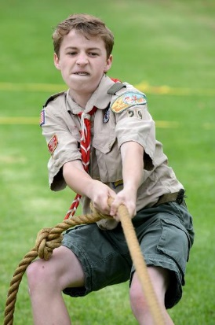
Manage the Match
Mismatch between expectations, capabilities distinctly possible, even likely.
Time commitments, conflicts always a concern.
Communication, transparency among all affected parties is vital. Seek consensus, flexibility.
Try to avoid spending energy on:
  Disconnects in expectations/priorities
  Atmosphere of conflict/ultimatum
Notes:
The engaged parties:
Den Chief
Den Chief’s Parents
Cub Scouts
Cub Scouts’ Parents
Den Leader
Cubmaster
Scoutmaster
Members of the Den Chief’s Patrol

Slide 24
Den Leader/
Den Chief
Relationship
Notes:
Note: for ease of discourse this presentation will presume the Den Chief comes from a troop. The same principles apply, though, regardless of the Den Chief’s unit.

Slide 25
Den Leader/Den Chief
Relationship
Congratulations - you are just starting a new job! You are the new manager of a department with a staff of eight people, all of whom are entry-level, inexperienced, and half your age.
You are somewhat familiar with what your company does, but you have never been a manager before, and you have never before been responsible for directing the schedules, activities, and workloads of others.
Your new boss is 20 years older than you are, and has known, worked with, and enjoyed success with the members of your new department for the past 2-3 years.

Slide 26
Den Leader/Den Chief
Relationship
How does this situation make you – as an adult – feel?
Anxious
Insecure
Alone
Positioned for failure
Wanting help
In need of training
Your Den Chief is likely 12-16 years old. Why do we assume he will just “figure it out” unaided?

Slide 27
Den Leader/Den Chief
Relationship
Meet your Den Chief’s needs:
  Praise
  Appreciation, confidence, satisfaction
  Tenure in position of responsibility
  Den Chief Service Award
You are your Den Chief’s leadership mentor/guide.

Slide 28
Den Chief Service Award
Serve the pack faithfully for one full year.
Attend Den Chief Training (if available within year of service) OR be trained by the assistant Cubmaster and den leader.
Know and understand the purposes of Cub Scouting.
Help Cub Scouts achieve the purposes of Cub Scouting.
Be the activities assistant in den meetings.
Notes:
.

Slide 29
Den Chief Service Award
Set a good example by attitude and uniforming.
Be a friend to the Scouts in the den.
Take part in weekly meetings.
Assist the den at the monthly pack program.
Meet as needed with the adult members of the den, pack, troop, or crew.

Slide 30
Den Chief Service Award
Complete four of these projects:
  Serve as a staff member of a special Cub Scouting event, such as a Scouting show, bicycle rodeo, etc.
  Serve as a staff member of a Cub Scout day camp or resident camp.
  Advance one rank.
  Assist in recruiting three new Cub Scouts.
  Assist three Cub Scouts to become Webelos Scouts.
  Assist three Arrow of Light Scouts to join a troop.
  Help to plan and carry out a joint pack-troop activity.
  Recommend to your Scoutmaster or Venturing Advisor another Scouts BSA member or Venturer to be a den chief.

Slide 31
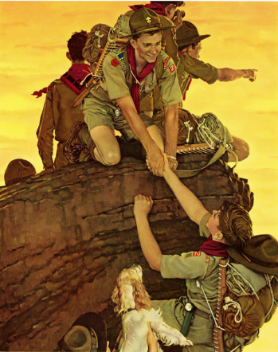
Den Leader/Den Chief
Relationship
Den Chiefs will make mistakes!
Den Leaders: coach/mentor rather than scold/dismiss
Parents: talk to Den Leader, not Den Chief or other parents
Pack/Troop: establish mechanism of course correction for struggling/failing Den Chiefs, unsupportive parents, and/or apparent misfit

Slide 32

Den Leader/Den Chief
Relationship
Den Chiefs:
Not expected to manage difficult situations alone
Never should be publicly embarrassed
Better to terminate Den Chief assignment than to continue bad experiences for Cub Scouts or Den Chiefs.
Notes:
Den Chief, ideally, is a heavily mentored and coached position. The Den Leader should be in weekly communication with the Den Chief, apart from the den meeting time. The purpose for this communication is not just planning for the meeting ahead, but to gauge the Den Chief’s process and to find out how the Den Chief is doing, and feeling about the position. A Den Leader must never lose sight of the age of the Den Chief, typically 12-16 years old. Be in the Den Chief’s corner.

Slide 33
Den Leader/Den Chief
Relationship
Talking about possible difficulties and responses in advance helps us Be Prepared in the event that they occur.

Slide 34

Den Leader/Den Chief
Relationship
Pack wants Den Chief continuity.
Troops often specify six months in position of responsibility.
Often Den Chiefs serve for one year…then decide.
  What does Den Chief want?
  What can Den Chief’s schedule accommodate?
Notes:
The key to establishing the Den Chief’s tenure is communication, on everyone’s part:
Does the Den Chief want to continue in service?
Does the Den Leader want the Den Chief to continue in service?
Packs and troops will have expectations, and these should be voiced. Advantages of Den Chief service and troop service should be expressed to the Den Chief. But neither the pack’s, nor the troop’s, expectations should trump the Den Chief’s desires to serve as a Den Chief, or conversely, return to the troop and serve there.

Slide 35
Using Your Den Chief
Notes:
Note: for ease of discourse this presentation will presume the Den Chief comes from a troop. The same principles apply, though, regardless of the Den Chief’s unit.

Slide 36
Using Your Den Chief
First assignments:
Become familiar with Cub Scout literature
Attend, observe den, pack meetings
Meet, get to know Cub Scouts
Assemble den activity chest

Slide 37
Using Your Den Chief
Activity chest:
Games, puzzles, diversions
Supplies for contests, races, etc.
Magic trick props
Puppet-making materials
Leatherworking kit
Handicraft (glue, tape, crayons, etc.)
Prizes
Costumes
.

Slide 38
Using Your Den Chief
Rehearse for pack meeting
Coach Scout Oath and Scout Law
Teach flag protocols
Assist with Whittling belt loop
Help Cub Scouts with derby cars
Day camp (assist den walkers)
Bike rodeo and other den events
Teach camping skills
Assist on pack overnighters, Webelos/AoL den camping

Slide 39
Using Your Den Chief
Den Chief logistic duties:
Run errands to prepare for meeting
Set up before meetings
Clean up after meetings
Ever-watchful pair of eyes
Notes:
Measure Den Chief’s capability by observation, then allow him/her to lead to the extent the Den Chief’s capabilities allow!

Slide 40
There Must be 50 Ways to
Use Your Den Chief
Allow the Den Chief’s duties to expand as your confidence in his/her capabilities grows.
Notes:
Measure Den Chief’s capability by observation, then allow him/her to lead to the extent the Den Chief’s capabilities allow!

Slide 41
Den Chief
Training

Slide 42
Den Chief Training
Cub Scout program refresher
Delineation of Den Chief role:
Responsibilities and expectations
Need for collaboration
Status as role model
Den Chief do’s and don’ts
Real-world problem solving
FUN! songs, skits, games, activities
Notes:
Advertise March Training.
Show Training handout, Den Chief Handbook.
Go over Warm-Up Questions Handout.

Slide 43
Den Chief Training
Den Chief do’s:
STAIRS
Safety
Teamwork
Activity Planning
Ideas
Role Model
Spirit
Den Chief don’ts:
PICKLE
Punish
Ignore
Control Too Much
Kid Around
Leave Jobs Undone
Expect Too Much
Notes:
Safety – if safety is compromised, nothing else matters.
Teamwork – DC and DL must work together, communicate, share leadership.
Activity Planning – DC must actively participate in den meeting planning, properly prepare in advance, rehearse/practice his role.
Ideas – DC should be creative, be willing to offer suggestions for program activities, outings, etc.
Role Model – DC sets the example, lives Oath and Law. No double standards.
Spirit – DC shows proper enthusiastic spirit, even if it’s a tough day.
Punish – Not appropriate or effective for DC or DL to issue.
Ignore – DC is counted on to keep a watchful eye.
Control Too Much – DC must let Cubs pursue their own activity challenges.
Kid Around – DC must not be a discipline problem for DL.
Expect Too Much – Cub Scouts are not Scouts BSA; DC to remember ages and stages.

Slide 44
Den Chief Training
A Den Chief’s “Can of Worms”…examples:
It’s softball day. A close play at third base. The two scouts get up and start punching each other, calling each other names, and swearing at each other.
A scout steals another scout’s cap and starts teasing, “Na, na, you can’t catch me!”

Slide 45

Training
District Trainers identify opportunities.
Packs can run their own Den Chief training.
Scouts can take Den Chief training even if they do not have a Den Chief assignment.
Den Chief Training, once taken, never expires.
Notes:
Advertise March Training.
Show Training handout, Den Chief Handbook.
Go over Warm-Up Questions Handout.

Slide 46
Den Chief
Insignia and
Recognition

Slide 47
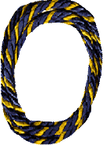
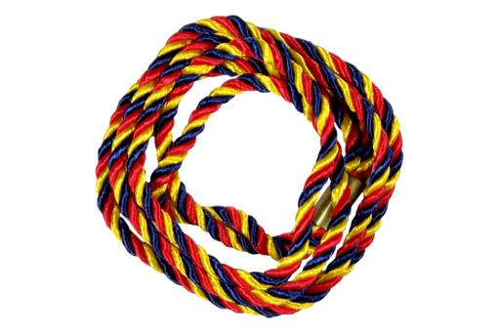
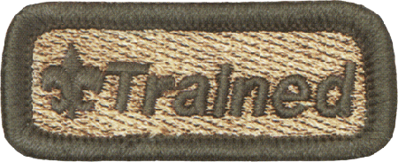
Uniform Insignia and
Recognition
Insist Den Chief wears his/her uniform – correctly:
Den Chief badge
Cub Scout Den Chief cord
Webelos/AoL Den Chief cord
Trained patch
Den Chief service award cord
Notes:
Demonstrate shoulder cords, Trained patch, badge of office.
Provide handout with service award requirements.

Slide 48
Final Thoughts

Slide 49
Make the Best Use of Your
Den Chief
A Den Chief is not:
A Den Leader or other adult leader
A Cub Scout
A drudge
A mind-reader
A miracle worker

Slide 50
Make the Best Use of Your
Den Chief
A Den Chief is:
Hard-working
Responsible
Enthusiastic
Motivated
Skilled in many areas
But still a boy/girl

Slide 51
References:
Norman Rockwell painting:
www.scouters.us/artist.html
Nodding cat image:
https://tenor.com/view/uh-hu-nodding-kitty-dinah-alice-in-wonderland-gif-16131429
Den Chief Badge of Office image from:
https://www.scoutshop.org/cub-scout-den-chief-emblem-387.html
Pirates of Caribbean image:
https://9gag.com/gag/ajm48mR
Den Chief Service Award image from:
www.usscouts.org/advance/boyscout/denchief.asp
Den Chief Handbook image from:
https://www.scoutshop.org/den-chief-handbook-647787.html
Den Chief Origins: Cub Scouting: The First 75 Years of Doing Our Best, BSA 34473, 2005, pp. 16-17.
Cub Scout Leader Book, BSA 33221, 2010.
Cub Scout Den & Pack Meeting Resource Guide, BSA 32354, 2010.
“Can of Worms”: “You are Boy Scouting!”, Scouting Magazine, BSA, October 2001,
www.scoutingmagazine.org/issues/0110/a-denc.html

