Slide 1
WORTHY OF NOTE:
Cub Scout Songs and Singing
Performed by: Susannah Conrad
ladydorcus@gmail.com

Slide 2
Let’s Sing!
Hi, Cub Scout
Tune: Hail, Hail, the Gang’s All Here
Hi! Hi! Hello, Cub Scout!
We are glad to meet you,
We are glad to greet you.
Hi! Hi! Hello, Cub Scout!
You are welcome to our den (pack)

Slide 3
AIMS OF SCOUTING
Character Development
Citizenship
Personal Fitness
Leadership Development

Slide 4
SCOUT OATH
On my honor, I will do my best to do my duty to God and my country and to obey the Scout Law;
to help other people at all times;
and to keep myself physically strong, mentally awake, and morally straight.

Slide 5
SCOUT LAW
A scout is: trustworthy, loyal, helpful, friendly, courteous, kind, obedient, cheerful thrifty, brave, clean, and reverent.

Slide 6
WHY WE SING WITH OUR SCOUTS
It’s fun!
Teaches, fulfills goals of scouting
Shared experience, sense of community
Teaches new skills
Increases a scout’s confidence
Helps concepts stick
Helps set tone for a meeting

Slide 7
WHY WE SING WITH OUR SCOUTS
Did I mention it’s fun?
Pumps up enthusiasm
Increases creativity
Gets the wiggles out
Reins in group focus
A filler with a purpose
Emotional regulation -

Slide 8
LET’S SING A SONG
THE JELLYFISH SONG
1st Verse: Arms up. Wrists together.
2nd Verse (above and): Elbows together.
3rd Verse (above and): Knees together.
4th Verse (above and): Feet together.
5th Verse (above and): Head back.
6th Verse (above and): Tongue out.
A jellyfish, a jellyfish,
a jellyfish, a jellyfish.

Slide 9
WHO SHOULD SING?
EVERYONE!
Leaders, parents, scouts, siblings, guests…
“I can’t sing” won’t work here!
If you can’t sing well… sing loud!
Have a culture of
full-participation singing!
Don’t force it.
Make it fun.

Slide 10
WHAT KINDS OF SONGS ARE THERE?
Opening/Greeting Songs
Rounds
Repeat After Me Songs
Silly Songs

Slide 11
WHAT KINDS OF SONGS ARE THERE?
Action Songs (arm/leg gestures, fast singing speed, etc.)
Patriotic Songs
Traditional Songs
Meaningful/Reflective Songs
Closing Songs

Slide 12
WHAT KINDS OF SONGS ARE THERE?
Some fall into more than
one category, e.g., an
action song could also
be a repeat after me song.

Slide 13
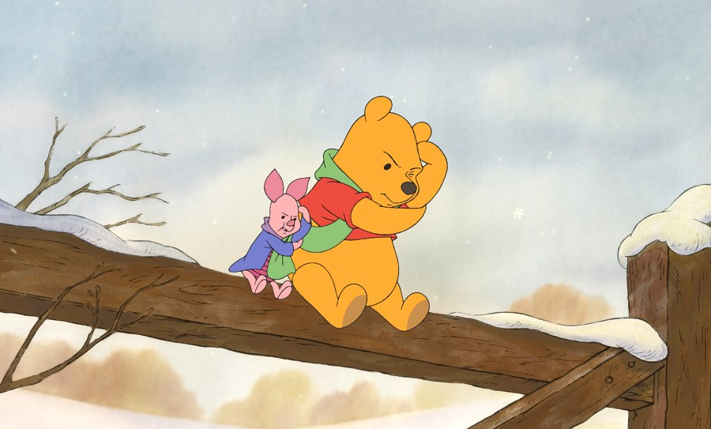
HOW TO CHOOSE A TYPE OF SONG
THINGS TO THINK ABOUT…
Source: https://pooh.fandom.com/wiki/Think,_Think,_Think

Slide 14
PURPOSE OF SINGING
Why are you singing?
Get the wiggles out
Filler with a purpose
Break
Enthusiasm

Slide 15
WHERE ARE YOU?
Inside/Outside?
Den Meeting
Pack Meeting/Akela’s Council
Hiking
Blue & Gold Banquet
Campfire

Slide 16
WHAT MOOD DO YOU WANT TO SET?
Feelings you want to inspire?
Silly
Energetic
Focused
Thoughtful
Thankful
Reverent

Slide 17
WHAT AGES ARE ATTENDING?
Mixed Ages
Single Den
Whole Pack
Families Present?
Lions
Tigers
Wolves
Bears
Webelos
AOLs

Slide 18
FORMULA FOR CHOOSING SONGS
BEGINNING OF MEETINGS
Action songs
Repeat after me songs
Rounds
Energetic – Silly - Fun
Let’s get the enthusiasm UP!

Slide 19
FORMULA FOR CHOOSING SONGS
MIDDLE OF MEETINGS
Songs that help focus
Lower energy than for opening
Patriotic Songs
Songs with a Message
Faith Based

Slide 20
FORMULA FOR CHOOSING SONGS
END OF MEETINGS
Reverent Songs
Preparing for Bed
Slower Paced/Thoughtful
Patriotic Songs
Faith Based
Closing Songs

Slide 21
WHAT MAKES A SONG GOOD TO SING?
Songs should be positive
Should help build up confidence
Be age appropriate

Slide 22
WHAT MAKES A SONG GOOD TO SING?
Patriotic Songs, Hymns, and Spiritual Songs should be sung respectfully and with unaltered lyrics.

Slide 23
WHAT MAKES A SONG GOOD TO SING?
Explore changing lyrics to other types of songs to encourage creativity and fun.
For example...

Slide 24
DOWN BY THE BAY
Down by the bay
Where the watermelons grow
Back to my home
I dare not go
For if I do
My mother will say
Did you ever you ever see a goose
kissing a moose?
Down by the bay

Slide 25
DOWN BY THE BAY
It’s fun and easy to change the last two lines that rhyme:
Have you ever seen a scout
fishing for trout?
Down by the bay
Or a den chasing a wren
Or a pack eating a snack
Or…

Slide 26
ALTERING LYRICS
Just be sure to match the syllables and the meter of the original lyrics.

Slide 27
SONGS SHOULD NOT HAVE
Name calling
Violence/physical harm
Body functions
Derogatory references
Put downs
Inside jokes

Slide 28
SONGS SHOULD NOT HAVE
Alcohol
Drugs
Guns
Undergarments or nudity
Grossness
Insensitivity
Disgust/gore
Food/water wastage

Slide 29
WHEN IN DOUBT
Skip it and don’t sing it;
modify it; or choose something else.
But I sang it when I was a scout!
Many traditional songs, cheers, and skits are no longer appropriate. Remember, you are serving today’s scouts, not your memories.

Slide 30
ALTERING LYRICS
Bear in Tennis Shoes
He said to me, why don’t you run,
Because you ain’t got any gun
Change second line to:
Away from here, we’ll have some fun.

Slide 31
DIFFERENT VERSIONS OF THE SAME SONG
Depending on where and when you learned a song, the lyrics may be slightly different than other people’s versions.
That’s okay. Pick one and make that your pack’s version.

Slide 32
WHAT IF I CAN’T SING
It doesn’t matter.
We are signing to have fun.
This is not a competition.
Practice.
Even practice singing with a funny voice.

Slide 33
HOW TO LEAD SONGS
Know the song really well.
Have the tune and the lyrics memorized.
Practice at home with your family or your pets.
BE CONFIDENT

Slide 34
TEACH IT
Announce name of song
Pass out lyric sheets, or written on a white board or projector

Slide 35
TEACH IT
Pack Song Book to use at meetings
Complex lyrics: leaders sing complex verses; scouts sing simpler chorus

Slide 36
SING IT
New song: sing through once for audience
All songs: practice before-hand

Slide 37
LEAD IT
Be enthusiastic in leading!
BELIEVE
in the value and fun of singing. If you don’t, no one else will!

Slide 38
LEAD IT
Keep a beat with your arm. You set the pace.
If singing in rounds, split the audience into groups before starting.
Point to group when it’s their turn to sing.

Slide 39
LEAD IT
Walk around as you sing.
Get everyone involved.
Silly is more than okay - Cubs appreciate when adults are silly with them.
They will follow you.

Slide 40
LEAD IT
Don’t overdo it. It’s supposed to be fun.
One or two songs per meeting is enough.
Sing in a middle key, think of the ages of your audience.

Slide 41
LEAD IT
It will take time to build up the songs they know.
Bring back favorites.
Don’t repeat ones they don’t enjoy (even if they are your favorites).

Slide 42
WHERE DO I FIND SONGS
Cub Scout Song Book
Boy Scout Song Book
Wood Badge Song Book
NYLT Song Book

Slide 43
WHERE DO I FIND SONGS
Old Cub Scout leader Pow Wow/Akela’s Trail books/discs
Roundtable handouts
Nursery rhymes
Folk song collections
Internet – such as Baloo’s Bugle
www.usscouts.org/bbugle
Other leaders

Slide 44
SCOUT VESPERS
TUNE: “O TANNENBAUM”
Softly falls the light of day, While our campfire fades away.
Silently each Scout should ask: “Have I done my daily task?
Have I kept my honor bright? Can I guiltless sleep tonight?
Have I done and have I dared Everything to be prepared?”

Slide 45
QUESTIONS

Slide 46
THANK
YOU

