Slide 1










NCAC UoS - CUB 206
Cub Scouting with
Special Needs
Notes:
- Unit Modification of Advancement Requirements – FULLY ALLOWED in Cub Scouts without Scouting America pre-approval. All requirements for all scouts are measured by “Do Your Best.” Note that this is NOT the case in other Scouting America program divisions.
- Guidance on the latitude allowed: pack committee, leadership should consider carefully what each requirement says and does not say. Example: “Discuss” includes the scout communicating with the parent, and the parent conveying to the Den Leader the gist of what the scout said. “Demonstrate” or “Show” in many cases does not necessarily imply communication in words is required.

Slide 2



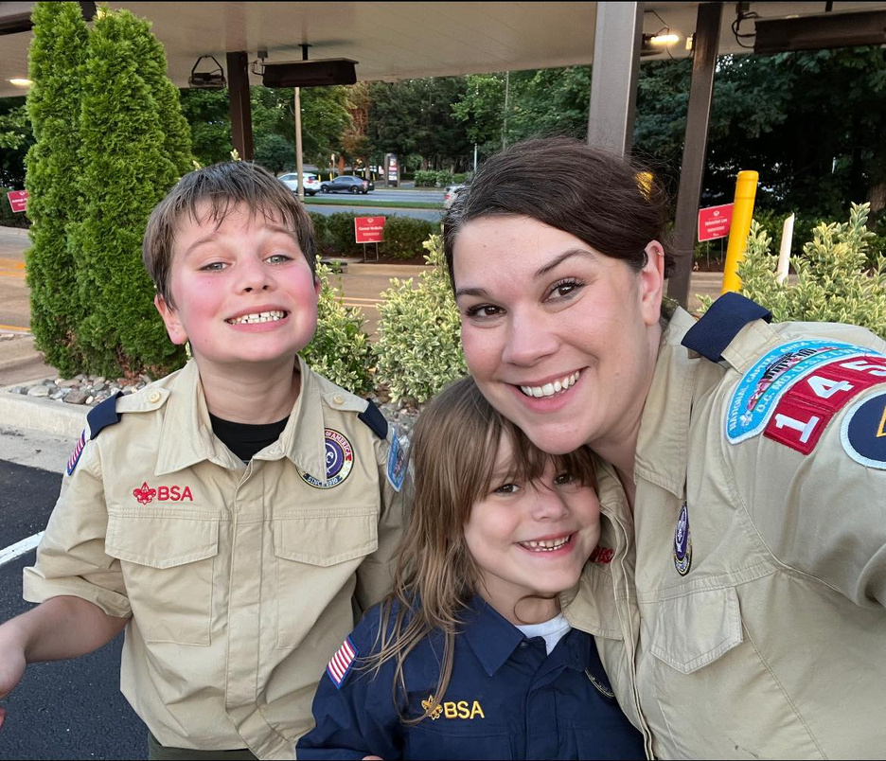



Heather Baucum
Cub Master 1459
Notes:
Heather Baucum
Cub MAster 1459
Mom to 3 autistic kids
Wife to autistic husband
School Librarian that serves Enhanced Autism Classes for the last 11 years.
Naitonal Speaker on Adapted Practices in School Libraries for Autistic Students
Neurospicy ADHD Lady too

Slide 3






Agenda
Inclusive Practices
Event Planning
Understanding Special Needs
Neuroscience Insights
Do Your Best
Scouting America Accomodations
Ensuring Success
Roles and Responsibilities

Slide 4



How the Mission of Scouting America impacts special needs communities
Scouting America’s mission is to prepare young people to make ethical and moral choices over their liftime by instilling in them the values of the Scout Oath and Law
Notes:
Scouting America’s mission is to prepare young people to make ethical and moral choices through the Scout Oath and Law
Scouting goals are character development, citizenship, personal fitness, leadership development.
How does inclusive scouting advance scouting goals?
Analogy of a broken horse vs being a zebra. Culture tells us we must be one way to be perceived as "appropriate or valuable". For many neurodivergent or differently abled scouts, they grow up feeling like a broken horse, rather than realizing they are a zebra.
Inclusive scouting means more scouts are reached and participate as citizens, scouts learn to appreciate others and apply Oath and Law across wider range of capabilities, scouts learn cooperation and communication skills, scouts learn to strive through and past their perceived limitations, scouts gain in self-confidence and leadership.
Autistic children spend 6 - 7 hours a WEEK in therapies learning how to fit in, but we are not provide the same kind of opportunities for neurotypical kids to understand those with a neurodivergent brain set.

Slide 5

Understanding Special Needs
Physical needs are the most readily visible.
Historically have the most resources available to them.
Notes:
Muscular dystrophy, multiple sclerosis, spina bifida, cerebral palsy, and other genetic conditions
Curb cut effect - how universal design benefits all

Slide 6

Understanding Special Needs
Neurodivergent Scouts
1 in 48 children are autistic
5% of children worldwide have ADHD
Notes:
Autism, apraxia, ADHD, bipolar, ocd, anxiety, depressive mood disorders, pathological demand avoidance
Scouters need to work on their own understandings and empathy around different conditions that are not inline with their own experiences.
Each child comes with their own unique hyperfixations, social skills sets, masking capabilities, scripting, and baggage. If you've met one person with autism, you've met one person with autism.
These scouts are different, not less.
Neurospicy - we come in many flavors.

Slide 7
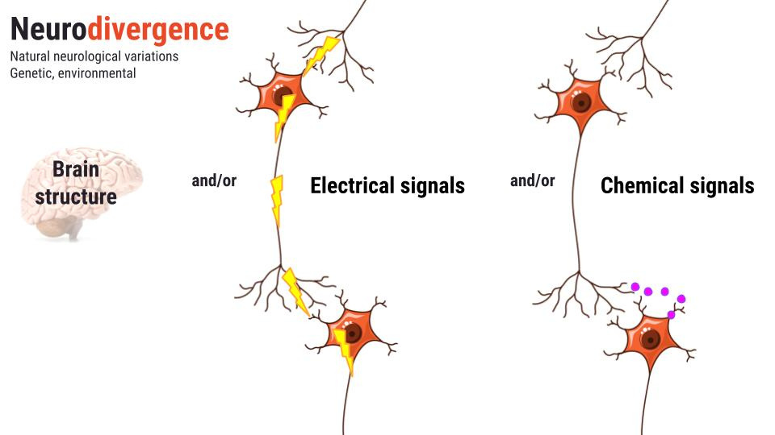
Notes:
When are talking about neurodivergence, we are actually talking about people who have different brain chemistries or brain structures. So the way we may talk, use our body language, or even present ideas may not be understood properly.
Dopamining - seeking dopamine to keep those comorbid conditions at bay. Hyperfixations and "pebbling" for those kids who may come and say the same things at your again and again.

Slide 8

Creating Inclusive Scouting Spaces
AbleScouts
Inclusion Toolbox

Slide 9
Creating Inclusive Scouting Spaces
Be flexible
Seek to understand
Communicate with parents
Notes:
Think of your pack meeting
The sounds, the lights, the feeling of a uniform seams on your skin, the belt pushing on your waist, any strange smells that are from people or cleaners.
For some of our kids they are coming to pack meetings after a full day or school or after medications have worn off. They are already potentially overstimulated and exhausted from masking all day.

Slide 10
Creating Inclusive Scouting Spaces
Parents – Concerns Vary Widely
Open, up front, honest - looking for support
New to learning about their child’s difference
Worried about oversharing
Afraid of child in any social/interactive environment
Don’t see, or refuse to see, difficulty integrating
Willfully closed to seeing differences, hearing labels
Tired and wanting respite care
Notes:
Parents are your first stop when it comes to working with special needs scouts.
For scouts with significant mental or emotional needs, mandating parent participation with the scout, as a parent/scout pair, is strongly recommended.

Slide 11
Inclusive Accomodations
  Sensory Accommodations:
    Quiet space available for scouts needing an emotional regulation break?
    Uniforms for scouts with sensory overload - Class A or B?
  Mobility Considerations:
    Wheelchair-accessibility
    Availability of adapted technology (example: fishing rods easier for fine motor skills)
    Hikes - paved trails, pre-hike to scout access points

Slide 12
Inclusive Accomodations
  Processing Differences:
    Clear, concise instructions; visual aids (e.g., charts, pictures)
    Extra time for activities and discussions
    ADHD - Stress reactions – extended time still results in last-minute task completion
  Structured Routines:
    Visual schedules to outline session, helping scouts know what to expect

Slide 13
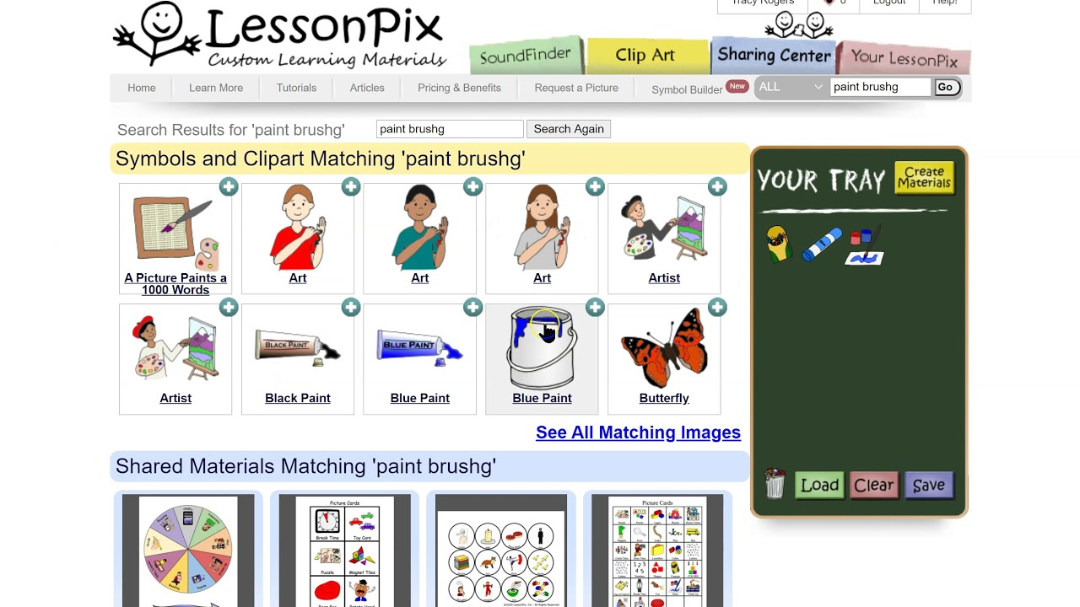

Notes:
Lesson Pix is a great resource if you are looking to make picture cards or visual schedules for scouts.

Slide 14
Inclusive Accomodations
  Emotional Regulation:
    Quiet Corner - to calm down if overwhelmed
    Social stories to prepare for group activities or transitions
      ChatGPT or other AI
        Provide to the family ahead of time to help set expectations.
  Social Skills Development:
  Encourage role-playing scenarios
  Team-Building Activities – cooperative games that require communication and teamwork at comfort level
  Story Time – Stories with relatable characters facing challenges
  Engage families according to talents and passion

Slide 15
Inclusive Accomodations
  Open Communication: Regularly check in with families
  Flexible Planning: Design activities with built-in flexibility, allowing for modifications based on real-time feedback. Remember everyone’s best looks different!
  Awareness: Training on recognizing, addressing diverse needs, ensuring all feel supported and understood.
  Encourage Peer Support: Foster environment where scouts learn to help each other, promoting friendships, teamwork across varying abilities.

Slide 16

Event Planning
Pack Meetings
  Observation: Watch for signs of discomfort or disengagement: body language, withdrawal, or difficulty following along.
  Feedback: Regularly ask families for feedback about meeting environment and child's experience.

Slide 17
Event Planning
Pack Meetings:
  Set Clear Expectations: Clearly outline agenda, use visual aids.
  Flexible Activities: Incorporate variety of activities that allow for movement, quiet time, and sensory engagement.
Notes:
Awareness - this was my woodbadge ticket item with a neurodiversity night for scouts.
Aware and Care
Maintain confidentiality with families. It's ok to ask about 504/IEP supports and how you can support the scout.
Many parents are looking for help.

Slide 18

Event Planning
Den Meetings:
  Know Your Scouts: Gather information from families about specific needs or accommodations well in advance.
  Activity Planning: Choose activities that allow for adaptability. Ensure that materials and tools are accessible to everyone.

Slide 19
Event Planning
Den Meetings:
  Routine: Establish consistent routine so scouts know what to expect. Use visuals or charts.
  Diverse Activities: Include mix of physical, creative, social activities that cater to different interests and abilities. For example, combine a nature hike with a quiet reflection activity.

Slide 20

Event Planning
Food:
  Ask families to inform you about allergies, sensitivities, dietary restrictions.
  Clearly label all food items, including ingredients, to help all feel safe.
  Always provide safe alternatives for scouts with dietary restrictions.
  Encourage Contribution. Invite families to contribute to meals, ensuring that those with dietary needs can provide their preferred foods.

Slide 21

Scouting America Accommodation of Special Needs

Slide 22
Do Your Best
Completion of all Cub Scout requirements is on the basis of the leader’s determination of the Scout’s best effort.
This principle allows flexible implementation of all Cub Scout requirements.

Slide 23
Special Needs Pack vs Inclusive Pack

Slide 24
Special Needs Pack vs Inclusive Pack
  Inclusive (Mainstream) Pack
  Diversity reflects society at large
  Scouts with and without special needs interact, support each other
  Scouts with special needs grow from challenge of unmodified program implementation, schedule
  Special Needs Pack
  “Do Your Best” definition, program pace calibrated to Scouts with special needs
  All achieve, advance at same rate and in the same way
  Scouts insulated from interaction with Scouts without special needs

Slide 25
Roles and Responsibilities
  Parents: expert on the child
  Leaders: position trained experts on Scouting
  Other Scouts: experts on being a kid (important!)

Slide 26
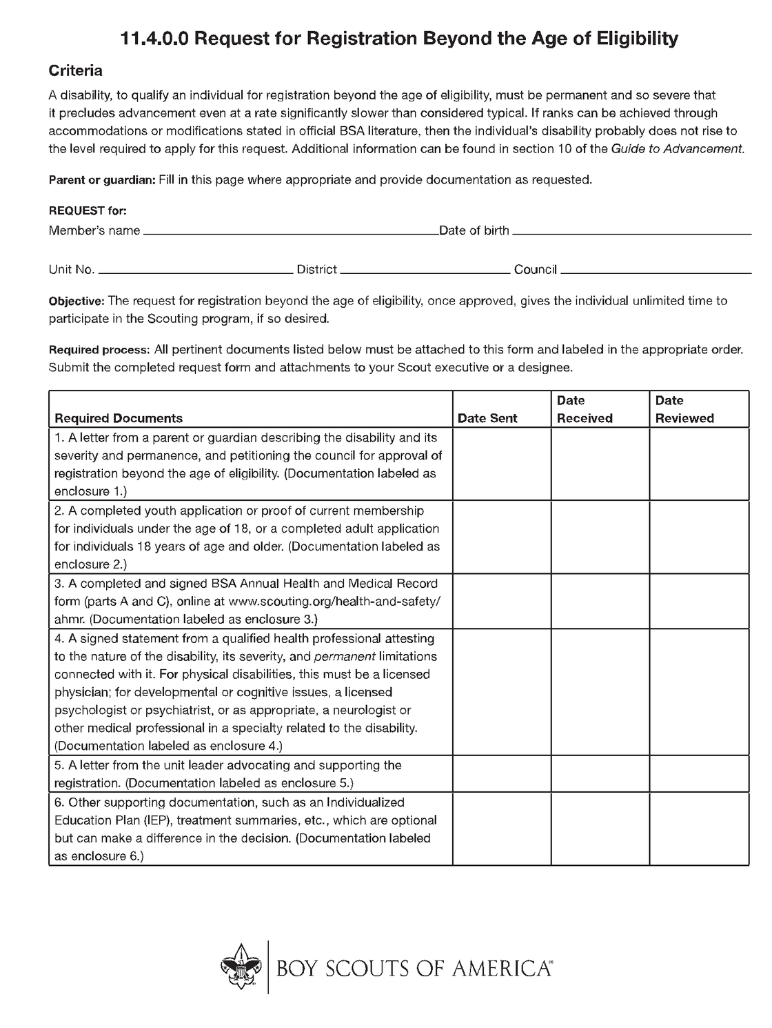
Scouting America Accomodations
Notes:
- Scout Application (Adult Application if over 18, marked as “Youth Participant”)
- Waiver of Age of Eligibility Form
- Exemption from Youth Protection Training Form (if scout is over age 18)
- Letter of Approval from Unit Leader (Cubmaster)
- Letter from Parents Citing Special Needs and Need for Waiver
- Letter from Medical Professional Attesting to Special Needs and Need for Waiver
- Scouting America Medical Form Parts A, B, and C, Including Physical

Slide 27

Ensuring Success
  Constant communication with parents and leadership
  Self-reflection - what went well, where can we grow?
Notes:
Remember how short their time with scouts is, the disability is life long. What can we do to create an inclusive environment that will keep families coming back and feeling safe with their child in a world that doesn't always want to adapt for their child.

Slide 28
Scouting America Resources
  Abilities Digest Newsletter
  AbleScouts - Inclusion Toolbox
  BSA Guide to Working with Scouts with Disabilities: This guide provides insights on accommodating various needs and promoting inclusion.
  Online webinars - https://www.scouting.org/resources/disabilities-awareness/
  No Scout Left Behind Facebook Group

Slide 29

Questions

Slide 30


