Slide 1

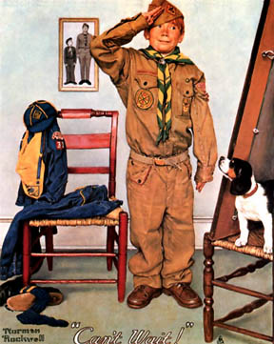
A Cub Scout’s
Character
University of Scouting
February 2025
Roger Claff
reclaff@aol.com

Slide 2
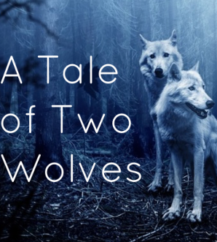
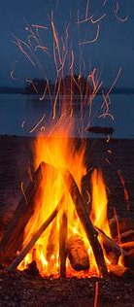
Notes:
The Cherokee elder began to speak I thought for a moment about this fight
Of a legend told him long ago; As the elder sat back with a grin;
It was Cherokee wisdom shared by Creek, I wondered aloud, “If might should make right,
Apache, Sioux, and Arapaho. Which one of the wolves was bound to win?”
The elder told how when the land was new The elder then paused, I think for effect,
And all men lived by the simple ways, The flames flickered in front of his face;
How having so little meant needs were few His glance was piercing, his response direct,
So, contentment reigned through all their days. Doubt of conviction absent a trace.
“And yet,” said he, “Now I will tell you son,” “My answer I urge you always to heed,
As across his face a grimace forms, Sure as the morning sun in the east;
“Theirs was a life not so easily won The wolf that wins is the one that you feed,
Twixt quests for food and shelter from storms.” Your desires fuel the triumphant beast.”
“But the fiercest struggle a man can face In silence his words shot straight to my heart,
Takes place deep within his very soul; Wisdom so true I could not deny;
There, buried deep inside that hidden place While offering thanks I rose to depart,
Nature doth exact its truest toll.” Hearing a voice, I could not say why.
“For the fiercest wolves live within the soul; As the years have gone by, often I speak
Like demons they fight to win the man; This legend told me so long ago;
Destroy each other is their only goal; It is Cherokee wisdom shared by Creek,
The sole survivor howe’er they can.” Apache, Sioux, and Arapaho.
“One wolf is selfishness, envy, and hate, The tale once told and reflections begun,
Arrogant pride, self-pity and guilt; A nagging voice compels each to heed;
Its loathing condemns the helpless to fate; “Answer me this,” the voice troubles each one,
Lies, o’er blood of our fathers was spilt.” “Which wolf is it you desire to feed?”
“The other is kindness, friendship and peace,
Justice, compassion, patience, and love;
From truth the strength of its passions release,
Joyously free as blue sky above.”

Slide 3
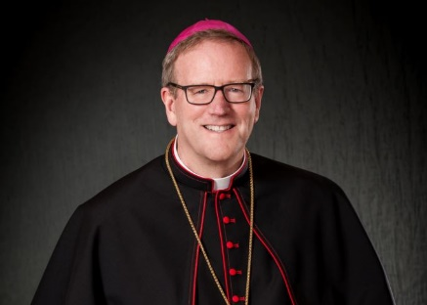
Character Does Matter
“So there’s the question, young graduates. What kind of soul will you have? What kind of person will you be? Will you do whatever it takes to get what you want? Or will you accept even great suffering to do what is right? Everything else in your life will flow from your answer to that question.”
― Robert Barron, Bishop, Winona-Rochester Diocese
Address to Hillsdale College Commencement
May 13, 2023

Slide 4
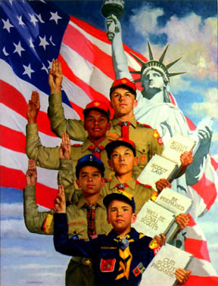
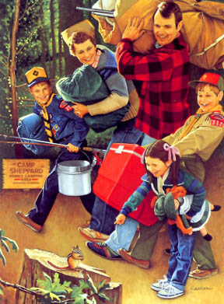
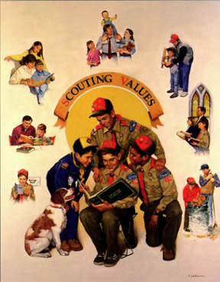
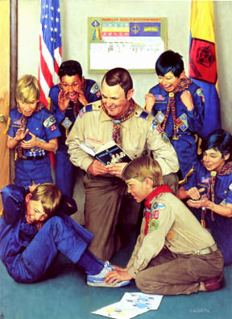
Character is Essential to Scouting
Notes:
Are we…
A camping club?
A patriotic association?
An after-school recreational group?
Vocational training?
A social group?
Asked another way… What do families registering their youth in Scouting America hope their youth will gain from the experience?

Slide 5
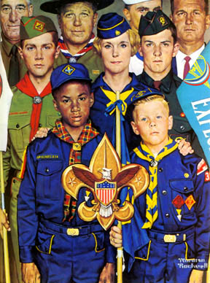
Character is Essential to Scouting
“The basis of a successful career is not A, B, C nor the three Rs. It is the character of the man in 99 cases out of 100 that carries him to the top. Character should be one of the first aims of education instead of being, as in the old world, about the last. Now there has been such a thing as scouting in history and it teaches character.”
- Robert Baden-Powell
Message to Boy Scouts of America
Tremont Temple, Boston, MA
February 1, 1912
Notes:
At the urging of James West, BSA’s first Chief Scout Executive, Baden-Powell came to America for a barn-storming tour across the country. He arrived in New York on Jan. 31, 1912.

Slide 6
Character is Essential to Scouting
BSA’s Federal Charter, at 36 USC 30902
“The purposes of the [Boy Scouts of America] are to promote, through organization, and cooperation with other agencies, the ability of boys to do things for themselves and others, to train them in scoutcraft, and to teach them patriotism, courage, self-reliance, and kindred virtues, using the methods that were in common use by boy scouts on June 15, 1916.”

Slide 7
Character is Essential to Scouting
"A realization that to the boys Scouting is a game
--to you, a game with a purpose: character building
and citizenship training"
- William “Green Bar Bill” Hillcourt
Ten Essentials of Scoutmastership, 1936
Notes:
William Hillcourt (August 6, 1900 – November 9, 1992) was a supremely influential BSA leader; for much of the 20th century, he was acclaimed as "the foremost influence on development of the Boy Scouting program.“ A prolific writer and teacher in the areas of woodcraft, troop and patrol structure, and training, his written works include three editions of Boy Scout Handbook, the first Handbook for Patrol Leaders, and numerous other Scouting-related books and numerous magazine articles. It was Hillcourt who developed and promoted the American adaptation of the Wood Badge program, the premier adult leader training program of Scouting.
Hillcourt earned Danish Scouting’s rank of Knight-Scout in 1918 and came to America in 1926. He quickly became a professional Scouter and was a trusted advisor to James West. From 1932 until his retirement in 1965, Hillcourt was a major contributor to Boys’ Life; his columns included his signature over the two green bars of patrol leader’s emblem, hence his nickname, “Green Bar Bill.”
He befriended Baden-Powell during B-P’s visit to the Schiff Scout Reservation in 1935. In 1964 would author B-P’s biography, Two Lives of a Hero. He came out of retirement to write the 1979 edition of the Boy Scout Handbook, emphasizing a much-needed return to woodcraft and camping skills. He received the Silver Buffalo in 1980.
If “character” or “character development” is not in our definition of scouting, it’s imprecise or incomplete. Character development is what scouting is all about.

Slide 8
Character is Essential to Scouting
Goals of Scouting:
Character Development
Citizenship Training
Personal Fitness
Leadership Development
Notes:
Note that character development comes first in this list. Character development is vital to the other goals.
Citizenship without character = blind obedience
Personal fitness without character = tenuous and untested
Leadership without character = feckless or reckless, possibly morally bankrupt, followers go astray

Slide 9
Character is Essential to Scouting
Mission Statement:
The mission of Scouting America is to prepare young people to make ethical and moral choices over their lifetimes by instilling in them the values of the Scout Oath and Law.

Slide 10

What do we mean by ethical and moral?
We mean the difference between right and wrong.
Morality: personal set of principles separating intentions, decisions, or actions between those that are right and those that are wrong. Character is the composite of personal moral qualities.
Ethics: expectations or standards of good and bad distinguished by a community or society. Ethics inform and help define personal morality. Virtue ethics are the ethics of traits deemed morally good.

Slide 11
What do we mean by ethical and moral?
We mean the difference between right and wrong.
An ethical person understands stealing is wrong.
A moral person does not steal.

Slide 12
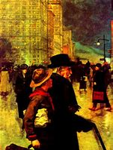
A Scout Expects No Compensation
“There was some discussion on the part of those who felt that it would have an unfortunate effect if the boys reported their Good Turns in public. Accordingly, the policy was adopted and has remained in force ever since that the boy’s individual Good Turns are not reported. They are a matter between his Scout conscience and himself.”
1911 Committee on Standardization of the Scout Oath and Law
The History of the Boy Scouts of America, 1937, BSA, New York, New York, p. 58.

Slide 13

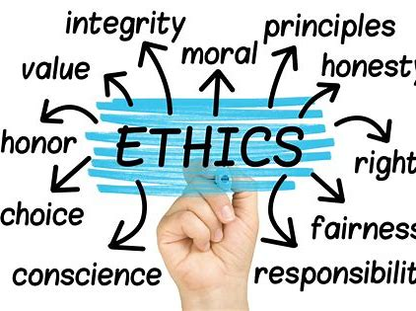
Where do our youth stand today on questions of ethics and morality?

Slide 14
Summit Ministries National Survey
1000 Voters – October 2022
Question: There is absolute truth, or each person determines their own version of truth?
Absolute truth: unalterable moral/ethical reality, applicable everywhere and for all time
39% said each person determines own version of truth
  55% among adults aged 18-29
  46% among adults aged 30-40
  Without absolute truth, one is free to self-define, self-justify any behavior as right/wrong, without consequence (absent a standard, who is to judge?)
  Judges 17:6 – “Every man did that which was right in his own eyes.”
  What are the consequences of individual relativism?

Slide 15
Character Survey of American Youth
Josephson Institute 2012 Survey
22,305 High School Students
10,440 Males; 11,865 Females
Within the past year:
- 14% confessed to have stolen from a friend
- 15% it’s not cheating if everyone is doing it
- 17% mistreated someone for belonging to different group
- 18% stole something from parents/relatives
- 20% confessed to have stolen from a store
- 24% think it’s okay sometimes to hit or threaten someone
who makes them angry
- 32% copied internet document for classroom assignment
36% one must occasionally lie or cheat to succeed
36% used racial slurs or insults
38% confessed to occasional lying to save money
40% bullied, teased or taunted someone
Notes:
Ground-breaking survey starkly revealed a deep lack of moral awareness and sensibility pervading our nation’s youth.

Slide 16
Character Survey of American Youth
Josephson Institute 2012 Survey
43% hit a person out of anger
45% confessed to have violated own religious beliefs
49% have been bullied, teased or taunted in upsetting way
- 52% confessed to cheating during a test
- 55% lied to a teacher about something significant
- 74% confessed to copying another’s homework
- 76% confessed to lying to parent about significant matter
- and just 70% answered the survey completely honestly
And yet:
- 81% believe they are better than most in doing what’s right
- 93% are satisfied with their ethics and character
- 95% say trust & honesty are essential in business/workplace
- 98% say trust & honesty are essential in relationships
- 99% feel being of good character is important

Slide 17
Character Survey of American Youth
“We laugh at honor and are shocked to find traitors in our midst.” – C. S. Lewis
The society has done its best to obfuscate basic moral understanding.
Our youth are both confused and unconcerned about what it means to have good character.
We have a responsibility to try to reverse these trends.
To make a difference, it takes constant, positive effort in the lives of our youth starting when they are young.

Slide 18
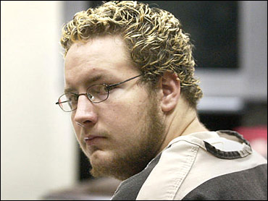
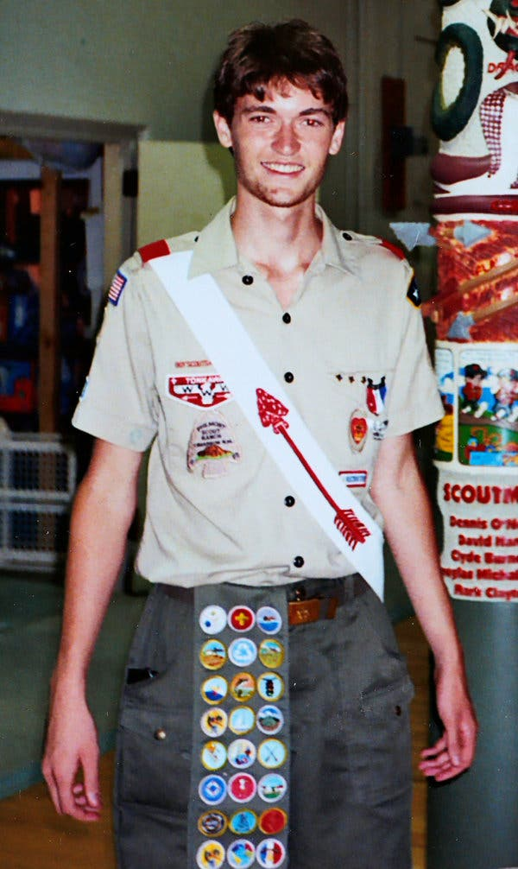
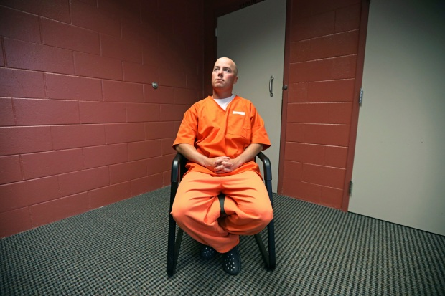
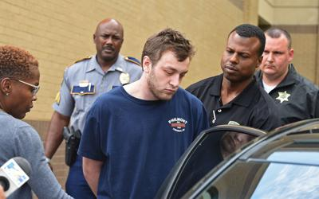
Russell Henderson
Gary Hirte
Ross Ulbricht
All of them are Eagle Scouts!
Kenneth Gleason
(note Philmont t-shirt!)
Notes:
Daniel Altstadt – killed family with ax (1975)
Richard Angelo – serial killer, gave lethal injections (1987)
Karleton Armstrong – anti-Vietnam War radical, University of Wisconsin bomber (1970)
Marion Barry – disgraced DC mayor, convicted on drug charges (1990)
Arthur Gary Bishop – embezzler, child molester, child murderer (1979-83)
Robert Black, Jr. –hired a hitman to kill his wife for insurance funds (1985)
Michael William Brescia – white supremacist implicated in OK City bombing (1995)
Kyle Dougherty/Stephen Lober – committed a shotgun murder as part of a fake pot deal, robbery attempt (2012)
David Foreman - Earth First eco-terrorist, saboteur (1980s)
George Fout – scout leader obsessed with child porn, raped, molested children over 4-yr period, including an 8-year-old Cub Scout (1994)
Daniel Gaynor – committed rape at knifepoint (2002)
Kenneth Gleason – gunned down two African-American men, shot up African-American's home (2017)
Lesley Lee Gosch – murdered bank president’s wife after failed ransom attempt (1985)
Chandler Halderson – murdered, dismembered parents (2021)
Dustin Hedrick – scout leader; forcible lewd acts on 13, 16-yr olds (2010)
Russell Henderson – murderer of Matthew Shepard (1998)
Gary Hirte – murdered to see if he could get away with it (2003)
Mark Hofmann – Mormon counterfeiter, forger, bombing murderer (1985)
Richard Walter Holtje – drowned girlfriend’s baby son in scalding water (1975)
John Joubert – Woodford Slasher, stabbed and slashed three boys to death (1982-3)
David Brian Legg – killed parents in their home, robbed them, fled on honeymoon with his 15-yr-old wife (1996)
Khallid Abdul Muhammad – black supremacist, anti-Semite (1993-2001)
Quintin P. O’Dell – bludgeoned woman to death with hatchet, slashed another in abdomen with razor (2011)
Stuart Jason Orr – Tonto National Forest arsonist
Fred Phelps – homophobic preacher and demonstrator (1929-2014)
Karl Pierson – CO Arapahoe High School shooter, killed female student, himself (2013)
Larry Matthew Puckett – murderer, sexual batterer (1995)
John Edward Robinson – con artist, forger, serial killer responsible for eight murders (2003)
Lee Scott – murdered female classmate at church (1949)
Ronald Scott Shamburger – murdered coed, set house on fire (1994)
Aaron Shamo – led multi-million-dollar drug operation, making, distributing counterfeit pain killers laced with fetanyl, Xanax (2016)
Arthur Shelton – murderer, shot roommate, believing him to be the devil (2004)
Ronald Bert Smith – pistol-whipped, shot store clerk to death during robbery (1994)
Zachary Stirewalt – murderer, committed to mental facility (2012)
Charles Whitman – stabbed mother, wife to death, then as University of Texas clock tower sniper, killed 14 (1996)
Wendell Williamson – schizophrenic, Chapel-Hill sniper, killed two, determined insane (1995)
Ross Ulbricht – founder of Silk Road, internet hub for $1.2 billion drug trade, inc cocaine, heroin, LSD (2011-13)

Slide 19
Scouting Influence on Character
of American Youth
Changes may be striking and permanent, or in spite of best efforts, temporary and superficial.
Not all scouts, not even all Eagle Scouts, retain good moral character.
There are no guarantees except...If we do not act, nothing will change.

Slide 20
What is Character?
The Scout Oath
On my honor I will do my best
To do my duty to God and my country, and to obey the Scout Law;
To help other people at all times;
And to keep myself physically strong, mentally awake, and morally straight.
Delineates duty to God and country, duty to others, duty to self.
The Scout Law
A Scout is trustworthy, loyal, helpful, friendly,
courteous, kind, obedient, cheerful,
thrifty, brave, clean, and reverent.

Slide 21
What is Character?
Definitions in Religious Texts:
“Finally, brethren, whatsoever things are true, whatsoever things are honest, whatsoever things are just, whatsoever things are pure, whatsoever things are lovely, whatsoever things are of good report, if there be any virtue, and if there be any praise, think on these things. Those things, which ye have both learned, and received, and heard, and seen in me, do, and the God of peace shall be with you.”
Paul, in his letter to the Philippians
Chapter 4, Verses 8-9

Slide 22
What is Character?
Cub Scout Wolf Handbook: “…a good feeling about themselves and a genuine concern for others.”
Frank Outlaw: “Watch your thoughts, for they become words. Watch your words, for they become actions. Watch your actions, for they become habits. Watch your habits, for they become character. Watch your character, for it becomes your destiny.”
J. C. Watts: “Character is doing the right thing when nobody’s looking.”
Golden Rule: “Do unto others as you would have them do unto you…Love your neighbor as yourself.”
Platinum Rule: “Do unto others as they would want done unto them.”

Slide 23

What is Character?
Character is living with honor.
“Probably the greatest thing a man can say to himself,
or have as his philosophy when he has to tackle a tough
job, or make a big decision, is the first eight words of the
Scout Oath: On my honor I will do my best…”
- Roger Chaffee, Apollo 1 Pilot
Honor is reputation - the good opinion of others concerning one’s integrity. Scouting instills in the Scout a sense of honor. Honor is the stake a Scout wages each time they recite the Scout Oath and Law. Scouts are often described as “Knights of Today,” upholding a code of honor similar to knighthood.
Cultivate honor in your Cub Scouts – pride that comes from being known for doing right and serving others.
Notes:
Roger Chaffee an Eagle Scout with Bronze and Gold Palms
B. S. Aeronautical Engineering, 1957, Purdue, in NROTC began flight training to become Naval Aviator
Commissioned in Navy in 1957, rose to rank of Lieutenant Commander
In 1963, was selected as one of fourteen astronauts in Astronaut Group 3, destined for Apollo program
Assigned as Pilot for Apollo 1 earth-orbit mission, with Ed White as Senior Pilot, Gus Grissom as Commander
Died January 27, 1967, in pre-launch demonstration test, when pure O2-fed fire broke out in cabin of command module. Died strapped to his seat feeding communications to blockhouse.

Slide 24
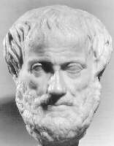
Aristotelian Concept of Character
Greek Philosopher: 384 – 322 BCE
Intellectual Influences: Socrates, Plato
Tutor to Alexander the Great
Teachings Dominated Western European Thought Up To and Beyond Renaissance
Expounded on Character in Nicomachean Ethics,
Lectures Dedicated to Son, Nicomachus

Slide 25
Aristotelian Concept of Character
A virtue is the habit of choosing the mean between the extremes with respect to some emotion, behavior, or action.
A vice is the habit of choosing an extreme
with respect to some emotion, behavior, or
action. A vice can be in deficiency, or in excess, of a particular virtue.
Character is the composite of one’s virtues
and vices. One’s character is always a work in progress.
Notes:
Happiness to Aristotle is fulfilling one’s potential in life.
Happiness is the purpose and end of human existence.
Happiness to Aristotle is the exercise of virtue.
Happiness depends on acquiring good moral character.
Happiness is not readily achieved, does not occur by chance, depends on the exercise of reason, and requires intellectual contemplation.

Slide 26
Aristotelian Concept of Character
The quest for good character is the quest for moral excellence – the Golden Mean of Virtue:
Deficiency Vice Scout Law Virtue Excess Vice
Untrustworthy Trustworthy Unaccountable
Disloyal Loyal Blind Allegiance
Unhelpful Helpful Meddlesome
Hostile Friendly Cloying
Rude Courteous Obsequious
Harsh Kind Bleeding Heart
Defiant Obedient Submissive
Grumpy Cheerful Giddy
Wasteful Thrifty Stingy
Cowardly Brave Reckless
Filthy Clean Fastidious
Irreverent Reverent Holier-Than-Thou
Notes:
Golden Mean is not merely the average behavior, action, or emotion but rather the point of excellence between deficiency and excess
The position of the Golden Mean depends on the individual and circumstance but is not arbitrary or relative.

Slide 27
Aristotelian Concept of Character
We become virtuous only by performing
virtuous acts:
“...[V]irtue of character is a result of habituation...we acquire [virtues] by first exercising them...For by acting as we do in our dealings with other men, some of us become just, others unjust; and by acting as we do in the face of danger…some of us become courageous, others cowardly...In a word, then, like states arise from like activities...So it is not unimportant how we are habituated from our earliest days; indeed it makes a huge difference – or rather all the difference.”
- Nicomachean Ethics
Bekker #1103b
Notes:
We would not expect a Cub Scout to get in good physical shape without exercise.
We would not expect a Cub Scout to be mentally sharp without learning, reading, and taking tests.
And so we would likewise not expect a Cub Scout to be of good character without moral practice. It is the responsibility of the Cub Scout leader to provide Cub Scouts with opportunities to exercise the virtues, habituate themselves to them, and by so doing, grow in character.

Slide 28
Aristotelian Concept of Character
Good moral character requires both
knowledge and action.
It is not sufficient merely to know
the right behavior – one can fully understand virtuous behavior yet act otherwise.
One must act in accordance with one’s knowledge of virtue to be virtuous.
We become virtuous only by performing
virtuous acts.
Notes:
Examples:
Dieter
Smoker
Procrastinator

Slide 29
The Internalizing
Virtue Triangle
We become
virtuous by
performing
virtuous acts.
KNOWLEDGE
COMMITMENT
CARING
REFLECTION
INTEGRITY
PRACTICE
Provide opportunities for your scouts to know, commit, and practice virtues…as a matter of scouting routine.
Notes:
The Boston University Center for the Advancement of Ethics and Character, now the Center for Character and Social Responsibility, devised the internalizing virtue triangle, as a way to conceptualize the experiential process of refining virtuous behavior.

Slide 30
Scouting and Character
Refining character takes both experience and effort. We cultivate character by providing opportunities for responsibility.
Responsibility = Response + Ability
A scout’s ability to respond well to the demands that have been placed on him/her.
Responsibility is the opportunity to demonstrate character.
Notes:
Aristotle felt youth were simply too intemperate and impulsive to cultivate good character. Indeed, we must constantly work with youth to encourage them to pause long enough to contemplate and pursue the Golden Mean of virtue. If they do not actively look for the Golden Mean, they will never find it.

Slide 31
How Do Scouts Feel About the Virtues?
Den Chief Quiz – What is your favorite point of the Scout Law? Of 1,235 responses:
Trustworthy – 183 (15%) Cheerful – 82 (7%)
Helpful – 157 (13%) Kind – 76 (6%)
Friendly – 154 (13%) Clean – 62 (5%)
Brave – 143 (12%) Reverent – 61 (5%)
Loyal – 141 (12%) Obedient – 24 (2%)
Thrifty – 106 (9%) Courteous – 21 (2%)
Cardinal virtues: Scouts prefer fortitude, justice, and sometimes prudence…not especially fond of temperance.
A pure reflection of virtues society tangibly rewards.

Slide 32
Den Leader Practices to Build Character
“Children are apt to live up to what you believe of them”
– Lady Bird Johnson
Set the Example – No Double Standards
Admit Your Character Mistakes – We are All Human
Raise Expectations – Trust Scouts to Meet High Standards
Respect Their Commitment – Call Them Scouts
Hold Them to Their Oath and Law
Apply Golden Rule or Platinum Rule
Assign Denner, Asst. Denner on Rotating Basis
Encourage Scouts to Earn Religious Emblems
Reflect on Character as Cub Scouts Progress, Advance
Give Den Leader and Cubmaster Minutes
Be Proud of Scout Achievements and Growth!

Slide 33
Den Leader Practices to Build Character
“Children are apt to live up to what you believe of them”
– Lady Bird Johnson
Do:
Assign Virtues as a Trigger for Reflection
See Character Growth Opportunities in all Activities
Be Opportunistic – Look for Teachable Moments
Set the Example, Say “Follow Me!”
Be Upbeat, Encouraging, Cheerfully Instructive
Don’t:
Admonish or Scold
Be Preachy or Obsessive
Be Long-Winded – Prefer Actions Over Words
Attempt to Define Virtues Precisely – Just Give Examples
Raise Unrealistic, Abstract, Grey-Area Dilemmas
Offer Tangible Awards as Incentive for Service

Slide 34
Den Activities to Build Character
“Children are apt to live up to what you believe of them”
– Lady Bird Johnson
Carry out Community Service Projects Often
Visit Fire, Police, EMT, Food Bank, etc.
Visit Veterans Memorials, Battlefield Sites, etc.
Encourage World Conservation Award
Assign Duties at Pack Overnighters
Role-Playing Skits – What Would You Do?
Den Sets Up, Cleans Up at Pack Meetings
Scouts Make Their Own Den Behavior Rules
Den Character Totem – to Build Den Pride
Maintain Character Record on Each Scout – Share with Parents
Capstone Service Project Before Rank Advancement

Slide 35
Bullying – A Chronic Concern
Josephson Institute 2012 Survey:
40% bullied, teased or taunted someone
49% have been bullied, teased or taunted in upsetting way
What causes bullying? Obsession with winning!
  Vince Lombardi: “Winning isn’t everything, it’s the only thing.”
  General George Patton: “Americans love a winner and will not
  tolerate a loser.”
  Al Davis: “Just win, baby!”
  Freddie Mercury: “We are the champions – no time for losers!”
  “Close only counts in horseshoes.”
  “Nice guys finish second.”
  Charles Schulz: “Nobody remembers who came in second.”
  Tom Seaver: “There are only two places in this league –
  first place and no place.”

Slide 36
Bullying – A Chronic Concern
“How Can I Matter if I Don’t Win? Coaches, Parents, and Character Development in Sport”
- Amy Baltzell, Character Newsletter, Volume 13, Number 1, Boston University, Fall 2005
Bullies want to win! Insecurity leads to leveraging strength, speed, coolness, popularity...any skill or trait to come out on top.
“Without believing that you matter, it is difficult to believe that others matter...When athletes believe that winning is the only thing that matters, they become willing to hurt themselves or others for a victory…Our kids will value what the adult mentors around them value. If we concentrate on their focus, effort, and respect for others, they, too, will begin to value such virtues.”

Slide 37
Bullying – A Chronic Concern
Talk and Listen: be engaged with your scouts.
Be Present: most bullying is out of sight of adults.
Lead by Example:
  Be kind to others, even when angry!
  Do not emphasize winning, verbally or emotionally.
  Emphasize taking part, striving, playing by the rules, good sportsmanship, empathy, doing your best.
  Value everyone.
Learn the Signs of a Bullying Environment:
Look for perceived cliques, power/status distinctions.
Bullying requires perceived power/status inequity.
Recognize scouts can be bullies!
Insecure about social dynamics
Uniform implies power
Competitive environment/Darwinian thinking
Observe scout behavior, demeanor.

Slide 38
Bullying – A Chronic Concern
Learn Scouting America Policies: youth protection, Oath/Law, etc.
Establish Rules: create pack and den rules.
Create Healthy Habits: coach against bullying behavior. End the cliques.
Teach Scouts Ways to Respond – safely and without reciprocity. Never blame the victim.
Talk about Cyberbullying.
If You See Bullying - Stop the bullying, firmly but dispassionately. Reproach the behavior. Report and follow up.
Bullying Will Not be Tolerated – Spread the Word: to parents, other leaders, etc.

Slide 39
Okay, Does Scouting Build Character?
Tufts University Survey:
1,800 Philadelphia-area Cub Scouts
400 Non-Scouts age 6-12
Three-year study
Baseline and subsequent repeat surveys on inculcation of basic virtues:
  Hopefulness
  Helpfulness
  Obedience
  Cheerfulness
  Kindness
  Trustworthiness
Notes:
Details in handout page.

Slide 40
Okay, Does Scouting Build Character?
Tufts University Survey Findings:
No significant difference at baseline
Cub Scouts demonstrated increasing embrace of virtues over time
Non-Scouts’ responses remained unchanged
Frequent-attending Cub Scouts showed higher increases than less frequent attenders
Increases also correlated to tenure, engagement (active participation)
Cub Scouts valued helping others, doing the right thing, more highly over playing sports, being smart, than did non-scouts

Slide 41

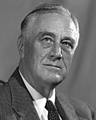
“We cannot always build the future for our youth, but we can build our youth for the future.”
- Franklin Roosevelt
Address, 200th Anniversary of UPenn
September 20, 1940

Slide 42
References:
“A Tale of Two Wolves” graphics:
https://www.thestressexperts.com/blog/a-tale-of-two-wolves
Primer: How To Start A Campfire | HiConsumption
Robert Barron quote:
Imprimis, Vol. 52, No. 6, Hillsdale College, June 2023.
Baden-Powell in America:
The Best of Boys’ Life, “Sir Robert Baden-Powell’s Message to the Boy Scouts,” Staff of Boys’ Life, Lyons Press, Guilford, CT, 2010, pp. 38-39.
Robert Barron photo:
Bishop Robert Barron – Diocese of Winona-Rochester — Church of the Resurrection – Catholic Church – (rescathroch.org)
Ethics and Morality graphics:
Code of Ethics vs. Morality: It Can Be Confusing (myrealestateauthority.blog)
Right Decision, Wrong Decision Road Sign – Malaysia’s Christian News Website (christianitymalaysia.com)
Accountant | Simply J Bookkeeping & Consulting | United States
Norman Rockwell and Joseph Csatari paintings:
www.scouters.us/artist.html

Slide 43
References:
A Game with A Purpose:
http://www.inquiry.net/ideals/scouting_game_purpose.htm
Baden-Powell: The Two Lives of a Hero, William Hillcourt, Gilwellian Press, New York, 1992.
Definitions of Ethics and Morality:
https://www.britannica.com/story/whats-the-difference-between-morality-and-ethics
https://en.wikipedia.org/wiki/Ethics
https://en.wikipedia.org/wiki/Morality
Summit Ministries Survey:
https://www.summit.org/about/press/poll-results-youth-abandoning-absolute-truth/
Josephson Institute Survey:
https://charactercounts.org/2012-report-card/
Photos of Eagle Scouts of Compromised Character:
https://www.mercurynews.com/2018/10/12/matthew-shepard-killer-russell-henderson-interview-20-years/
https://en.wikipedia.org/wiki/Charles_Whitman
https://en.wikipedia.org/wiki/Arthur_Gary_Bishop
https://www.wisconsinhistory.org/Records/Image/IM33877
https://www.cbsnews.com/news/eagle-scout-accused-of-thrill-kill/
https://www.nytimes.com/2014/01/19/business/eagle-scout-idealist-drug-trafficker.html
https://www.theadvocate.com/baton_rouge/news/article_7d8e8e9c-9d65-11e7-a156-53626665de7f.html

Slide 44
References:
Roger Chaffee:
http://history.nasa.gov/Apollo204/zorn/chaffee.htm
“Knights of Today”:
Walter MacPeek, in The Scout Law in Action, Walter MacPeek, ed., Abingdon Press, Nashville, 1966, Madawaska Times reprint, Madawaska, ME, pp. 117.
Aristotle image from site:
www.thocp.net/biographies/aristoteles.html
Aristotle background:
Nicomachean Ethics, Roger Crisp, Cambridge University Press, Cambridge, U.K., 2000, pp. vii-xxxvii.
Virtues/Vices and Internalizing Virtue Triangle:
www.bu.edu/education/caec/files/IVframework.htm
“Sermons We See” poem:
www.appleseeds.org/Guest_Sermons.htm
Winning and Bullies:
“How can I Matter if I Don’t Win?” Amy Baltzell, Character Newsletter, Fall 2005, Boston University Center for the Advancement of Ethics and Character, pp. 1-2.

Slide 45
References:
“The Boy We Want” poem:
The Book of Virtues, William J. Bennett, Simon & Schuster, New York, 1993, p. 196.
FDR quote:
Address at University of Pennsylvania | The American Presidency Project (ucsb.edu)
FDR photo:
1940 United States presidential election - Wikipedia
“Tufts Study Confirms: Scouting Builds Character in 6 Areas”:
http://blog.scoutingmagazine.org/2015/10/22/tufts-study-confirms-scouting-builds-character-six-critical-areas/

