Slide 1

GSC704 Getting Listed (on the Calendar)
National Capital Area Council
#ScoutingAtHome
BlackPug Basics for your District (or Council Committee / Program)

Slide 2
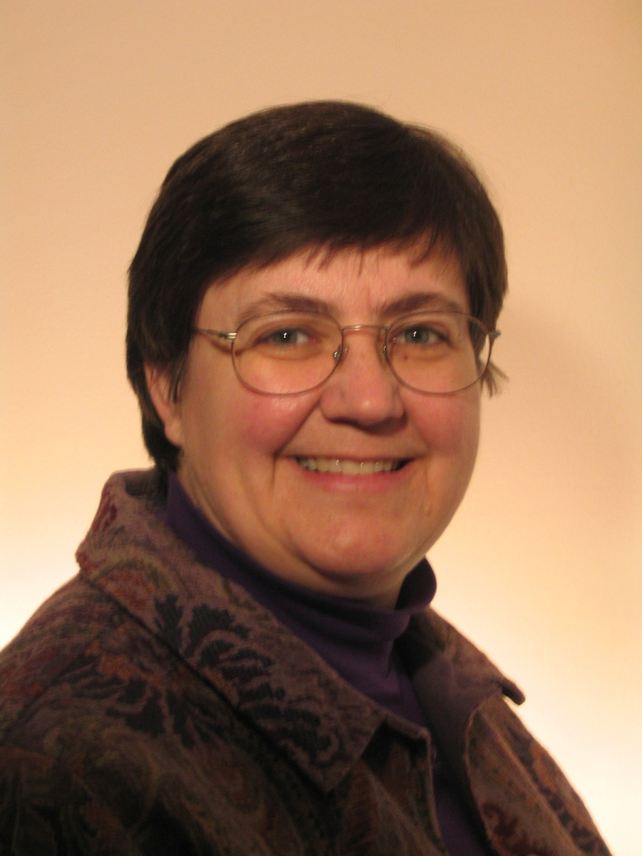
Who is Lynn?
Seneca District, Webmaster
Seneca District, Assistant Cub Scout Roundtable Commissioner
Scouting family with two Eagle Scouts
Registered Scouting leader since 1994
Lynn Hamilton
Ping in Basecamp or Email: lynn.hamilton5@comcast.net
Cell: 301-758-1085

Slide 3
Today’s Agenda
What is BlackPug?
Why are we using it?
Getting Started
Open Q&A
Reporting Favorites for reference

Slide 4
What is BlackPug?
https://247scouting.com/
Anything that collects money at district or NCAC level must use BlackPug.
If you want to play without touching real world?
https://demo.247scouting.com/

Slide 5
Why are we using it?
What goes in BlackPug?
Money collecting events
Calendar items (select between basecamp or BP)
  Schedule of your “not-all-the-world-is-invited” meetings

Slide 6
Getting Started
Contact to get BlackPug access
Cynthia Griffiths – Chief Communications Officer
  Cynthia.Griffiths@Scouting.org
Lynn Hamilton – BlackPug instructor/Seneca Webmaster
  Lynn.hamilton5@comcast.net
Diana Medina
  Diana.Medina@scouting.org

Slide 7
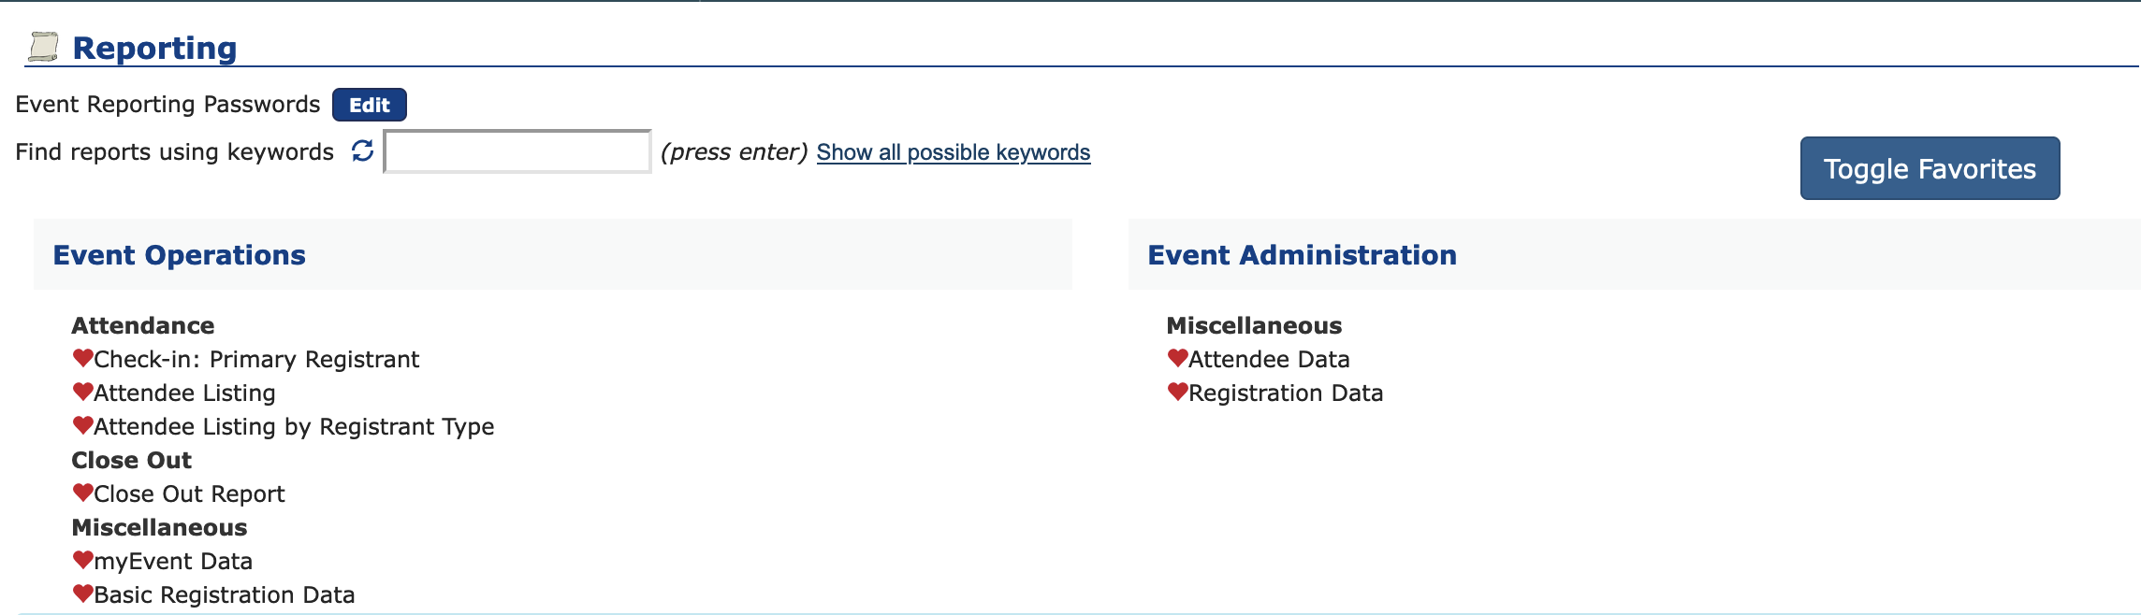
Reporting Favorites
These are my personal favorites

Slide 8
Thank You.
National Capital Area Council
#ScoutingAtHome

