Slide 1
­2025 National Capital Area Council
University of Scouting – College of Scouts BSA
BSA 403
Troop Record Keeping
James Dunham
mma90wbu95@gmail.com
Aquia District

Slide 2

Troop Record Keeping
National Capital Area Council
University of Scouting
James Dunham
NCAC Advancements Committee
Aquia District Membership Committee
UoS 2025
Notes:
1

Slide 3
Course Catalog
This session discusses the need for keeping timely and accurate records of a unit’s finances, as well as the attendance and advancement of each Scout. The different forms of records – paper/computer – will be reviewed. Council requirements for advancement reports and re-chartering will also be addressed.

Slide 4
Agenda
The Why, Who & How of record keeping
Forms, in general
Registration Form – “where it all begins”
Advancement (& Automated Record Keeping)
Medical Forms
Rechartering
Financial

Slide 5
Why Keep Records?
Youth protection
Adult protection
Risk management and preparedness
Conduct of scouting methods
Affirmation and renewal of scouting aims

Slide 6
Who Keeps Records?
Youth and Adult members
Scoutmaster
Committee Chair
Merit Badge Counselor
Activity Coordinator & delegates
Advancement Chair/Coordinator
Treasurer
Chartered Organization Rep

Slide 7
Record Keeping … How?
Scouts BSA – National level
  Standard formats which convey information outside the unit
  Authentication, preparation & documentation -- tied to “why”
Automated Troop Record Software
  Convey information from one purpose to another, easily
  Supports many troop functions
  Relieves volunteers of administrative workload
Hardcopy Troop Records
  OK for smaller units

Slide 8
BSA Forms
No job is finished until the paperwork is complete
All Forms Must be …
  Accurate (don’t estimate)
    Don’t use “Approximately 15 Scouts and 4 Adults”
  Legible (typed or printed is best)
    If your intended audience can’t read it …
  Complete (don’t submit a partial form)
  So, where do we get the forms ?

Slide 9
Finding Scouting Forms
Ask yourself – or someone else – who owns it?
  National ? … Council ? … District ? … Unit ?
District Executive or District Chair
Council Office
  Marriott Scout Service Center
  9190 Rockville Pike Bethesda, MD 20814-3897
Council Website
  ncacbsa.org … search for ‘forms’ or ‘resources’
  Or, determine the ‘owning’ committee
Scouting America National Website
  scouting.org/resources/info-center/forms/
  Alternatively … ask yourself which committee/program would likely ‘own’ it?

Slide 10
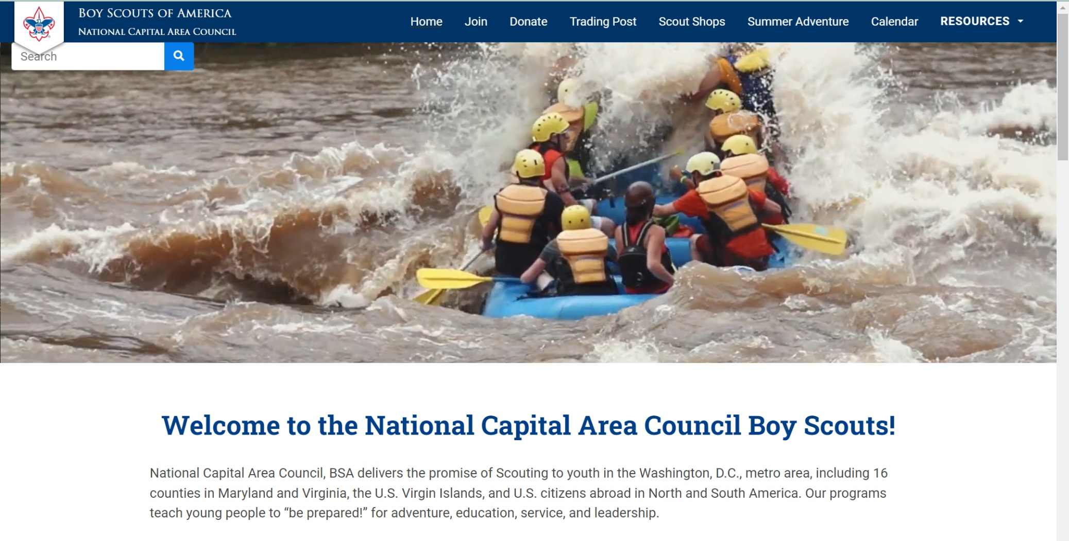
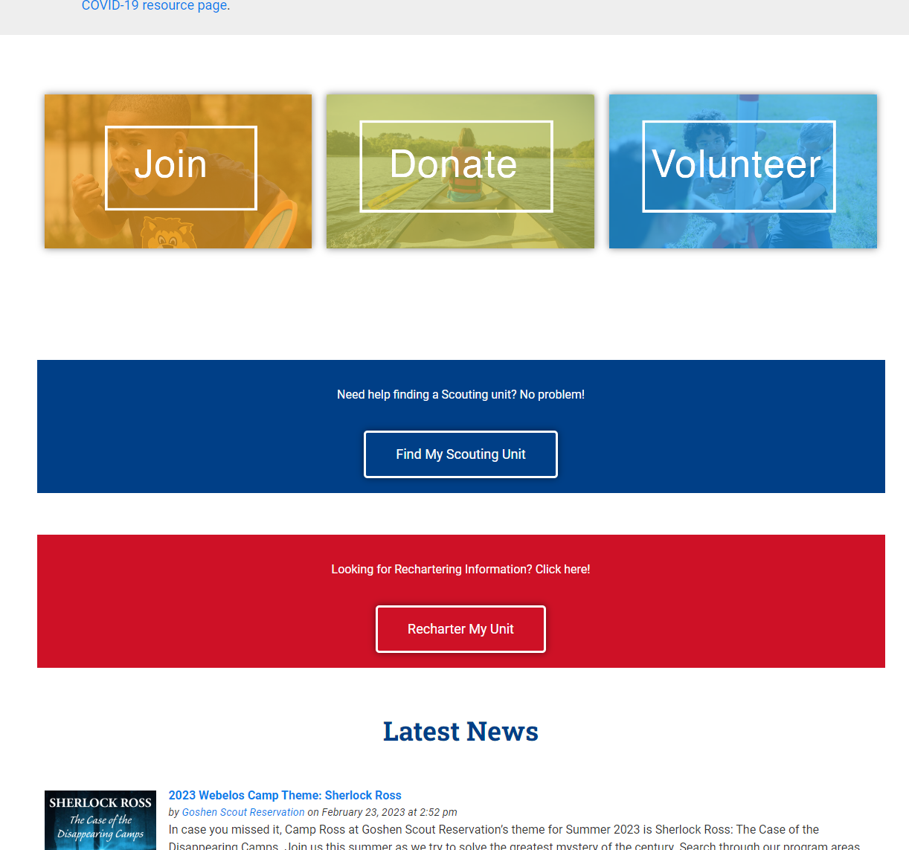
NCAC’s Website
<Search>
https://www.ncacbsa.org/

Slide 11
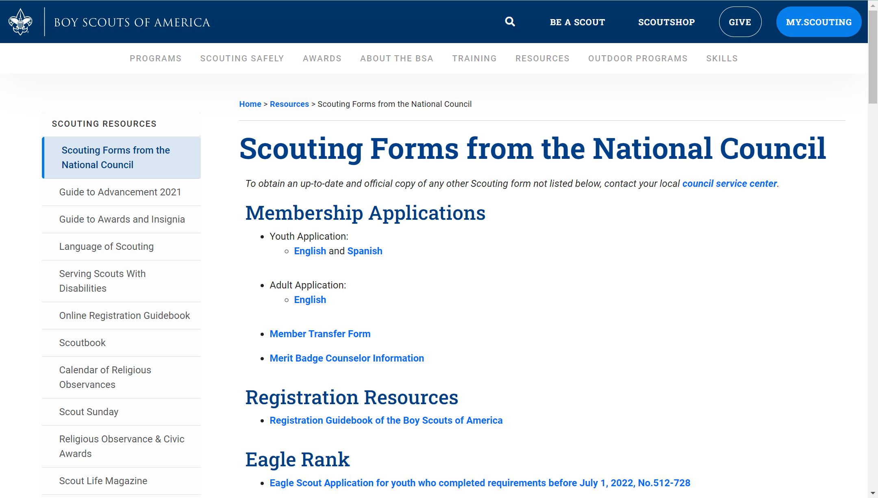
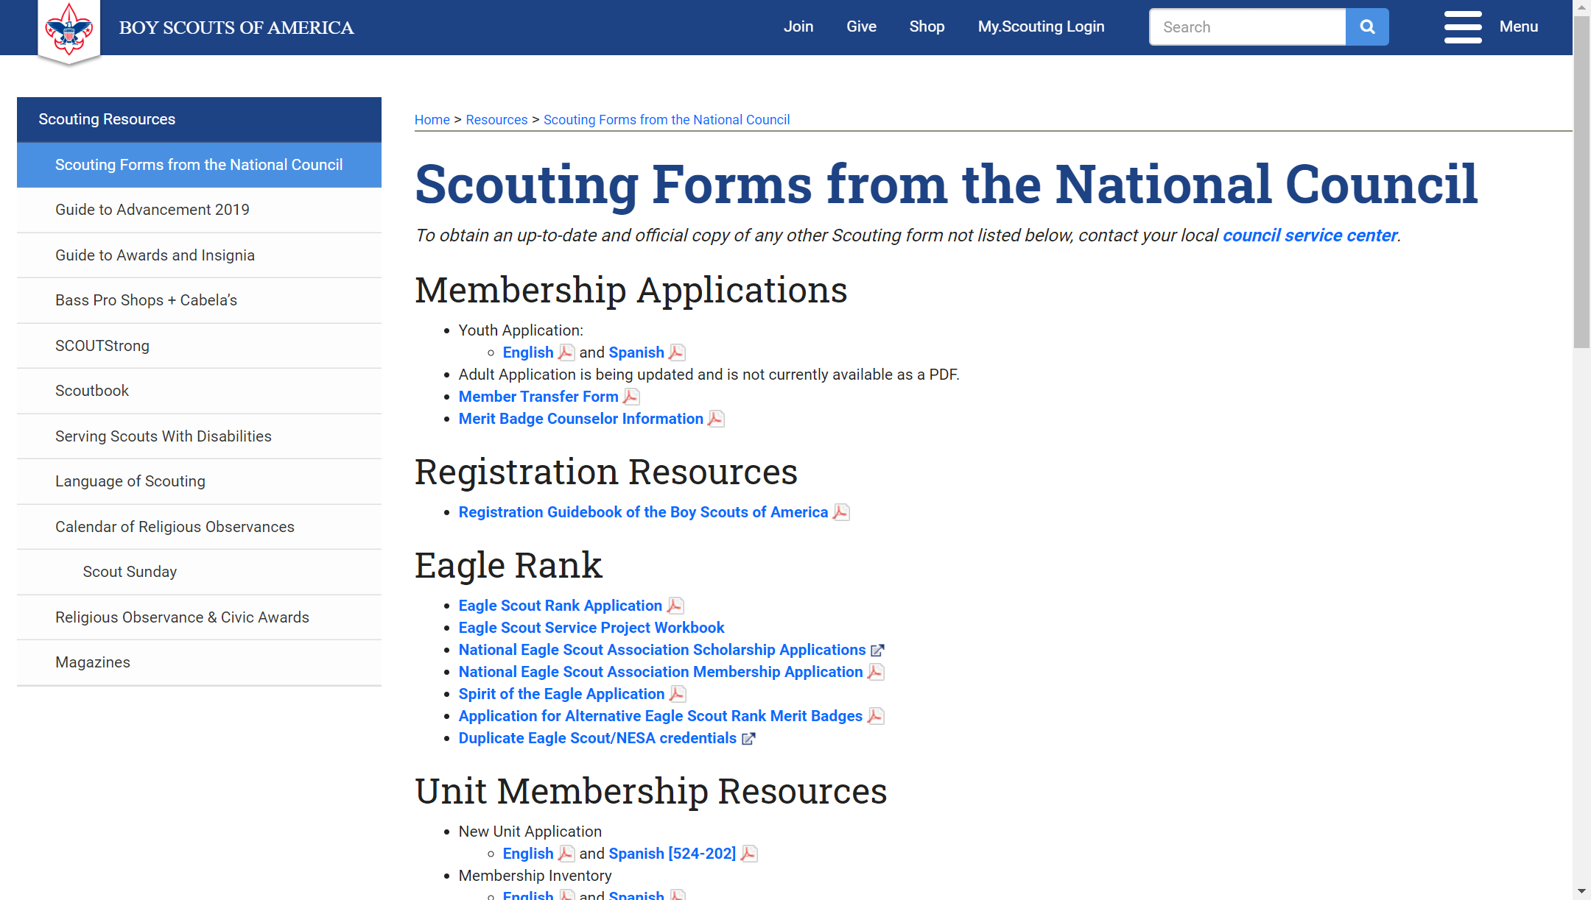
National’s Info Center Website
And further down the page …
Unit Resources
&
Awards
https://www.scouting.org/resources/forms/

Slide 12
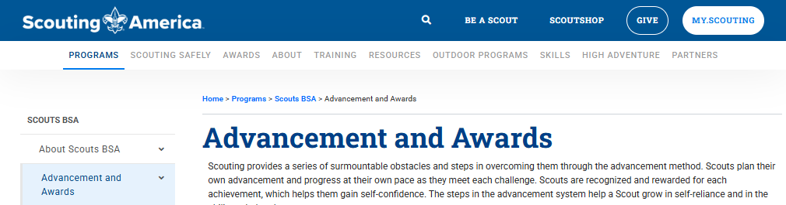
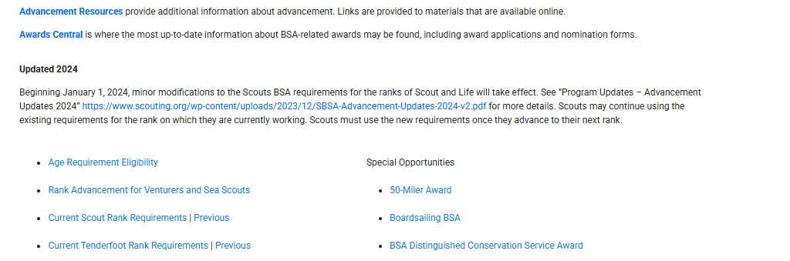
National’s Advancement Site
. . .
… and then toward the bottom of the page … .
. . .
https://www.scouting.org/programs/scouts-bsa/ Advancement-and-Awards/

Slide 13
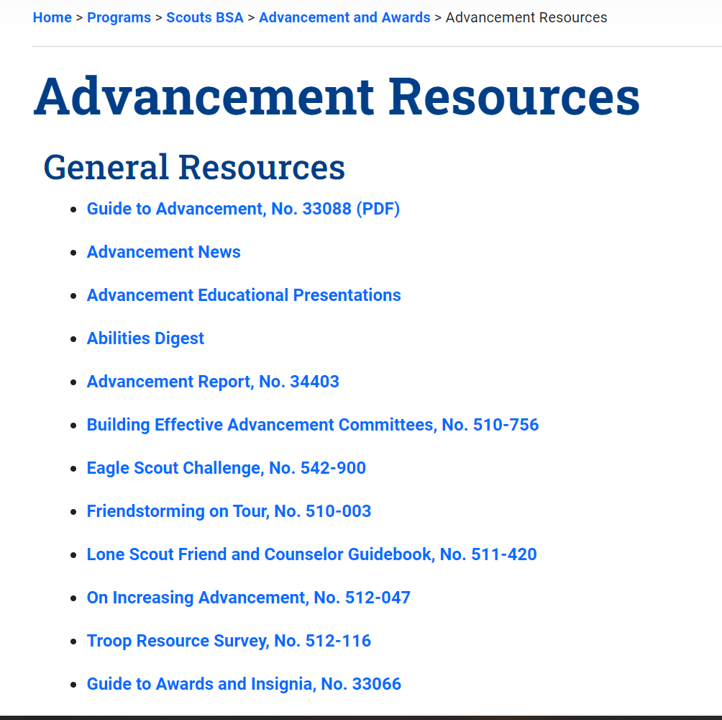
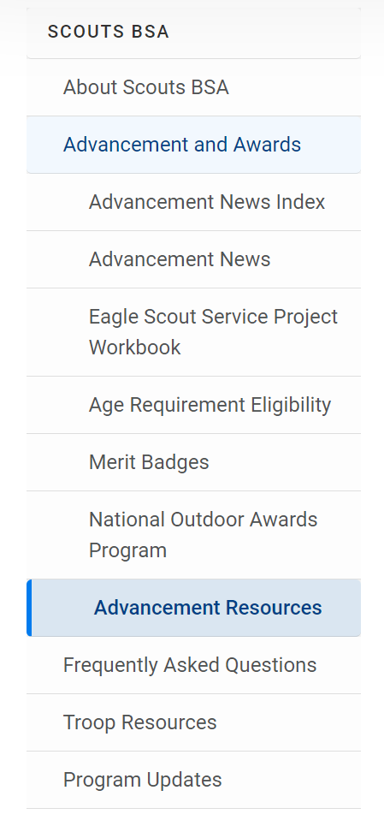
National’s Advancement Site
And further down the page …
Rank Advancement Forms
Merit Badges

Slide 14
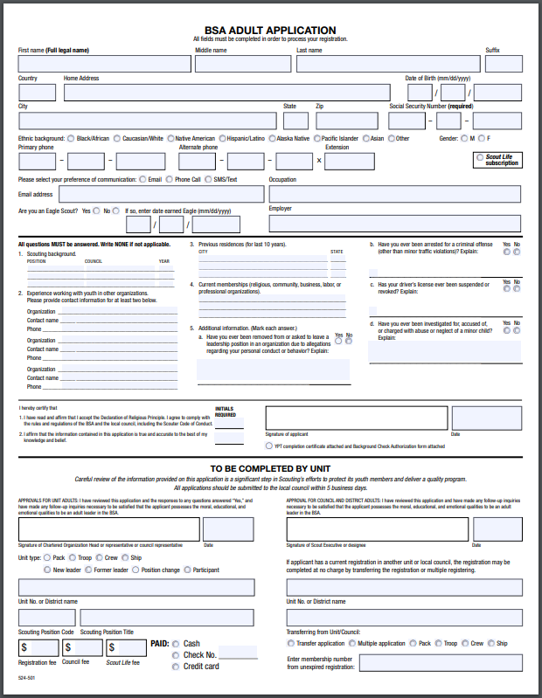
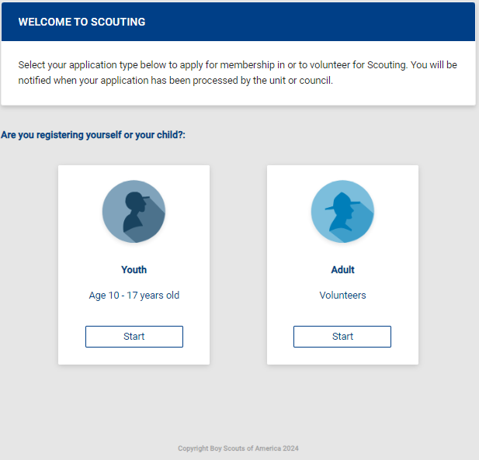
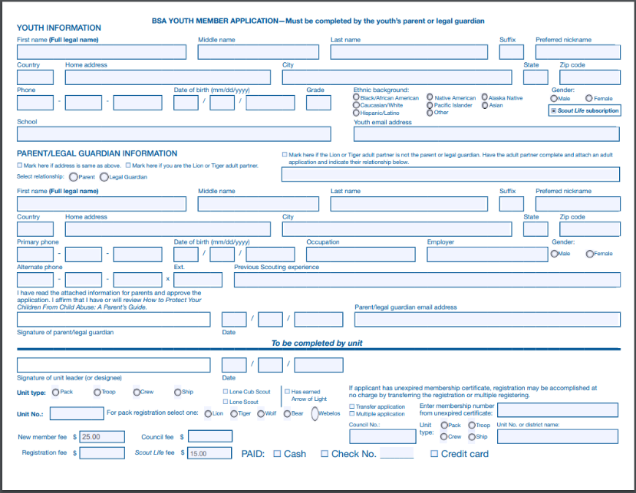
Scouting Membership Application Forms
Paper Forms
Online Application
Online Applications Superior to Paper

Slide 15
Scouting Membership Application Forms
Establishes identity in the Scouts BSA database
  Troop … District … Council … National
Information will follow you throughout your involvement in Scouting
  Name
  Personal ID (a.k.a. Scouting ID#)
  Training
  Unit (+) databases will be updated using the initial information provided on the applications.

Slide 16
Scouting Membership Application Forms
Using different information, such as nicknames, etc. makes it difficult to locate your Scouts or Scouters in Council or National databases.
  Internet Advancement & ScoutBook
  Internet Rechartering
  My.Scouting.org Training Database
  Only use abbreviations or acronyms if you are sure they are understood by all who view the form, or are already defined on the form

Slide 17
Scouting Membership Application Forms
When in doubt, spell it out
CC = Committee chairman
MC = Committee member
SM = Scoutmaster
SA = Assistant Scoutmaster
NL = Crew Advisor
NA = Crew Associate Advisor
SK = Skipper
MT = Mate
42 = Merit badge counselor
UP = Unit Participant
Read the form.
  Don’t assume someone else will complete the missing information
  Fill in references; always
  Double-check Dates

Slide 18
Scouting Membership Application Forms
Social Security Number is required on all first-time adult registration forms
Date of Birth is required on all registration forms
Use suffixes (Sr, Jr, II, III, etc) as appropriate
Don’t use nicknames
Scouting professionals have many responsibilities.
  Data entry is not one of their favorites.
  When they can’t read the scribbles, they will guess rather than trying to verify the information
Print all the information on the form … clearly
  If you can’t read it, chances are council can’t either.

Slide 19
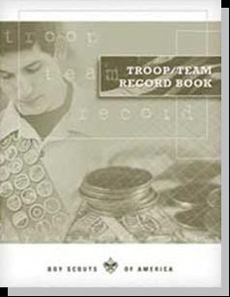



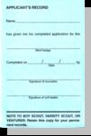
Individual Record Forms
Who keeps them?
Paper
  Troop Record book
  Individual Scout Record
  Internet
    Scout Handbook
    Merit Badge Blue cards
    Rank Pocket Certificate
  Coordination between in-contact leaders
How are the records kept?

Slide 20

Automated Troop Record Keeping
  Desktop Options Abound
  ScoutBook (Owned by BSA … and free)
    ScoutNet/Akela certified
  Troopmaster 20xx (Troopmaster Software, Inc)
    ScoutNet/Akela certified
    Troop and Venture Crew entries
  Web Search will reveal others (simply look for “Akela” (or perhaps “ScoutNet” ?)

Slide 21

BSA Record Standards
Akela
(nee ‘ScoutNet’)
  BSA's computerized record keeping system makes it possible for all councils to keep their records in a standard information format
Internet Advancement
Desktop SW Programs
SB
TM
TT
etc

Slide 22
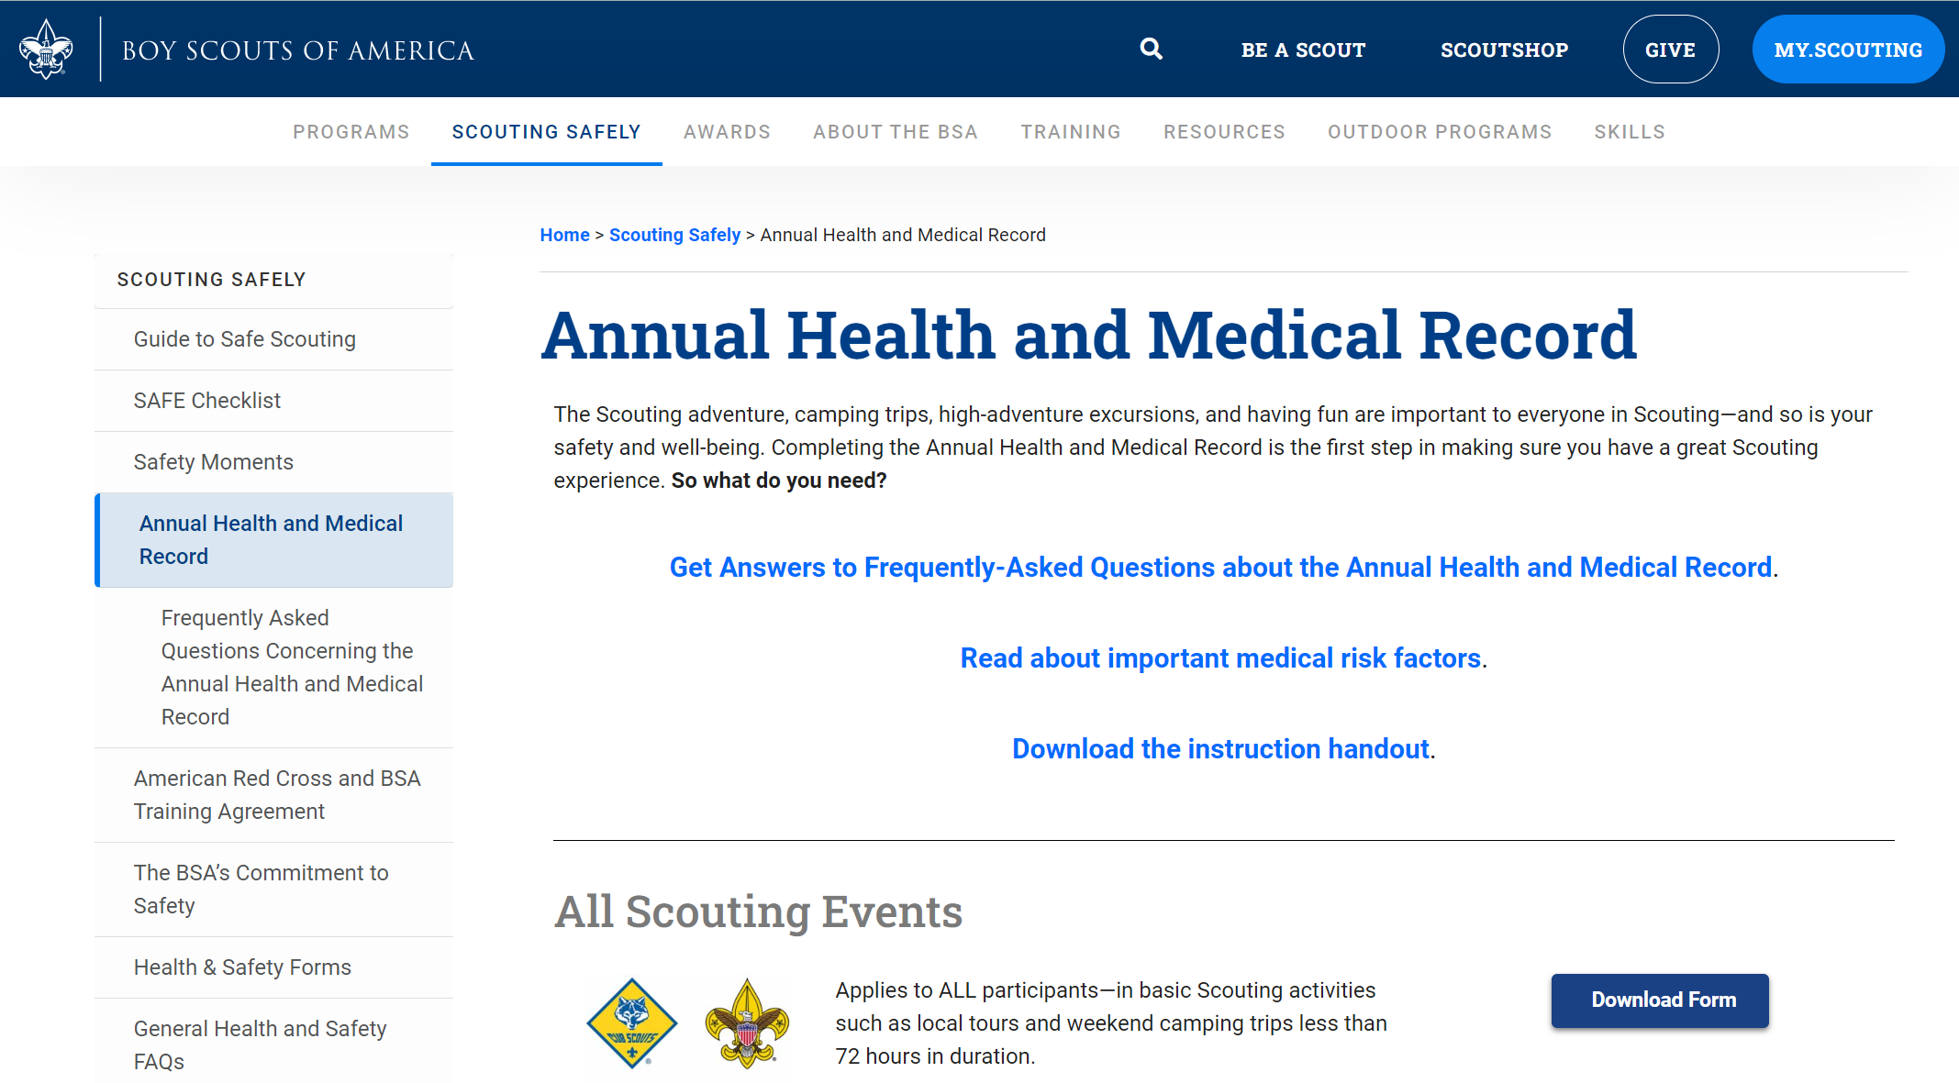
Annual Health & Medical Records

Slide 23
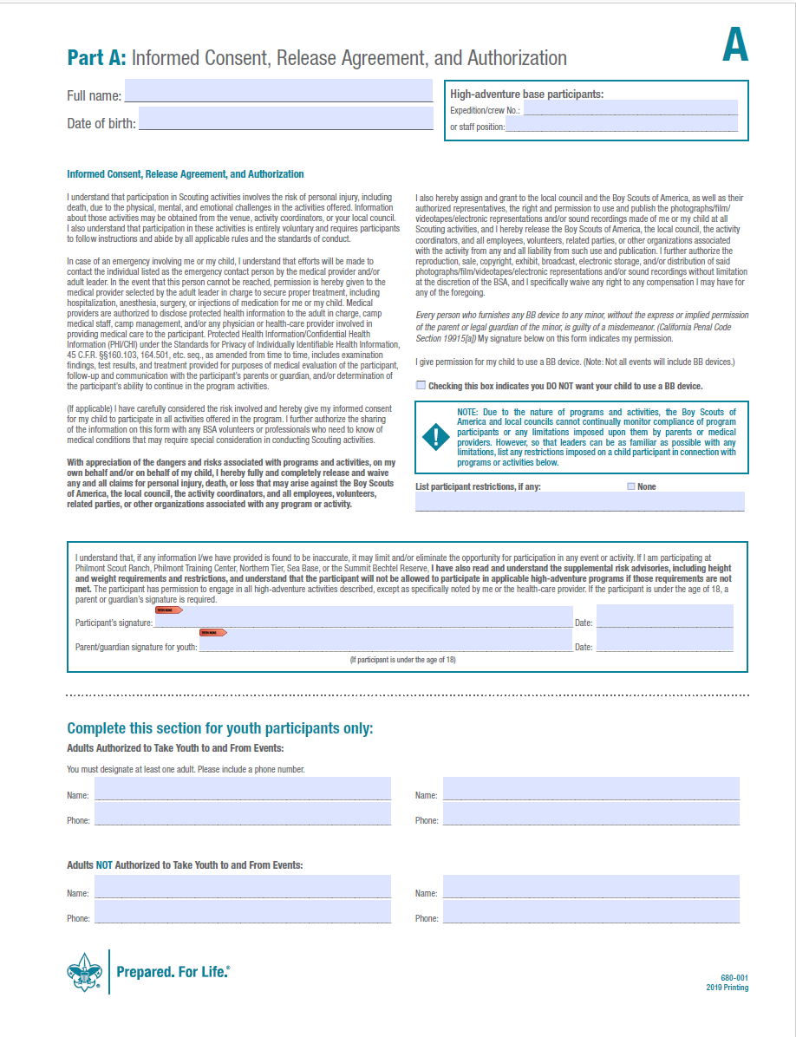
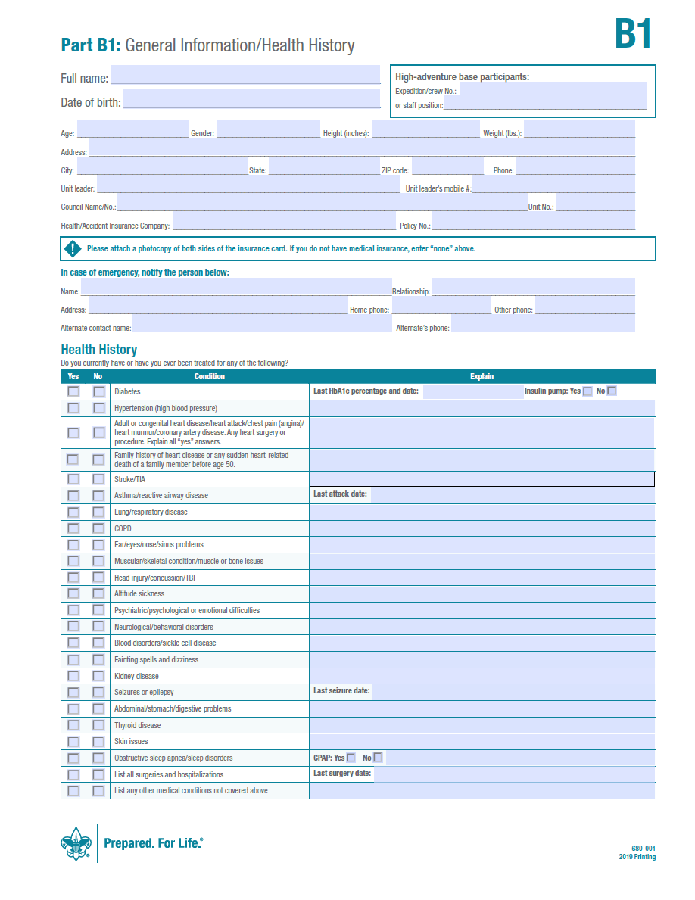
Medical Forms – 2019 Printing
How are the records kept?
https://www.scouting.org/Health-and-Safety/ahmr/
Parts A & B are to be completed annually by all unit members
Informed Consent/Release
Food allergies
Medicines
A

Slide 24
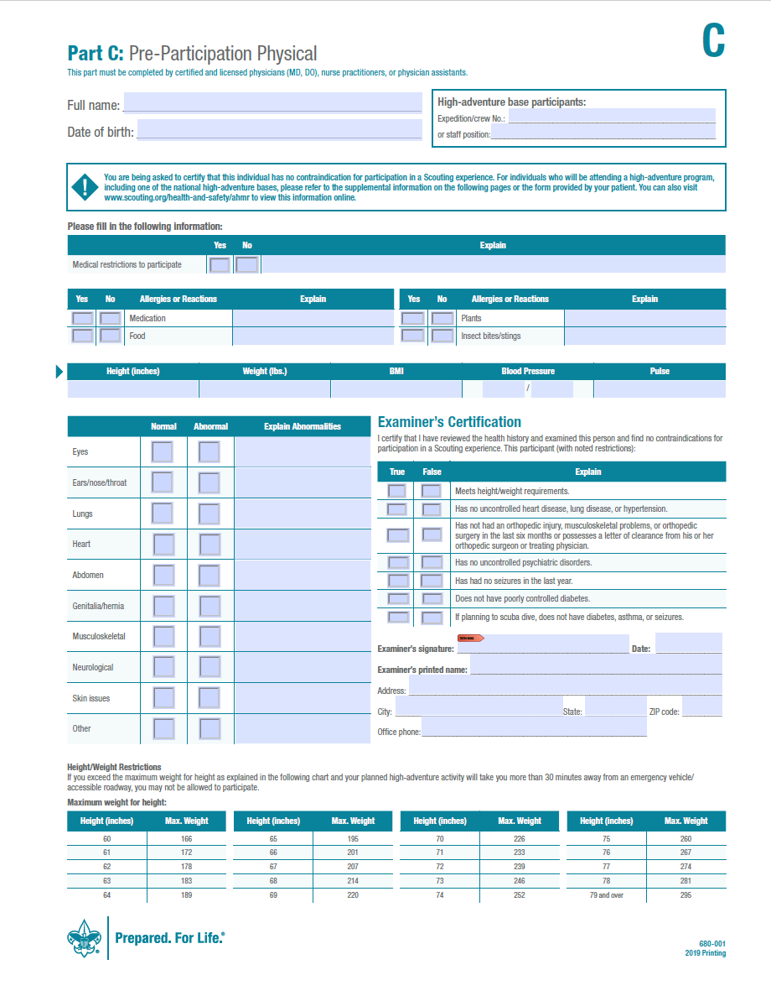
Medical Forms – Part C
680-001 Part C is required with parts A and B for any event that exceeds 72 consecutive hours or a resident camp setting.
Must be completed annually for these types of events, by certified and licensed physicians (MD, DO), nurse practitioners, or physician assistants for everyone
High adventure camps carry unique medical qualification forms available at:
  http://www.scouting.org/Health-and-Safety/ahmr/
C

Slide 25
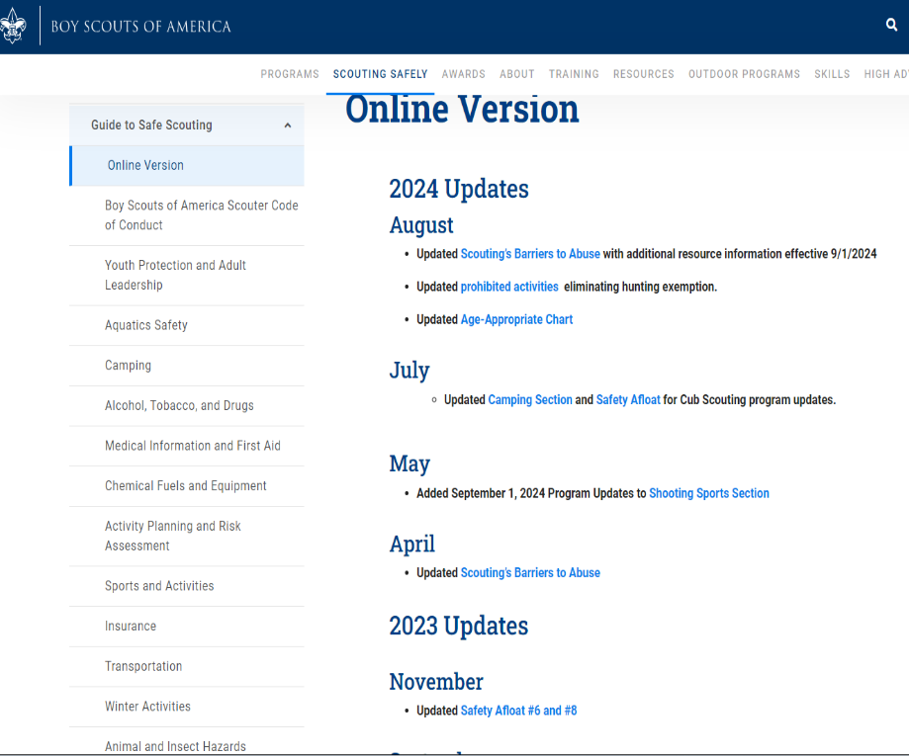
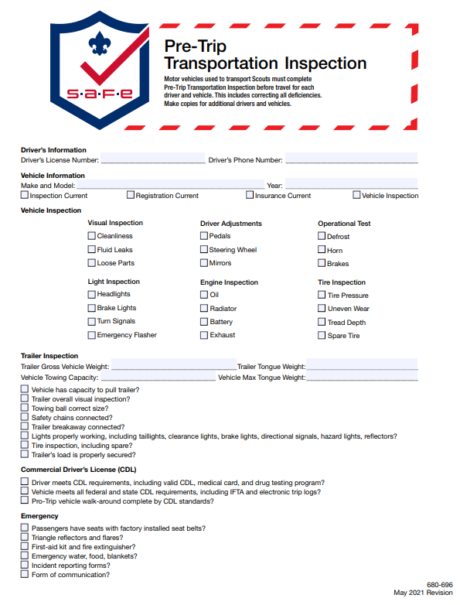
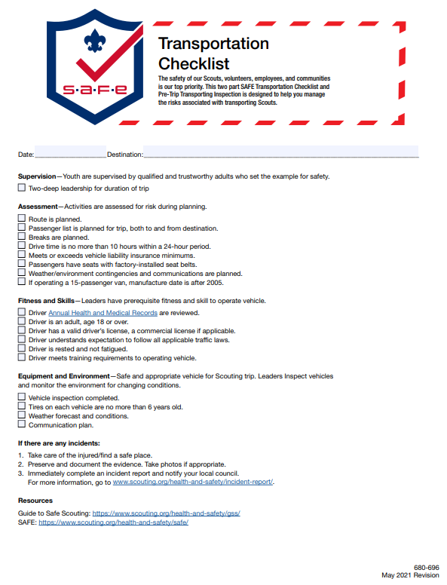
Guide to Safe Scouting/Health and Safety
https://www.scouting.org/health-and-safety/resources-forms/

Slide 26
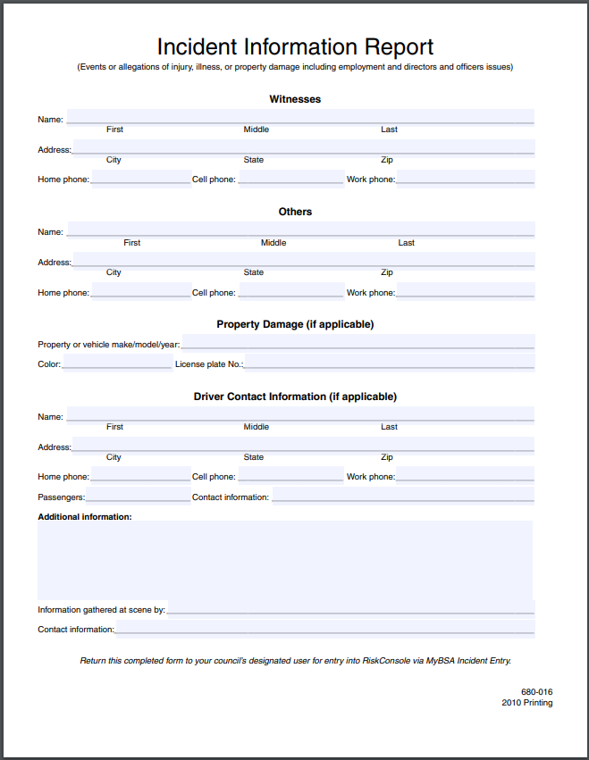
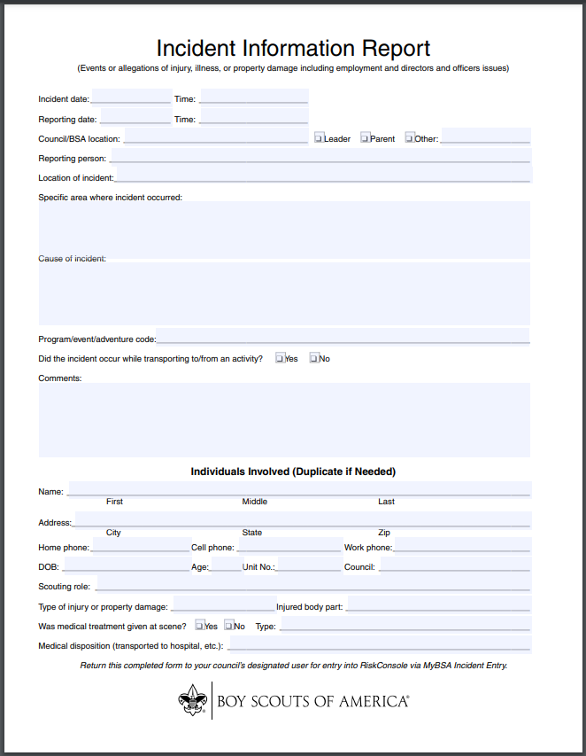
Accident and Near Miss Reporting https://www.ncacbsa.org/wp-content/uploads/2020/03/Incident-Report-680-016_fillable.pdf
Incident Reporting: Timely, clear, concise, and complete incident reports allow for an appropriate response and an opportunity for analysis while promoting continuous improvements of our programs.
When to filled out: Situation dictates. As soon as safe to for major incidents. Scout rendered First Aid with in 24 to 48 hours. Near miss within 30 days.
Why should it be filled out: It formally documents the accident or near miss, and shows what actions lead up to the incident and what actions were taken.
WHEN IN DOUBT FILL IT OUT!

Slide 27
Rechartering
1. Internet update using unit software.
  Update unit records from wherever you have Internet access and update council records directly from your unit management software.
  If your unit records are up-to-date, this is the fastest and easiest way to renew your unit charter.
2. Internet update without unit software.
  Do you have computer and Internet access?
  You update your unit records by entering the data online.
Seek out your Unit Commissioner and start/complete early

Slide 28
Rechartering (cont’d)
Common mistakes to avoid
You must have five paid youth members*
Changes/deletions to the field sheets
Adding members and leaders
  New members can only be added by using a paper Scouting America application
Must have the signature of the Executive Officer of Charter Organization, or the COR
All monies must be paid in full … best to pay by check, not Credit Card!
* 3 dual-registered OK as long as 2 primary-registered

Slide 29
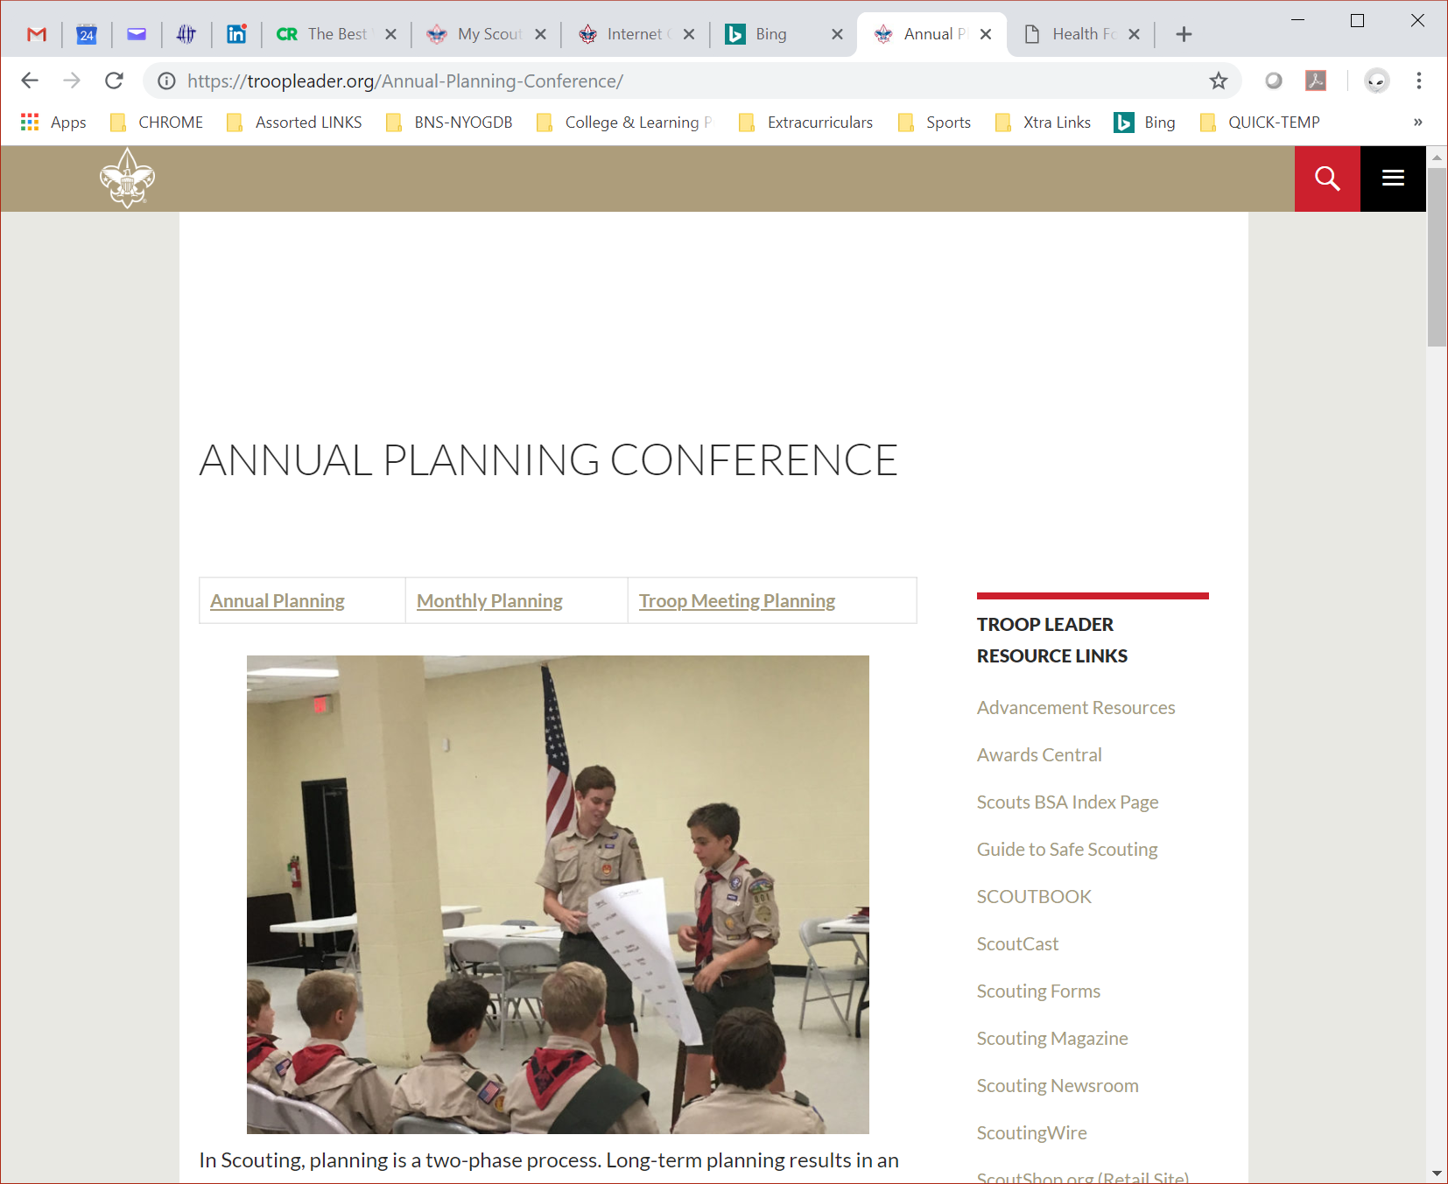
Annual Program Records
TroopLeader.org/Annual-Planning-Conference/

Slide 30
Annual Program Records (cont’d)
Research Results …
  A common element of strong troops is they all have a good annual program planned a year in advance … shared with all families via a calendar.
  A shared annual program calendar will attract more families and Scouts will stay involved longer
A key element of all successful troops; their annual program plan & planning conference

Slide 31
Program Planning Conference
Preparations
  Gather key info
  Discuss with SPL
  SPL shares with PLC+
  Conference Invites to
    Youth Leaders
    Committee
    ASMs
    Unit Commissioner (opt)
    Others?
The Conference
  Unit goals discussion
  Share draft calendar
  Discuss dates & events
  SPL shares ideas/ desires of youth
  Other important dates
    Open House, W2S Xtn,
    BORs, COHs, Service
  Final discussion & vote
  Share it!

Slide 32
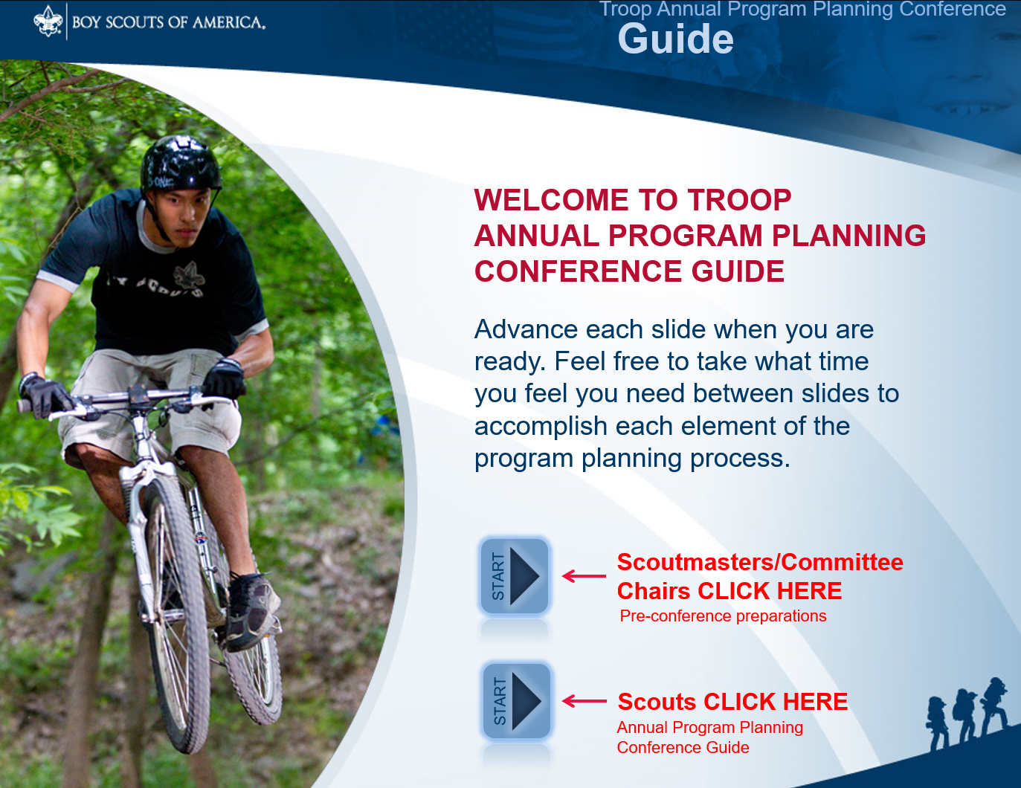
Troop Financial Records
Coordinate unit fundraising – Guide to Safe Scouting
  “… all unit fund raisers must obtain written approval from the local council not less than 14 days before the fundraising activity.” – Unit Money-Earning Application, BSA 34427
Unit budget records
  - BSA 510-275, Budget Guide
  https://filestore.scouting.org/filestore/boyscouts/pdf/510-275-BudgetPlanning.pdf
  - Annual Program Planning
  Conference Guide (interactive PPTX)
  https://filestore.scouting.org/filestore/boyscouts/pdf/510-275-BudgetPlanning.pdf

Slide 33
Troop Financial Records
BSA 510-277, Troop Operating Budget Worksheet
EXPENSES
INCOME
IF THESE DON’T MATCH, THE COMMITTEE AND UNIT LEADER MAY HAVE WORK TO DO!

Slide 34
BSA Forms Recap – Why ?
Youth protection
  Registration
Adult protection
  Training and tour permits
Risk management and preparedness
  Guide to Safe Scouting: www.scouting.org/scoutsource/HealthandSafety/GSS/toc.aspx
  Tour permits and medical forms
Conduct of scouting methods
  Unit management and advancement records
Affirmation and renewal of scouting aims
  Rechartering

Slide 35
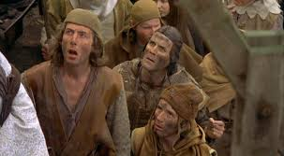
Any Questions?
Thank you for YOUR Service!

