Slide 1
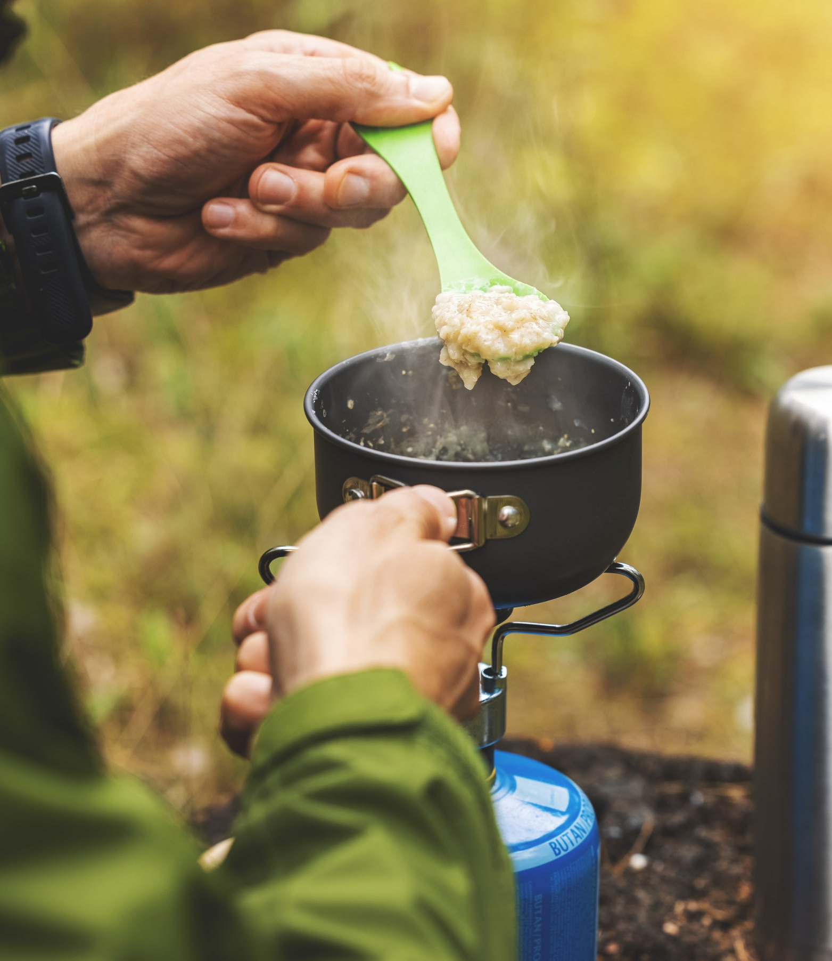
Trail Cooking Safety
University of Scouting
NCAC
Feb 2025
Notes:
Introduction
Objectives:
Adult roles in meal planning, prep and safety
Focus on the trail where weight and gear, safety challenges, are factors

Slide 2
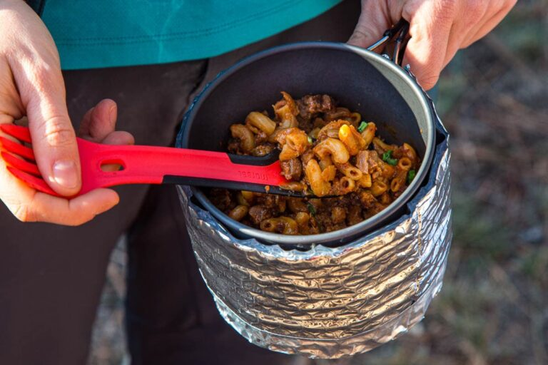
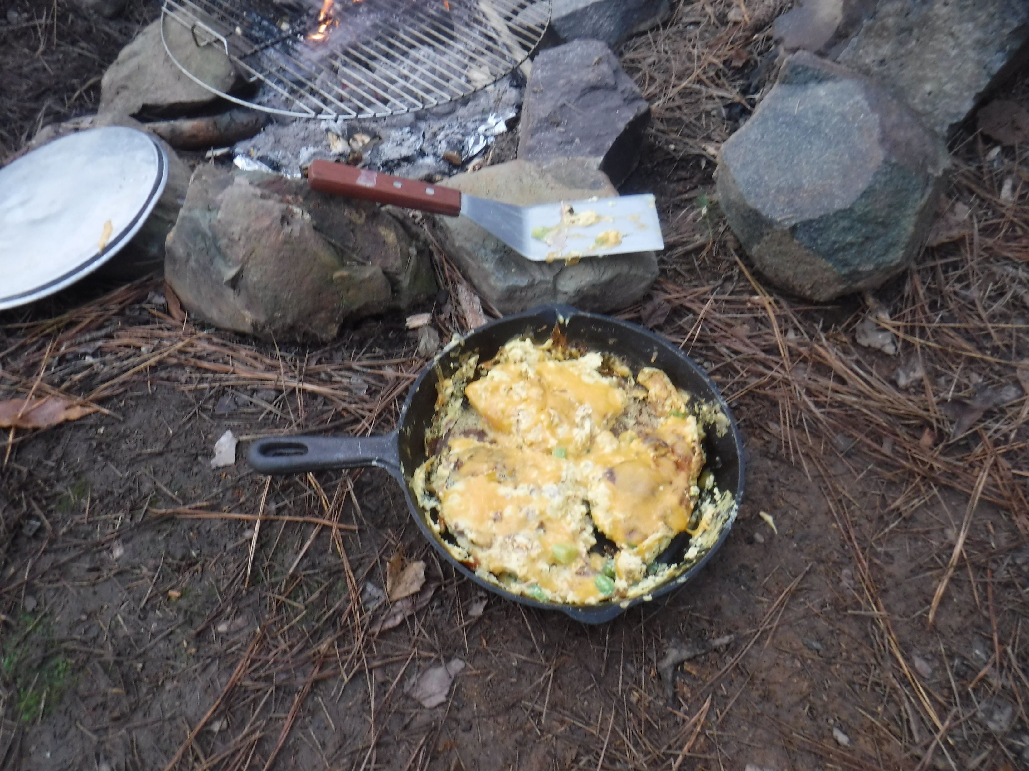
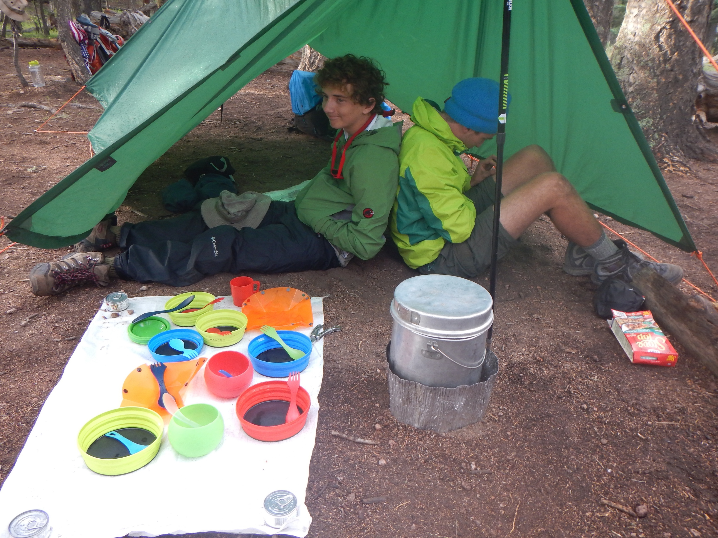
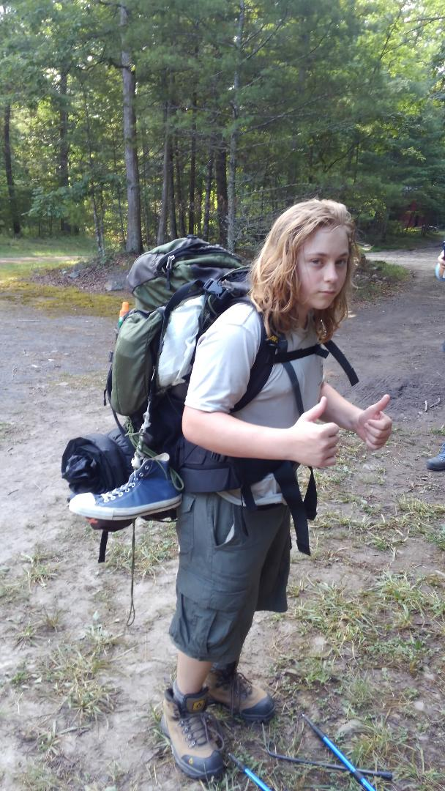
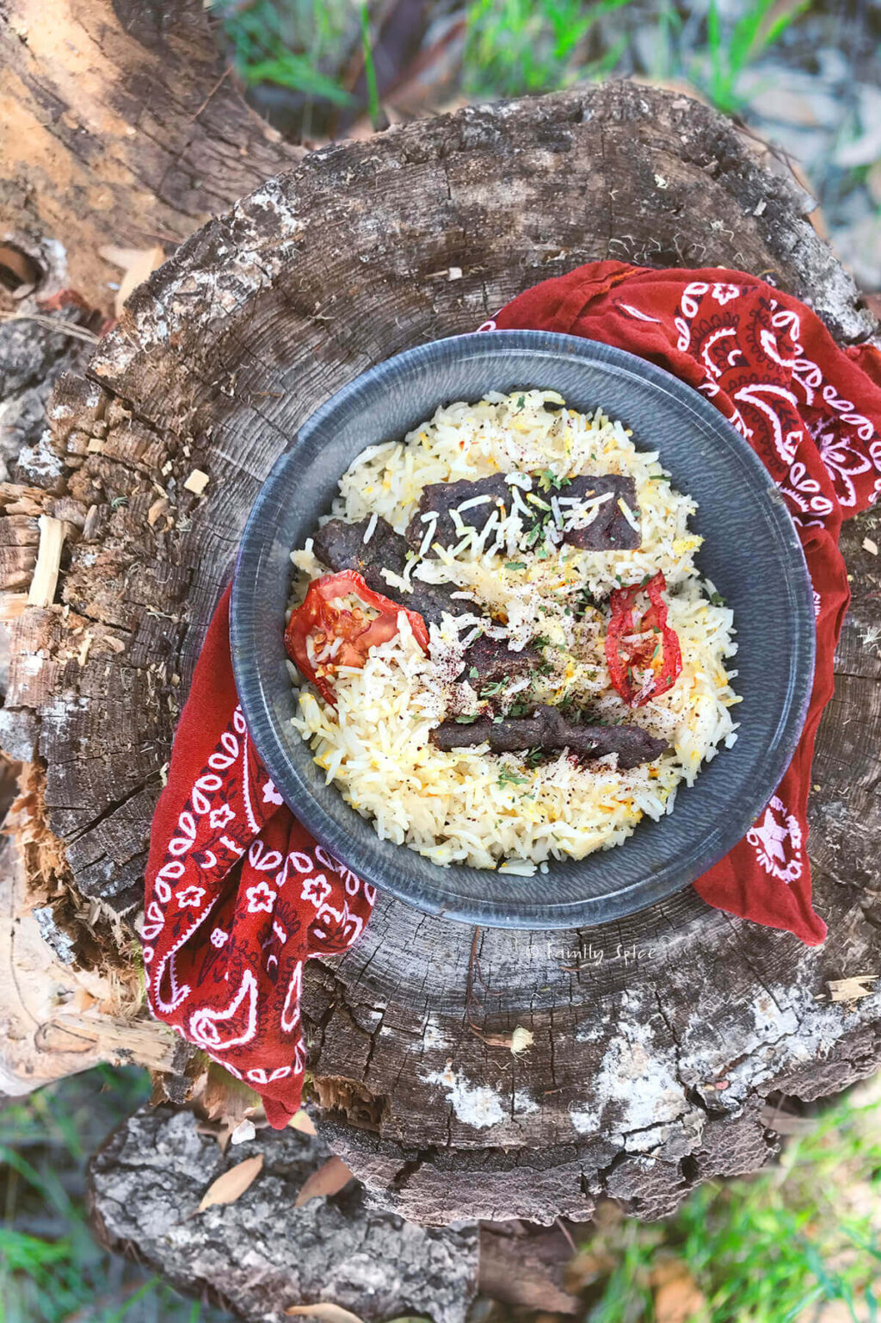
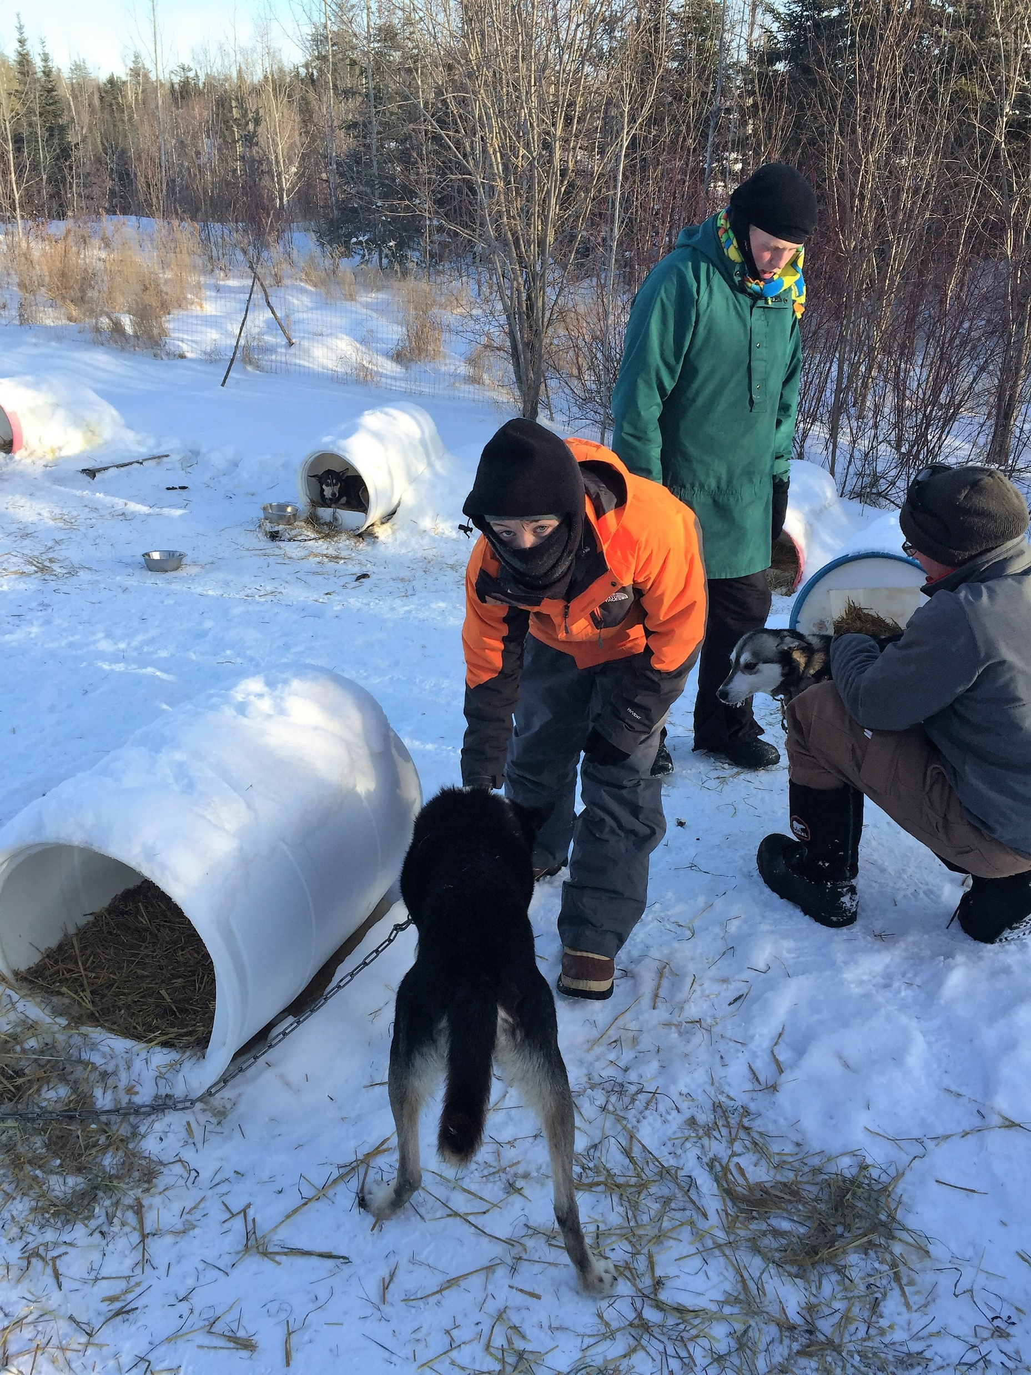
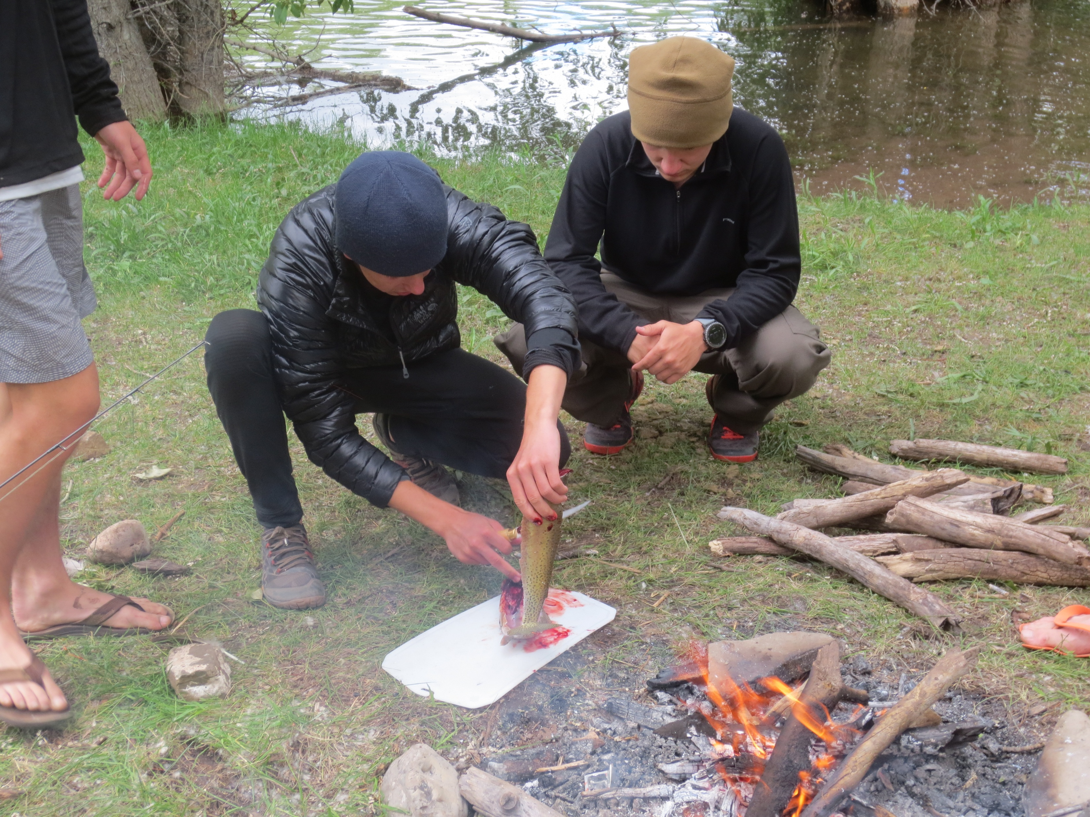
Cooking Outdoors is Essential to Scouting

Slide 3
Where Trail Cooking Fits In
Physical Fitness
Planning
Daily Conditioning
Shake-Downs
Program vs. Event
Medical Exams
Terrain Profile
Medications
Knowledge
Time Control Plan
Balanced Menus
Contingency Plan
Wilderness First Aid
Personal Hygiene
Ball-out Plan
Menu Plan
Equipment
Risk Mgmt
Personal Gear
Leave No Trace
Leadership
Crew Gear
Safe Food Handling
Packing
Interpersonal Skills
Field Maintenance
Team Building
Stoves & KP Gear
Team Dynamics
Skills
Stages of Team Devel
EDGE
Model Campsite
Initiative Games
Site Selection/Campsite Set-up
Morale
Cooking & Clean-up
Land Navigation Tools
Notes:
Ask for biggest concerns (student input 3-4)
Focus on adult roles:
Scout Leadership (Guide/Advise): Team Building/Team Dynamics
Monitor/Prioritize Safety: Fitness/Conditioning, Food Handling, Equipment Use & Repair
Review Planning: Menus, Time, Quantity
Develop Discipline: Shakedowns, Skills
Consider Cooking Merit Badge requirements:
Plan a meal for trail hiking or backpacking that includes one breakfast, one lunch, one dinner, and one snack
Must consider weight, not require refrigeration and feed 3-5 people
List the equipment and utensils needed
Create a shopping list with amount of food for each meal, and the cost
Share and discuss your meal plan and shopping list with your counselor
Include how to repackage foods to limit bulk, weight, and garbage
While on hike, prepare and serve 2 meals and a snack from the plan – 1 over a fire or a trail stove

Slide 4
How It Fits Together
Relax, Recreate & Re-fuel
Proper
Clean-up
Good Morale
Good Food
Prep
Health & Safety
Planning
Notes:
Importance:
Fuel for activity
Time factor in overall event planning (quick or main event)
Safety, especially in prep and clean-up
Factor in group morale (positive and negative): coming together after a long day versus food not liked / prepared well
Honoring dietary / religious limitations
Well distributed / quick work – versus a chore
Skills development & Leadership

Slide 5
Menu Planning
Trek Type | Backpacking Canoeing | Lightweight, Min Bulk Heavier, Bulkier
Length | Longer | Planning Crucial
Experience | Low High | Prepackage More Complex
Weather | Cold or Wet Hot | High Energy, Warm (Soups) Light, Tasty, Liquid
Weight: 1½ - 2 lbs/person/day
Address religious, health & personal taste -- Ask
The longer the trek,
the more important menu planning is
Notes:
Trek type
Differing means of moving from one place to the other impact what’s sensible
For backpacking the emphasis is on light weight and minimum bulk.
Canoeing, you have a bit more latitude and can use slightly heavier and bulkier food and equipment, although you can’t get too carried away.
What about sailing or dog-sledding?
Length - As the length of the trek increases planning becomes more crucial.
Crew Experience
Less experienced crews success is more likely if more prepackaged meals like those from the outdoor stores are used more often.
As the crew gains experience more complex approaches can be used leaning toward meals totally planned by the crew and bought from the supermarket or ethnic stores. Adult input on complexity.
Weather
For cold, wet situations use a lot of hot soups and high energy foods to keep the crew well fueled.
In hot weather appetites may be depressed so food needs to be lighter and tasty to ensure that everyone eats enough to maintain their strength.
Weight - Figure on about 1 1/2 to 2 lb per person per day.
Religious and Health
Be sure to meet the religious and health needs of everyone.
Food allergies like lactose intolerance are not all that uncommon.
Make sure no one is made to feel uncomfortable if they have special needs.
The best way to find out is to ASK. The time to find out someone has a special need is not on the second day of a ten day trek.
The longer the trek, the more important sound menu planning is.

Slide 6
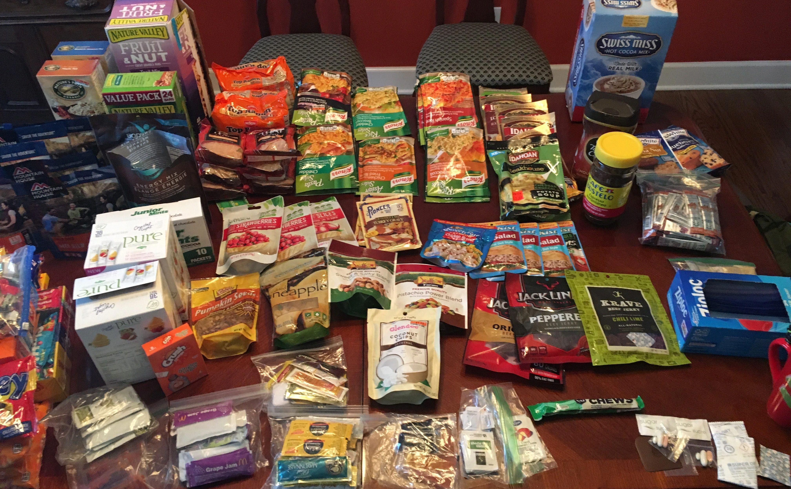
Approximate Fuel Mix
50 % Carbohydrates
  Fast Energy
25% Protein
  Body Repair
25% Fat
  Slow Burning
Figure 3000 - 5000 Cal/day
Must provide the fuel mix to meet the physical demands of the trek
Notes:
Mix of fuel types is important
Approximate % based on calorie content and how the body uses them
Scout activities are often strenuous and last of extended periods of time
Often located away from ready food sources – plan for meals and snacks integrated with the activity plan
Need to handle and store food correctly – limits grazing habits of some Scouts – eat when its time to eat
Figure about 3000 – 5000 calories per day – General rule about twice normal activity
Level of activity – easy, moderate, strenuous – as well as weather conditions will affect calorie requirements
Observe eating habits, likes and dislikes, to ensure appropriate eating to last the entire trek
You must be sure to provide the fuel to meet the physical demands of the trek.
Shakedowns vital to home in on correct calories for longer treks
NEED I MENTION THE IMPORTANCE OF HYDRATION?
Carbohydrates include candy, fruit, honey, cereals, pasta, and other starches.
Protein includes meats, cheese, peanut butter, and oat and wheat cereals with powdered milk.
Fats include bacon, margarine, butter, nuts and salami.
Obviously some foods like meat or peanut butter can contain more than one of the three food types.

Slide 7

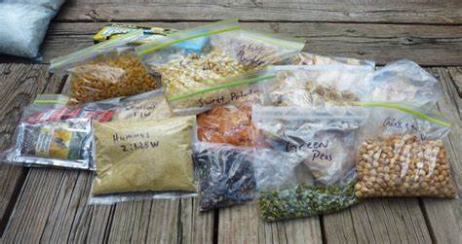
Re-Packaging Food
Supermarket food
  Cheaper
  Repackage required
  Packaged by meal
  Pre-measured
  Instructions attached
  All ingredients included
Use smallest containers
possible
Minimize trash remaining
Notes:
Trail versus Camp
Prepackaged versus Store bought
It is possible to get your trek meals from grocery stores or bulk food online – without resorting to all pre-packaged meals
Requires more planning but has definite advantages
Less costly – roughly $3-$4 per meal versus $10-$12 per meal (or more)
May find pre-packaged meals are not enough – 2 servings totally 400-500 calories
Store bought approach can scale to specific crew size – prepackaged meals come in the unit size sold
Weight and Cube usually the same or less
Generally, store bought can have more variation in recipes (many substitutions possible)
Prepackaged meals usually generate more trash, wet trash, which we will discuss later
May be easier to address dietary and religious limitations
Repackaging (EXAMPLE)
Removing boxes and other unnecessary packaging materials saving saves weight and minimizes trash
Package the ingredients by meal with instructions included
Take only as much as you need
Include all of the ingredients in one package to the maximum extent practical
Individuals can vary the spices and probably the protein
Use the smallest containers possible
Proper repackaging, and pre-measurement of ingredients are an effective way to optimize portions and minimize garbage/leftovers, an important Leave No Trace concept, as are little details such as refraining from using twist-ties and tearing off the tops of envelopes.
Crew training important beforehand – improved skills and cooperation – leverage shakedown runs

Slide 8
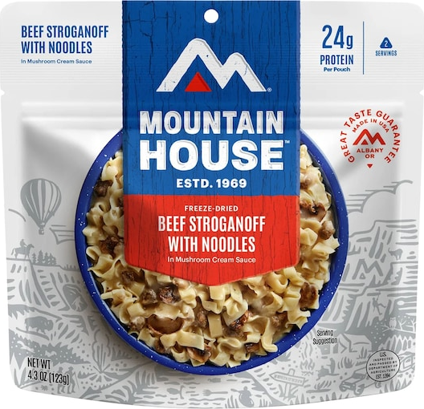
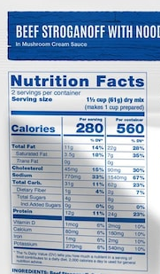
Sources - Prepackaged
Freeze-Dried / Dehydrated Food – 5 Crew
Required: 5+ packages – Is each package really 2 servings?
400-600 calories per pkg (2500+ cals/day)
Complete meal – or will you augment with other items? Likely
with other items?
Scales up by adding packages
Variations: Primarily limited to what’s in the bag
Cost = Approximately $10-$14 each ($50-$70+)
Weight = 4-5 oz + water approx. 2 cups (13-16 oz weight) = 17-21 oz each (85-105 oz / meal)
Cube = 62 in³ (310 in³)
Time: 20-25 minutes
Notes:
Here are a couple of examples of freeze-dried food. The first is where the whole meal is included in the packages and the second is where the main dish only is included. You can see from the two examples that for a fairly typical crew size of 6-9, the cost, weight and volume for even one meal can be quite significant.

Slide 9
Sources – Supermarket
Many On-Line Sources Now Available
Store bought & Re-Packages – 5 Crew
3320 calories = 664 cals/person (2500+ cals/day)
Complete meal
Scales up by adding rice and protein
Variations: Many – vegetables, proteins,
spices, noodles/rice
Cost = Approximately $3 each ($15+)
Weight = 21 oz mix + 26 oz protein
+ 100 oz water = 146 oz
Cube = 320 in³
Time: 25-30 minutes
* Another thought – add the protein and
spices to each individual serving
BCOLS Blend Recipe – 5 Crew
Ramen noodles: 2 pkgs (w/o flavor pkt)
Instant rice: 4 cups
Dried vegetable mix: 1 cup
Dried broccoli: 1 cup
Chicken gravy: 1 envelope
Chicken or Vegetable soup: 1 envelope
Onion soup: 1 envelope
Protein choice: 4.5 oz cans (4) – chicken, salmon, tuna
Water: 10-12 cups
Optional: beans, spices*
Vegetarian ???
Notes:
Here is one example of a main dish from supermarket trail foods. Its big advantages are that you can vary the composition to suit the crew’s tastes, the amount to match crew size, and that it is relatively inexpensive and does not take up as much room as the prepackaged examples shown on the previous slide.

Slide 10
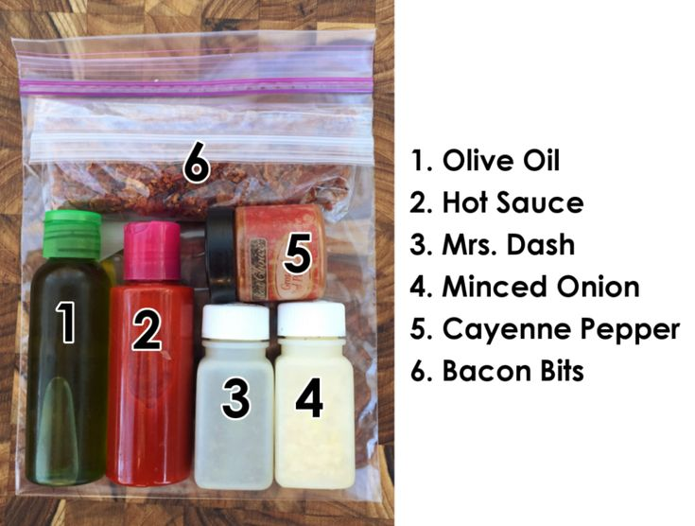
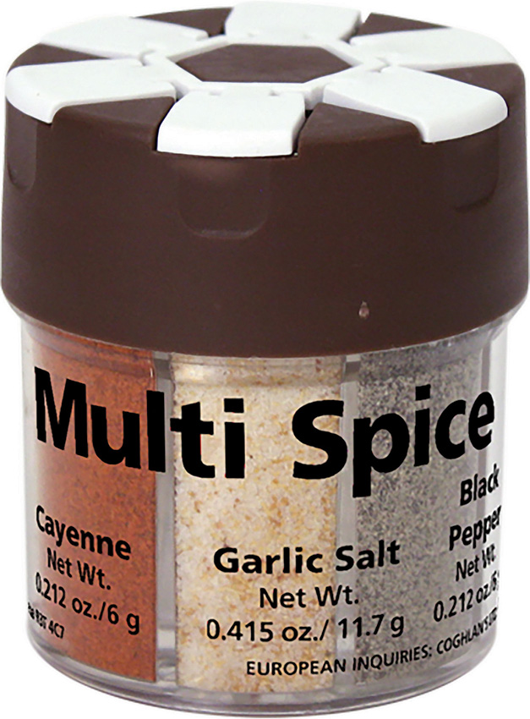
Keep It Fun
Be creative, try new stuff
Use spices
  Garlic (powder / cloves)
  Curry powder
  Cinnamon
  Dried peppers
  Hot Sauce
  Others
Hold a one-pot recipe competition
Troop recipe book
Notes:
Scouts are usually interested in cooking – but it does take skill and poor success can be discouraging
On the trail, it is important everyone participates and shares the workload – everyone needs cooking skills (provides leadership and teaching opportunities)
Encourage crews to keep it fun, encourage participation, encourage improvement and experimentation.
Ideas can come from books, talking to other Scouts, and family – might help to have a Troop recipe book for variety
Spices make a difference, but probably not the first thing Scouts think about in the planning – often can be added personally and to taste
Competitions (One Pot / Blind Ingredient) provide opportunities to try new dished, gauge acceptance, evaluate portions and cookability, before taking it on the trek.

Slide 11

Leave No Trace
Plan food prep, packaging and pack out
Use existing camps, durable surfaces or spread out
Pack out discipline
Camp stoves, not campfires for cooking
No need to gather firewood
Placement of sumps/
latrines away from
water (200’)
Cooking Area
Bear canister
Tents
Durable
Surfaces
Sump/latrines

Slide 12
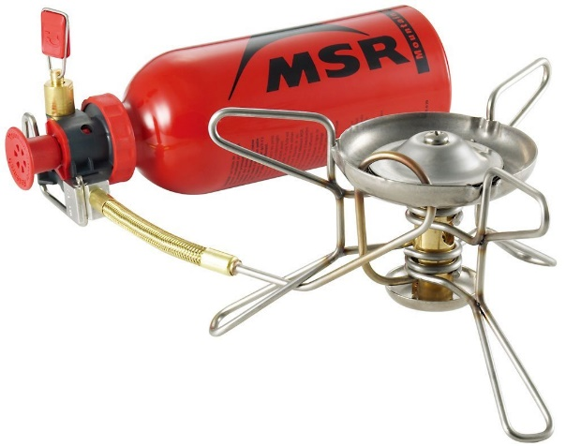
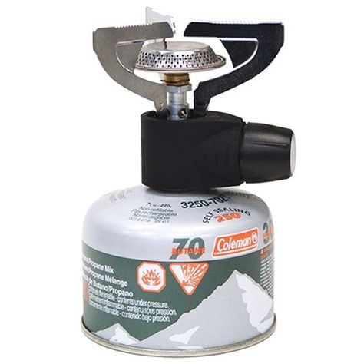
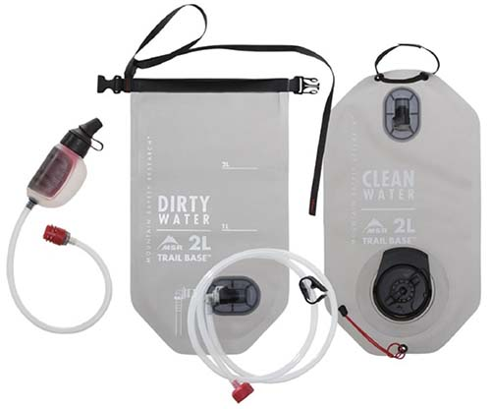
Risk Management
Stoves
One cook + one assistant
Do not leave unattended
Operating instructions
Clear zone (4’ above & 1’ on sides)
Ventilation & Wind
Stable surface
Overload weight
Fuel
Filter prevent clogs
Allow stove to cool 10 mins
Prevent spills (funnel)
Exposure in cold
Water
Filter discipline (dirty / clean)
Boiling works (boil cooking water)
Chemicals (bleach, iodine)?
Clearly mark purified and unpurified water

Slide 13
Risk Mgmt - Safe Food Handling
Five Critical Areas of Focus
Acquisition
Storage
Preparation
Cooking
Clean-up
The Culprits
  Bacteria
  Viruses
  Parasites
  Fungi, Mold, Yeast
  On the Trail
  Storage temperature is not an issue – typically food is dehydrated or freeze dried and packaging is air- and water-tight
  Usually no preparation required – add water, heat, serve
  Almost always a one-pot meal
  Usually only one cooking/serving spoon
  Hand washing discipline
  The 3C’s still apply -- cleanliness, cross contamination, & clean-up
  Consider impact of “wet” trash -- breeding ground for bad stuff, storage concerns
Notes:
Train Scouts on food safety through all 5 steps of the process
Acquisition mostly occurs at home in controllable environment – food selection from a safe source, but consider resupply actions and water sources as well
Storage needs caution in re-packaging and handling – but menu planning should eliminate concerns on storage temperature
Food repackaging and prep before departure requires cleanliness and may involve use of tools
Cooking on the trail may involve stoves but likely minimal food handling and utensils
Discipline in thoroughly cleaning gear after the meal reduces risk of illness and ensures readiness for the next meal
Think of culprits and how they can enter into the trail cooking process
Possible risks from source of water
Other activities expose hands to soil, water and surfaces with possible contaminants
Cross contamination in preparation at home and possibly on trail if multiple meals are in work
Improper cleaning creates breeding ground for contaminants (as does storage of waste – especially anything left wet
Reiterate the 3-C’s often in training – Cleanliness, Cross Contamination, and Clean-up

Slide 14
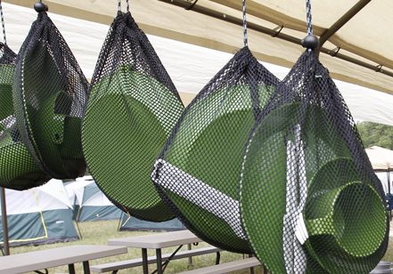
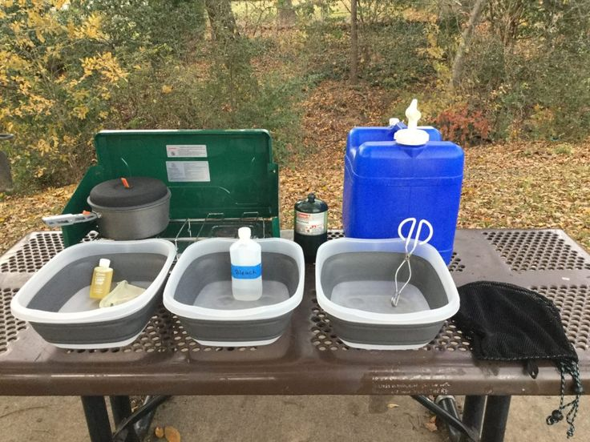
The 3-Pot Method
Three ½-gal containers, 4 qts water
  Hot wash w/ biodegradable soap
  Hot rinse
  Sanitize
“Gut sump”
“Spatulate” and wipe w/paper towel
Wash personal, then crew gear
Cleaning pots ➔ cleanest thru dirtiest
Strain water thru screen
Scatter water 75’ from camp &
200’ from water sources
Scraps in “yum yum” bag
Notes:
Be sure to have hot water ready right after the meal so food doesn’t dry on the gear/utensils
Habit of putting water to boil while crew eats so it’ll be ready when you need it
The 3-pot method
Extra 1/2 gal containers (ice cream containers work well and free you to use the cook pots for cooking)
1qt of hot water in the warm wash container, add enough cool potable water to allow you to put your hands in it. Add a few drops of biodegradable soap.
Add 1 qt of hot water to the second container
2 qts to the third with sanitizer if that is used
Most items air dry quick enough, otherwise secure to pack until dry
Key to success
Limit use of gear by single pot recipes / meal planning
Get crew and personal gear a clean as possible before washing – gut sump means eat everything (practice and attention to portion control helps)
Gut sump means add some liquid to container to gather remaining food and drink -- not as bad as it sounds once you have done it a few times
Greatly limits food waste in cleaning water and in storage after screening – the intent is to eliminate discard of food into wild environment
In the end, only relatively clean water should remain to be broadcast into the environment – sufficient distance from natural water sources 200’
Other hints
Individual gear should be done first, then cooking pots going from cleanest to dirtiest; they shouldn’t be very dirty at all at this point
Wash water can be poured into the pot to be cleaned, then poured back into the plastic container
Manage your time and the water – ensure water isn’t allowed to cool before it’s used to clean gear
Nylon screen and storage bags gather final waste, which gets transported out of the back country and stored appropriately to prevent access by wildlife
Some crews reverse water from 3-pots – 1) filter and broadcast pot 1, 2) pot 2 into pot 1 swirl filter broadcast, and 3) repeat from pot 3-2-1

Slide 15
Some Tips
Manage Risk & LNT
  Adult supervision
  Build leadership / crew
  Training / Practice
  Maintain Equipment
  Test drive before you go
Keep a notebook
  Portions
  Taste
  Acceptance
  Difficulty
  Fuel use
Read, Study
Talk & share ideas
Team Building
Team Dynamics
Leadership
Notes:
Practice in advance
Teach how to use equipment at home base and on shorter events
Cook simple meals first, then increase complexity
Simple well-liked foods, then expanding tastes (ensuring everyone gets fed)
Experiment and find what works (portion sizes, taste, dietary/religious limitations)
Introduce Leave no Trace concepts – food, cooking methods, and clean-up, all have LNT considerations
Encourage Scouts to capture learning in a notebook – express interest, discuss what worked and what could be better
Build a Unit cookbook and pass it on
Weave into discussions and reflections, what skills need more work, how the group can be more efficient, what could make it more fun next time
Encourage follow-through to achieve these improvements – through Scout leadership

Slide 16
RULE #1
YOUR BRAIN IS THE BEST SAFETY DEVICE
BE SURE TO USE IT!
Notes:
Planning, training and trial runs are important, but …
Not a substitute for considering the environment and the situation
Look for leadership opportunities and keep it focused on Scout’s doing for themselves
Keep an eyes out for safety and emergency response

