Slide 1
BSA 408 - How to Recruit and Keep Volunteers
National Capital Area Council
University of Scouting 2025
Ann Lyles MacPhail – Four Mile Run District
Vice Chair, Membership and Troop 2535 ASM

Slide 2
Assumptions about volunteers
Want to be helpful, but don’t always know how
Should have a clear job description and goals
Expect to spend a reasonable amount of time volunteering
Should delegate but…
Are not necessarily leaders
Notes:
Josh

Slide 3

Why don’t we delegate?
It’s hard to ask for help
Solving problems feels good!
We like to feel needed
No one can replace me
People don’t step up
Notes:
Ann – Some of like feeling uniquely qualified. But that can lead to problems. What are some of the consequences of not getting the help you need?
Most of you probably know how to get people to do small jobs, but in case these aren’t obvious:
Print out each adventure for your den and let parents pick which one they’d like to host. That leaves the den leader as the scheduler, coordinator, point of contact, helper.
Online signups like Signup Genius, Volunteer Spot, Amazon Wish Lists for donations of supplies
Paper signup sheet at pack or den meetings
Give choices. Ask people “Would you rather grill hamburgers or help with cleanup?” (They will choose hamburgers)
Do you have a Costco membership? We need someone to pick up the food.
Is there someone with a truck? Could you pick up the popcorn order on Sept. 8?
Today, we’re not talking about the little jobs that you can fill with Volunteer Spot or Signup Genius.
These are the jobs that require a registered leader.

Slide 4
Consequences
Burnout
Others don’t get a chance
Motivated people find other jobs
No succession plan
Leaders fail to set example for Scouts
Unit fails
Notes:
Josh - Some of the consequences of not delegating.
Are there others?
People assume you don’t need help so they stop offering
You get a reputation as a control freak
Other leaders don’t feel like they’re on your team

Slide 5
“Your Scoutmaster and other adult leaders will help Scouts become good leaders, then will step back and allow the troop’s youth leaders to take charge of planning and carrying out activities.”
-- Scouts BSA Handbook 14th Edition
Notes:
Ann

Slide 6
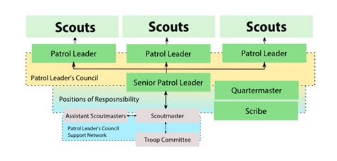
Shared leadership
Less Sharing
Less Trust
More Control
More Sharing
More Trust
Less Control
Notes:
Josh

Slide 7

Create A Culture of volunteering
Form a Nominating Committee
Culture of pitching in
Make new parents feel needed
Make sure experienced leaders feel valued
Notes:
Ann
Create a culture of pitching in - welcome new parents by giving them a SMALL responsibility right away. It will make them feel like part of the family, show that they are needed, and set up the expectation that we all do a little to help out.
Every committee meeting should have succession planning on the agenda. Every position needs a succession plan. Every major leadership position should have a shadow.

Slide 8
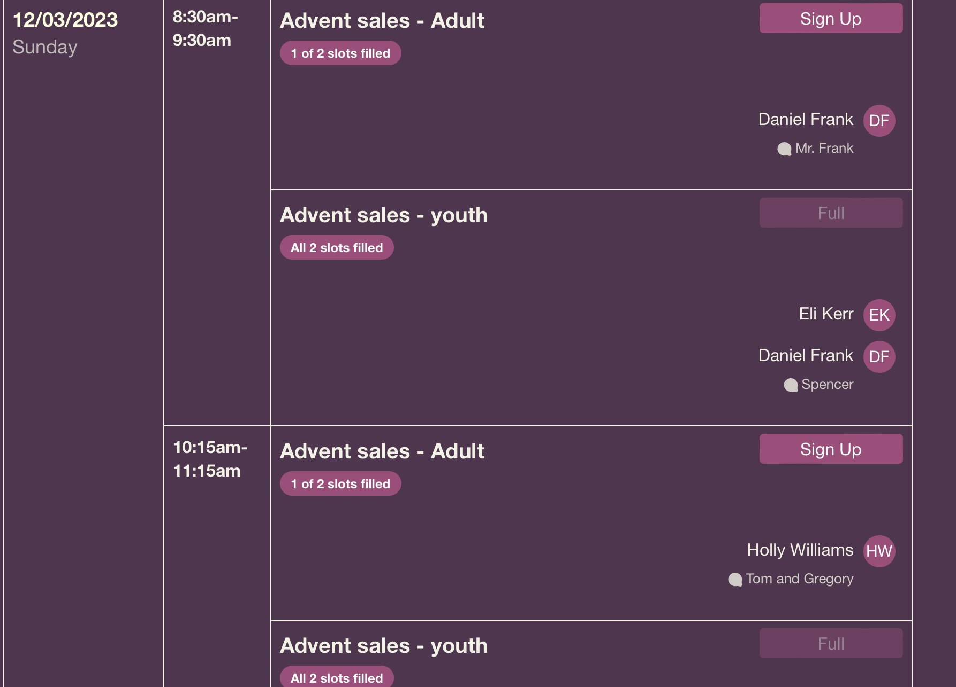
Signup websites
Notes:
Signup Genius and Volunteer Spot are two websites that work well for getting people to sign up for small things. This is NOT how you get a new Committee Chair! BUT if you’ve delegated all the little jobs, it’s a lot easier to get someone to coordinate.

Slide 9
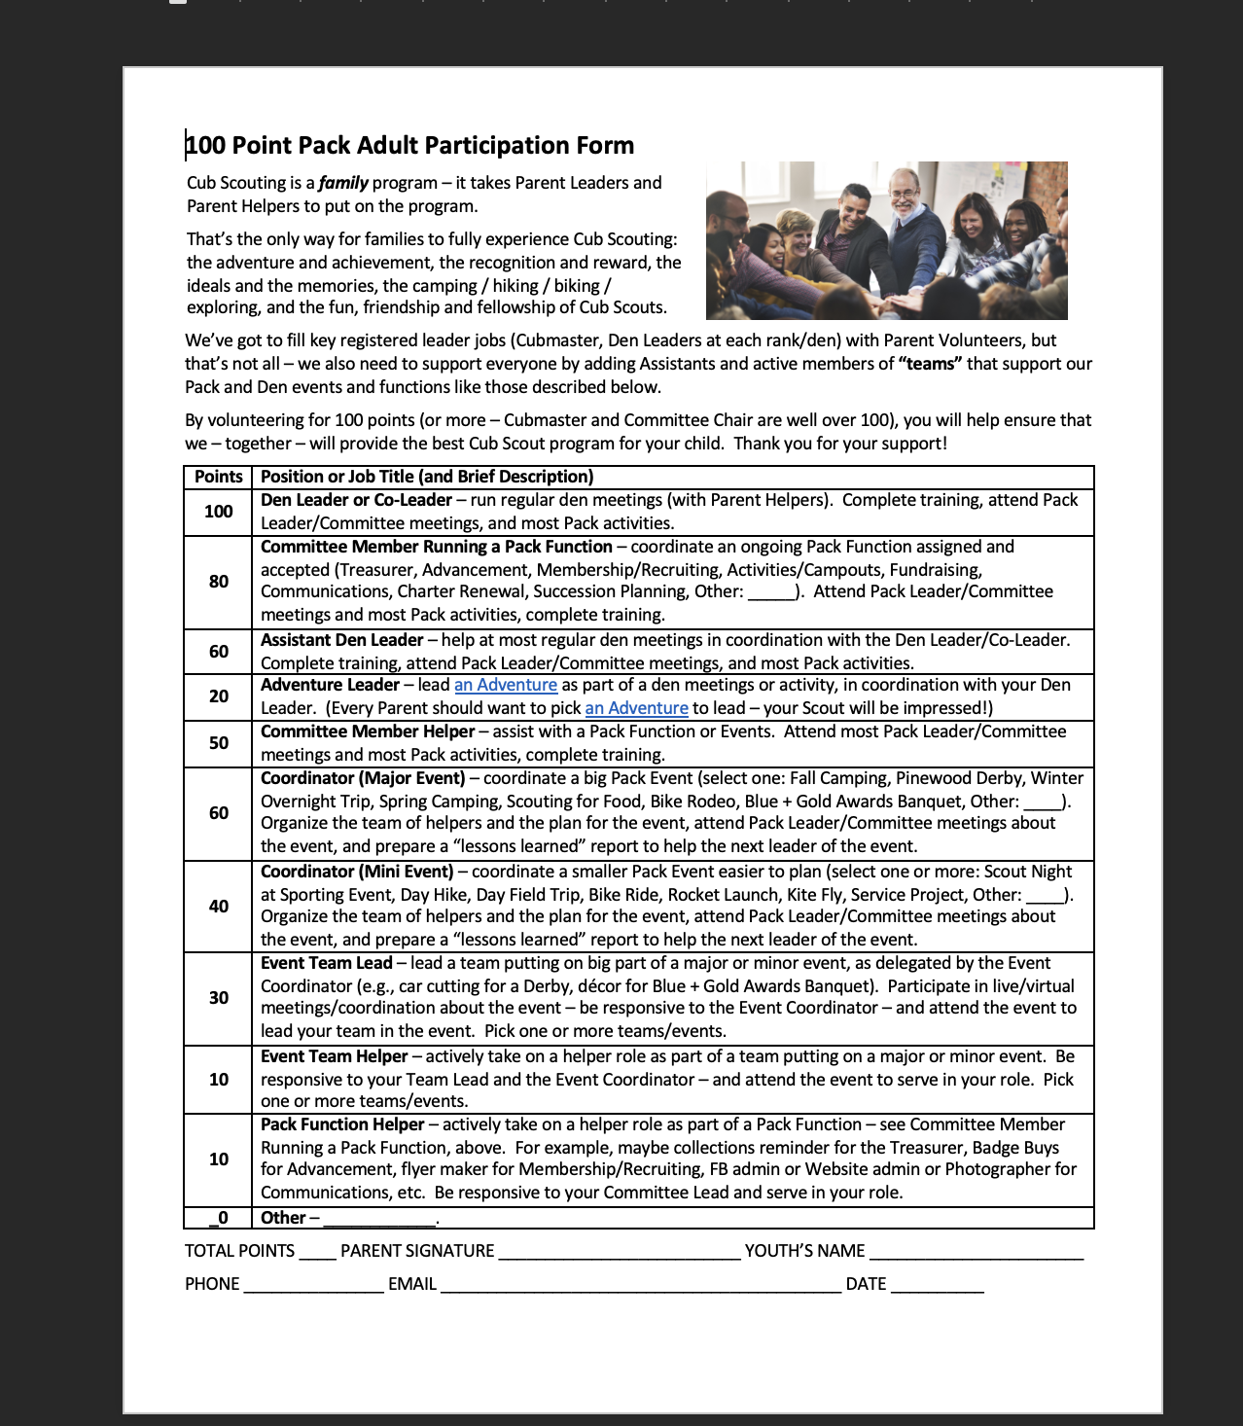
Notes:
This is a whole system where the parents earn points for doing various things and they have to add up to 100. But someone has to track all of this and enforce it.

Slide 10
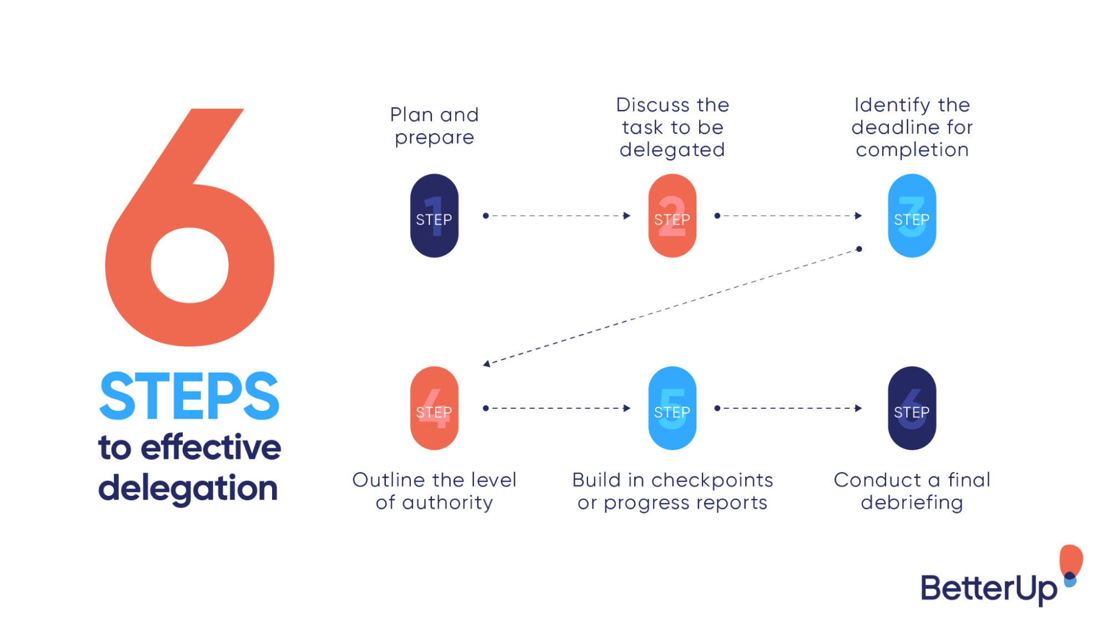
Effective Delegation
Notes:
Josh – This is one pathway for delegating a job with six steps.

Slide 11

Eight ways leaders delegate successfully
- Deborah Grayson Riegel, Leadership coach
Harvard business review, 08/15/2019
Pick the right person, explain why you chose that person
Be clear about what the person is responsible for and how much autonomy they have
Describe the goals in detail and explain why
Provide resources to do the job
Establish checkpoints and milestones for feedback
Encourage new ways of doing the job
Create a motivating environment
Tolerate risks and mistakes and use them as learning opportunities
Notes:
Ann – Here’s another pathway for delegating a job with 8 steps.

Slide 12

The Nominating process
Define the job
Identify a prospect
Approach and sell
Train, Mentor, Support
Recognize
Notes:
Josh
This is how we can delegate using a nominating process in a troop.
Options for forming a nominating committee:
- Everyone on the troop is committee is now the nominating committee.
- Find out who is comfortable asking people to do things.
- Ask for a chair or two co-chairs to lead a search process.

Slide 13

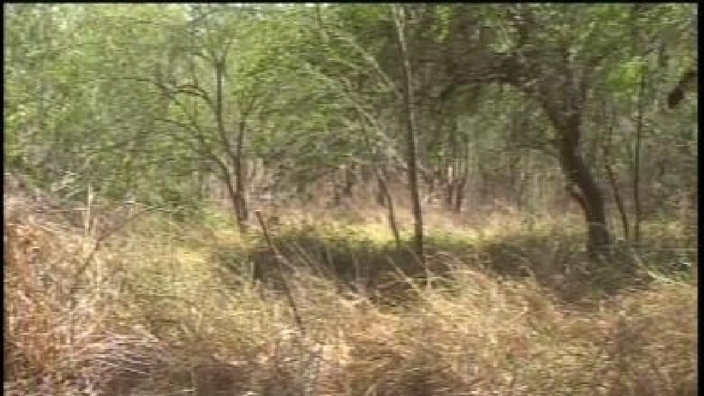
1. Define the job
Provide a written job description
What should the person do? Goals, outcomes.
Explain the reason someone needs to do this
Be honest about time commitments
Who would take an undefined job?
Notes:
Ann

Slide 14
2. Identify a prospect
Who would be the ideal candidate or candidates?
Rank them
List the skills or qualities of the ideal candidate
Notes:
Brainstorm. Talk to other leaders. Talk to parents. What names keep coming up? Who do people see as an effective leader? Who would they be willing to help?

Slide 15
3. Approach and sell
Schedule a time to talk, ideally in person
1
Explain WHY that candidate is a good fit for the job
2
Share the benefits of being a leader
3
Offer to train, mentor and support
4
Give the person time to think
5
Notes:
In that fifth step, you acknowledge that you will take yes or no for an answer. You’re leaving the person an out, but you’re not taking a NO yet. You can should also mention that if the nominee doesn’t wind up taking this job, you want to find a good fit somewhere else. Find out what position WOULD be a good fit.

Slide 16

4. Train, Mentor, support
EDGE
Don’t forget all the great training opportunities provided by BSA
Many adults want to be mentored and they want to contribute
Let them do their job – in compliance with the Guide to Safe Scouting
Periodic check-ins with feedback
Notes:
Josh

Slide 17
5. Recognize
Thank them in private
Shout outs in emails
Court of Honor recognition
Awards
Training Awards
District recognition, Unit Scouter of the Year
Ceremonial gifts
Ad hoc awards
Provide helpful feedback
Leader Recognition Chair
Notes:
Ann (slides 15-17)

Slide 18
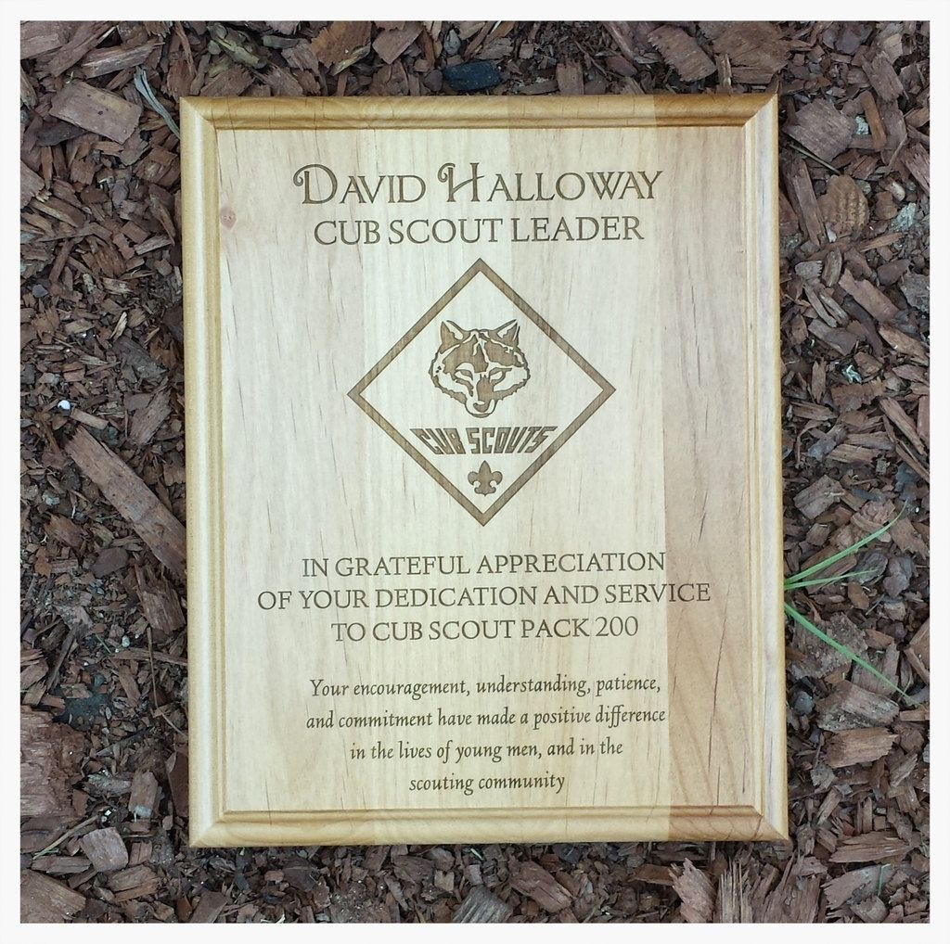


Recognition
Notes:
Ann
Pinterest, Word templates
Scout Shop
Etsy

Slide 19
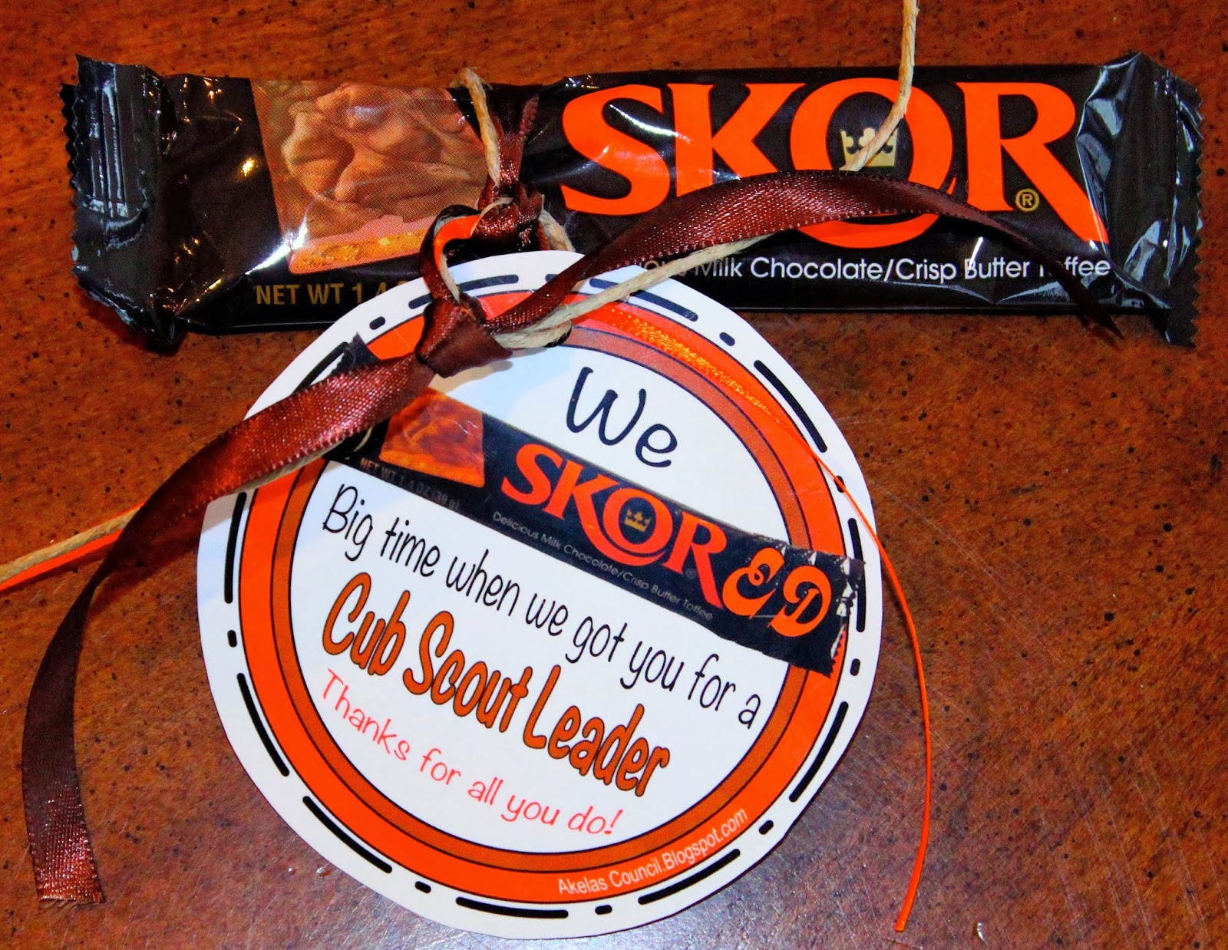



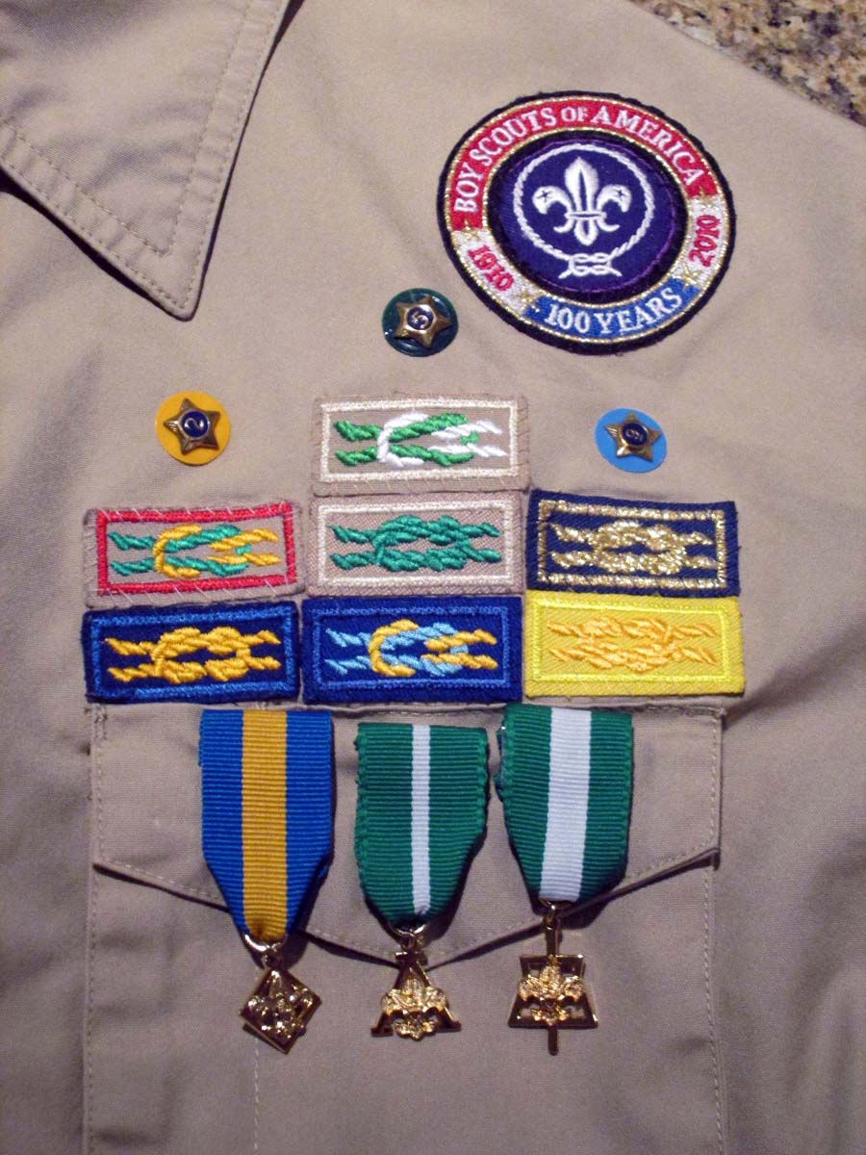

recognition
Notes:
Ann
Official and unofficial recognition
Scout Shop
Pinterest

Slide 20
SAMPLE Position Description: Popcorn Kernel
Attend a Popcorn Kernel Training in August
Communicate with the treasurer, driver, and storefront sales coordinator
With your committee, set sales goals and a timeline
Update and distribute the parent handout and order forms
Announce details at our September Court of Honor
Send reminders about important dates
Place the popcorn orders and prize orders
Distribute prizes in November
Notes:
Josh - We're going to demonstrate how the conversation could go when Ann asks Josh to be the new Popcorn Kernel.

Slide 21
Approach and Sell
Schedule it
Allow time to build rapport.
Show you’re going to enjoy working together.
Do it face to face
Present a position description
Close or schedule a time to talk again to close
Notes:
Ann - This is how we recommend asking someone to fill a significant position.

Slide 22
Discussion
Challenges you’ve encountered
What works best? What DOESN’T work?
Have you used a nominating process before?
Notes:
Josh - Divide group, start discussion, share ideas.

Slide 23
BSA 408 - How to Recruit and Keep Volunteers
Ann Lyles MacPhail – Four Mile Run District
Vice Chair, Membership and Troop 2535 ASM
annlyles@yahoo.com (408)410-6211

