Slide 1


NCAC University of Scouting 2025
EAC297
Exploring in NCAC: How the Exploring Program Enhances the Experience for Older Scouts
JEFF SCHWEIGER,
ASSISTANT COUNCIL COMMISSIONER (EXPLORING, STEM, COMMUNICATIONS AND RESOURCES)
NATIONAL CAPITAL AREA COUNCIL
scouter.jeff@earthlink.net

Slide 2

Safety Moment Ideas & Tips*

Slide 3
Safety Moment Ideas & Tips
Ideas for Safety Topics…
  The possibilities of what to cover in your safety moment are unlimited. Your subject doesn’t even need to be about an Exploring activity or an event or the participating organization’s workplace. Driving, diet, fitness, home emergency preparedness—all are worthy subjects.
  If you’re feeling overwhelmed, experiencing a safety topic block, or seeking inspiration from others, there are loads of resources online. For example, the National BSA offers excellent safety moment examples at https://www.scouting.org/health-and-safety/safety-moments/
Keep It Fresh & Fun…
    Safety moments happen often. To make them effective, vary them in terms of topics, presentation format, and style. You can use videos, first-person narratives, demonstrations, or interactive role play, and be sure to throw in some humor when appropriate
    Keep your Explorers engaged to ensure your safety moment ideas make the maximum impact

Slide 4
Safety Moment Ideas & Tips continued
Make Your Safety Moment Useful & Personal…
  Your Explorers & participating organization personnel are an excellent source for topic ideas. Seek suggestions and encourage them to share their own health and safety experiences, or share your own
  Personal Explorer or Advisor stories have a particularly strong impact. They often show vulnerability, and vulnerability is linked improved post safety. They’re also a great way to encourage communication and post team building. This is an important part of creating a strong post culture, because safety is a team effort
  But certainly don’t shy away from general safety moment ideas. For guidance, look to the weather or upcoming holidays. Winter brings icy surfaces: bring awareness to preventing slip and falls. Summertime is pool time, so address the hazard of drowning and encourage pool safety. If you’re searching for a safety moment of the day, think through the particular risks the participating organization’s workplace environment poses every day
  What is most important when choosing a topic is that it be relevant to your Explorers and their needs, and useful

Slide 5
Safety Moment Ideas & Tips continued
Anatomy of a Safety Moment…
  So you’ve homed in on your topic, and it’s one that you feel will be very useful to your post. Now what? You’ve got about five minutes to communicate the message. A few key elements to consider for a successful presentation include the following:
    Provide the “why”: Begin by letting Explorers know why you chose this topic, why you felt it was relevant to them. If the topic was someone suggestion, say so. Let post know you’re listening
    Make it concise and narrowly focused: You have a couple minutes to present your topic; stay on point and don’t try to cover too much
    Make it conversational: These are not formal safety meetings nor are they a time for you to dictate behavior. Keep the tone friendly and conversational
    Provide takeaways: Give your post ways to implement the topic you’ve presented. This makes your safety moment feel useful and applicable in the real world
    Ask and encourage questions: This is an excellent opportunity for dialog, feedback, and creating community.
.

Slide 6

What is Exploring?
A career education program for young men and women
  Helps them make more informed decisions about future careers
Exploring serves two different age groups, both coed.
Exploring Clubs serve middle schoolers, aged 10 – 13, in sixth through eighth grades. Exploring Posts serve older youth 14 – 20 years old.
The program model is the same for both age groups:
  Hands-on and interactive character and career activities are facilitated by trained business leaders in your local community.

Slide 7

LEARNING FOR LIFE CORPORATE MISSION:
To develop and deliver engaging, research based academic, character, leadership and career focused programs aligned to state and national standards that guide and enable all students to achieve their full potential.
NON-DISCRIMINATION STATEMENT:
Learning for Life programs are designed for all age groups from pre‐kindergarten and not yet age 21. Youth participation is open to any youth in the prescribed age group for that particular program. Adults are selected by the participating organization for Involvement in the program. Color, race, religion, gender, sexual orientation, ethnic background, disability, economic status or citizenship is not criteria for participation by youth or adults.
Notes:
AFFILIATION STATEMENT
Learning for Life is one of the programs that local Boy Scouts of America councils are authorized to deliver, with local executive board approval. Learning for Life is an affiliate of the Boy Scouts of America that is comprised of both a written character education curriculum for PreK – 12th graders and students with special needs, as well as Interactive career Exploring programs for 6th graders thru 20 year olds. Youth participation is open to any youth in the prescribed age group for that particular Program. Adults, 21 years of age and older, are selected by participating organizations for involvement in the Learning for Life programs. Color, race, religion, gender, sexual orientation, ethnic background, disability, economic status or citizenship is not criteria for participation by youth or adults. Youth and adults involved with Learning for Life programs, including Exploring, are registered with Learning for Life as participants. Learning for Life participants are not members of the Boy Scouts of America. Learning for Life, a District of Columbia non‐profit corporation, is a separate 501(c)(3) Corporation, with a Board of Directors that is separate from the Boy Scouts of America. While they have different policies, there are occasions when local Learning for Life and Traditional BSA programs may participate in an event. Both programs will be required to follow the appropriate guidelines, especially regarding safety. Completion of training, registration and annual fees are program specific and not transferable between programs

Slide 8

  Learning for Life Curriculum-Based Programs consists of grade specific, age-oriented, character education lesson plans that are utilized in schools and other educational settings to help instill character and ethical decision making in our youth. The available lesson plans that are offered for Learning for Life Groups include PreK-12 grades, Champions for students with special needs, along with additional digital resources. Learning for Life uses these interactive lessons to help youth make informed decisions while becoming better students and citizens.
  CURRICULUM PROGRAM VISION:
  To provide engaging and relevant PreK‐12 solutions that positively impact academic performance, social & emotional maturity, character development, and career education for all students.
www.learningforlife.org

Slide 9

  Exploring is a co-ed program for youth that are in the 6th grade through 20 years old. Exploring provides opportunities for real-world hands-on career experiences, while helping them “Discover their Future”. The program links youth with mentors and experts with partner businesses and agencies in their communities. Participating in an Exploring Club or Post ensures youth make informed decisions about careers they may or may not be interested in pursuing, while allowing businesses and organizations the opportunity to meet and cultivate future employees.
EXPLORING MISSION:
Deliver character-building experiences and mentorship that allow youth to achieve their full potential in both life and work.
EXPLORING VISION :
Shape the workforce of tomorrow by engaging and mentoring today’s youth in career and life enhancing opportunities.
www.exploring.org

Slide 10
Where Did Contemporary Exploring Come From?
Interesting Parallels With Family Scouting
B.S.A. Research on Serving Teenage Boys
  University of Michigan (1955)
  Study update by Daniel Yankelovich (Mid 1960s)
Findings The Same In Both Studies
  Outdoors was not the primary appeal; uniforms not cool
  Over 80% not getting enough guidance on careers
  Wanted to participate in activities with girls!
“Experimentation” in Orange County, California
  Career program focus within ”Explorer Scout” programs
  Surreptitiously registering young women
  Led by National Executive Board member Bill Spurgeon
After Two Year Pilot: Co-ed April 1971

Slide 11
What Happened To Exploring?
1980’s 17 Career and Traditional Program Clusters
Curriculum-based Learning for Life Program started (1991)
Venturing Split Off In 1998; Remained Traditional B.S.A.
Exploring Joined Learning for Life, an Affiliate of the B.S.A.
  12 Career Exploring Fields
  Separate 501(c)3 non-profit formed in 1992
  Original mission of running in-school programs
  Curriculum based
  No Duty to God requirement
Why the Change?
  Membership standards challenging for Exploring
  Protect ”Duty to God” requirement in traditional programs
For A Period, Not Counted as Membership (“below the line”)
  Fully counts now!!

Slide 12
Post or Club
Exploring serves two different age groups, both coed.
Exploring Clubs were established in 2013
Exploring Clubs serve middle schoolers, aged 10 – 13, in sixth through eighth grades. Exploring Posts serve older youth 14 – 20 years old.
The program model is the same for both age groups – hands-on and interactive character and career activities are facilitated by trained business leaders in your local community.

Slide 13












Twelve Career Fields

Slide 14
Leading Career Specialties
November 2023 (28,312 Members)
Explorer Clubs
All Other Specialties
Aviation
Business
Law Enforcement
Law & Government
Science/Engineering
Fire/EMS
Career Education
General Interest
Health Care

Slide 15
Exploring is very different from Our Traditional B.S.A. Young Adult Programs
 | Venturing and Sea Scouts | Exploring
Mission | Leadership and Character Development
Target Age | 14-20
Recruiting Hook | Outdoors | Careers
Chartered Partners and Sponsors | Religious and Civic Organizations | Businesses and Public Agencies
Advancement | Yes | Certificate Program
Scout-Like Uniform | Yes | Post Identity Attire
Scout Oath & Law | Yes | No
Order of the Arrow | Yes | No

Slide 16
Issues With Exploring
Based on Conversations Around the Country
Not Everyone is Promoting Exploring
It Looks and Feels Different Than Traditional Programs
Not Part of our Mission
There Are No Manuals (But A Program Library)
Our Professionals Have No Experience
We Have Higher Priorities (Family Membership/Survival)
Exploring Doesn’t Fit Our Revenue Model
  Don’t Use Camps/Sell Popcorn/Do FOS/Buy Uniforms

Slide 17
Exploring: Additive to Traditional Programs
Benefits to Local Councils
New Sources of Membership Growth
  New entry point in addition to Cubs
New Source of Senior Volunteer Recruitment
  Business and civic leaders with no Scouting history
  Candidates specifically interested in high school age youth
New Sources of Foundation and Corporate Giving
  Workforce readiness a hot topic for foundations
  Funders looking for “return on investment”
School Access and Cooperation
Outreach to Economically Challenged and Underserved Diverse Communities

Slide 18

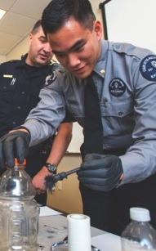



PROGRAMS ARE BASED ON
5 AREAS OF EMPHASIS
CAREER
OPPORTUNITIES
LEADERSHIP
EXPERIENCE
LIFE SKILLS
CITIZENSHIP
CHARACTER
EDUCATION

Slide 19
Exploring’s Value Proposition
Something for Everyone
Youth: Try On Your Future, Lead Others, Fun
Parents: Career For My Child
Sponsors: Build New Employee Pipeline/Give Back
Schools: Career & Technical Education (CTE)
Partners: Workforce Development
Councils: New Membership, Volunteers and Funds
Community: Help for Underserved Diverse Neighborhoods

Slide 20
Exploring: Consistent with Scouting America Mission/Vision
Mission Statement
The mission of Scouting America is to prepare young people to make ethical and moral choices over their lifetimes by instilling in them the values of the Scout Oath and Law.
Vision Statement
Scouting America will prepare every eligible youth in America to become a responsible, participating citizen and leader who is guided by the Scout Oath and Law.
Exploring’s Mission: Deliver character-building
experiences and mentorship
that allow youth to achieve their full potential
in both life and work.

Slide 21
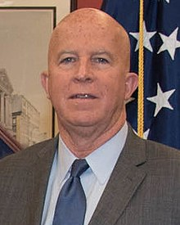
NYPD Police Commissioner on Exploring
Hundreds of New York City Cops Started in Exploring
“Now it would be nice if some of these Explorers go on to become New York City cops or join another agency, but that’s not really the point, is it? The important thing is that these young people become better citizens and leaders in their communities.”
James O’Neill

Slide 22

Current Exploring Participation Status

Slide 23
Exploring Membership Growth Opportunity…
As of… | Units |  | Youth Membership |  | Adult Membership
 | Clubs | Posts | Clubs | Posts | Clubs | Posts
31 Jan 2020 * | 395 | 4,055 | 14,903 | 80,474 | 704 | 19,095
2 Jan 2025 | 205 | 1,647 | 5,191 | 29,401 | 922 | 10,488
Opportunity | 190 | 2,408 | 9,712 | 51,073 | 218+ | 8,607
* Just before the COVID-19 Pandemic shut-down all in-person meetings

Slide 24
Exploring Participants as of 18 November 2024
Clubs/Posts = 1,806 (+58) Youth = 33,434 (+2695) Adults = 11,314 (+282)
Career Area Units Youth Adults
Arts & Humanities 5 168 52
Aviation 45 (+1) 817 (+58) 360 (+7)
Business 14 (+1) 570 (+36) 67 (+2)
Education 37 1,625 (+73) 202
Communications 5 132 (+26) 36
Engineering & Technology 27 (+1) 962 (+157) 184 (+8)
Exploring Clubs 200 (+13) 5,137 (+707) 908 (+42)
Fire/Emergency Services 476 (+12) 5,947 (+279) 3,140 (+78)
General Interest 65 (+3) 2,274 (+182) 395 (+11)
Health Care 55 (+2) 2,050 (+389) 293 (+8)
Law Enforcement 666 (+9) 8,107 (+415) 4,347 (+56)
Law / Gov’t / Public Service 74 (+3) 2,594 (+65) 475 (+7)
Sailing & Boating 1 38 5
Science 18 1,159 (+4) 94 (+1)
Skilled Trades 18 306 (+61) 138 (+2)
Social Services 4 155 (+3) 33
STEM 14 (+6) 322 (+13) 81 (+14)
No Special Interest Selected 82 (+7) 1,071 (+227) 524 (+46)
NOTE: Numbers in parentheses are changes since 15 October 2024. Jeff Schweiger, National Exploring Membership & Retention Lead, discovered that previous reports had under-counted clubs & over-counted posts because currently 109 clubs do not reflect “0999” special interest code (SIC) which will require each of these clubs’ council registrar to correct)
With the exception of 1 month due to annual MOU renewals, 32 straight months of growth in all categories

Slide 25
2024 National Membership Statistics

Slide 26

Exploring in comparison to Traditional Scouting
 | SCOUTS BSA | VENTURING | SEA SCOUTS | EXPLORING
UNIT | Troop | Crew | Ship | Club/Post
LEADER | Scoutmaster | Advisor | Skipper | Sponsor/Advisor
YOUTH LEADER | Senior Patrol Leader | President | Boatswain | President or Agency Nomenclature
YOUTH PARTICIPANT | Scout | Venturer | Sea Scout | Participant or Explorer
RE-REGISTRATION | Charter Renewal | Charter Renewal | Charter Renewal | Renewal
SPONSOR | Chartered Org | Chartered Org | Charter Org | Participating Org
SPONSORING AGREEMENT | Charter | Charter | Charter | Memorandum of Understanding (MOU)
UNIT SERVICE | Commissioner | Commissioner | Commissioner | Service Team
YOUTH RUN | Yes | Yes | Yes | Yes
AGE SPAN | 11-18 | 13-20 | 13 - 20 | 11-13/14-20
RELIGIOUS DECLARATION | Duty to God | Duty to God | Duty to God | None
UNIFORM | Scouts BSA | Venturing (Unit Selected) | Sea Scouts (Unit Selected) | Club/Post Selected, not required

Slide 27
A word about CORs and Exploring
NOTE: The COR position does not exist in Exploring. COR’s are voting members of a council, and Exploring leaders are not voting members because they are officially participants under our Learning for Life Affiliate program.

Slide 28
What We Expect…
That an Exploring Chair position be incorporated into the District Committee
  Exploring chair will work with other elements of the district committee (membership, program, activities and civic service, etc.) in promoting the district’s Exploring program
  Exploring units can participate in district activities
  Note: Three Exploring Posts (including one from NCAC) participated in the 2023 National Jamboree as part of the Exploring Service Corps
That all Exploring units in NCAC have an assigned commissioner providing unit service

Slide 29

Exploring Training
SCO_756 “Servicing Exploring Units”.
  Targeted for Commissioners, but good overview of Exploring for Scouters
  LEARNING OBJECTIVES:
  Understand the role and structure of an Exploring Service Team
  Understand the role of a Unit Commissioner in supporting Exploring Units acting in place of a service team member
  Understand the role of the Exploring Committee
  Become familiar with the tools and resources available for unit support and finally to
  Understand the differences between unit service of a traditional Scouting Unit and an Exploring Unit

Slide 30
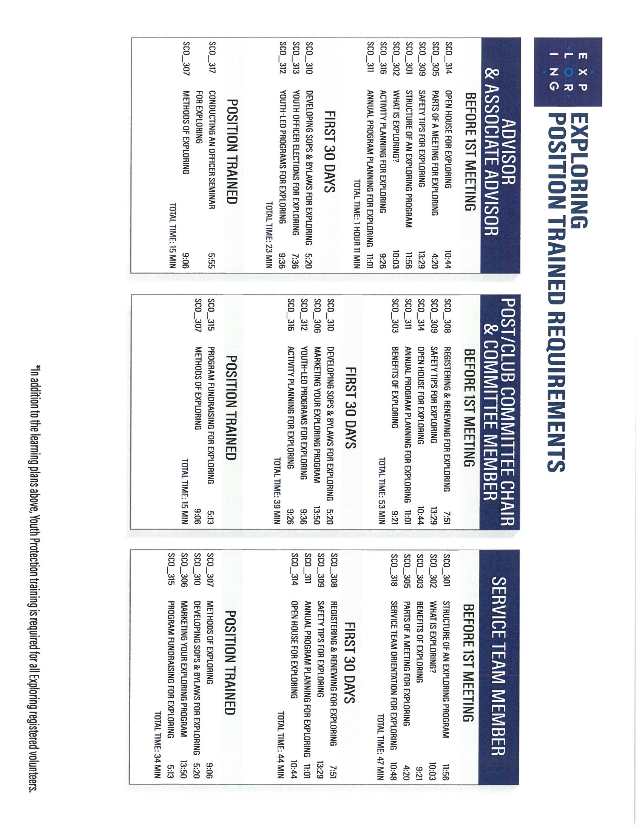
Exploring Position-Specific Training Modules

Slide 31
A Word About Uniforms
Uniforms are selected by the individual Exploring Post or Club
  Uniforms are not required by the Exploring program
Commissioners and other Scouters are not expected to wear Scouting uniform when visiting an Exploring meeting

Slide 32
4 Steps/Phases In Organizing A New Post
1. Research-
Determine the career interests of potential participants
and develop business/community prospects
2. Leadership-
Meeting with the top leadership within the
businesses/community and identifying program
leaders; includes training of leaders
3. Program-
Develop the organization’s meeting/program
themes and prepare for an open house
4. Participation-
Recruiting youth through an organized open house and
involvement of youth in program development

Slide 33
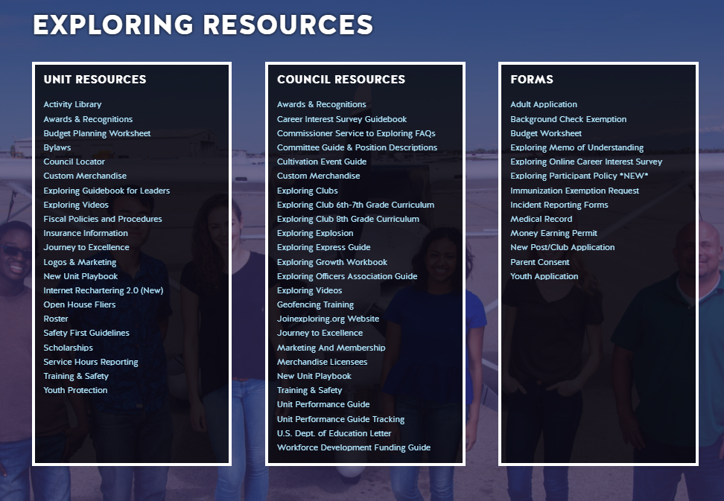
www.exploring.org

Slide 34
Current NCAC Exploring Units by District
District Unit Participating Organization (Sponsor) Career Field
Aquia Post 1896 Stafford Regional Airport Aviation
Prince Georges Club 0696 Prince George’s County Office of the Sheriff Exploring Club (Law Enforcement)
Prince Georges Club 0931 Seat Pleasant Police Department Exploring Club (Law Enforcement)
Prince Georges Club 1911 Mount Rainier Police Dept Exploring Club (Law Enforcement)
Prince Georges Club 3820 Cottage City Police Department Exploring Club (Law Enforcement)
Prince Georges Club 7600 Prince George's County Police District III Exploring Club (Law Enforcement)
Prince Georges Post 1004 District IV Law Enforcement Post 1004 Law Enforcement
Prince Georges Post 1696 Prince George’s County Office of the Sheriff Law Enforcement
Prince Georges Post 1910 Mount Rainier Police Dept Law Enforcement
Prince Georges Post 1924 Cottage City Post #1924 Law Enforcement
Potomac Post 0742 Wheaton Volunteer Rescue Squad Fire/Emergency Service
Powhatan Post 0202 US Dept of Homeland Security Law Enforcement
Prince William Club 0042 The QBE Foundation Inc Exploring Club (STEM)
Prince William Post 1268 Prince William County Police Department Law Enforcement
Prince William Post 1882 Us Stem Engineering and Technology
Seneca Post 1010 Rockville Science Center Science
Seneca Post 1986 Montgomery County Police Department Law Enforcement
Western Shore Post 0091 Calvert County Sheriff's Department Law Enforcement

Slide 35
Exploring Can Complement Scouting for Older Scouts
Scouting and Exploring are NOT mutually exclusive
Addresses need for career information/experience
  Wanted and needed by older youth and young adults
  Association with other youth with similar career interests
  Gives opportunity for hands-on experience in career areas with adults working in those areas
Exploring Emphasis Areas and Methods reinforce the Aims and Methods of Scouting

Slide 36
Exploring Impact on Membership Goals
Scouting and Exploring are separate programs with separate National organizations
  Cannot multiple between the programs
  Separate paid membership
  Same member in both programs counts in both programs (i.e., counts twice in membership statistics)
Appeals to youth and young adults that are not otherwise involved with Scouting
  Allows us to serve these additional members

Slide 37



STAY CONNECTED
page | @lflexploring
group | Exploring Success!
group | National Explorer Alumni Association
learningforlifeusa
exploring.org | Stay Connected
exploring@lflmail.org

Slide 38
Questions?

Slide 39
Jeff Schweiger | Vice Chair (Marketing and Recruitment)
LEARNING FOR LIFE & EXPLORING
National Learning for Life Executive Board
National Exploring Committee
exploringmarketing@scouting.org
www.exploring.org | www.learningforlife.org
Assistant Council Commissioner (Exploring, STEM, Communications and Resources)
Council Exploring Service Team Chair
Assistant District Commissioner, Colonial District
NATIONAL CAPITAL AREA COUNCIL, Boy Scouts of America
scouter.jeff@earthlink.net
www.ncacbsa.org

Slide 40
Exploring Emphasis Areas and Methods
Emphasis Areas:
  Career Opportunities
  Leadership Experience
  Life Skills
  Citizenship
  Character Education
Methods:
  Voluntary association of youth and adults
  Ethical decision-making guidance
  Group activites
  Recognition of achievement
  Democratic processes
  Interactive/hands-on experiences

