Slide 1
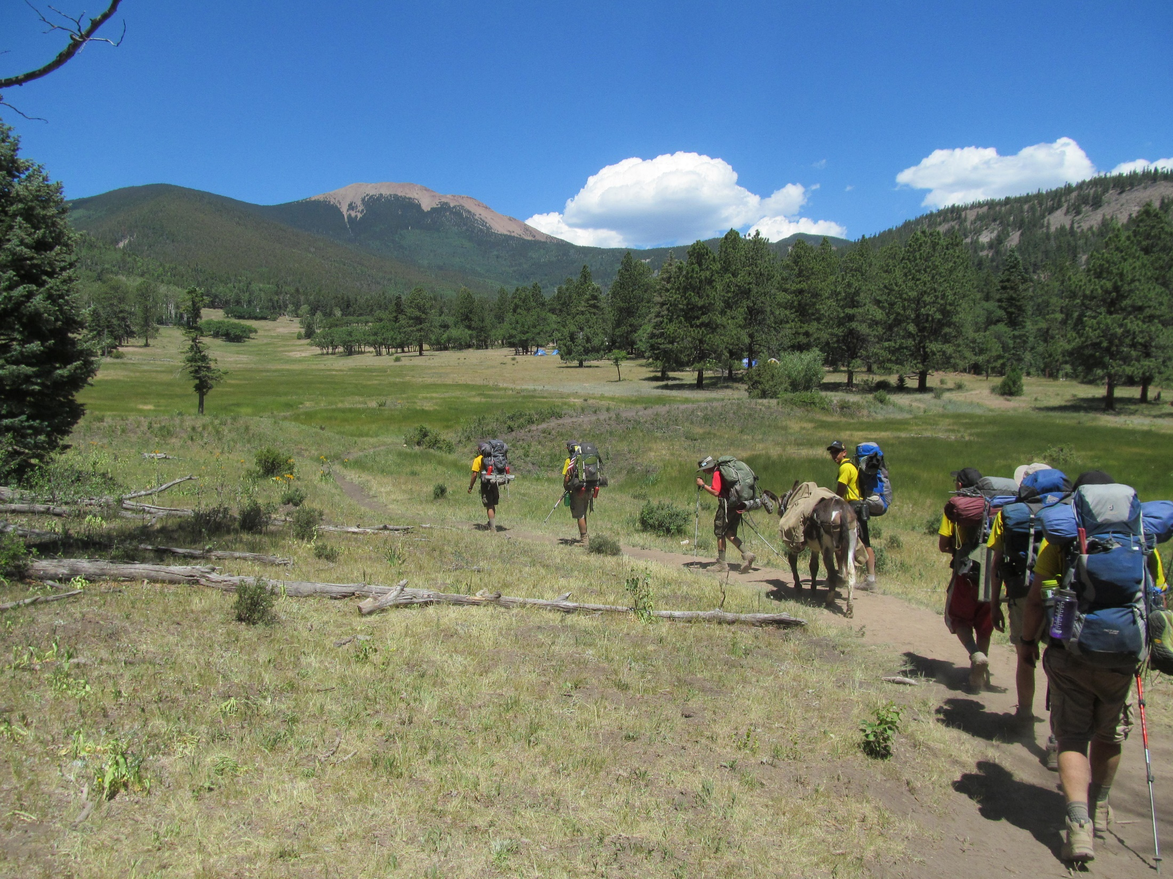
EAC 324
Philmont Scout Ranch
February 2025

Slide 2
Philmont in Two
(video)

Slide 3
Agenda
What’s Philmont?
Challenges
Typical Trip overview
Preparations:
  Warm-ups
  Trip logistics
Administration

Slide 4
What is Philmont Scout Ranch?
Located in northeastern New Mexico, near the town of Cimarron (pop. 800) in the Sangre de Cristo section of the Rocky Mountains
137,000 acres (214 sq. mi.), ranging from 6,500 to 12,441 feet elevation - the largest youth camp in the world
Established 1939 by donation of 35,000 acres by oilman Waite Phillips
Expanded 1941 to 127,000 acres with 2nd gift;
Baldy purchase 1963, Chase Ranch 2014

Slide 5
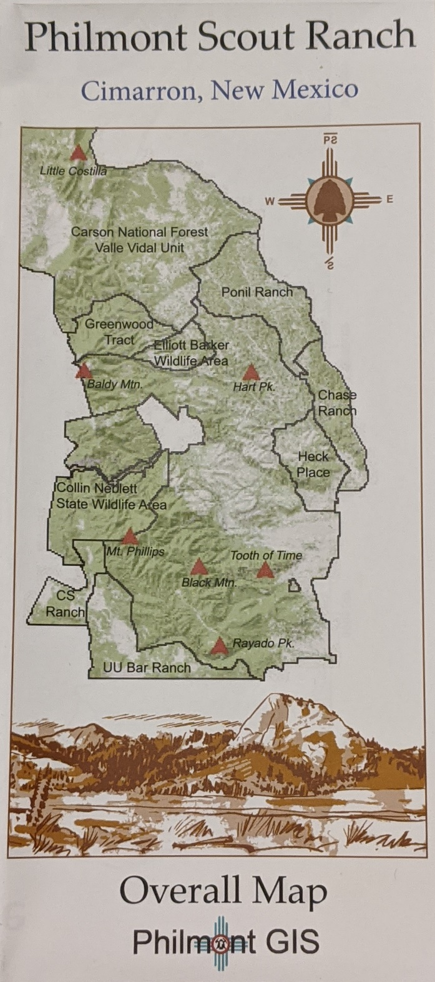
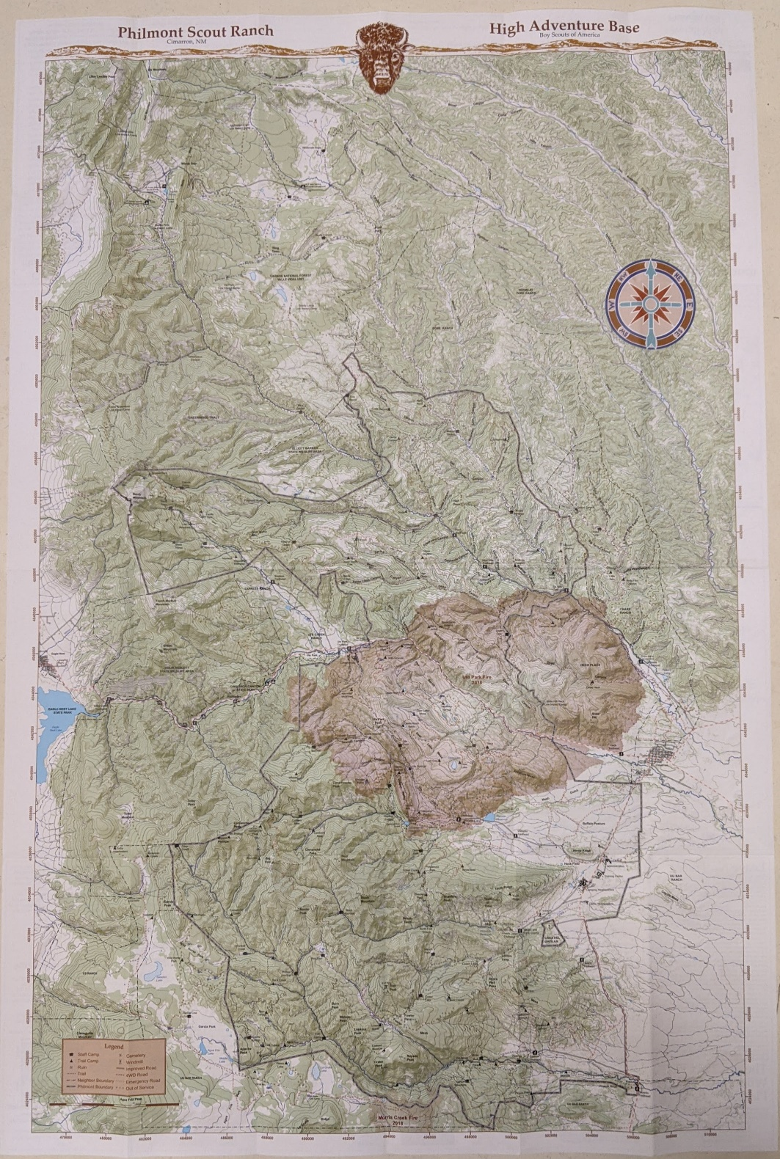

Slide 6
What do you do there?
11-day backpacking trip covering 46-78 miles (also 7-day and 9-day)
30+ staff camps, 70+ trail camps
Daily activities include
  Rock climbing
  Spar pole climbing
  Black powder rifle
  Gold panning/mine tour
  Burro packing
  Western lore
  Challenge events
  Shotgun shooting
  Blacksmithing
  Challenge events

Slide 7
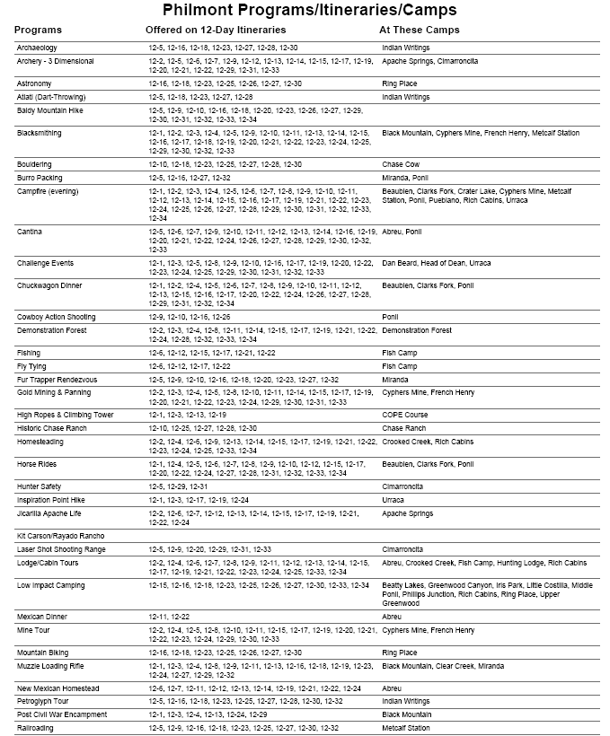

Slide 8
(Handout - 31 Photos Removed Of:)
  Rock climbing
  Rappelling
  Spar pole climbing
  Black powder rifle
  Tomahawk throwing
  Gold panning
  Blacksmithing
  Mine tour
  Burro racing
  Burro packing
  Western lore/branding
  Challenge events
  Shotgun shooting
  Mud
  Musical programs
  Wildlife
  Crew - Tooth of Time
  Crew - Baldy Mt.

Slide 9
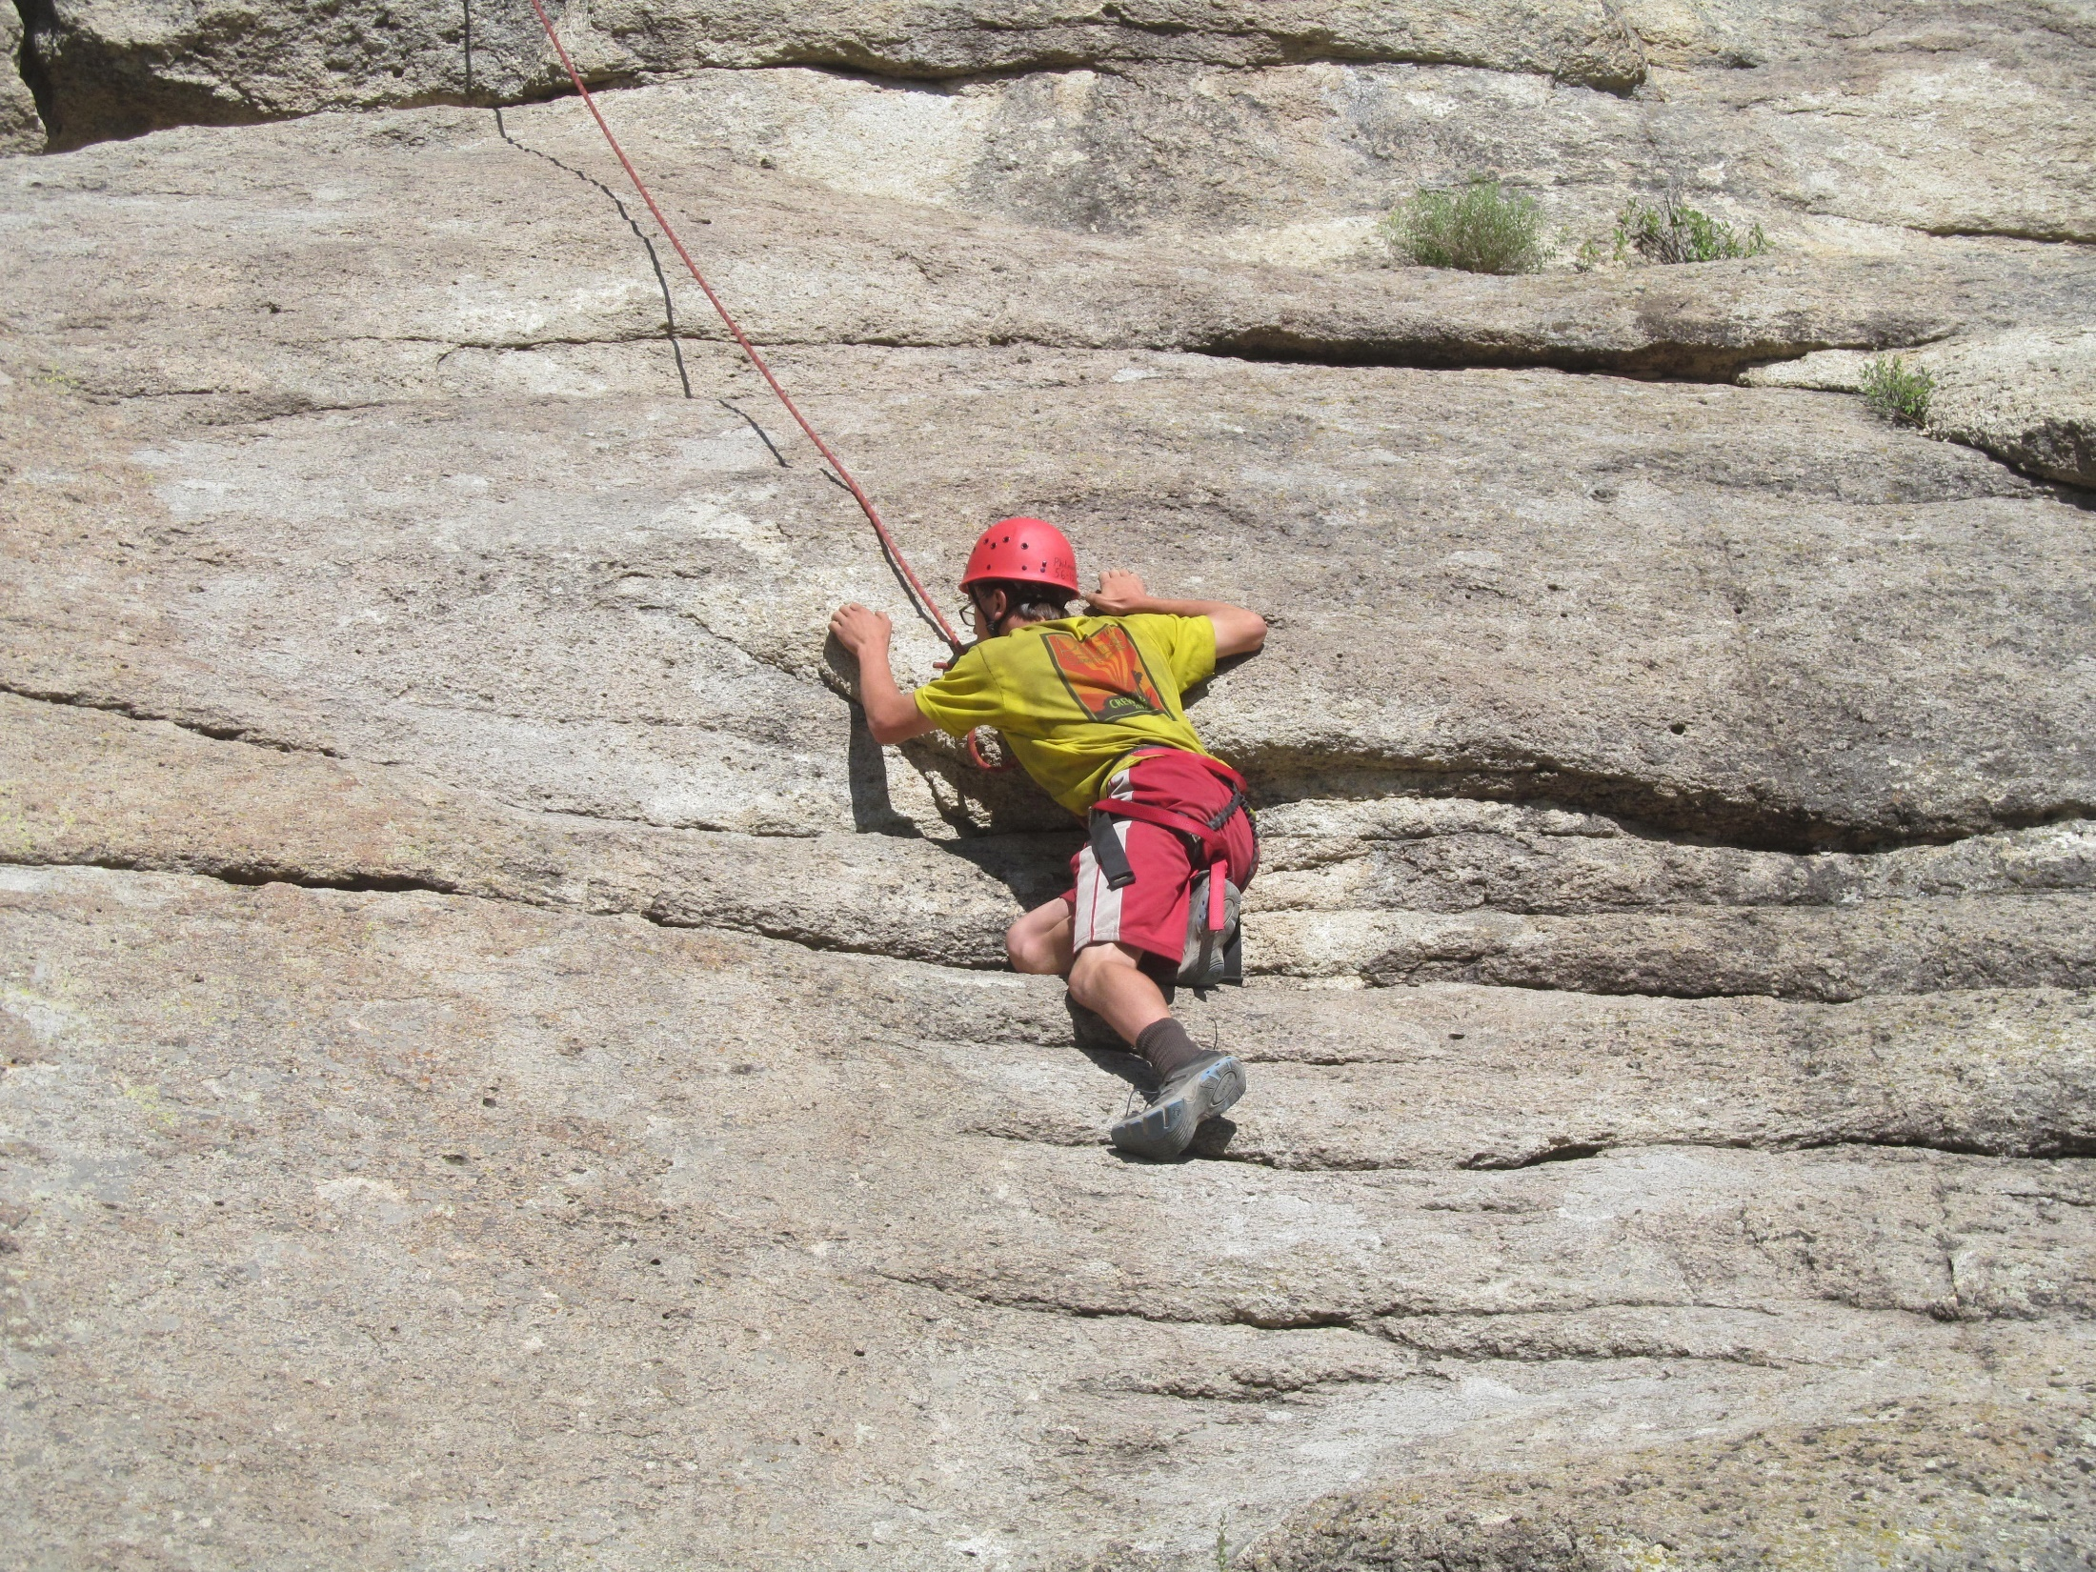

Slide 10
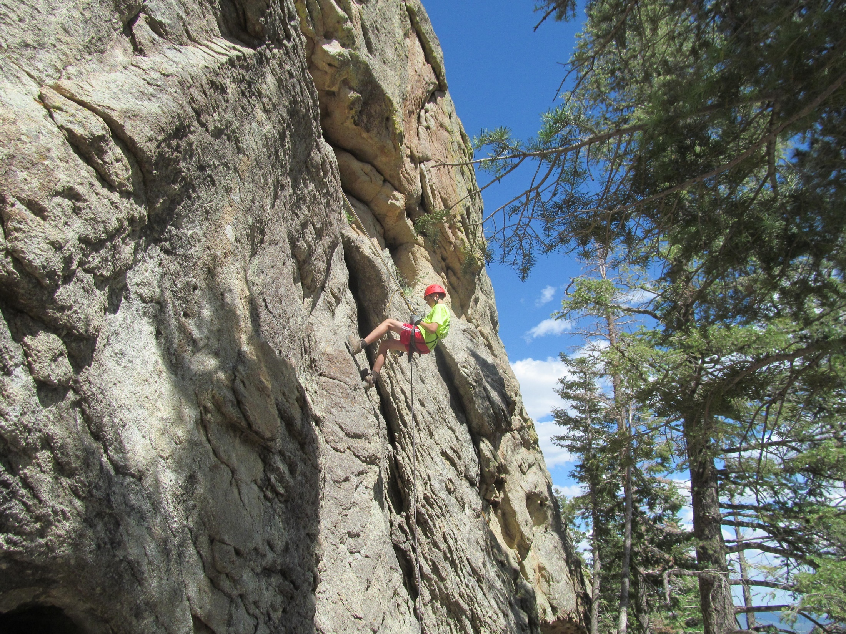

Slide 11
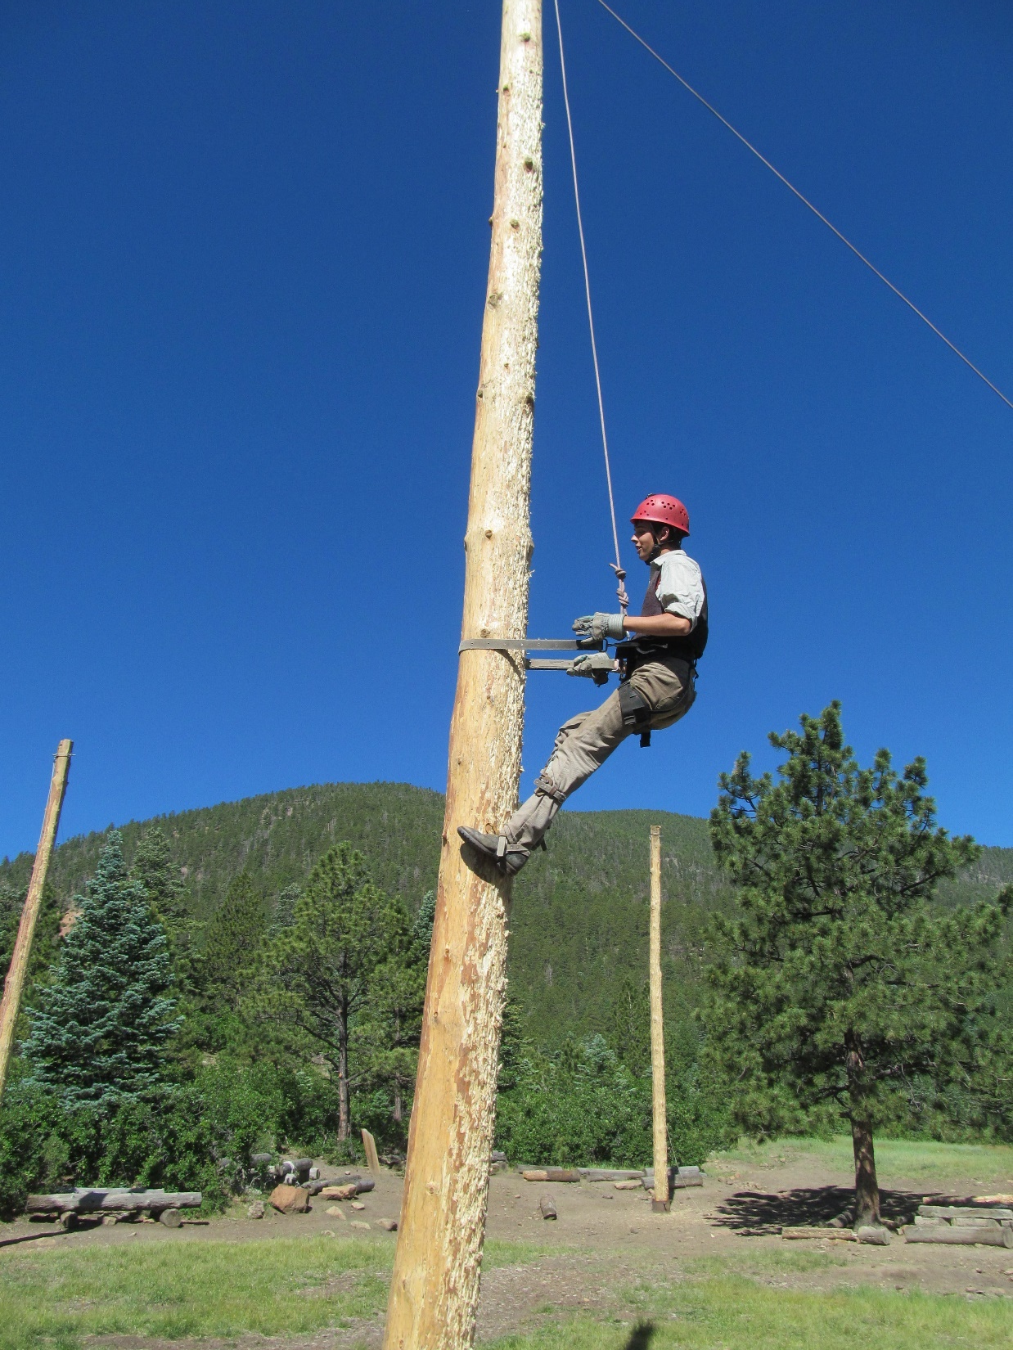

Slide 12
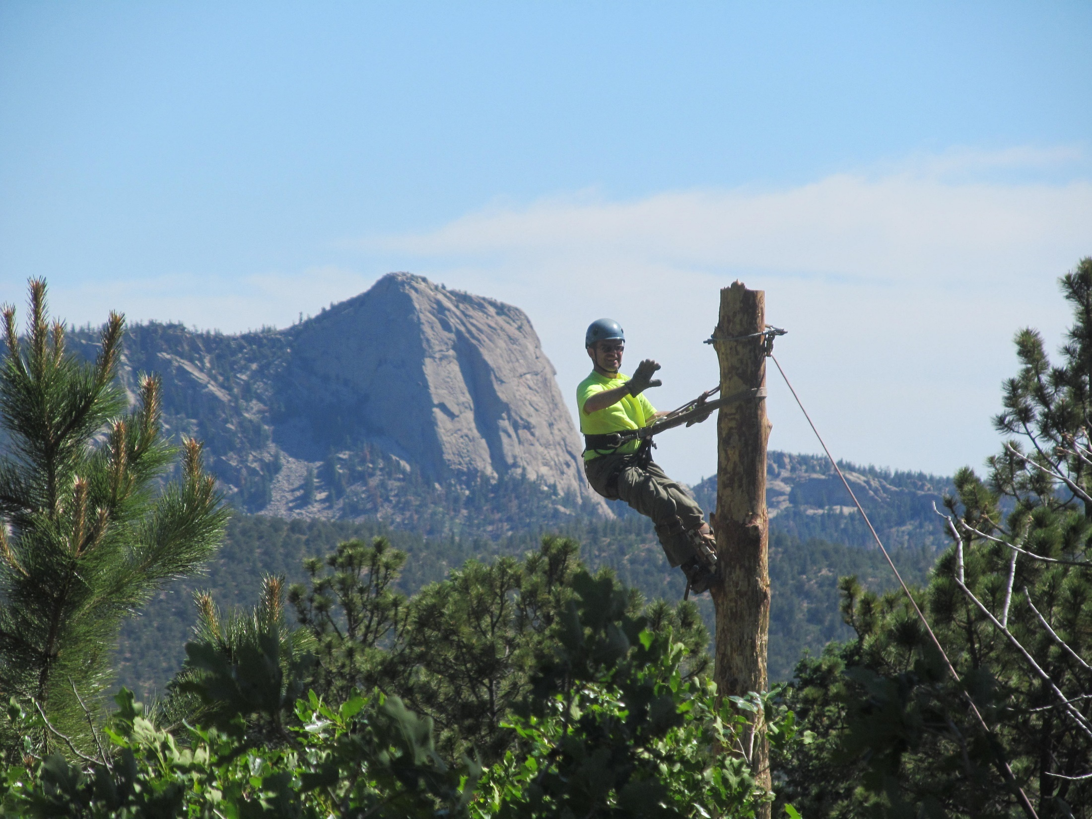

Slide 13
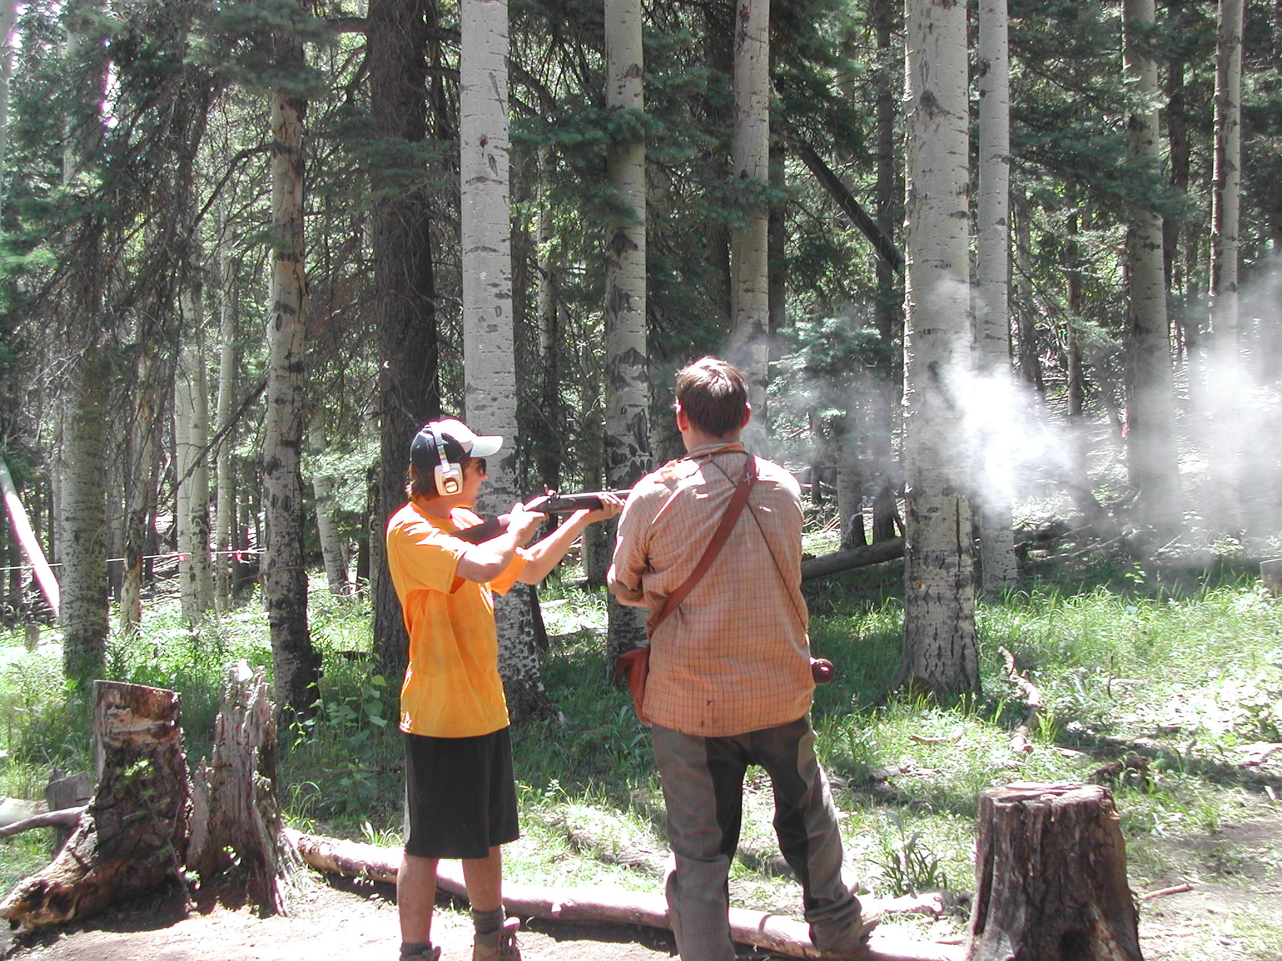

Slide 14
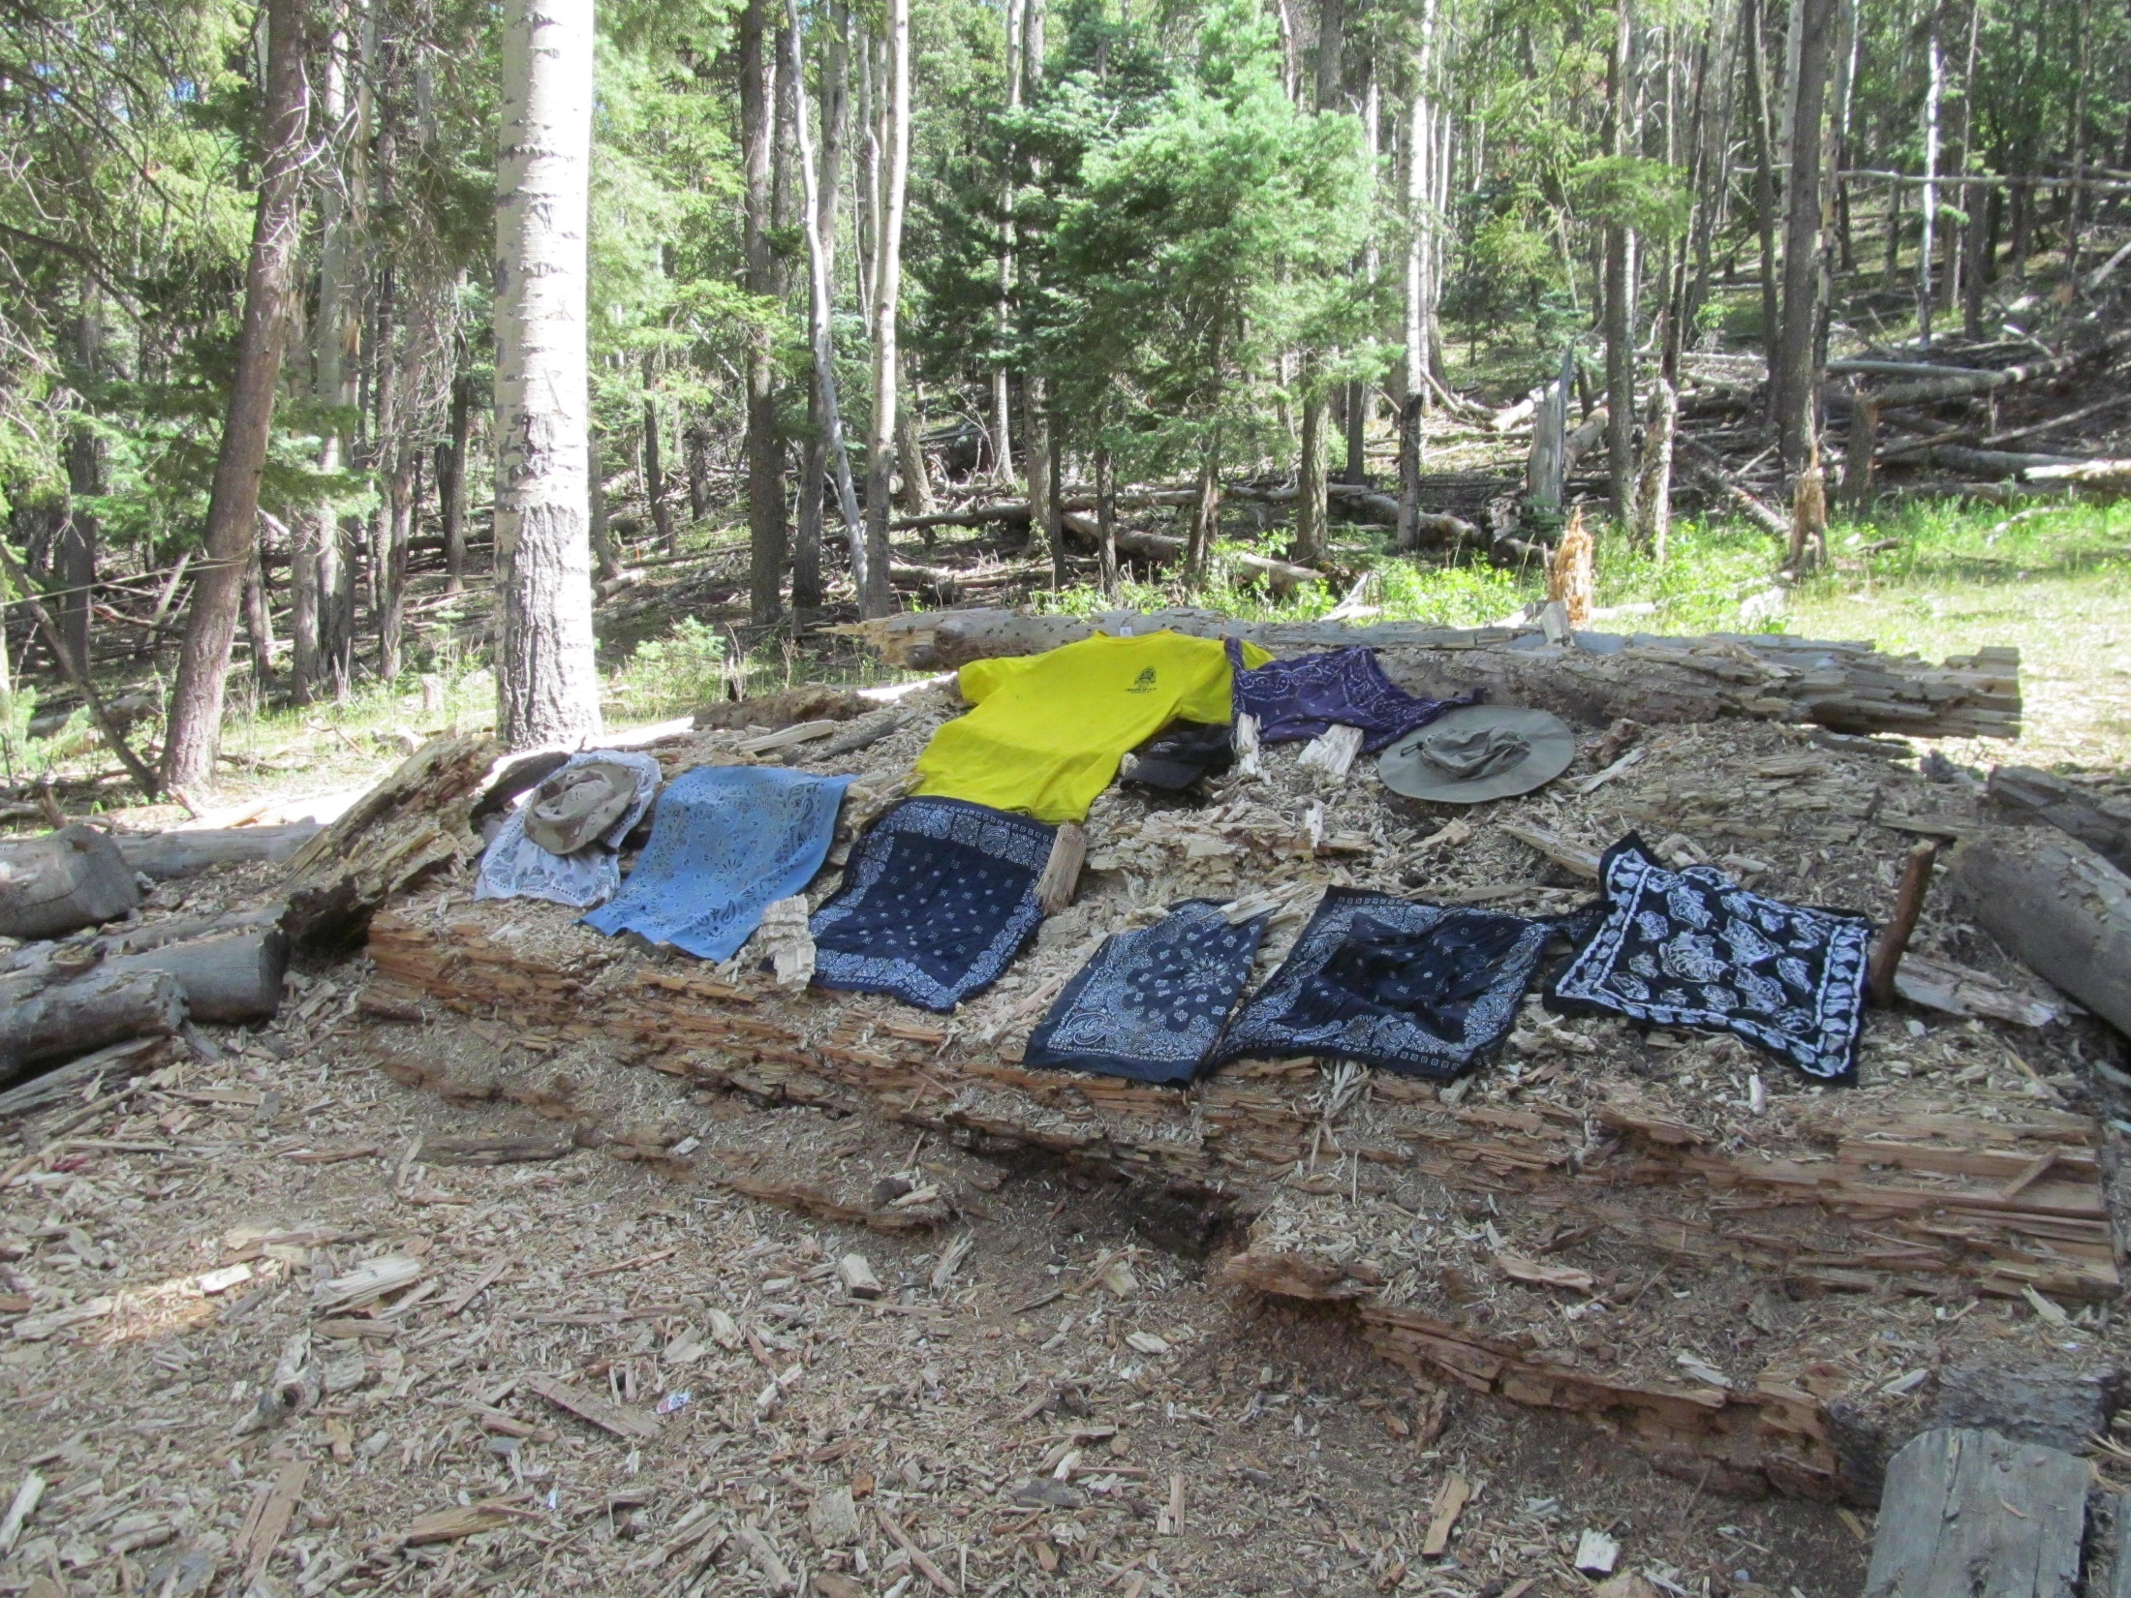

Slide 15
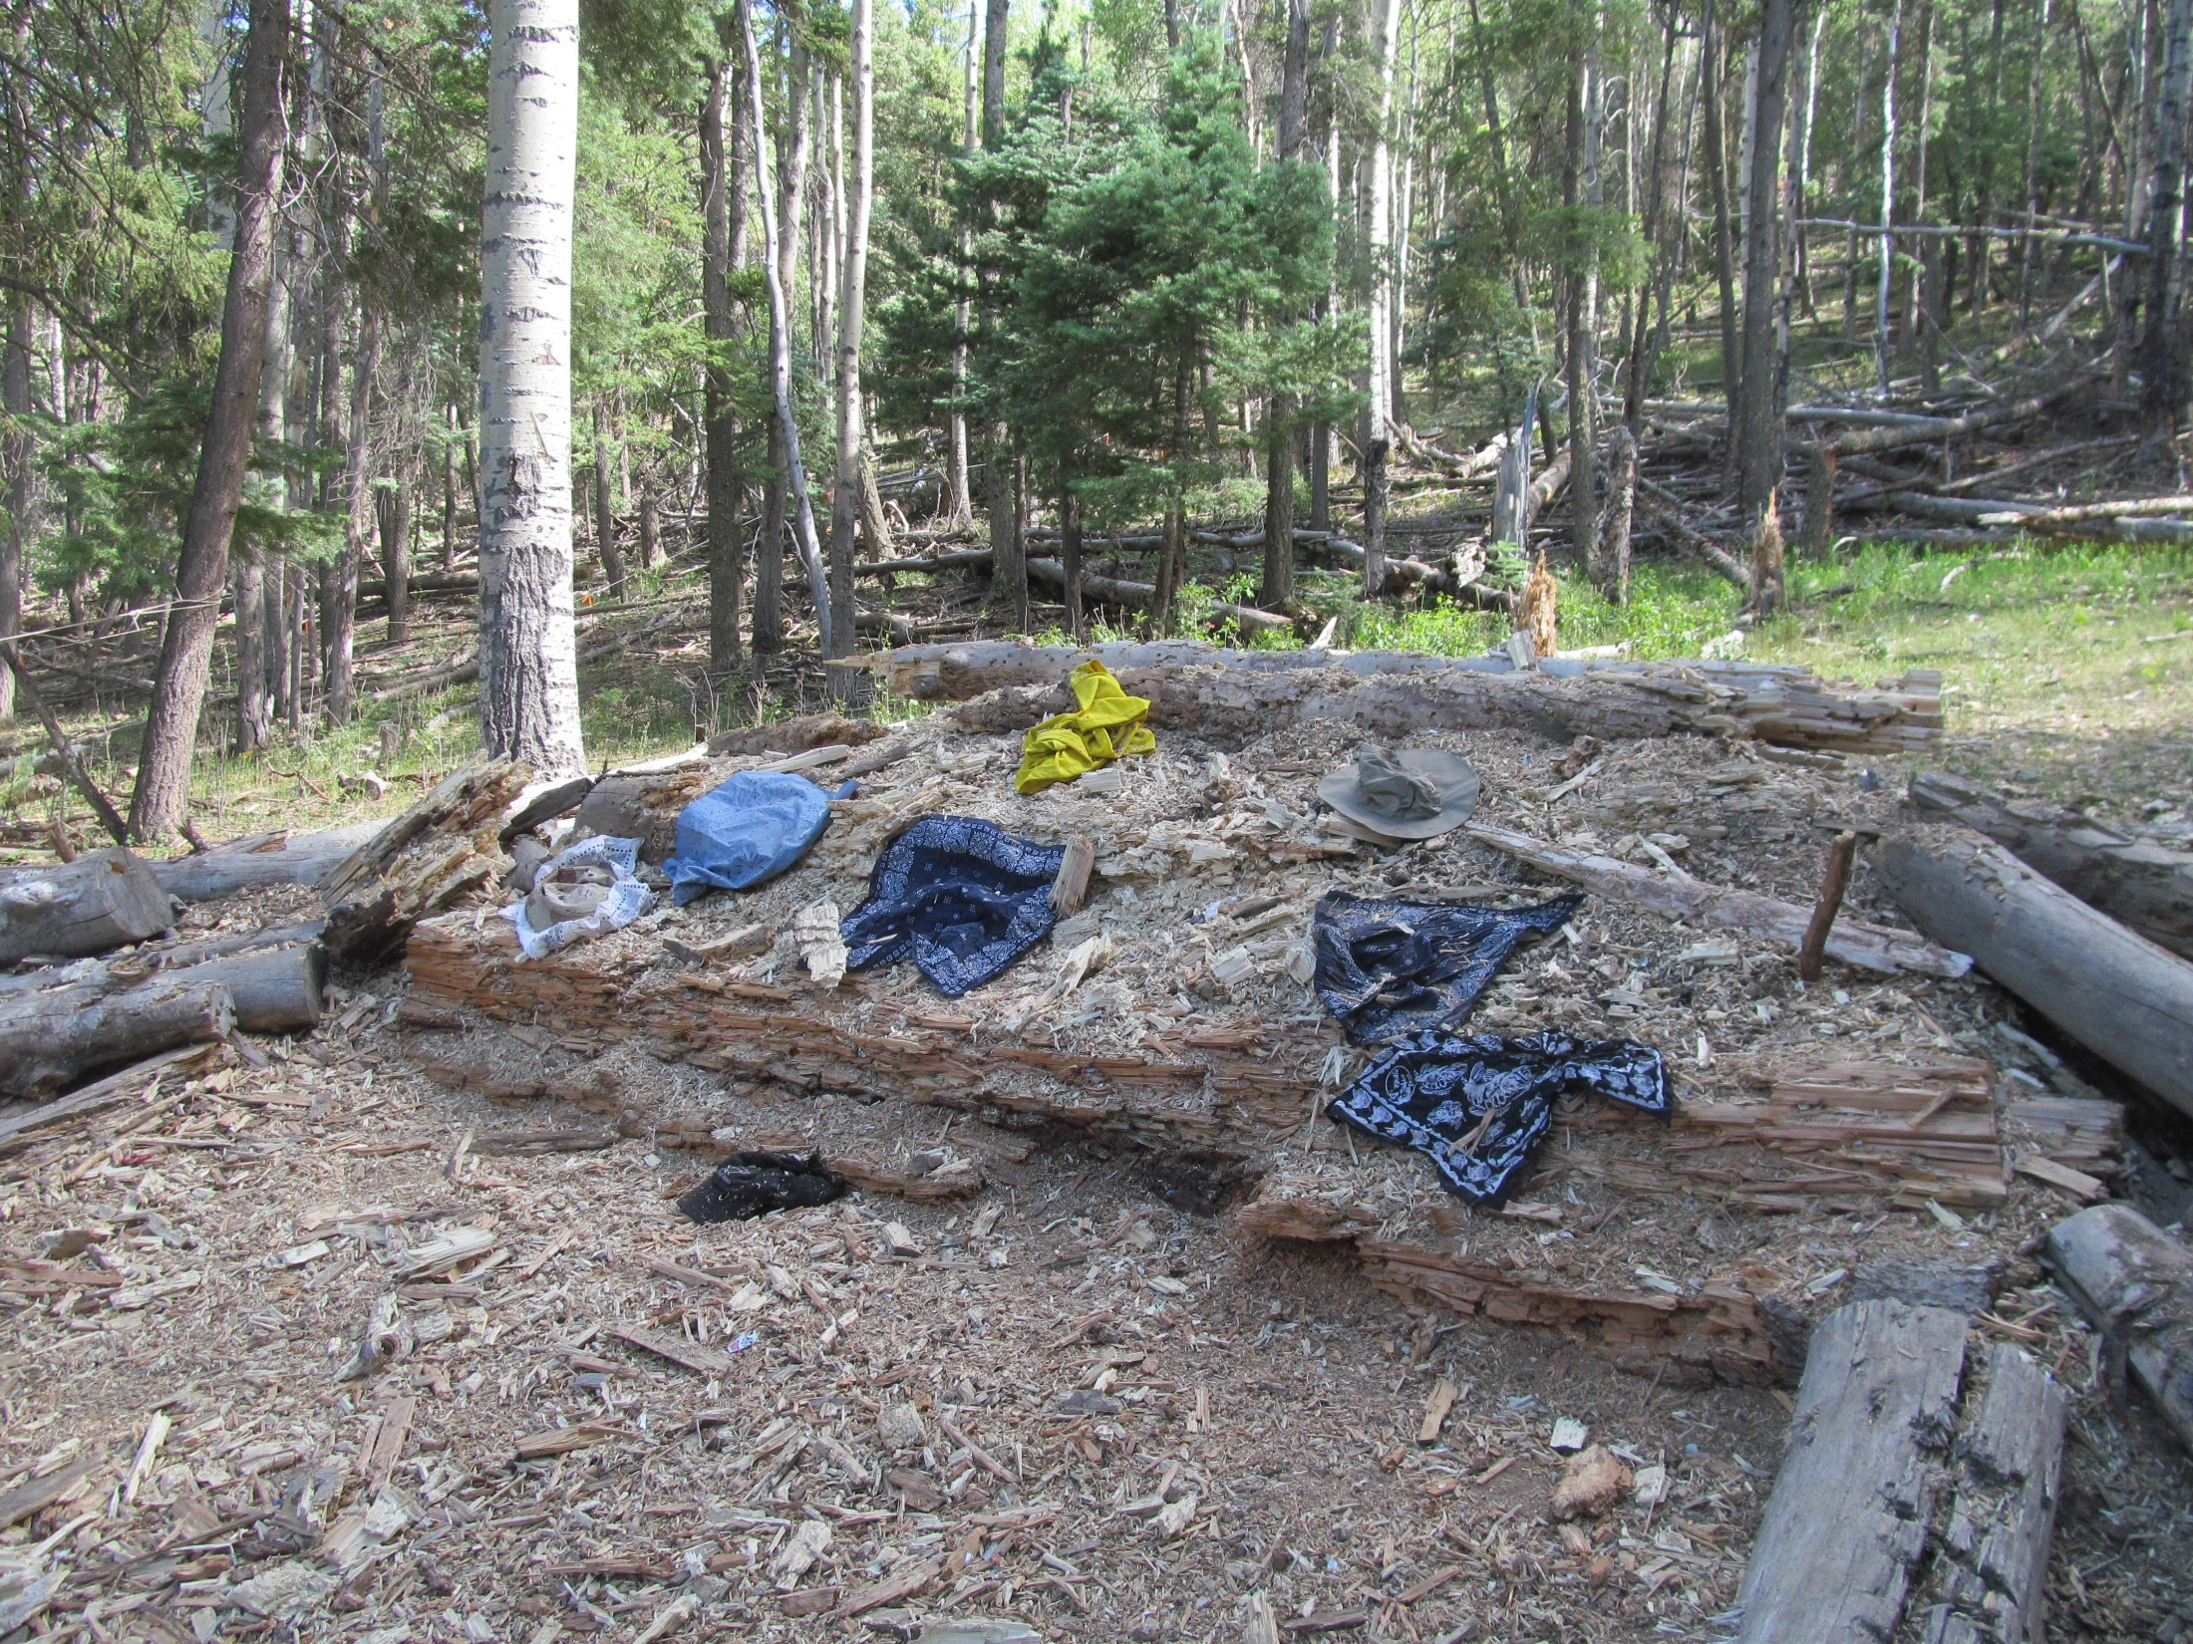

Slide 16
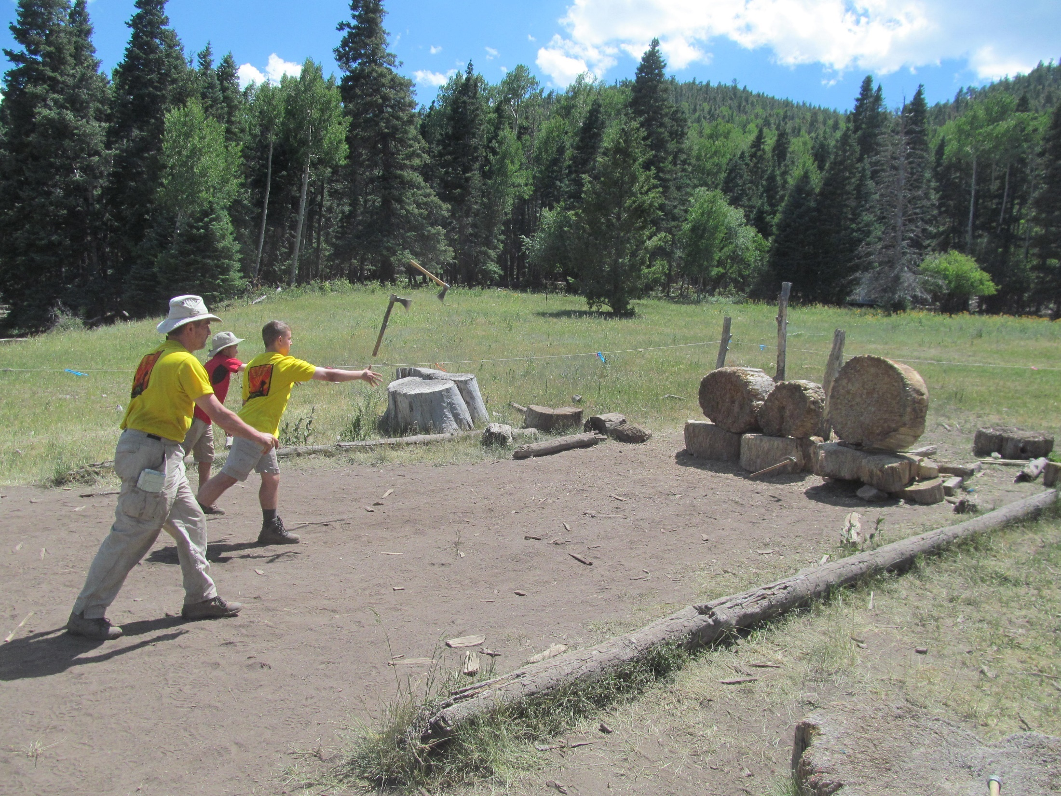

Slide 17
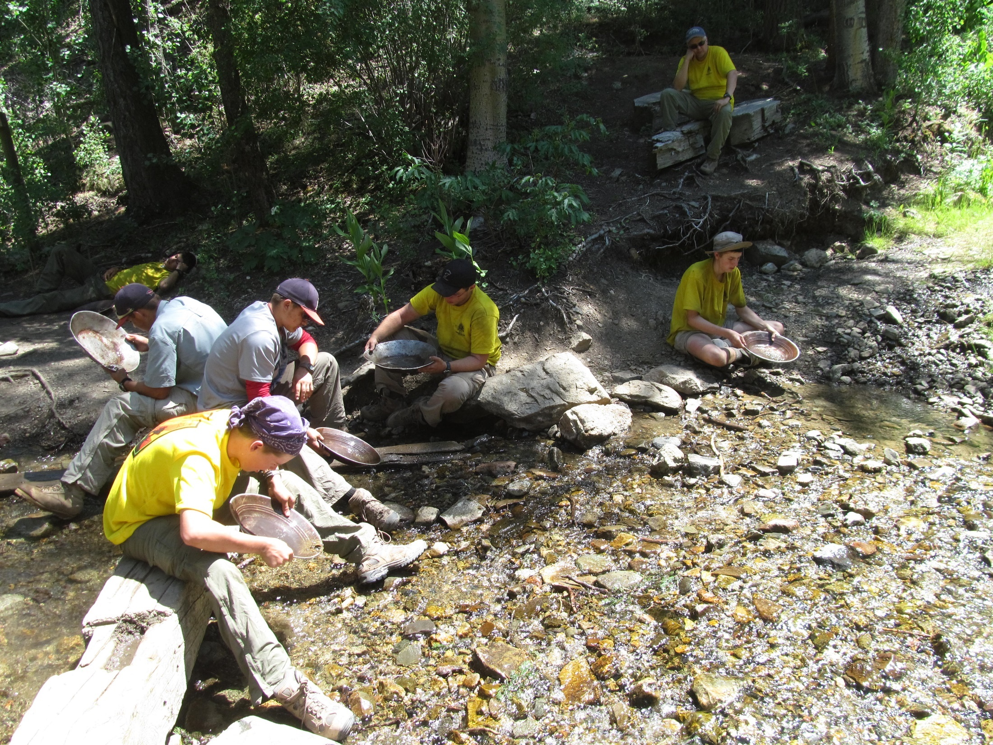

Slide 18
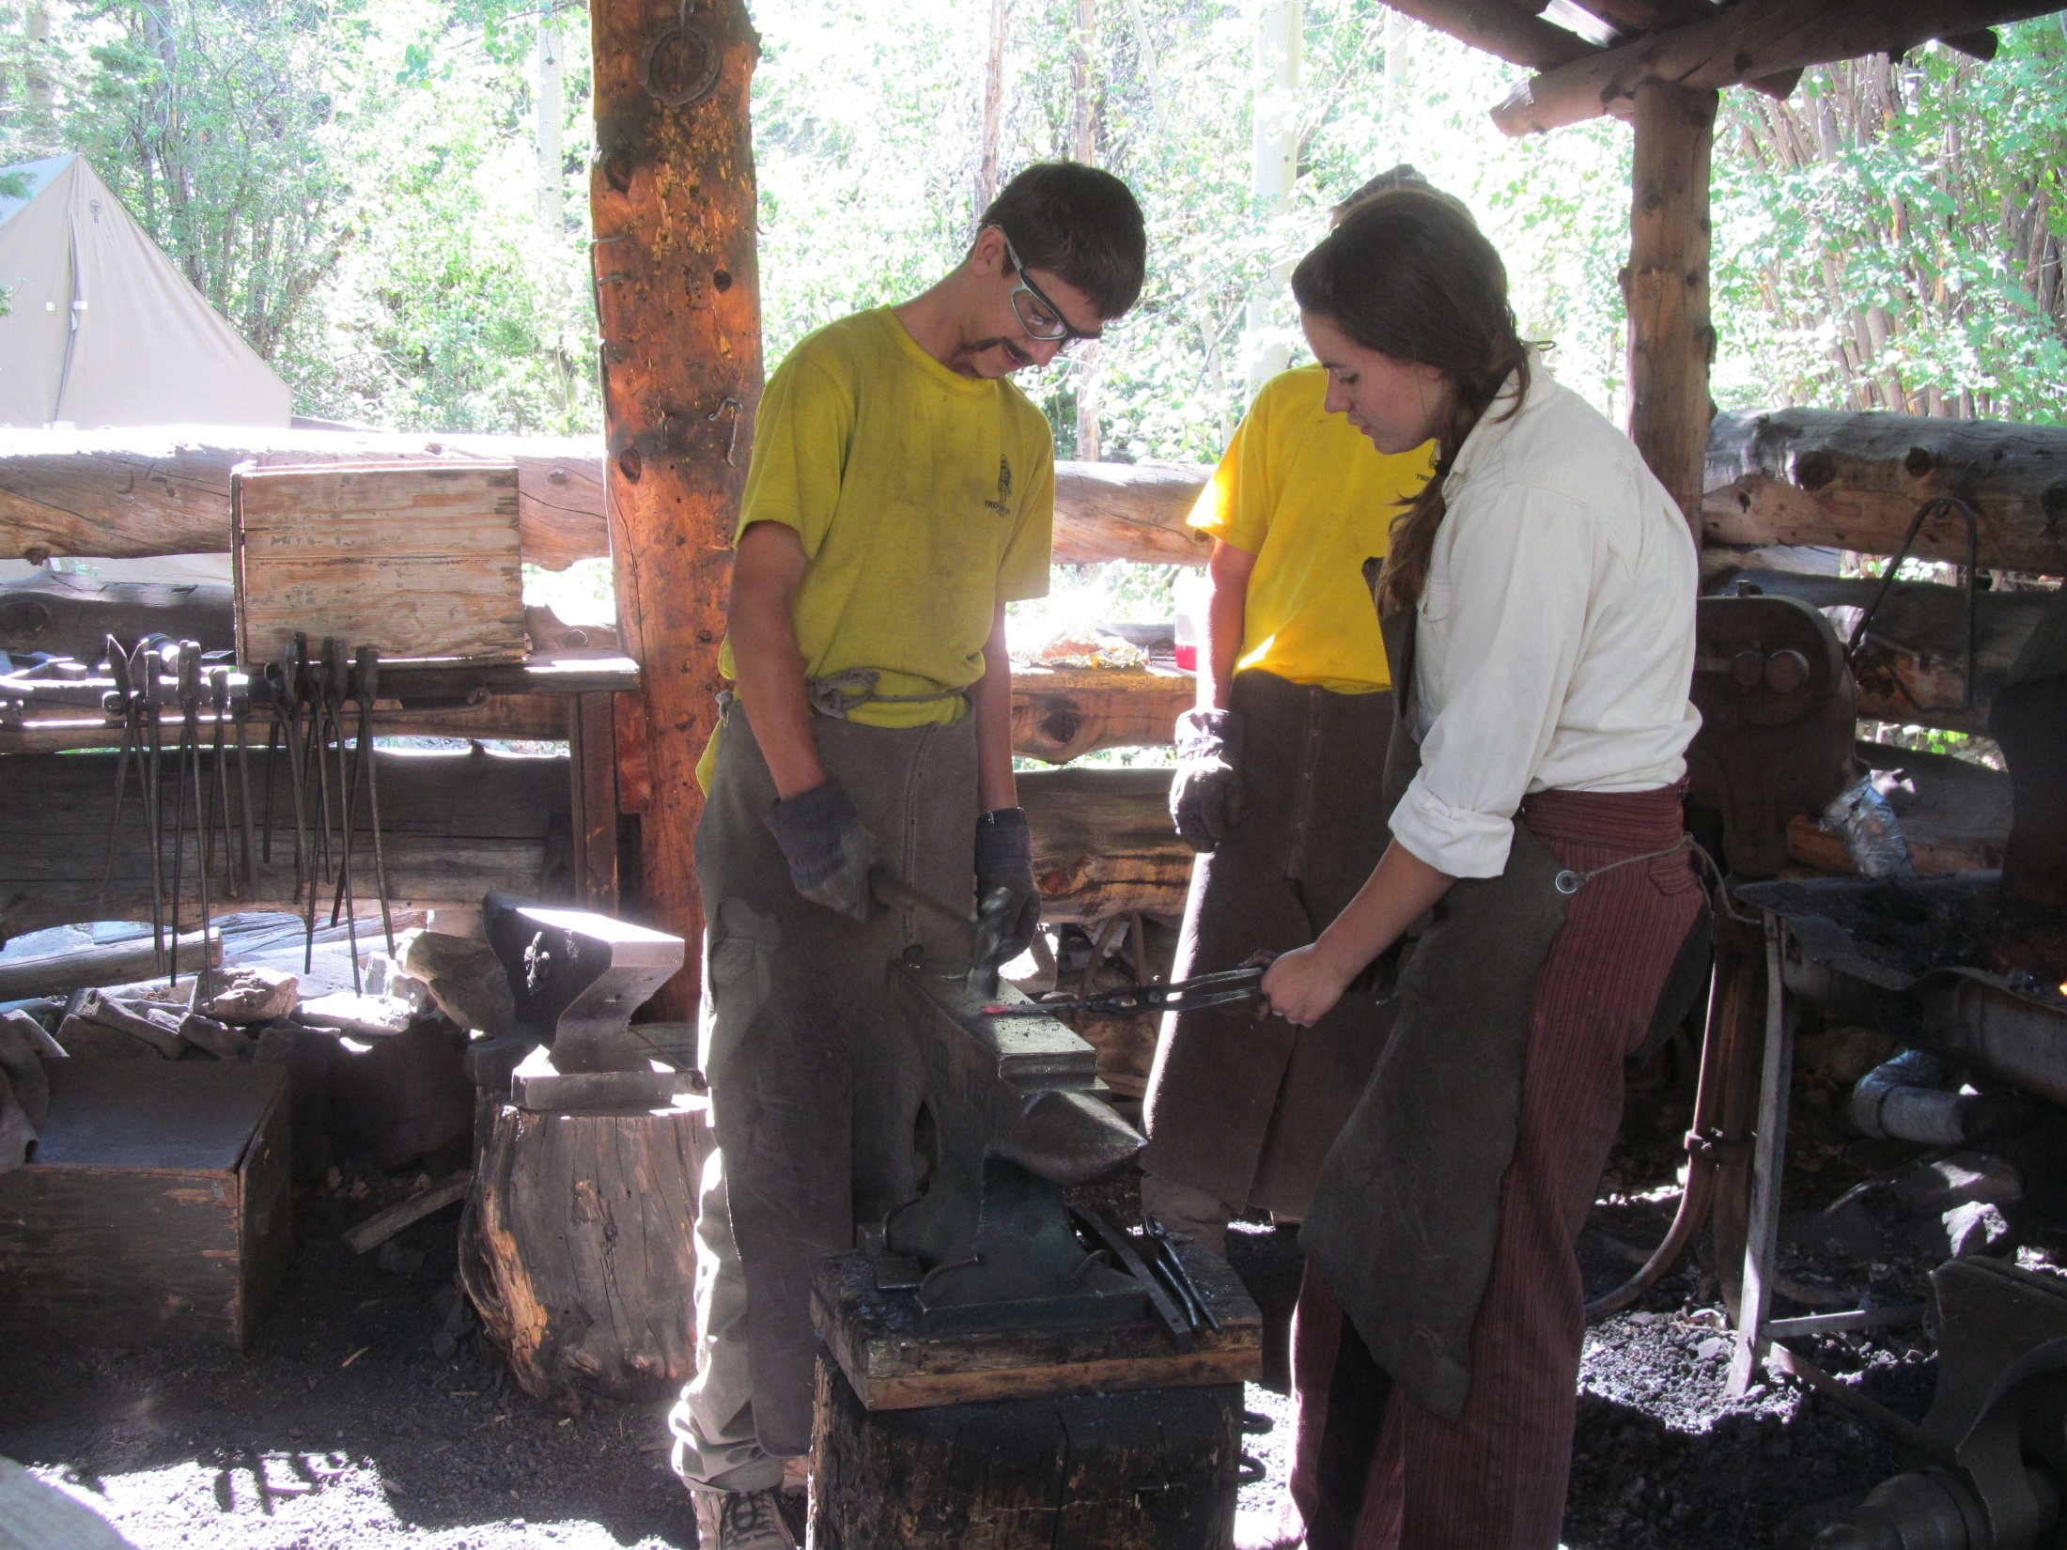

Slide 19
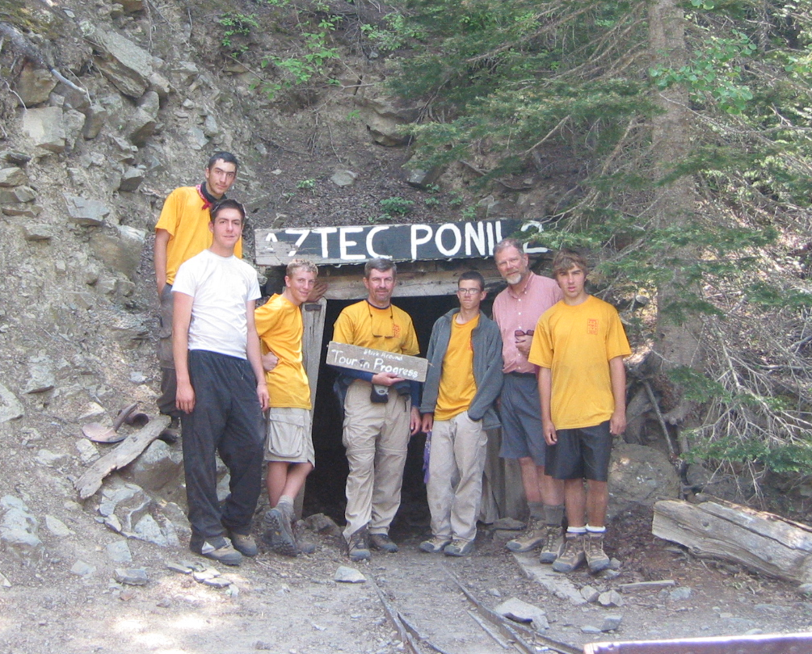

Slide 20
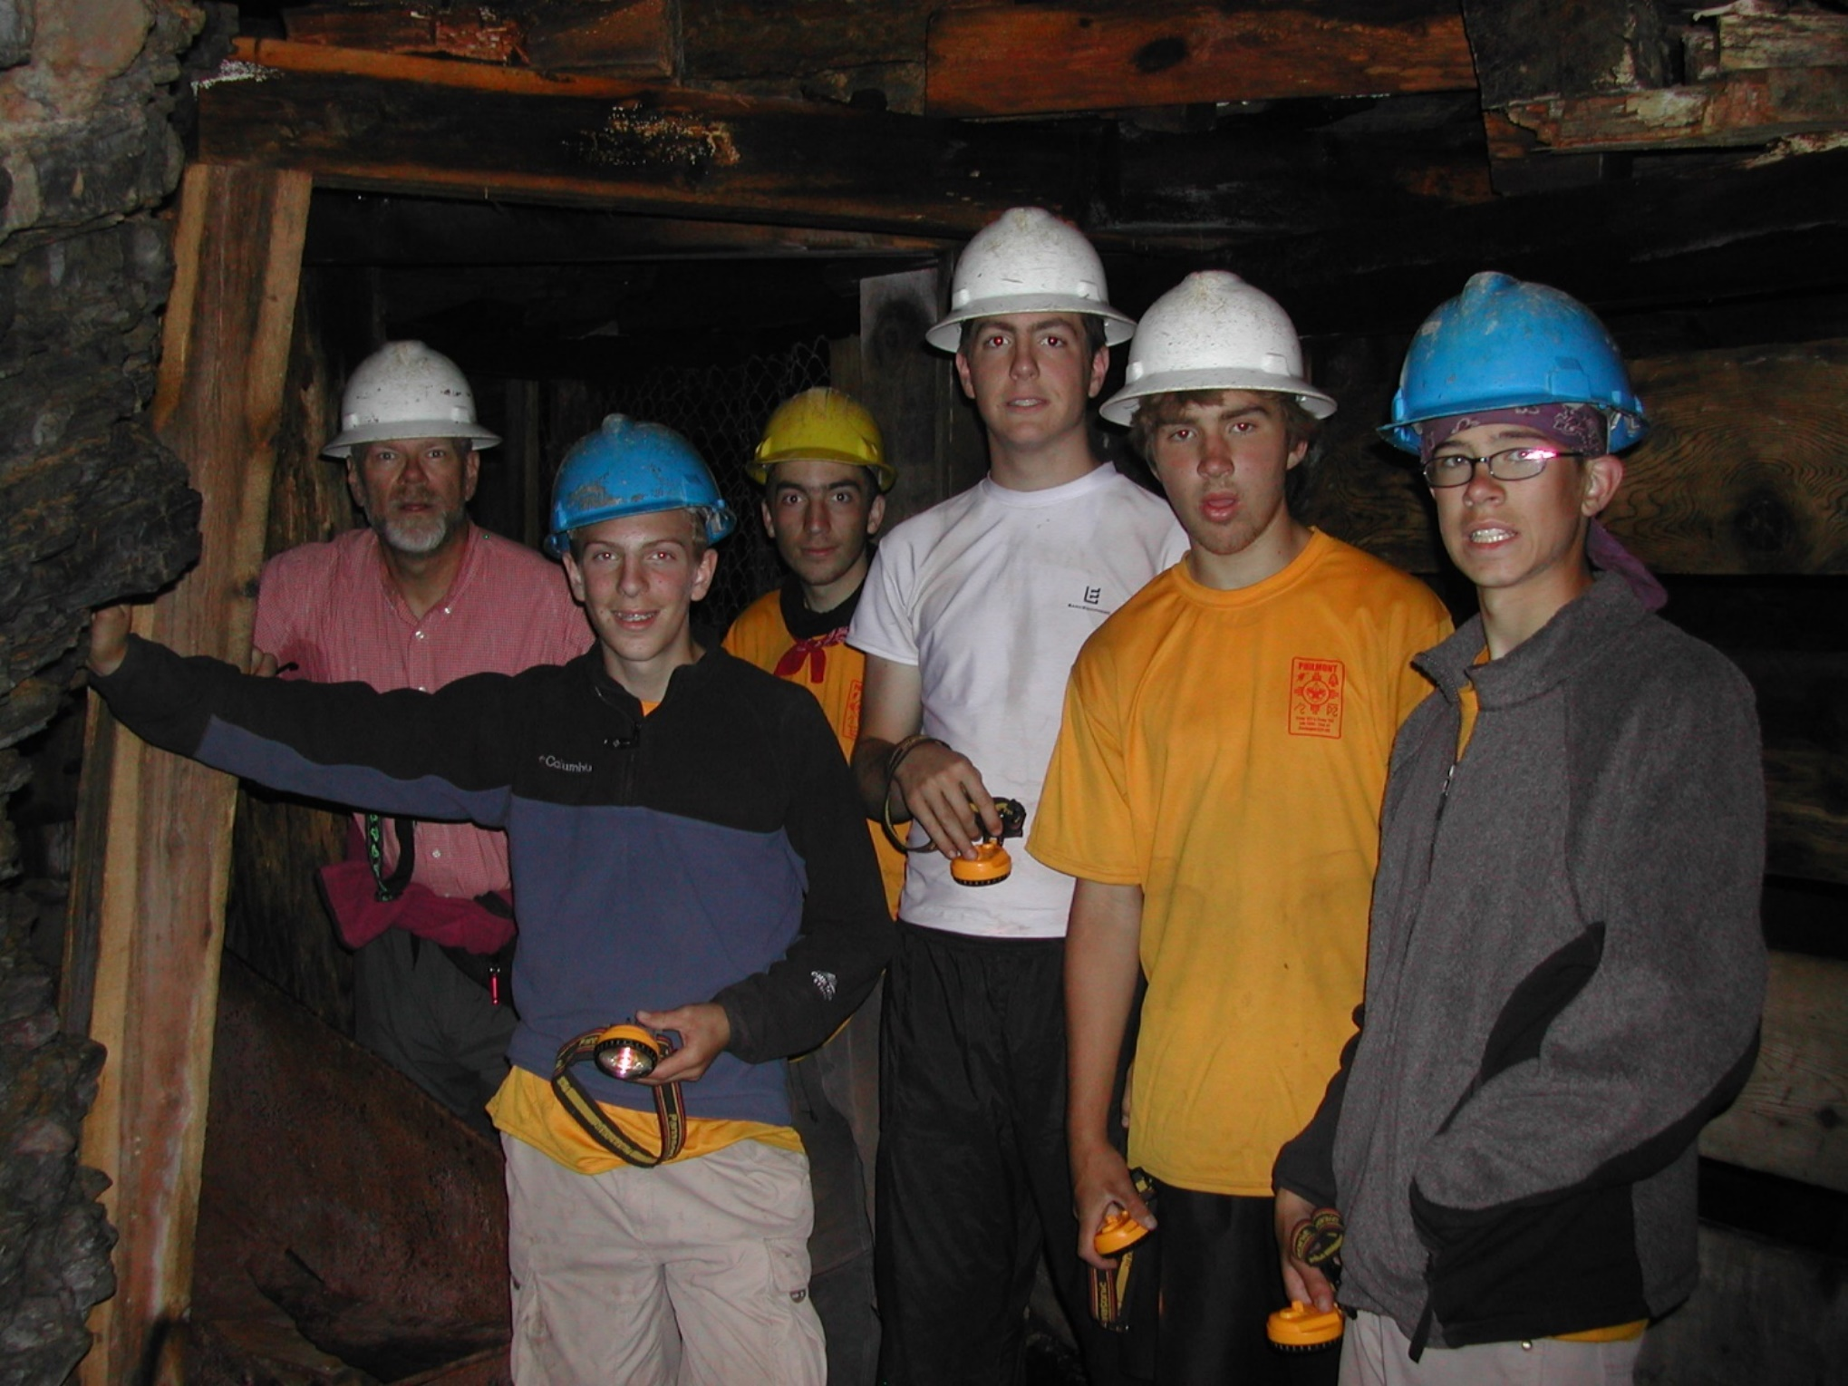

Slide 21
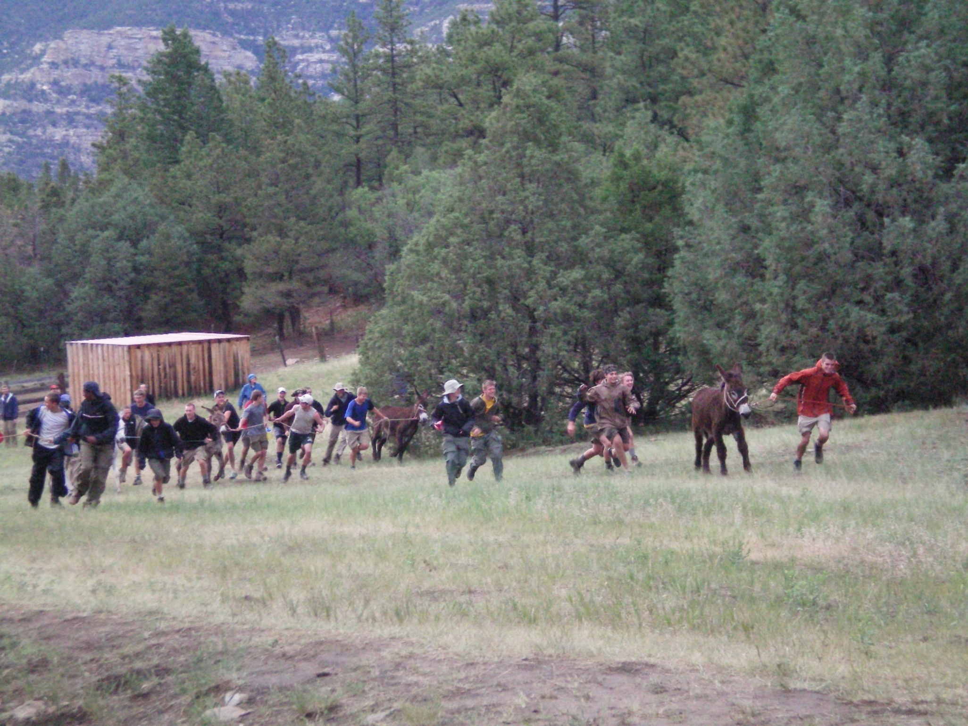

Slide 22
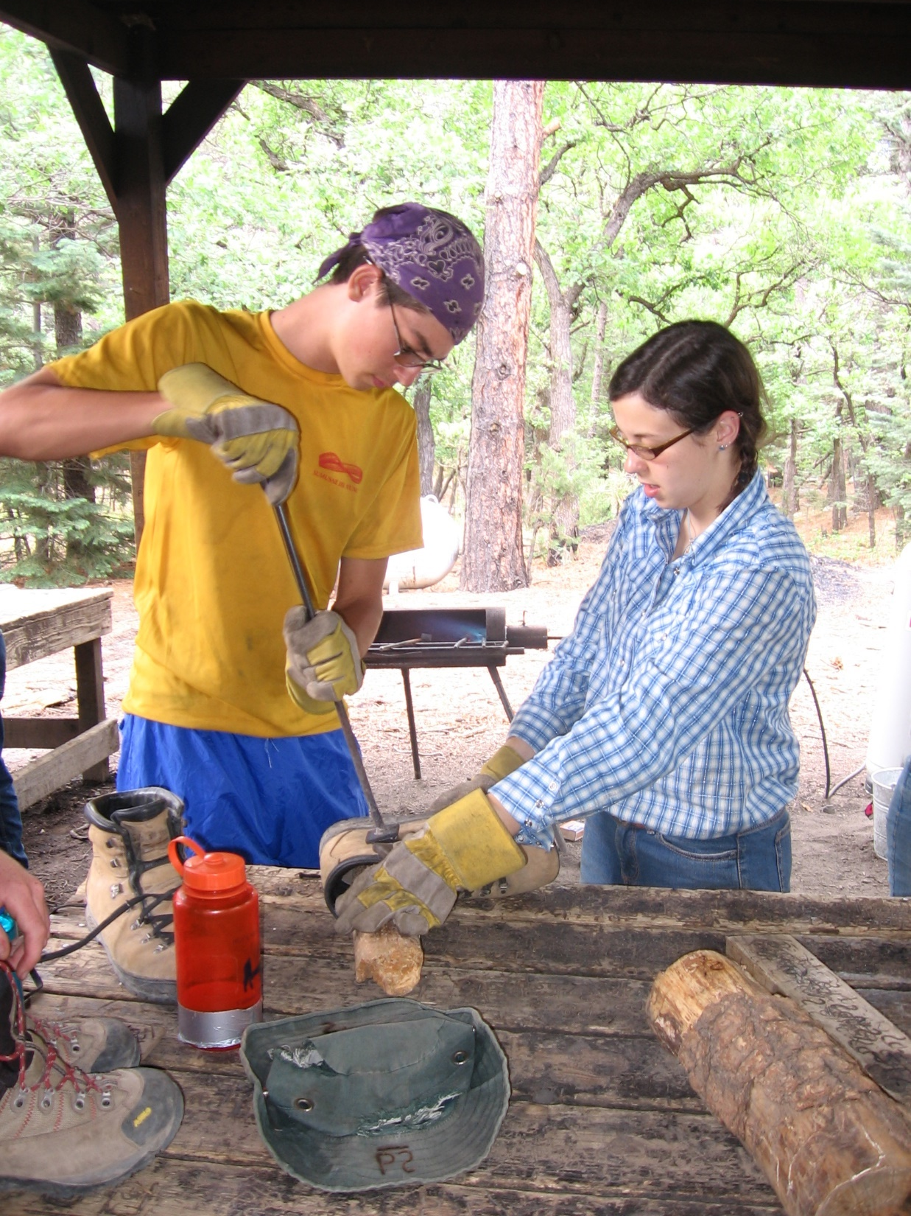

Slide 23
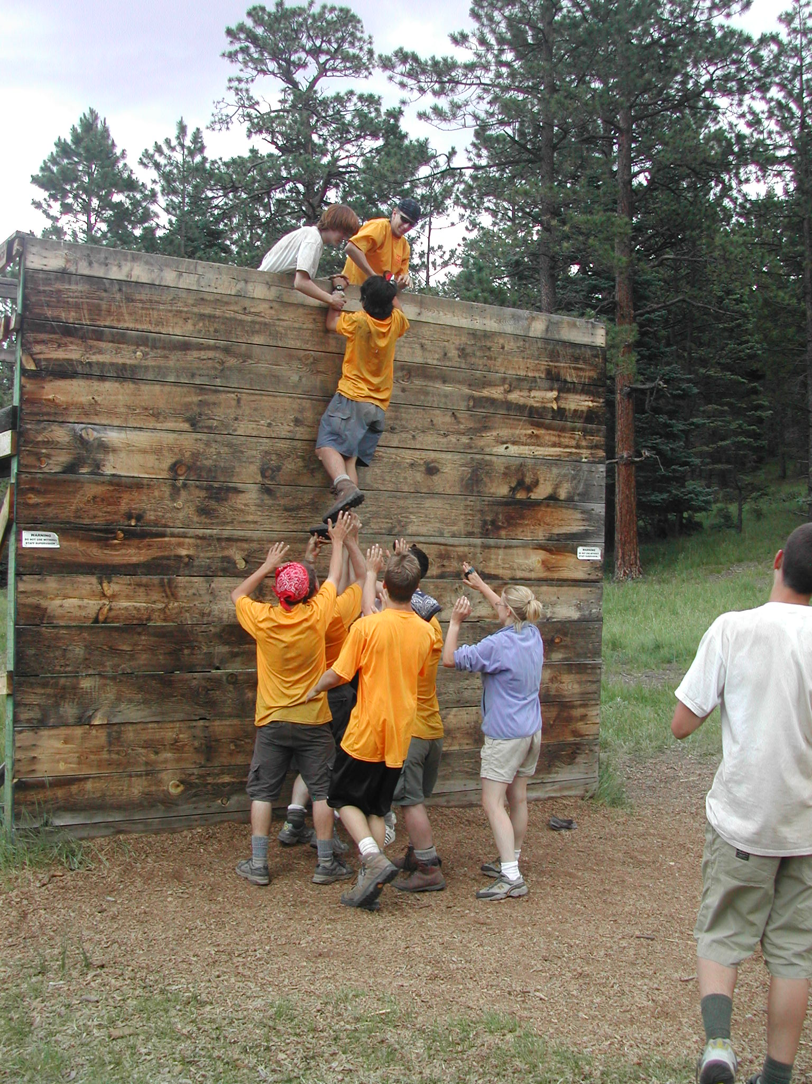

Slide 24
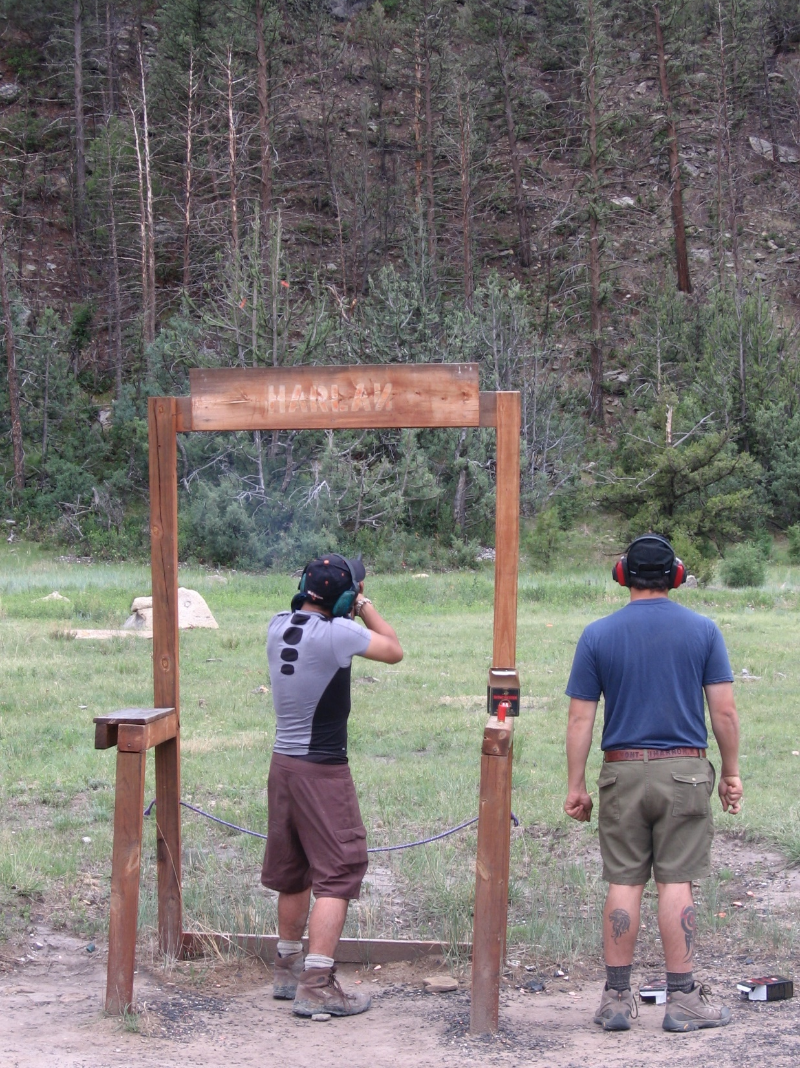

Slide 25
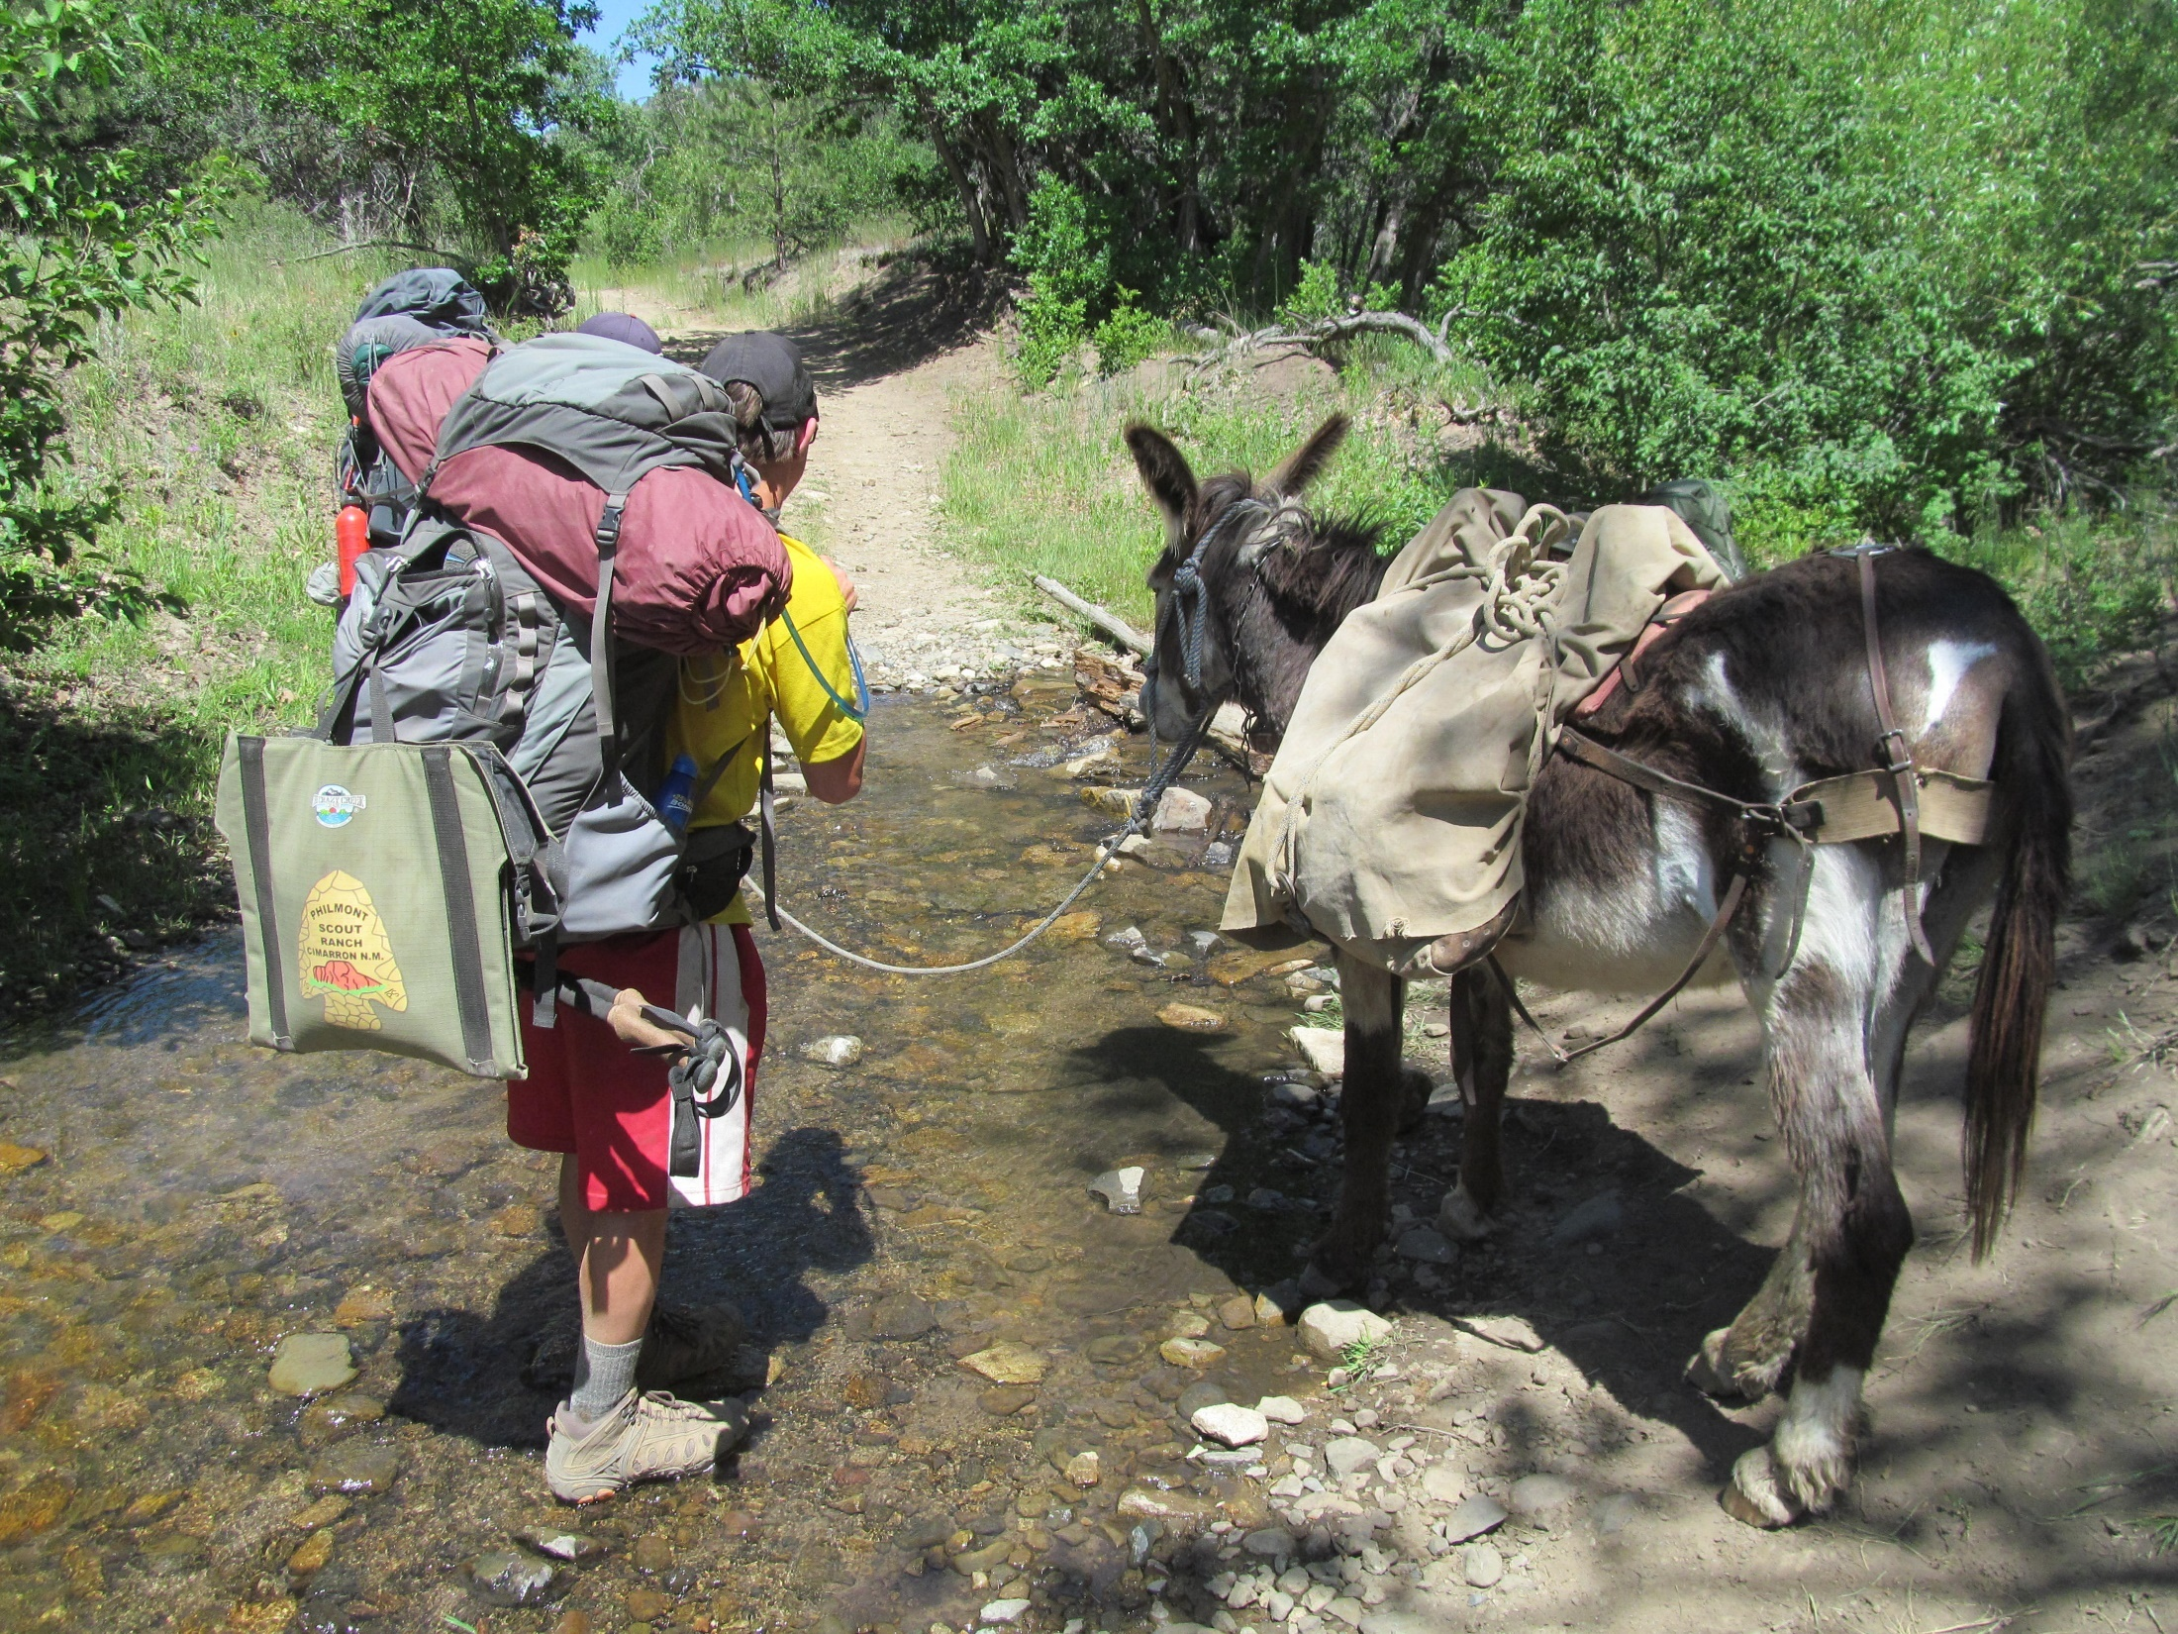

Slide 26
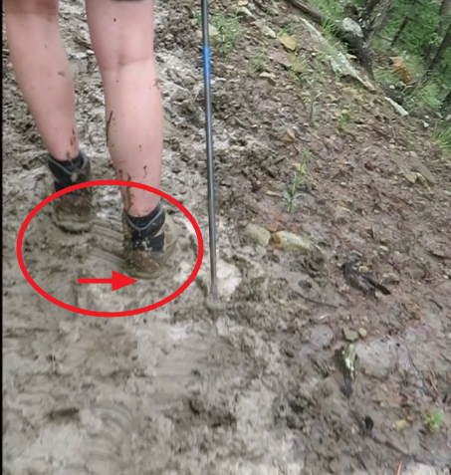

Slide 27
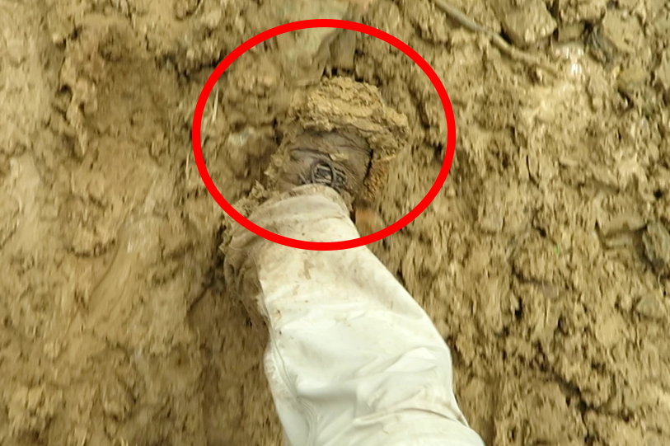

Slide 28
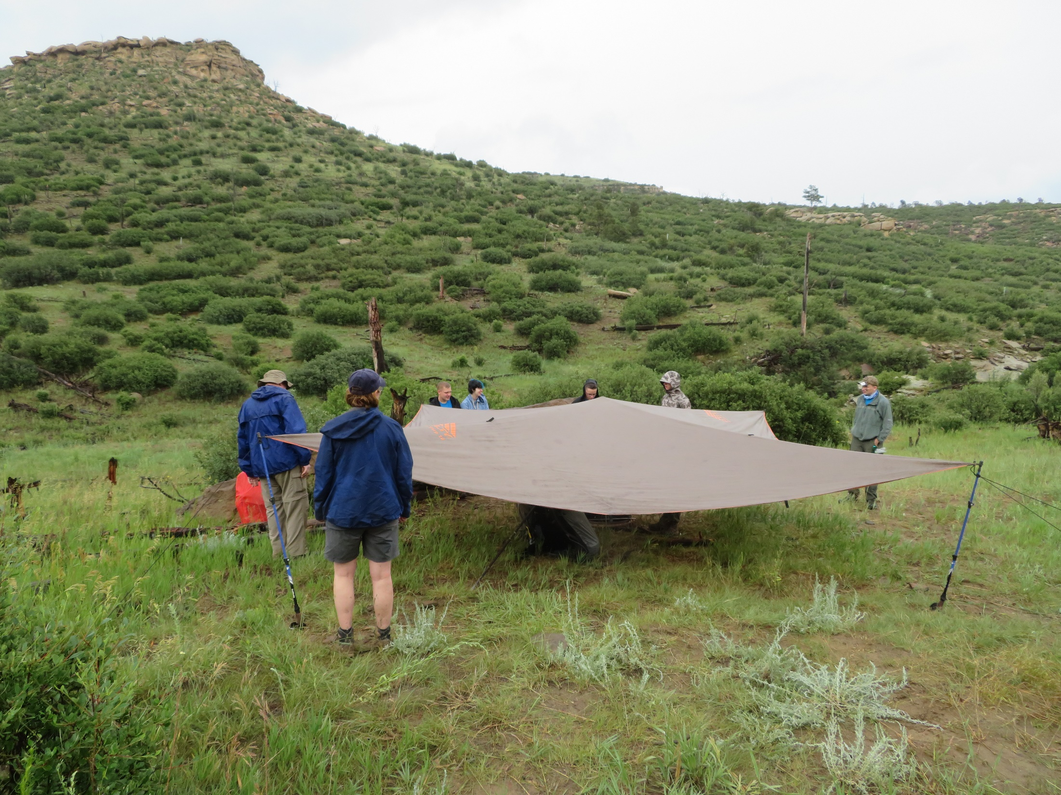

Slide 29
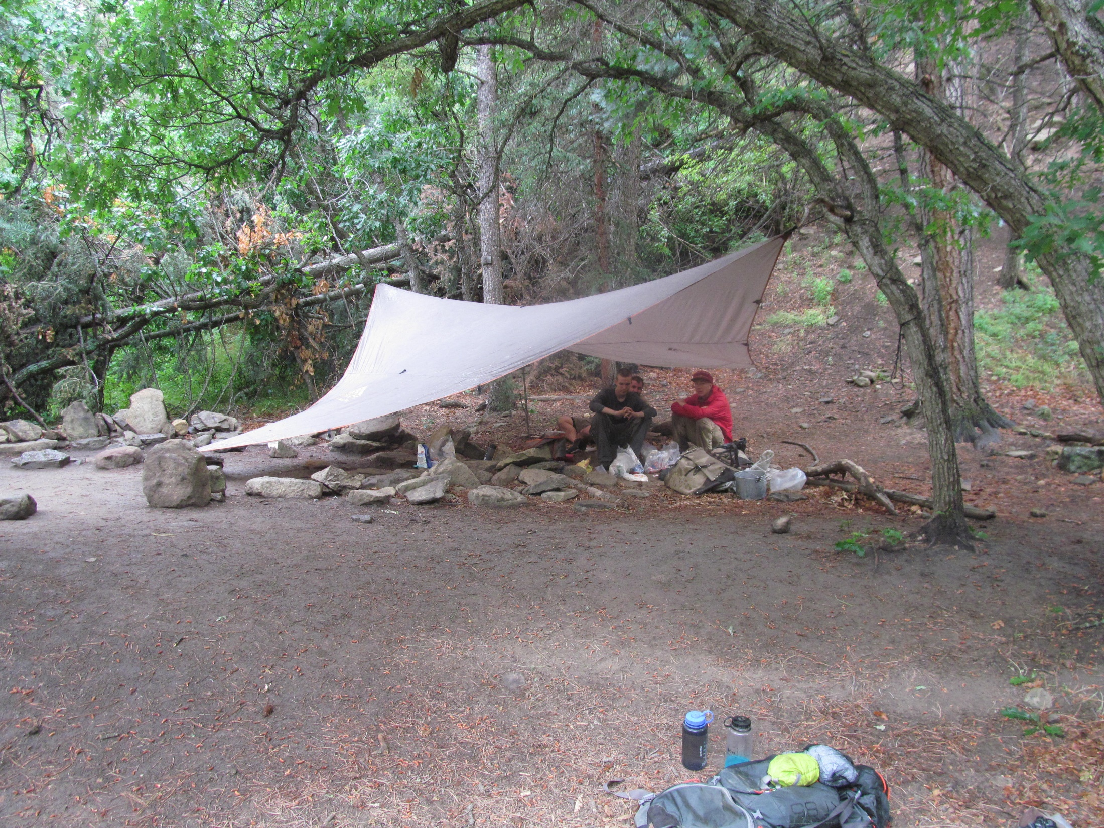

Slide 30
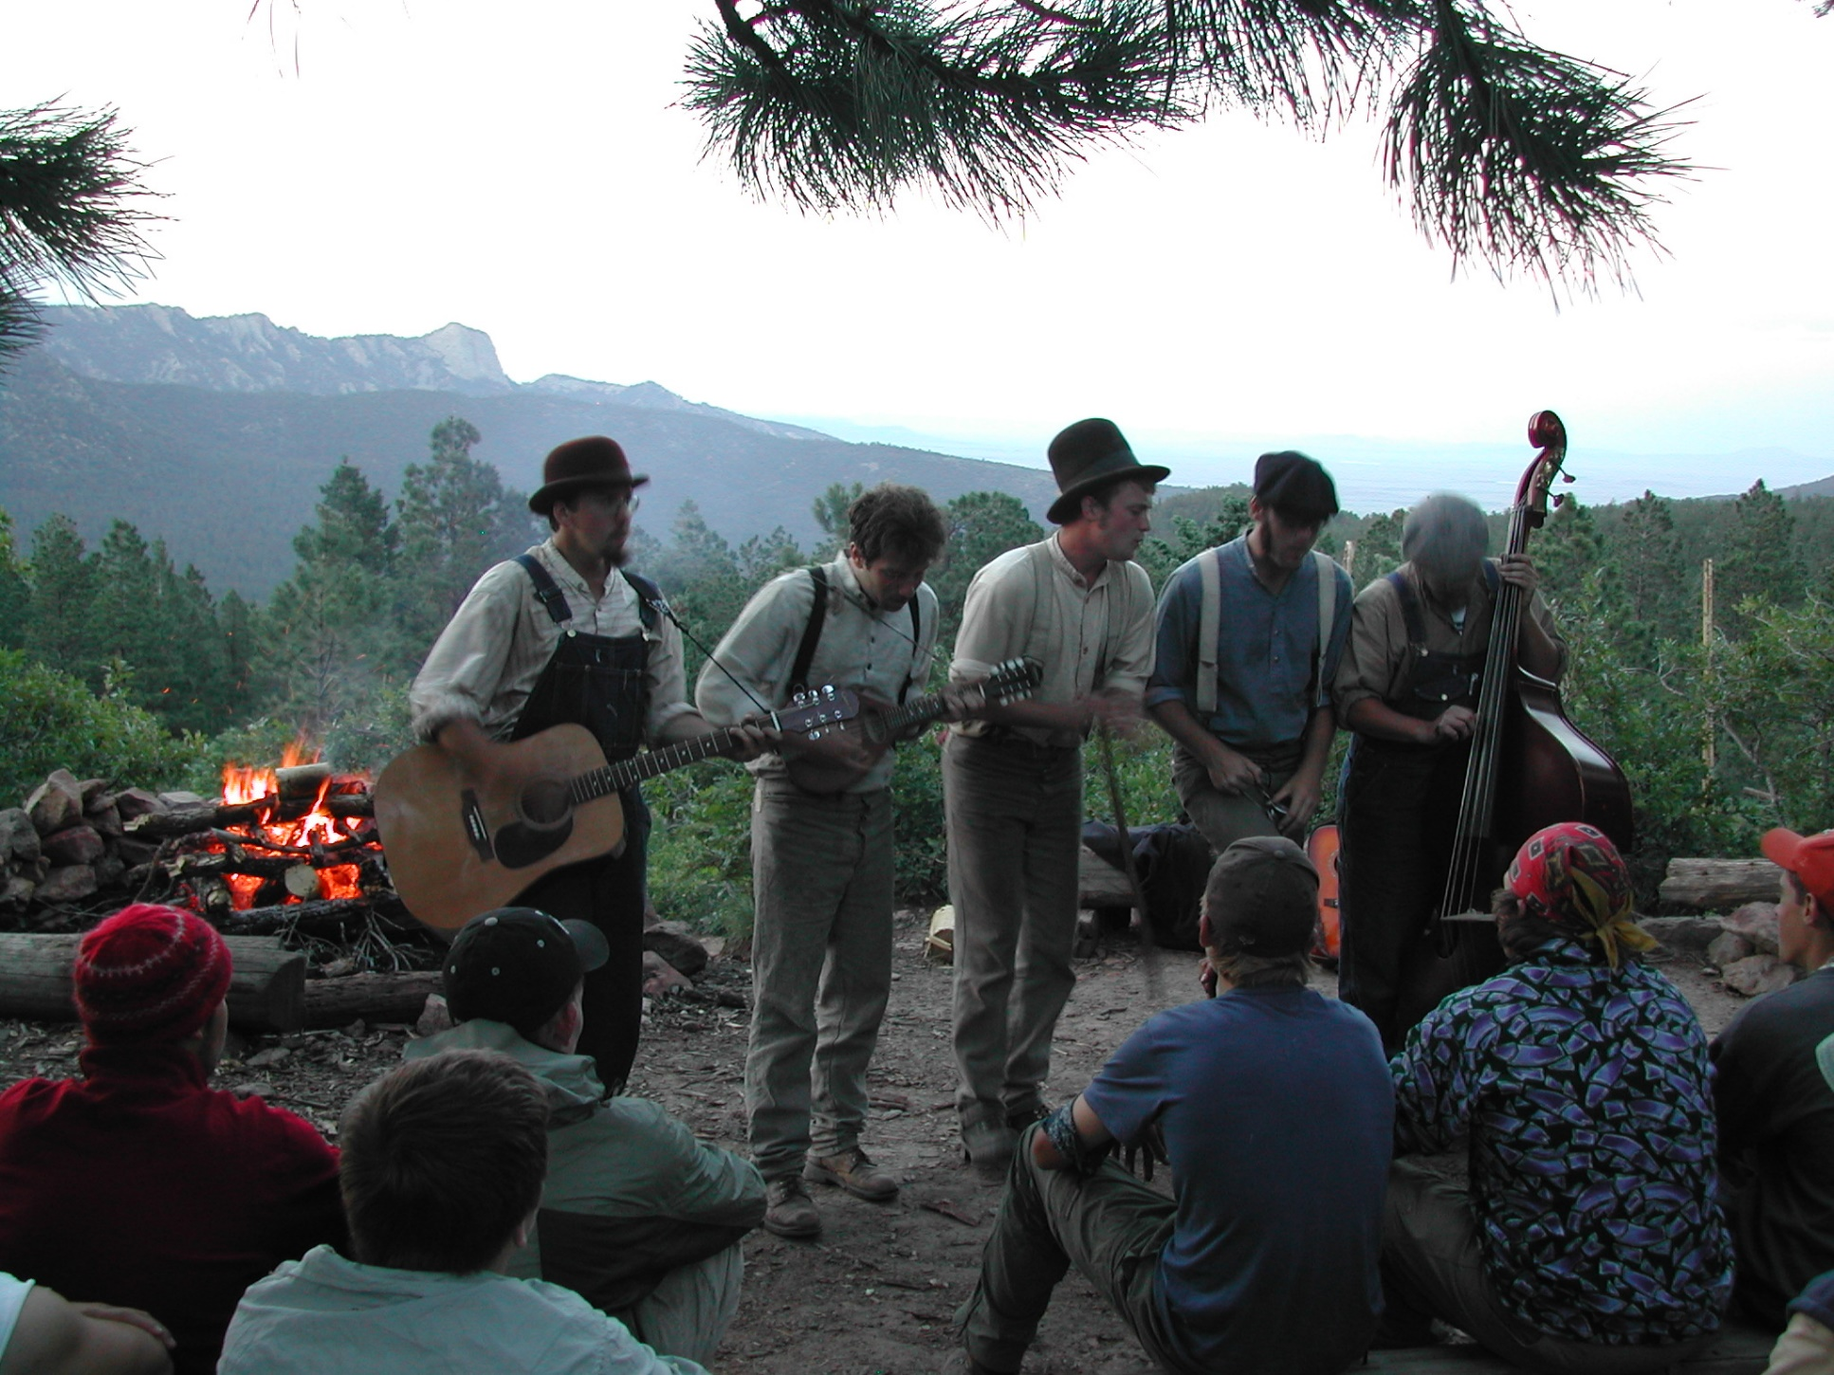

Slide 31
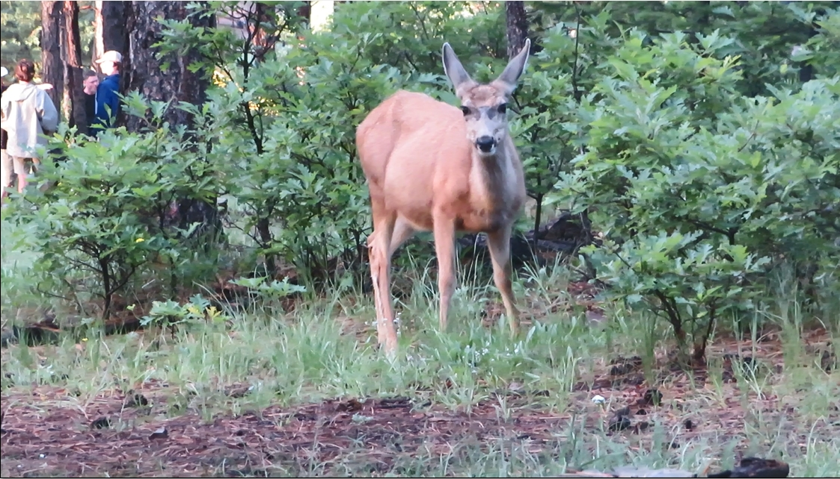

Slide 32
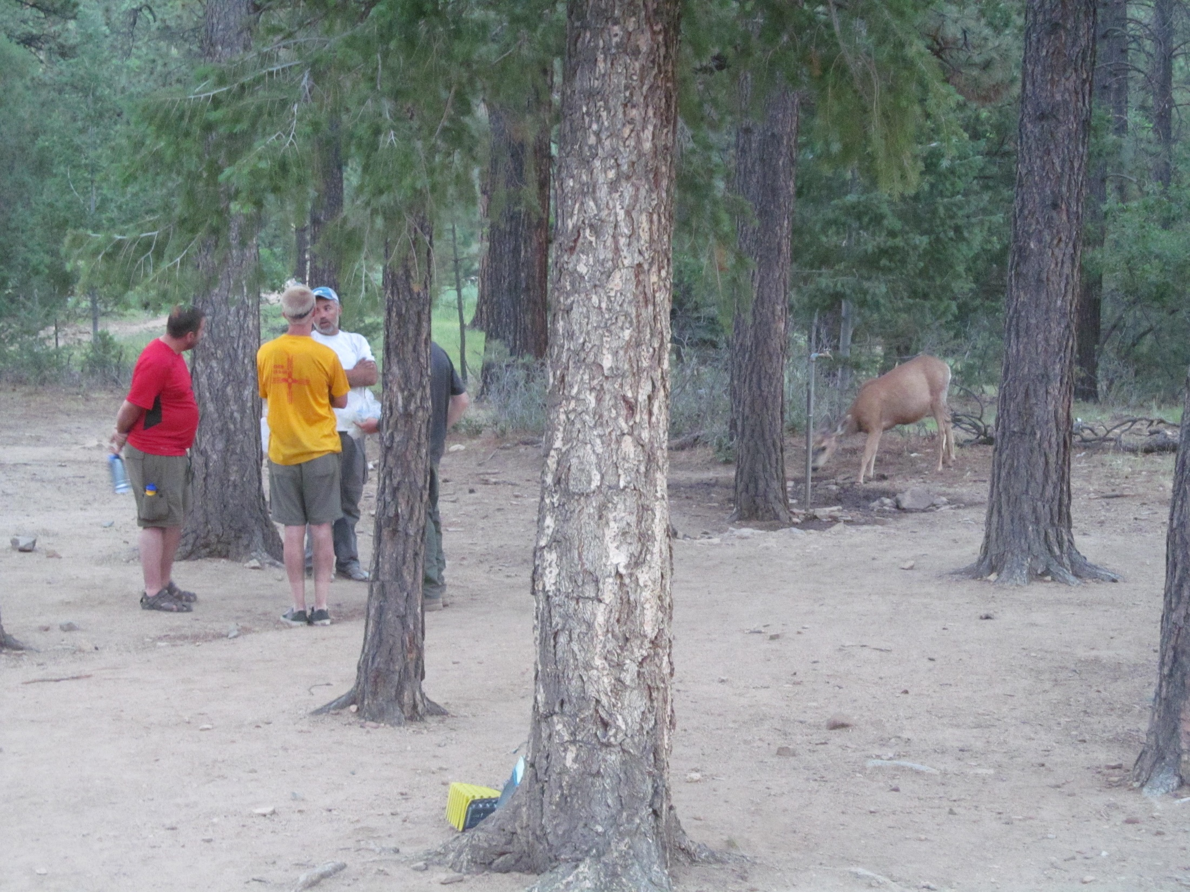

Slide 33
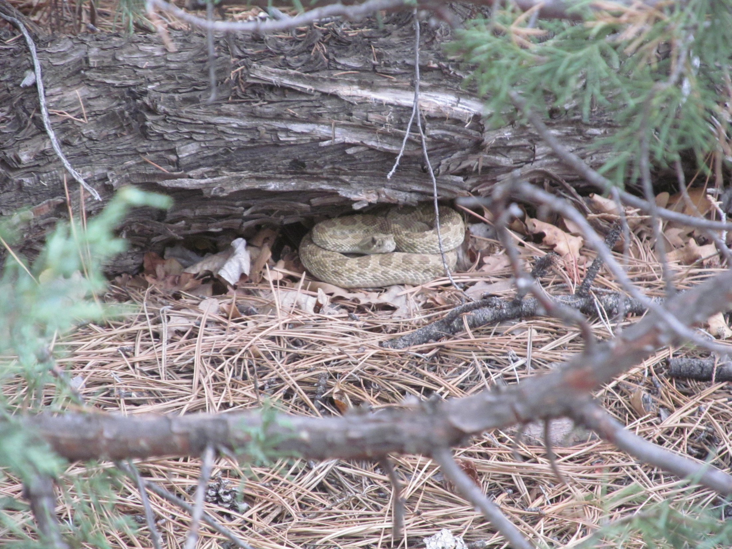

Slide 34
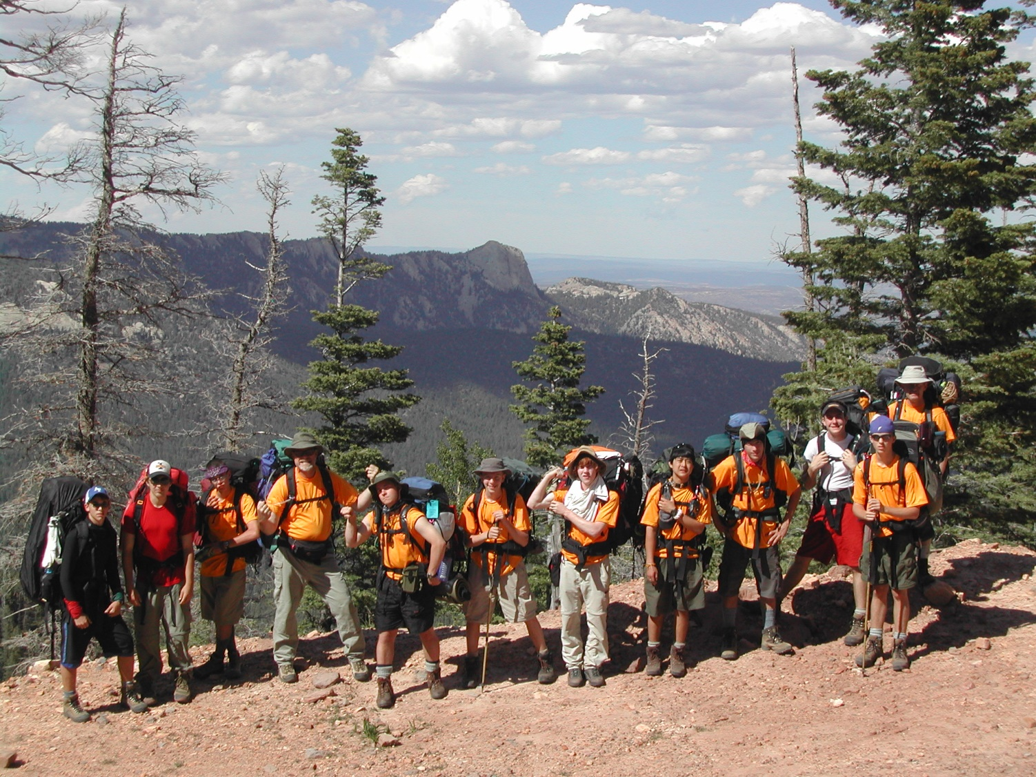

Slide 35
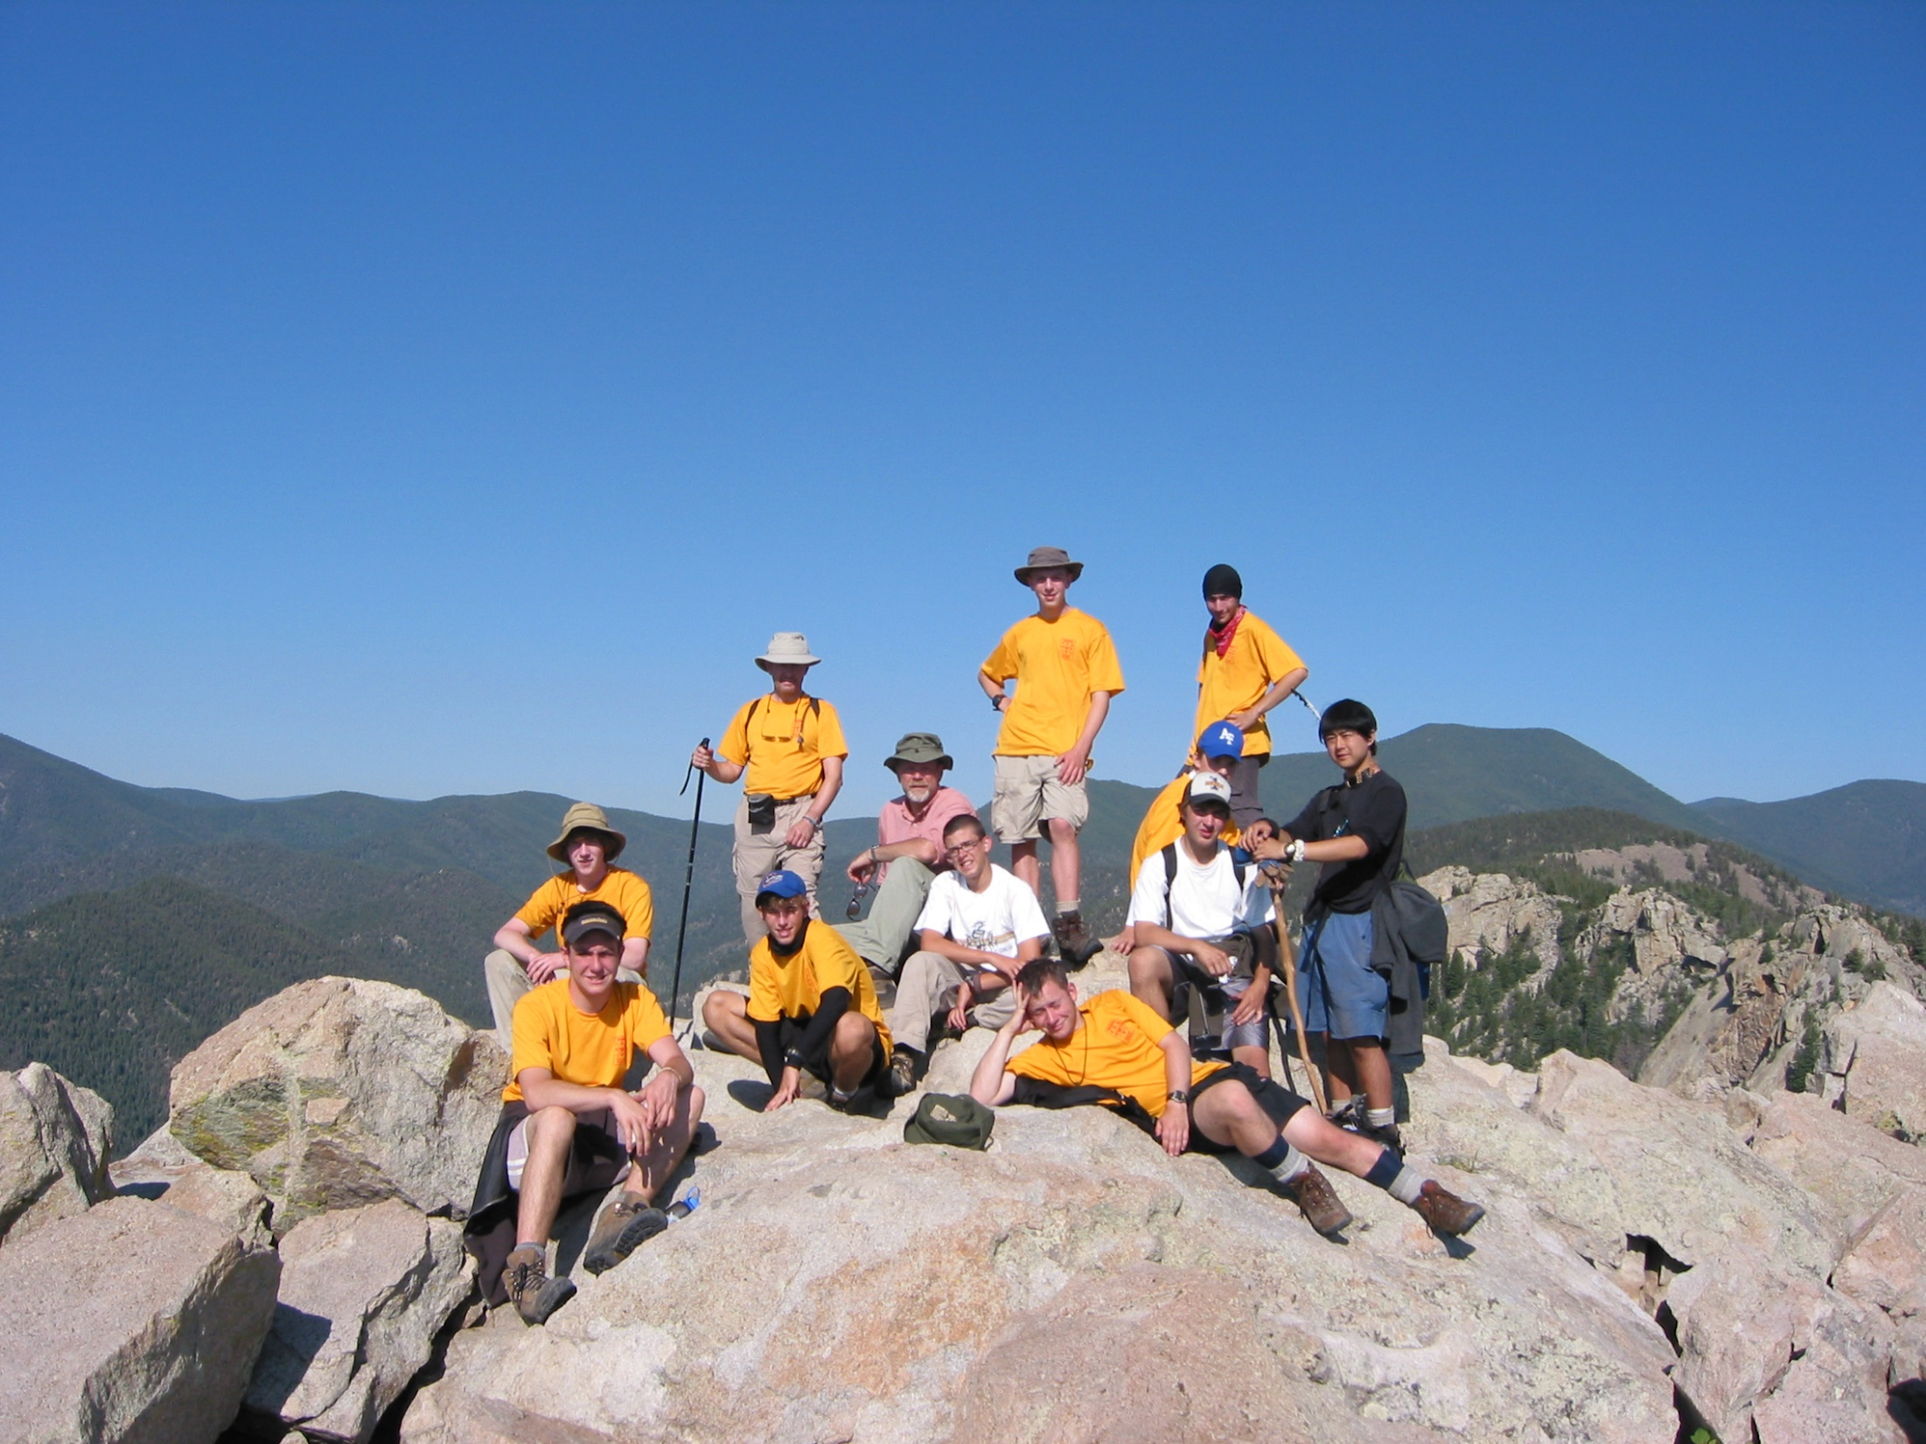

Slide 36
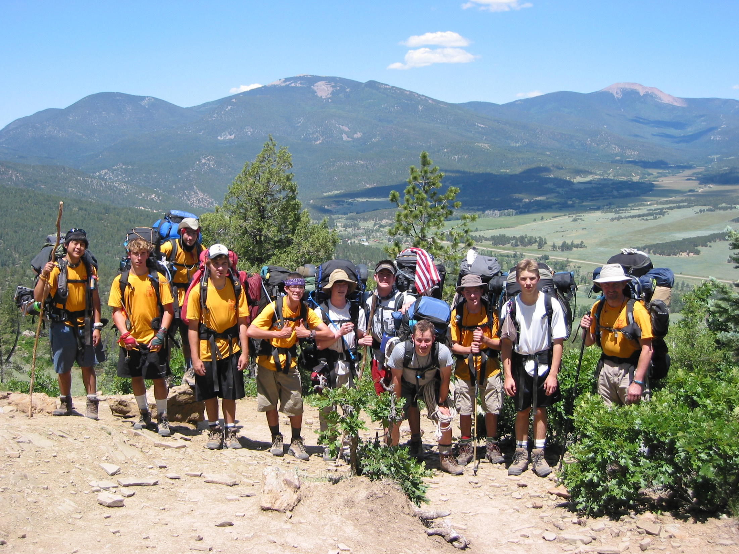

Slide 37
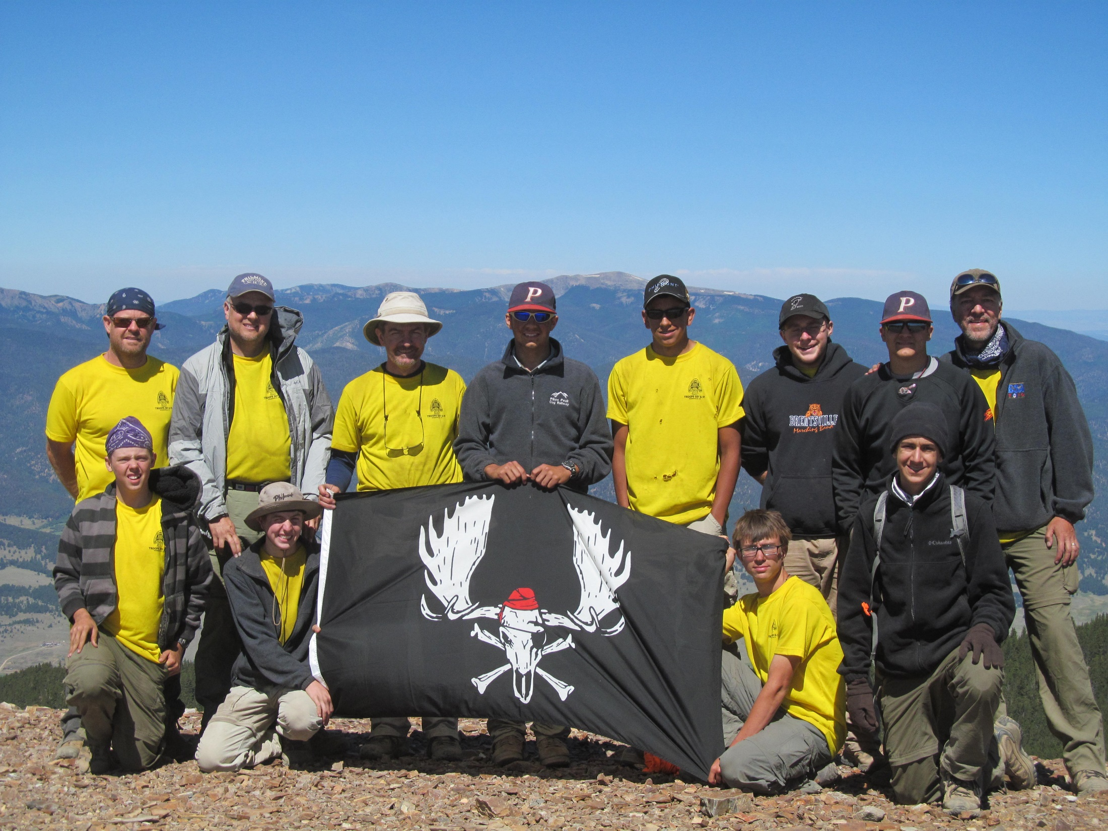

Slide 38
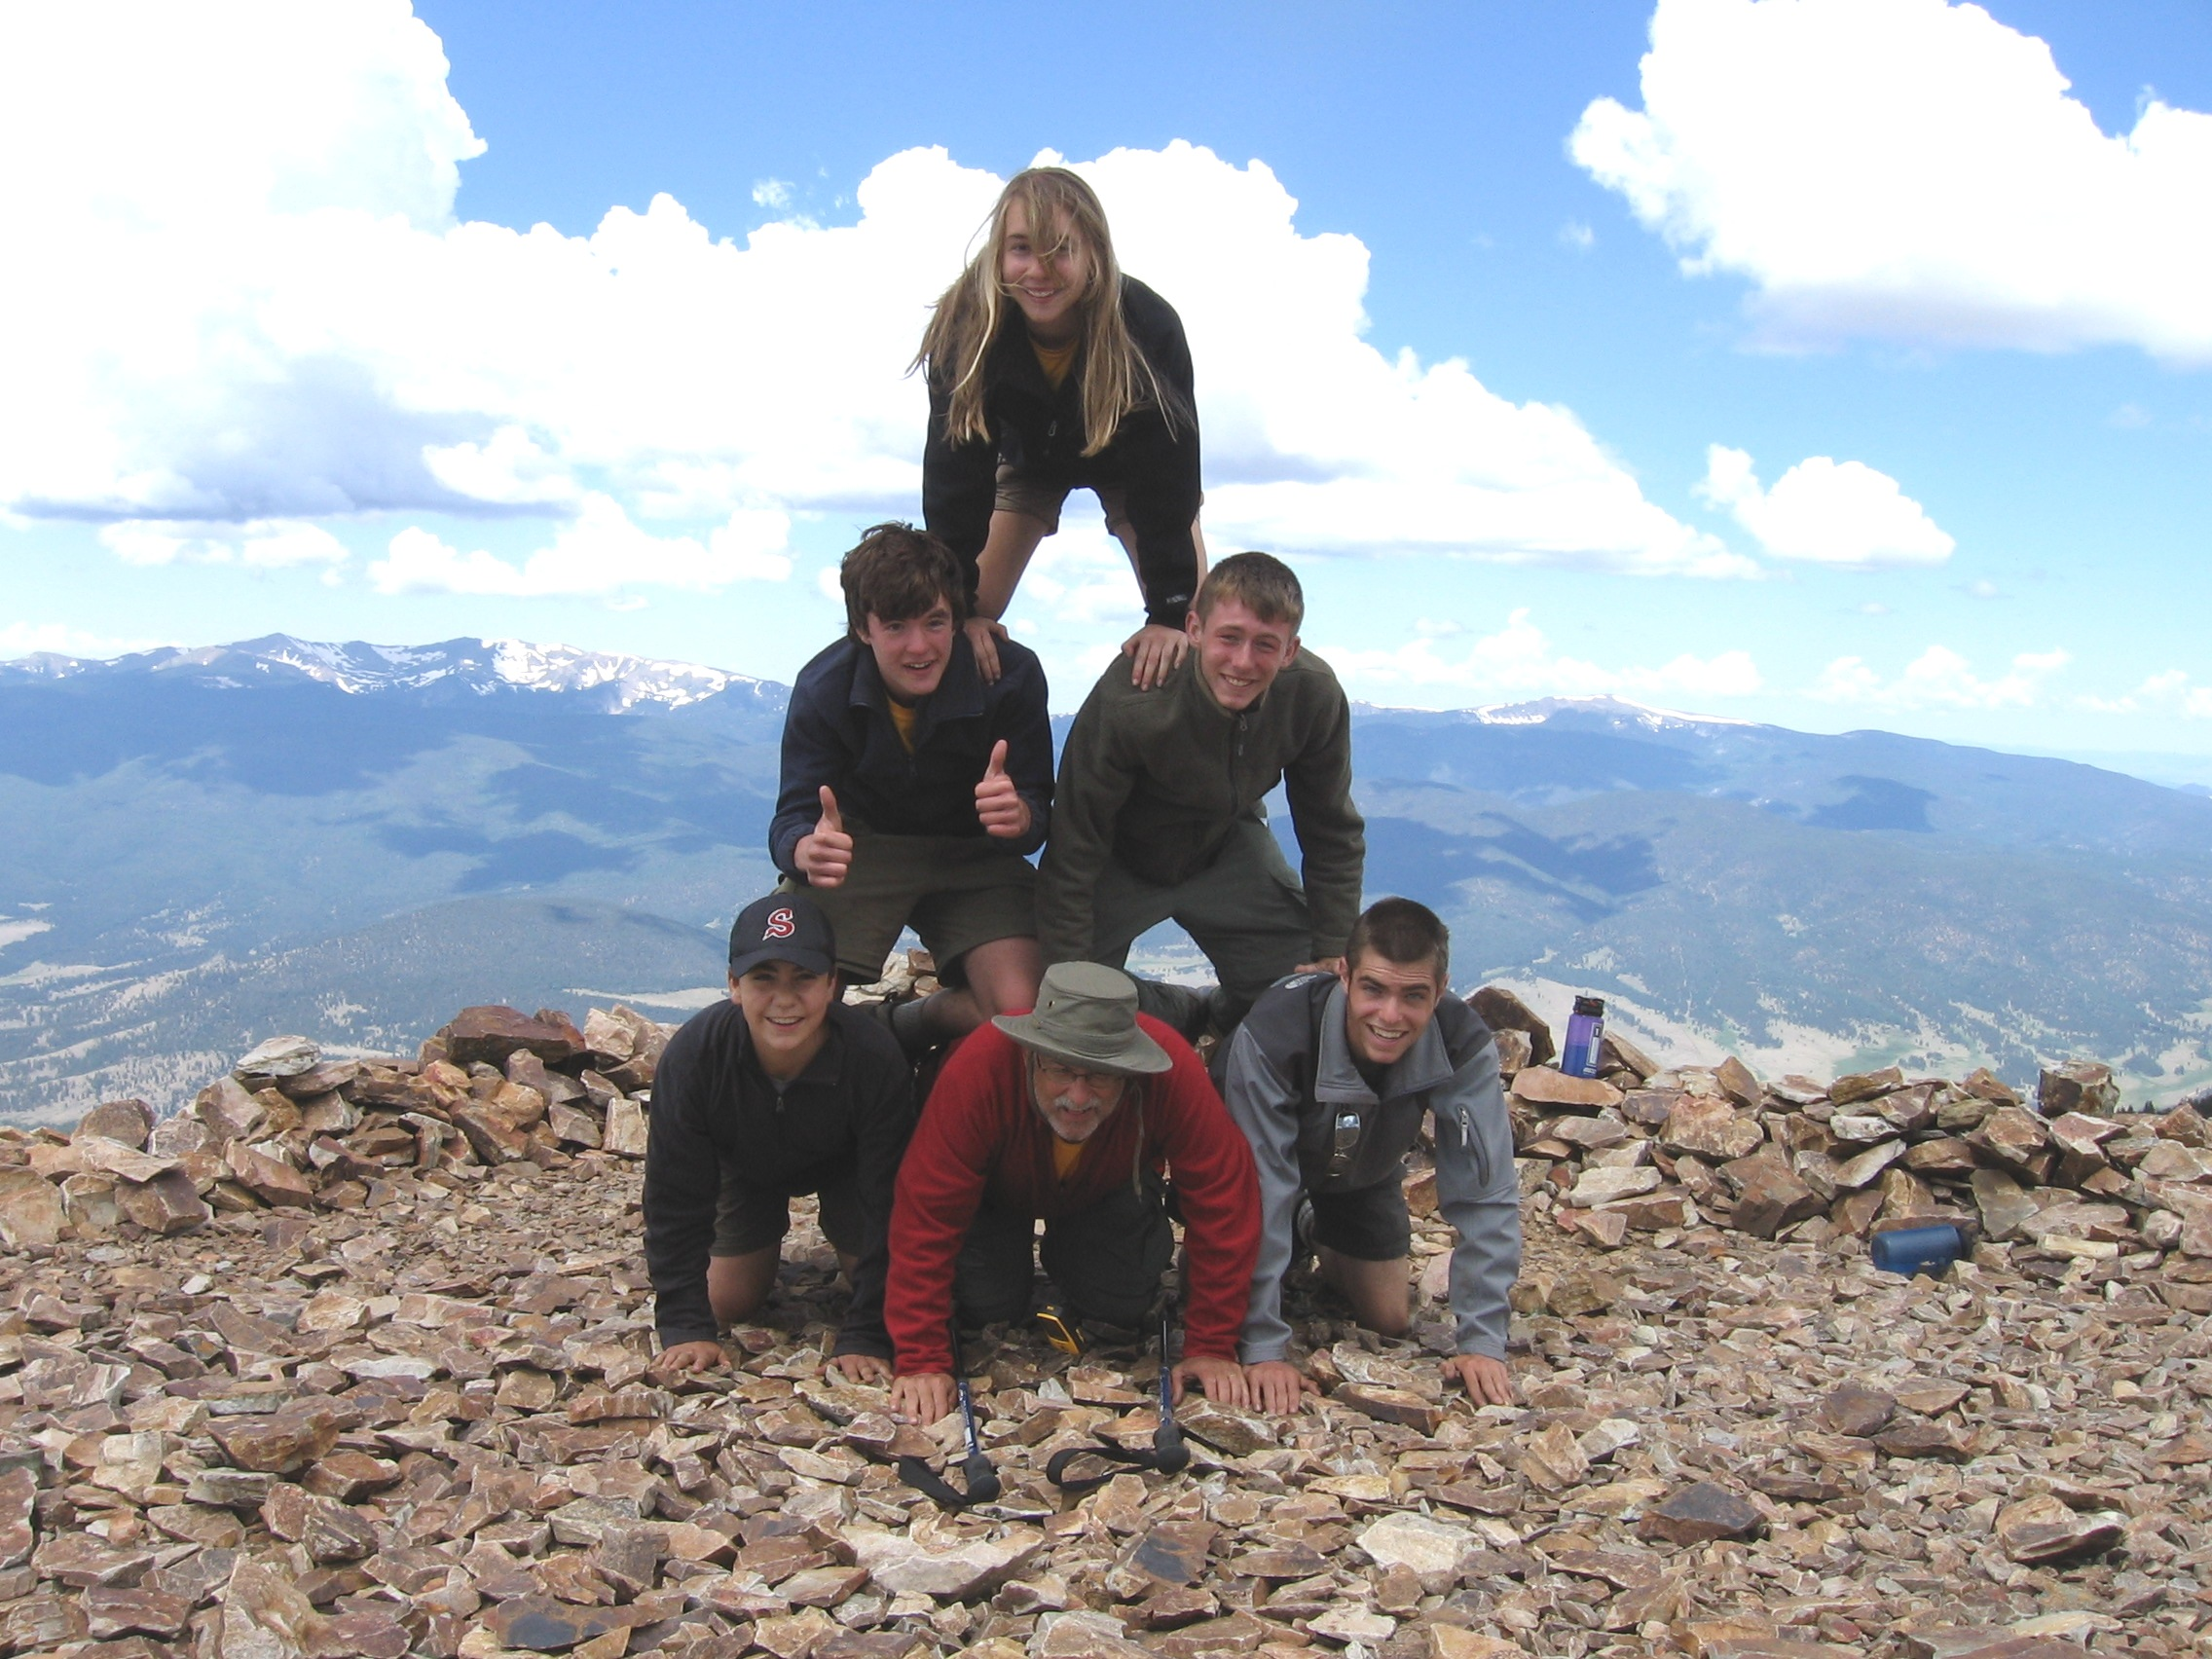

Slide 39
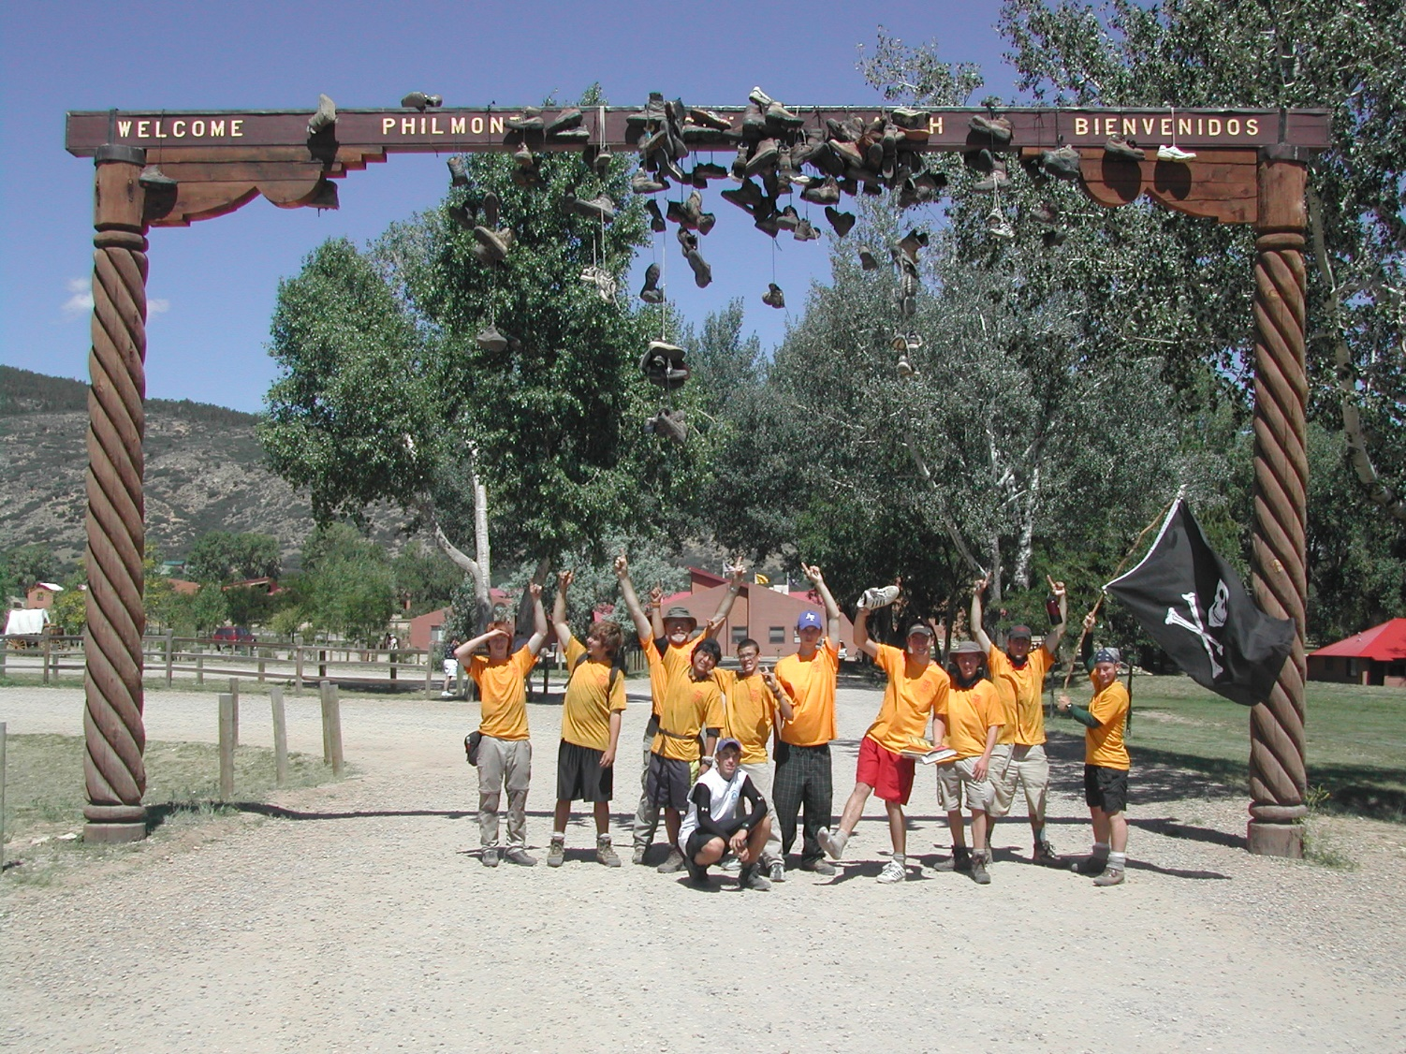

Slide 40
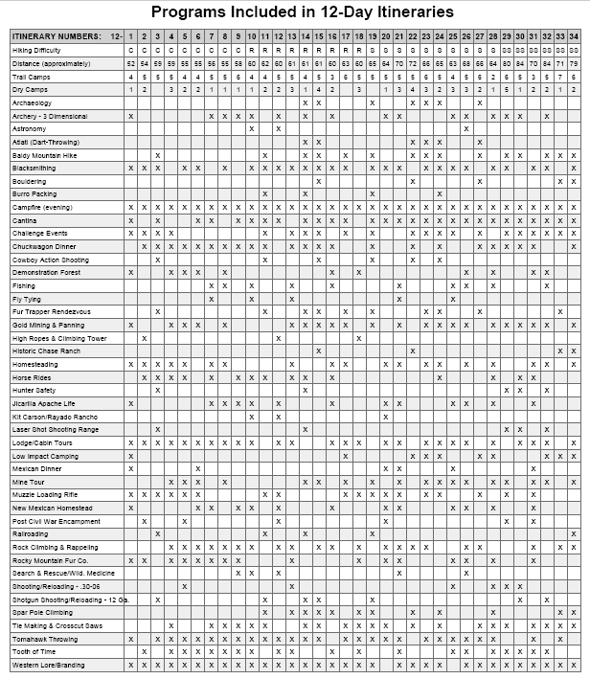

Slide 41
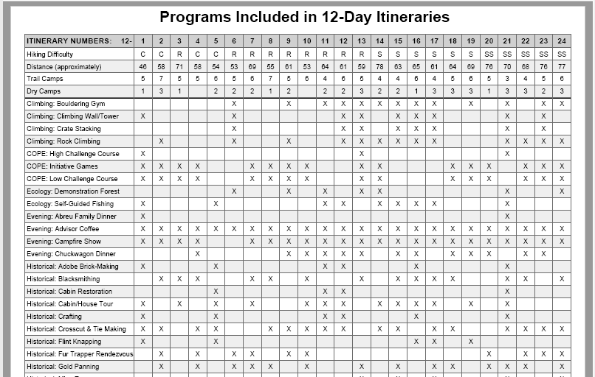

Slide 42
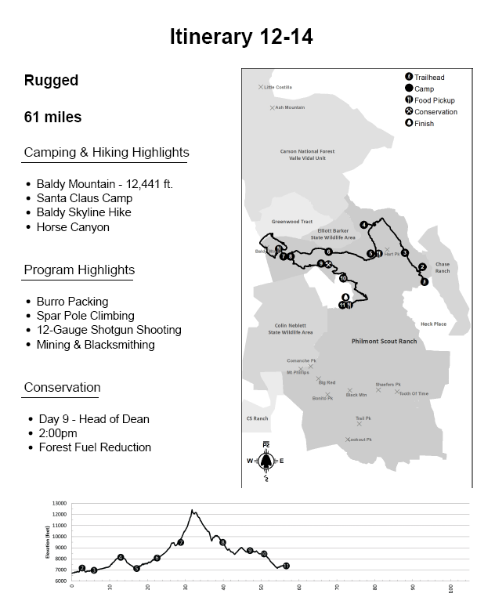

Slide 43
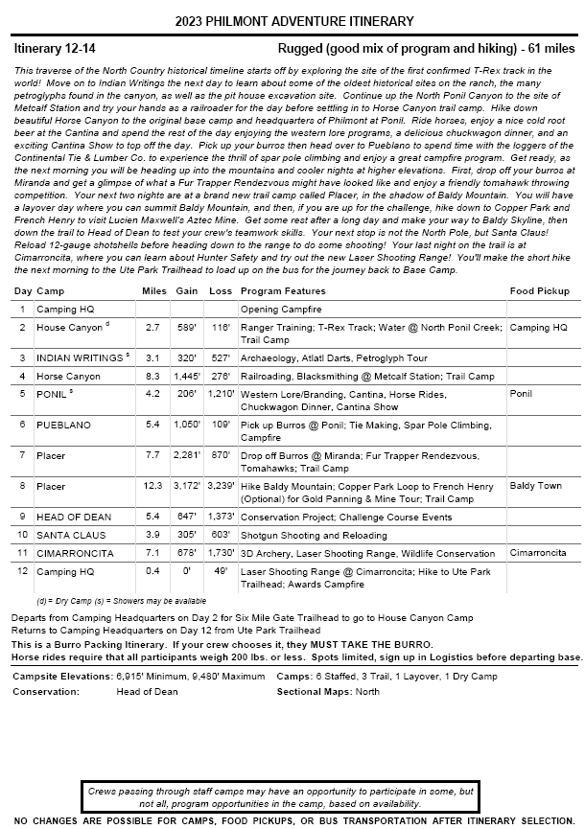

Slide 44
Challenges
Equipment
Physical
Camping/backpacking skills
Teamwork and Leadership

Slide 45
Challenges – Equipment
Boots
Pack
Sleeping bag
Rain gear
Clothing

Slide 46
Challenges – Physical
Strength – figure about 30% of body weight as pack weight
Aerobic – 7-10 miles a day, often in direct sun
Standing breaks 15-30 minutes
Packs off ever 1-2 hours
Hydration – minimum 4 liters, plus refills
Foot care – boots are key to no blisters

Slide 47
Challenges – Physical
Once you see that you
can handle the physical,
the rest is all mental.

Slide 48
Challenges – Camping Skills
Proper camp setup/arrangement
“Load management” and proper packing techniques
Map and Compass skills (how to orient/read contour maps, use compass with map, do basic trail profiling)
Backpacking stove usage (sometimes “no fires”)
Dishwashing and sanitation
Personal hygiene
Bear bags and proper “smellable” management
Water purification
Cooking (at high altitudes)

Slide 49
Challenges – Teamwork and Leadership
Plenty for everyone to do:
  Cooking, Cleanup, Water, Bear bags,
  Dining fly
Advisors are crew members for duties
“Navi-guessing” – plan the night before
Hiking pace – find a pacesetter (not the navi-guesser)

Slide 50
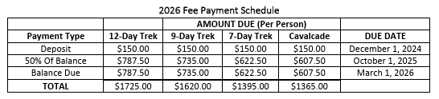
Costs
All-inclusive cost in 2023 (Philmont fee, air fare, car rental, food, lodging, activities: $2800-3000 per person)
12-day trek in 2025 is $1675; in 2026 is $1725 (below)
Camperships are available (~$400)
2026 Program costs:

Slide 51
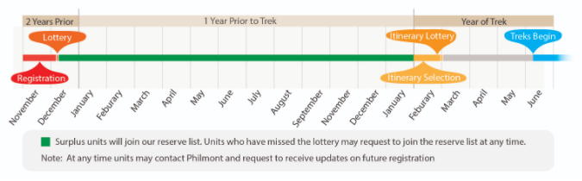
Getting There
Registration (lottery) – 18-20 months in advance
Preparations – conditioning, warm-up hikes
Logistics – transportation (air, ground), accommodations, sightseeing
$
$
$

Slide 52
Typical Trip Overview
Depart Saturday
En-route activities Saturday, Sunday, Monday
Arrive at Ranch Tuesday by 11:00 AM
Return 2nd Sunday (16 days)

Slide 53
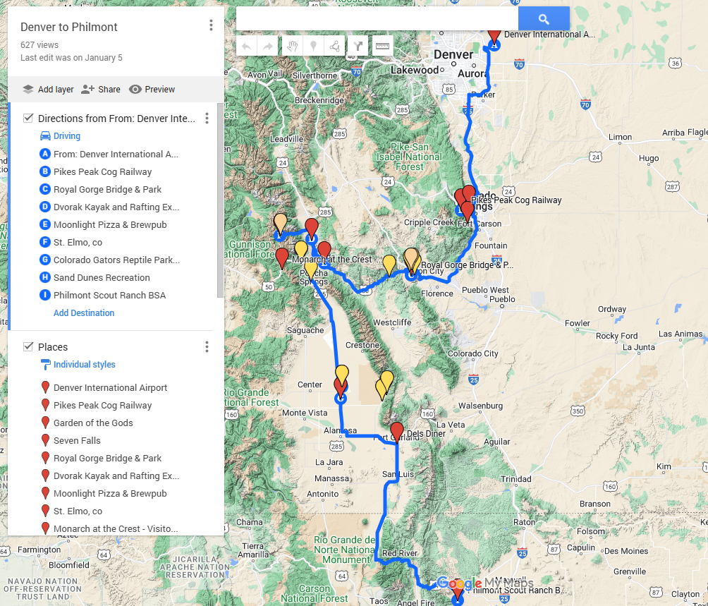

Typical Trip Itinerary
Maps of things to do enroute
Denver to Philmont
Link to spreadsheet

Slide 54
Typical Trip Itinerary (cont.)
ITINERARY:
Saturday morning – fly into Denver, rent SUVs
Saturday afternoon – Pikes Peak and Garden of the Gods – Colorado Springs
Saturday evening – drive via Canon City, CO, camp near Royal Gorge
Continue to near Salida/Poncha Springs, CO – Altitude 8000 ft)

Slide 55
Typical Trip Itinerary (cont.)
ITINERARY:
Sunday – whitewater rafting on Arkansas River, St. Elmo ghost town; camp near Salida, CO
Monday – drive up to Monarch Pass (tram to top of Continental Divide); drive to Great Sand Dunes National Park, explore/surf the dunes, swim/dinner at hot spring in Hooper, CO, camp in National Park or at pool in Hooper)
Tuesday – drive to Philmont, arrive around 11 AM

Slide 56
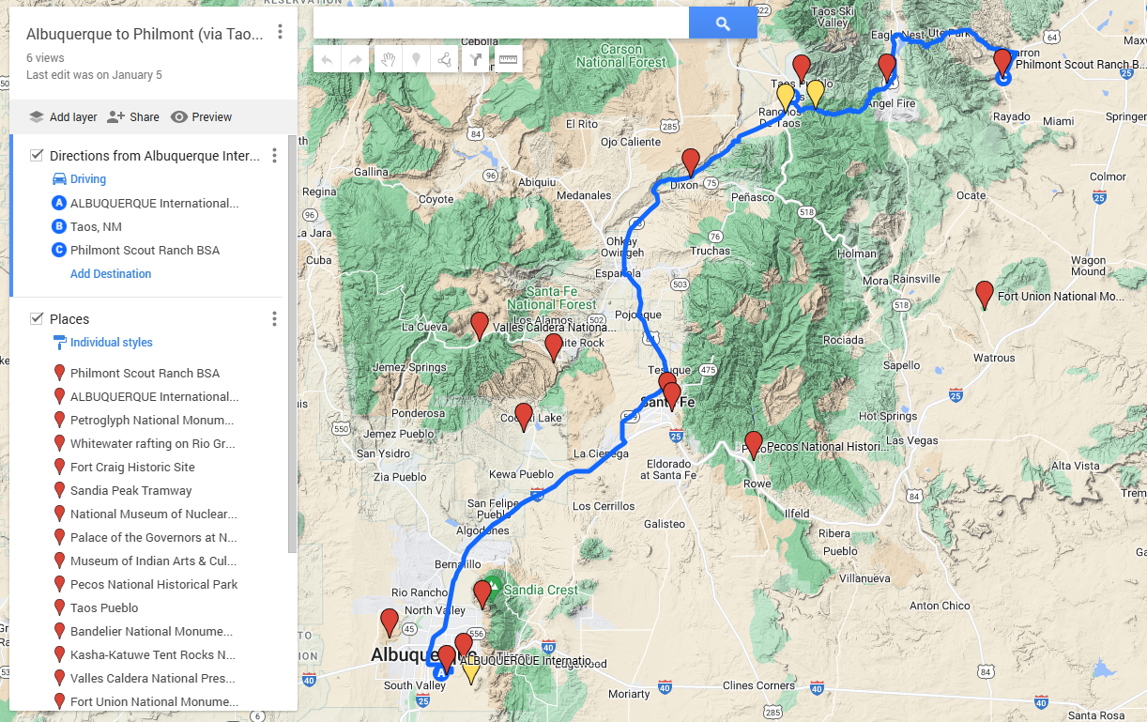
Typical Trip Itinerary (cont.)
Maps of things to do enroute
Albuquerque to Philmont

Slide 57
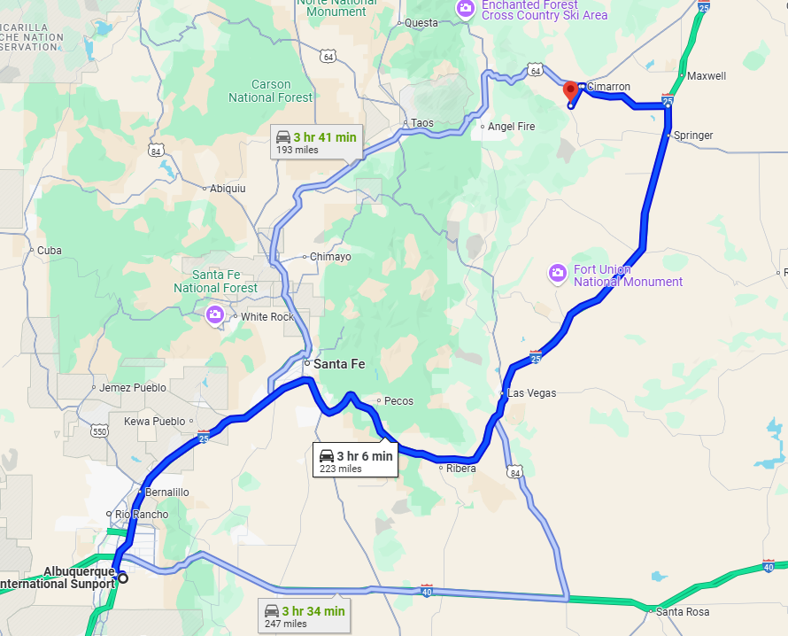
Albuquerque to Philmont Options

Slide 58
Travel Logistics
Airline reservations
  Group reservation in Jan/Feb
  (groups of 10+ direct to airlines)
  No problem using frequent flyer miles if book early
Ground transportation
  Rental vehicles probably more economical than “services” and don’t restrict itinerary
    Blue Sky Adventures ($$$$); Leading the Way Tours ($$)
  Three large SUVs (Yukon XLs) worked for 2 crews
  Standard sedans may be economical alternative
  12 or 15-passenger vans now allowed by BSA but may be restricted by rental companies

Slide 59
Travel Logistics (cont.)
Reservations for attractions/accommodations
  Pike’s Peak – train reservation (pre-pay at 30 days)
  KOA campgrounds – camping
  Whitewater rafting – used Dvorak in ’12, Arkansas River Tours in ‘23
  Great Sand Dunes National Park – camp site reservation (<$5 per person)
  Sand Dunes Recreation (Hooper, CO) – also has camping, more convenient to pool than dunes

Slide 60
Preparations
Warm-up hikes
Travel logistics

Slide 61
Warm-up Activities
Factors to consider:
Minimum 2 nights – at least one 3 nights
Room to camp full crew (or two)
Short/no hike Friday night (it gets dark…)
9-10+ miles Saturday, fewer Sunday
Car access to start, finish, moving cars
Camping permits (national parks)
OR… Multiple make/break camp in 1 day

Slide 62
Potential Warm-up Sites
Prince William Forest Park (intro hike)
AT between Front Royal/Manassas Gap
AT between I-66 and 50 (Sky Meadows)
AT between 7 and 50 (roller coaster)
AT from 7 to Harpers Ferry
AT in Maryland
Signal Knob/Eliz. Furnace/Massanutten Trail
White Oak Canyon/AT/Old Rag (3 night)

Slide 63
Warm-up Planning
Group for venue selection
Philmont food storage (if available)
Transportation coordination
Map acquisition (AT, SNP, other)
  PATC maps/REI
  HikingUpward.com
  Also AllTrails.com

Slide 64
Warm-up Planning (cont.)
HAC High Adventure Sourcebooks
  Vol. 1 – National and Council HA bases
  Vol. 2 – Local hikes and overnights

Slide 65
Administration
Online tracking
Payments
Additional participants (new Philmont service)

Slide 66
Online Spreadsheet
Payments/expenses
Attendance
Meal usage
Shirt sizes/orders
Airline ticket info

Slide 67
Payments
12-day trek costs: 2025: $1675 2026: $1725
9-day: $1560/$1620 7-day: $1335/$1395
Lottery opens October 1, closes Oct. 16
Random selection announced within a day
Deposit of $150 due by Dec. 1 (or 30-days)
Half of remaining fee due the following Oct. 1
Remainder due March 1
Other advance fees to be expected:
  Air fares
  Lodging and en route activities
  Crew t-shirts
  Philmont meals for warm-ups (available Aug-Sept)

Slide 68
Camperships
Philmont offers one campership per crew (generally around $400)
Applications online (due ~Jan. 31)
Troop resources may also be available

Slide 69
Advice
Minimum crew size is 8 (w/3 adults, max 4)
Payments to Philmont are one-way
If you pay them for more than the minimum on Oct. 1 and anyone drops out, you can’t get that money back (but can replace)
You can always add people (late fee if less than 30-45 days before arrival)
Consider paying for 1-2 less than have up to deadline for adding w/o penalty

Slide 70
Additional Participants
New service in 2024 – “Trek Match”
Accessed through Gateway
Check box to indicate interest
Applicants can’t see list of openings, but fill out form
You are notified of interest
You contact them

Slide 71
Resources
Philmont web site https://philmontscoutranch.org/
  Philmont Council/Unit Planning Guide
  Philmont Itinerary Guidebook
  Guidebook to Adventure (+ new Advisors edition)
  Philmont Shakedown Guide
Philmont YouTube channel (large number of instructional videos)
Maps (overall and sectional - physical/digital) – from Tooth of Time Traders (new around April)
Philmont overlays for Google Earth (camps, trails)
Philmont meals for warm-ups (usually available Aug-Sept)
Philtrek.com – detailed itinerary selection tool
REI online equipment selection guides

Slide 72
Training
Philmont YouTube channel
  Large number of instructional videos
Philmont Preparedness Webinars (Zoom)
  Monthly starting in November (archived)
NCAC High Adventure Committee
  Training sessions in Nov, Jan, March, April (separate content in each)
  April in person, includes demonstrations

Slide 73
Promoting Philmont
NCAC High Adventure Committee
  Members available to present to your Troop
  Live or virtual
Also for other high adventure bases

Slide 74
Philmont Promo Video https://youtu.be/Jxx5L872yVc

Slide 75
Embedded links from earlier
Philmont: https://philmontscoutranch.org/
Philmont YouTube Channel: https://www.youtube.com/user/philmontscoutranch
Philmont in Two: https://drive.google.com/file/d/1WLDYFKDUZ2qlDET1Os07SIJgwITqTd_6/view?usp=share_link
Denver to Philmont Map: https://www.google.com/maps/d/u/0/edit?mid=1AlgFcfmBAnDEnb74JWKd1OSxZo23NF9x&ll=38.28715622379136%2C-104.7452436638618&z=8
Albuquerque to Philmont Map: https://www.google.com/maps/d/u/0/edit?mid=1CYsa4ReCQLzYGH-45Qy6pUcR4krvJzQ&ll=35.690905477164186%2C-106.0036075625&z=9
Getting to Philmont Spreadsheet: https://www.google.com/maps/d/u/0/edit?mid=1CYsa4ReCQLzYGH-45Qy6pUcR4krvJzQ&ll=35.690905477164186%2C-106.0036075625&z=9
KOA Campgrounds: https://koa.com/find-a-koa/
Philtrek.com: https://www.philtrek.com/index.php
PATC maps: https://www.patc.net/PATC/Our_Store/PATC_Guides.aspx
Hiking Upwards: https://www.hikingupward.com/
AllTrails: https://www.alltrails.com/
High Adventure Sourcebook-National/Council HA bases: https://public.3.basecamp.com/p/gPPyixZdGr1FLP5M2C8yuAt1
High Adventure Sourcebook-Local hikes/overnights: https://public.3.basecamp.com/p/UEH3o3JD9c1XtSYRFmr9nFKS

Slide 76

Questions?
QR Code to Documents https://bit.ly/49hxod3

Slide 77
From Photo to T-shirt

Slide 78

Notes:
It all started when I was looking for a card for one of my Scouts who made Eagle, and Hallmark had this card for the occasion. I realized immediately that it was a view of Baldy from the Miranda meadow at Philmont. So when we went through there in 2012 - with a burro - I staged a photo to try to recreate the image on the card.

Slide 79
Notes:
This is the photo, and I've used this as a Zoom background for years.

Slide 80
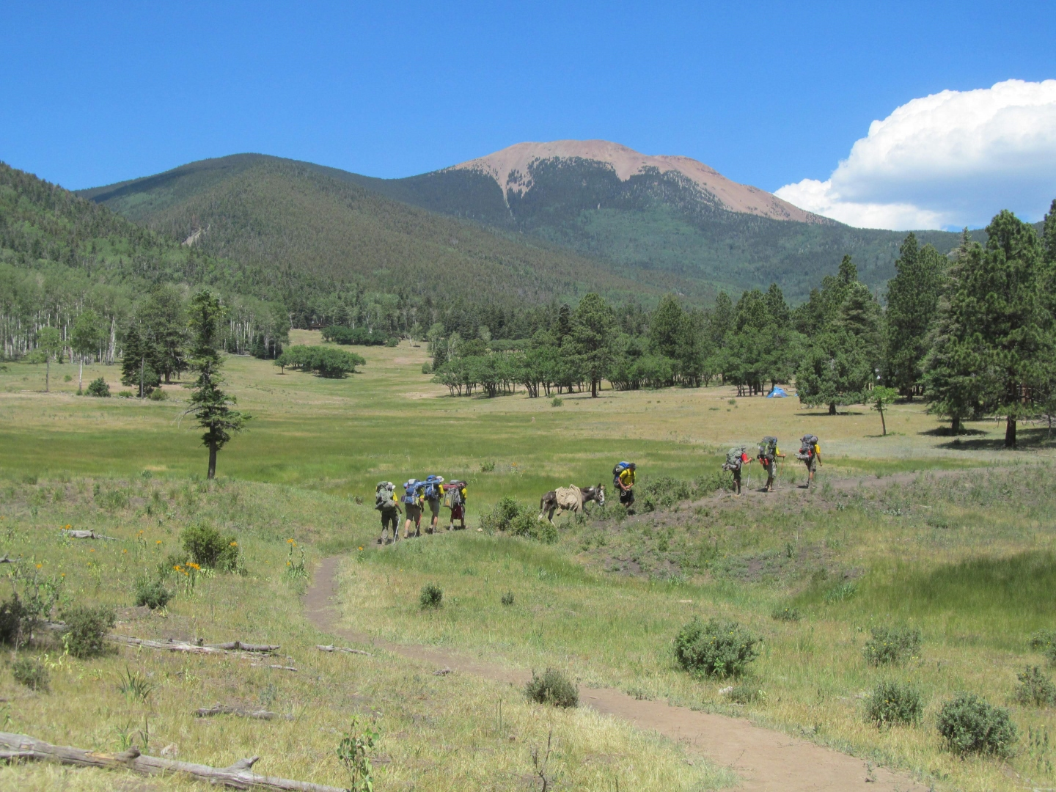
Notes:
In 2023 when I was looking for a different design for our Philmont crew shirts, I realized they could use a photo as the basis for a design, so I found this one, taken about a minute after the other one - because it had the crew more centered under the mountain. They did a GREAT job...

Slide 81
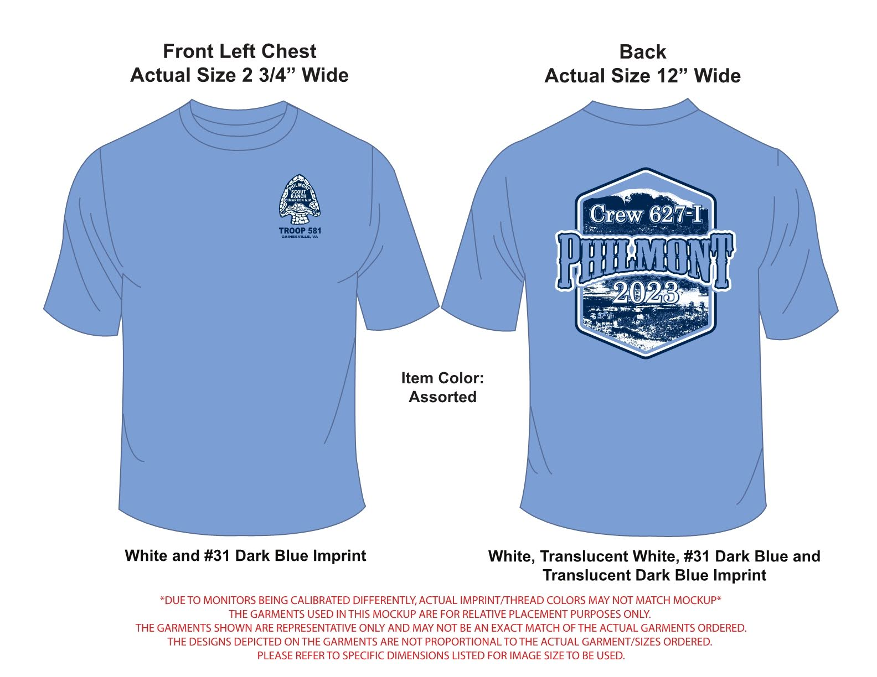
Notes:
This was the design they came up with...

Slide 82
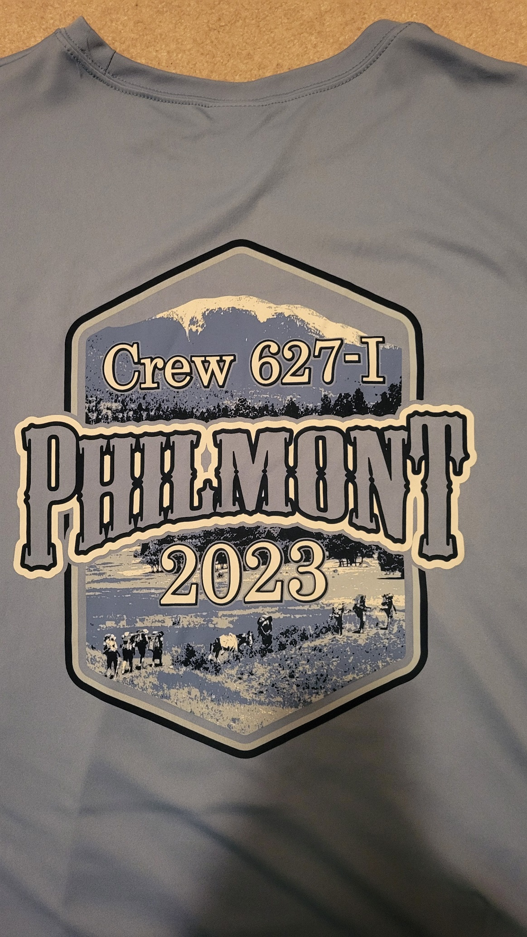
Notes:
And this is the resulting shirt - even better than I imagined.

