Slide 1

Neurodiversity and Scouting
Janet M. Griffiths, PhD
Instructor

Slide 2
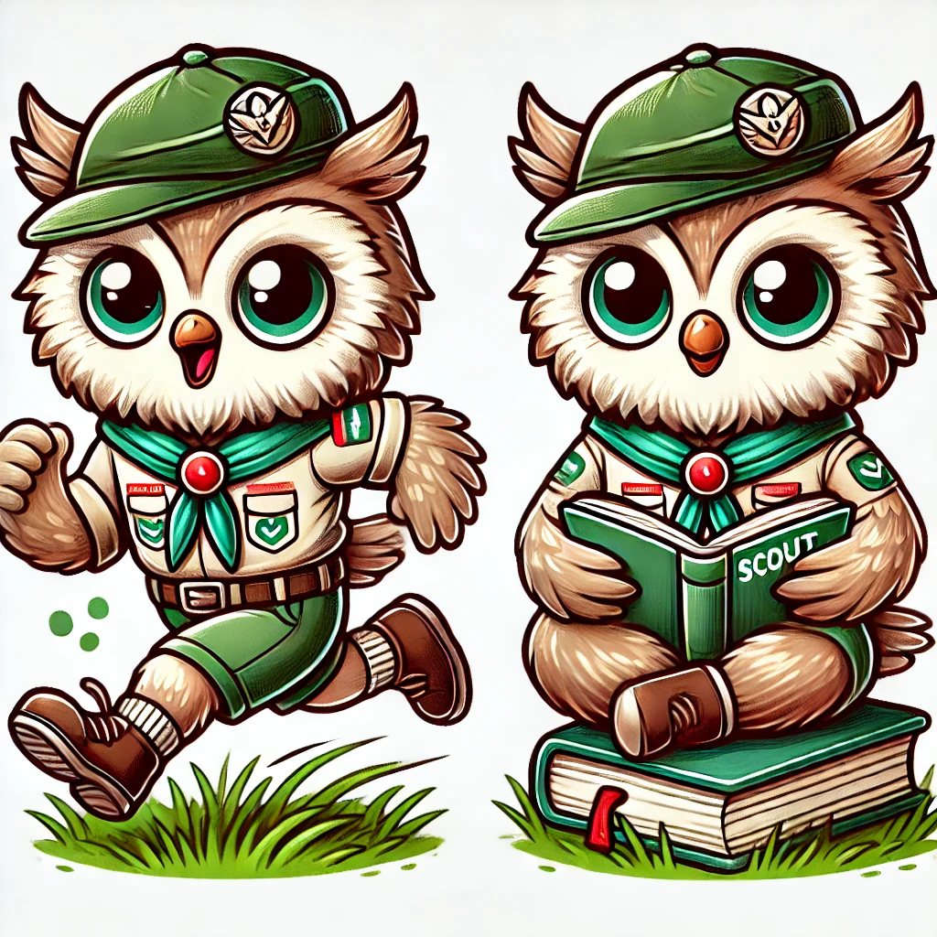
Purpose
Develop awareness of neurodiversity in scouting
Enable inclusion of neurodiverse Scouts

Slide 3

Neurodiversity: prevalence amongst children ages 3-17
Based on a 2019/20 statistical survey of 14,000 children in the USA*
Attention Deficit Hyperactivity Disorder (ADHD) 8.5%
Autism Spectrum Disorder (ASD) 2.9%
Intellectual Disorder 1.4%
Learning Disability 6.4%
*Reported for all genders, but noted a higher prevalence in boys for ADHD (11%) and ASD (4.4%)
Informal Troop survey: 30% of families interested in learning more
Notes:
“Prevalence of neurodevelopmental disorders among US children and adolescents in 2019 and 2020” Frontiers in Psychology, 2022; 13 997648
Attention Deficit/Hyperactivity Disorder (ADD/ ADHD)—A neurobiological disability characterized by inappropriate degrees of inattention, hyperactivity, and/or impulsivity.
Autism Spectrum Disorder – several definitions, eg, American Association on Intellectual and Developmental Disabilities (AAIDD), WHO
Intellectual Disorder – several definitions, e.g, American Association on Intellectual and Developmental Disabilities (AAIDD), WHO
Learning Disability - United States: IDEA (Individuals with Disabilities Education Act) definition: A disorder in one or more of the basic psychological processes involved in understanding or in using language, spoken or written, which may manifest itself in the imperfect ability to listen, think, speak, read, write, spell, or to do mathematical calculations. This includes conditions such as: Dyslexia (reading difficulties), Dysgraphia (writing difficulties), Dyscalculia (math difficulties), Auditory and Visual Processing Disorders

Slide 4
Neurodiversity is Complex
Prevalence of ADHD subtypes
Neurologic differences are a natural part of human diversity
Each Scout is an individual
Neurodiversity is enormously complex
Limitations
Strengths
In 2008, American Disabilities Act (ADA) strengthened accommodations for neurodiversity
and
Inattentive type 35%
Hyperactive type 10%
Combined type 55%

Slide 5

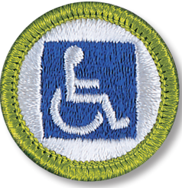
Inclusive Scouting
Adults
Scouts
Roll model:
Encourage empathy
Use positive reinforcement
Talk to parents:
Medications and food triggers
Build in accommodations with parent awareness
Consider: Individual Scout Advancement Plan
Training
Watch for bullying (YPT)
Leadership:
Listening skills
Inclusion; e.g, noise level
Disabilities Awareness Merit Badge
Eagle projects
Engagement:

Slide 6
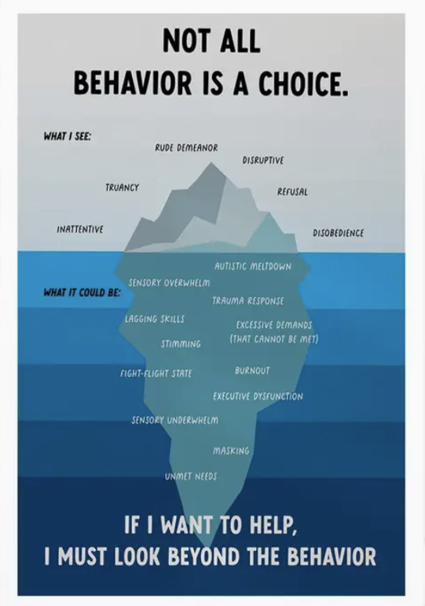
Adult Leader discussions with parents:
Be objective about what you see
  Provide examples
Ask about triggers
Ask what works well at home or school
If necessary, ask that a parent or guardian always be present and participatory in a way that fits the situation
Refer to Code of Conduct especially if safety is a concern

Slide 7
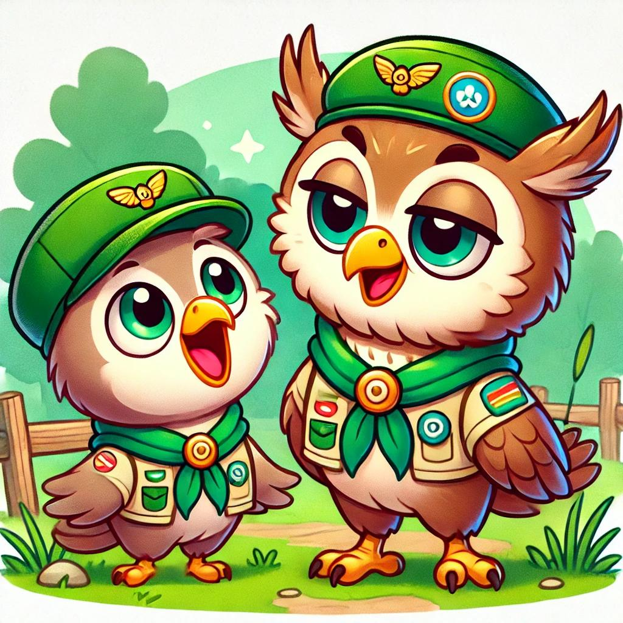
Three ideas to enable inclusion of neurodiverse Scouts

Slide 8
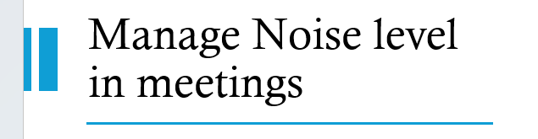

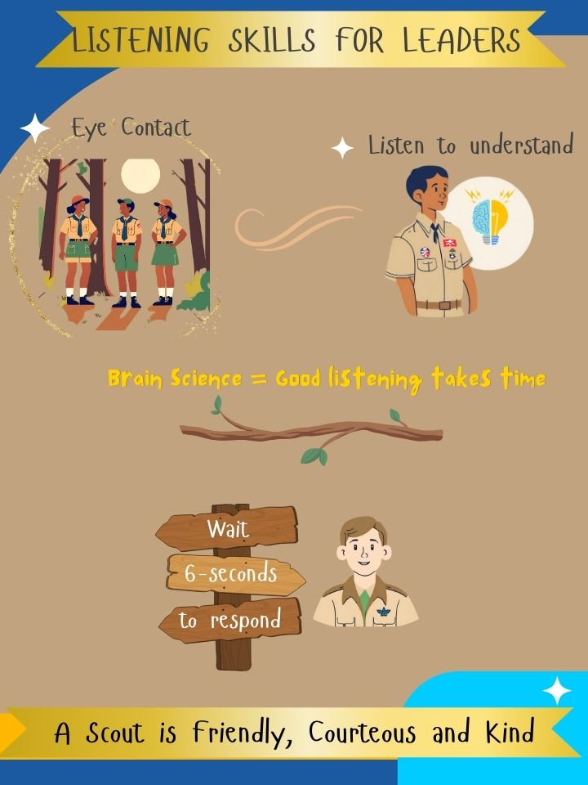

1. Listening Skills based on Brain Science
Handout
Attention
Empathy & Connection
Memory Encoding
Reduce Impulsivity
Focus
When the mind is active and planning its next move; i.e., fight or flight, listening abilities decrease dramatically
It takes six seconds for the brain chemicals produced in the amygdala response to dissipate
Delaying any kind of response for 6 seconds can prevent the amygdala from taking control leading to an emotional reaction
Note: eye contact may be uncomfortable for some youth
Notes:
Attention and Focus: The first 6 seconds activate the prefrontal cortex and reticular activating system (RAS), directing focus and signaling to the brain that the conversation is important, increasing dopamine release to sustain engagement.
Empathy and Emotional Connection: Listening attentively engages the mirror neuron system and limbic system, fostering emotional resonance and empathy, which helps build social bonds and trust.
Memory Encoding: The hippocampus and prefrontal cortex begin encoding information into short-term memory during these initial moments, improving retention and preventing information loss.
Reducing Cognitive Bias: Focused listening in the first few seconds overrides biases like selective listening or snap judgments, promoting open-mindedness and thoughtful responses.

Slide 9
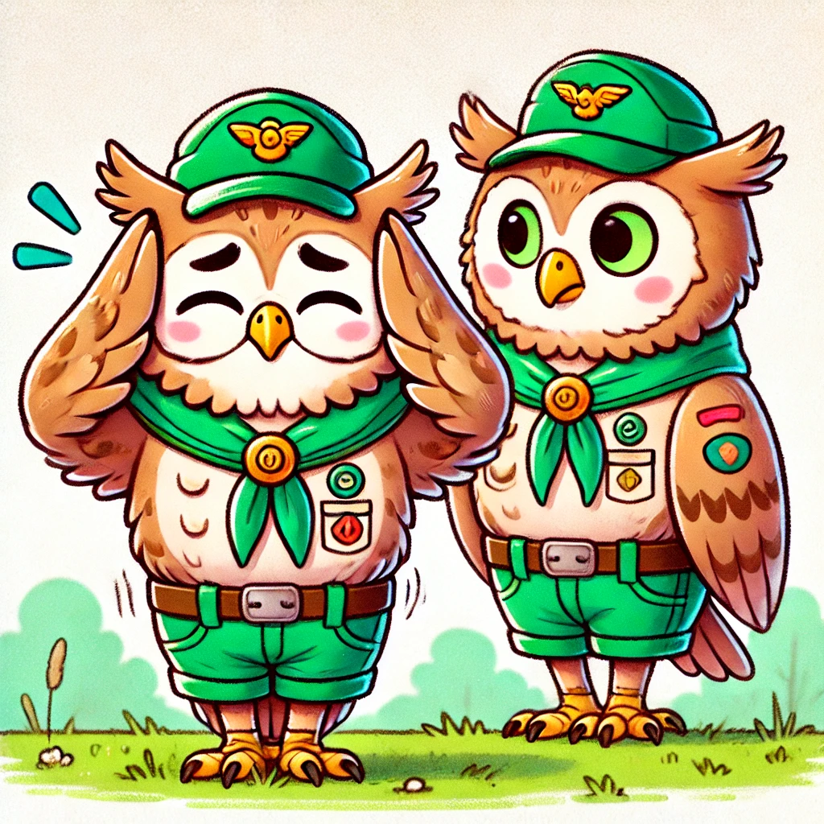

2. Manage Noise level
Many children love noise
Adults often equate “noise” with Scouts having fun
But many neurodiverse children have sensory challenges including noise, lights, food
Use Scout hand symbol and a word or prop (ie, listening stick) chosen by your Troop to lower the noise level.
Avoid “Quiet” and “Silence”
Better words are “Focus,” “Team,” “Eyes”

Slide 10
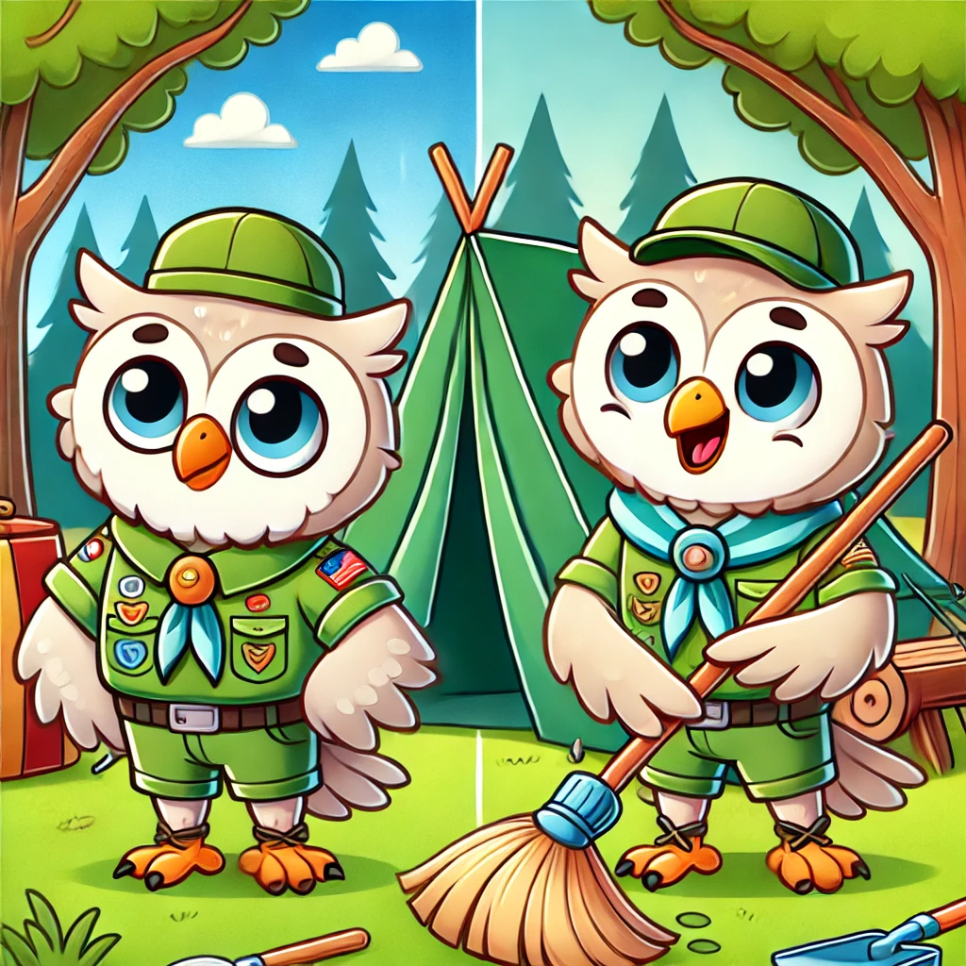
3. Individual Scout Advancement Plan
Individual Scout Advancement Plan (ISAP), Form 512-936
  Similar to a school IEP
Application for alternative Eagle Merit Badges, Form 512-730
Beyond age of eligibility, Form 512-935

Slide 11
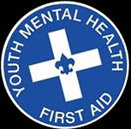


Training
Required:
YPT
Optional:
Diversity, Equity and Inclusion (SCO-1800)
https://www.scouting.org/resources/disabilities-awareness/ - includes some specialized training materials on ADHD, Autism, Learning Disabilities
Consider: Youth Mental Health First Aid
  Offered periodically for Adult Scout Leaders
  Contact Mark Greer mfgreer@verizon.net

Slide 12
Resources (page 1)
National Capital Area Council
Resources online
Scouts BSA Guide to Advancement, Section 10, "Advancement for Members With Special Needs"
Guide to Working With Scouts With Special Needs and Disabilities, No. 510-071
  Providing supervision and discipline
Scouting for Youth With Disabilities (160 pages)
      Comprehensive guide for Councils
  4. BSA Disability Awareness Merit Badge Book
  5. The Americans with Disability Act (ADA)
A good starting point: https://www.bsacac.org/resources/special-needs/
NCAC Council on Special Needs
Ask who is the District representative (or volunteer yourself!)
Open office hours are periodically available for discussion/problem solving
University of Scouting curriculum

Slide 13
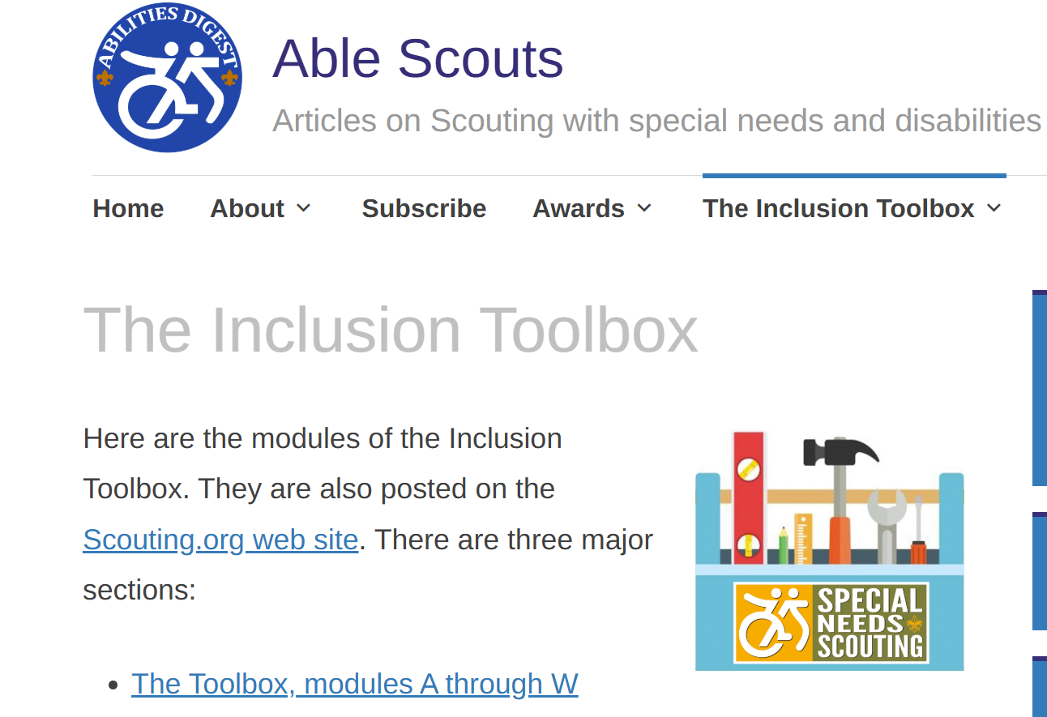
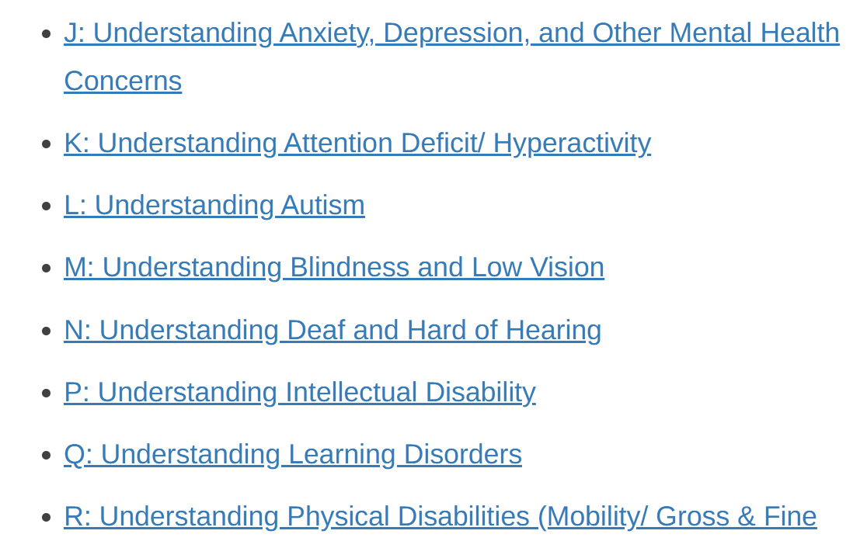
Resources (page 2): Able Scouts Inclusion Tool Box
New and excellent resource
“Neurodiverse” categories in the Inclusion ToolBox
Online and downloadable PDF https://ablescouts.org/toolbox/

Slide 14

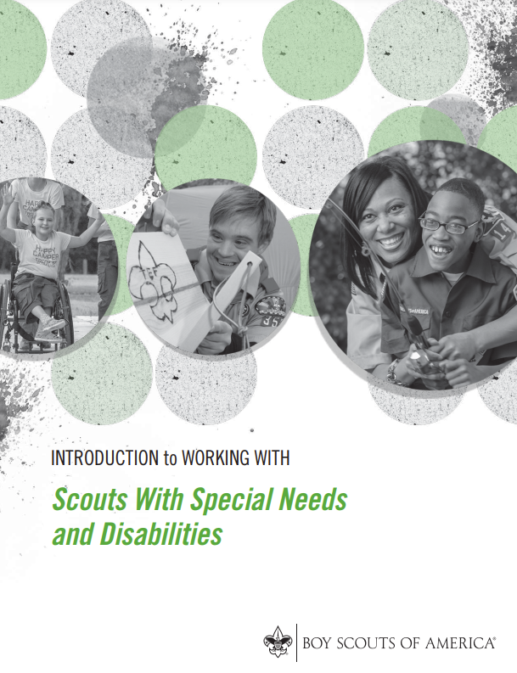
Summary of Forms and Informational Worksheets
Forms
Application for alternative Eagle Merit Badges – Form 512-730
Beyond age of eligibility - Form 512-935
Individual Scout Advancement Plan (ISAP), Form 512-936
Informational and worksheets
Know your Scout – guide to enable parent and leader discussions
Accommodations for Scouts (sensory needs, etc)
Facilities accommodations – checklist
Special event care plan – info sheet
Instructional
Listening Skills for Leaders – 1-page handout
Notes:
The Individual Scout Advancement Plan (ISAP), No. 512-936 is similar to an Individual Education Plan (IEP), which is used in schools to establish a student’s special education eligibility. It can also help plan an approach for the education of a student who has disabilities that preclude his or her full participation in a typical curriculum. An ISAP is specific to each Scout and is usually prepared in a cooperative effort between parents, Scout leaders and a healthcare professional. The objective of an ISAP is to chart a course through the advancement program that helps a Scout or Venturer with disabilities achieve as much as any limitations will allow, and to facilitate applications for alternative requirements, merit badges and registration beyond the age of eligibility, as appropriate.

Slide 15
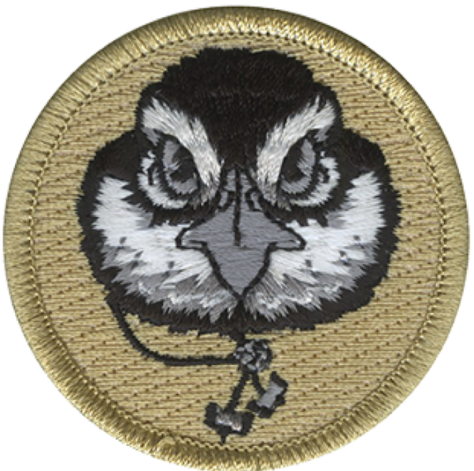
Thank you
Wood Badge Mentors
Damon Baldini
David Rockwell
Course Director Jai Evans
NCAC Wood Badge leadership team
The Bob White Patrol: David S, Sam S, Palani R, John H, Michelle P
Troop 1094 and Troop 1097 and Seneca District
Philip Zabriskie, Univ of Scouting Instructor

Slide 16
Scout Oath and Scout Law
TRUSTWORTHY. Tell the truth and keep promises. People can depend on you.
LOYAL. Show that you care about your family, friends, Scout leaders, school, and country.
HELPFUL. Volunteer to help others without expecting a reward.
FRIENDLY. Be a friend to everyone, even people who are very different from you.
COURTEOUS. Be polite to everyone and always use good manners.
KIND. Treat others as you want to be treated. Never harm or kill any living thing without good reason.
OBEDIENT. Follow the rules of your family, school, and pack. Obey the laws of your community and country.
CHEERFUL. Look for the bright side of life. Cheerfully do tasks that come your way. Try to help others be happy.
THRIFTY. Work to pay your own way. Try not to be wasteful. Use time, food, supplies, and natural resources wisely.
BRAVE. Face difficult situations even when you feel afraid. Do what you think is right despite what others might be doing or saying.
CLEAN. Keep your body and mind fit. Help keep your home and community clean.
REVERENT. Be reverent toward God. Be faithful in your religious duties. Respect the beliefs of others.
On my honor I will do my best to do my duty to God and my country and to obey the Scout Law; to help other people at all times; to keep myself physically strong, mentally awake, and morally straight.
Be a friend to everyone, even people who are different from you

Slide 17

Americans with Disability Act (ADA)
Neurodiversity refers to the idea that variations in brain functioning, such as autism, ADHD, dyslexia, and other neurological differences, are natural and part of human diversity. Under the ADA, many of these neurological conditions can be considered disabilities if they substantially limit one or more major life activities, such as learning, working, or social interactions.
The ADA is designed to protect individuals with disabilities from discrimination and ensure they have equal access to employment, public services, and accommodations. Since conditions like autism, ADHD, and other neurodivergent conditions can affect someone's ability to perform certain activities or interact in certain environments, people with these conditions are often entitled to reasonable accommodations under the ADA. These accommodations could include things like modified work environments, flexible schedules, or assistive technology to help with communication.

Slide 18
Scouting America
The Boy Scouts of America promotes a culture where each youth, volunteer, and employee feels a sense of belonging and builds communities where every person feels respected and valued.
Leading by example and encouraging each other to live by the values expressed by the Scout Oath and Scout Law, we welcome families of all backgrounds to help prepare young people to serve as successful members and leaders of our nation’s increasingly diverse communities.

