Slide 1
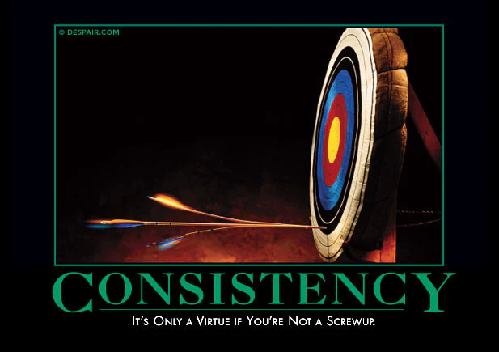
Aim Small Miss Small:
Becoming a Successful Smaller Unit
2025 NCAC University of Scouting, GSC108
Jeff Baker
Seneca District
jcb1836@gmail.com

Slide 2
Three truths
Scope
Scope
Time
Resource
Time
Resource
“Positivity”
of experience
Prioritization is not about what you are going to do.
Prioritization is about what you are NOT going to do.

Slide 3
Briggs Transition Model
For more reading: James Briggs Managing Transitions 1991
“Ending & Letting Go”
“The Neutral Zone”
“A New Beginning”
  Fear.
  Denial.
  Anger.
  Sadness.
  Disorientation.
  Frustration.
  A sense of loss.
Resentment towards the change.
Low morale and low productivity.
Anxiety about role, status or identity.
Skepticism.
Increased energy and enthusiasm
Openness to learning mew approaches
Renewed commitment to the group
Briggs suggests that effective change managers provide
  A high sensitivity to workloads and capacity management
  Sense of direction and progress
  Effective feedback
  Visible and immediate reward and recognition
To pass through the Neutral Zone as quickly as possible

Slide 4
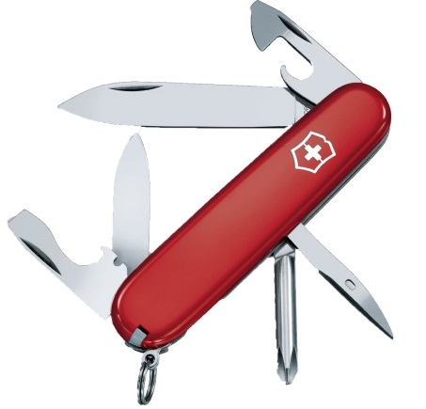

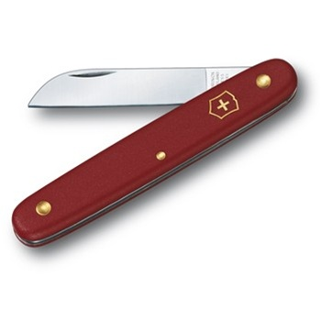
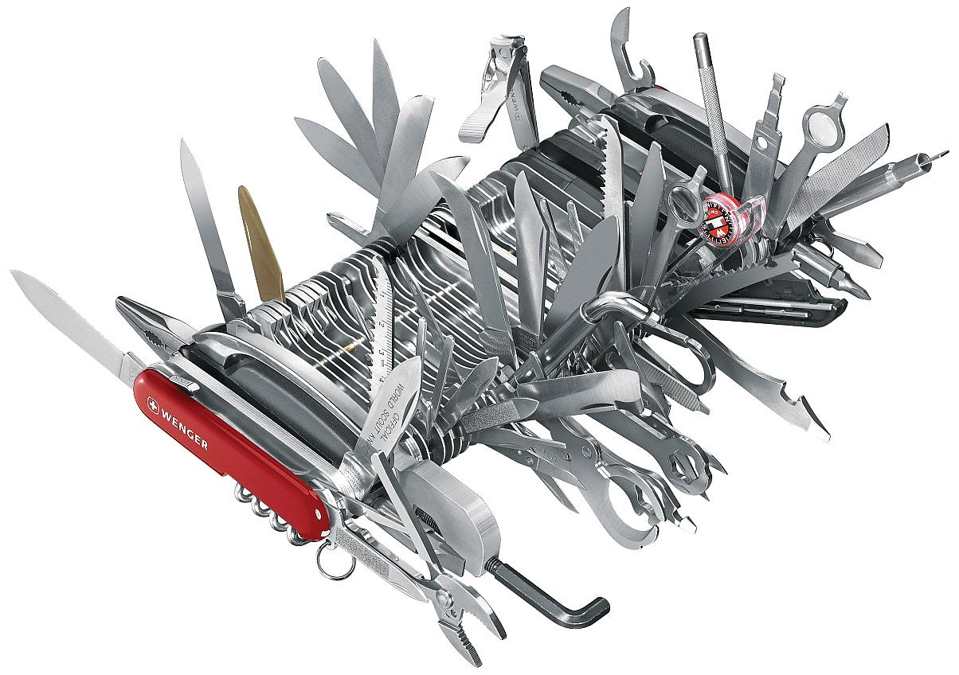
Tools should be fit for purpose
The value of a tool is in the experience that it provides.

Slide 5
A Fully Unofficial Baker’s Dozen of Suggestions for Small or Contracting Troops
Let’s start our discussion of tools for managing small or contracting troops with 13 suggestions .
If you think this is a great suggestion, joyfully raise your right toe.
If you think this is a great suggestion and then think “but we could never actually do this” briefly close your eyes and wince and then do a silent root casue analysis.
If you think this is a terrible suggestion, clench, and prepare to share your wisdom.

Slide 6
A Fully Unofficial Baker’s Dozen of Suggestions for Small or Contracting Troops in
It is better to do fewer things well and make good memories than to try to do too much and make poor or comic memories. Have an Annual Calendar and communicate the plan weeks in advance. Nothing sends negative messages to youth and parents more than poor planning and cancelling events. If you want the program to be taken seriously treat it seriously.
Re-emphasize the patrol method even if you just have one patrol. Do not blend patrols on an event by event basis. Patrols gel from shared pain and shared gain. The patrol leader should be the scout to whom others listen. Consider the Scout Patrol/ Eagle Patrol format and only rarely work on merit badges outside of summer camp until 1st Class is reached.

Slide 7
A Fully Unofficial Baker’s Dozen of Suggestions for Small or Contracting Troops
3. Re-emphasize uniform discipline for youth and adults as part of the Scouting Method. It is important to the identity of smaller groups and individual issues with the uniform (e.g. cultural, religious concerns, body image, adolescent development, cost) can actually be addressed with more sensitivity in a smaller unit. Reintroduce sashes.
4. It is better to do fewer things well and make good memories than to try to do too much and make poor or comic memories. Nothing sends a negative messages to youth and parents more than planning then cancelling events. If you want the program to be taken seriously treat it seriously.
5. Partner with another troop of the same size and gender once or twice a year. This promotes fellowship and develops critical mass in attendance, equipment, and finance. Attend District Events.

Slide 8
A Fully Unofficial Baker’s Dozen of Suggestions for Small or Contracting Troops
6. Partner with local Cub Scout Packs on an event other than join Scouting night. A scout is helpful—help Pack and Den Leaders with a campout or challenging achievement. Helping is different from don’t imposing your troop upon them.
7. Have meaningful ceremonies. Ceremonies are even more important in small units. Invite parents and Scouters from District or Council to your ceremonies. Have a ceremony planning session with the scouts with lots of examples of different ways to go. Do not let the ceremony become a party for an advancing scout thrown by the parents.
8. Have a locational identity. THIS is where and when we meet. Consider meeting outside (3/4 of Scouting is outing). It helps the reset from “when we were large” and small units can meet in big tents—it’s fun and challenges the PLC to think about “why not?” .

Slide 9
A Fully Unofficial Baker’s Dozen of Suggestions for Small or Contracting Troops in No Particular Order
9. Punctuation marks are important. For example: When x happens the meeting has started (flag ceremony, reciting oath or law, lighting the Scout Candle, etc) and when y happens we are done and not before (e.g. retreating the colors, SM minute, closing prayer, closing song, etc). Punctuation marks manage pace and sequence. Start and end on time.
10. SMs and ASMs are in charge of executing the program and providing safe, meaningful, youth experiences. Administration, budget, resource scheduling etc are the role of the Committee. If one group can’t do their job and the other has to do it for them, fix it.
11. Size doesn’t matter unless you insist that it does. If you use size as a metric , size becomes a goal for success (never fully met) or inadequacy. ‘Nuff said.
(Best concert I ever attended: A guy named Springsteen looked out over a not sold out crowd at a small venue, smiled, yelled “We are few but mighty!” then rocked the house for 3 hrs. Thank you for the life lesson, Boss. )

Slide 10
A Fully Unofficial Baker’s Dozen of Suggestions for Small or Contracting Troops in No Particular Order
12. Be aware of the fork in the road where one direction is “I get to do scouting” and the other is “I have to do scouting”. Choose the first. Help others choose the first. Scouting is supposed to be fun. If the second path seems inevitable ask why, talk about it with other make changes. Do not be a victim, be a Scout.
13. KISMIF

Slide 11
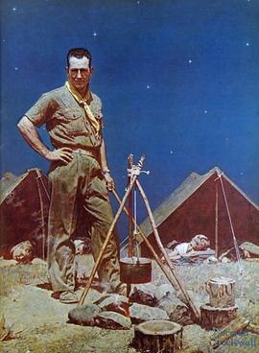
A final thought…
Y = f(x)

