Slide 1
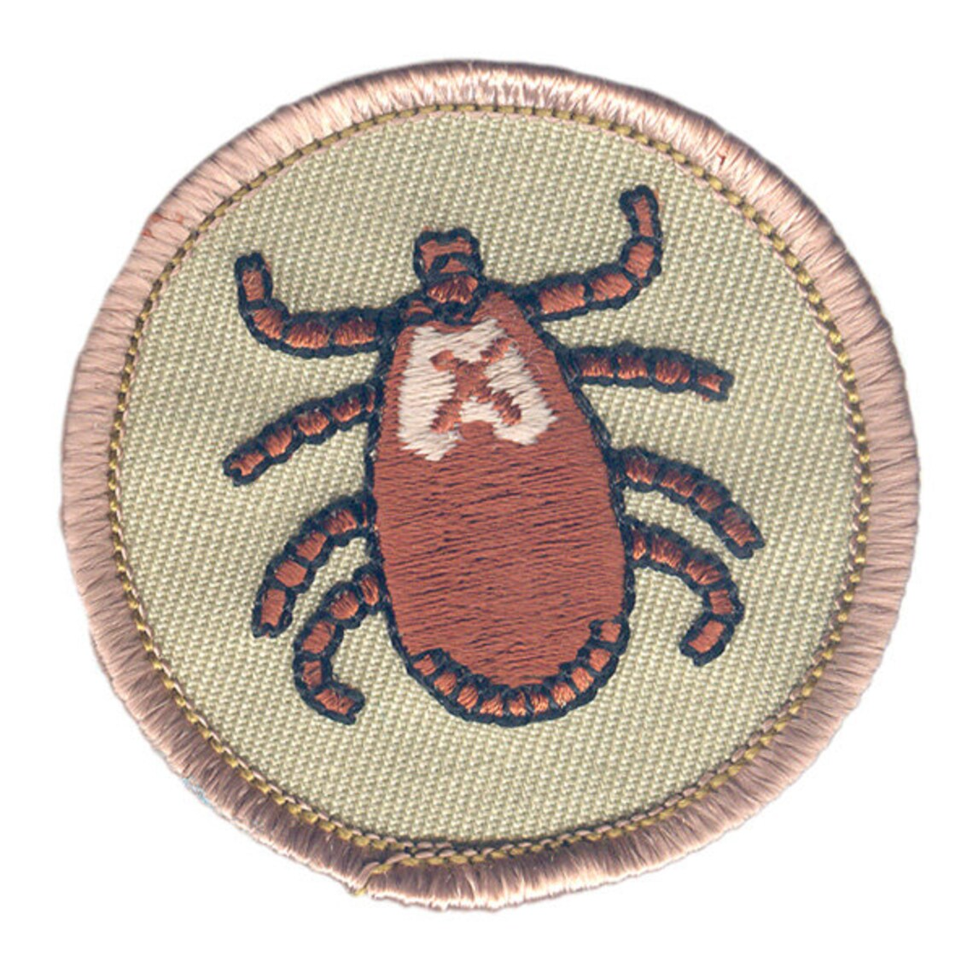
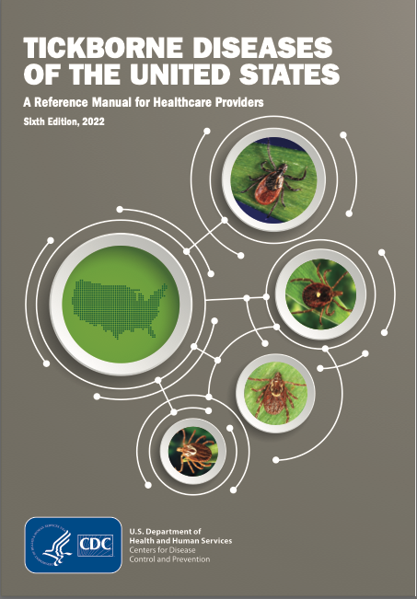
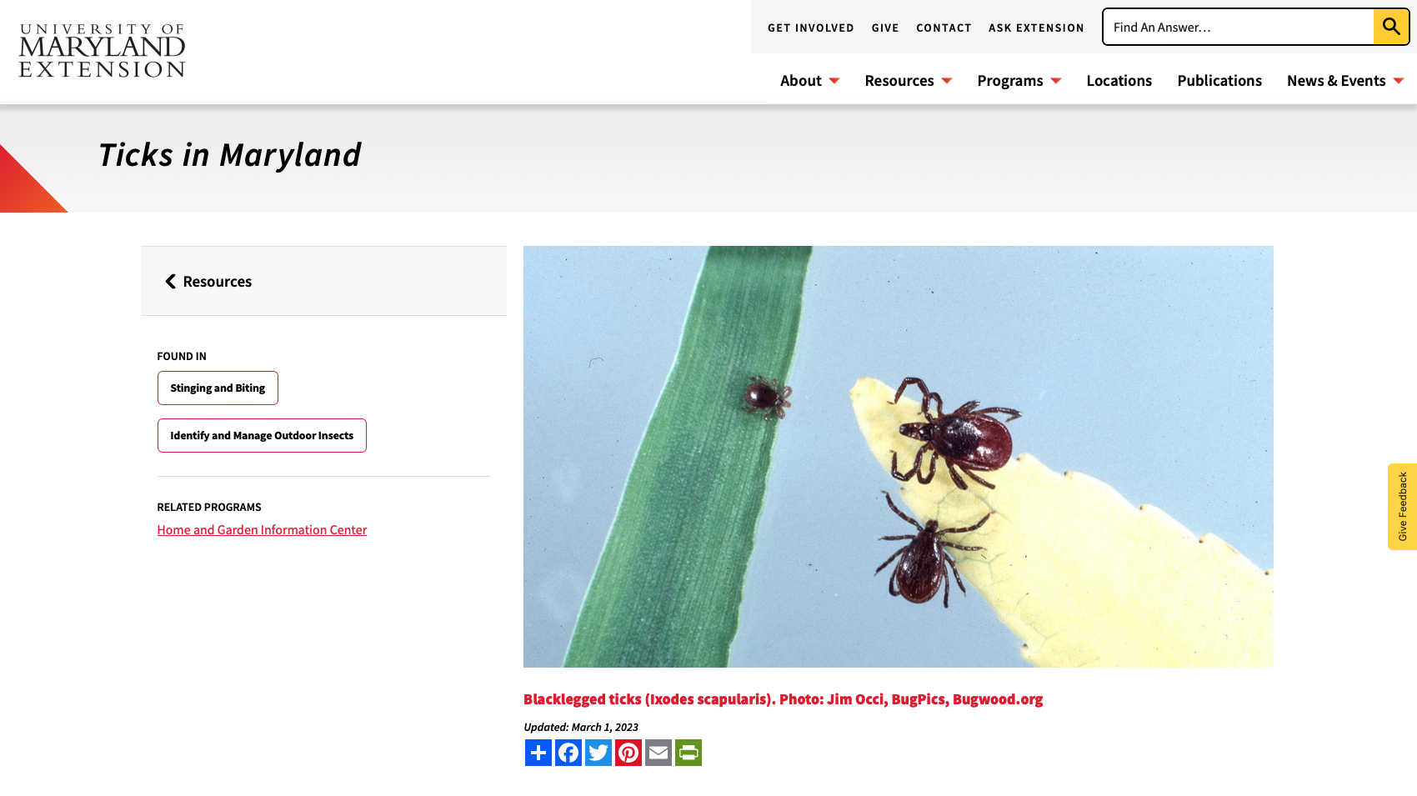
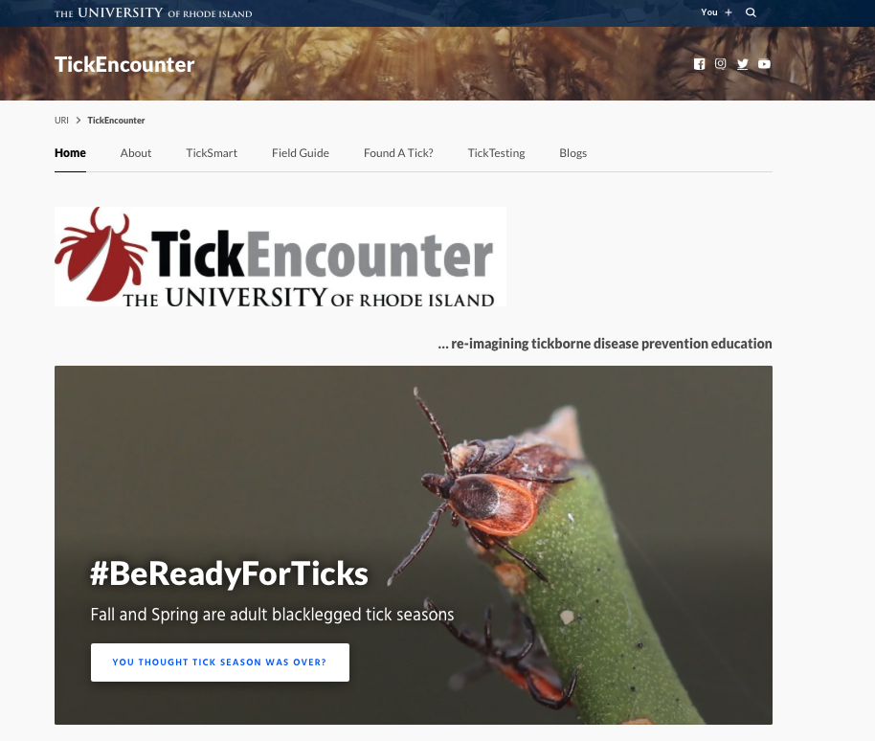

Tick Talk! One Pager
An overview of tick related concerns for Scouts and Scouters
2025 NCAC University of Scouting, GSC104
Three great quotes:
“Knowledge is the antidote to fear.” Ralph Waldo Emerson
“Fear is bred from ignorance. So knowledge is a weapon against it, and reason is the tool of knowledge.” Jim Butcher
“Do not fear the lack of knowledge, fear false knowledge.” – Leo Tolstoy
One ok quote:
“90% of managing the fears and anxieties of scouts is managing the fears and anxieties of parents or other influential adults and 90% of that is sharing high quality information with calm confidence”. Jeff Baker
Three key terms:
Tick check
Tick key
Permethrin
Three really great words that have nothing to do with this class but they’re great words:
Defenestrate
Denouement
Phosphene (not to be confused with phosphine which is not a great word…)
Three sets of references – knowledge is power y’all.
”Tickborne Diseases of the United States” and Tick Resource Index from the Centers for Disease Control. These sites have than you will likely ever want to know with lots of data and footnotes. This reference is good when talking to that Mom or Dad who works at the NIH or has recently discovered Wikipedia.
University of Maryland Extension web page “Ticks in Maryland” has good regional tick news and information and local trends. This reference is good for that Mom or Dad who blinks with confusion when confronted with the suggestion that the MD/DC/Northern VA region is not the center of all that matters or who is suspicious of anything from a source without a football team. All joking aside, ”local” resources do sometimes bring credibility to discussions with an anxious parent.
“Tick Encounter” from the University of Rhode Island. This is my go-to site. I like the tone, the balance of science and empathy, and they offer excellent information services. I highly recommend this site so I’m providing both the link and QR code which lets scouts and parents use their phones and we all know that if it’s on your phone it must be true, yes? And University of Rhode Island Ram FCS football counts as football… at least in the northeast… no it’s real football.
https://www.cdc.gov/ticks/tickbornediseases/TickborneDiseases-P.pdf
https://www.cdc.gov/ticks/index.html
https://extension.umd.edu/resource/ticks-maryland/
https://web.uri.edu/tickencounter/
Seneca District has made Tick Talk!, in an abbreviated form, a part of their Scouting Roundtable Program as well as IOLS and BALOO training. For more information on how to integrate Tick Talks into your training programs or for a unit presentation, contact Jeff Baker at jcb1836@gmail.com
Always take questions and concerns about symptoms and illnesses to a health care professional!

