Slide 1
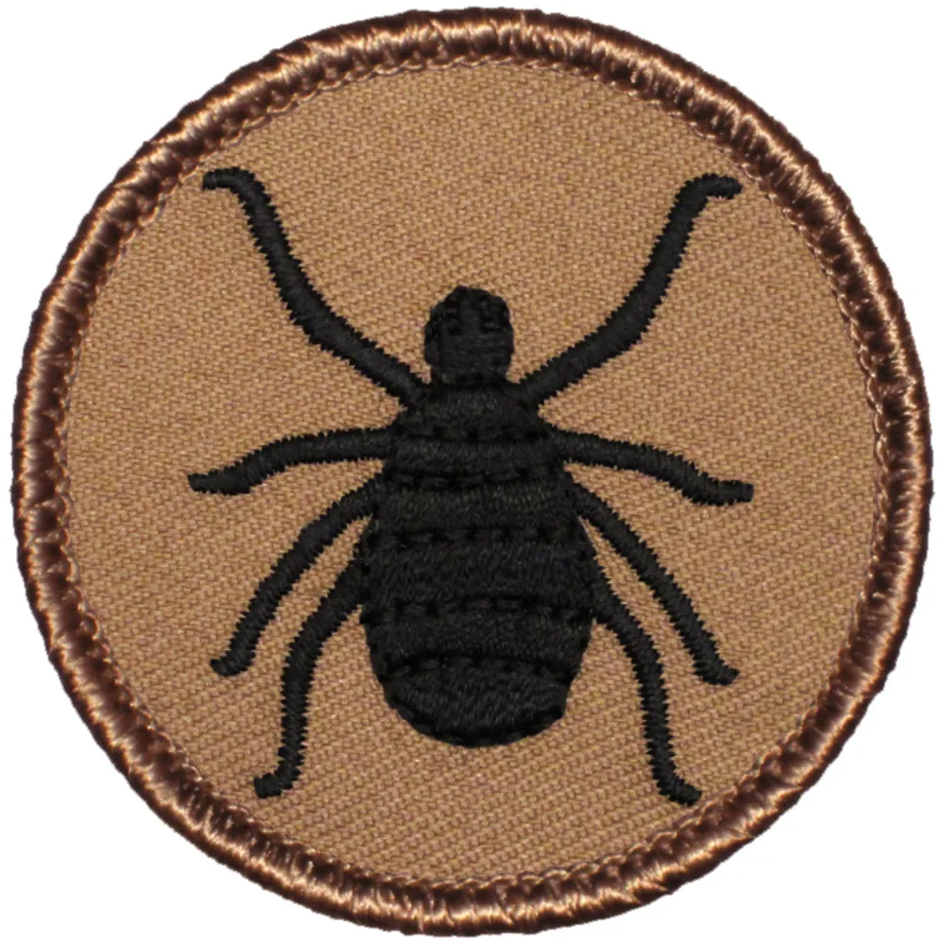
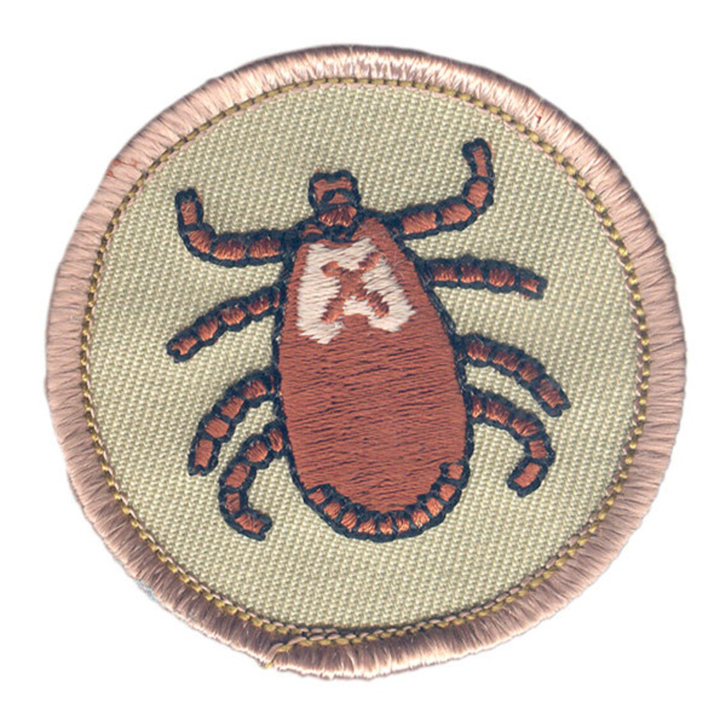
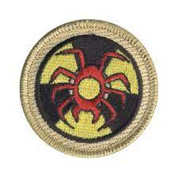
Tick Talk! An overview of tick related concerns for Scouts and Scouters 2025 NCAC University of Scouting, GSC104
Jeff Baker
Seneca District Committee
jcb1836@gmail.com

Slide 2
The Tick Talk is Not
A biology lesson! (Although there will be a little)
A medical consultation! (Always consult a physician for medical advice!)
A communal sharing of our Garden of Tickish Anxieties, Remembrances, and Lore!
Ok… we will talk some about tickish anxienties, remembrances, and lore…

Slide 3
Be safe.
Be prepared.
Make good memories.
Develop calm confidence.

Slide 4
References and Resources!
(They’re in your handout and will be uploaded into Basecamp if they’re not already there.)

Slide 5
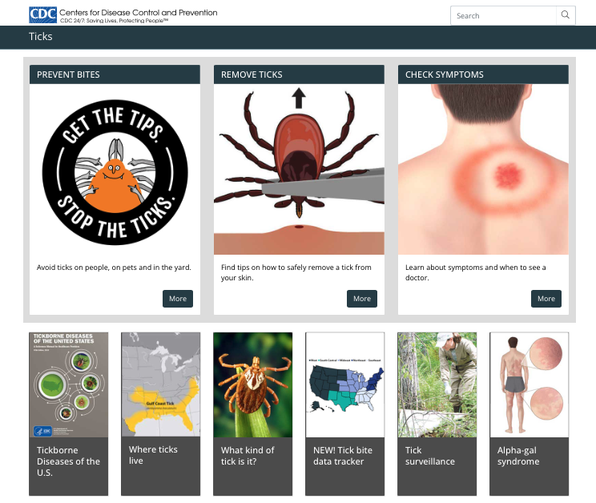
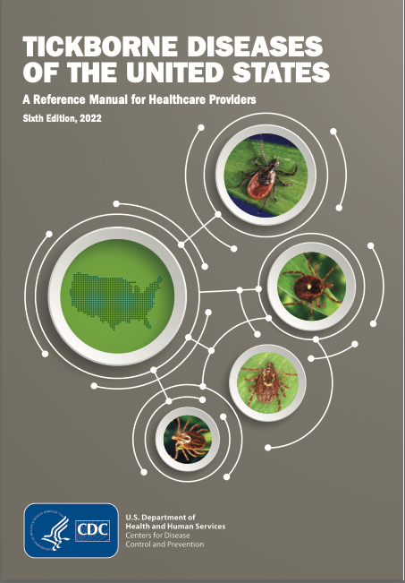
https://www.cdc.gov/ticks/index.html
https://www.cdc.gov/ticks/tickbornediseases/TickborneDiseases-P.pdf

Slide 6
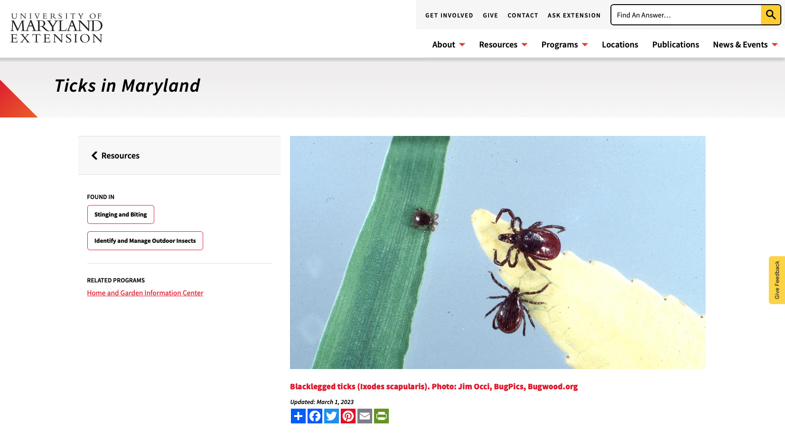
https://extension.umd.edu/resource/ticks-maryland/

Slide 7
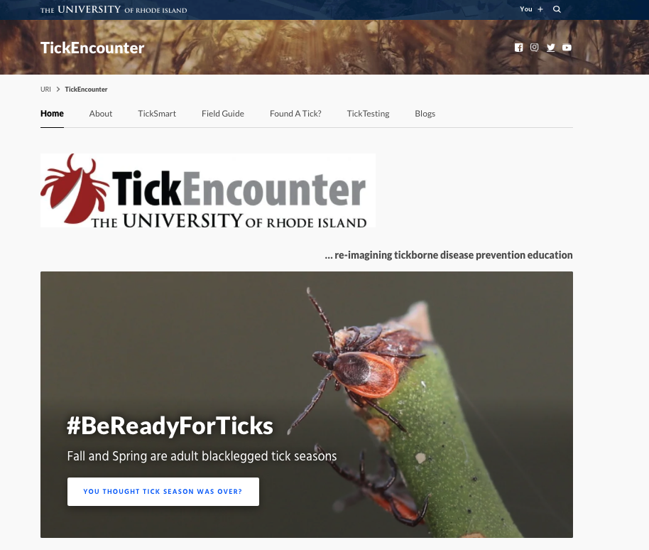
Tick Talk “Best Of” Award goes to…
“Tick Encounter”
University of Rhode Island

Slide 8
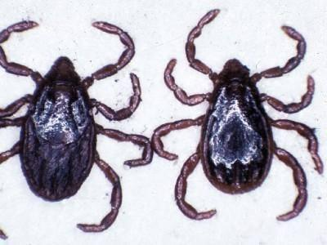
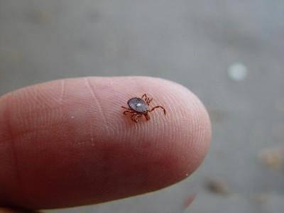
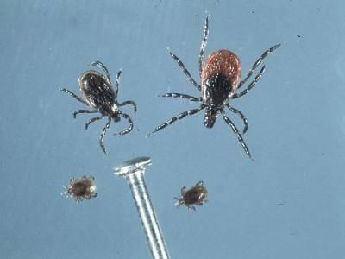
Local actors
Three species of tick are linked to health risks in the northeastern US.
The Blacklegged Tick can transmit Lyme Disease, Anaplasmosis, Babesiosis, and Powassan Disease.
The Lone Star Tick is an aggressive tick distinguished by the white dot or “Lone Star” on the back of the female. Lone Star Ticks can cause Ehrlichiosis and Tularemia.
The American Dog Tick, sometimes called a Wood Tick, can transmit Tularemia and Rocky Mountain Spotted Fever.

Slide 9
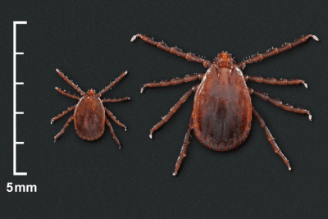
New arrival
The Asian Long Horn Tick (or Longhorn Tick) is native to East Asia and was first reported in the US in 2017.
As of April 13, 2023, Lononghorn Ticks have been found in Arkansas, Connecticut, Delaware, Georgia, Indiana, Kentucky, Maryland, Massachusetts, Missouri, New Jersey, New York, North Carolina, Ohio, Pennsylvania, Rhode Island, South Carolina, Tennessee, Virginia, and West Virginia.
Unlike our native tick species, female longhorn ticks can reproduce and lay eggs without mating, a process called parthenogenesis. Males are rare. Female Longhorned ticks can lay up to 2,500 eggs in the late spring to early summer.

Slide 10
Why do I care?

Slide 11
Tick Bourne Diseases in the US
Anaplasmosis and Ehrlichiosis both have an incubation period of 1-2 weeks and symptoms including fever, headache, malaise, GI problems, and cough. Rocky Mountain Spotted Fever has many of the same symptoms with the additional of a measles-like rash and an incubation period of 2-14 days
Babesiosis has an incubation period of 1-9+ weeks and is caused by parasites that infect red blood cells. Typical symptoms include Fever and chills, malaise and fatigue, GI problems, and dark urine.
Lyme Disease has an incubation period of 3-30 days and is characterized by a red, ring like expanding rash, flu-like symptoms, and arthritis like pain in the joints.
Tularemia has an incubation period of just 3-5 days and is characterized by fever, headache, fatigue, chest discomfort, cough, sore throat, vomiting, and diarrhea. Many cases exhibit a sore at the infection site.
Powassan Disease is a rare disease in the US that can become quite serious. The incubation period is 1-4 weeks and symptoms include Fever, headache, vomiting, and weakness. Powassan Disease can cause very serious neurological problems. Powassan Disease has received a fair amount of press coverage recently but, again, it remains a rare event.
Remember: a red or painful tick bite does not indicate infection!
Always consult a health care professional for diagnosis and treatment

Slide 12
Why else do I care?

Slide 13
De-Risking 101
What can go wrong?
What is the likelihood of it going wrong?
What is the impact of it going wrong?
What is the likelihood of it going wrong and having the failure be undetected?
What can I do to prevent a problem from from having a really negative impact?

Slide 14
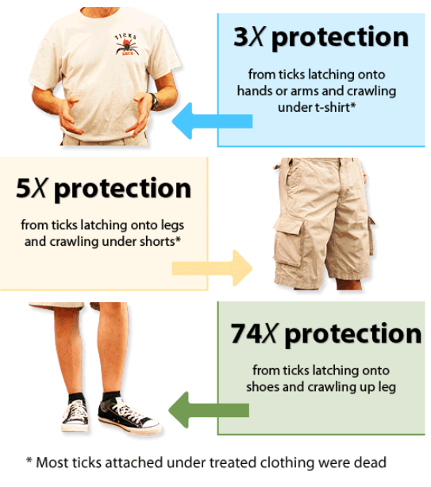
Prevention
Insect repellents represent one of the first lines of defense against attacks by blood feeding ticks and the diseases they can transmit. The most common products contain DEET and are applied to skin.
An alternative strategy is to apply permethrin to clothing and shoes rather than directly on the skin and can last through multiple launderings. Permethrin can be purchased as a spray and pre-treated clothing is available Permethrin is safe for use on tents and sleeping bags as well!

Slide 15
More Prevention: Tick Check!
In most cases, a tick must be attached for 36 to 48 hours or more before bacterium are transmitted. If you remove a tick quickly (within 24 hours), you can greatly reduce chances of tick bourne disease.
Check for ticks daily, specially under arms, around ears, inside the bellybutton, behind the knees, in the groin area, around the waist, and on the hairline and scalp.
“Two deep” always applies in scouting including tick checks!
Know your scouts, know your parents, be respectful.

Slide 16
Removing a Tick
Know your scouts, scouters, and parents. Help the person first, including their fears and anxieties, then remove the tick!
Use fine tip tweezers or a “tick key” to pull upward on the tick with a steady even pressure. Try not to twist or jerk the tick as this can cause mouth parts to break off and stay in the skin.
After removing the tick, wash the site and disinfect if possible.
Why is it a good idea to put removed Ticks in a ziplock bag?
Be matter of fact, calm, and confident, especially with young people!

Slide 17
Even More Prevention
Listen
Teach
Encourage
Smile
Calm Confidence

