Slide 1
University of Scouting
NATIONAL CAPITAL AREA COUNCIL
Backpacking Lite 2025
ROBERT W HANCHETT
Bhanchett45@yahoo.com

Slide 2
HISTORY
OF
LIGHTWEIGHT
BACKPACKING
START FROM WHERE
YOU ARE TODAY
HAPPY-COMFORTABLE-SAFE
SCOUT HIKING
SCOUT CAMPING
SCOUT BACKPACKING

Slide 3
WHY?
Ultra-lite
Backpacking
Luck is not a piece of gear
THE
ULTRALIGHT EQUATION
COURTESY: MR. NIGEL HOLMES

Slide 4
BASEWEIGHT
DEFINITION my goal: 11 pounds
(weight everything)
THREE SEASONS
WEIGHT OF FULLY LOADED PACK
MINUS CONSUMABLES (WATER - FOOD - FUEL)
IF IT IS LESS THAN 10 POUNDS
(OR THEREABOUTS)
YOU ARE ULTRALIGHT

Slide 5
BIG
FOUR
The lightest fully functional high quality option
1 DOWN QUILT
2 SLEEPING PAD
3 SHELTER
4 BACKPACK

Slide 6

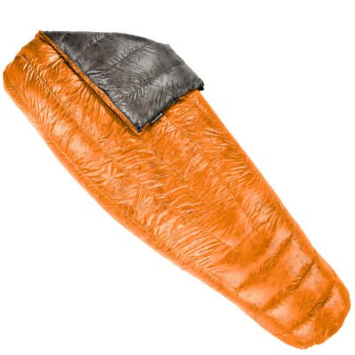
QUILT
Enigma Custom
$ 352.00
Key Features
ZIPPERLESS DESIGN
SEWN CLOSED FOOTBOX
Weight: 19.45 ounces
CUSTOM
Down Type 950 FP
Temperature 20°F (-6°C)
Length Regular / Width Wide
outside 7d, inside 7d
ENLIGHTENED
EQUIPMENT
ENIGMA
CUSTOM
- COLOR MATTERS -

Slide 7
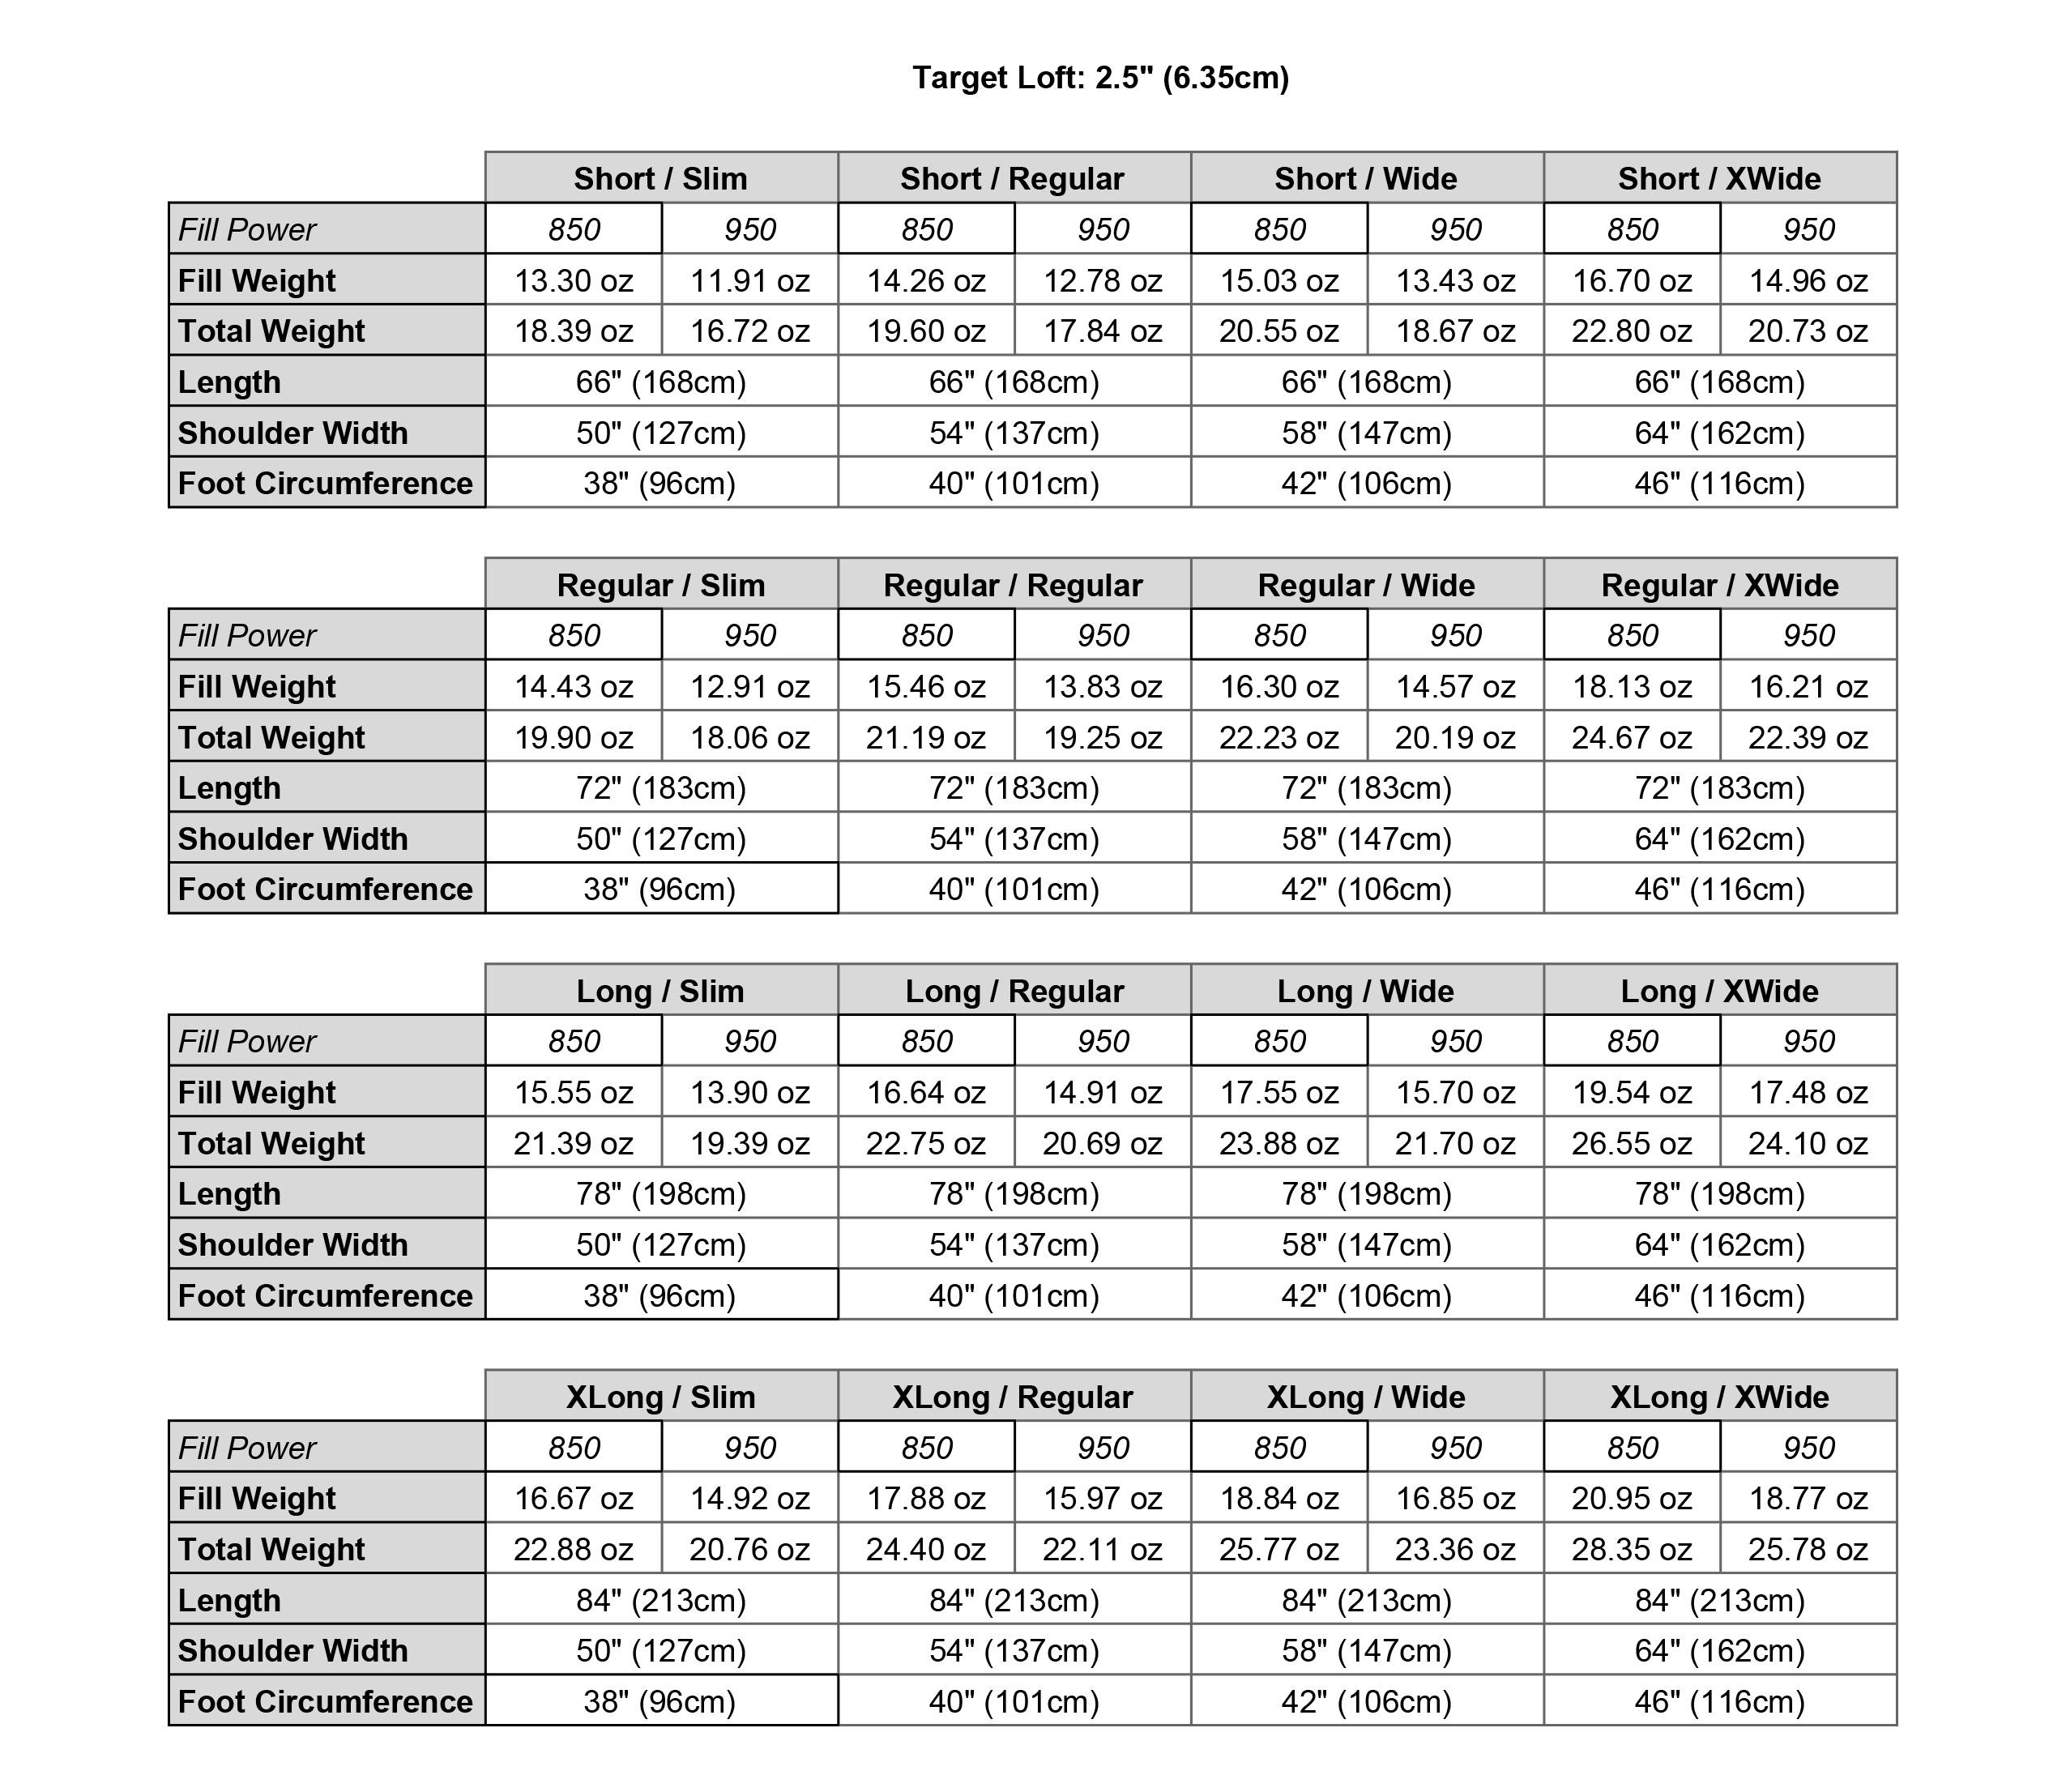

CUSTOM ENIGMA
HOW TO CHOOSE

Slide 8
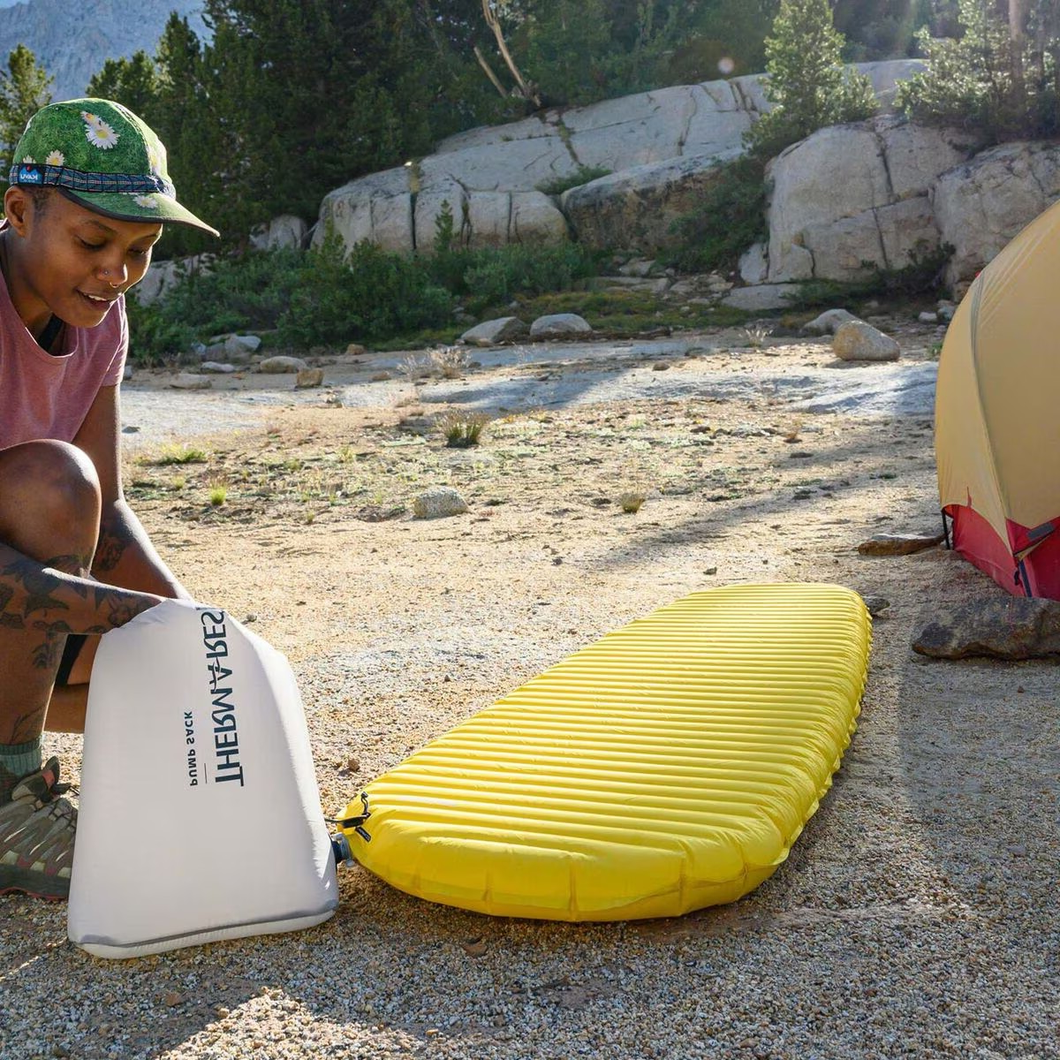

SLEEPING PAD
THERMAREST NEOAIR XLITE NXT
REGULAR WIDE
16 OUNCES, R-VALUE 4.5
72 X 25 X 3
$219.95

Slide 9
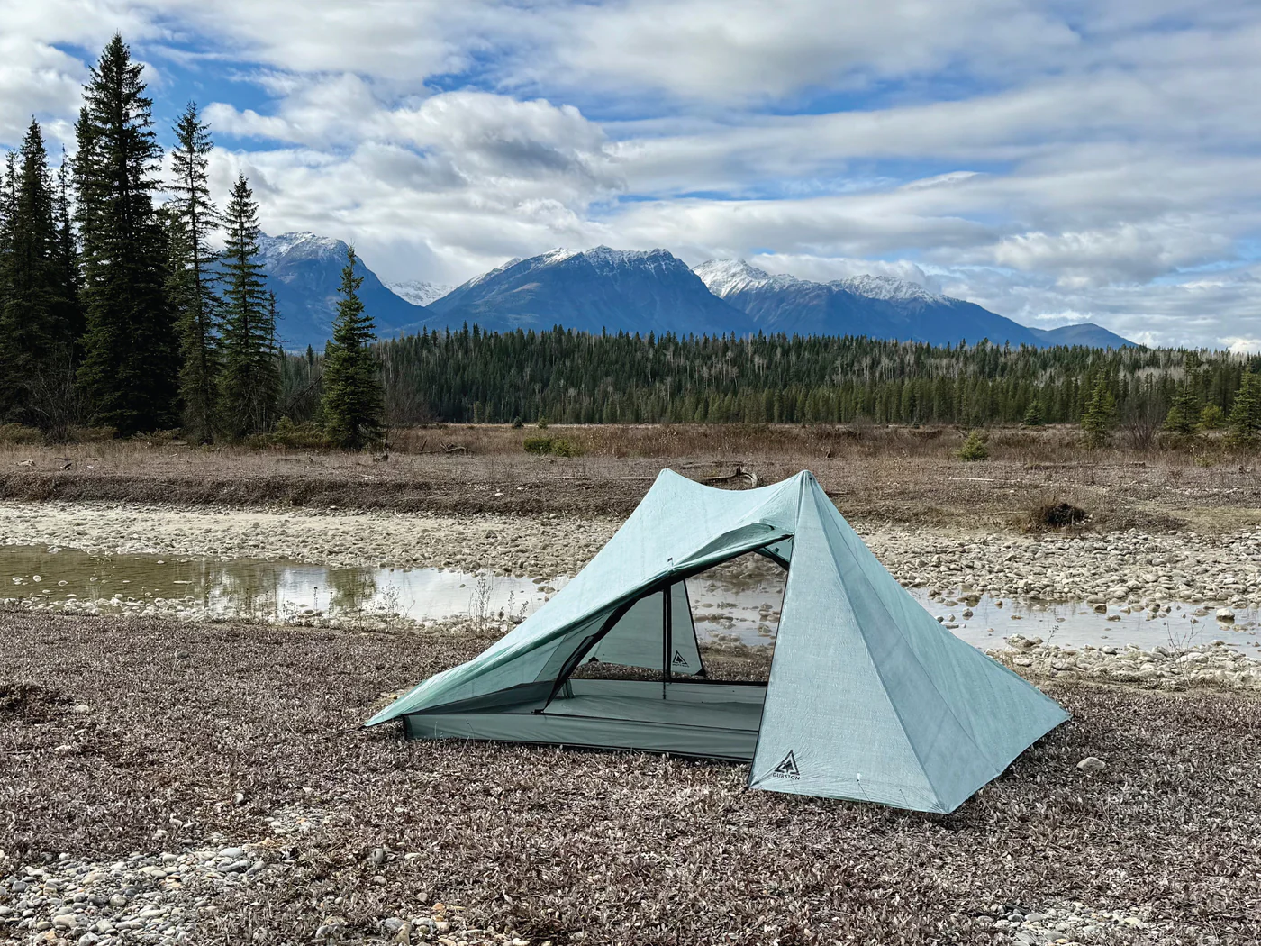
SHELTER
DURSTON
X-MID PRO 2+
Dyneema floor
$779.00 USD
19.2 OUNCES

Slide 10
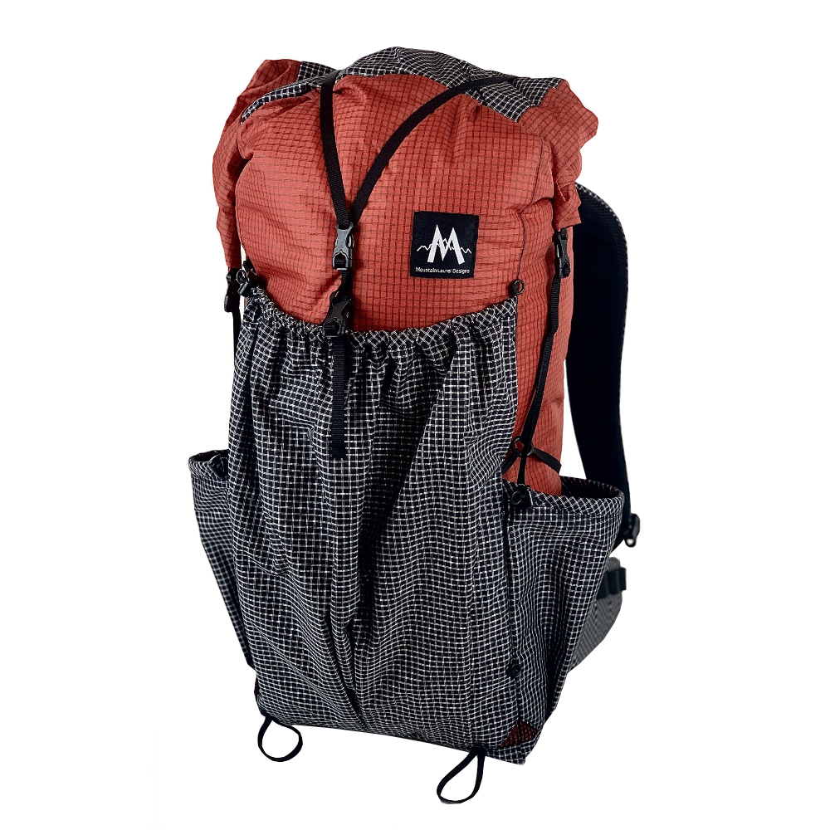

BACKPACK
MOUNTAIN LAUREL DESIGNS
EXODUS 58 LITERS
RED CHILI ULTRAGRID
18 OUNCES
$245.00
CLOUD

Slide 11
ARE YOU A GRAM WEENIE
THERE IS
NO SUBSTITUTE FOR
GOOD HIKING
AND
CAMPING SKILLS
HOW TO BE LIGHT
REPLACE GEAR WITH KNOWLEDGE
TAKE LESS STUFF – LEAVE IT HOME
DON’T CARRY YOUR FEARS
NO WATER
TOO COLD
INJURED
AVOID MANUFACTURERS WHO MAKE THEIR GEAR BOMBPROOF
MATCH GEAR TO SEASON AND TRIP
TAKE INVENTORY – DID YOU USE IT?
LOOK FOR MULTIPLE USE GEAR
SIMPLIFY – STRIP TO BASIC
LIMIT CONTIGENCIES
USE TEAMWORK – SHARE TENT AND COOKING GEAR
TEN POUNDS IS TEN POUNDS -STREAMLINE YOUR BODY
LIGHT GEAR REQUIRES CARE DURING USE
UPGRADE OVER TIME – DON’T WASTE YOUR MONEY
TO GET ULTRALIGHT GEAR – YOU MUST ORDER ON LINE
MAKE GREAT GEAR PART OF YOUR LONG TERM PLAN

Slide 12
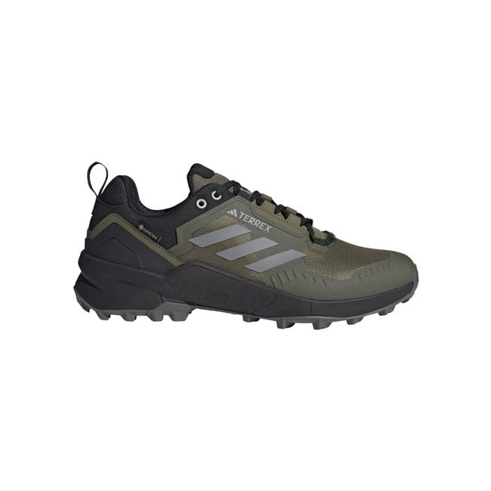
WORN
RULE OF THREE’S
THE GOLDEN RULE
DRY, DRY, & DRY
ADIDAS SWIFT
GORE-TEX
RAIN GEAR
PUT ON RAIN GEAR BEFORE YOU GET WET
DON’T SWEAT OUT YOUR CLOTHES- WET IS ENEMY
NORSE NET IS PERFECT BASE LAYER
SOCKS & LEGGINGS
DIRTY GIRL & ZPACKS GATORS
WADING/CAMP SHOES
HOOD RAINGEAR ONLY
WATERPROOF TRAILRUNNERS
RAIN MITTS

Slide 13
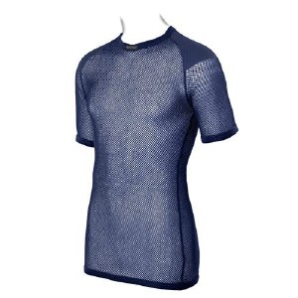
WORN
WARM
LAYERING
THERMO
BRYNJE - UNISEX MERINO THERMO T-SHIRT BASE LAYER WITH INSERTS $84.95
NORSE NET
MERINO ¼ ZIP & HALF PANT
ALPACA TEE & SLEEVES
WINDBREAKER & CALENDERING
ALPHA DIRECT
FLEECE
PUFFY JACKET
HAT/DOWN HOOD
BUFF, GLOVES & MITTENS
SLEEP CLOTHES/SOCKS
SWIM SUIT

Slide 14
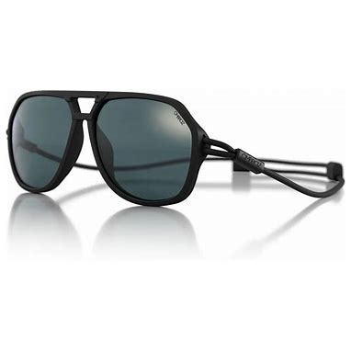
CARRIED
THE CONUNDRUM -
SKRIMP AND BE MISERABLE, HURTING AND UNSAFE. ADD WEIGHT AND INCREASE RISK OF PAIN AND INJURY
NOT REALLY SO NOW WITH MODERN MATERIALS, UNLESS STUPID LITE
TREKKING POLE
WATCH & COMPASS
FANNY PACK
SUN & READING GLASSES
IPHONE
NOTE BOOK
PEN & PENCIL
HANKY & HANKY

Slide 15
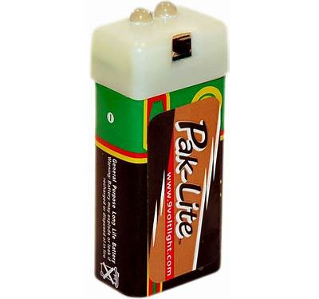
INDISPENSIBLE
GEAR
SCOUT BASIC ESSENTIALS
PAK-LITE 9 VOLT FLASHLITE
NIGHT VISION LIGHT
SPARE POWER SOURCE
SIT PAD & RUNWAY
BUG HEADNET
TREATING AGAINST TICKS, NATS, & MOSQUITOS
HYGIENE KIT
NOSE BAG
UMBRELLA
BIG CARL PACK HANGER
GUZUNDER

Slide 16
ADDITIONAL
CONSIDERATIONS
FIRST AID KIT
WATER PURIFYING OR TREATING (REDUNDANT)
POTTY KIT (REDUNDANT BIDET)
TOILET PAPER? FOLDING TECHNIQUE
COLD SOAKING/STOVES/EATING
COFFEE – JOGO BREW STRAW
UP SIDE DOWN BREATHING
LOGGER BOOT KNOT ( TIE ONE TIME)
LAVILIN SEVEN DAY ODOR CONTROL
BEAR CONTAINERS & BEAR HANGS (MINIBEARS)
ICE CREEPERS & ICE AXE
100 POUNDS OF ULTRALIGHT GEAR

Slide 17
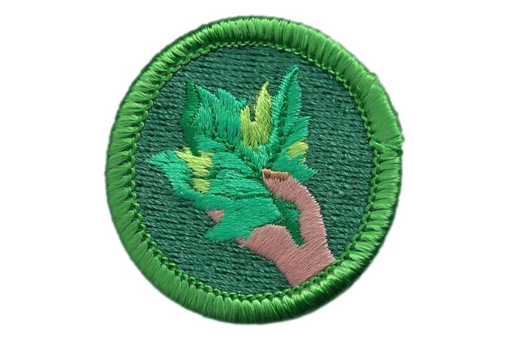
Using
Leaves
FOR BUSINESS
MERIT BADGE
Bhanchett45@yahoo.com

Slide 18
Bhanchett45@yahoo.com
HAPPYTRAILS

