Slide 1
Culture of Safety:
Sounds great; What the heck is it?
Sven J. Rundman III
University of Scouting 2025
February 20, 2025

Slide 2
What is “Culture of Safety”?
#1 Priority Goal
Safety culture embodies the value placed on safety and the extent to which scouts and scouters take personal responsibility for safety in our organization
Safety culture is often described as the 'personality' of an organization, as it is a shared value of safety.
Culture is but one element of our overall Safety program which includes Safety Leadership, Safety Climate, and Scout Safety Behavior

Slide 3
What it Means to Create a Culture of Safety
What does a culture of safety look like? What are the hallmarks?
Leadership is Committed and Vocal
Standards are clear
Standards are enforced
Everyone knows safety is part of their job
Everyone takes warning signs seriously
Concerns are reported
Morale is high
Quality is institutionalized

Slide 4
Check yourself – What is SAFE?

Slide 5
S A F E
We are committed to injury and illness prevention by integrating safety measures in our handbooks, literature, and training materials including the Guide to Safe Scouting. We expect leaders to use the four points of SAFE when delivering the program. SAFE Scouting measures include:
Youth are Supervised by qualified and trustworthy adults who set the example for safety.
Activities are Assessed for risks.
Pre-requisite Fitness and Skill levels are confirmed before participation.
Appropriate Equipment is utilized, and Environmental conditions are monitored.
When incidents do occur, we expect a timely, clear, and complete incident report. We are committed to learning from the data and modifying program guidance for the prevention of future occurrence.

Slide 6
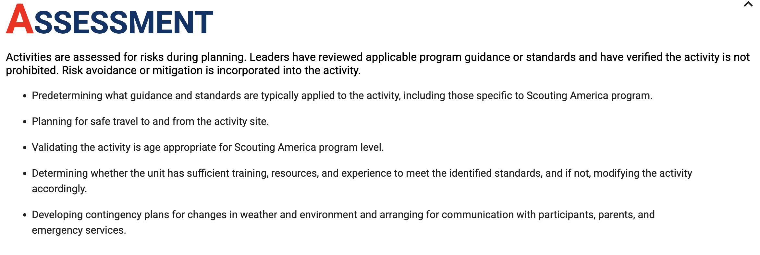
SAFE

Slide 7
SAFE

Slide 8
“Evidence” of our COS
Guide to Safe Scouting
S.A.F.E.
Safety Moments
Cope & Climbing Manual
Event Checklists
Safe Swim Defense Plan
Safety Afloat
Scouting Safely website
Range and Target Activities
Annual Health & Medical Record
Safe Driving Tools
ERM Committee – ACTIVE
ERM Guidebook – Program Hazard Analysis (PHA)
NCAP Standards
Short Term Camps
NCAP PD-111, PD 112
Regular communications to Scout Executives and the Scouting Community
Code of Conduct
Elements of safety in advancement, handbooks, program materials

Slide 9
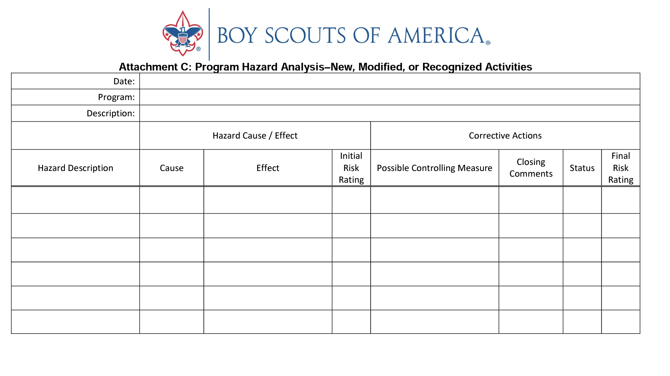
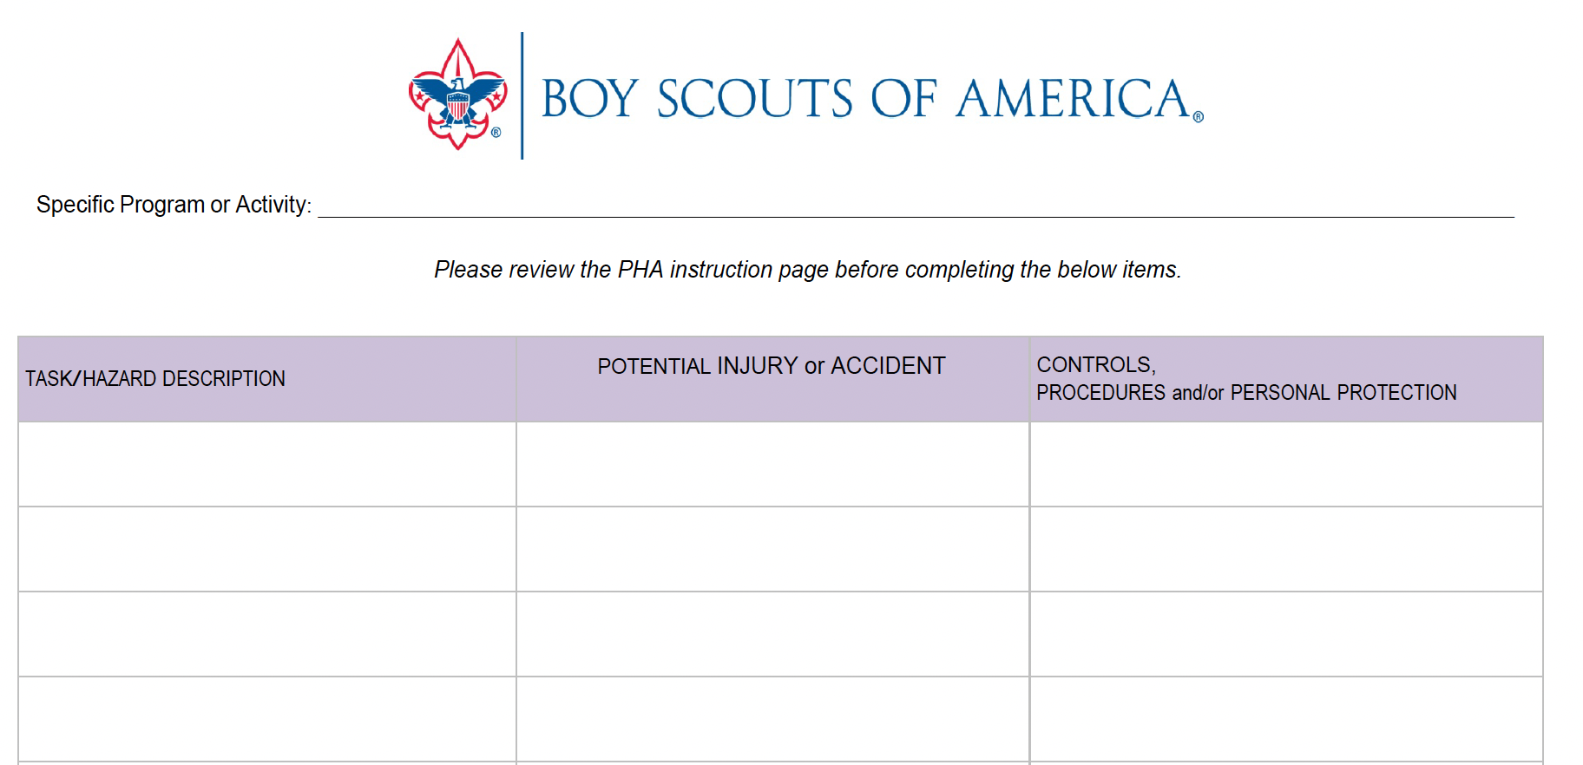
Program Hazard Analysis
680-026
Do not develop a PHA just to “check the box.” Develop a PHA to determine if the program/activity should even be conducted.

Slide 10
BSA’s Scouter Code of Conduct
On my honor I promise to do my best to comply with this Scouting Americas(Boy Scouts of America) Scouter Code of Conduct while serving in my capacity as an adult leader:
I have or will complete my registration with the Scouting America (Boy Scouts of America), answering all questions truthfully and honestly.
I will do my best to live up to the Scout Oath and Scout Law, obey all laws, and hold others in Scouting accountable to those standards. I will exercise sound judgment and demonstrate good leadership and use the Scouting program for its intended purpose consistent with the mission of the Scouting America (Boy Scouts of America).
The Guide to Safe Scouting
SAFE Checklist
I will make the protection of youth a personal priority. I will complete and remain current with Youth Protection training requirements. I will be familiar with and follow:
-BSA Youth Protection policies and guidelines, including mandatory reporting

Slide 11
Scouting America’s Commitment to Preventing Abuse
Mandatory reporting
Report to local law enforcement and child protective services
Report to the Scout executive or Scouts First Helpline at 1-844-SCOUTS1 (1-844-726-8871)
Ensure notification has been made to parents or guardians
In Scouting, we will not compromise the safety of our youth, volunteers, and employees.
Safety is a value that must be taught and reinforced at every opportunity. We are all responsible and must hold each other accountable to provide a safe environment for all participants.
We are committed to abuse prevention by using:
Mandatory youth protection training.
Criminal background checks.
Banning one-on-one adult and youth interactions.
Mandatory reporting of suspected abuse to law enforcement.
A volunteer screening database.

Slide 12
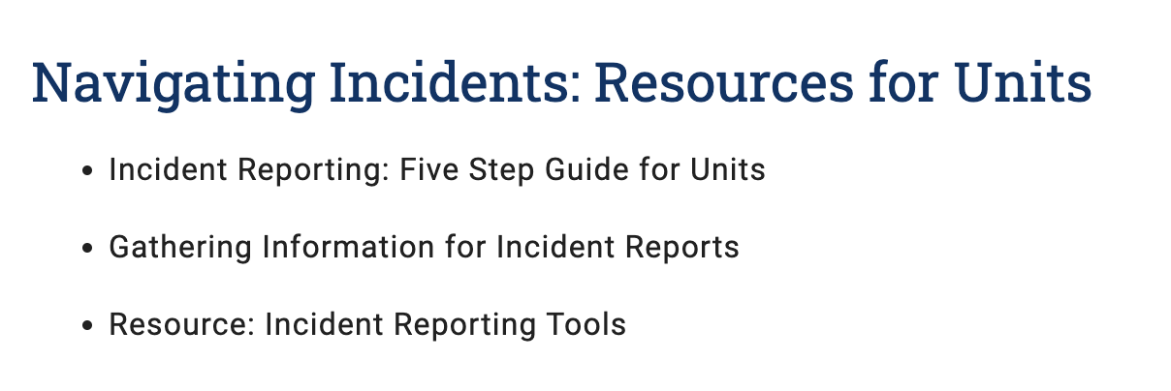
Incident Reporting – https://www.scouting.org/health-and-safety/incident-report/

Slide 13
What Can WE Do?
Understand and use
Adhere to following the established policies and programs
Understand and use the Guide to Safe Scouting and other Scouting America safety-related publications
Model
Model consistent use of Safety Moments in all meetings
Support
Support prevention first
Continue
Continue to recognize and encourage the critical nature of incident reporting
Drive
Drive all who lead toward the ideals of our improving culture of safety – delivery of the program as written, prevention over reaction, use of SAFE to evaluate all we do

Slide 14
Words from CSE James West (c. 1940)
“So many things are the result of lack of careful planning, lack of careful thinking through, thoughtlessness. And the health and safety practices of Scouting, we hope, are going to help boys to plan more definitely to avoid accident and illness, and to prepare themselves in a positive way to face life.”
Notes:
Ya gotta love this slide… thanks for including - David

Slide 15
