Slide 1
Post-Go-Live E-Resource To-Dos
Michelle Eichelberger
Michelle.Eichelberger@suny.edu
Notes:
Have a lot of slides to get through, will try to leave time for questions

Slide 2
You're live! Woohoo! Now what?
This session will cover:
Using your link resolver file to check for migration problems
Testing e-resources in and out of your IP range
Checking your P2E content
Managing your link resolver changes
Google Scholar
How to fix what you can fix and how to report what you can't fix
We'll look at the basics but won't get into advanced configuration
Notes:
This session will cover basics of how to check your migrated e-resources, how to change your link resolvers, and how to report problems
Take it with a grain of salt – there may be different ways to do what I'll be covering – do what works best for you

Slide 3
Your Link Resolver file is your friend
Remember your link resolver file that you sent to Ex Libris for migration?
You can use this file as your framework for extensive data testing
Notes:
This file includes everything that you said that you wanted to make live in the new system and you can use it to test everything that you're supposed to have
You should have a copy of this file because you attached it to your go-live case. If you can't find it, you can download it from that case.

Slide 4
Tabs and How to Use Them
Notes:
First thing: make a copy of this file that you can mark up/edit
Licensed Aggregator packages are those packages where you get the whole thing, not just parts of it. Examples are EBSCOhost databases like Academic Search Complete, Computer Source, etc.

Slide 5
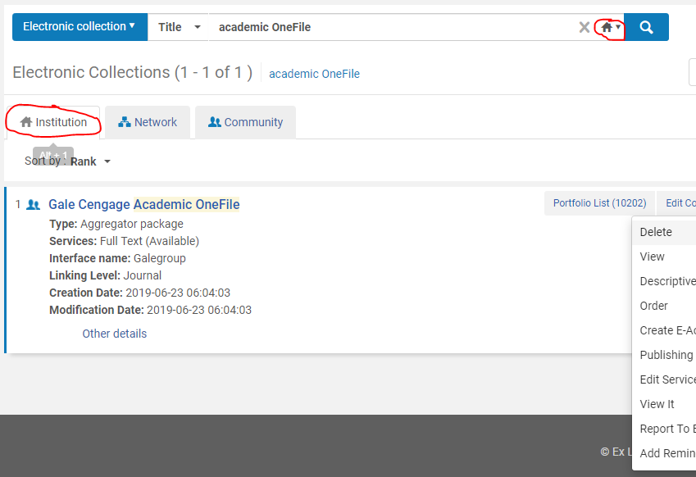
Aggregator Databases
Highest priority – make sure that these are working first
Check Electronic Collection:
Look it up in Alma as Electronic Collection – Make sure that it shows in your Institution Zone
Notes:
Highest Priority – you pay for these databases and you want your patrons to have access to them
try alternate wording if it doesn't come up right away, e.g. Gale Academic Onefile fails because Cengage is in title

Slide 6
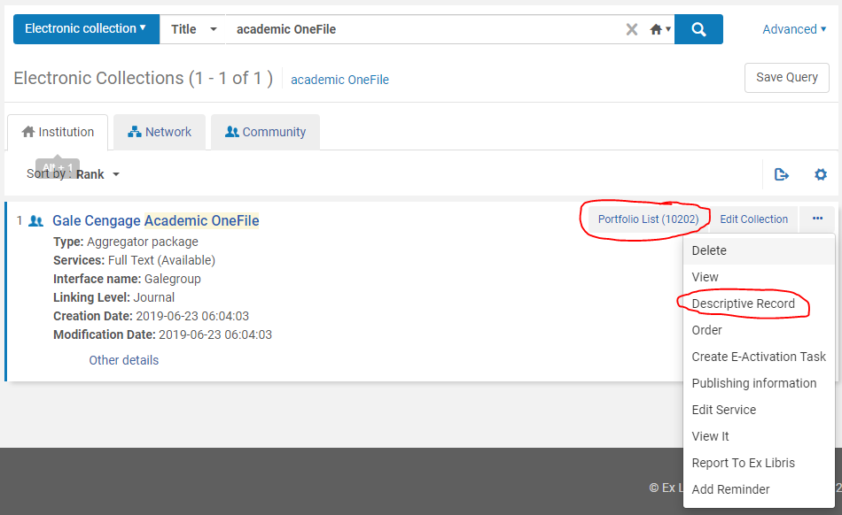
Aggregator Databases: Electronic Collection
Check Electronic Collection cont.:
Spot check the portfolio number to see if it's close to what you had activated in EBSCO holdings or 360 – may not be exact
If no portfolios, may need to link to different collection – CZ is fluid
Notes:
Number of portfolios might be different in EBSCO holdings or 360 and Alma but you're more worried about if there are no portfolios at all. If so, your collection may have linked to an obsolete collection in the Community Zone. As Shannon mentioned in 7/10 Q&A recording, portfolio lists will never be perfect – EBSCO's holdings weren't perfect, and it's an ongoing state of imperfection.
Collections change rapidly, Proquest Research Library example, only knew about it because of a post on the Alma list, probably noted in quarterly updates, bear in mind if your staff report that a collection stops showing up in Primo
Note the drop down menu – we're going to talk about Edit service, descriptive record, and delete

Slide 7
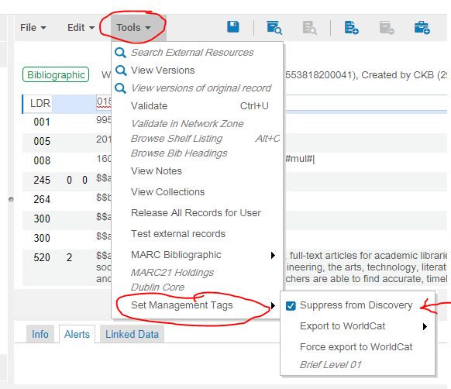
Suppress from Discovery
Pro tip: If you don't want your collection name to be searchable in Primo go to Descriptive Record.
in Record View click Edit, in MD editor choose Tools, Set Management Tags, and check the "suppress from discovery" box.
You don't have to save to make this take effect, just click back to go back to collection.
Notes:
Usually don't want collection name to be searchable - linking is flakey, the material type might not be "database," and you could end up with resource sharing request links
you may need a cataloger role to see descriptive record option
If you back out and suppress from publishing still says no, back out again and then click on descriptive record and change should have taken effect
Has been some lag time in suppressing of records – keep an eye on it and it should suppress. If not, please submit a case.

Slide 8
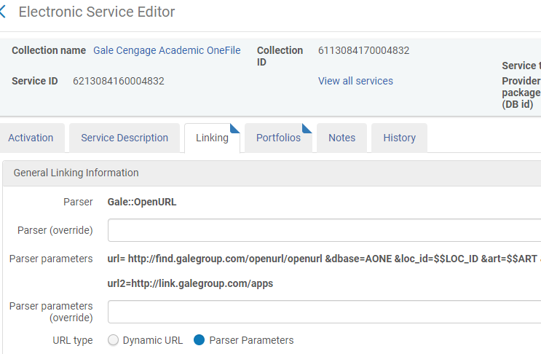
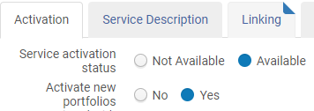
Aggregator Databases: Edit Service
Edit Service:
Make sure that your proxy is activated – only need to activate it at edit service, not at portfolio level
Parser parameters/URLs may look odd, but if it works, go with it
Notes:
Activation and Linking pages are vital

Slide 9
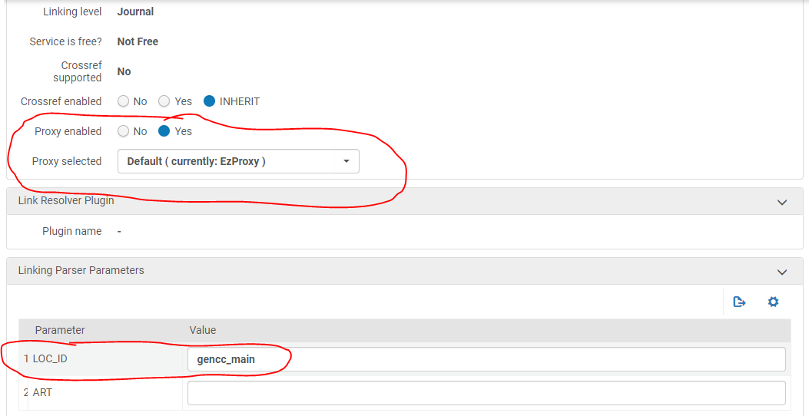
Aggregator Databases: Edit Service
Notes:
This is where you activate your proxy – best to use default so if you ever need to change it, it'll populate out. Choosing ezproxy specifically won't let you do that.
Some databases will need you to add local authentication information. If your link fails when you're testing your databases, come back and check this section of the Linking tab.

Slide 10
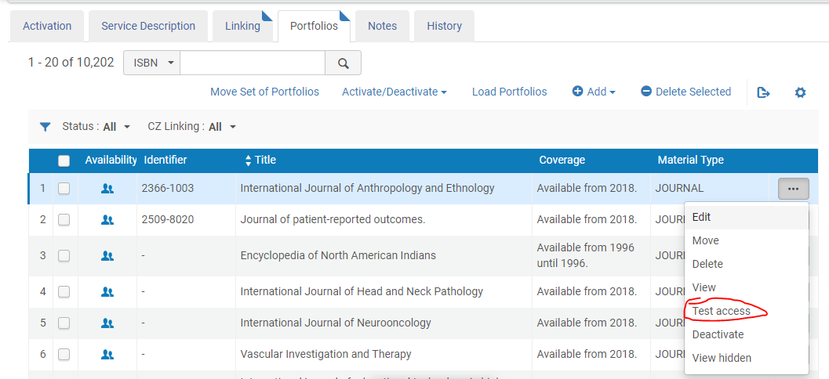
Aggregator Databases: Edit Service
Portfolios: This is where you can do your first test:
Notes:
Will bring you to the journal page in the database if it's working

Slide 11
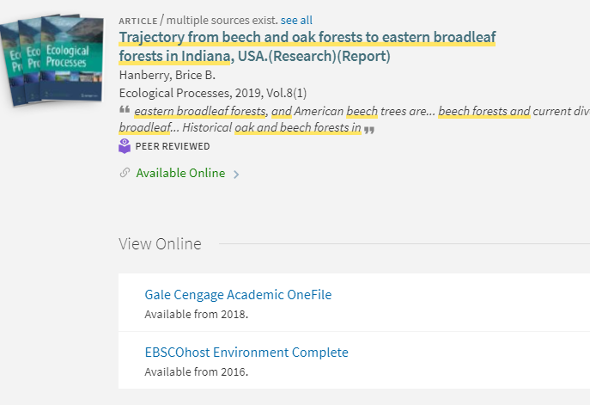
Aggregator Databases: Testing
Other things to test:
Go to your stand-alone databases and do a search in the database that you're testing. Copy the name of a full-text article that you find, and then do a search for that article in quotes in Primo.
When you get a result, make sure that it says "available online" and that the database that you're testing shows up in the View It list
Test access to the article from Primo both from within your campus IP range and from outside of it to make sure that your proxy is working correctly
Notes:
May have to try a couple of articles if indexing doesn't catch all articles

Slide 12
Aggregator Databases: Odds and Ends
If you find that the wrong database has been activated, you can delete it. To do this, you need the Electronic Inventory Operator Extended role, which isn't part of the out-of-the-box admin account. In the collection edit options (three dots), choose "Delete" and for the Handling bibliographic records without inventory question, choose delete bib records. Don't worry: this will only delete them from your IZ not from the CZ.
If you're getting proxy errors, make sure that you have the most current proxy stanzas, especially if you're self-hosted for ezproxy
If you decide to hide your electronic collection bib records from Primo Publishing, don't worry about the "Export to Worldcat" option. This would only happen if you had a profile set up to publish electronic resources, and that's not something that came out of the box.
In general, if you can get one database from a vendor working (e.g. EBSCOhost), the others should work the same way. Note: Gale can be tricky.

Slide 13
Aggregator Databases: Odds and Ends
If you're having trouble getting your link working, check the https://knowledge.exlibrisgroup.com/Cross_Product/Integrations/Alma_and_SFX document for parser parameters for the collection that you're trying to activate. Once you get the correct parser parameter, it can give you new fields where you can enter your customer id
Also check https://knowledge.exlibrisgroup.com/Alma/Product_Documentation/010Alma_Online_Help_(English)/040Resource_Management/050Inventory/020Managing_Electronic_Resources

Slide 14
Tabs and How to Use Them
Notes:
Selective Packages are just what they sound like: you've selected titles from within the package. You don't subscribe to the whole thing. This could be eBooks, eJournals, etc. Some of the databases that seem like aggregators (Literature Resource Center) had to go in this section for correct migration. You should see the title of the package here, and then By_Titles to tell it that you only get some of the titles.

Slide 15
Selective Packages
Like the Aggregator Packages, these are listed in your link resolver or 360 file
You'll want to go down your list of titles and make sure that each title was activated, especially because EBSCO campuses were unable to get a list of the things that failed, so you won't know what didn't work unless you test it
Known issues:
If your title had nothing in ISSN or ISBN fields, it couldn't match and didn't load
If your title had a | dividing two ISBN numbers in both ISBN columns, the title probably didn't load – numbers came from EBSCO holdings or 360 export
If the title didn't exist in the collection you listed, it didn't load – could be in another collection or might not be in CZ at all
Notes:
Do what you can do with this list. If you're a small shop, you may be able to manually check all of the titles. If you have large collections, Shannon went over ways to compare title lists, export your current holdings from your collection admin portals, etc., in his presentation during the 7/10 Q&A

Slide 16
Selective Packages: How to Fix Problems
Manually title by title: If you're a small shop with not many title records, you can fix manually and track what you've done in the link resolver file.
Manually with bulk portfolio loader: fix the problems that you find in the link resolver file, get these titles into the correct file format and load with bulk portfolio loader
Download correct holdings from vendor and upload them into electronic collection – can do incremental and that won't load duplicates
Notes:
Bulk portfolio loader info and title loading info at end of presentation. Shannon and Pam did a great job of going over this.

Slide 17
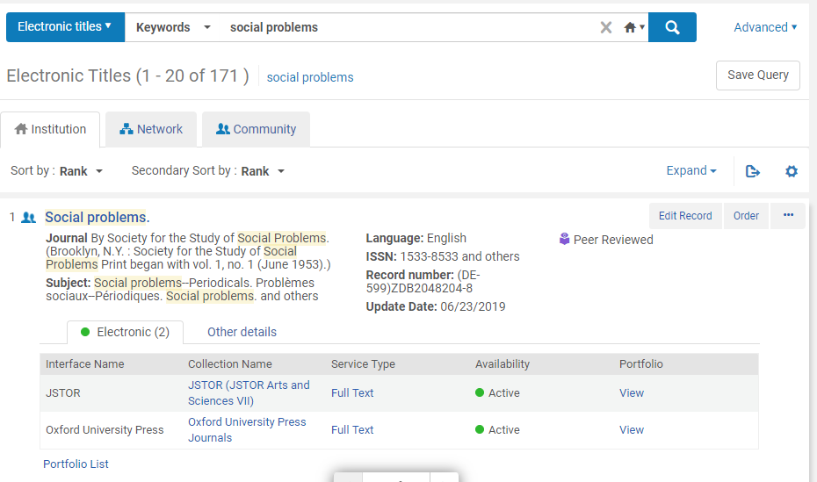
Selective Packages: Finding Titles in Alma
Notes:
Want to search by electronic title instead of collection, want it to show in your IZ with Electronic portfolio, click portfolio link to display portfolio – can have multiple ones with different coverage – eg eJournal covered with embargo in dbs and you pay for current access from publisher site – all will show, this feeds into link resolver/fulfillment options in Primo
Make sure that the correct portfolio is listed

Slide 18
Selective Packages: Missing Title
What to do if your title is missing:
Find the title in the CZ, choose the correct electronic collection and activate it:
Notes:
You don't need to worry about acquisitions for electronic titles do the same proxy, linking, and portfolio testing that you did for the aggregator databases

Slide 19
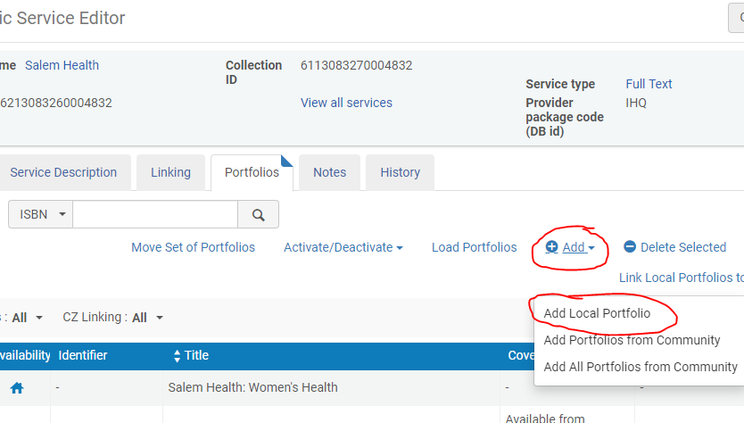
Selective Packages: Missing Title is in CZ
What to do if your title isn't in the CZ in the correct collection:
Search for the collection that you want and activate the collection if it's not activated
Go to Edit Service
Make sure that your linking/proxy/activation info is correct
Add portfolio from Community
Notes:
Sometimes you'll find the right title but it won't be in the collection that you want - I.e. 2019 Salem titles in EBSCO collections but not Salem

Slide 20
Selective Packages: Missing Title not in CZ
Add Local Portfolio
Title is mandatory
Fill in as much as you can – this will help record be discoverable in Primo
You will probably want to use a static URL for access
Leave proxy as no as long as service is proxy = yes
Notes:
Like creating a brief bib record – Liz
Won't be updated with the other collection records if URL changes, but it'll be in the right place

Slide 21
Tabs and How to Use Them
Notes:
Free_pkg

Slide 22
Free Packages
These are Open Access packages that you activated in EBSCO holdings or 360
Open Access works a little differently in Primo – some Open Access content only has to be activated in the PCI to make it both searchable and fulfillable, some has to be activated in both the PCI and Alma
If you choose to activate a collection in the PCI, for collections that say "Link in Record" that will be enough to make it accessible. You don't have to activate it in Alma as well. However, if the collection says "Link via Link Resolver" then you'll need to activate that collection in your Alma CZ
Notes:
You probably didn't have a lot of these.

Slide 23
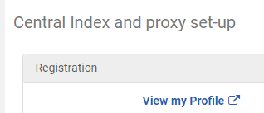
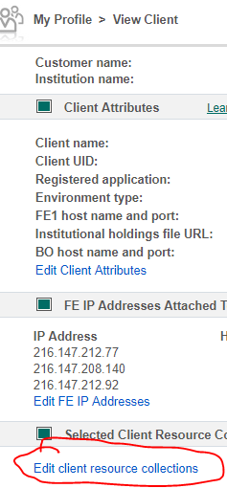
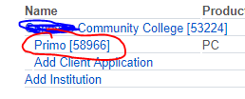
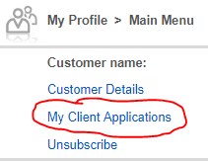
Free Packages: Check Activations
Notes:
Helpful links at end of presentation has info about PCI including suggestions for what Open Access to activate
Many arrows! This is not intuitive!

Slide 24
Free Packages: Check Active for Search
Notes:
Good idea just to do a general active for search to see what you've got activated – Ex Libris automatically activates LOTS of Open Access, and that can make open access content show up above licensed content in your Primo searching. Not all of the Open Access is good, fulfillable content. If you're getting weird Primo results, this is probably why. Takes 7-10 days to remove from Primo once you've deactivated in PCI.
Note inherit Consortium Collection Activation: picked things that everyone has via Novel or SUNYConnect, can use view to see what we activated

Slide 25
Free Packages: e.g. Open SUNY Textbooks
Notes:
Open SUNY says Link in Record – don't need to have it activated in Alma too, can delete in Alma

Slide 26
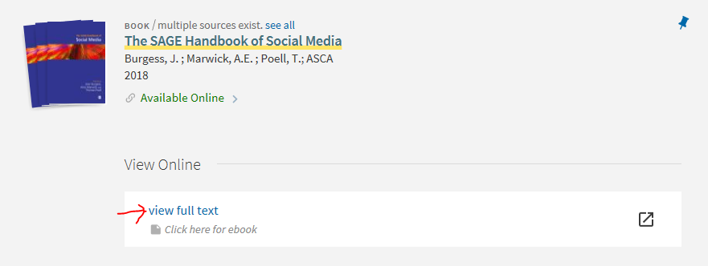
P2E Checking the Hard Way
The blunt force way to check if your P2E worked is to figure out how many titles you migrated for each collection from Aleph then compare that number to what you see for portfolios in Alma
Problem with missing collection name:
Notes:
Link still works, patrons will get to content, but it didn't add to GVRL like it was supposed to

Slide 27
P2E Fix
There doesn't seem to be an easy way to pull out the unmatched titles from Alma.
The manual way to find them would be to pull them from Aleph and go down the list and search for them in Alma.
You can also pull the list of what you should have from the vendor site and then load them in the correct collection using the bulk portfolio loader
You have to figure out how to hide or delete the bad records in Alma
Notes:
If you have a better way, use it! This is for small collections only – there's been discussion on Basecamp about this.
Can see interface name is blank

Slide 28
P2E Inefficient Fix
To do a manual fix of the missing collections:
Once you find the record, click on Portfolio List and choose Edit Portfolio
Then choose attach to an electronic collection, making sure that your collection was already activated, so that it'll appear in your dropdown choices.
Notes:
If you have a better way, use it! This is for small collections only – there's been discussion on Basecamp about this.
Can see interface name is blank

Slide 29
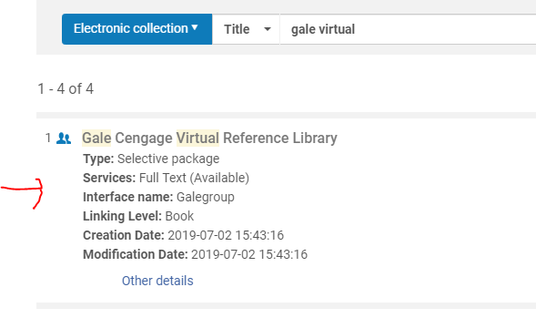
P2E Inefficient Fix

Slide 30
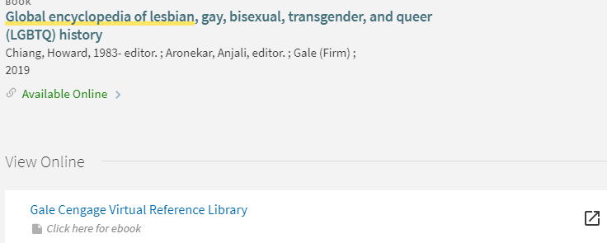
P2E Inefficient fix
Once it's fixed, you'll see the correct collection in Primo:

Slide 31
Link Resolver Change
What's a link resolver?
The magic behind "Get Full-Text" links in your aggregator databases
Points patrons to full-text of an article when it's not available in the database
It knows what you have access to in all of your other databases because you've kept your holdings updated in EBSCOhost holdings or SFX or wherever
Why do you need to change it?
Current link resolver (EBSCOhost Full Text Finder, SFX, etc.) is either going away (EBSCOhost) or becoming obsolete because all new electronic content will be added in Alma instead of another system
When do you need to change it?
Soon! EBSCOhost FTF going away 9/30, as you add more content to Alma old link resolver info will become dated
Notes:
EBSCO going away 9/30, link resolver keeps track of what you buy so that it can point patrons to full-text if full-text is not available where they're looking for it

Slide 32
Link Resolver Change
Where do you need to change it?
Figure out which of your current stand-alone databases have some kind of "get full-text" link
Don't need a link resolver in databases where everything is full-text – patrons won't need to link out. E.g. Credo, Britannica, GVRL, etc.
What's your new link resolver address?
https://<Primo_domain>/openurl/<Alma_institution_code>/<view_code>
eg.: https://suny-ups.primo.exlibrisgroup.com/openurl/01SUNY_UPS/01SUNY_UPS:01SUNY_UPS
If you've seen mention of adding a ? mark to the end of this code, ignore that, you don't need it
Notes:
You may already have a list of databases that use it, or you may have to go look at all of them

Slide 33
Link Resolver Change
How do you change it?
Most of your databases will have some kind of administrative portal where you can add your library logo to the database, get stats, update your IP addresses, and change your link resolver address
If you're new in your position and/or don't have your admin account info, you can contact the vendor tech support and they'll help you get set up
For most of the databases, it's an easy swap out of URLs
Some databases don't give you an admin portal (we're looking at you, Jstor), so you'll need to contact their tech support and ask them to change it for you
EBSCOhost's link resolver set up includes complicated coding, so you'll probably have to contact their tech support to ask them to change it for you

Slide 34
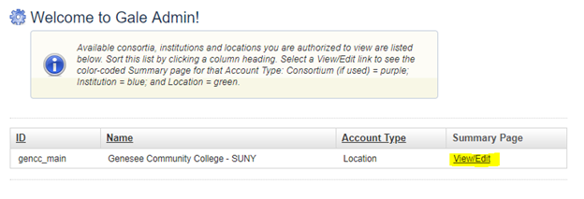
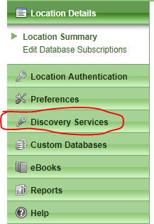
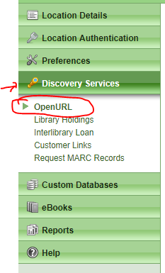
Link Resolver Change: Example: Gale

Slide 35
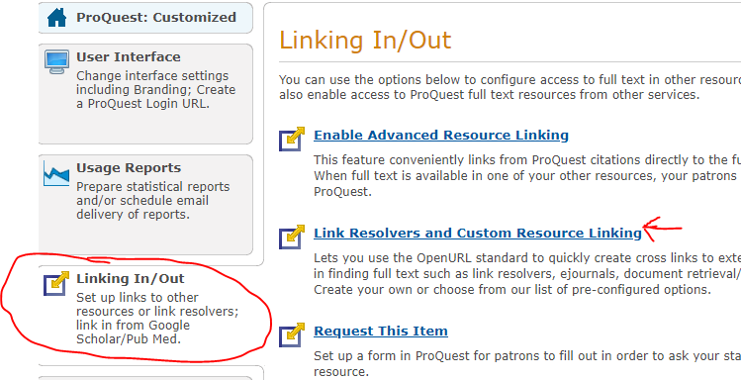
Link Resolver Change: Example: Proquest

Slide 36
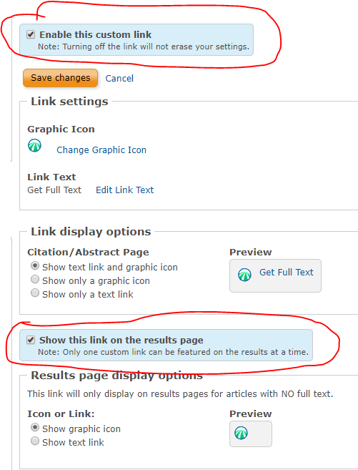
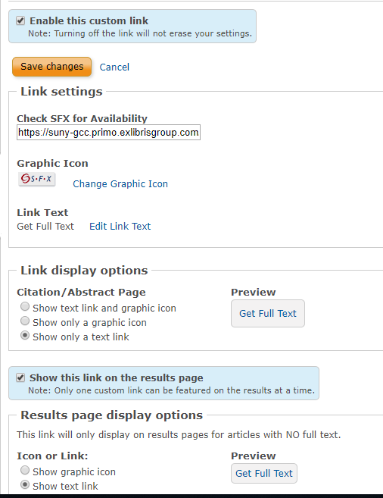
Link Resolver Change: Example: Proquest
Disable FTF
Enable Alma (SFX)
Notes:
Have to disable FTF AND enable SFX
Should take effect pretty quickly. If it doesn't even after clearing cache in your browser, contact Tech Support – my mistake was that it wasn't enabled

Slide 37
Google Scholar
Google Scholar is usually mentioned at the same time as the link resolver is discussed because they are related, however Google Scholar is a separate thing.
Your current link resolver provider has probably set up Google Scholar linking for you, so that if you do a Google Scholar search on campus computer, links to your articles will show in the results.
You should see a link either to the right of the article result or in the "more" link under the article that says something like "Get It from [your campus]."
Most schools set this up so that when a patron is within the campus IP range, the links automatically show, but if the patron is at home or outside of the range, they'll need to identify themselves as being affiliated with your campus so that Google will know to show them the links. Here's an explanation about how to set this up for GCC students.
We can't change this link resolver connection ourselves.
If you're an EBSCO full-text finder customer, you need to contact tech support to have them remove themselves. It can take 1-2 weeks for the change to take effect.
Ex Libris has already set up our connection with the Alma link resolver, but you also need to make sure your Google Scholar publishing job is set up and running in Alma.
Notes:
Link to Lynn's post about Google Scholar Publishing in Helpful Links

Slide 38
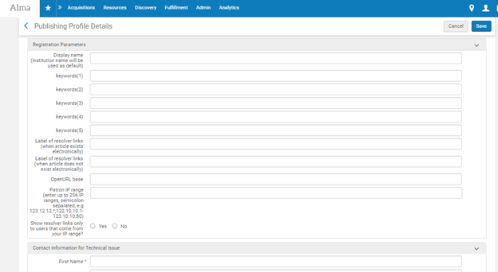
Google Scholar
From Lynn Higgins: "SUNY institutions have been registered for Google Scholar. Prior to your go live, please plan to configure the Google Scholar publishing profile. At go live, ExL will run publishing for the first time if we see a configured profile. The profile is found under Resources > Publishing > Publishing Profiles> Publish electronic records to Google Scholar. Please complete the Registration Parameters and Contact Information for Technical Issue sections of the profile:"
Notes:
Link to Lynn's post about Google Scholar Publishing in Helpful Links

Slide 39
What to do if you can't fix something
Basecamp
Create a Salesforce case
More info coming soon from Ex Libris about Switch to Support.

Slide 40
Helpful Links
Knowledge Center general overview of electronic resources
Parser Parameter Documentation: use if you're having trouble getting your databases to link properly
Shannon and Pam from Ex Libris presentation about title loading with bulk portfolio loader
Bulk portfolio loader format information
More info about how Open Access works in Primo, including recommendations for packages to activate
Google Scholar publishing
Alma Release Notes: tells you what's changing with each update
Community Zone Updates Task List: this job tells you what CZ changes have affected your content every week

