Slide 2
Connecticut’s Air Quality Challenges and Mobile Source Focus
September 17, 2020
Municipal EV Readiness Toolkit: Module 1
Paul E Farrell, Air Planning Director
Department of Energy and Environmental Protection

Slide 3
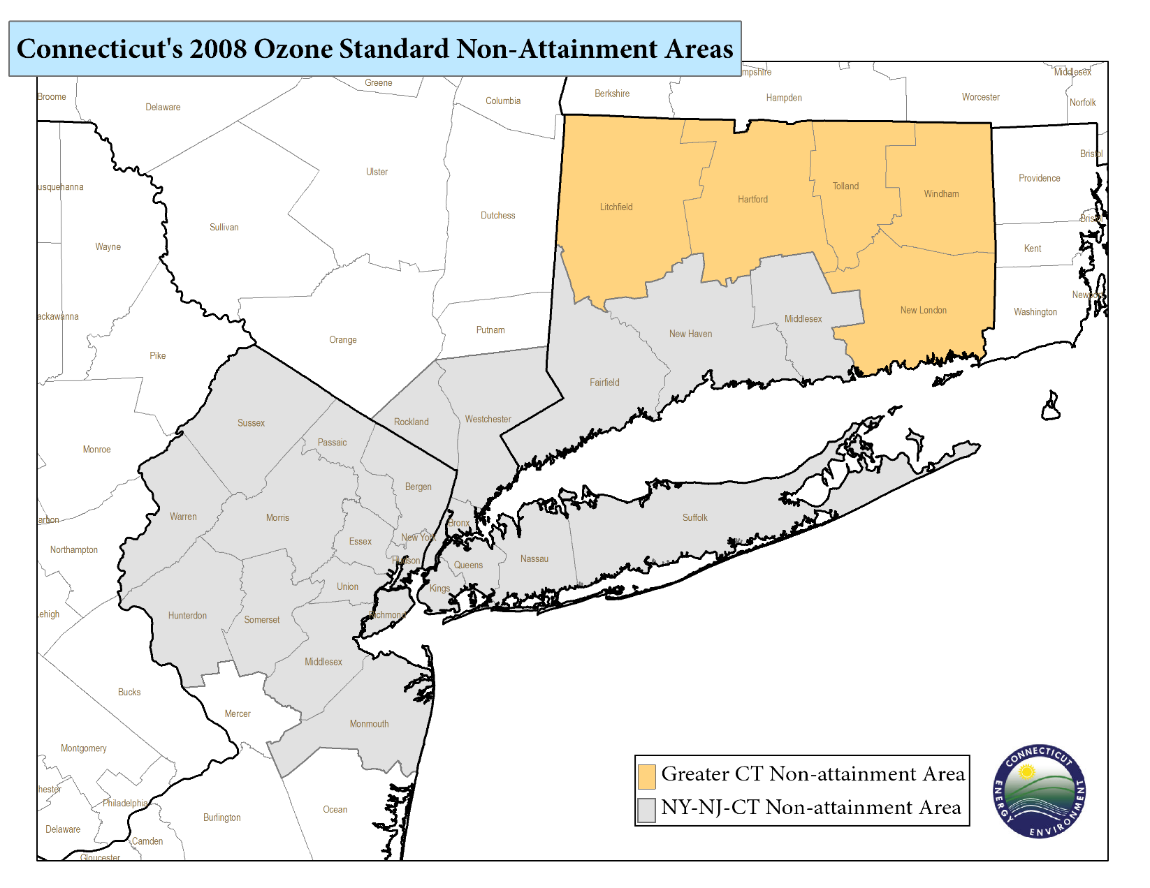
Connecticut's Air Quality Challenges
Connecticut air quality fails to meet both the 2008 and 2015 8-hr ozone national ambient air quality standards
Ozone Design Values
  Greater CT: 73 ppb
  NY-NJ-CT: 82 ppb
  17 exceedance days this summer
Long term greenhouse gas reduction targets of 80% below 2001 levels by 2050
Notes:
The preliminary 2019 design value for southwest CT ( NY-NJ-CT nonattainment area ) is 82 ppb (Westport, Stratford and Madison have all measured highs of 82 ppb).
For the Greater CT nonattainment area DV is 75 ppb. These are the same design values as last year.

Slide 4
Connecticut Ozone Trends
Notes:
Highest monitor in the region is usually Westport – sometimes Stratford or Madison at 82 ppb

Slide 5
Northeast Greenhouse Gas Emissions
Source: State Inventory Tool - 2015

Slide 6
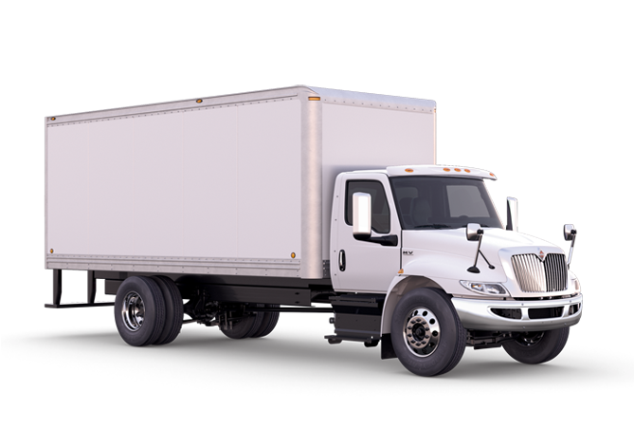
Why Focus on Heavy Duty?
Today…
65%
of all NOx emissions in Connecticut are emitted by mobile sources
40%
of those mobile source emissions are from on-road highway vehicles
40%
of those on-road mobile source emissions are from heavy duty vehicles
Note: Data from NEI Tier 1 Estimates and CT local data

Slide 7
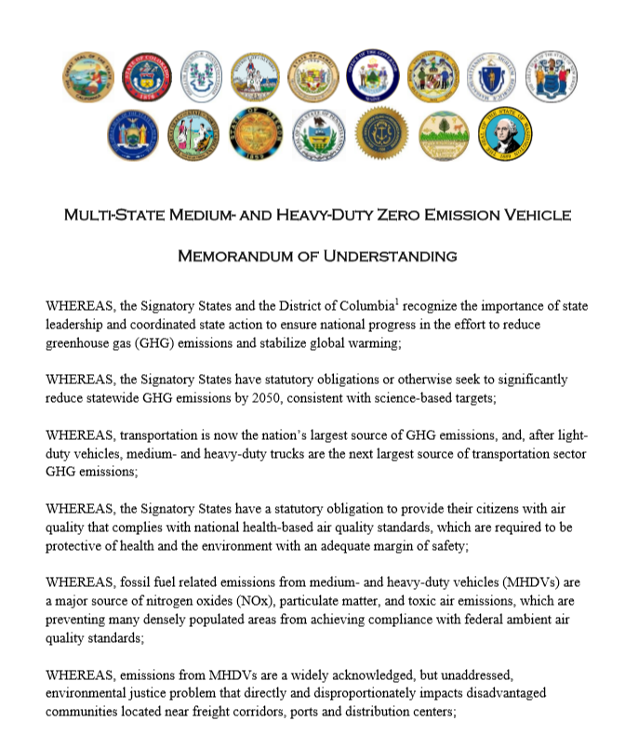
MHD ZEV MOU – July 14, 2020
Builds off success of 2013 8 state ZEV MOU and subsequent Action Plans for light-duty vehicles.
Commits signatories to work together to foster a self-sustaining market for zero emission medium- and heavy-duty vehicles.
Consistent with CT’s Global Warming Solutions Act, calls for 30% of new truck and bus sales to be zero-emission by 2030 and 100% by 2050.
Emphasizes need to accelerate deployment of zero-emission trucks and buses in disadvantaged communities.
Directs development and implementation of a MHD ZEV Action Plan.
https://portal.ct.gov/DEEP/Air/Mobile-Sources/EVConnecticut/EVConnecticut---CTs-EV-Commitment

Slide 8
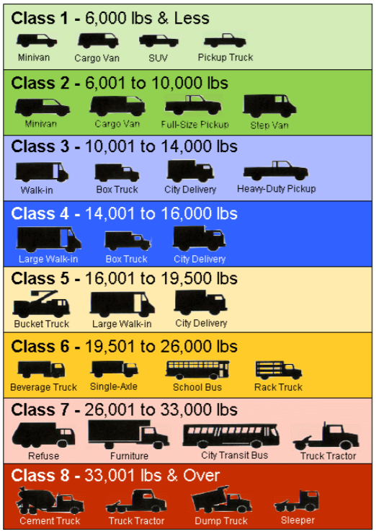
MHDs Covered by the MOU
Covered Truck Classifications
  Based on Gross Vehicle Weight Rating (GVWR)
  Class 2 subdivided into:
    Class 2a (GVWR 6,001- 8,500 lbs., and
    Class 2b (GVWR of 8,501-10,000)
    MHDVs cover class 2b-8

Slide 9
Determining MOU Goals

